Slide 1
Digestion
The process by which food is converted into substances that
can be absorbed and assimilated by the body.
Mechanical & chemical breakdown of food into
nutrients.
  Four main macromolecules in food: nucleic acids, proteins,
  fats, and carbohydrates.
  broken down into smaller molecules of nucleotides, amino
  acids, fatty acids and glycerol, and simple sugars.
  being absorbed
Important minerals, vitamins, and water are also extracted from
food during the process of digestion.
‹#›

Slide 2
Food Sources
Biologists categorize animals into three groups based
on their food source.
  Herbivores obtain all food from plants. Examples:cows, horses, and nearly all rodents.
  Carnivores obtain all food from meat.
  Examples: cats, eagles, wolves, and frogs.
  Omnivores obtain food from both plants and meat. Examples: humans and bears.
An animal’s digestive system is specifically suited to processing food obtained from its food source. For example, herbivores’ digestive systems are equipped to break down plant material, and carnivores’ are not.
‹#›

Slide 3
Digestive system(Tract)
The digestive tract is the area where digestion takes place.
The digestive tract varies widely in complexity from species to species.
The most primitive form found in nematodes is simply a
tubular gut with no specialized features.
The slightly more advanced digestive tract found in earthworms includes specialized areas for ingestion, storage, fragmentation, digestion, and absorption.
The most advanced digestive tracts, found among the vertebrates,exhibit specialization on a much greater scale.
‹#›

Slide 4
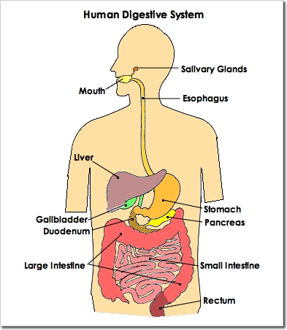
Human Digestive system
The Human Digestive System: a) the alimentary canal or
gastrointestinal tract
b) several accessory organs
a) The alimentary canal or gastrointestinal tract:
a tube, or gut, through which
food travels in one direction
Components:
Mouth
Esophagus
Stomach
Small intestine
Large intestine
Rectum
Anus
‹#›

Slide 5
Human Digestive system (contd.)
b) Accessory organs:
  Aid in digestion. However, food does not pass through
  Liver
  Gall bladder
  Pancreas
‹#›

Slide 6
Human Digestive system
The human alimentary canal:
The alimentary canal begins at the
mouth and the pharynx.
From here, food travels down a
muscular tube called the esophagus
and into the stomach.
The stomach connects to the
small intestine, which in turn
connects to the large intestine.
Some form of mechanical and chemical
digestion breaks down food at every
step along this tube and
Nutrients are absorbed across the walls
of both intestines.
All products remaining after food travels
through the large intestine are waste, which
exit the body through the anus.
‹#›

Slide 7
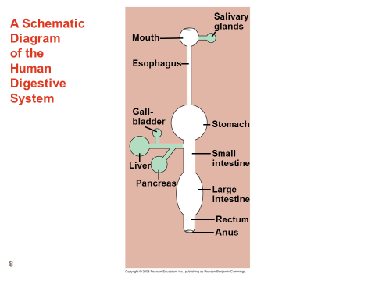
‹#›

Slide 8
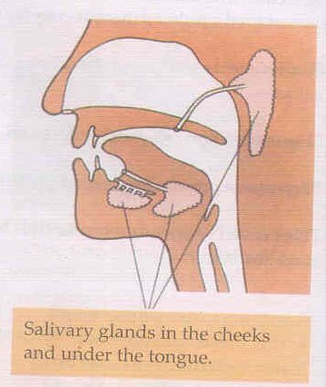
Structure and functions of components of Human Digestive System
The oral cavity (Digestion in Mouth):
Mouth, the teeth. the tongue, Salivary Glands.
The teeth: break food into smaller pieces to expose more of the food’s surface area to digestive enzymes.
The tongue: a muscle used to manipulate food and form it into a bolus, a round, easy-to swallow ball.
Salivary glands: secrete mucous saliva,
Saliva:
contains water, salt and an enzyme
called salivary amylase.
salivary amylase breaks down starch
into smaller sugars.
contains buffers, substances
that neutralize acidic foods
antibacterial substances that kill bacteria
in the food.
also eases the passage of food through
the pharynx and esophagus.
‹#›

Slide 9
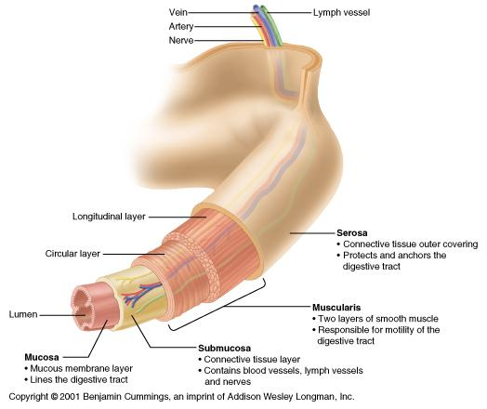
Structure and functions of components of Human Digestive System
The Esophagus
The esophagus shuttles food from the
pharynx (part of mouth) to the stomach.
The muscles surrounding the esophagus
perform peristalsis, the rhythmic and
stepwise contraction of muscle that
forces food to move along the
esophageal passage.
Sphincter muscles at each end prevent
backflow.
The wall of the digestive tube is
composed of 4 basic layers:
Serosa, Muscularis, Submucosa
and mucosa.
‹#›

Slide 10
Structure and functions of components of Human Digestive System
The Stomach
a saclike organ.
inner surface is highly convoluted, allowing it to fold up when empty and expand when full.
Digestion occurs in the stomach as gastric juice,
is secreted by gastric glands located in the
stomach lining.
Gastric juice is an acidic mixture of enzymes
and mucus.
Gastric glands are composed of two types of
cells:
Parietal cells: secrete hydrochloric acid (HCl)
Chief cells: secrete pepsinogen, the precursor to the enzyme pepsin.
Protein digestion is initiated by the acidic environment of the stomach.The HCl, higher the acidity of the gastric juice to a pH level of 2.
‹#›

Slide 11
Structure and functions of components of Human Digestive System
The Stomach (Contd.)
Low pH levels are necessary for pepsinogen to be converted into the active digestive enzyme pepsin, which further breaks down food proteins.
If chief cells were to secrete pepsin directly into the stomach, the pepsin would digest the cells themselves.
Additionally, mucus lines the stomach walls and prevents it from being digested.
A mixture of gastric acid and partially digested food called
chyme passes out of the stomach.
‹#›

Slide 12
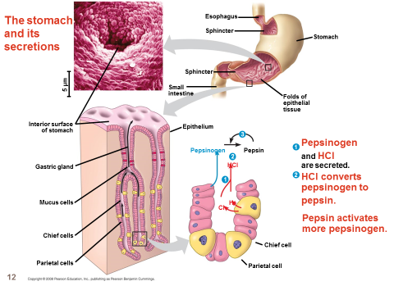
‹#›

Slide 13
Structure and functions of components of Human Digestive System
The Small Intestine (Contd.)
The small intestine is split into three sections:
the duodenum, jejunum, and the ileum.
Chemical digestion takes place in the duodenum and the jejunum.
The ileum, the final section of the small intestine, is where most absorption of the nutrients takes place.
Small projections called villi cover the ileum walls.
Cells lining the villi are covered in folds of plasma membrane that form even smaller projections called microvilli.
Villi and microvilli increase the ileum’s surface area, providing more surface across which nutrients can be absorbed.
Nutrients pass through capillaries in the lining of the villi and into the bloodstream, where they circulate first to the liver, then throughout the rest of the body.
Villi and microvilli projections also contain digestive
enzymes to further digest food.
‹#›

Slide 14
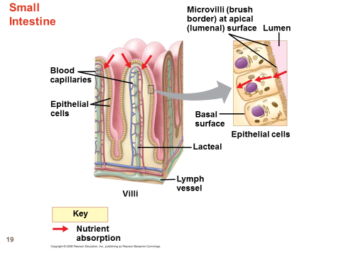
Structure and functions of components of Human Digestive System
The Small Intestine (Contd.)
‹#›

Slide 15
Structure and functions of components of Human Digestive System
Duodenum: Controls the release of food into the small intestine
The Small Intestine
Most of the chemical breakdown (Digestion) and absorption of Food takes place here.
Bile salts break down fats in the chyme while pancreatic fluid, composed of bicarbonate, neutralizes the acid.
The small intestine also contains a host of enzymes that help digest various food molecules.
The enzymes present in the small intestine and their functions are
outlined in the table below.
Pancreatic amylase, maltase, sucrase, lactase Starch
Trypsin, chymotrypsin, aminopeptidase,
carboxypeptidase Protein
Nucleases Nucleic acids
Bile salts, lipase Fats
‹#›

Slide 16
Structure and functions of components of Human Digestive System
The Large Intestine
Food from the small intestine empties into the large intestine, or colon.
No digestion and only a small percentage of absorption
take place in the large intestine.
The large intestine primarily functions to concentrate waste material into a form called feces.
Movements of the large intestine compact feces and move it into the rectum, where it is exited from the body through the anus.
Feces is expelled from the body through the voluntary movements of muscles surrounding the rectum.
‹#›

Slide 17
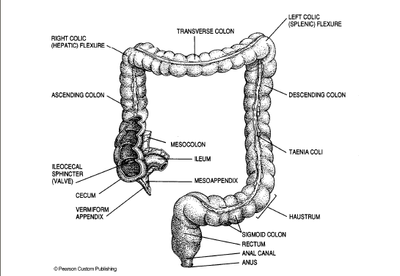
Structure and functions of components of Human Digestive System
The Large Intestine (Contd.)
‹#›

Slide 18
Structure and functions of components of Human Digestive System
Rectum
Musculuar storage chamber where the undigested food (feces) is held and molded before being pushed through anus during expulsion.
Anus
The exit of alimentary canal
It is closed by a ring of muscle (the analy sphincter)
The ring is relaxed during expulsion of feces.
‹#›

Slide 19
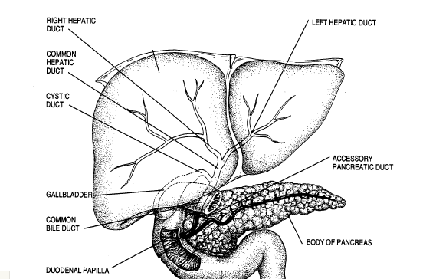
Accessory organs
Produce and store digestive chemicals
Food does not pass through these
‹#›

Slide 20
Accessory organ
Liver - Produces bile; Stores glucose as glycogen & releases glucose into blood stream
Gallbladder - Stores bile, Squirts bile into small intestine when fat arrives
Pancreas - Makes enzymes. Empties into small intestine
Pancreatic juice: enzymes, bicarbonate
Insulin and glucagon secreted directly into blood
Insulin: Enables cells to use glucose (glucose enters
cells) & promotes formation of glycogen in liver
Glucagons: Signals to the liver to convert glycogen
into glucose & release it into the bloodstream
‹#›

Slide 21
Liver
Largest internal organ
Called the ‘chemical factory’
The liver has multiple functions:
  its main function within the
  digestive system is to process
  the nutrients absorbed from the
  small intestine.
  Bile from the liver secreted into the small intestine also plays an
  important role in digesting fat.
  the liver is the body's chemical "factory." It takes the raw materials absorbed by the intestine and makes all the various chemicals the body needs to function.
  the liver also detoxifies potentially harmful chemicals. It breaks down many drugs.
‹#›

Slide 22
Gallbladder and Bile
The gallbladder (or cholecyst sometimes gall
bladder) is a pear-shaped organ that stores
about 50 mL of bile (or "gall") until the body
needs it for digestion. It is connected to the
liver and the duodenum by the biliary tract.
Bile is a complex fluid containing water,
electrolytes and a battery of organic molecules
including bile acids, cholesterol, phospholipids
and bilirubin that flows through the biliary tract
into the small intestine.
Two fundamentally important functions of bile:
  Bile contains bile acids, which are critical for digestion and absorption of fats and fat-soluble vitamins in the small intestine.
  Many waste products, including bilirubin, are eliminated from the body by secretion into bile and elimination in feces.
The gall bladder stores and concentrates bile during the fasting state.
‹#›
Notes:
‹#›

Slide 23
Pancreas
Leaf like organ which lies between the stomach and
duodenum
It secretes pancreatic juice which passes to the
duodenum to help in digestion
  Amylase – for digesting starch
  Protease – protein
  Lipase – fat
  amylase
  Starch ------------------ glucose
  protease
  Proteins --------------- polypetides
  lipase
  Fats -------------------- fatty acid + glycerol
  Role in Digestion:
  enzymes break down protein, fats, and carbohydrates.
  Bicarbonate in the pancreatic juice neutralizes the acidic nature of chyme from stomach.
  The pancreas also makes hormone insulin, secreting it directly into the bloodstream. Insulin is the chief hormone for metabolizing sugar.
‹#›
Notes:
‹#›

Slide 24
Digestion animation
‹#›

