Slide 1
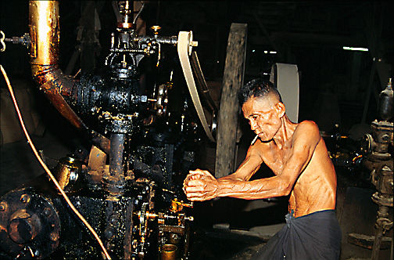
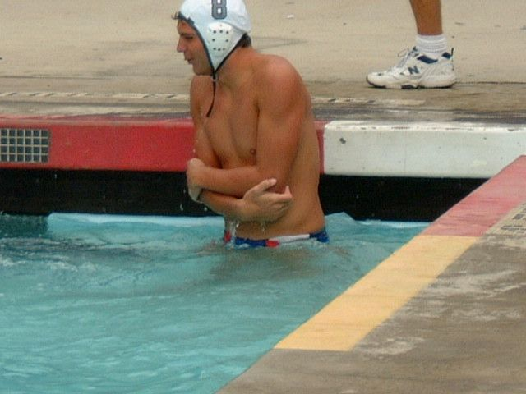
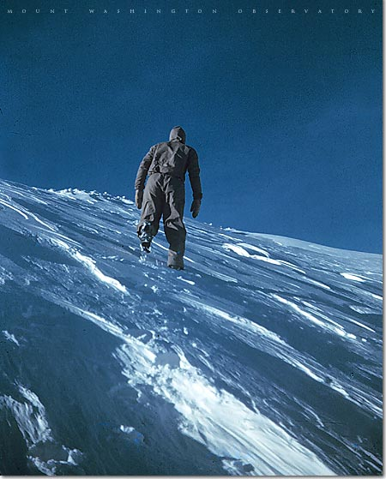
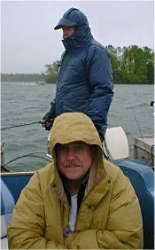

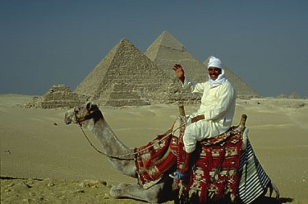
Homeostasis
Prof. Dr. Md. Mahbubul Morshed
Notes:
‹#›
‹#›

Slide 2
Homeostasis
The basic living unit of the body is the cell. The entire body contains about 100 trillions of cells.
About 60-80% of the adult human body is fluid. The cells of ours are bathed in this fluid termed as tissue fluid- a watery solution of ions and the other substances.
Tissue fluid forms the internal environment in which human body cells live.
The maintenance of nearly constant internal environment in side the body is called Homeostasis.

Slide 3
Control of Homeostasis
Homeostasis is controlled by feedback mechanism.
The feedback mechanism consist of three parts:
1. A sense organ
2. A control centre (usually the brain)
3. A responding organ
Feedback
Control centre
Sense organ
Information
Messages to speed up or slow down
Responding organ
The 3 parts of a typical feedback mechanism

Slide 4
Organs of Homeostasis
Lungs and respiratory tract
Heart and circulatory system
Liver, pancreas and gastrointestinal tract
Kidneys
Musculoskeletal system
Skin
Nervous system
Endocrine glands

Slide 5
Lungs and respiratory tract:
Lungs provide oxygen to the tissues and remove carbon dioxide to outside.
It does respiration includes two phases (i) inspiration (ii) expiration.
Inspiration means supply of oxygen from the atmosphere to the tissue space through respiratory tract and blood.
Expiration means transport of carbon dioxide from the tissue space to atmosphere through respiratory tract and blood.

Slide 6
Heart and circulatory system:
The heart acts as a pump to propel blood to all tissues of the bodies and maintains blood pressure.
Because of blood circulation, cells get nutrients and oxygen.
Carbon dioxide is carried away from the cell through blood circulation.
Through blood, waste products created due to metabolism are taken to the kidney for filtering.

Slide 7
Kidneys:
Kidneys keep blood and tissue fluid clean by filtering the substance not needed by the cells.
These substances include different end products of cellular metabolism, such as urea and uric acid; they also include excesses of ions and water from the food that might have accumulated in the extracellular fluid.
This controls the amounts of dissolved substances in the blood and tissue fluid, a process called osmoregulation. This is important for two reasons.
  If the tissue fluid becomes too concentrated, cells will lose water by osmosis and become dehydrated.
  And if it becomes too dilute, cells will take the excess water by osmosis.
For instance, when we drink a lot of liquid, the water content of our blood rises. This is detected by special sense organs and our kidneys respond by increasing the amount of water in the urine. As a result, a greater amount of more dilute urine is excreted until the water level in the tissue fluid returns to normal.

Slide 8
Skin:
Skin helps to keep the body at a steady temperature of 37ºC± 1 ºC.
Sweat glands let the body loss excess heat and cool down.
A layer under our skin helps keep heat inside our body, and the shivering action of muscles generates extra heat to warm the body up in the cold weather.

Slide 9
Nervous system:
The nervous system consists of three major parts: the sensory input portion, the central nervous system, and the motor output portion.
Sensory receptors detect the body or the state of the structure of the surroundings. For instance, the eyes are sensory organs that give one a visual image of the surrounding area.
The central nervous system is composed of the brain and the spinal cord. The brain can store information, generate thoughts, create ambition, and determine reactions that the body performs in response to the sensations.
Appropriate signals are then transmitted through the motor output portion of the nervous system to carry out one’s desire.

Slide 10
Endocrine glands:
Located in the body are eight major endocrine glands that secrete chemical substances called hormones.
Hormones are transported into the extracellular fluid to all parts of the body to help regulate cellular function.
For instance, thyroid hormone increases the rates of most chemical reactions in all cells, thus helping to set the tempo of bodily activity. Insulin controls glucose metabolism. Adrenocortical hormones controls Na+, K+ and protein metabolism. Parathyroid hormone controls bone calcium and phosphate.
Thus, the hormones are a system of regulation that complements the nervous system.
The nervous system regulates mainly muscular and secretory activities of the body, whereas the hormonal system regulates mainly metabolic functions.

Slide 11
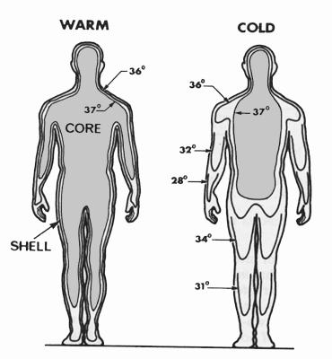
Temperature Regulation (Homeostasis)
In humans it is the core body temperature which is maintained by homeostasis.
Variations in Core Temp
There are several reasons for normal variations in core temperature.
It increases during exercise and during digestion and absorption of food due to heat production.

Slide 12
The hypothalamus contains
a central heat control center.
An area in the Hypothalamus called “The Thermo-regulatory Center (TRC)” has the responsibility of maintaining the body’s core temperature.
It can respond to extremely small changes in blood temperature.
The TRC is the body’s thermostat.

Slide 13
Hypothalamus
A region of the brain, between the thalamus and the midbrain, that functions as the main control center for the autonomic nervous system by regulating sleep cycles, body temperature, appetite, etc., and that acts as an endocrine gland by producing neurohormones, including the releasing factors that control the hormonal secretions of the pituitary gland.
Anterior Region in the hypothalamus is responsible for marinating body temperature constant, which is also called TRC

Slide 14
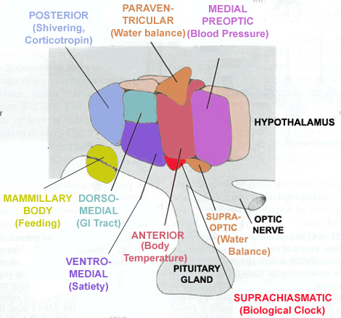
Hypothalamus
Different areas in the Hypothalamus responsible for different autonomic functions:

Slide 15
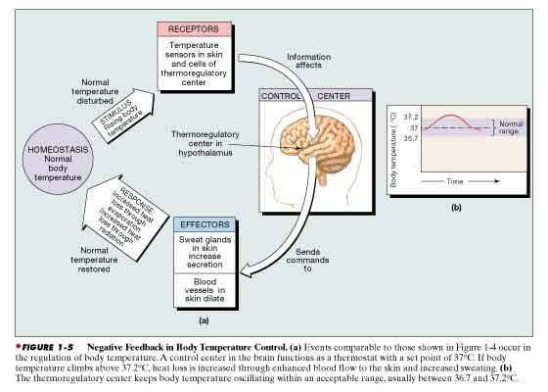
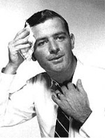
Overview: Temperature Regulation
Cyclic representation

Slide 16
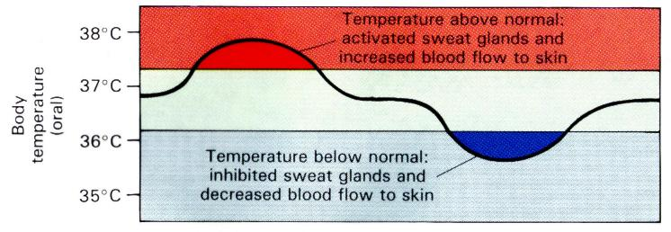
Overview: Temperature Regulation
Linear representation

Slide 17
How The TRC Works?
1. It receives information from the body regarding temperature.
2. It sends signals to the body to adjust the temperature to maintain a relatively fixed core temperature.
3. The body has two thermo-receptors which signals the TRC when temperature changes.
4. The Thermo-Receptors signal the Thermo-regulatory center (TRC).

Slide 18
Skin Function
It protects our body against damage, dirt and germs.
It contains millions of tiny sense organs, which are sensitive to touch, temperature and pain.
It excretes water and salts from the body as sweat.
It helps to keep the body at a steady temperature of 37⁰C±1⁰C.
Acts as a storage center for lipids and water, as well as synthesise vitamin D by action of UV on certain parts of the skin.

Slide 19
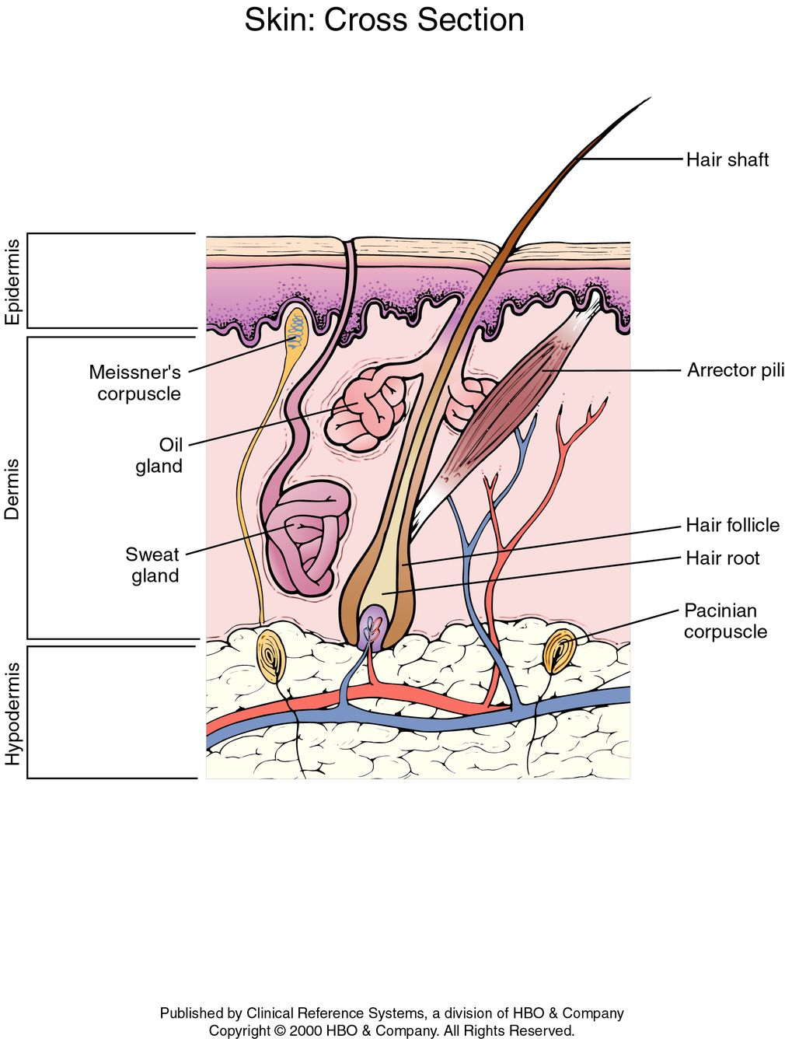
The structure of skin:

Slide 20
Skin layers:
Skin is composed of three primary layers:
Epidermis, provides waterproofing and serves as a barrier to infection.
Dermis, serves as a location for the appendages of skin.
Hypodermis

Slide 21
Epidermis:
Epidermis, is the outermost layer of the skin. It forms the waterproof, protective wrap over the body's surface. The epidermis contains no blood vessels, and is nourished by diffusion from the dermis. Epidermis is divided into several layers where cells are formed through mitosis at the innermost layers.
Dermis:
The dermis is the layer of skin beneath the epidermis that consists of connective tissue and cushions the body from stress and strain. The dermis is tightly connected to the epidermis by a basement membrane. It also harbors many nerve endings that provide the sense of touch and heat. It contains the hair follicles, sweat glands, sebaceous glands, apocrine glands, lymphatic vessels and blood vessels.

Slide 22
Hypodermis:
The hypodermis is not part of the skin, and lies below the dermis. Its purpose is to attach the skin to underlying bone and muscle as well as supplying it with blood vessels and nerves. It consists of loose connective tissue and elastin. The main cell types are fibroblasts, macrophages and adipocytes (the hypodermis contains 50% of body fat). Fat serves as padding and insulation for the body.

Slide 23
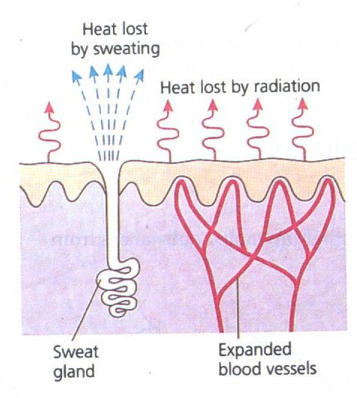
Temperature Regulation
When we get too hot, we sweat a lot. The sweat evaporates and cools us down.
The blood vessels below our skin expand. So a lot of blood flows near the body surface and loses heat.
During Hot Weather

Slide 24
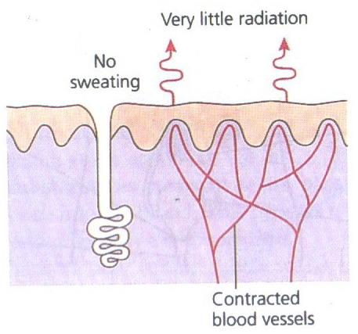
Temperature Regulation
When we get too cold, we stop sweating, blood vessels below the skin contract.
So only a little blood flows near the surface and loses heat.
Muscles start rapid, jerky movements which we call shivering. This produces extra heat, which warms up the body.
During Cold Weather

Slide 25
Fever and hyperthermia
1. Fever occurs when the core temperature of the body is raised above normal steady state levels. The body reacts as if it is too cold, while the temperature rises up to the new higher set point. Fever attacks imply shivering combined with vasoconstriction, headache, body pains, and general discomfort.

Slide 26
2. Fever results from the action of endogenous pyrogens on the hypothalamic heat control centre (they increase the set point for the core temperature via prostaglandins).
3. Exogenous pyrogens from microbes cause these endogenous polypeptides to be released from the defence cells of the body. Antipyretic drugs inhibit cyclo-oxygenase activity, hereby interfering with the synthesis of prostaglandins and thromboxanes.
4. Following an attack of fever, vasodilatation and sweat evaporation reduces the core temperature.
Pyrogen is a substance, as a thermostable bacterial toxin, that produces a rise in temperature in a human or animal

Slide 27
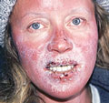
Excessive Heat Loss Can cause Hypothermia and Frostbite
Hypothermia (colder than normal body temperature) and frostbite can happen to anyone who is not properly protected from the cold.

Slide 28
Hypothermia
Hypothermia occurs when the body temperature falls below 95 degrees F. The normal body temperature is 98.6 degrees F. In the early stages, this may cause memory loss, confusion and shivering. Eventually, a low body temperature may cause cardiac arrest and death.
The best way to prevent hypothermia is to protect the body from the cold.

