Slide 1
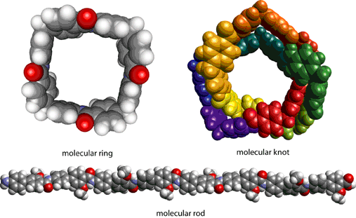
BIO-103:
Biological Macromolecules
Prof. Dr. Md. Mahbubul Morshed

Slide 2
Lecture Outline
Introduction & basic terminologies
Carbohydrate
Protein
Lipid
Nucleic Acid

Slide 3
Introduction/ at a glance
Living Systems
Organic compounds
Inorganic compounds
Macromolecules
Carbohydrates
Lipids
Proteins
Nucleic Acids
Carbon containing!
And the rest!
Assembling into complex form
Building Blocks of living organism
Notes:
Living systems are composed of various types of molecules. There are two main types: Organic and Inorganic molecules. All organic molecules contain carbon and those that don't are classified as Inorganic molecules. Organisms maintain reserves of small organic molecules that they can assemble into complex Macromolecules such as carbohydrates, lipids, proteins, and nucleic acids. These are the building blocks of the living organisms.

Slide 4
Terminologies/Definitions
Macromolecule:
Small molecules assemble in different orientation to make large molecule or Macromolecules.
Example: Glucose molecules assemble to make cellulose (a carbohydrate) .
glucose
glucose
glucose
glucose
cellulose
glucose
glucose
glucose
glucose

Slide 5
Terminologies/Definitions
Monomers are small molecules or building blocks which may be joined together in a repeating fashion to form more complex molecules called polymers.
A polymer may be a natural or synthetic macromolecule comprised of repeating units of a smaller molecule (monomers).
glucose
glucose
glucose
glucose
cellulose
glucose
glucose
glucose
glucose
glucose
Monomer
Polymer

Slide 6
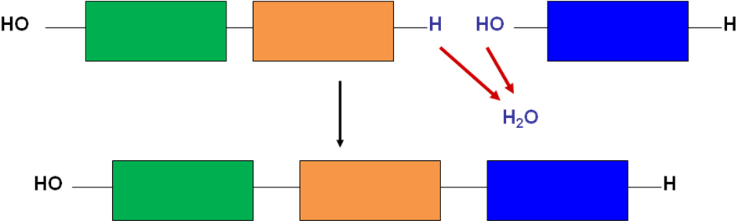
Terminologies/Definitions
Polymerization is the linking together of monomers to form polymers.
A condensation reaction occurs via the loss of a small molecule, usually from two different substances, resulting in the formation of a covalent bond.
Need the
Input of
energy

Slide 7
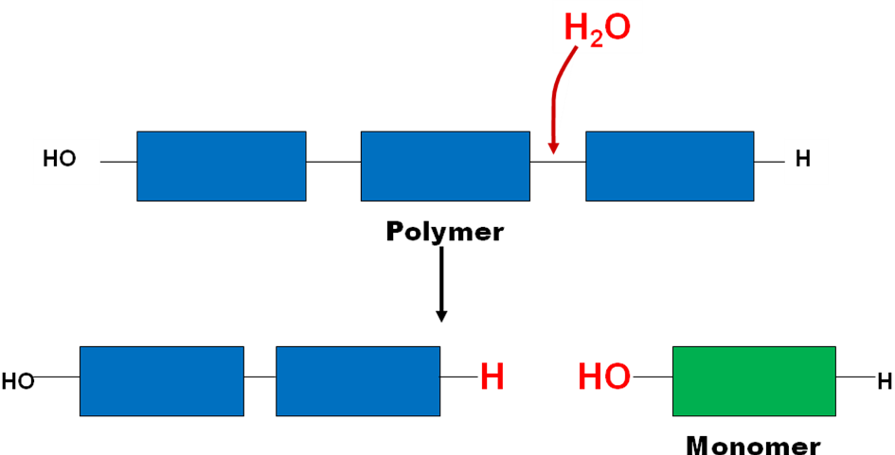
Terminologies/Definitions
Hydrolysis, which is the reverse of condensation, breaks apart large organic molecules into smaller ones.
By breaking the bonds between monomers, Hydrolysis liberates the energy that polymers contained during condensation; thus, some of the energy required to polymerize is returned upon hydrolysis.
Liberation of
energy
Try to link up with the context of Metabolism that we’ve learned earlier…!!!

Slide 8
Terminologies/Definitions
Carbohydrates
Glucose
Building Blocks/monomers
Macromolecules
Proteins
Amino acids
Lipids
Fatty acid and glycerol
Nucleic Acids
Nucleotide

Slide 9
CARBOHYDRATE
Common symbol: (CH₂O)_{n}
Most common is Glucose.
In glucose, Carbon, Hydrogen and Oxygen makes a molecule of glucose in 1:2:1 ratio.
Chemical formula: C₆H₁₂O₆. or (CH₂O)₆
Structural materials, storing and transporting energy
Three types: monosaccharides, oligosaccharides, and polysaccharides.

Slide 10
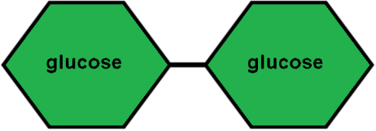
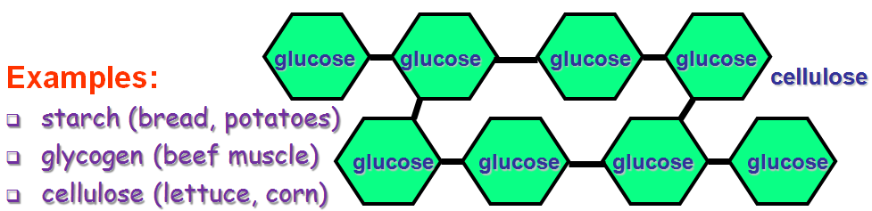
CARBOHYDRATE
Two monosaccharide's will make disaccharide.
Examples:
Sucrose (glucose+fructose) (Table Sugar)
Lactose (glucose+galactose) (Milk Sugar)
Maltose (glucose+glucose) (Barley/germinating seeds)
Polysaccharides: Long chains of monosaccharide units bound together

Slide 11

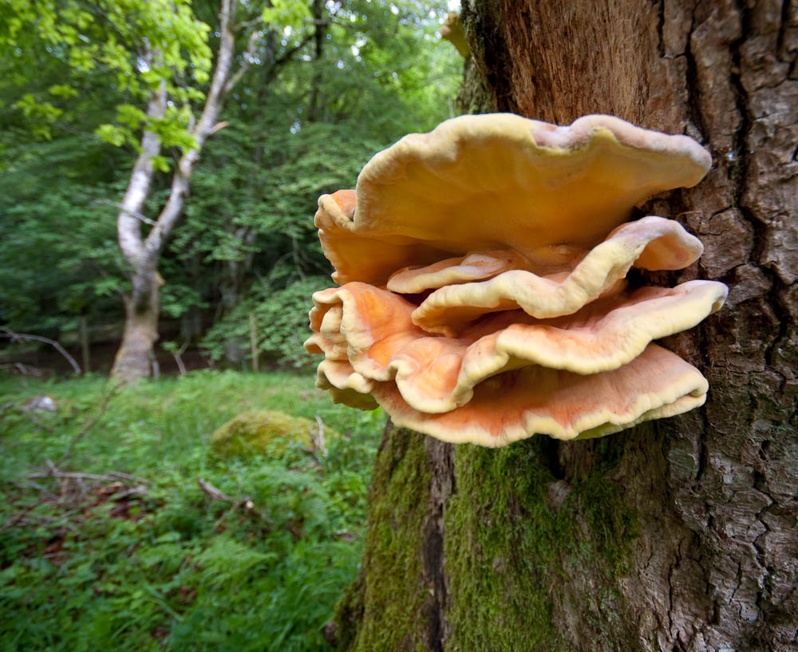
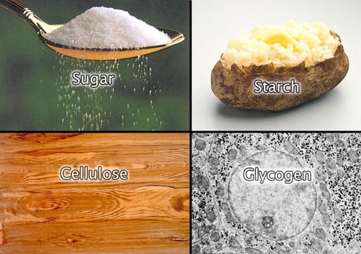

Slide 12
Starch and Glycogen
Starch is energy storage molecule in plants
Cellulose
Different bond formed than starch
Chitin
Partly derived from non-sugars (nitrogen)
Glycogen is energy storage molecule in animals.
Starch and glycogen can be digested by animals.
Structural component in plants
Cannot be digested by animals
Composes exoskeletons of insects

Slide 13
Functions of Carbohydrates
Providing energy and regulation
Sparing the use of proteins for energy
Preventing ketosis and breakdown of fatty acids and
Biological recognition processes
Flavor and Sweeteners
Dietary fiber, which is also a form of carbohydrate, is essential for the elimination of waste materials and toxins from the body

Slide 14
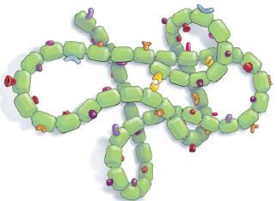
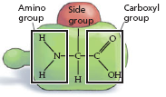
PROTEINS
Most diverse in both structure and function
Proteins are the polymers of amino acids
Thousands of different kinds of proteins are made from only twenty monomers, called amino acids.
Monomer
Polymer

Slide 15
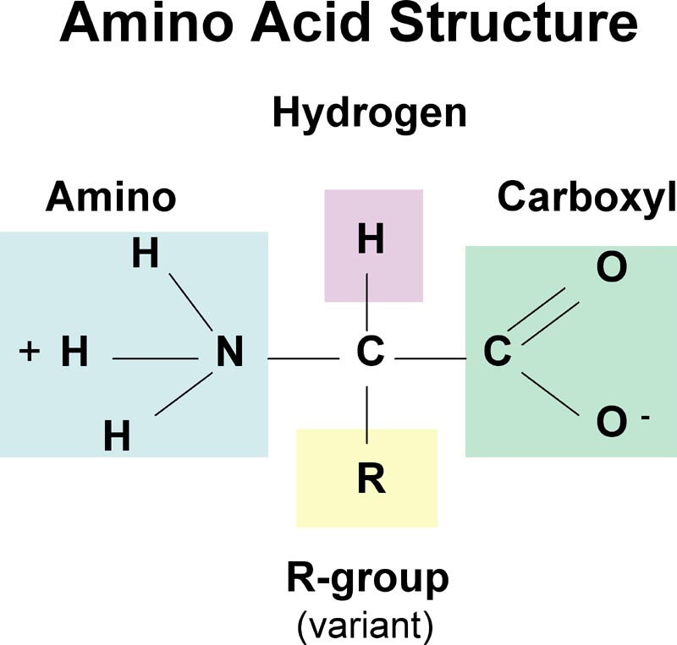
Amino Acids: Building Block of Proteins
Contains an amine group (NH₃) (basic/positive)
A carboxyl group (COOH) (acidic/negative)
One or more atoms called an “R group”
All three groups are attached to the same carbon atom

Slide 16
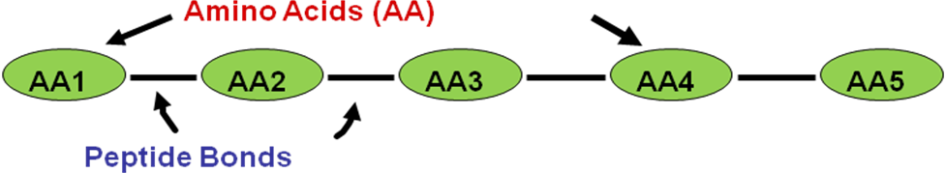
Amino Acids: Building Block of Proteins
Amino acids are divided into two groups-
Essential: must be supplied in the diet.
Non-essential: not supplied in the diet.
Amino acids are bonded together by peptide bonds to form protein.

Slide 17
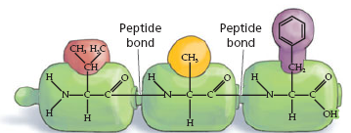
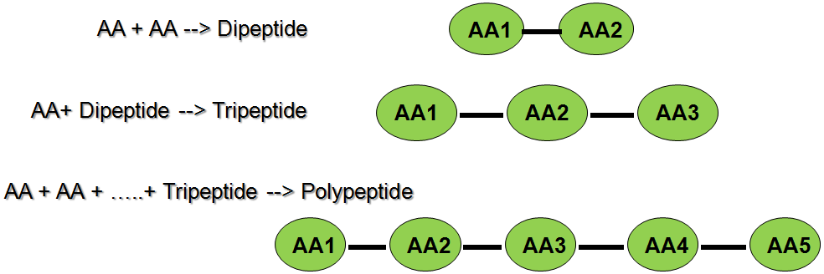
Peptide Bonds
The bond that forms between two amino acids is called a peptide bond.

Slide 18
Levels of protein structure
Primary structure: The linear arrangement of amino acids in a protein
Secondary structure: Areas of folding or coiling within a protein. e.g. α-helices and β-pleated sheets
Tertiary structure: Final three-dimensional structure of a protein, which results from a large number of non-covalent interactions between amino acids.
Quaternary structure: Non-covalent interactions that bind multiple polypeptides into a single, larger protein. e.g. Hemoglobin

Slide 19
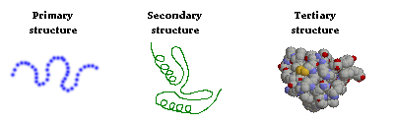
Levels of protein structure

Slide 20
Main functions of proteins
Protein's main function is to build, maintain and repair all our body tissues
Protein can also be used as energy source by body
Biological functions of proteins
Protein acts as storage material of food and energy.
Many proteins are enzymes that catalyze biochemical reactions
Proteins are molecular instrument through which genetic information is expressed.
They act as antibodies to prevent disease.
The milk proteins help the growth of infant mammals.
For detail functions see the notes underneath…
Notes:
Biological function of Protein
Protein acts as storage material of food and energy.
Many proteins are enzymes that catalyze biochemical reactions, and are vital to metabolism.
Proteins are molecular instrument through which genetic information is expressed.
They act as antibodies to prevent disease.
The milk proteins help the growth of infant mammals.
Like other biological macromolecules such as polysaccharides, lipids and nucleic acids, proteins are essential parts of organisms and participate in virtually every process within cells.
Many proteins are enzymes that catalyze biochemical reactions and are vital to metabolism.
Proteins also have structural or mechanical functions, such as actin and myosin in muscle and the proteins in the cytoskeleton, which form a system of scaffolding that maintains cell shape.
Other proteins are important in cell signaling, immune responses, cell adhesion, and the cell cycle.
Proteins are also necessary in animals’ diets, since animals cannot synthesize all the amino acids they need and must obtain essential amino acids from food. Through the process of digestion, animals break down ingested protein into free amino acids that are then used in metabolism.

Slide 21
Lipids
Composed of Carbon, Hydrogen, and Oxygen
Differ from carbohydrates: no specific ratio (C:H:O)
Building blocks are fatty acids and glycerol.
Energy storage molecules “stores the most energy” 2X of Carbohydrates
Structurally heterogeneous, Not soluble in water
Are soluble in hydrophobic solvents.
Examples: 1. Fats 2. Oils 3. Phospholipids
4. Waxes 5. Steroid hormones 6. Triglycerides

Slide 22
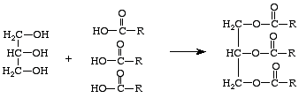
Synthesis of triglycerides
Glycerol
Fatty acids
Can be saturated/unsaturated
Relate with the melting points and physical states……..
Higher the un-saturation-lower the melting point……..

Slide 23
Fats
Fats are solid at ordinary temperatures. Generally, fats are produced by animals. In animals, fats are stored in adipose cells. Fats are also important as cushions for body organs and as an insulating layer beneath skin.
Oils
Oils are liquid at ordinary temperatures. Generally, oils are produced by plants. Some common vegetable oils are peanut, soybean, and corn oil.
Waxes
Both plants and animals produce waxes. The waxy coating on some plants leaves is an example of plant waxes. Beeswax is an example of a wax produced by an animal.
Recall the saturated and unsaturated FA in this context….

Slide 24
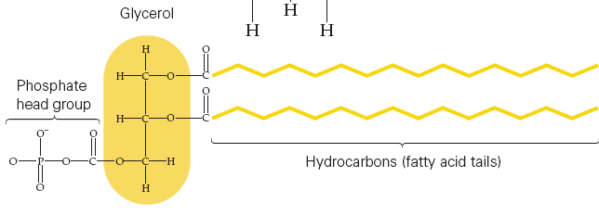
Phospholipids
Phospholipids are a variation on the triacylglycerol theme in which
  One fatty acid is replaced with a phosphate group, which in turn is bound to additional functional groups.
Structurally and functionally, the important thing about phospholipids is that
  These molecules are simultaneously hydrophobic (at one end, the fatty acid end) and hydrophilic
  (at the other end, the phosphate end). Amphiphile
Recall the cell membrane in this context…

Slide 25
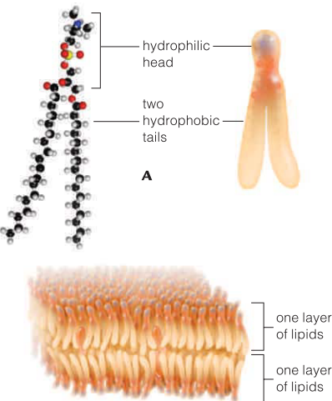
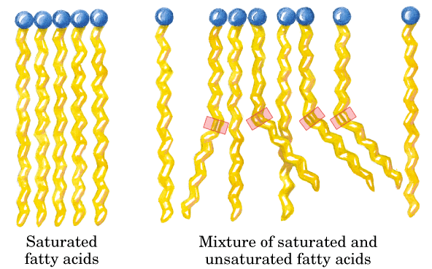
Here it goes…let’s think laterally..!

Slide 26
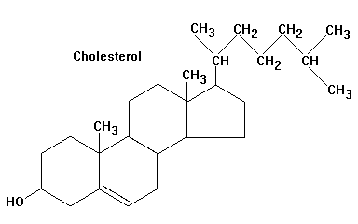
Steroids
All steroids possess a common ring structure.
These ring structures vary by attached functional groups.
Cholesterol is example of a steroid; cholesterol is a membrane component
The common steroid structure is the
basis of sterol hormones including the
human sex hormones
(the estrogens and the
androgens, including
testosterone).

Slide 27
Nutrition and Health
Most of the lipid found in food is in the form of triacylglycerols, cholesterol and phospholipids
A minimum amount of dietary fat is necessary to facilitate absorption of fat-soluble vitamins (A, D, E and K) and carotenoids
Essential Fatty Acids
Trans Fat

Slide 28
The fat guidelines
Limit total fat intake to less than 25–35% of your total calories each day;
Limit saturated fat intake to less than 7% of total daily calories;
Limit trans fat intake to less than 1% of total daily calories;
The remaining fat should come from sources of monounsaturated and polyunsaturated fats such as nuts, seeds, fish and vegetable oils; and
Limit cholesterol intake to less than 300 mg per day, for most people

Slide 29
Nucleic Acids
The chemical link between generations
The source of genetic information in chromosomes
Dictate amino-acid sequence in proteins
Simple units called nucleotides, connected in long chains
Nucleic acids are composed of long chains of nucleotides linked by dehydration synthesis

Slide 30
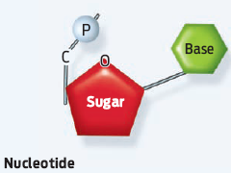
Nucleic Acids
Two types:
a. Deoxyribonucleic acid (DNA-double helix)
b. Ribonucleic acid (RNA-single strand)
Nucleotides have 3 parts:
1- phosphate group (P)
2- pentose sugar (5-carbon)
3- nitrogenous bases:
adenine (A)
thymine (T) DNA only
uracil (U) RNA only
cytosine (C)
guanine (G)

Slide 31
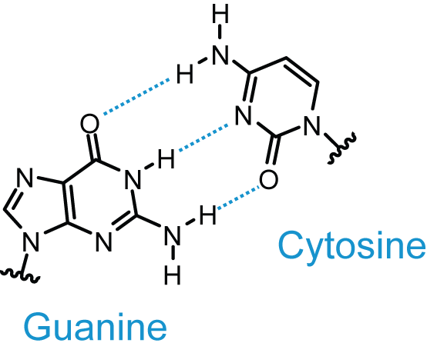
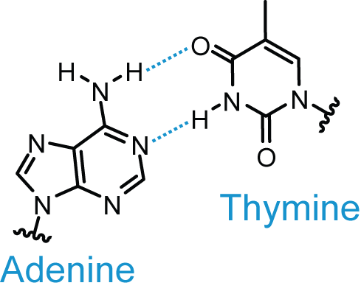
Nucleic Acids
The secondary structure is similar to the proteins
The concentration of adenine equals that of thymine
The concentration of guanine equals that of cytosine
Why?

Slide 32
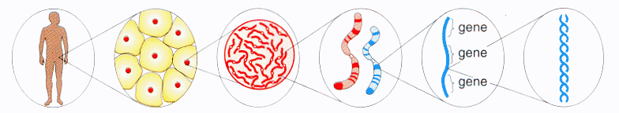
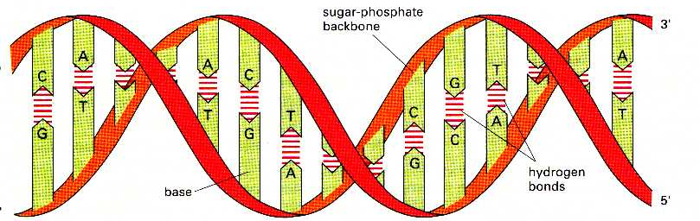
Cells
Genes
Chromosomes
DNA

Slide 33
 | DNA | RNA
Structural Name: | Deoxyribonucleic Acid | Ribonucleic Acid
Function: | Medium of long-term storage and transmission of genetic information | Transfer the genetic code needed for the creation of proteins from the nucleus to the ribosome. Without RNA, proteins could never be made.
Structure: | Typically a double- stranded molecule with a long chain of nucleotides. | A single-stranded molecule in most of its biological roles and has a shorter chain of nucleotides.
Bases/Sugars: | Long polymer with a deoxyribose and phosphate backbone and four different bases: adenine, guanine, cytosine and thymine. | Shorter polymer with a ribose and phosphate backbone and four different bases: adenine, guanine, cytosine, and uracil.
Base Pairing: | A-T (Adenine-Thymine), G-C (Guanine-Cytosine) | A-U (Adenine-Uracil), G-C (Guanine-Cytosine)

Slide 34
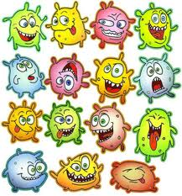
Thank you.
Any Questions?

