Slide 1
Food and Nutrition
Prof. Dr. Md. Mahbubul Morshed

Slide 2
Contents:
Nutritional Requirements
Nutrient: are the raw materials, which provide the essential matter and energy for life.
Nutrition: refers to all the processes by which living organisms obtain and use these nutrients.
The Nutrient and Nutrition
Classes of Nutrients
Functions and source of all nutrients.
Food as Fuel: Calories Count
Healthy weight/ Body Mass Index(BMI)
Food label
Malnutrition
Plant nutrition
Contents:
The Nutrient and Nutrition
Classes of Nutrients
Functions and Sources of Major Vitamins Important to Humans
Food as Fuel: Calories Count
Healthy weight/ Body Mass Index(BMI)
Malnutrition
Plant nutrition

Slide 3
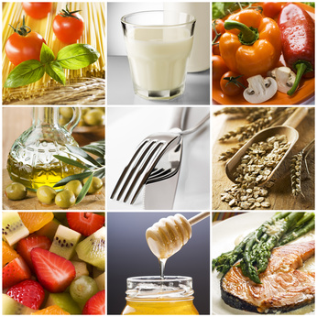
Classes of Nutrients
There are six classes of nutrients:
  (1) carbohydrates,
  (2) fats (lipids),(20%)
  (3) proteins,
  (4) vitamins,
  (5) minerals, and
  (6) water. (60%)

Slide 4
Energy Nutrients: Carbohydrates, Lipids and Proteins
Used by body as source of energy.
All these three nutrients are Carbon containing compounds.
Proteins are not preferred energy source. They are building blocks to make our body.
Body does not get energy from vitamins, minerals, water.

Slide 5
Carbohydrates
Fresh fruits, whole grains, and vegetables—especially legumes such as peas and beans—provide abundant complex carbohydrates .
The body breaks the starch in these foods into glucose, your primary source of energy. These foods also provide essential vitamins and fiber.
Eating foods high in soluble fiber helps lower one's cholesterol level and may reduce the risk of heart disease.
A diet high in insoluble fiber helps prevent constipation.
Foods rich in processed carbohydrates such as white flour, refined sugar, and corn syrup are sometimes said to be "empty calories” This is a way of saying that these foods provide little in the way of vitamins or fiber.

Slide 6
Lipids
Body uses lipids to build cell membranes, as energy stores, and as a reservoir for fat-soluble vitamins.
Linoleic acid and alpha-linolenic acid are essential fatty acids, meaning the human body needs them but cannot make them.
Mainly 2 types: saturated and unsaturated fatty acids.
Dairy products and meats are rich in saturated fats and cholesterol. Overindulging in these foods increases one's risk for heart disease, stroke, and some cancers.
Trans fatty acids, or trans fats, are manufactured from vegetable oils.
  Worse for the heart than saturated fats.

Slide 7
Proteins
Amino acids are building blocks of proteins.
Your cells can make some amino acids but you must get essential amino acids from food.
Most proteins in meat are "complete," meaning their amino acid ratios match a human's nutritional needs.
By contrast, most plant proteins are "incomplete," meaning they lack one or more amino acids essential for the human diet.

Slide 8
Vitamins
Vitamins are organic molecules required by the body in small amounts for metabolism, to protect health, and for proper growth.
Many functions in body though required in small amount.
Required in small amount. But there are 13 essential vitamins for human. Major ( A, B, C, D, E and K)
They are differentiated according to their absorbency in fat/water.

Slide 9
Vitamins
1. Fat soluble Vitamins: A, D, E and K
  Taken with fat containing foods.
  They can remain stored in body fats.
  Not necessary to consume everyday.
2. Water soluble Vitamins: B and C.
  Cannot be stored.
  Need to take frequently/Everyday.

Slide 10
Minerals
Minerals are inorganic substances and are transported around the body as ions dissolved in the blood and other body fluids.
Different minerals perform different role in human body.
Example:
  Calcium: Make up different body structure, bones, teeth etc. and help in blood clot.
  Sodium: maintains fluid balance.
  Magnesium: Helps in energy release from energy nutrients.

Slide 11
Water
Water provides the medium in which all the body’s reactions take place.
It aids in the digestion and absorption of food.
It is a medium of transport, through arteries and veins, within an organism.
It even lubricates your joints and cushions organs such as the brain and spinal cord.
It helps in the excretion of harmful by-products of metabolic processes.
It aids in the regulation of heat loss.
Key players when bonds are broken (by hydrolysis) or formed (by dehydration synthesis) in these molecules.

Slide 12
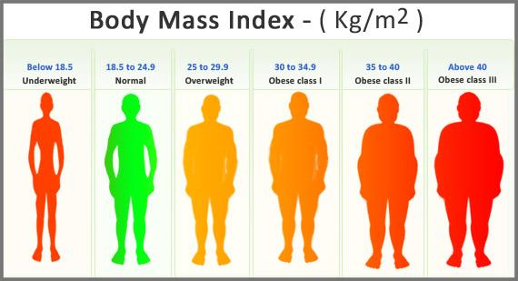
Body Mass Index

Slide 13
Food as Fuel: Calories Count
Food energy is usually measured in kilocalories (kcal), also called Calories (Cal).
A large apple contains about 70 Cal worth of energy-producing compounds; and jogging 1.6 km (1 mile) burns about 100 Cal of stored energy.
The food energy in a slice of bread could bring a liter of water to a boil, and a pound of body fat has enough energy to bring 52 liters (13 gal) to a boil!
Each person has a minimum daily energy requirement that varies with age, sex, body size, activity level, and other factors.
  In general, a normally active female college student needs around 1,800-2,000 Cal a day to fuel her total metabolic needs;
  a male college student needs about 2,200-2,500 Cal.
Carbohydrate and protein each provide about 4 Cal/g, while fat provides more than twice as much, or 9 Cal/g.
A person would have to run for about 30 minutes, for example, to burn off the calories in a cheeseburger.

Slide 14
Food as Fuel: Calories Count
Calorie value of food :
a) Carbohydrate - 4.4 cal/g.
b) Fat - 9.3 cal/g.
c) Protein - 4.0 cal/g.
A person would have to run for about 30 minutes, for example, to burn off the calories in a cheeseburger.

Slide 15

Food as Fuel: Calories Count
intake food(energy nutrients) > Energy needs : stored in body fat.
Energy need > intake food : burn body fat.

Slide 16
Balanced Diet
Balanced diet is a diet containing all the proximate principles of food in adequate and proportionate amounts; including essential amino acids and fatty acids for normal growth, activity, reproduction.
Adequate : Means the amount that supply the exact calories.
Proportionate amount : Means presence of appropriate proportion of food stuffs.

Slide 17
Criteria of a balanced diet
Proximate principles of food in adequate and proportionate amount.
One third to half of protein
Lipid should come from plant sources.
Sufficient fruits and vegetables.
Easily digestible , absorbable and assailable food.
Easily available food.
Certain amount of cellulose to promote peristalsis.

Slide 18
Factors considered to formulate a balanced diet
Age
Sex, height, weight
Quality and quantity of food.
Socio-economical value
Seasonal factor
Geographical
Allergic condition

Slide 19
Body Mass Index (BMI)
The body mass index (BMI) or Quetelet index is a value derived from the mass (weight) and height of an individual.
The BMI is defined as the body mass divided by the square of the body height, and is universally expressed in units of kg/m², resulting from mass in Kilograms and height in meters.

Slide 20
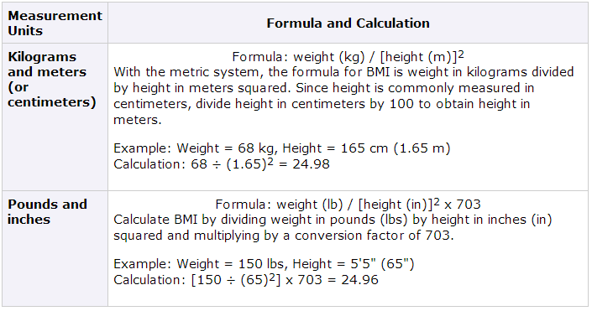
Body Mass Index(BMI) count

Slide 21
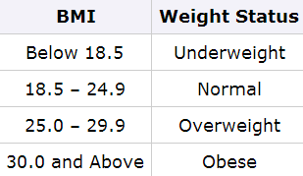
Body Mass Index (BMI) count
The correlation between the BMI number and body fatness is fairly strong
  however the correlation varies by sex, race, and age.
    At the same BMI, women tend to have more body fat than men.
    At the same BMI, older people, on average, tend to have more body fat than younger adults.
    Highly trained athletes may have a high BMI because of increased muscularity rather than increased body fatness.

Slide 22
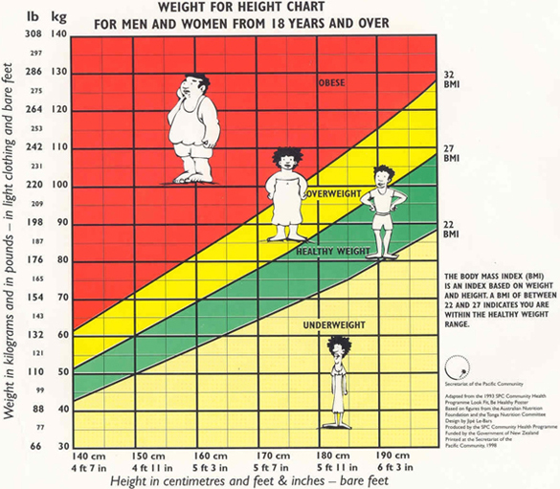
Body Mass Index(BMI) count
BMI is only one factor related to risk for disease, For assessing someone's likelihood of developing overweight- or obesity-related diseases
  The individual's waist circumference (because abdominal fat is a predictor of risk for obesity-related diseases).
  Other risk factors the individual has for diseases and conditions associated with obesity are for example, high blood pressure or physical inactivity.

Slide 23
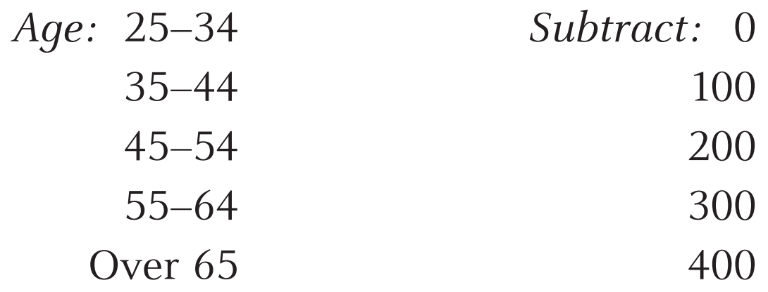
How To Calculate How Many Kilocalories You Need
Multiply the weight (in pounds)
by 10 if you are not active physically,
by 15 if you are moderately active, and
by 20 if you are highly active
2. Subtract one of the following amounts from the multiplication result
Notes:
For example, if you are 25 years old, are highly active, and weigh 120 pounds, you will require 120 X 20 = 2,400 kilocalories daily to maintain weight. If you want to gain weight you will require more; to lose, you will require less. The amount is only a rough estimate.
Other factors, such as height, must be considered. A person 5 feet, 2 inches tall and active does not require as much energy as an active 6-footer whose body weight is the same.
‹#›

Slide 24
How To Calculate How Many Kilocalories You Need
For example, if you are 25 years old, are highly active, and weigh 120 pounds, you will require 120 X 20 = 2,400 kilocalories daily to maintain weight. If you want to gain weight you will require more; to lose, you will require less. The amount is only a rough estimate.
Other factors, such as height, must be considered. A person 5 feet, 2 inches tall and active does not require as much energy as an active 6-footer whose body weight is the same.

Slide 25
Malnutrition
Malnutrition refers to insufficient, excessive, or imbalanced consumption of nutrients by an organism.
In developed countries, the diseases of malnutrition are most often associated with nutritional imbalances or excessive consumption.
Although there are more organisms in the world who are malnourished due to insufficient consumption, increasingly more organisms suffer from excessive over-nutrition; a problem caused by an over abundance of sustenance coupled with the instinctual desire (by animals in particular) to consume all that it can.

Slide 26



