Slide 1
Coffee Shop Menu Abstraction and Design Sprint

Slide 2



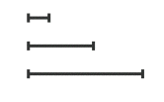


Data Abstraction
Categorical
no implicit ordering
Ordinal
Ordered
Quantitative
meaningful magnitude
(can do arithmetic)

Slide 3
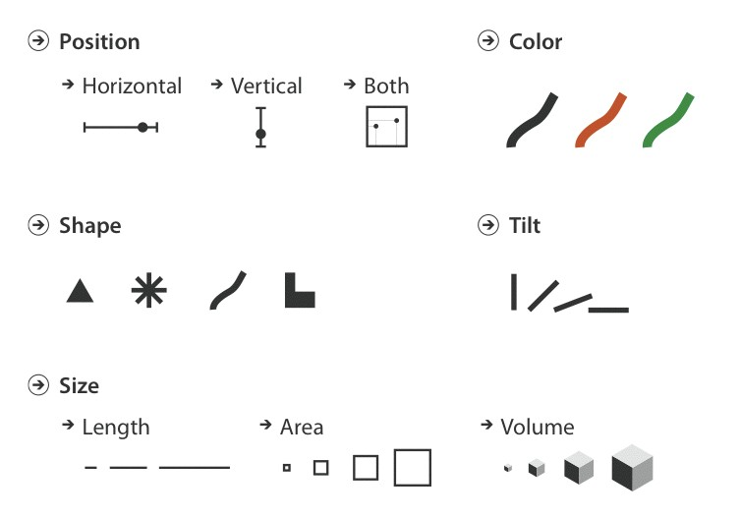
Visual Encoding
identity (what or where)
magnitude (how much)

Slide 4
Part 1: Coffee Shop Menu Abstraction
Determine all the data attributes included on the menu (around 5). For each attribute, determine the type (categorical, ordinal, or quantitative).
Develop some possible derived quantities, along with their type (typically 5-10).
Given the attributes identified in #1 and #2, build a spreadsheet to hold the attributes and the data.

Slide 5
Part 2: Coffee Shop Menu Visualization
Your next goal is to use that data to develop a static visualization for that data
You can use any tools you want
Your visualization can convey any information about the menu you wish
Keep in mind how perception principles influence the utility of your visualization

Slide 6
Part 3: Present your design
Give a 2-minute elevator pitch about your design to the group
Should we vote on the best?

