Slide 1

Kubernetes
BY
Krishna Kumar

Slide 2

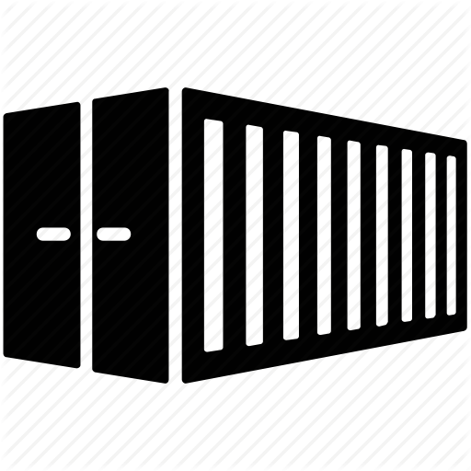
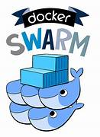
Kubernetes
Container management or orchestration engine or tool which automates the deployment, scaling and management of containerized applications
Open source
Developed in Golang
Developed by Google and donated to CNCF
(Cloud native computing foundation)
Also Called as K8s
Other Container management tools :
Docker Swarm
Apache mesos marathon
Containerized applications
Deploying
Scheduling
Scaling
Load balancing
Batch Execution
Rollouts / Rollback
Monitoring
Kubernetes
Docker Swarm

Slide 3
Kubernetes features
Automatic bin packing
Service Discovery and load balancing
Storage orchestration
Self-healing
Automated Rollout/Roll Backs
Secrets and Config maps
Horizontal Scaling

Slide 4
Kubernetes features – Automatic bin packing
We have 5 servers each is having 10 GB of memory(RAM)
We have list of jobs to run on these servers
Each job has different resource (memory) requirement
J1
j2
j3
j4
j5
j7
j6
j10
j8
j9
1
2
3
4
5

Slide 5
Kubernetes features – Automatic bin packing
We have 5 servers each is having 10 GB of memory(RAM)
We have list of jobs to run on these servers
Each job has different resource (memory) requirement
j3
j7
J1
j8
j10
j6
j5
j9
j4
j2
1
2
3
4
5

Slide 6
Kubernetes features – Automatic bin packing
Kubernetes automatically places your applications into the servers and schedules the containers based on the resource requirements like CPU and RAM and resource availability without sacrificing the availability of resources
This feature saves the resources
5

Slide 7
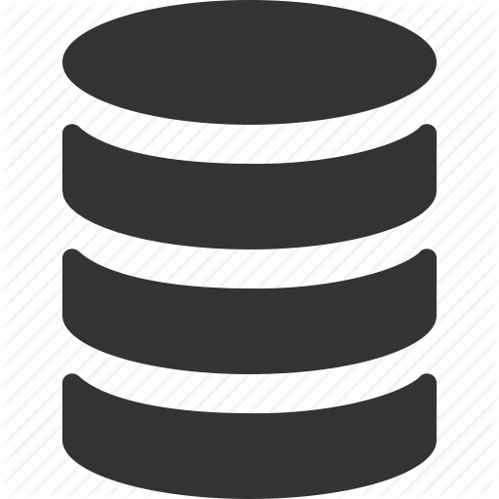
Kubernetes features Service Discovery and load balancing
A Pod is Logical Functional Unit of Containers
A Pod contains
An application container (or multiple containers)
Storage resource
A Unique Network IP
10.10.10.101
Container
Storage
POD
10.10.10.101
10.10.10.101
Node
Container
Container
Storage
Storage
POD
POD

Slide 8
Kubernetes features Service Discovery and load balancing
Pods that have same set of functions are abstracted into sets called service
Kubernetes gives Pods their own IP addresses and a single DNS name for a set of Pods and can load-balance across them. With this system, Kubernetes has control over network and communication between pods and can load balance across them
Service
( DNS Name)
10.10.10.101
10.10.10.102
10.10.10.103
Container
Container
Container
Storage
Storage
Storage
POD
POD
POD

Slide 9
Storage Orchestration
A container running inside the pod may need to store data.
Pod can have storage volumes
Usually, a single volume can be shared with all containers running inside the Pod
10.10.10.101
Kubernetes allows to mount the storage system on your choice
Local
Cloud(AWS)
Network File system (NFS)
Container
Volume /Storage
POD

Slide 10
Self-healing
Replication Controller
If container fails ---→ Restarts the container
If node fails ---→ replaces and reschedules the containers on other nodes
If container does not respond ---→ Kills the container
to user defined health checks

Slide 11

Automatic Rollout / Rollback
Roll Out : Deploys changes to application or its configuration
Roll Back : Reverts the changes and restores to its previous state
Kubernetes ensures there is no downtime during this process
Kubernetes progressively rolls out changes to your application or its configuration while monitoring application health to ensure that it does not kill all your instances at the same time .Also if anything goes wrong it automatically roll backs

Slide 12
Secrets and Configuration management
Kubernetes manages secrets and configuration details for the application separately from the container image

Slide 13
Secrets and Configuration management
Secret
Config Map
Secret is Kubernetes object created outside the pod and containers
Secrets contains the sensitive information of the application like passwords, tokens etc.
Secret is Kubernetes object that
separates the sensitive data from
pods and containers
In Kubernetes configurations are handled
using config maps
Config map is Kubernetes object that is created
outside the pods and containers
Config map is Kubernetes object that
separates the configurations from
pods and containers
Secrets
10.10.10.101
Config Map
Containers
Storage
POD
Node

Slide 14
Secrets and Configuration management
Secrets and config maps are stored in data store called ETCD
ETCD is key-value data store
Max limit for secret is 1 MB

Slide 15
Batch Execution
Kubernetes supports batch execution, long-running jobs, and replaces failed containers

Slide 16
Horizontal scaling
In Kubernetes we can scale up or scale down the pods
We can do scaling in different ways
- Using Commands
- Dashboard
- Automatically based on CPU utilization
Automatically scales the numbers of pods in a RC based on the observed CPU utilization or with custom metrics
Horizontal pod auto scaler
Replication controller(RC/RCS) is a structure that enables to create multiple pods then make sure that number pods always exists .
If the pod crashes RC replaces it .
RC get the no of pods to run and make available at any time from the manifest file
RC ensure that desired no of pods are maintained always
Replicas:3
Replication controller
Manifest file
POD
POD
POD

Slide 17
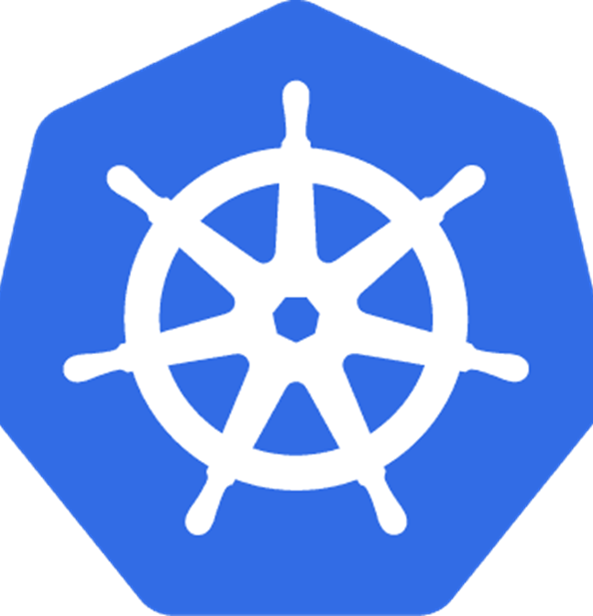


Kubernetes Architecture
Team member
Team member
Manager
Team member

Slide 18
Kubernetes Architecture
Team
Team member
Team member
Manager
Team member

Slide 19
Kubernetes Architecture
Cluster
Worker node
Worker Node
Master node
Worker Node

Slide 20
Kubernetes Architecture
Cluster
A cluster is set of machines called nodes
A cluster has at least one master node and one worker node
There can be more than one master node in a cluster to provide a cluster with failover and high availability
There can be multiple clusters in Kubernetes architecture
Master
Worker nodes

Slide 21
Kubernetes Architecture
Cluster
Nodes and Pods
A node can be
virtual machine
Physical machine
Or Virtual machine on Cloud
Master
Worker nodes

Slide 22
Kubernetes Architecture
Cluster
Nodes and Pods
Container
Master
Worker nodes
POD
Node

Slide 23
Kubernetes Architecture
Cluster
Nodes and Pods
Kubernetes supports :
Upto 5000 nodes
Upto 1,50,000 total pods
300000 total containers
100 pods per node
Master
Worker nodes

Slide 24
Kubernetes Architecture
Cluster
POD
Node 1
Node 2
Node 3
Workers
Master

Slide 25
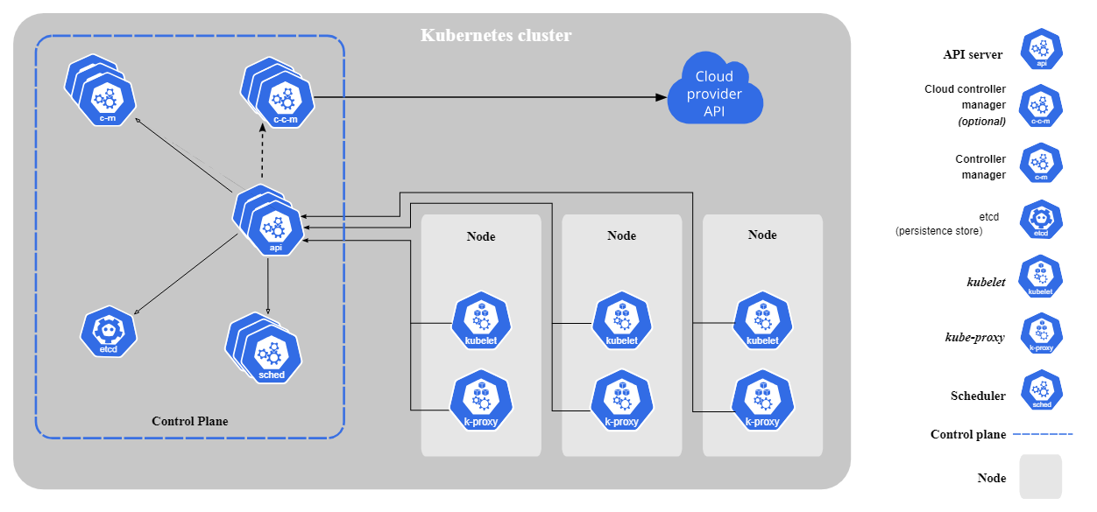
Kubernetes Architecture

Slide 26
Kubernetes – Master Node Components
API Server : It will act as cluster gateway and exposes some API to access all the operations in cluster
Api server can be accessed by using kubectl (command line tool) or K8s GUI
Ex: kubectl get pods
kubectl get nodes
API Server
Scheduler
Scheduler schedules the pods in nodes by using the config information stores in ETCD
Controller Manager :
The kube-controller-manager is a critical daemon in a Kubernetes cluster, acting as the control center for maintaining the desired state of your cluster.
Node Controller - monitors and responds all nodes activities
Replication Controller – monitors health of the pods
End Point Controller - responsible for all services and communications
Service Account and token controller – responsible for account , api access and name spaces
Controller Manager
ETCD
Key Value Pair distributed data base
contains config information about cluster , nodes , pods
Master Node

Slide 27
Kubernetes – Worker Node Components
Kubelet is an agent running on each node and it will communicate with master node using api server
Kubelet works in terms of PodSpec . APodSpec is a YAML or JSON Object that describes about pods
Worker Node
Kubelet
Kube-proxy
Kube_proxy is a network agent running on each node and is responsible for maintaining network configuration and rule.
These rules allow network communication to pods from inside and outside of cluster
Container Runtime
10.10.10.101
Container runtime also known as container engine and it helps to run the containers inside the pod
Container
Storage
POD

