Slide 1
Rechargeable Battery Degradation Prediction and Classification
Tai-Jung Chen
05/03

Slide 2
Outlines
Background
Data Description
Data Preprocessing
Modeling
Results
Acknowledgement

Slide 3
Background

Slide 4
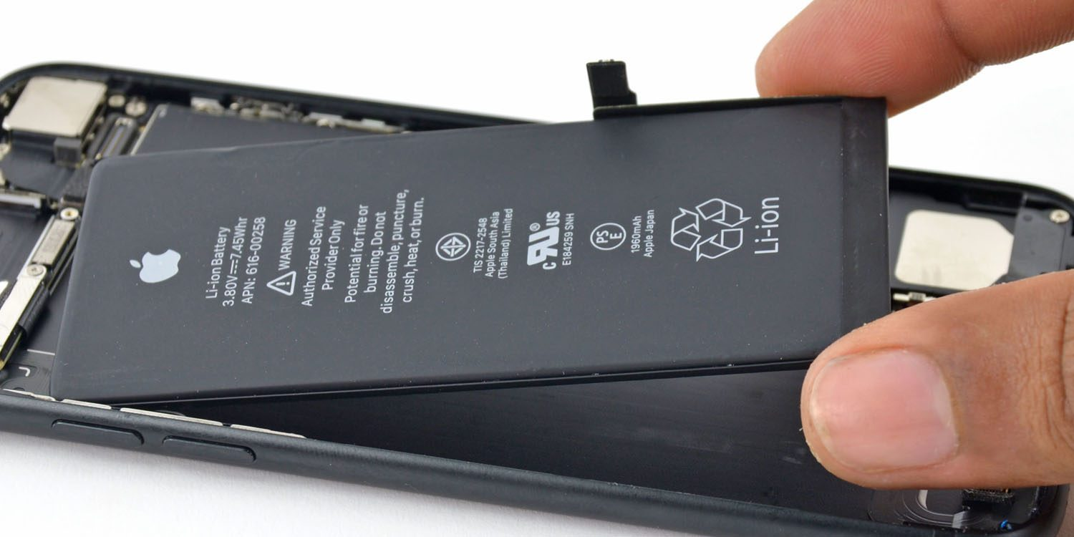
Background
Lithium-ion batteries are widely used in nowadays
When will the battery die out?
Knowing the State of Health (SOH) would help allocate the battery system properly
Aiming on using early life cycles to predict SOH
Data-driven Machine learning algorithm are often used
In this project:
MIT dataset
Gradient Boosting Regression Tree (GBRT)
Extreme Gradient Boosting (XGBoost)
Notes:
Phone battery
Car inspection

Slide 5
Data Description

Slide 6

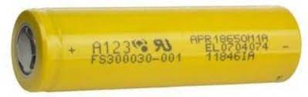
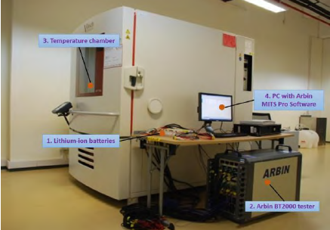
Data Description
The dataset consists of 124 commercial lithium-ion batteries cycled to failure under fast-charging conditions
These lithium-ion phosphate (LFP)/graphite cells, manufactured by A123 Systems (APR18650M1A)
Failure = cycle to 80% of nominal capacity (0.88 Ah)
Cycled in the 48-channel Arbin LBT potentiostat
Temperature chamber set to 30°C
Photo credit:
< X. Song et al.: Combined CNN-LSTM Network for SOC Estimation of Lithium-Ion Batteries >

Slide 7
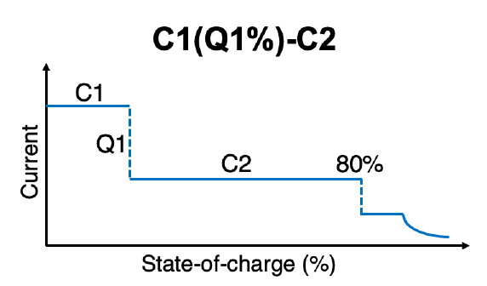
Data Description
< Fast charge policy >
72 different policy
1C-3.6V
0%
80%
100%
<SOC>
4C-2.0V

Slide 8
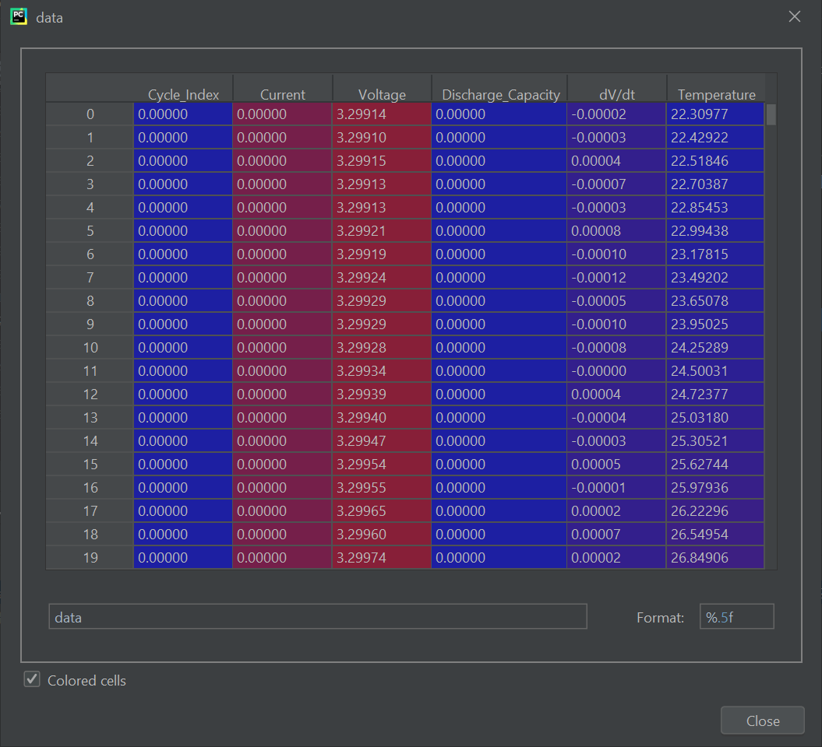
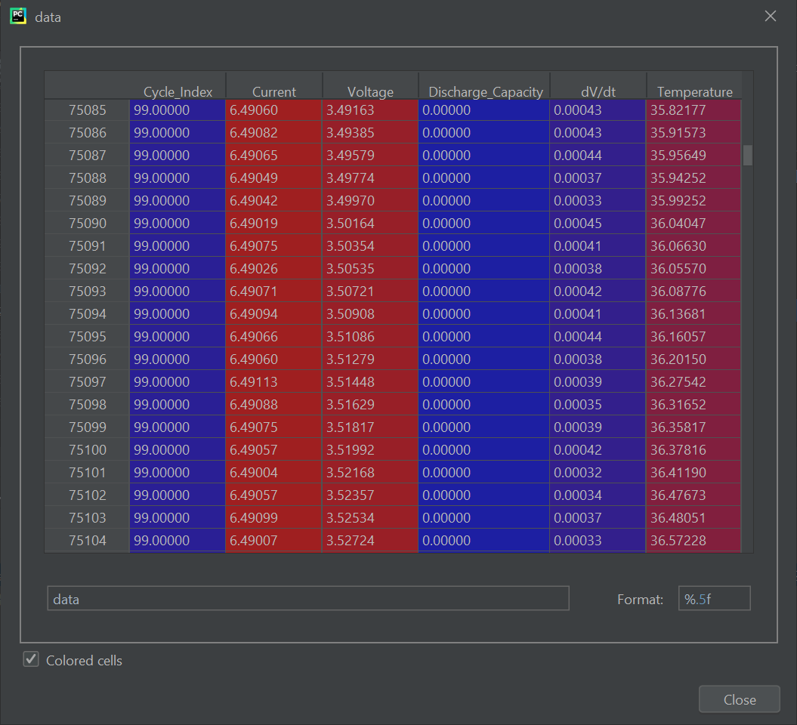
Data Description
< Look for one particular cell for example >

Slide 9
Data Preprocessing

Slide 10
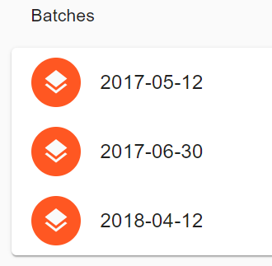
Data preprocessing
Accumulated cells
One Batch
43
<2018/4/12>
43 cells
Raw Data
Two Batches
46
<2018/4/12 + 2017/6/30>
89 cells
Three Batches
42
<2018/4/12 + 2017/6/30 +2017/5/12>
131 cells

Slide 11
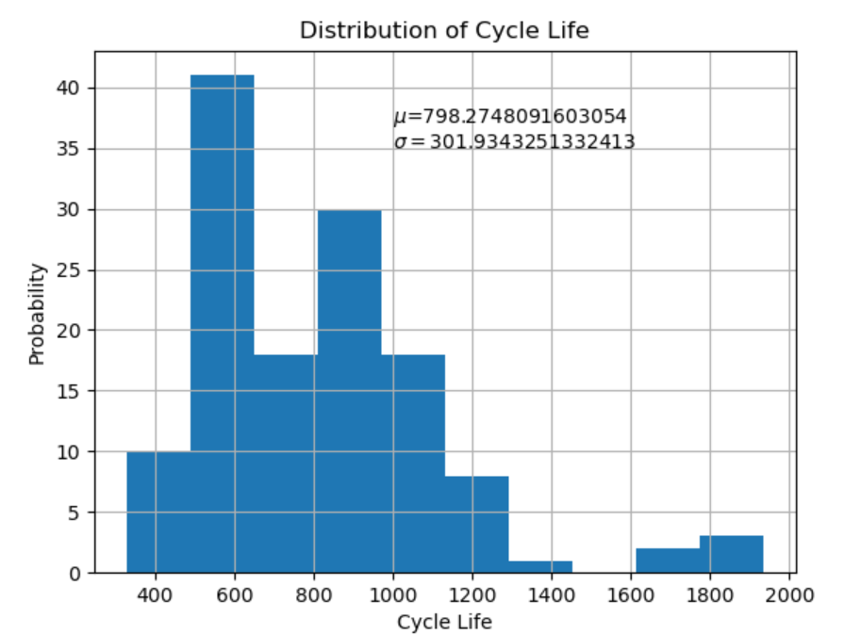
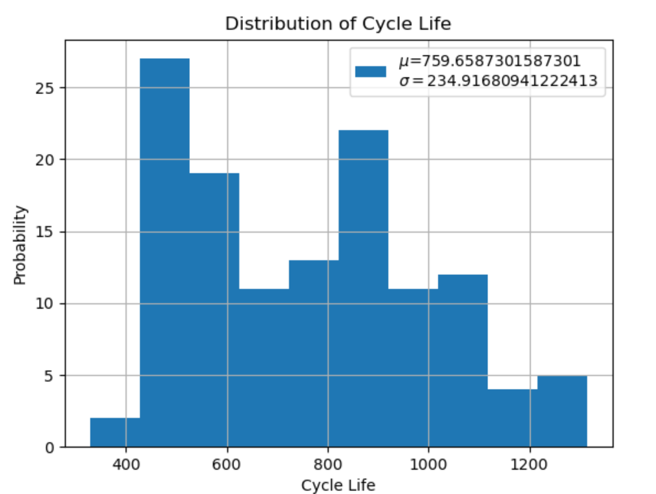
Before
After
Remove cycle life >= 1600
131 examples
126 examples

Slide 12
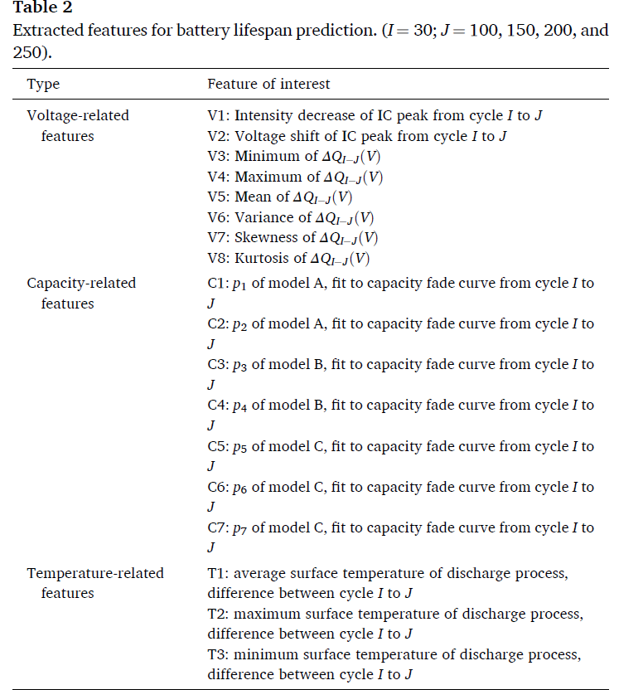
Data preprocessing
Number of Features = 72
Data Frame
Number Of Cells = 126
< F. Yang et al. “Lifespan prediction of lithium-ion batteries based on various extracted features and gradient boosting regression tree model” >

Slide 13
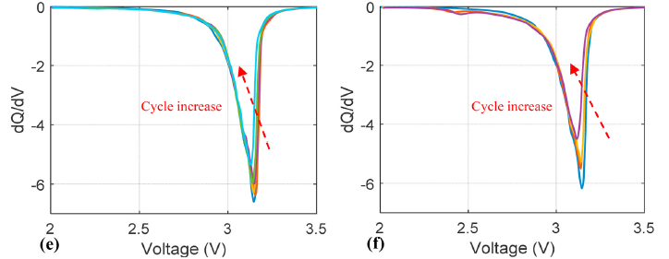
Data preprocessing
< IC curve of two particular cells >

Slide 14
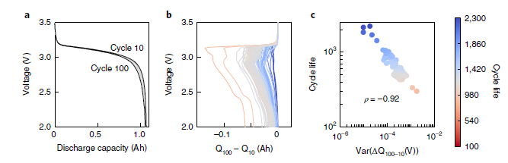

Data preprocessing
$$ΔQ_{100−10}\left(V\right)=Q_{100}\left(V\right)−Q_{10}\left(V\right)$$
Var($ΔQ_{100−10}\left(V\right)$) is highly correlated to the cycle life.
Notes:
discharge capacity is Q

Slide 15
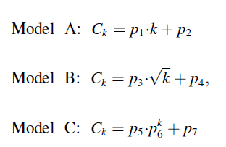
Data preprocessing
Model A is a Linear regression model.
Model B and C semi-empirical models and have been widely used to capture the capacity degradation of lithium-ion batteries.

Slide 16
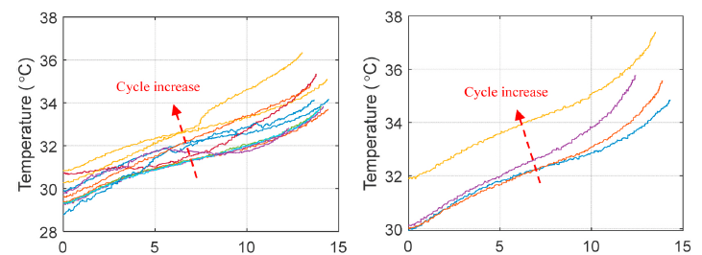
Data preprocessing
Discharge time (min)
Discharge time (min)
Constructed by Temperature data during discharge process.

Slide 17
Data preprocessing
Number of Features = 72
Data Frame
Number Of Cells = 126

Slide 18
Modeling

Slide 19
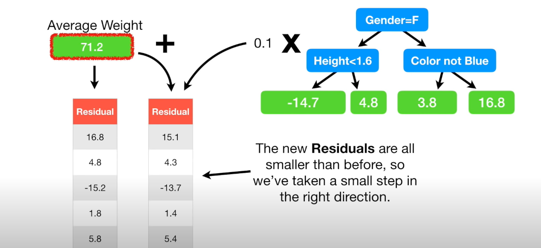
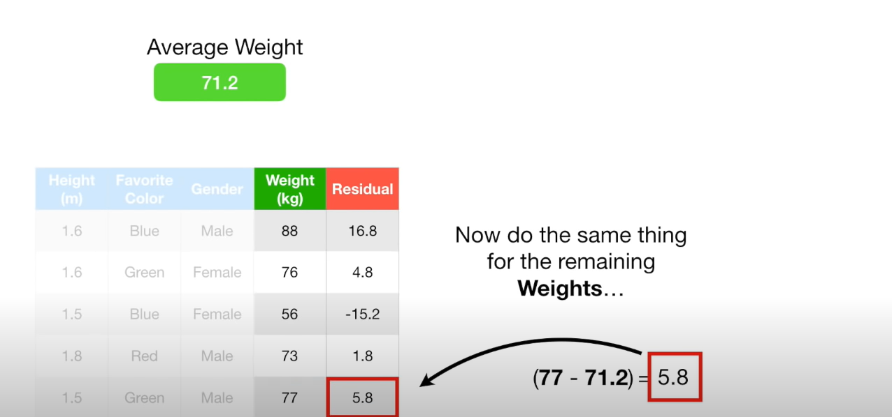
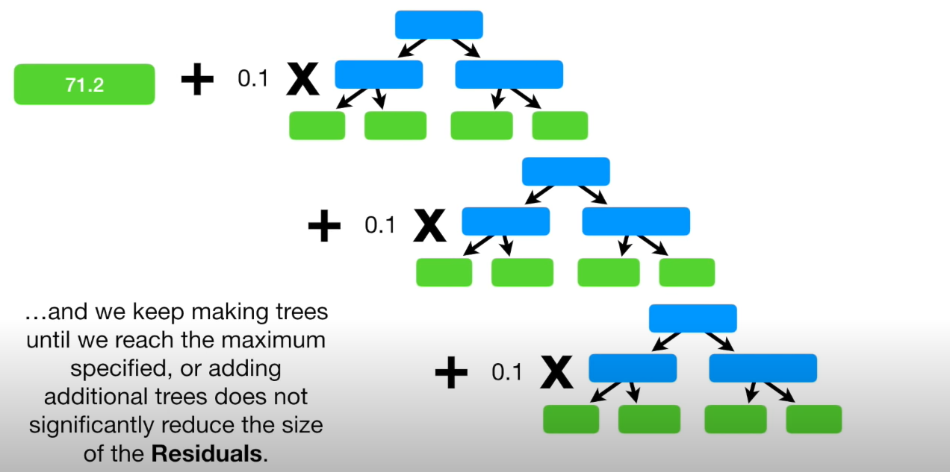
Modeling
Gradient Boosting Regression Tree
Take Learning rate, number of trees, and number of splits as the hyper parameters
< Slide credit: StatQuest with Josh Starmer >

Slide 20
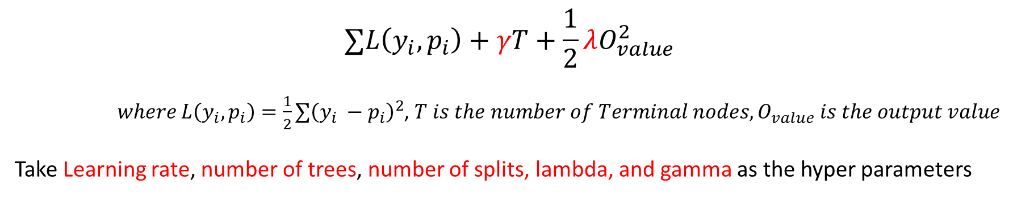
Modeling
Extreme Gradient Boosting (XGBoost)
$$∑L\left(y_{i}, p_{i}\right)+γT+\frac{1}{2}λO_{value}^{2}$$
$where L\left(y_{i}, p_{i}\right)=\frac{1}{2}{∑\left(y_{i} −p_{i}\right)}^{2}$, $T is the number of Terminal nodes, O_{value} is the output value$
Take Learning rate, number of trees, number of splits, lambda, and gamma as the hyper parameters
< Slide credit: StatQuest with Josh Starmer >

Slide 21
Modeling
Number of Features = 72
Number of Features = 72
Training and Validation Set
Evaluation Set
Training Set
Validation Set
4/5
2/3
1/5
1/3
5-fold cross validation
<Data Frame>

Slide 22
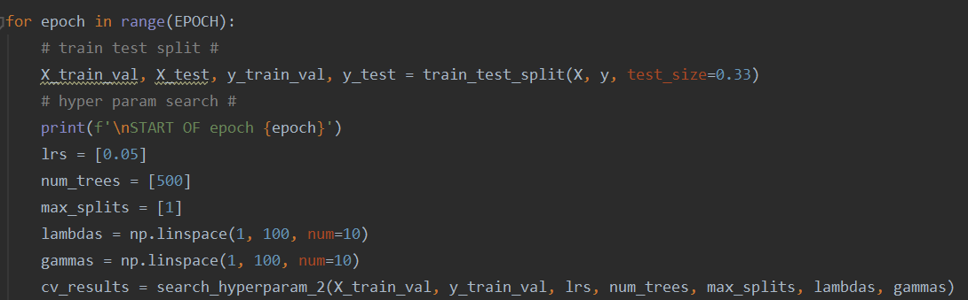
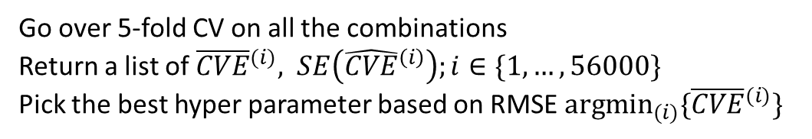
Modeling
<Learning Rate>
<Number of trees>
Go over 5-fold CV on all the combinations
Return a list of ${\overline{CVE}}^{(i)}, SE\left({\hat{CVE}}^{\left(i\right)}\right);i∈\{1,…,56000\}$
Pick the best hyper parameter based on RMSE ${argmin}_{(i)}⁡\{{\overline{CVE}}^{(i)}\}$
<Maximum Number of Split>
<lambda>
<gamma>

Slide 23
Modeling
epoch: perform different training and evaluation set
<Learning Rate>
<Number of trees>
Go over 5-fold CV on all the combinations
Return a list of ${\overline{CVE}}^{(i)}, SE\left({\hat{CVE}}^{\left(i\right)}\right);i∈\{1,…,56000\}$
Pick the best hyper parameter based on RMSE ${argmin}_{(i)}⁡\{{\overline{CVE}}^{(i)}\}$
<Maximum Number of Split>
<lambda>
<gamma>

Slide 24
Results

Slide 25
Result
Top 4 epochs with fixed hyper param on XGBoost | RMSE | MAE | MAPE | R^2 | R^2 adj
lr = 0.05; num_tree=500; max_split=1; lmb=1; gamma = 96 | 82.2472 | 57.3341 | 8.37% | 0.8577 | 0.6644
 | 77.1562 | 58.1224 | 7.12% | 0.8921 | 0.7455
 | 77.9134 | 59.2571 | 9.15% | 0.8795 | 0.7157
 | 68.8885 | 55.9075 | 7.97% | 0.8845 | 0.7277
mean | 76.5513 | 57.6553 | 0.081549 | 0.87845 | 0.71333
std | 5.57922 | 1.40735 | 0.008462 | 0.01477 | 0.03484
Adding lambda and gamma

Slide 26
Result
top 4 epochs with fixed hyper param on XGBoost | RMSE | MAE | MAPE | R^2 | R^2 adj
lr = 0.05; num_tree=500; max_split=1; lmb=1 | 83.7588 | 64.5968 | 8.90% | 0.8802 | 0.7175
 | 83.3241 | 63.5248 | 9.27% | 0.8604 | 0.6708
 | 80.1853 | 62.0573 | 8.59% | 0.8594 | 0.6684
 | 83.025 | 65.9253 | 8.10% | 0.8755 | 0.7064
mean | 82.5733 | 64.0261 | 0.0871643 | 0.86888 | 0.69078
std | 1.62026 | 1.63912 | 0.0049796 | 0.01055 | 0.02489
Adding only lambda

Slide 27
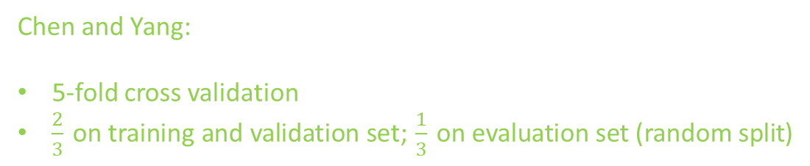
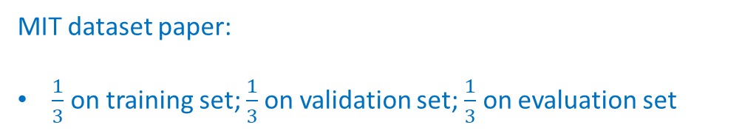
Comparison
 | Model | Hyper-parameter tuning | RMSE
MIT | Linear Regression | Full model | 100
Yang | GBRT | Learning rate; number of trees; maximum split | 84.91
Chen | XGBoost | Learning rate; number of trees; maximum split; Lambda | 82.57
Chen | XGBoost | Learning rate; number of trees; maximum split; Lambda; Gamma | 76.55
MIT dataset paper:
$\frac{1}{3}$ on training set; $\frac{1}{3}$on validation set; $\frac{1}{3}$ on evaluation set
Chen and Yang:
5-fold cross validation
$\frac{2}{3}$ on training and validation set; $\frac{1}{3}$ on evaluation set (random split)

Slide 28
Result
best_lr: 0.2, best_num_tree: 100, best_max_split: 1 | Accuracy | Precision | Recall | F1 score
 | 97.62 %
0 (short lifespan) |  | 0.92 | 1 | 0.96
1 (long lifespan) |  | 1 | 0.97 | 0.98
 | 95.24 %
0 (short lifespan) |  | 1 | 0.88 | 0.93
1 (long lifespan) |  | 0.93 | 1 | 0.96
Using XGBoost to classify battery lifespan thresholding on 550 cycle

Slide 29

Acknowledgement
Thanks to Prof. Kwok Tsui for advising.
Thanks to Dr. Fangfang Yang for providing details and answering questions from paper.

Slide 30

Thank You! Q&A

Slide 31
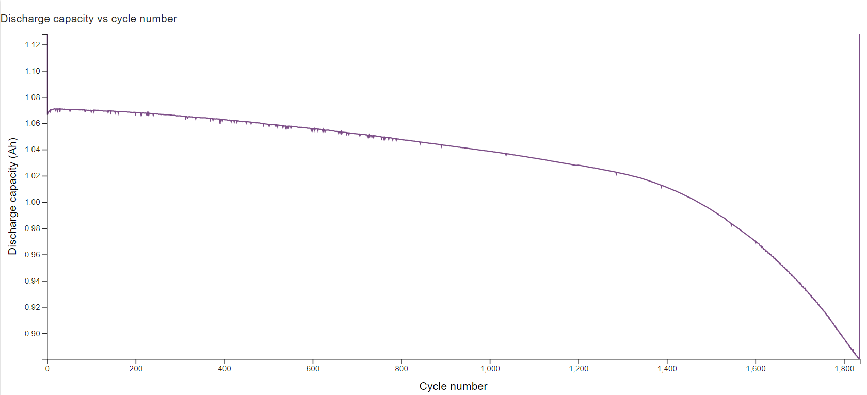
Data Description
< Look for one particular cell for example >

Slide 32
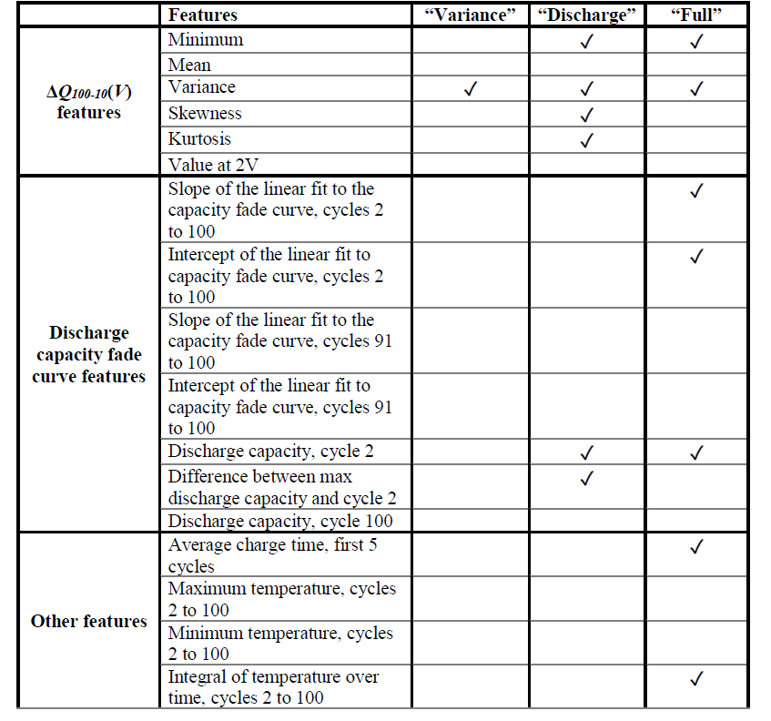
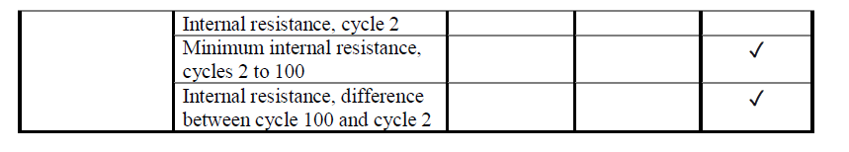
Features for the MIT dataset

Slide 33
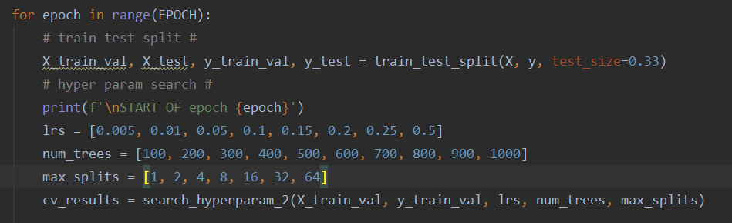
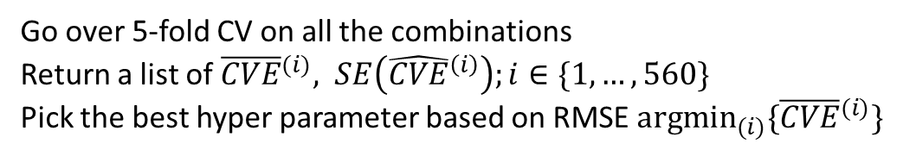
Modeling
epoch: perform different training and evaluation set
<Learning Rate>
<Number of trees>
Go over 5-fold CV on all the combinations
Return a list of ${\overline{CVE}}^{(i)}, SE\left({\hat{CVE}}^{\left(i\right)}\right);i∈\{1,…,560\}$
Pick the best hyper parameter based on RMSE ${argmin}_{(i)}⁡\{{\overline{CVE}}^{(i)}\}$
<Maximum Number of Split>

Slide 34
Results- run 20 epochs
 | RMSE | MAE | MAPE (%) | R^2 | R^2 adj
best_lr: 0.25, best_num_tree: 900, best_max_split: 8 | 113.41 | 88.23 | 13.53 | 0.7661 | 0.4483
best_lr: 0.2, best_num_tree: 700, best_max_split: 1 | 119.21 | 96.17 | 12.37 | 0.7355 | 0.3762
best_lr: 0.15, best_num_tree: 300, best_max_split: 4 | 100.01 | 77.61 | 10.64 | 0.8292 | 0.5972
best_lr: 0.2, best_num_tree: 800, best_max_split: 32 | 98.03 | 75.26 | 10.49 | 0.8208 | 0.5774
best_lr: 0.5, best_num_tree: 1000, best_max_split: 8 | 114.65 | 83.25 | 11.62 | 0.7158 | 0.3297
best_lr: 0.1, best_num_tree: 600, best_max_split: 4 | 88.81 | 70.99 | 10.17 | 0.836 | 0.6132
best_lr: 0.25, best_num_tree: 1000, best_max_split: 32 | 84.96 | 61.33 | 8.02 | 0.8781 | 0.7125
best_lr: 0.05, best_num_tree: 500, best_max_split: 4 | 104.40 | 81.81 | 10.63 | 0.8085 | 0.5483
best_lr: 0.25, best_num_tree: 700, best_max_split: 8 | 96.35 | 73.23 | 9.49 | 0.8496 | 0.6453
best_lr: 0.15, best_num_tree: 900, best_max_split: 4 | 114.19 | 89.24 | 13.44 | 0.7567 | 0.4262
best_lr: 0.01, best_num_tree: 1000, best_max_split: 1 | 116.05 | 90.87 | 12.65 | 0.7708 | 0.4594
best_lr: 0.2, best_num_tree: 100, best_max_split: 2 | 122.24 | 92.52 | 14.33 | 0.7363 | 0.3781
best_lr: 0.15, best_num_tree: 500, best_max_split: 4 | 107.16 | 77.11 | 11.53 | 0.7857 | 0.4946
best_lr: 0.05, best_num_tree: 400, best_max_split: 2 | 95.55 | 68.28 | 9.96 | 0.8483 | 0.6422
best_lr: 0.15, best_num_tree: 100, best_max_split: 4 | 100.24 | 76.54 | 9.58 | 0.8096 | 0.5509
best_lr: 0.01, best_num_tree: 600, best_max_split: 2 | 91.26 | 69.02 | 8.59 | 0.8552 | 0.6585
best_lr: 0.5, best_num_tree: 800, best_max_split: 1 | 136.90 | 98.75 | 11.11 | 0.759 | 0.4316
best_lr: 0.05, best_num_tree: 300, best_max_split: 1 | 80.14 | 59.23 | 7.29 | 0.8846 | 0.7278
best_lr: 0.5, best_num_tree: 900, best_max_split: 32 | 113.99 | 87.18 | 11.86 | 0.775 | 0.4693
best_lr: 0.25, best_num_tree: 600, best_max_split: 4 | 125.27 | 97.37 | 11.81 | 0.7664 | 0.4491
Mean | 106.14 | 80.70 | 10.96 | 0.7994 | 0.5268
Std | 14.67 | 11.73 | 1.85 | 0.0496 | 0.1169
UL (Mean + 3*Std) | 150.15 | 115.88 | 16.51 | 0.9480 | 0.8774
LL (Mean - 3*Std) | 62.13 | 45.52 | 5.40 | 0.6507 | 0.1762

Slide 35
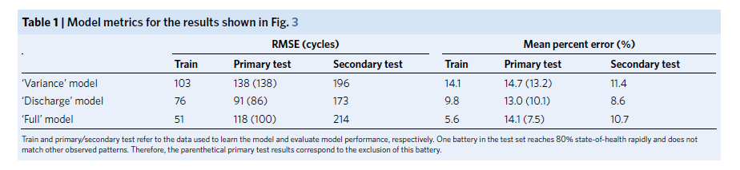
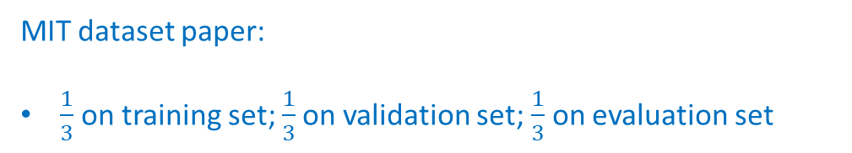
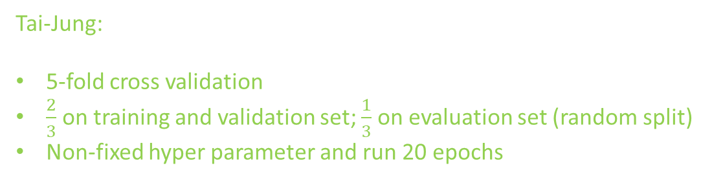
Comparison
MIT dataset paper:
$\frac{1}{3}$ on training set; $\frac{1}{3}$on validation set; $\frac{1}{3}$ on evaluation set
 | RMSE | MAE | MAPE (%) | R^2 | R^2 adj
case 1 | 80.14 | 59.23 | 7.29 | 0.8846 | 0.7278
case 2 | 84.96 | 61.33 | 8.02 | 0.8781 | 0.7125
case 3 | 88.81 | 70.99 | 10.17 | 0.836 | 0.6132
case 4 | 91.26 | 69.02 | 8.59 | 0.8552 | 0.6585
Tai-Jung:
5-fold cross validation
$\frac{2}{3}$ on training and validation set; $\frac{1}{3}$ on evaluation set (random split)
Non-fixed hyper parameter and run 20 epochs

Slide 36
Future Outlook

Slide 37
Future Outlook
Feature selection aspects:
Deep learning-based stacked denoising autoencoder
Look up the Feature importance and construct better features
Modeling aspects:
Try other Algorithms such as XGBoost, and Neural Network
Other aspects:
Data bias and variances between different batches
Look into the classification problem

