Slide 1
Summarize with NLP

Slide 2
01
Data Preprocessing

Slide 3
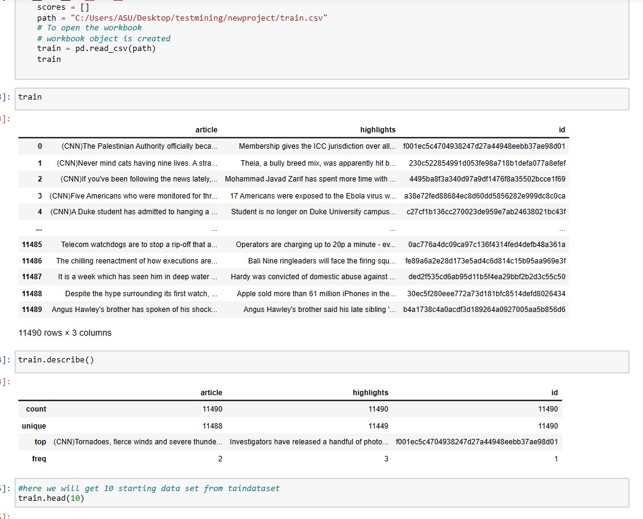
Data Preprocessing:
Loading Data

Slide 4
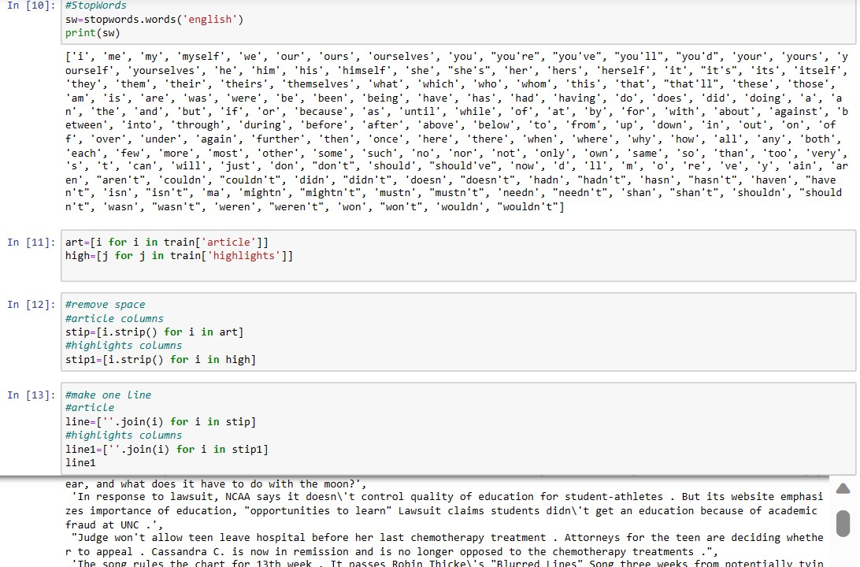
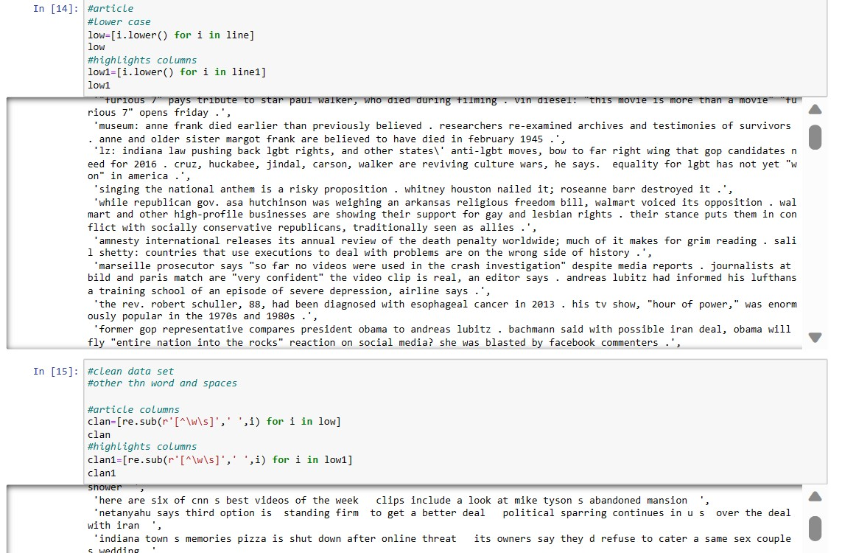
Working with StopWords

Slide 5
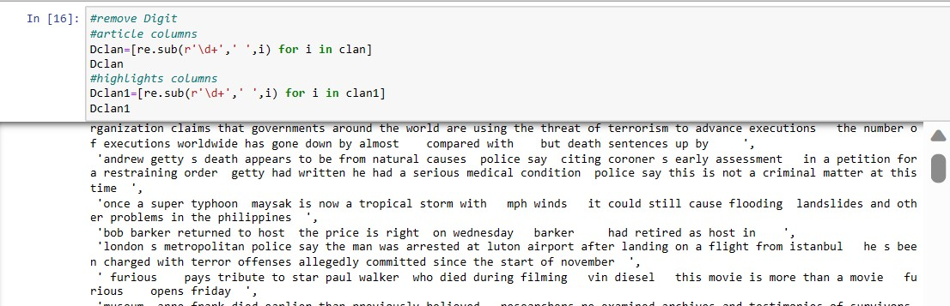
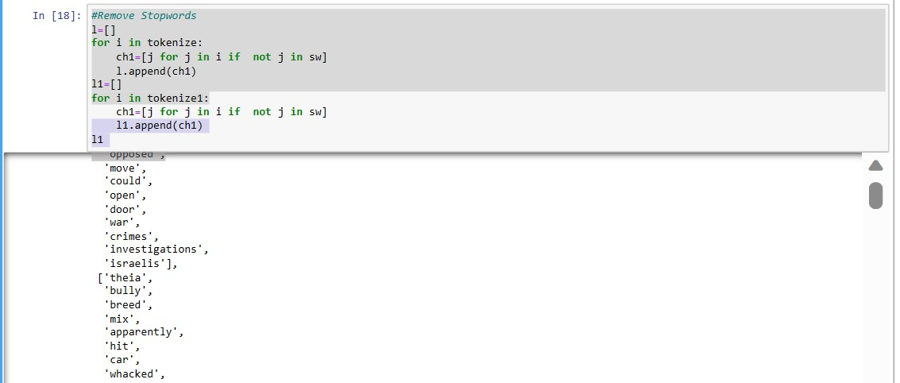

Slide 6
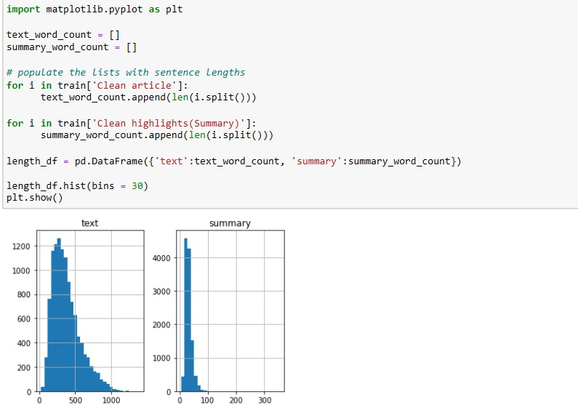
Visualization distribution of reviews and summaries

Slide 7
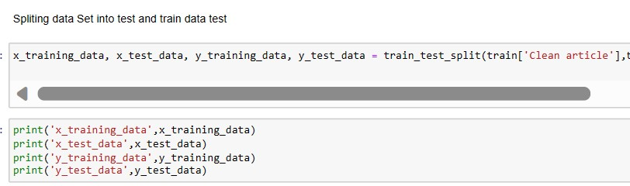
Split the dataset into a training set and a testing set.

Slide 8
02
Model Building

Slide 9
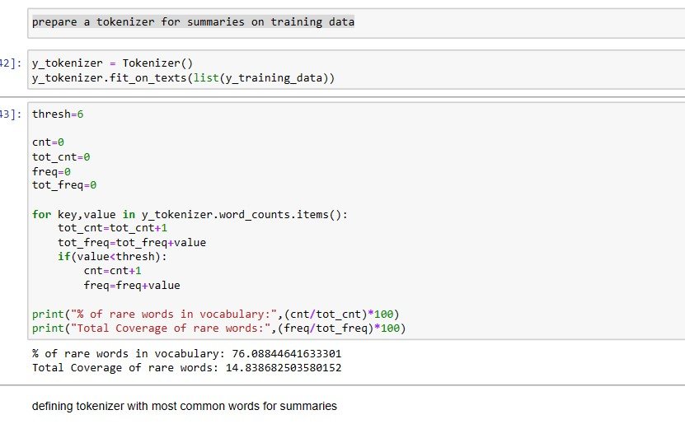
Prepare a tokenizer for summaries on training data

Slide 10
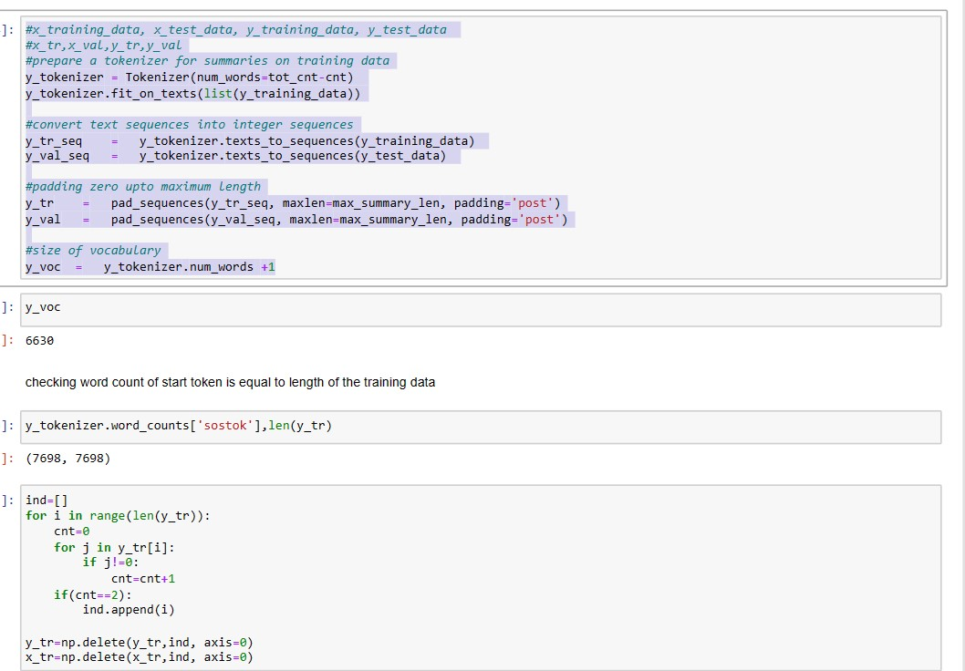
Tokenize for summaries on training data

Slide 11
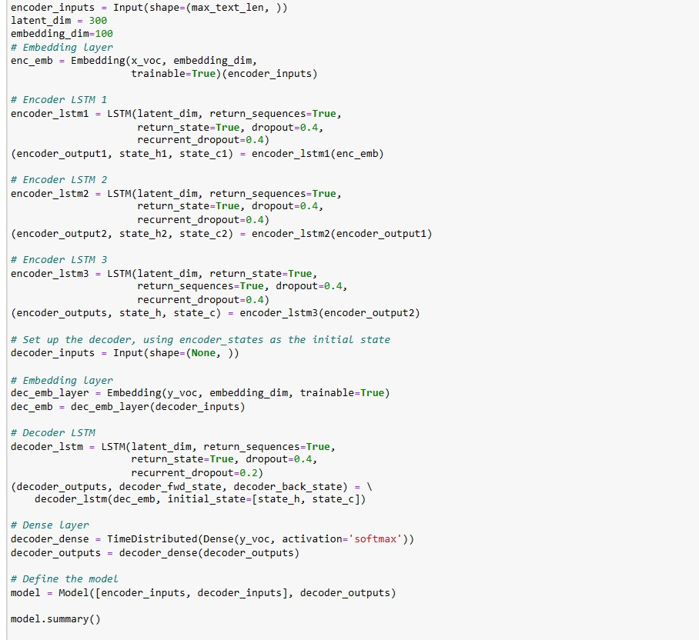
Model building, defining LSTM layers, Encoder and Decoder

Slide 12
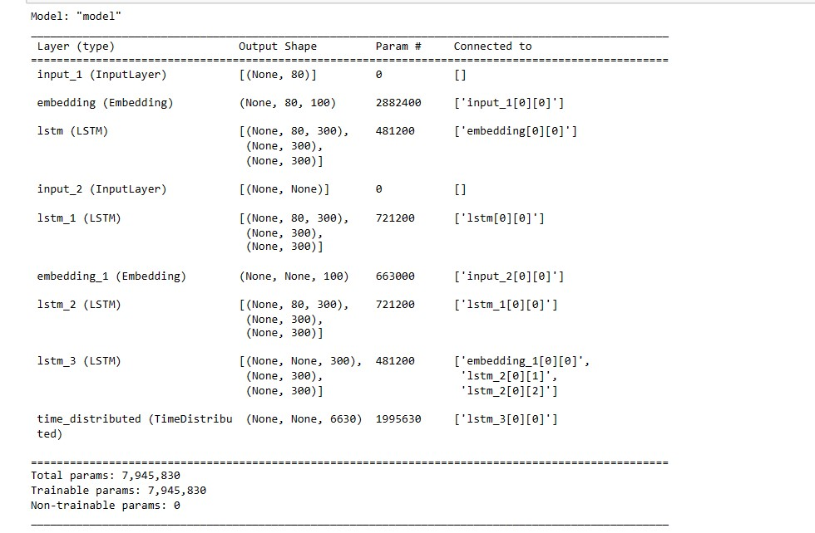
Output

Slide 13
03
Data Evaluation

Slide 14
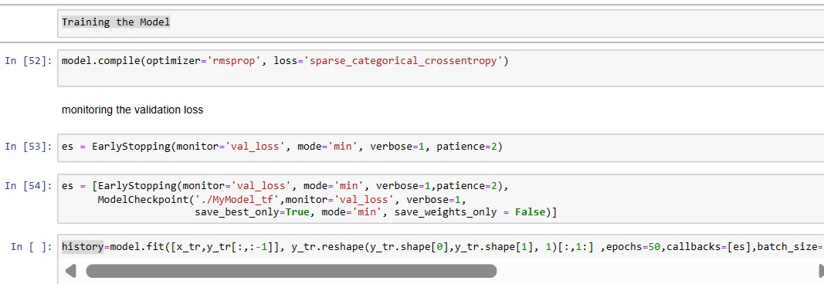
Training the Model

Slide 15
04
Challenges Faced
Adjusting the model
Running heavy Scrip
Testing the model

Slide 16
Thank You

