Slide 1
VHWA (Vision Hardware Accelerator)

Slide 2
Agenda
VHWA Drivers in PDK
Driver Architecture
FVID2 Interface
Application Flow
VPAC Overview
Multi-Scalar
NF
LDC
VISS
DMPAC Overview
DOF
SDE

Slide 3
VHWA Drivers in PDK

Slide 4
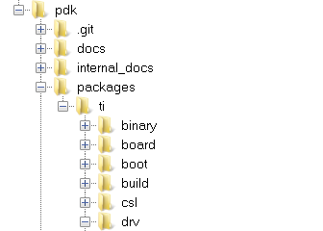
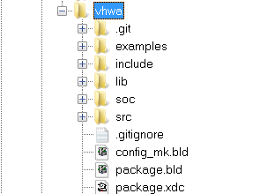
VHWA Driver Architecture
Application (TI – RTOS)
OpenVX Nodes
FVID2 API
M2M
LDC
M2M
MSC
2 INST
M2M
NF
M2M
VISS
M2M
DOF
M2M
SDE
RES
MNGR
Q
M
N
G
R
INTR
MNGR
OSAL
CSL
LDC
MSC
NF
DOF
SDE
RFE
VTOP
NSF4
GLBCE
H3A
HTS
LSE
FCC
DTOP
Hardware
LDC
MSC
NF
VISS
DOF
DOF
HTS
LSE
UTC
SL2

Slide 5
VHWA FVID2 Driver: Understanding FVID2 Interface
FVID2 APIs:
FVID2_init
Initializes the drivers and the hardware. Should be called before calling any of the FVID2 functions
FVID2_deInit
Un-initializes the drivers and the hardware
FVID2_create
Opens a instance/channel video driver
FVID2_delete
Closes a instance/channel of a video driver
FVID2_control
To send standard (set/get format, alloc/free buffers etc..) or device/driver specific control commands to video driver
FVID2_processRequest
Submit a pixel processing request to the driver. Used in memory to memory drivers
FVID2_getProcessRequest
Get back the completed pixel processing request from the driver

Slide 6
VHWA FVID2 Driver: Application Flow
Init/DeInit Sequence
Task Context
ISR Context
FVID2 Init
UDMA Init
Sets path, Selects number of input/output, their frame size and format etc,
VHWA Driver Init
Open Driver
FVID2_Create
SET Params
SET_PARAMS IOCTL
Sets IP specific configuration
Based on timeout value Blocks until HW is free.
Triggers the HW
SET Config
SET_CONFIG IOCTL
Submit Process Request
FVID2_processRequest
Returns the last completed request
Wait for Completion
Frame Completion Callback – Signals Task
Get processed Request
FVID2_getProcesedReq
Closes Instance handle, release resources
Close Driver
FVID2_Delete
VHWA Driver DeInit
UDMA DeInit
FVID2 DeInit

Slide 7
VPAC (Vision Pre-Processing Accelerator)

Slide 8
VPAC Block Diagram
CSI-Rx_IF0
Video Imaging Sub-System (VISS)
Noise Filter (NF)
Multi-Scalar (MSC)
Lens Distortion Correction (LDC)
Hardware Thread Scheduler
Shared Memory (SL2)
Interrupt Distributor (INTD)
Unified Transfer Controller (UTC) x2
CTSET
SCR
HTS: Hardware Thread Scheduler
UTC: Universal Transfer Controller
NF: Noise Filter
LDC: Lens Distortion Correction
VISS: Vision Image signal Processing
SL2: Level-2 Memory

Slide 9
Typical Functional Flow in VPAC
CSI2Rx
DDR
VPAC
Image
Sensors
RFE
FCP
VISS
NF
LDC
DSP
& ARM
Lens Corrected Base Image
SCALER
Pyramids
SDE-Depth
Depth, Confidence
DOF-Motion
Motion, Confidence
DMPAC

Slide 10
Scalar: Introduction
Downscaling ratio is between 1x and 0.25x
Programmable kernel sizes for vertical/horizontal filter (3,4, or 5)
4 sets of 5 tap-32 phase coefficients
Two set can be combined to support 5-tapx64-phase filters
2 additional sets of 5-tap Gaussian filter coefficients (single-phase) dedicated for Pyramid (Octave) generation
12 bit input & output
Programmable ROI for input and output for each scalar
Performance: 1pixel/cycle
Video Imaging Sub-System (VISS)
Noise Filter (NF)
Multi-Scalar (MSC)
Lens Distortion Correction (LDC)
Hardware Thread Scheduler
Shared Memory (SL2)
Interrupt Distributor (INTD)
Unified Transfer Controller (UTC) x2
CTSET
SCR
Supported DataFormats
Data Format | Input Bit Depth | Output Bit Depth | Data Format | Input Bit Depth | Output Bit Depth
Luma | 8Bit | 8Bit | Chroma | 8Bit | 8Bit
 |  | 12Bit |  |  | 12Bit
 | 12bit | 8Bit |  | 12bit | 8Bit
 |  | 12Bit |  |  | 12Bit

Slide 11
MSC: Multiple Scaling
Downscale o/p#1
SCALER HW
Input Thread #1
Downscale o/p#2
Down Scalar #1
Down Scalar #2
Down Scalar #3
Downscale o/p#3
Input Thread #2
Down Scalar #10
Downscale o/p#10

Slide 12
Bilateral Noise Filter
Support for bilateral and general filtering
Supports filter size upto 5x5
LUT based Bilateral weights generation
8 bits for weight
5 zones x 256 coefficients
Performance : 1 pixel/cycle
Supported formats: one plane (interleaved plane and non-interleaved) YUV 420, 12-bit
Video Imaging Sub-System (VISS)
Noise Filter (NF)
Multi-Scalar (MSC)
Lens Distortion Correction (LDC)
Hardware Thread Scheduler
Shared Memory (SL2)
Interrupt Distributor (INTD)
Unified Transfer Controller (UTC) x2
CTSET
SCR
Supported DataFormats
Data Format | Input Bit Depth | Output Bit Depth | Data Format | Input Bit Depth | Output Bit Depth
Luma | 8Bit | 8Bit | Chroma | 8Bit | 8Bit
 |  | 12Bit |  |  | 12Bit
 | 12bit | 8Bit |  | 12bit | 8Bit
 |  | 12Bit |  |  | 12Bit

Slide 13
Mesh LDC
Purpose
Remap pixels from a distorted input space to an undistorted output space.
Apply perspective transform/homography operations.
Mechanism
Perspective transform applied to output coordinates.
Remap function described by a 2D offset table (Δx/Δy).
Offsets are added to perspective output coordinates to locate input pixels.
Interpolation applied to input data to compute output pixels.
Video Imaging Sub-System (VISS)
Noise Filter (NF)
Multi-Scalar (MSC)
Lens Distortion Correction (LDC)
Hardware Thread Scheduler
Shared Memory (SL2)
Interrupt Distributor (INTD)
Unified Transfer Controller (UTC) x2
CTSET
SCR
Supported Formats
YUV 420 & YUV422
Up to 12 bits/component
Interpolation Type
Bicubic (2 cyc/Pixel)
Bilinear (1 cyc/Pixel)

Slide 14
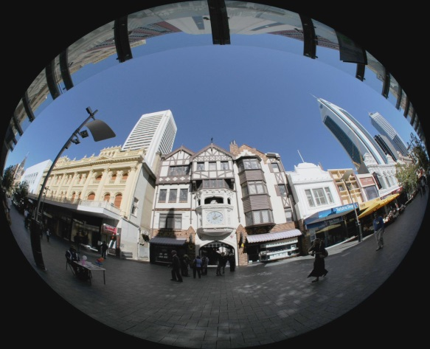
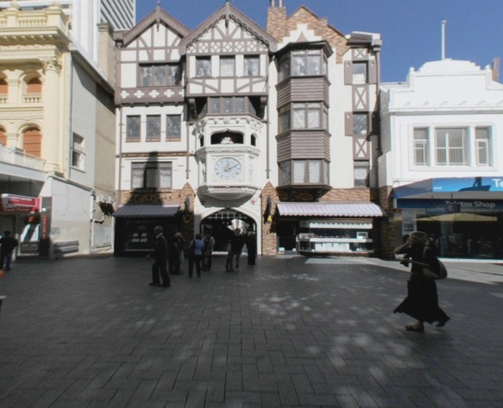
Mesh Warp (LDC)
LDC &
Perspective Warp HW
FISHEYE LENS
Supports fisheye lenses upto 180/360⁰
PERSPECTIVE TRANFORM
Changing user view point
PERSPECTIVE TRANFORM
Stereo Rectification
14

Slide 15
Mesh LDC: Data Formats
Input |  | Output
Data Mode | Data format | Data Mode | Data format
YUV420 (NV12) | 8bit | YUV420(NV12) | 8bit
 |  |  | 12bit - packed
 | 12bit - packed |  | 12bit - packed
 | 12bit - unpacked |  | 12bit - unpacked
Luma Only | 8bit | Luma Only | 8-bit
 |  |  | 12bit - packed
 | 12bit - packed |  | 12bit - packed
 | 12bit - unpacked |  | 12bit - unpacked
YUV420(NV12) Chroma Ony | 8bit | YUV420(NV12) Chroma Only | 8bit
 |  |  | 12bit packed
 | 12bit - packed |  | 12bit - packed
 | 12bit - unpacked |  | 12bit - unpacked
YUV422 (UYVY) | 8bit | YUV420(NV12) | 8bit
 |  |  | 12bit - packed

Slide 16
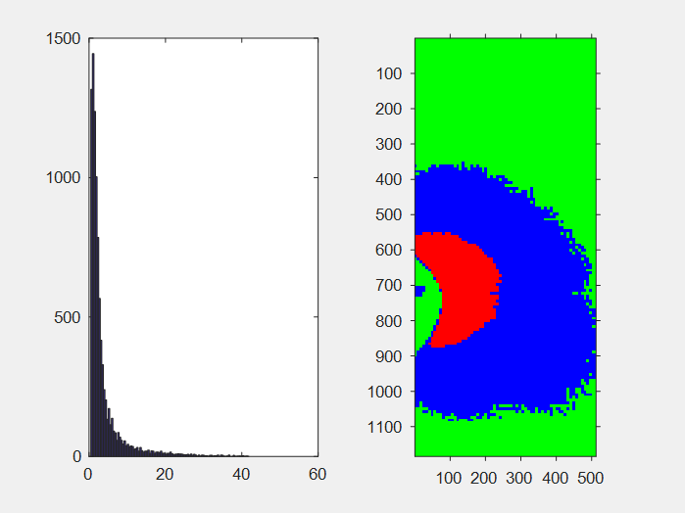
Mesh LDC: Multi-Region
Ideally the output block width (OBW) and output block height (OBH) should be sufficiently large but with the constraint that input block must fit into available internal memory.
Distortion in wide angle lenses causes block size to be very small due to extreme scaling in particular regions of the image in some cases specially the surround-view cases. This affects the performance of the LDC hardware and overall memory bandwidth.
No. of blocks
Ratio of Fetched block to output block size
Distribution of fetched block sizes compared to output block size in ratio
RW1
RW2
RW3
Solution in New LDC: Multi-Region LDC
Divide the frame into multiple slicing regions based on pattern of the transformation.
Frame will be divided into up to 3 horizontal slices and 3 vertical slices-Total of 9 regions
Each region can be programmed with independent output block size and optimal pixel pad.
LDC can be programmed with bigger block size for region with less spatial variation (i.e. scaling factor) and smaller block size for region with high spatial variation
This improves the band width as well as performance as portion of the image with bigger block size increases
RH1
R-0
R-1
R-2
R-3
R-4
R-5
RH2
RH3
R-6
R-7
R-8

Slide 17
VISS Block Diagram
VISS
Input-0
RAW Front End (RFE)
NSF4
GLBCE
FLEX Color Proc (FCP)
Y12
UV12
Input-1
Y8
UV8
Input-2
S8
H3A
Input format : 16b unpacked (RAW10/12/14/16) , 12b packed
Output format : 12b yuv420, 8b yuv420, 8b RGB, 8b S8
Supports On-the-fly processing ➔ Low latency DDR path (QoS through NavSS and MSMC)
Supports M2M processing

Slide 18
VISS Features
Performance : 1 pixel/cycles
Support for 12/16 bit input RAW format
Support for 8/12 bit YUV output
Support for multiple RAW formats (e.g. Bayer, RCCC)
Flexible to handle any 2x2 RAW format
Enables Support for other color spaces
Support other color spaces e.g. Support for Color saturation and Gray scale for HSV/HSL etc (Hue is not supported)
Enables RGB output
Support for Multiple WDR /HDR Formats and Up-to 3 Exposures
Compounded format (12 & 14 bit formats)
Stagger format of WDR
Rest of WDR Format
Support of statistics for 3A (Auto-Exposure, Auto-white-balance and Auto-Focus)
Dual Output (Vision and Visual)
TI’s proven Visual Processing with proven Noise filter and GLBCE (Local Tone Mapping)

Slide 19
RAW Front End (Processing in RAW Domain)
WDR Pre-processing, : To decompress sensor’s companded data
WDR Merge : Merge up to 3 RAW images into a WDR image
LSC : Lens Shading Correction using a pre-computed LUT read from memory
Digital WB Gain : Applies WB gains computed by AWB algorithm
H3A : Statistics generator for 3A (AWB, AE, AF) Algos.
GTM : Global Tone Map – Maps output of WDR merge block from 20->16 bpp
DPC : Defect Pixel Correction – OTF & LUT (256 entries) based

Slide 20
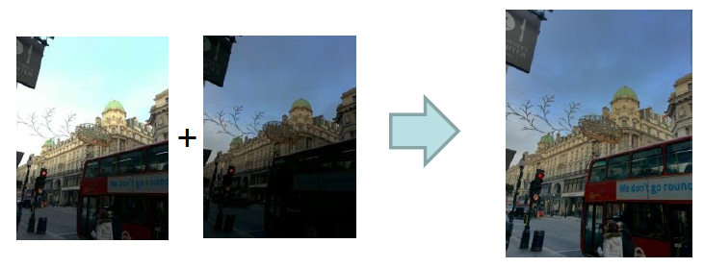
Wide Dynamic Range
Consumer cameras have limited Dynamic Range (60 dB)
Leads to clipped highlights or/and underexposed shadows
Human visual system has a much higher dynamic range
WDR Sensor
Capture Multiple exposures using time multiplexing and/or sensor architecture
Combine multiple exposures or transmit them separately

Slide 21
Flexible Color Processing
VISS
Input-0
RAW Front End (RFE)
NSF4
GLBCE
FLEX Color Proc (FCP)
Y12
UV12
Input-1
Y8
UV8
Input-2
S8
H3A
State-of-the-art TI’s 5th Generation Flexible CFA
Can support any 2x2 RAW Sensor Pattern
Flexible Color Conversion Scheme
Color Correction Matrix
Flexible HSV color plane generation (S &V) only to support different standards
12 bit/Component YUV 420 output generation
Full color RGB (24 bits/pixel) output

Slide 22
Flexible Color Processing
Low latency, On-The-Fly (OTF) operation of 3 key blocks
Global Tone Map (16 to 12)
Used when locally adaptive Tone Map is disabled
Flexible CFA
Generates 12 bit up to 4 color planes output (Eg Full Resolution RGBC or RGB IR)
Flexible Color Conversion
Implements multiple color conversion schemes for both analytics / visual use cases

Slide 23
Flexible Color Conversion
Flexible architecture for supporting multiple data flows
Color Correction Matrix (CCM) for supporting accurate color reproduction
LUT Based Gamma correction / Contrast Stretch Module
Flexible RGB-HSV Color generation (No Hue)
RGB-YUV with programmable coefficients
12 bit native output with option 8 bit using LUT based tone map.
Supports RGB output / Supports Saturation outputs
Supports Grayscale/Luma/IR/Clear Output
Single cycle/pixel performance
Support for flexible output format generation including YUV as well as custom
23

Slide 24
DMPAC (Depth and Motion Perception Accelerator)

Slide 25
DMPAC Block Diagram
Dense Optical Flow (DOF)
Stereo Disparity Engine (SDE)
Hardware Thread Scheduler
Shared Memory (SL2)
Interrupt Distributor (INTD)
Unified Transfer Controller (UTC)
CTSET
SCR
DOF: Dense Optical Flow
SDE: Stereo Disparity Engine
UTC: Universal Transfer Controller
HTS: Hardware Thread Scheduler
SL2: Level-2 Memory

Slide 26

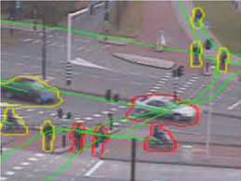
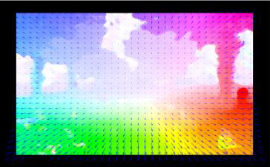
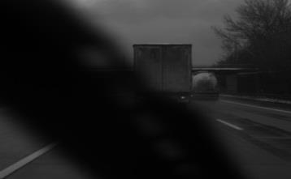
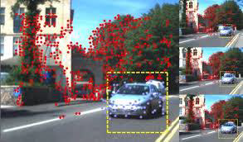
Dense Optical Flow (DOF)
Input Video Frame
Object Tracking
Dense Optical Flow
Dense Optical Flow HWA
Input Video Frame
Applications
Moving Object Segmentation

Slide 27
DOF: Feature Set
Overview
Optical Flow estimates 2D motion vector field given two images
Pyramidal approach based coarse-to-fine search strategy
Can estimate Large motions with fractional pixel precision
Features
Input Image resolution: upto 2MPix (max)
Max resolution 2048H x 1024V
Input Image Frame Rate: upto 60fps
Allows Scalability of input image resolution vs frame rate
eg. higher fps at lower resolution
12bit/pixel input and output format
Other bit depths can be supported using Format Conversion Module
Large Motion search range
Dense flow vector map generated for each input pixel
Confidence score generated for each flow vector output
Supports Sparse optical flow
Dense Optical Flow (DOF)
Stereo Disparity Engine (SDE)
Hardware Thread Scheduler
Shared Memory (SL2)
Interrupt Distributor (INTD)
Unified Transfer Controller (UTC)
CTSET
SCR

Slide 28
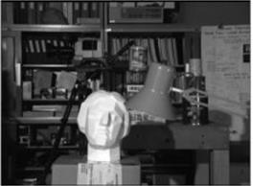
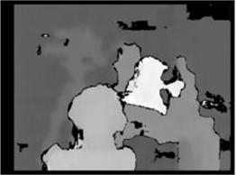
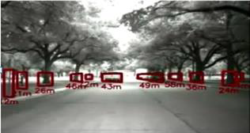
Stereo Disparity Engine (SDE)
Input Video Frame: Left Camera
Stereo Disparity Engine HWA
Applications
Input Video Frame: Right Camera
Depth Map
Object Distance Measurement
Large range applications
Collision Warning
Path Plannng

Slide 29
SDE: Features Set
Overview
Stereo estimates depth by measuring disparity from 2 different views
Can run in parallel with Optical Flow
Feature set
Input Image resolution: 2MPix (max)
Max resolution 2048H x 1024V
Input Image Frame Rate: 60fps (max with 2MPix)
Allows Scalability of input image resolution vs frame rate
eg. higher fps at lower resolution
12bit/pixel input and output format
Other bit depth can be supported using Format Conversion Module
Disparity Search range of -3/+188 (far object)
Dense disparity map for each input pixel
Confidence score assigned for each disparity output
Dense Optical Flow (DOF)
Stereo Disparity Engine (SDE)
Hardware Thread Scheduler
Shared Memory (SL2)
Interrupt Distributor (INTD)
Unified Transfer Controller (UTC)
CTSET
SCR

Slide 30

Questions? Thank You

Slide 31

© Copyright 2019 Texas Instruments Incorporated. All rights reserved.
This material is provided strictly “as-is,” for informational purposes only, and without any warranty.
Use of this material is subject to TI’s Terms of Use, viewable at TI.com

