Slide 1
DSS Overview

Slide 2
Agenda
What is DSS?
DSS Hardware Overview
Display Controller
Video Pipeline
Write back Pipeline
Overlay Manager
Video Port
Display Interfaces: eDP, DSI, DPI
DSS Interrupt Architecture
DSS Driver Overview
DSS Advance Features
Safety Checks
FIFO Buffer Mapping
Security Isolation
Display Sharing

Slide 3
What is DSS?

Slide 4
Introduction
DSS: Display Sub System
Displays video frames from memory to LCD
Provides the logic to output video frames stored in the memory to the external display interfaces.
Performs multi-layer composition for the display output
Supports a set of industry standard display interfaces to drive wide range of display panel resolutions
Supports Scaling, Color Space Conversion, Blending, Color Keying
4

Slide 5
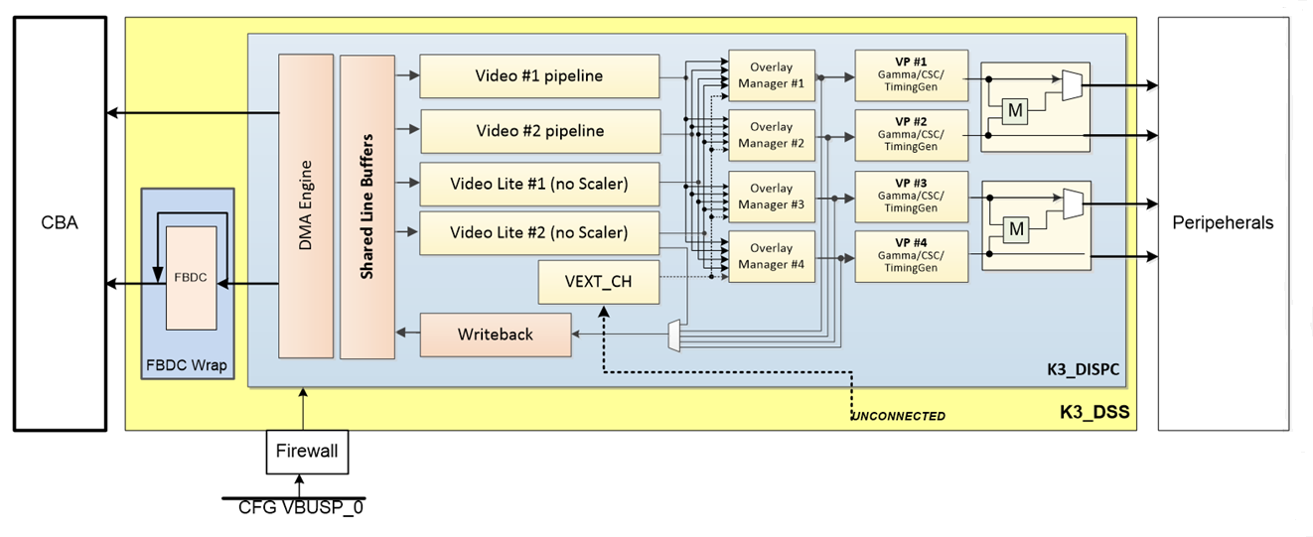
DSS Block Diagram for J721E
5

Slide 6
DSS Hardware Overview

Slide 7
Display Controller
Four Video Pipelines
Two Video pipelines - Supporting 8/10-bit/component RGB or 8/10/12-bit/component YUV source data formats with 3/5-tap 16-phase scaler capable of 0.25x to 16x resizing.
Two Video_Lite pipelines - Supporting 8/10-bit/component RGB or YUV source data formats (including YUV420/422 source data)
Four Overlay Managers
Fully mapped to all input pipelines
Multi-layer alpha blending
Four Video Ports
Support up to four simultaneous 4K display outputs (600MHz pixel clock)
24/30/36-bit per pixel RGB output
Additional 8/10-bit per component YUV422 embedded sync stream (BT1120/BT656) on every output
One optional Write-back pipeline with a scaler to perform memory to memory operations or to capture one of the display outputs.
DMA controller capable of supporting up to 8K-wide input source frame
7

Slide 8
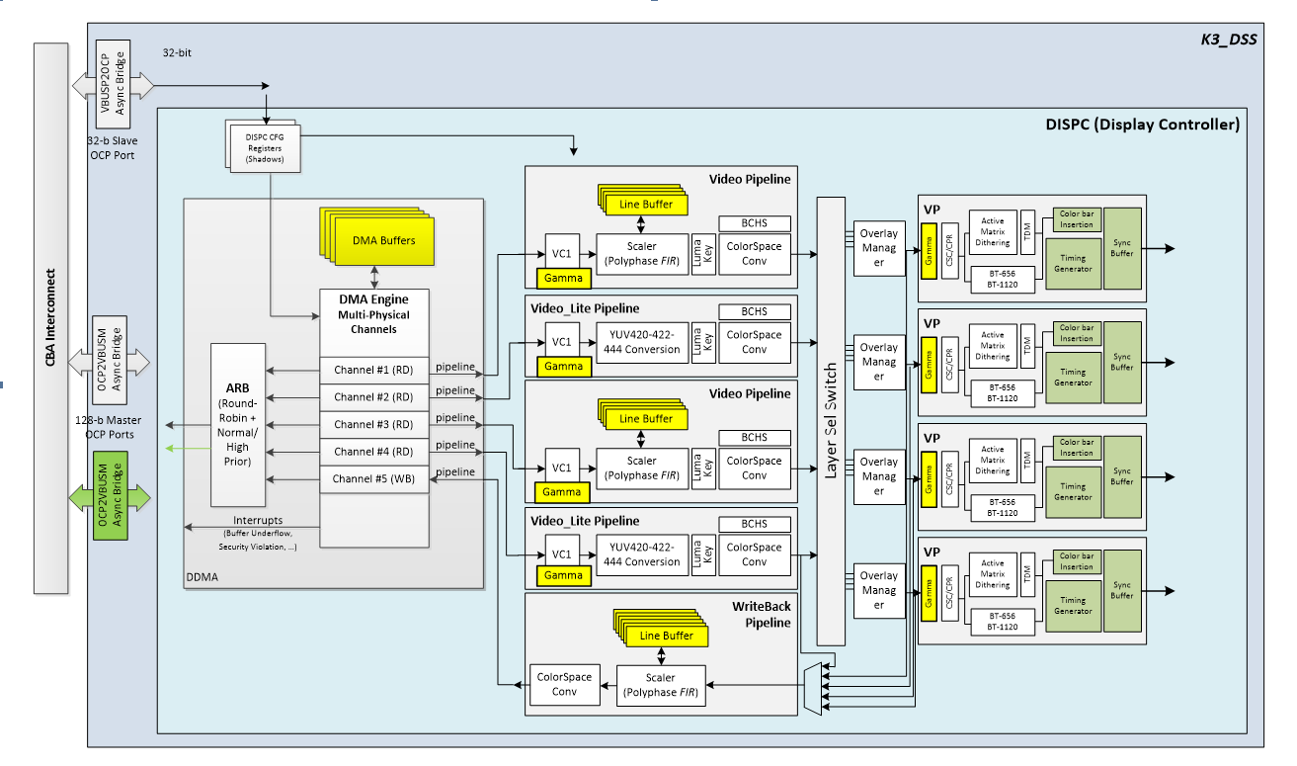
Display Controller Architecture
8

Slide 9
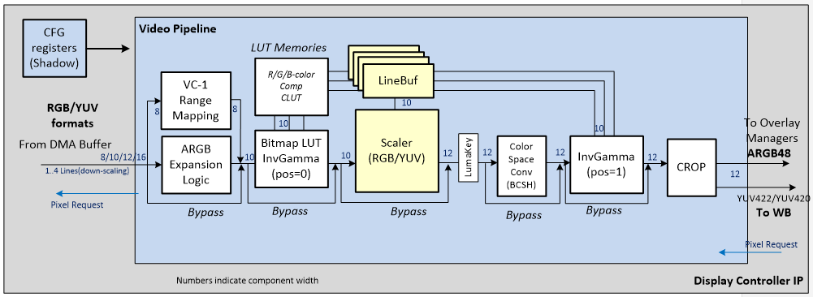
Video/Video Lite Pipeline
The video pipeline is connected to the video DMA buffer controller for the input port and to the overlay manager. It performs all functionalities of a Graphics pipeline.
Polyphase-filter based resizer
Programmable BCHS (Brightness/Contrast/Hue/Saturation) control
Luma-key support (for Blue-Ray application)
Crop support at the output of the video pipeline
Video Lite is identical to the Video pipeline except polyphase-filter based resizer is not included
9

Slide 10
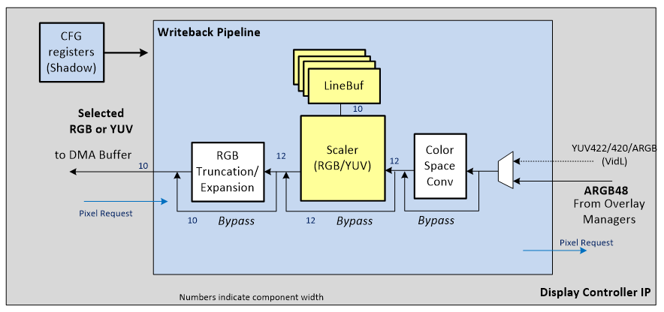
Write back Pipeline
The write-back pipeline is connected to
a pipeline output (video lite 2 pipeline only for J721E)
the output of one of the overlay manager, either in M2M (memory-to-memory) or Capture mode.
Write back pipeline consists of
Color Space Conversion Unit
Resizer unit
RGB truncation logic
10

Slide 11
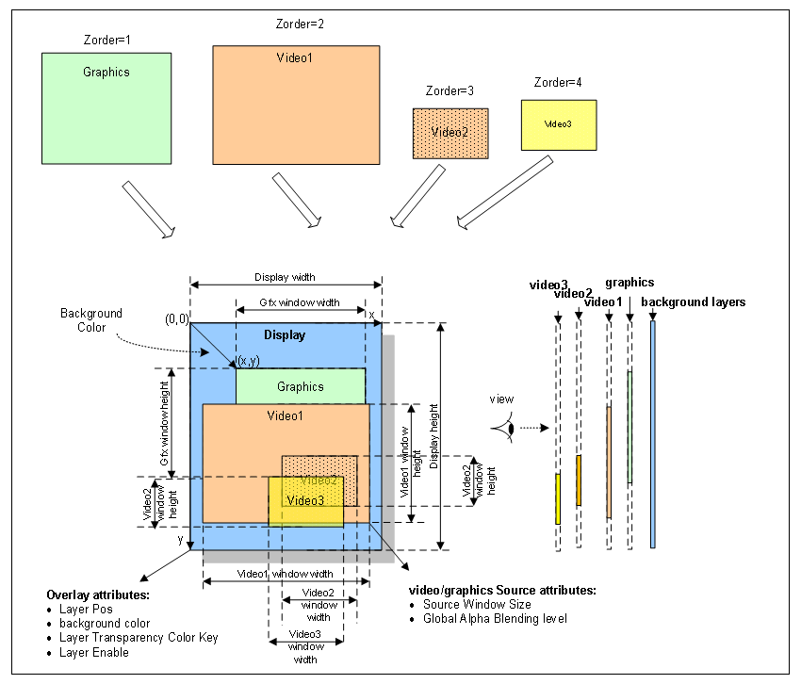
Overlay Manager
Composites selected input layers together to generate the final display output frame based on
Priority rule following the display Z-order (selected by configuring the input selector)
Color key configurations (destination and source transparency)
Alpha Blending values (using the Alpha component of each pixel or a global alpha value set by the user)
Size and position attributes of the source window data
Each overlay manager supports a simple internal color bar insertion to enable testing of display output interface without using the frame buffer data from the memory
11

Slide 12
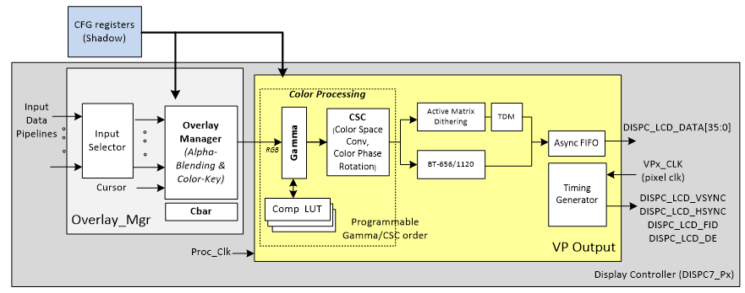
Video Port
36-bit per pixel on the RGB output interface (12-bits per component)
Independent programmable timing generators for each display output to support – up to 600 MHz pixel clock video formats
Fully programmable Color Space Conversion matrix to serve as color phase rotation (CPR) and/or as Brightness/Contrast/Saturation control on the combined output
Selection between RGB(progressive) and YUV422(progressive/interlaced) output pixel format. YUV4:2:2 only available when BT656/1120 output is enabled.
12

Slide 13
Display Interfaces
J721E supports below display interfaces:
One Display Port/embedded Display Port (DP/eDP)
One MIPI Display Serial Interface (DSI) port
Two Display Parallel Interface (DPI) ports.
Future devices will have multiple DP/eDP and DSI ports
The DP/eDP interface supports the following features:
VESA Display Port (DP) 1.3 specification compliant with DSC(1.1)/FEC support
VESA embedded Display Port (eDP) 1.4 specification compliant
Physical link rates up to HBR3 (up to 8.1 Gbps per lane)
Video pixel clock rate range from 25-600MHz
DSI interface supports following features:
4,2, or 1 data lane configurations
MIPI Display Serial Interface (DSI) 1.3 specification compliant with DSC(1.1) support
D-PHY 1.2 Physical link rates up to 2.5 Gbps per lane
Video pixel clock rate range from 25-400MHz (up to 3K Display Panels)
4,3,2, or 1 data lane configurations
13

Slide 14
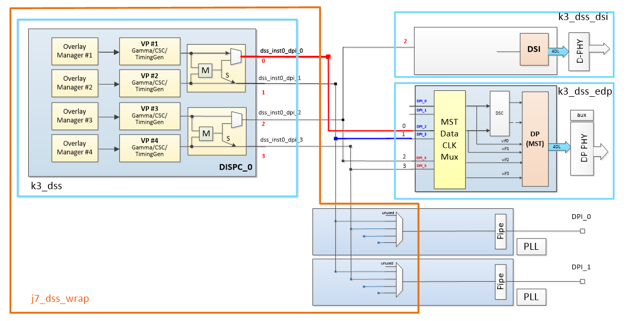
Connectivity Diagram for J721E
14

Slide 15
DSS Interrupt Architecture
DSS supports multiple interrupt outputs each of which can be set independently
There are separate interrupt lines for different category of events:
Functional
Safety
Security
There are four common register regions which allows fully independent monitoring/control of the interrupt events by multiple hosts
15

Slide 16
DSS Driver Overview
16

Slide 17
FVID2 Introduction
What is FVID2?
Provides interface to streaming operations like queuing of buffers to driver and getting back a buffer from the driver
Abstracts the underlying hardware for the video application with a standard set of interface
Gives a same look and feel for video applications across different SOC
Interface is independent of OS/Hardware/Driver
FVID2 is currently supported on BIOS
What is not FVID2?
Not the actual driver
Does not define hardware specific APIs and structures
FVID2 Interfaces
Fvid2_init, Fvid2_deInit
Fvid2_create, Fvid2_delete
Fvid2_start, Fvid2_stop
Fvid2_queue, Fvid2_dequeue
Fvid2_processFrames, Fvid2_getProcessedFrames
Fvid2_control
17

Slide 18
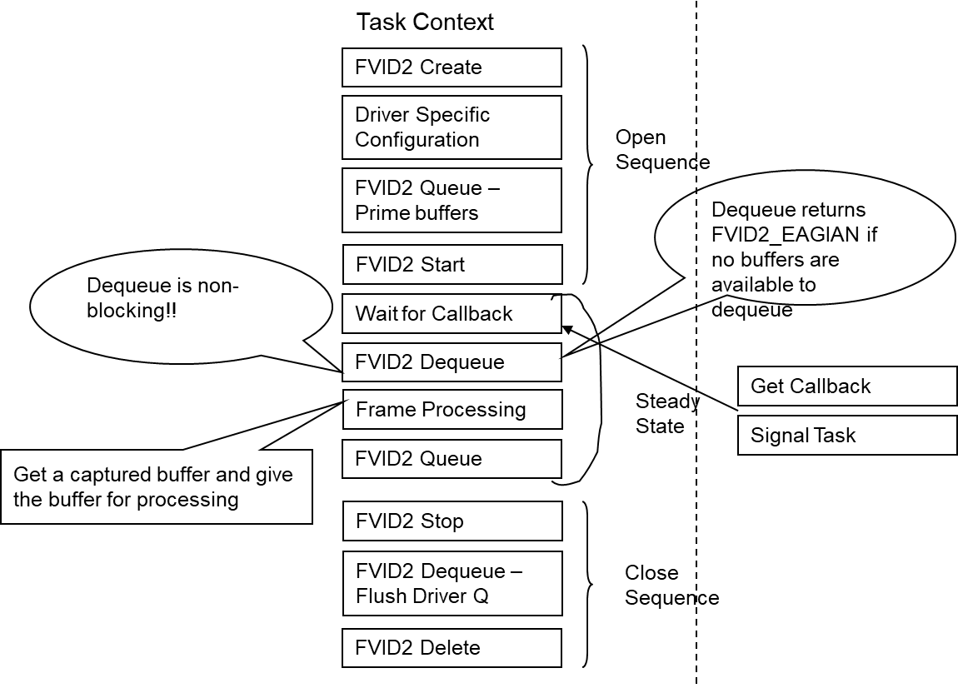
Typical Application Flow
18

Slide 19
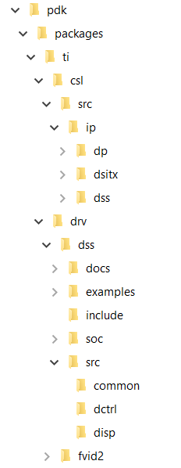
Directory Structure
DSS CSL RL and CSL FL files are present in <pdk>/packages/ti/csl/src/ip/dss
FVID2 driver is present in <pdk>/packages/ti/drv/fvid2
DSS driver is present in <pdk>/packages/ti/drv/dss
19

Slide 20
DSS Advance Features

Slide 21
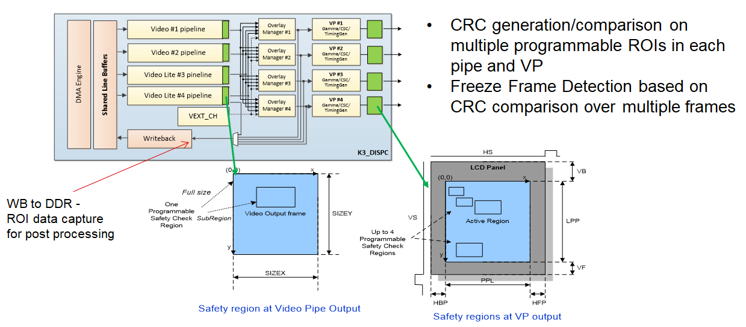
DSS Safety Checks
21

Slide 22
FIFO Buffer Mapping (1/2)
When Scaler is enabled, the DMA needs to send multiple lines simultaneously (in parallel) to the VID pipeline.
The number of lines could be up to 4 lines in parallel (the case when there is downscaling by 4).
The buffer in this case needs to be used in “ping-pong” mode.
Hence, the requirement on the buffer memory size is to have space to store at least eight full lines (The size in bytes of a line depends on the resolution as well as the pixel format)
The below table lists the size of a line in bytes for the common resolutions and formats
Resolution | Format | 1-line (in KB) | 8-lines (in KB)
1920 (1080p) | ARGB32 (32bpp) | 7.5 | 60
 | RGB24p (24bpp) | 5.625 | 45
 | YUV422 (16bpp) | 3.75 | 30
2560 (2.5K) | ARGB32 (32bpp) | 10 | 80
 | RGB24p (24bpp) | 7.5 | 60
 | YUV422 (16bpp) | 5 | 40
4096 (4K) | ARGB32 (32bpp) | 16 | 128
 | RGB24p (24bpp) | 12 | 96
 | YUV422 (16bpp) | 8 | 64
22

Slide 23
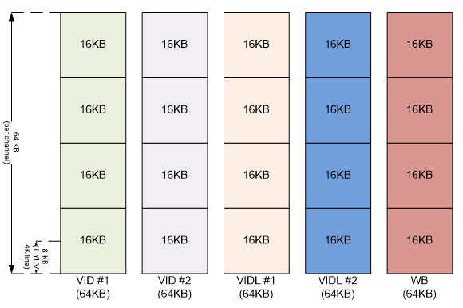
FIFO Buffer Mapping (2/2)
Each channel in DMA is allocated a uniform buffer size of 64 Kilo Bytes at reset.
To support resolutions larger than 4K YUV or 2K ARGB (with ping-pong configuration), the default buffer size of 64KB per RD channel is not sufficient as demonstrated above.
In such cases, the design allows dynamic repartition of the allocated buffers across the different RD channels. In this way each RD channel can have a variable buffer size allocated to it, starting from a minimum of 16KB to a maximum of 256KB, in 16KB increments.
23

Slide 24
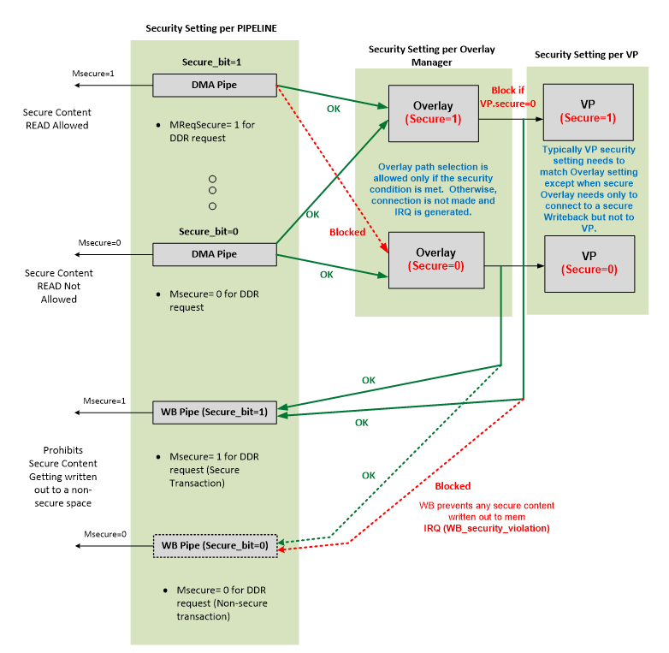
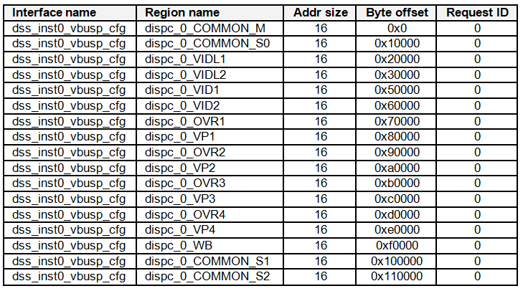
Security Isolation
Configuration Firewall – Each Common Region, Pipe, Overlay & Video Port has 64KB FW region
Secure Mode setting – Hardware based connection check/illegal connection prevention
Multiple sets of Interrupt Logic for secure/non-secure host handling
24

Slide 25
Display Sharing

Slide 26
Display Sharing for K3 SoCs
Cockpit Use case: Simultaneous Safety and QM Requirements on Display
Safety content is generated by a safety certified OS running on a dedicated core
QM content is usually generated by HLoS (Linux)
There may be multiple instances of QM SW running on different cores / same core with virtualization support
Static partitioning of Resources
Resources are allocated at system boot time
VP thread as Atomic Resource Partition Entity
VP Thread : A VP, Overlay-Manager and all pipes terminating at the VP
Any core can drive one / multiple end-to-end VP threads
All pipe, overlay manager and VP register updates for a thread shadowed by asserting VPx.GO bit
All interrupts for pipes and VP in a thread used by the driving core
Distributed DSS Initialization
R5F boots up first and initializes DSS
Any core who owns a VP thread initializes the thread specific setup
Pipes are initialized and setup on-demand
Pipe Subscription and IPC based Frame update requests
VP thread owner can
Reserve a set of pipes to be used by local applications
Export a set of pipes to a remote core via a local display-server
Remote cores probe a display-server to get a list of exported pipes
Remote cores send frame update requests to display-server for exported pipes
26

Slide 27
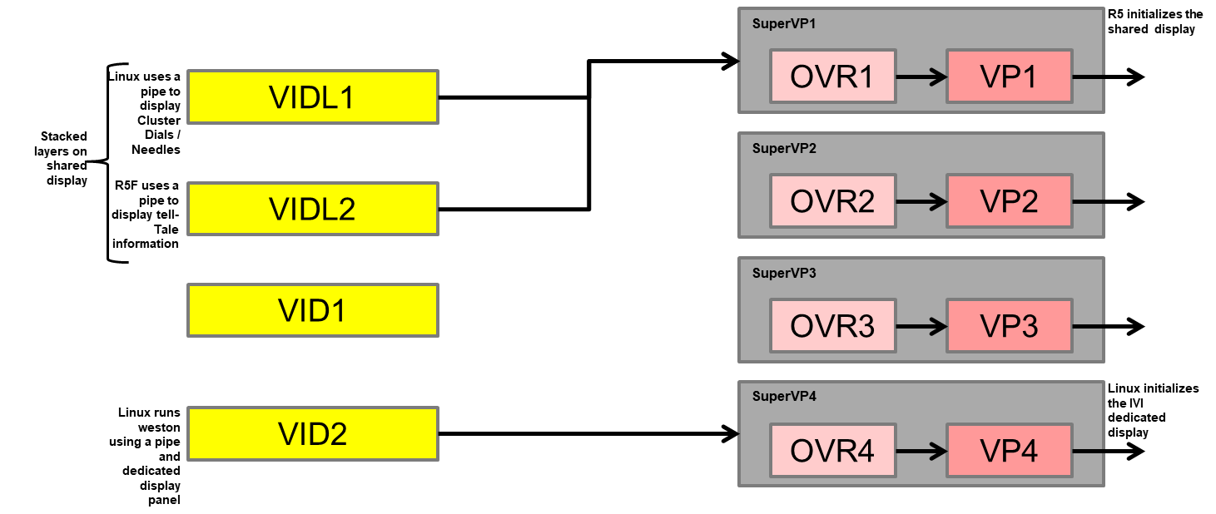
Design: Logical HW Split
27

Slide 28
Thank You!
28

