Slide 1
J7 Interrupt Architecture K3 Processors 18th March 2019 V1.0

Slide 2
Agenda
Understanding Interrupt Aggregator
Understanding Interrupt Router
J721E Interrupt Architecture
MCU/Wakeup Domain
ARMSS0
ARMSS1
C66x 0/1
Compute Cluster: A72, C7x

Slide 3
Interrupt Aggregator (IA)
For each received event, the IA performs a lookup into an interrupt mapping table which specifies:
Interrupt Status Register Number (regnum) – up to 256
Interrupt Status Bit Number (bitnum) – up to 64 per register
Provides option to enable, disable and clear status per status bit (event)
Can generate interrupt through Interrupt Router (IR) via Virtual Interrupts (VINT)
SW can poll on these bits without interrupt as well
GE 5
GE 30
IA
GE 3
63:0
VINT 1
Global Event (GE): up to 65K
63:0
VINT 2
GE 1
VINT 3
63:0
GE 1000
GE 10
63:0
VINT 256

Slide 4
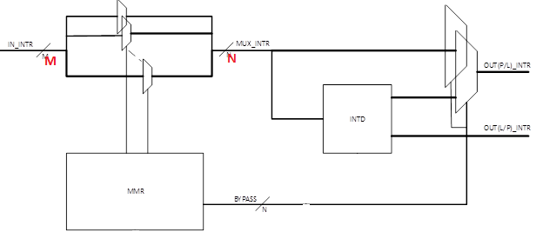
Interrupt Router (IR)
M
IR
N
Interrupt Router is a M to N mux

Slide 5
J721E Interrupt Architecture – MCU/Wakeup Domain
cslr_intr_wkup_gpiomux_intrtr0.h
GPIO (WKUP_0)
120
IR
32
MCU ARMSS0
VIM
INT Core 0 (up to 512)
R5_0
MCU NAVSS
IA0
256
IR
31:0
32
cslr_intr_mcu_armss0.h
63:32
32
INT Core 1 (up to 512)
R5_1
MCU Domain Peripherals
All Peripheral Interrupts
cslr_intr_main2mcu_lvl_intrtr0.h
64
IR
MAIN2MCU LVL
320
To Main Domain
48
IR
MAIN2MCU PULSE
104
From Main Domain
cslr files are present In pdk/packages/ti/csl/soc/j721e/src
cslr_intr_main2mcu_pls_intrtr0.h

Slide 6
J721E Interrupt Architecture – Main Domain: ARMSS0
cslr_intr_gpiomux_intrtr0.h
GPIO (Main 0)
136
IR
64
GPIO (Main 1)
66
ARMSS0
VIM
256 Direct
INT Core 0 (up to 512)
R5_0
Main NAVSS
IA0
256
IR
223:192
32
cslr_intr_armss0.h
255:224
32
INT Core 1 (up to 512)
R5_1
256 Direct
Main Domain Peripherals
224
224
256
All Peripheral Interrupts
432
IR
Main 0
*shared between R5 0/1
cslr_intr_main_pulsar0_introuter0.h
From MCU Domain
To MCU Domain
cslr files are present In pdk/packages/ti/csl/soc/j721e/src

Slide 7
J721E Interrupt Architecture – Main Domain: ARMSS1
cslr_intr_gpiomux_intrtr0.h
GPIO (Main 0)
136
IR
64
GPIO (Main 1)
66
ARMSS1
VIM
256 Direct
INT Core 0 (up to 512)
R5_0
Main NAVSS
IA0
256
IR
287:256
32
cslr_intr_armss1.h
319:288
32
INT Core 1 (up to 512)
R5_1
256 Direct
Main Domain Peripherals
224
224
256
All Peripheral Interrupts
432
IR
Main 1
*shared between R5 0/1
cslr_intr_main_pulsar1_introuter0.h
From MCU Domain
To MCU Domain
cslr files are present In pdk/packages/ti/csl/soc/j721e/src

Slide 8
J721E Interrupt Architecture – Main Domain: C66x 0/1
cslr_intr_gpiomux_intrtr0.h
GPIO (Main 0)
136
IR
64
cslr_intr_c66_corepac0.h
cslr_intr_c66_0_introuter0.h
C66x 0
GPIO (Main 1)
66
IR
C66x 0
400
97
INTC
128 (30 internal)
C66x Core
Main NAVSS
IA0
256
IR
351:320
32
383:352
32
C66x 1
IR
C66x 1
97
INTC
128 (30 internal)
C66x Core
400
Main Domain Peripherals
All Peripheral Interrupts
cslr_intr_c66_1_introuter0.h
cslr_intr_c66_corepac1.h
From MCU Domain
To MCU Domain
cslr files are present In pdk/packages/ti/csl/soc/j721e/src

Slide 9
J721E Interrupt Architecture – Main Domain: A72/C7x
cslr_intr_gpiomux_intrtr0.h
GPIO (Main 0)
136
IR
64
Compute Cluster
GPIO (Main 1)
66
GIC500
SPI [991:32]
cslr_intr_gic0.h
Dual A72 Corepac
Main NAVSS
IA0
256
IR
CLEC
C7x Corepac
191:0
192
Out
SOC IN
[959:0]
IN
cslr_intr_compute_cluster0.h
DRU
Main Domain Peripherals
SOC OUT
[63:0]
IN
All Peripheral Interrupts
MSMC
From MCU Domain
To MCU Domain
cslr files are present In pdk/packages/ti/csl/soc/j721e/src

Slide 10

© Copyright 2019 Texas Instruments Incorporated. All rights reserved.
This material is provided strictly “as-is,” for informational purposes only, and without any warranty.
Use of this material is subject to TI’s Terms of Use, viewable at TI.com

