Slide 1
Jacinto™ Automotive Processor
Getting Started with PDK (Platform Development Kit) in J7
5 Aug 2019

Slide 2
Agenda
PDK Overview
Directory Structure
Prerequisite & Build System
Software Modules
Documentation
Q&A

Slide 3
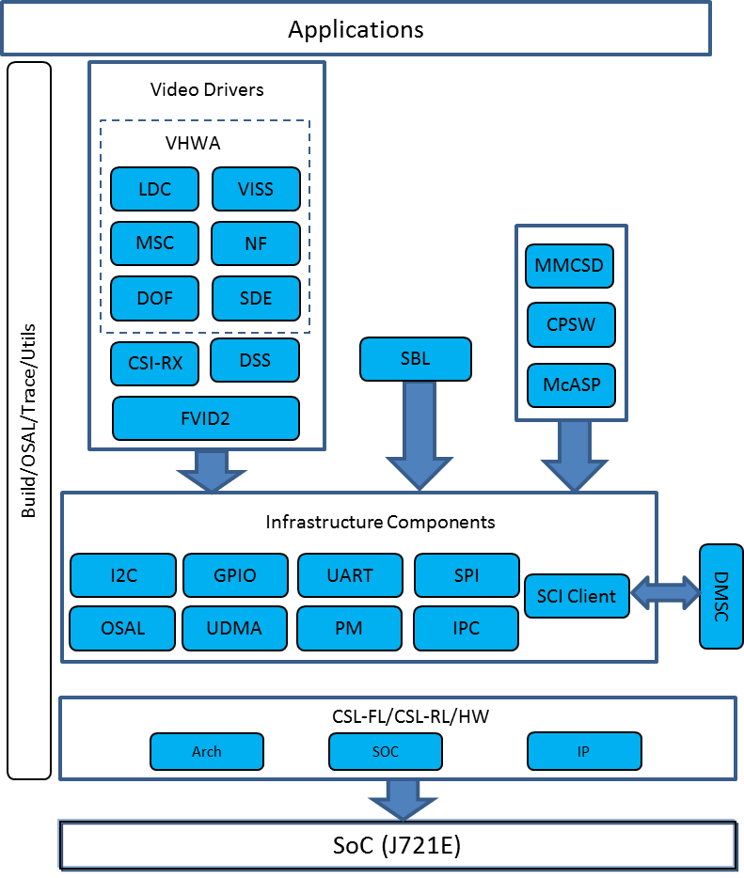
PDK Overview
PDK Software Architecture
Supported SoC: J721E
Supported OS: TI-RTOS, Baremetal
Supported CPUs: R5, A72, C6x, C7x
Misra-C compliant
C based OS agnostic code
Provides stand-alone examples and UT’s
Makefile based build system

Slide 4
PDK Overview – Not Supported
Full featured software for peripherals (async, state machine, queuing)
Depend upon any OS services (e.g. thread, locks, memory management)
Peripheral “IP version specific” software
Code with dependency (like algorithms, OS) for examples, demos
PDK is not a middleware complete solution

Slide 5
Agenda
PDK Overview
Directory Structure
Prerequisite & Build System
Software Modules
Documentation
Q&A

Slide 6
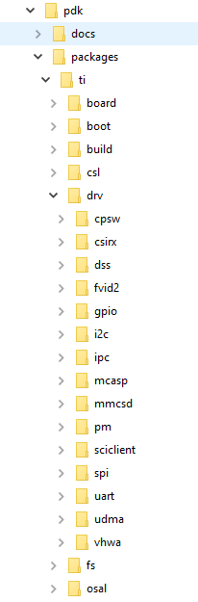
Directory Structure
Examples and sample applications are part of corresponding module
Docs – Contains api guide, release notes and test reports
Binary – Contains generated application binary
Build – Contains makefile build system
CSL – Baremental API’s for multiple IP’s/Cores
OSAL – Interface layer for OS and NonOS
Drv – Drivers for different modules

Slide 7
Agenda
PDK Overview
Directory Structure
Prerequisite & Build System
Software Modules
Documentation
Q&A

Slide 8
Pre-requisite & Build System
Building and running PDK examples requires
Code Composer Studio
Compiler and Tool chains
Refer to Processor SDK RTOS release noted for tool chain versions
Makerules for different cores are specified in “<pdk>/packages/ti/build/makerules”
Environment variables are specified in “<pdk>/packages/ti/build/makerules/env.mk”
All build command’s should be issued from “<pdk>/packages/ti/build” directory

Slide 9
Pre-requisite & Build System
Module/Example | Command | Description
All cores | gmake -j allcores BOARD=j721e_evm | Command to build all example and libraries for J721E soc
All examples/Library | gmake -j all BOARD=j721e_evm CORE=<core> | Command to build all examples and libraries for a given core of J721E
Example/Library | gmake <module> BOARD=j721e_evm CORE=<core> | Command to build an examples and libraries for a given core of J721E
Help | gmake help | Help Menu
<core> can be mcu1_0, mcu1_1, mcu2_0, mcu2_1, mcu3_0, mcu3_1, mpu1_0, c7x_1, c66xdsp_1, c66xdsp_2

Slide 10
Agenda
PDK Overview
Directory Structure
Prerequisite & Build System
Software Modules
Documentation
Q&A

Slide 11
Software Modules
Module | Description | Path
CSL | Chip Support Library provides functional layer API’s to configure and access peripherals | <pdk>/packages/ti/csl
SBL | Secondary boot loader initializes the execution environment and load’s multicore image | <pdk>/packages/ti/boot/sbl
CSIRX | CSI2RX library provides FVID2 API’s to configure the and capture sensor data stream using CSI2 protocol | <pdk>/packages/ti/drv/csirx
DSS | Display Sub System library provides set of FVID2 API’s to configure and control DSS engine to output video frames stored in the memory to the external display interfaces | <pdk>/packages/ti/drv/dss
VHWA | Vision Hardware Accelerator library provides FVID2 API’s to configure and used hardware accelerators such as NF, LDC, MSC, VISS, DOF and SDE | <pdk>/packages/ti/drv/vhwa

Slide 12
Software Modules
Module | Description | Path
PM | Power Management Module provides API to configure Power domain and Clock domain. | <pdk>/packages/ti/drv/pm
UDMA | Unified DMA is a versatile system DMA which provides multiple TX Channels and multiple RX Channels to transfer data using either TR based or Packet oriented control structures | <pdk>/packages/ti/drv/udma
SPI | SPI driver provides API’s to configure and use McSPI and Octal SPI | <pdk>/packages/ti/drv/spi
IPC | IPC used mailbox to provide two way communication between multiple host cores | <pdk>/packages/ti/drv/ipc
I2C | I2C library provides interface to configure and use multiple instance I2C | <pdk>/packages/ti/drv/i2c

Slide 13
Software Modules
Module | Description | Path
SCI Client | An Interface to the TI-SCI protocol for RTOS and non-OS based applications to exposes the core message details, valid module/clock IDs to the higher level software and abstracts the communication with the firmware based on the TI-SCI protocol | <pdk>/packages/ti/drv/sciclient
UART | UART library provides interface to read and write data on UART port | <pdk>/packages/ti/drv/uart
OSAL | OSAL provides an simplified interface layer to use access RTOS feature | <pdk>/packages/ti/osal
Board | Provides API to initialize the board environment including clock, PLL, DDR and uart | <pdk>/packages/ti/board

Slide 14
Software Modules – CSL Module
Chip Support Library contains
Logical group of register reads and writes to get a functional layer for a given IP
Stateless functions; blocking and runs to completion
System Configuration Code:
Provides functions specific to SoC level System Configuration.
Provides the following functionalities:
Start-up Code
Interrupt-vector initialization
Low level CPU specific code
May involve assembly code and hence can be tools specific
Sub module to further abstract and group the functionality.
Notes:
Chip Support Library or CSL constitutes a set of well-defined APIs that abstract low-level details of the underlying SoC device so that a user can control configure and have read/write access to peripherals.
CSL is realized as twin-layer – a basic register-layer and a more abstracted functional-layer. The lower register layer comprises of a very basic set of macros and type definitions. The upper functional layer comprises of “C” functions that has an increased degree of abstraction and provide directed control of underlying hardware.
CSL does not model the device state machine and also does not manage data-movement over underlying hardware devices

Slide 15
Software Modules – CSL Module
Sub Modules | Description
Arch | This sub module contains the core specific functionality and initialization code for the system and cores. The interrupt controller API’s to configure and enable/disable the interrupt is also part of this sub module. Source code is available under ‘csl/arch’ folder.
SoC | SoC specific defines are abstraction under this sub module. SoC specific base address, macros and cross bar configuration code is available under this sub module. Source code is available under ‘csl/soc’ folder.
IP Specific Code | API to use the functionality of different IP’s is available as part of this sub module. Source code is available under ‘csl/src/ip’ folder.
Notes:
CSL can be further split into following sub modules Architecture, SOC and IP. Architecture sub module contains API to configure cache, interrupt, ECC for cores such as A15, M4, C66x and EVE. SOC sub module contains the base address, macros and abstraction for the ADAS SoC’s. Source code and interface to configure different available IP’s in device is part of IP sub module.

Slide 16
Software Modules – SBL
SBL
Initializes the execution environment for multi-core application
Configure the Voltage rails
Initialize the Interrupt Controller
Setup the ADPLL values
Power on I/O peripherals
Power on slave cores
Configure required PADs
Initialize DDR
Load the multicore application image into DDR
Bring slave cores out of Reset
Boot Modes: MMCSD, OSPI and Uniflash (UART)

Slide 17
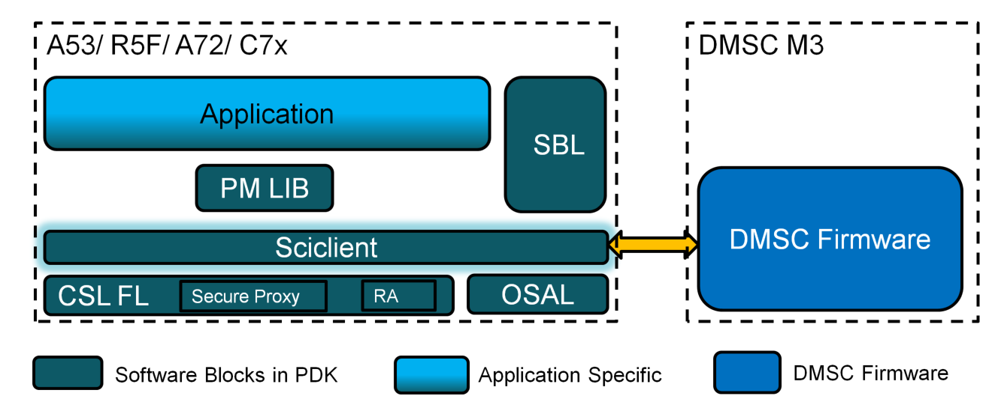
Software Modules – PM
PM Module
Provides API to turn on/off the modules in the device
Set clock rate for different module
Supports Dynamic Power Management for cores
Provides API to detects device temperature and alerts on over temp
Interacts with System firmware via SCI client for Power management

Slide 18
Generic FVID2 Driver Stack
Application (TI – RTOS)
FVID2 API
Generic Driver (VHWA/DSS/CSIRX)
Interface
Layer
Resource
Management
Queue
Management
Core
Interaction
Core1 - IP Specific
CSL – Common (optional)
Hardware
Peripheral 1
Peripheral 2
Notes:
18
18

Slide 19
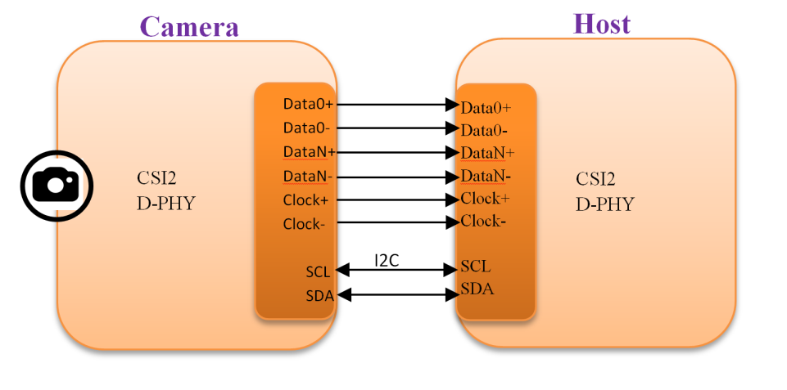
Software Modules – CSI2RX
Uses FVID2 API interface
Up to 32 capture channels
Supported Data formats
RAW8/10/12/14/16/20
YUV422-10 bit
RGB888
OTF mode and loop-back mode to support re-transmission through CSI2TX
2.5 Gbps per lane and 4 independent lane in total
FIFO handling
Error Handling and Recovery
D-PHY configuration
Frame drop buffer programming

Slide 20
Software Modules – VHWA
Uses FVID2 API interface
Consists of
Lens Distortion Correction (LDC)
Multi-Scalar (MSC)
Vision Imaging Sub System(VISS)
Noise Filter (NF)
Dense Optical Flow (DOF)
Stereo Disparity Engine (SDE)
Independent drivers for supported IP’s
Supports 8bit Packed, 12bit Packed and 12 bit unpacked format
Wide input/ouput resolution
Up to 2K for DOF and SDE
Up to 8K for LDC, NF, MSC and VISS

Slide 21
Software Modules – DSS
Single instance of display controller driver and one instance of display driver for each of the forward pipes
Supports both 8/10-bit YUV222 and 24/30/36-bit RGB input data formats
Different output interfaces: DPI, eDP, DSI and OLDI
Supports Scaling, Color Space Conversion, Blending, Color Keying
Supports display sharing with other cores/OS
Support up to four simultaneous 4K display outputs
CRC generation/comparison and freeze frame detection
Hardware based connection check

Slide 22
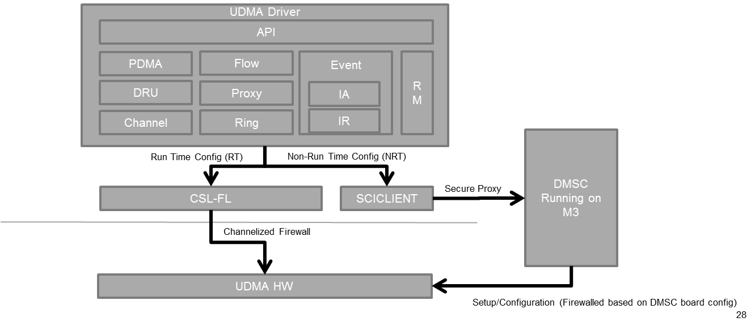
Software Modules – UDMA
TR based and Packet oriented control structure
Multiple TX and RX channels
M:N mux to generate interrupt on various cores
Event based trigger mechanism
Up to 64K system events
Supports polling and interrupt mode

Slide 23
Software Modules – I2C
Compliant with Philips I2C specification version 2.1
Supports a standard mode (up to 100 kbps) and fast mode (up to 400 kbps)
Supports HS mode for transfer up to 3.4 Mbps
7-bit and 10-bit device addressing modes
Supports both master and slave mode
Built-in configurable FIFOs
Programmable multi-slave channel

Slide 24
Agenda
PDK Overview
Directory Structure
Prerequisite & Build System
Software Modules
Documentation
Q&A

Slide 25
Documentation
Document | Directory/Path | Description
API Guide | <pdk>/docs/pdk_introduction.html | Contains the API description for all drivers/libraries of PDK
User Guide | <pdk>/docs/pdk_introduction.html | Detailed used guide with steps to build and run each module
Release Notes | <pdk>/docs/pdk_introduction.html | Release note for PDK release
Test Report | <pdk>/docs/pdk_introduction.html | Test report for the PDK release
Traceability Matrix | <pdk>/docs/pdk_introduction.html | Requirement – Design –Code traceability matrix

Slide 26
Q&A

