Slide 1
Time Sync Overview

Slide 2
Agenda
What is Time Sync?
Time Sync supported features
Time Sync not supported features
Time Sync stack diagram
PTP stack to application layer
Time Sync HAL to PTP stack layer
APIs from Low level driver layer
Time Sync PTP Sequence diagram
Multi-core Time-synchronization design

Slide 3
What is Time Sync?
Time Sync is a PDK transport library developed to provide uniform IP abstracted PTP support to CPSW & ICSS IPs.
Time Sync library utilizes hardware timestamping provided by CPTS(CPSW) or IEP(ICSS) to enable time synchronization with better accuracy
Time Sync library consists of two parts:
Time Sync HAL
Time Sync Protocol (PTP)
Time Sync HAL:
HAL provides an uniform API to the protocol layer by abstracting CPSW and EMAC APIs
HAL provides Timer and PTP frame transmission/reception APIs
Time Sync Protocol:
Protocol layer implements TI-RTOS based PTP stack with generic time sync capabilities

Slide 4
Time Sync supported features
Configurations expected from application:
Device configurations: Master/Boundary/Transparent/Ordinary slave
Step-mode configuration: Two-step
Network protocol: IEEE802.3.
Delay mechanism: P2P
PPS configuration
APIs expected from Low-level network driver:
DMA APIs:
Tx & Rx packet submit/retrieve functions
Tx & Rx event notify
Hardware timer functions:
Get Tx/Rx timestamp
Get time, Set time
Periodic pulse
Set compensation (PPM)

Slide 5
Time Sync not supported features
Best Master Clock algorithm
Currently, the first announce message sender is assumed as master
PTP management frame handling
IPv4/ IPv6 PTP frame handling
Not tested on CPSW2G, AM3xxx/AM4xxx/AM5xxx platforms

Slide 6
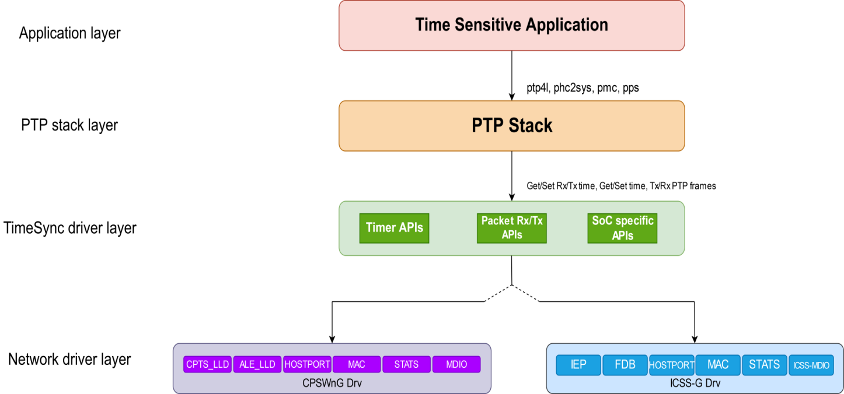
Time Sync stack diagram
1
PTP stack to application APIs
Comparison with Linux PTP
Linux PTP | TimeSync PTP
ptp4l | TimeSync_initPtp
phc2sys | TimeSync_coupleTimer
pmc | TimeSync_ptpMgmt
pps | TimeSync_configPps
1
2
3
TimeSync driver layer refers to Time sync HAL abstracting underlying network driver layer

Slide 7
APIs to PTP stack layer
hTimeSync = TimeSync_open(&timeSyncConfig)
Timer APIs
TimeSync_getTxTimestamp(hTimeSync, txFrameType, txPort, seqId, &nanoseconds, &seconds)
TimeSync_getRxTimestamp(hTimeSync, rxFrameType, rxPort,seqId, &nanoseconds, &seconds)
TimeSync_getCurrentTime(hTimeSync, &nanoseconds, &seconds)
TimeSync_setClockTime(hTimeSync, nanoseconds, seconds)
TimeSync_adjTimeSlowComp(hTimeSync, adjOffset, interval)
PTP stack layer
PTP Stack
2
Packet Tx/Rx APIs APIs
Time Sync driver layer
Timer APIs
Pkt Tx/Rx APIs
SoC specific APIs
TimeSync_getPtpFrame(hTimeSync, &buff, &size, &portNum)
TimeSync_sendPtpFrame(hTimeSync, &buff, size, portNum)
SoC/ Use case specific APIs
For AM335x & AM437x
TimeSync_ecapEdmaConfig(ecapEdmaConfig)

Slide 8
APIs from Low level driver layer
Time Sync driver layer
Timer APIs
DMA APIs
SOC/IP specific APIs
3
Network driver layer
CPSW LLD
IEP LLD
Hardware layer
CPTS
IEP
TimeSync API | CPSW API | ICSS API
TimeSync_getTxTimestamp | CPSW_CPTS_IOCTL_LOOKUP_EVENT | IEP register read/writes
TimeSync_getRxTimestamp | CPSW_CPTS_IOCTL_LOOKUP_EVENT | “”
TimeSync_getCurrentTime | CPSW_CPTS_IOCTL_PUSH_TIMESTAMP_EVENT | “”
TimeSync_setClockTime | CPSW_CPTS_IOCTL_LOAD_TIMESTAMP | “”
TimeSync_adjTimeSlowComp | CPSW_CPTS_IOCTL_SET_TS_PPM | “” (For AM335x & AM437x ECAP config API)
TimeSync_getPtpFrame | CpswDma_retrieveRxPackets | ICSS_EmacRxPktGet
TimeSync_sendPtpFrame | CpswDma_submitTxReadyPackets | ICSS_EmacTxPacket

Slide 9
Time Sync Configuration (parameters from PTP to HAL)
timeSyncConfig
protocolConfig
frameNotifyCfg
socConfig
protocol
(Annex D/E/F )
deviceCfg
(MC/OC/TC/BC)
StepMode
VLAN Configuration
PPS configuration
(PPS: interval, callback function)
Port mask
txNotifyCb
txNotifyCbArg
rxNotifyCb
rxNotifyCbArg
socVersion
ipVersion

Slide 10
Sequence diagram
Application
TimeSync PTP
TimeSync HAL
Network driver
TimeSyncPtp_init(ptpCfg)
TimeSync_open(&timeSyncConfig)
Configure timer
Configure DMA (register callbacks)
SoC specific configurations
Return hTimeSync
Store hTimeSync
Call registered rxNotfiyCallbackFxn
PTP frame
TimeSync_getPTPframe(hTimeSync, &buff, &size, &portNum)
CpswDma_retrieveRxPackets / ICSS_EmacRxPktGet
Retrieve and return packet
TimeSync_getRxTimestamp(hTimeSync, rxFrameType, rxPort,seqId, &nanoseconds, &seconds)
PTP stack process received frame and sends response if required
TimeSync_sendPtpFrame(hTimeSync, &buff, size, portNum)
CpswDma_submitTxReadyPackets / ICSS_EmacTxPktGet
Call registered txNotfiyCallbackFxn
TimeSync_getTxTimestamp(hTimeSync, txFrameType, txPort, seqId, &nanoseconds, &seconds)
PTP stack computes
clock correction offset
TimeSync_setClockTime(hTimeSync, nanoseconds, seconds)
Call registered PPS callback function
PPS interrupt
PTP stack performs ToD synchronization,
Calculates drift correction
TimeSync_adjTimeSlowComp(hTimeSync, adjOffset)

Slide 11
Multi – core Time Synchronization (similar to phc2sys in Linux)
Remote Core
Time Sync Router Configuration
Time-sensitive
Application
Remote
core
TSR
Remote core’s Timer
GTC0
CPTS
GTC0/ TIMER[14-19]
Hw Push
64-bit Time Stamp
TIMER[14-19]
Coupling is done periodically
PWM
CPTS Timer
Coupling between remote core’s timer and CPTS timer is done through Hardware push events of CPTS and Time Sync Router(TSR).
With this a linear relation is established between CPTS & remote timer.
Once the relation is established, remote core can independently use this coupled timer.

Slide 12
Multi – core Time Synchronization (similar to phc2sys in Linux)
Remote core
Main R5 (switch)
snmpd
mstpd
lldpd
lacp
mvrp
Remote Configuration Server
iproute2
brctl
ethtool
vconfig
tc
Bonds
Bridges
VXLAN
Time Sync SW
Firmware Application API
Other Drivers
RT Netlink
ethtool ioctl
TI-RTOS
Apps
IP Router
EAPOL
Call to Register the Remote Timer with the CPTS timer
Time Sync
switchdev driver
cpsw driver
NDK
swp0
swp1
CPSW_LLD
Remote Configuration Client
swp1
Remote Configuration Client
ENETPHY
LLD
CPTS
LLD
ALE
LLD
swp7
CPSW_9G
Time Sync provides get Time and Lookup event APIs to remote cores via existing rpmsg layer.
Using UDMA descriptor metadata, any Tx/Rx packet can also be time-stamped by CPTS.
In addition to this, remote core can use its local synchronized timer for getting current time.
CPSW 9G Register
Grand Master
Direct Control Path
Kernel driverr
PDK CPSW LLD (AUTO)
Switch resident protocols
IPC Control Path
Demo app
Ethernet Firmware (AUTO)
Direct Data Path

Slide 13
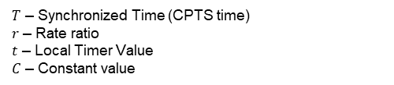

Multi – core Time Synchronization sequence
Remote core
IPC
EthFw(with TimeSync)
Sets up DM TIMER[14-19] / GTC0 and enable periodic PWM output/ HW push output
R5 runs PTP and synchronizes with the external master clock
Register HW Push
4. Allocates a Hardware Push Instance.
Configures TSR to map the DM Timer’s PWM to the HW Push Instance
Save the callback for the Hardware Push Instance
Call CpswProxy_registerRemoteTimer with timer Information & call back function.
.
.
.
Call back with Event Info
With two consecutive Hw push Time stamp values, the DMTIMER/GTC to CPTS clock rate ratio and linear relationship are established.
When hardware push event occurs, remote core’s registered callback is called with CPTS timer value.
Hw Push Time stamp value N
Next Hw Push event
$$T=r∗t+C$$
Call back with Event Info
$T$ – Synchronized Time (CPTS time)
$r$ – Rate ratio
$t$ – Local Timer Value
$C$ – Constant value
Hw Push Time stamp value N+1

Slide 14

© Copyright 2020 Texas Instruments Incorporated. All rights reserved.
This material is provided strictly “as-is,” for informational purposes only, and without any warranty.
Use of this material is subject to TI’s Terms of Use, viewable at TI.com

