Slide 1
Capture on J7 through CSI2RX Controller – Deep Dive
Camera
Serial
Interface
13th March 2019

Slide 2
Agenda
Capture Use-cases on J7
What’s CSI2?
CSI2RX Controller
CSI2RX FVID2 Driver

Slide 3
Acronyms
CMS – Camera Mirror Systems
OTF – On the fly
WDR – Wide Dynamic Range
VC – CSI2 Virtual Channel
DT – CSI2 Data Type
VISS – Vision Imaging Sub System
ISP – Image Signal Processing
bpp – bits per pixel
ECC – Error Correction Code
I2C – Inter-Integrated Circuit
UDMA – Unified DMA Controller
PSI – Packet Streaming Interface
EMI – Electro Magnetic Interference
CRC – Cyclic Redundancy Check
DDR – Dual Data Rate
SoC – System on Chip

Slide 4
Capture Use-case on J7

Slide 5
Capture Use-case(1/3): Multi-Sensor (e.g. Surround View, CMS, Radar)
SoC
DDR
CSI2RX-1 VC1 on UDMA RX
CH-0
Sensor 1
FPDLink
CSI2
DDR
CSI2RX-1 VC2 on UDMA RX
CH-1
Sensor 2
UB96x
CSI2RX-1
Sensor 3
DDR
CSI2RX-1 VC3 on UDMA RX
CH-2
De-serializer
PSI-L
VBUS-M
Sensor 4
CSI2RX-1 VC4 on UDMA RX
CH-3
UDMA
DDR
CSI2
FPDLink
CSI2RX-2 VC1 on UDMA RX
CH-4
Sensor
UB953
DDR
Serializer
CSI2RX-2 VC2 on UDMA RX
CH-5
Sensor 1
Key Points,
4 sensors multiplexed on a single CSI2 port
De-multiplexing done using VC field
Each VC frame output to a separate buffer via a separate UDMA RX CH
DDR
FPDLink
CSI2
Sensor 2
CSI2RX-2 VC3 on UDMA RX
CH-6
UB96x
CSI2RX-2
DDR
Sensor 3
De-serializer
DDR
CSI2RX-2 VC4 on UDMA RX
CH-7
Sensor 4

Slide 6
Capture Use-case(2/3): Single-Sensor (e.g. Front Camera, CMS, Radar)
SoC
VBUS-M
DDR
CSI2RX-1 DT1 on UDMA RX
CH-0
High Exposure Frame
Sensor
CSI2
CSI2RX-1
UDMA
Normal Exposure Frame
DDR
CSI2RX-1 DT2 on UDMA RX
CH-1
CSI2
Low Exposure Frame
CSI2RX-1 DT3 on UDMA RX
CH-2
Sensor
CSI2RX-2
PSI-L
DDR
High Exposure Frame
DDR
CSI2RX-2 DT1 on UDMA RX
CH-3
Normal Exposure Frame
DDR
CSI2RX-2 DT2 on UDMA RX
CH-4
Key Points,
Single sensor on a single CSI2 port
Single sensor can output multiple exposure frames using distinct “Data Type (DT)”
De-multiplexing done using DT field
Each DT frame output to a separate buffer via a separate UDMA RX CH
Low Exposure Frame
DDR
CSI2RX-2 DT3 on UDMA RX
CH-5
DT1 = RAW10
DT2 = RAW12
DT3 = RAW14

Slide 7
Capture Use-case(3/3): Single-Sensor OTF (e.g. Front Camera, CMS)
SoC
VBUS-M
VPORT
CSI2
VPAC
CSI2RX-1, VISS-1 on UTC CH-0
Sensor
CSI2RX-1
VISS-1
UTC
DDR
PSI-L
Raw Data Capture Card
Storage
FPGA
CSI2
CSI2TX-1
Key Points,
Single camera on a single CSI2 port
CSI2RX output directly connects to VISS in VPAC
CSI2TX loopback to record raw data in real-time for offline analysis
Allows lower latency, lower DDR BW (some features like multi-exposure WDR not possible)

Slide 8
What’s CSI2?

Slide 9
Quick Facts
Widely used in mobile and automotive applications
High performance with low power and low EMI
Compatible with MIPI D-PHY and/or MIPI C-PHY
Unidirectional differential serial interface with high speed data and clock lanes
Packet based protocol for data transmission
Uses bi-directional control interface compatible with I2C standard

Slide 10
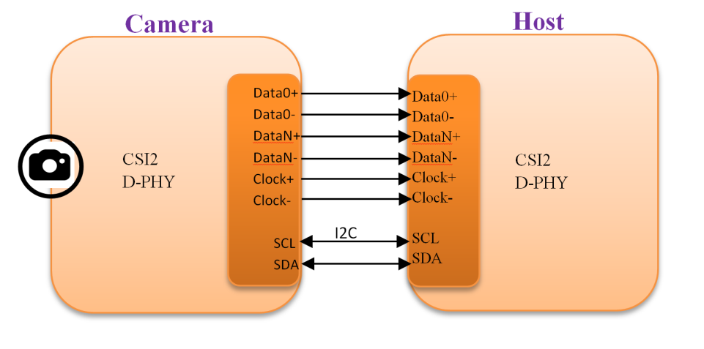
CSI2 Standard
Up to 16 Virtual Channels(with v2.0)
Data formats supported:
RAW6/7/8/9/10/12/14/(with v2.0)16/20
RGB444/555/565/666/888
YUV420 8/10 bit
YUV422 8/10 bit
MIPI D-PHY: 2.5 Gbps per lane and 4 lanes in total

Slide 11
CSI2RX Controller

Slide 12
CSI2RX Controller: Features
Compliant with MIPI CSI‑2 v1.3
Virtual channel extension and RAW16/20 for MIPI CSI2 v2.0 support
Support of the MIPI CSI-2 protocol over DPHY PPI interface up to maximum 4*2.5 Gbps
Configurable Data Lane positions
Programmable Interrupt Events
Protocol Error Detection
Virtual Channel / Data type de-interleaving
Processing of data on 4 independently configurable Streams
Payload FIFO operation

Slide 13
CSI2RX FVID2 Driver

Slide 14
CSI2RX FVID2 Driver: Features
FVID2 Interface for applications
Capture of following formats:
RAW8/10/12/14/16/20
YUV422-10 bit
RGB888
Up to 32 capture channels per CSI2RX controller instance
OTF mode and loop-back mode to re-transmission pads of CSI2TX controller
Error Handling and Recovery
FIFO handling
D-PHY configuration
Configurable number of Data Lanes to use and their ordering
Frame drop buffer programming in case of Queue did not happen in time

Slide 15
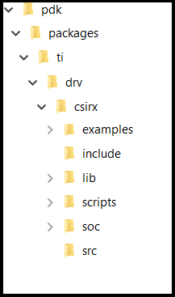
CSI2RX FVID2 Driver: Overview(1/2)
CSIRX Driver Directory Structure
Capture Application Layers
Application Layer
FVID2 Interface
Capture Driver
UDMA Driver
External Serdes and Camera sensors
CSL
Common
CSIRX
SHIM

Slide 16
CSI2RX FVID2 Driver: Overview(2/2)
Interface files:
pdk/packages/ti/drv/csirx/csirx.h
It is a capture driver interface file. Application should only include this file.
pdk/packages/ti/drv/csirx/include/csirx_cfg.h
It is a capture drivers configuration file.
Implementation files:
pdk/packages/ti/drv/csirx/src
SoC files:
pdk/packages/ti/drv/csirx/soc

Slide 17
CSI2RX FVID2 Driver: Understanding FVID2 Interface
FVID2 APIs:
FVID2_init
Initializes the drivers and the hardware. Should be called before calling any of the FVID2 functions
FVID2_deInit
Un-initializes the drivers and the hardware
FVID2_create
Opens a instance/channel video driver
FVID2_delete
Closes a instance/channel of a video driver
FVID2_control
To send standard (set/get format, alloc/free buffers etc..) or device/driver specific control commands to video driver
FVID2_queue
Submit a video buffer to video driver. Used in display/capture drivers
FVID2_dequeue
Get back a video buffer from the video driver. Used in display/capture drivers
FVID2_start
Start video capture or display operation.
FVID2_stop
Stop video capture or display operation.

Slide 18
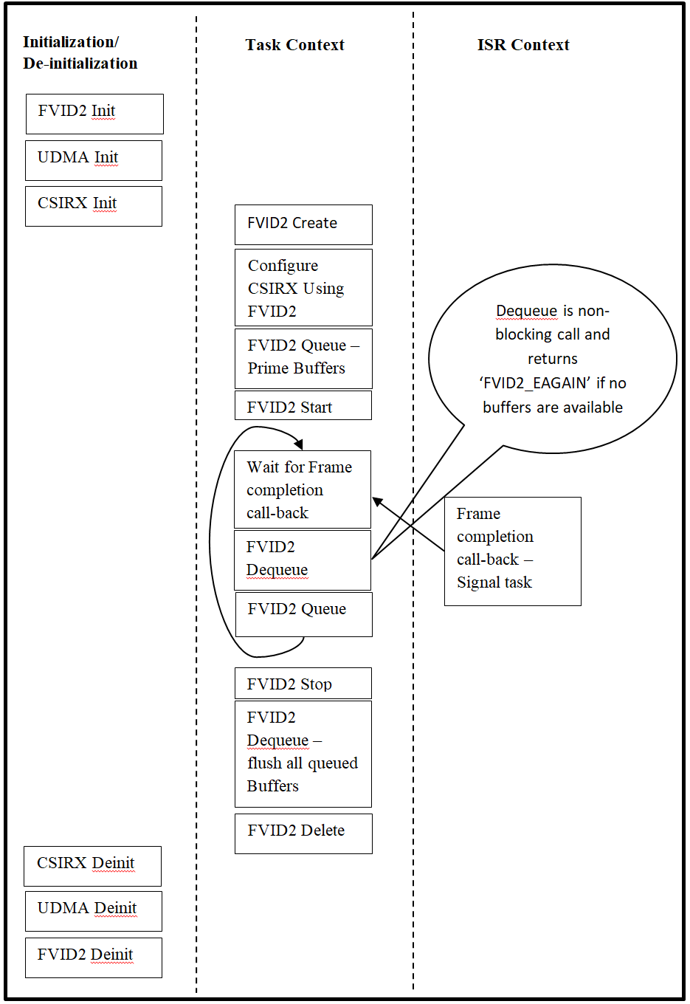
CSI2RX FVID2 Driver: Usage - Application(1/3)
Building CSI2RX Driver:
gmake.exe -s -j csirx BOARD=j721e_sim CORE=mcu2_0 BUILD_PROFILE=release
Building CSI2RX Driver Sample Application:
gmake.exe -s -j csirx_capture_testapp BOARD=j721e_sim CORE=mcu2_0 BUILD_PROFILE=release
Application Calling Sequence

Slide 19
CSI2RX FVID2 Driver: Usage-Configurations(2/3)
Create parameters(Csirx_CreateParams):
numCh
Number of channels to be configured/processed
chCfg
Channel configuration
instCfg
Instance configuration
frameDropBuf
Address of Frame Drop buffer
frameDropBufLen
Frame Drop buffer length in bytes
Channel configuration(Csirx_ChCfg):
chId
Unique channel ID
chType
Channel type: Capture, OTF, loop-back
vcNum
Virtual channel number
inCsiDataType
CSI2 data format for capturing
outFmt
Frame attributes like dimension, storage format specifier
Instance configuration(Csirx_InstCfg):
enableCsiv2p0Support
Optional CSI2 v2.0 support enable control
numDataLanes
Number of data lanes used for capturing
dataLanesMap
Position of data lanes
enableErrbypass
Error bypass mode control

Slide 20
CSI2RX FVID2 Driver: Usage-Example(3/3)
Two channels RGB888 (1920 x 1080) capture configuration:
Code Snippet:
createPrms.numCh = 2U;
createPrms.chCfg[0U].chId = 0U;
createPrms.chCfg[0U].chType = CSIRX_CH_TYPE_CAPT;
createPrms.chCfg[0U].vcNum = 0U;
createPrms.chCfg[0U].inCsiDataType = FVID2_CSI2_DF_RGB888;
createPrms.chCfg[0U].outFmt.width = 1920U;
createPrms.chCfg[0U].outFmt.height = 1080U;
createPrms.chCfg[0U].outFmt.pitch[0U] = (1920U * 4U);
createPrms.chCfg[0U].outFmt.dataFormat = FVID2_DF_BGRX32_8888;
createPrms.chCfg[1U].chId = 1U;
createPrms.chCfg[1U].chType = CSIRX_CH_TYPE_CAPT;
createPrms.chCfg[1U].vcNum = 1U;
createPrms.chCfg[1U].inCsiDataType = FVID2_CSI2_DF_RGB888;
createPrms.chCfg[1U].outFmt.width = 1920U;
createPrms.chCfg[1U].outFmt.height = 1080U;
createPrms.chCfg[1U].outFmt.pitch[0U] = (1920U * 4U);
createPrms.chCfg[1U].outFmt.dataFormat = FVID2_DF_BGRX32_8888;

Slide 21
CSI2RX FVID2 Driver: Un-supported Features
Capture of following formats:
RAW6/7
YUV420-8 bit
RGB565/RGB666
Dynamic Stream configuration
Lane Polarity Position change
Clock Lane position configuration

Slide 22

Questions? Thank You

Slide 23

© Copyright 2019 Texas Instruments Incorporated. All rights reserved.
This material is provided strictly “as-is,” for informational purposes only, and without any warranty.
Use of this material is subject to TI’s Terms of Use, viewable at TI.com

Slide 24
Backup

Slide 25
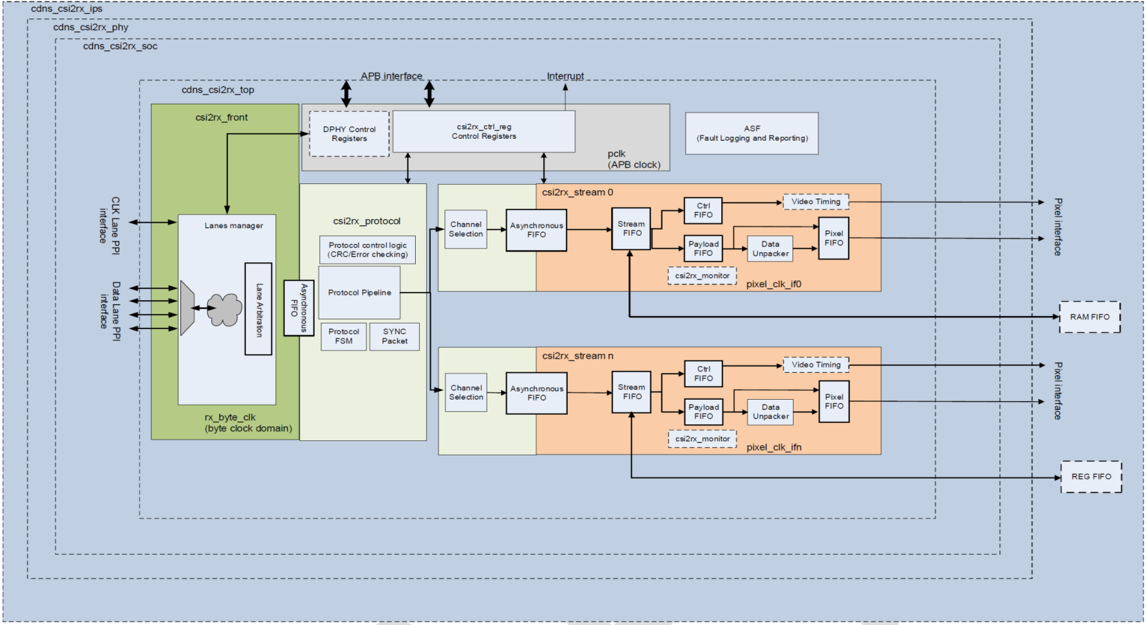
CSI2RX Controller: Top-level Block Diagram

Slide 26
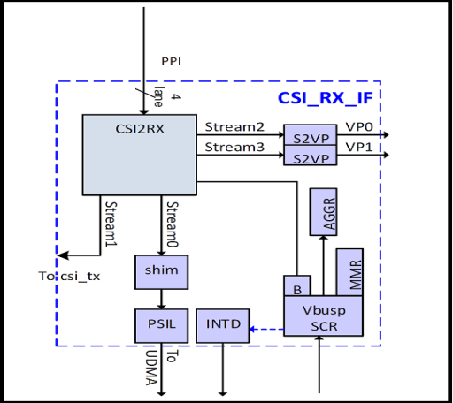
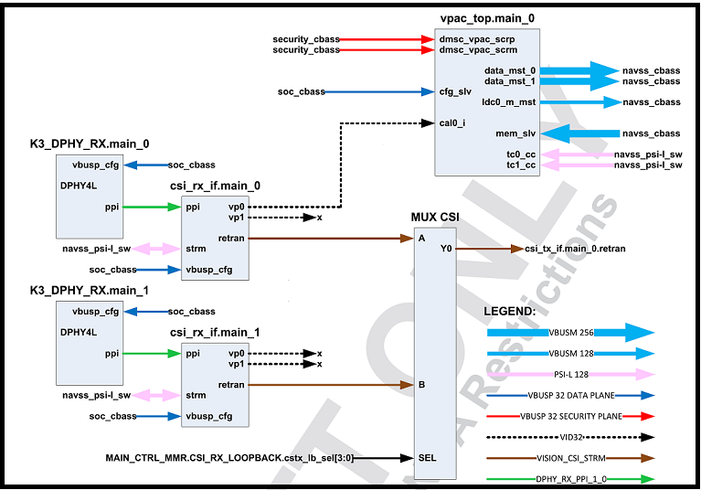
CSI2RX Controller: J721E Integration
CSI2RX Functional Block Diagram
J721E Integration Overview

