Slide 1
Veryl: A New HDL as an Alternative to SystemVerilog
Naoya Hatta
PEZY Computing K.K.

Slide 2
Veryl
A new HDL being developed as open-source software
Refined syntax based on SystemVerilog
Compile into human-readable SystemVerilog
/// Counter
module Counter #(
param WIDTH: u32 = 1,
)(
i_clk: input clock ,
i_rst: input reset ,
o_cnt: output logic<WIDTH>,
){
var r_cnt: logic<WIDTH>;
always_ff {
if_reset {
r_cnt = 0;
} else {
r_cnt += 1;
}
}
}
Veryl
// Counter
module Counter #(
parameter WIDTH = 1
)(
input logic i_clk ,
input logic i_rst_n,
output logic [WIDTH-1:0] o_cnt
);
logic [WIDTH-1:0] r_cnt;
always_ff @ (posedge i_clk or negedge i_rst_n) begin
if (!i_rst_n) begin
r_cnt <= 0;
end else begin
r_cnt <= r_cnt + 1;
end
end
endmodule
SystemVerilog
Compile

Slide 3
Agenda
Motivation
Enhancing SystemVerilog development
Existing approach: Alternative HDLs
Overview and challenges
Veryl: A new HDL as an alternative to SystemVerilog
Concept and vision
Key features and benefits
Conclusion
Development status

Slide 4
Agenda
Motivation
Enhancing SystemVerilog development
Existing approach: Alternative HDLs
Overview and challenges
Veryl: A new HDL as an alternative to SystemVerilog
Concept and vision
Key features and benefits
Conclusion
Development status

Slide 5
Enhancing SystemVerilog Development
Possible ways
Introduce useful SystemVerilog features
Introduce new tools

Slide 6
Introduce Useful SystemVerilog Features
No tool supports all features completely
Each tool has a different support area for features
Synthesizability is not guaranteed
Introducing inexperienced features is challenging
Need to explore usable feature combinations
System
Verilog
Feature A
supported
RTL
Simulation
Logic
Synthesis
Equivalence
Check
FPGA
Implementation
Feature A / C
supported
Netlist
Feature B / C
supported

Slide 7
Introduce New Tools
A variety of support tools for programming languages
e.g., linters, formatters, and specialized editors
In contrast, it is difficult to develop such support tools for SystemVerilog
Complex syntax and semantics make it very challenging
Few options for support tools in SystemVerilog
Very limited choice of both commercial and open-source software
Support
Tools
System
Verilog
RTL
Simulation
Logic
Synthesis
Equivalence
Check
FPGA
Implementation
Netlist

Slide 8
Enhancing SystemVerilog Development
Possible ways
Introduce useful SystemVerilog features
Introduce new tools
Both approaches are difficult
How about the existing alternative HDLs?
For example, Chisel

Slide 9
Agenda
Motivation
Enhancing SystemVerilog development
Existing approach: Alternative HDLs
Overview and challenges
Veryl: A new HDL as an alternative to SystemVerilog
Concept and vision
Key features and benefits
Conclusion
Development status

Slide 10
Overview of Existing Alternative HDLs
Advantages over SystemVerilog
Extensible language features
Reuse the existing ecosystem

Slide 11
Extensible Language Features
Adding
new features
Alternative HDLs as software libraries
For example, Chisel is developed as a library in Scala
Generate standard Verilog
Ensuring compatibility with existing EDA tools
Flexible features integration
New features can be added freely without compatibility issues
Chisel
Library
Chisel
Compile
Lint Check
Format
No compatibility
issues
Verilog
RTL
Simulation
Logic
Synthesis
Equivalence
Check
FPGA
Implementation
Netlist

Slide 12
Reuse the Existing Ecosystem
Scala
ecosystem
Based on programming language
Compiler and tooling ecosystem can be used as is
Sophisticated language features compared to traditional HDLs
Software libraries can be easily integrated
Quick development can be achieved
Both compiler and logic design
Chisel
Library
Chisel
Scala
Library
Compile
Lint Check
Format
Verilog
RTL
Simulation
Logic
Synthesis
Equivalence
Check
FPGA
Implementation
Netlist

Slide 13
Overview of Existing Alternative HDLs
Advantages over SystemVerilog
Extensible language features
Reuse the existing ecosystem
There are some good points
Can alternative HDLs be used instead of SystemVerilog?

Slide 14
Challenges in Using Alternative HDLs
Syntax is not optimal
Semantics differences from Verilog
Interoperability with SystemVerilog

Slide 15
Syntax is not optimal
Take over the base language syntax
Extensibility is limited
HDL-specific syntax can’t be introduced
Chisel
Library
Chisel
Scala
source code
Compile
Lint Check
Format
import chisel3._
class Mux2IO extends Bundle {
val sel = Input(UInt(1.W))
val in0 = Input(UInt(1.W))
val in1 = Input(UInt(1.W))
val out = Output(UInt(1.W))
}
class Mux2 extends Module {
val io = IO(new Mux2IO)
io.out := (io.sel & io.in1) | (~io.sel & io.in0)
}
Chisel
Bit width notation
Verilog
Nested function calls are required
RTL
Simulation
Logic
Synthesis
Equivalence
Check
FPGA
Implementation
Netlist
IO is a general variable

Slide 16
Semantics differences from Verilog
Small code generates voluminous Verilog
Low readability of generated Verilog
Debug with generated flat signals
Debug in Verilog side is difficult
Sophisticated
data structure
Chisel
Library
Chisel
Compile
Lint Check
Format
Verilog
Voluminous
code
RTL
Simulation
Logic
Synthesis
Equivalence
Check
FPGA
Implementation
Debug with
flat signals
Netlist

Slide 17
Semantics differences from Verilog
Small changes in code cause large-scale changes in Verilog
Predicting induced changes is difficult
Changing generated Verilog in detail is difficult
Timing improvement
pre/post-mask ECO flow
How should
be changed?
Chisel
Library
Chisel
Compile
Lint Check
Format
Verilog
Logic change
is required
RTL
Simulation
Logic
Synthesis
Equivalence
Check
FPGA
Implementation
Netlist
Timing
error

Slide 18
Interoperability with SystemVerilog
SystemVerilog can’t be used directly
A Verilog wrapper is required
Integrating into existing SystemVerilog projects is difficult
Chisel
Library
Chisel
Compile
Lint Check
Format
Verilog Wrapper
System
Verilog
Verilog
RTL
Simulation
Logic
Synthesis
Equivalence
Check
FPGA
Implementation
Netlist

Slide 19
Challenges in Using Alternative HDLs
Syntax is not optimal
Semantics differences from Verilog
Interoperability with SystemVerilog
The existing alternative HDLs are difficult to use as alternatives to SystemVerilog
A new HDL is required: Veryl

Slide 20
Agenda
Motivation
Enhancing SystemVerilog development
Existing approach: Alternative HDLs
Overview and challenges
Veryl: A new HDL as an alternative to SystemVerilog
Concept and vision
Key features and benefits
Conclusion
Development status

Slide 21
Introduction to Veryl Concept
Optimized syntax for synthesizable HDL
Designed to enhance readability and reliability
Generate human-readable SystemVerilog
Ensures generated code is easy to understand and debug
Productivity tools by default
Incorporates tools that enhance developer productivity automatically

Slide 22
Introduction to Veryl Concept
Optimized syntax for synthesizable HDL
Designed to enhance readability and reliability
Generate human-readable SystemVerilog
Ensures generated code is easy to understand and debug
Productivity tools by default
Incorporates tools that enhance developer productivity automatically

Slide 23
Optimized Syntax for Synthesizable HDL
Basic syntax
Streamlined for easier understanding and use
Clock and reset
Simplified handling of clock and reset signals
Quickly detection of errors around clock and reset
Generics
Enhanced support for generics to increase flexibility and reusability

Slide 24
Basic Syntax
Introduce language features of
modern programming language
Comparison between SystemVerilog and Veryl
Documentation comments
// Counter
module Counter #(
parameter WIDTH = 1
)(
input logic i_clk ,
input logic i_rst_n,
output logic [WIDTH-1:0] o_cnt
);
logic [WIDTH-1:0] r_cnt;
always_ff @ (posedge i_clk or negedge i_rst_n) begin
if (!i_rst_n) begin
r_cnt <= 0;
end else begin
r_cnt <= r_cnt + 1;
end
end
always_comb begin
o_cnt = r_cnt;
end
endmodule
SystemVerilog
/// Counter
module Counter #(
param WIDTH: u32 = 1,
)(
i_clk: input clock ,
i_rst: input reset ,
o_cnt: output logic<WIDTH>,
){
var r_cnt: logic<WIDTH>;
always_ff {
if_reset {
r_cnt = 0;
} else {
r_cnt += 1;
}
}
always_comb {
o_cnt = r_cnt;
}
}
Veryl
Trailing comma
Simplify idiomatic syntax
in SystemVerilog
Bit width
notation
Context-aware
assignment

Slide 25
Clock and Reset
Dedicated clock and reset type
Sensitivity list can be omitted in single-clock modules
module Counter #(
param WIDTH: u32 = 1,
)(
i_clk: input clock ,
i_rst: input reset ,
o_cnt: output logic<WIDTH>,
){
always_ff {
if_reset {
o_cnt = 0;
} else {
o_cnt += 1;
}
}
}
Veryl
Clock and reset type
Automatically inferred clock and reset
Dedicated reset condition syntax

Slide 26
Clock and Reset
Synchronicity and polarity configurable during compiling
Sensitivity list and reset condition are automatically adjusted
Single Veryl code can be compiled for both ASIC and FPGA
clock_type = posedge
reset_type = async_low
always_ff @ (posedge i_clk or negedge i_rst) begin
if (!i_rst) begin
end
end
SystemVerilog
module ModuleA (
i_clk: input clock,
i_rst: input reset,
) {
always_ff {
if_reset {
}
}
}
Veryl
always_ff @ (negedge i_clk) begin
if (i_rst) begin
end
end
SystemVerilog
clock_type = negedge
reset_type = sync_high

Slide 27
Clock and Reset
Synchronicity and polarity configurable during compiling
Special types indicating synchronicity and polarity are supported too
Clock and reset types
indicating synchronicity and polarity
module ModuleA (
i_clk: input clock_posedge,
i_rst: input reset_sync_high,
) {
always_ff {
if_reset {
}
}
}
Veryl
always_ff @ (posedge i_clk) begin
if (i_rst) begin
end
end
SystemVerilog
any clock_type
any reset_type

Slide 28
Clock and Reset
Clock domain annotation
Annotation is mandatory in multi-clock modules
Unexplicit clock domain crossings are detected as error
annotation
module ModuleA (
i_clk_a: input `a clock,
i_dat_a: input `a logic,
o_dat_a: output `a logic,
i_clk_b: input `b clock,
o_dat_b: output `b logic,
) {
always_ff (i_clk_a) {
o_dat_a = i_dat_a;
}
unsafe (cdc) {
assign o_dat_b = i_dat_a;
}
}
Veryl
Signals belonging
clock domain `a
Signals belonging
clock domain `b
Assignment in the same clock domain is OK
Clock domain crossing
requires unsafe block

Slide 29
Generics
Type parameter to reduce code duplication
module SramQueueVendorA;
SramVendorA u_sram();
// queue logic
}
module SramQueueVendorB;
SramVendorB u_sram();
// queue logic
}
module Test {
SramQueueVendorA u0_queue();
SramQueueVendorB u1_queue();
}
SystemVerilog
module SramQueue::<T> {
inst u_sram: T;
// queue logic
}
module Test {
// Instantiate a SramQueue by SramVendorA
inst u0_queue: SramQueue::<SramVendorA>();
// Instantiate a SramQueue by SramVendorB
inst u1_queue: SramQueue::<SramVendorB>();
}
Veryl
Parameterized
module instance
Actual module
can be specified here
Duplicated code

Slide 30
Introduction to Veryl Concept
Optimized syntax for synthesizable HDL
Designed to enhance readability and reliability
Generate human-readable SystemVerilog
Ensures generated code is easy to understand and debug
Productivity tools by default
Incorporates tools that enhance developer productivity automatically

Slide 31
Generate Human-readable SystemVerilog
Interoperability with SystemVerilog
Reuse the existing SystemVerilog codebase
Introduce Veryl to the existing SystemVerilog project gradually
Debug with SystemVerilog features
struct and interface can be used in waveform viewers
Veryl
Directly interface with
SystemVerilog code
Compile
Lint Check
Format
System
Verilog
System
Verilog
RTL
Simulation
Logic
Synthesis
Equivalence
Check
FPGA
Implementation
Debug with
SystemVerilog types
Netlist

Slide 32
Generate Human-readable SystemVerilog
Consistent semantics with SystemVerilog
Predictable changes in generated SystemVerilog when modifying Veryl code
Generated SystemVerilog can be finely tuned
Timing improvement and pre/post-mask ECO flow can be applied
Fix original
code
Veryl
Compile
Lint Check
Format
Regenerate
System
Verilog
RTL
Simulation
Logic
Synthesis
Equivalence
Check
FPGA
Implementation
Netlist
Check
equivalence
Change
by hand

Slide 33
Introduction to Veryl Concept
Optimized syntax for synthesizable HDL
Designed to enhance readability and reliability
Generate human-readable SystemVerilog
Ensures generated code is easy to understand and debug
Productivity tools by default
Incorporates tools that enhance developer productivity automatically

Slide 34
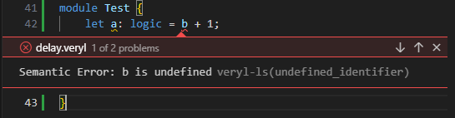

Productivity Tools by Default
Real-time diagnostics
Editor integration using standardized language server protocol
Visual Studio Code
Vim

Slide 35
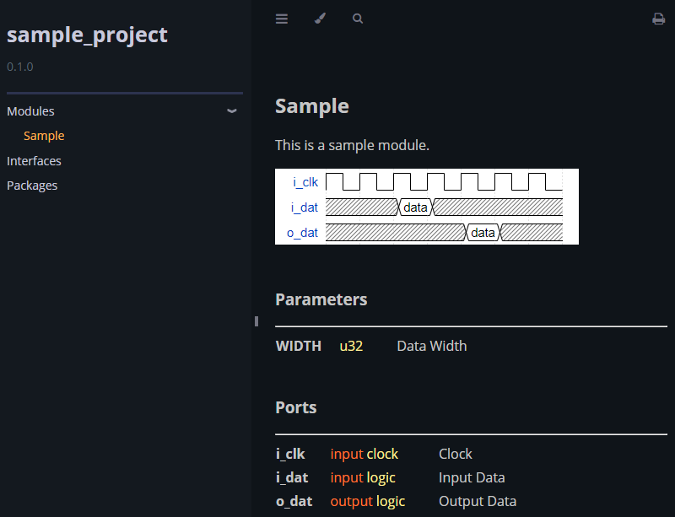
Productivity Tools by Default
Automatic document generation
Supports Markdown format and waveform description
/// This is a sample module.
///
/// ```wavedrom
/// {signal: [
/// {name: 'i_clk', wave: 'p......'},
/// {name: 'i_dat', wave: 'x.=x...', data: ['data']},
/// {name: 'o_dat', wave: 'x...=x.', data: ['data']},
/// ]}
/// `
pub module Sample #(
/// Data Width
param WIDTH: u32 = 1,
)(
i_clk: input clock , /// Clock
i_dat: input logic<WIDTH>, /// Input Data
o_dat: output logic<WIDTH>, /// Output Data
){}
Veryl

Slide 36
Productivity Tools by Default
Other features
Auto formatting for cleaner, standardized code layout
Integrated unit testing to streamline testing process
Ability to publish projects as libraries for easy reuse
Dependency management for efficient handling of project dependencies

Slide 37
Agenda
Motivation
Enhancing SystemVerilog development
Existing approach: Alternative HDLs
Overview and challenges
Veryl: A new HDL as an alternative to SystemVerilog
Concept and vision
Key features and benefits
Conclusion
Development status

Slide 38
Conclusion
Veryl: A new HDL as an alternative to SystemVerilog
Optimized syntax for synthesizable HDL
Generate human-readable SystemVerilog
Productivity tools by default
Open-source development
Developed as open-source software
Available on GitHub: https://github.com/veryl-lang/veryl

Slide 39
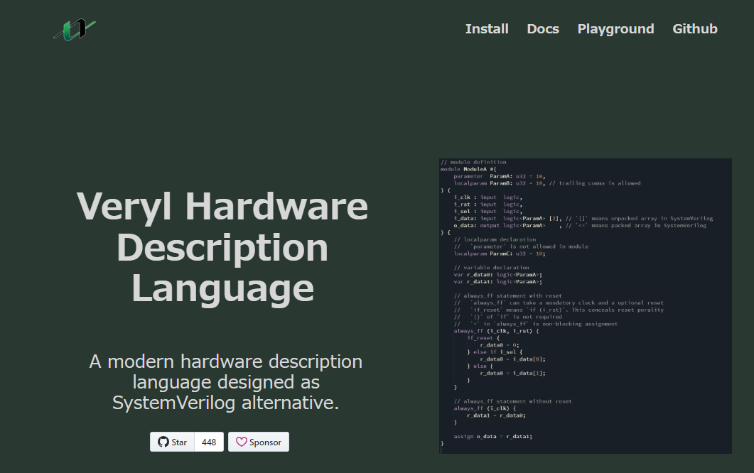
Development Status
Project Status
GitHub Stars : 448
Commits : 1778
Issues : 54 Open, 211 Closed
Pull Requests : 0 Open, 563 Closed
Contributors : 9
Resources
Official site : https://veryl-lang.org
Language reference : https://doc.veryl-lang.org/book/
Playground : https://doc.veryl-lang.org/playground/

Slide 40
Questions

