Slide 1
E-Commerce Product Recommender
Technical Overview - Methodology, Models & Evaluation
Capstone Project | notebooks/01_eda_and_recommender.ipynb

Slide 2
Problem & Approach
• Task type: Recommendation system (not classification/regression)
• Approach: Item-based Collaborative Filtering vs. Content-Based baseline
• Metric: Precision@5 - of the top 5 recommended products, how many did the user actually buy
• Business KPI: Increased cross-sell rate / average order value

Slide 3
Dataset Overview
• 10,000 orders | 2,890 users | 500 products
• No missing values, no duplicates, no negative prices/quantities
• 88% of users have 2+ orders - enough repeat-purchase signal for collaborative filtering
• Price/qty/total_price: 7-9% flagged as outliers (IQR rule) - genuine bulk/premium orders, not errors
• Critical finding: product_id does not map to a fixed real-world product
- Each ID shows up under an average of 7.3 of 8 possible categories, with wildly different prices
- Caps content-based model quality and adds noise to fairness results (see later slides)

Slide 4
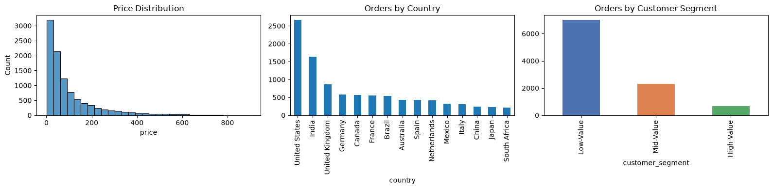
Data Distributions
Price distribution, orders by country, orders by customer segment

Slide 5
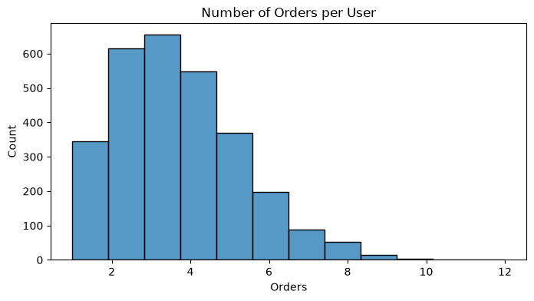
Applied EDA
Orders per user - most users have 2-5 orders

Slide 6
Feature Engineering & Selection
• 15 engineered per-user features: 7 behavioral (spend, tenure, recency...) + 8 category-spend shares
• Feature Selection (Filter Method): correlation check found num_orders / num_categories redundant (r=0.87)
- Dropped num_orders, kept num_categories (more directly tied to cross-sell KPI)
• Result: 14 features carried forward

Slide 7
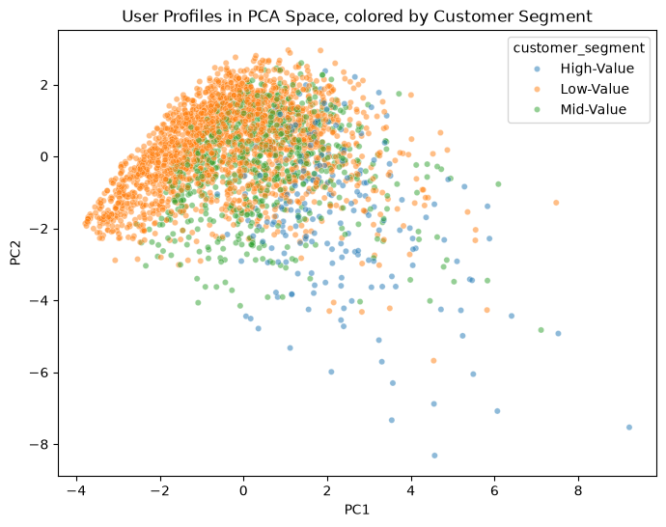
Dimensionality Reduction - PCA
8 of 14 components needed for 80% variance; PC1/PC2 shown here explain 35%

Slide 8
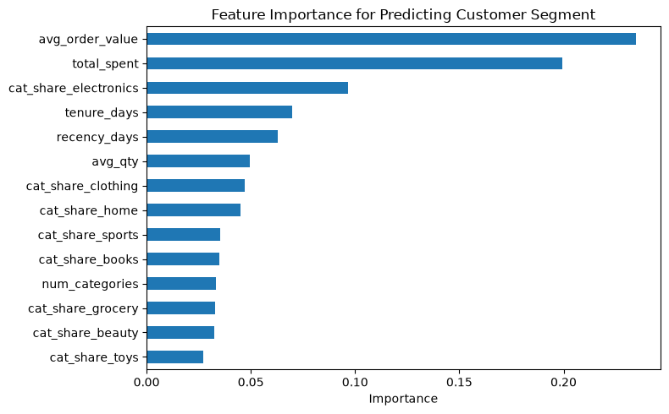
Feature Importance (Model-Based)
Random Forest predicting customer_segment: avg_order_value & total_spent dominate

Slide 9
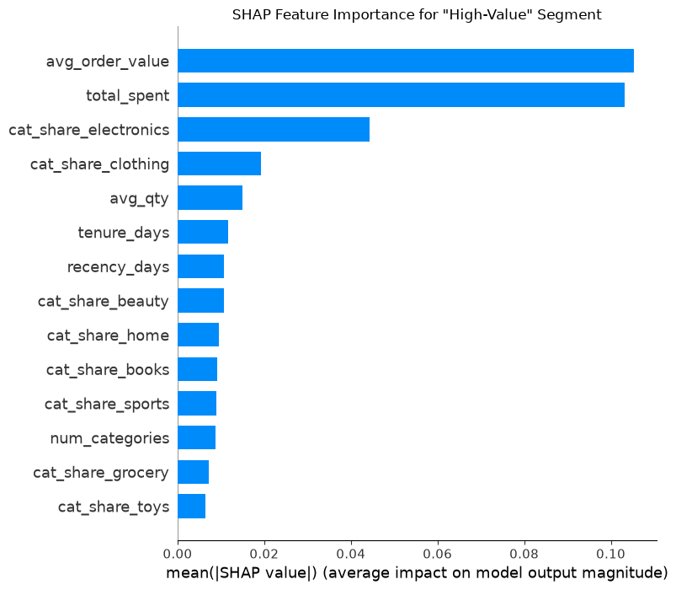
Explainability - SHAP
SHAP values for the High-Value segment class confirm feature importance findings

Slide 10
Model Comparison & Evaluation
Model | Precision@5 | Basis
Item-based Collaborative Filtering | 0.011 (3/266 hits) | Co-purchase behavior
Content-Based (category + price) | 0.011 (3/266 hits) | Item content similarity
• Leave-one-out evaluation: hold out each user's most recent purchase, check if top-5 recovers it
• Leakage bug found & fixed: original code excluded the held-out item from candidates by construction
• Final choice: Collaborative Filtering (doesn't depend on unreliable product_id metadata)

Slide 11
Fairness Audit
• Checked Precision@5 across customer_segment and country
• Demographic parity difference: 0.077 (segment) / 0.083 (country)
• Disparate impact ratio: ~0.0 for both - technically fails the 80% rule
• Caveat: group sizes are tiny (segments 13/74/179; countries down to n=1)
- Read as 'not enough data to rule out unfairness', not 'proven unfair'

Slide 12
Limitations & Mitigations
• Cold-start: 11.3% of test users got zero recommendations (no purchase history)
• Overfitting: segment classifier 99.3% train vs 68.3% test accuracy
• Mitigations: popularity fallback for cold-start, reweighting underrepresented groups,
- more data collection, regularize classifier, fix product_id data quality upstream

