Slide 1
Automation of Software Fault Prediction
Thomas Ostrand
Elaine Weyuker
AT&T Labs – Research
Florham Park, NJ

Slide 2
What is a Fault?
A fault is a change to an executable file made in response to observed incorrect or undesirable behavior of the software.
A single observation can lead to multiple faults, if multiple files have to be changed.

Slide 3
What is Fault Prediction?
Identifying the X% of files most likely to have faults in a future release of the software.
Identifying the files most likely to have X% of the faults in a future release.

Slide 4
Is Fault Prediction Feasible and Useful?
In large systems we have studied, faults tend to be concentrated in very small percentages of the system.
The models we have constructed have identified 20% of all files that contain 80-90% of all faults in a given release.

Slide 5
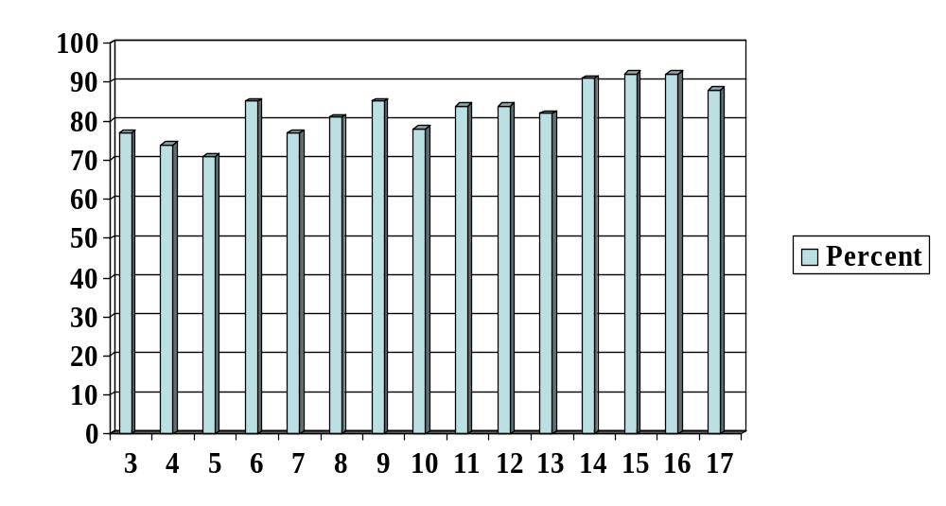
Percent of Faults Contained in Top 20% of Files Selected by Model
(Average = 83%)
Release

Slide 6
Request for X% of Faults
120
100
80
% Requested
60
% Actual
% Files
40
20
0
60
70
80
90
95

Slide 7
Goal / Non-Goal
List the files that are most likely to have faults, in order of decreasing number.
Provide a list of files that are likely to have a given percentage of all faults.
Pinpoint specific locations where faults will be.
Predict number of faults.

Slide 8
Model 1
Needs only LOC of all files
Very simple to produce fault-proneness ranking
Results are not as accurate as other models, but still surprisingly good
Rank(f) = KLOC

Slide 9
Model 2
Needs LOC, New/Old, Changed/NotChanged
Still very simple to acquire data
Coefficients are fixed
Results approach Model 3 in accuracy
Rank(f) =
0.7*log(KLOC) + 2.0*(New) + 1.0*(Changed)

Slide 10
Model 3
Age, Language, and count of Changes straightforward
Need count of prior Faults; may be difficult
Coefficients for each release are adjusted based on prior releases
Accuracy is very high
Rank(f) = 0.52*log(KLOC) + 1.86*(New) + 0.91*(Age==1) + 0.35*(Age==2,3,4) + 0.44*sqrt(Changes[-1])
+ 0.32*sqrt(Changes[-2]) + 0.38*sqrt(Faults[-1])
+ func(Language)

Slide 11
Model 4 (“research model”)
Data collection same as Model 3
Structure of equation adjusted to produce best possible results
Coefficients based on prior releases
Not suitable for operational fault prediction

Slide 12
Data Needed for Predictions
LOC
New file (0/1)
Changed file (0/1)
Age (1,2,3,4)
Prior changes
Prior faults
Language
Model 1
Model 2
Model 3

Slide 13
Automated Prediction System
Phase 1: Data acquisition
Phase 2: Construct prediction model
Phase 3: Apply model to current data

Slide 14
Current Status (Phase 1)
Data acquisition driven by shell scripts, from Unix command line
User provides small configuration file:
  releases to be analyzed
  location of code
  filetypes to be considered
  information to characterize faults

Slide 15
Current Status (Phases 2 & 3)
Models 1 & 2 are immediately usable.
Interface for applying prediction not yet built.

Slide 16
Issues of Modeling
Different fault databases
Different version control systems
Locating all the data (active/inactive DB)
Proper interpretation of data – what is a fault?
Data credibility – do users enter accurate information?

Slide 17
Issues of Presentation
Users need simplicity – minimal information entry, no tough decisions
Results presented clearly and simply
Mathematics should be transparent, but available if user wants to see it

Slide 18
Future Automation
Universal intermediate data format
Individual transformers from each separate fault DB/version control system
Model constructor to fit predictor equations to collected data
Visual or form-based user interface
Graph presentation of results

Slide 19
Cumulative faults
with files in different orders
300
250
200
150
Cumulative Number of Faults
100
Actual Fault Order
Predicted Fault Order
Random Order
50
0
1
92
183
274
365
456
547
638
729
820
911
1002
1093
1184
1275
1366
1457
1548
1639
1730
Number of Files

