Slide 1
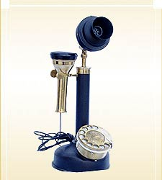




Incremental Inference of Black Box Components to support Integration Testing [PhD paper]
Muzammil Shahbaz
France Telecom R&D
Grenoble Institute of Technology
Grenoble, France
Supervisor:
Prof. Dr. Roland Groz
INPG / LSR-IMAG
Grenoble, France
TAIC PART, Windsor, UK
August 29, 2006

Slide 2
Motivation
New Trends for Designing Complex Systems (e.g. telecom services)
  Integration of COTS
  (Components Off-The-Shelf)
  Testing of the overall system's behavior
    to assess the quality of service
    to develop better know-how of the component's interaction
  Formal Models form good basis
    for applying rigorous testing techniques
    for reducing the scope of analysis
Notes:
Describing the background of our work

Slide 3
But…
COTS
  Formal Models are not provided normally
  Documentation is insufficient
  Internal Structure is usually unknown
Tester
  Relies on his own intuitions
  Cannot assess the quality of assembly
Notes:
Stating problem in the testing environment

Slide 4

Framework service: providing list of hotels on mobile
mobile id
Mobile
Locator
Portal
current location
request
Accommodation
Service
<use operator service>
response
location
user preferences
Hotel
Finder
hotel list
DB
Notes:
An example to demonstrate an industrial framework related to telecom service

Slide 5
Approach
Hotel
Finder
User
Locator
service
PPFSM
(Implicit Predicate
Parameterized
Finite State Machines)
Learn Model
Learn Model
Black Box
Reverse
Engineering
Test
Integrate
Integration
Testing
using
Formal
Models
Integrated System
Test Generation
using
Integration Testing Strategy
Notes:
Our approach to facilitate the Tester of the service. Introduction of PPFSM model

Slide 6
Related Work
  Finding a minimum DFA is NP-HARD
    Complexity of automaton identification from given data. [E. Gold 78]
  Even a DFA with no. of states polynomially larger than the no. of states of the minimum is NP-Complete
    The minimum consistent DFA problem cannot be approximated within any polynomial. [Pitt & Warmuth 93]
  Probably Approximately Correct (PAC)
    A theory of the learnable. [L.G. Valiant 84]
Passive Learning
Notes:
Related work in the field of Machine Learning (Passive Learning Approach).

Slide 7
Angluin's Algorithm
Polynomial Time Algorithm to identify minimum DFA
    Learning regular sets from queries and counterexamples [D. Angluin 87]
  In the domain of Language Accepters
Optimized & Reused in
  Map Learning Scenarios [Rivest & Schapire 93]
  Adaptive Model Checking [Peled et al. 02]
  Testing of Telecom Systems [Steffen et al. 03]
  …
  Adaptation to Mealy machines
    [presented by K. Li]
Active Learning
Notes:
Introduction of Angluin's Algo

Slide 8
Why PPFSM?
Better adapted for real-world complex systems
  having very large set of alphabets
  inputs are supplied along with the parameters
Modelling with simple FSM is inadequate
  whole parameter domain needs to be abstracted
  blow up & loose parameterized structure
Interoperability problems in components often linked to parameter values
  pose challenges on learning & testing methodologies
Not so complex as EFSM
  skip variables, complex guards and assignments
  more expressive in terms of representing parameters
Notes:
Why PPFSM?
The reason to support PPFSM model is its ability to keep a parameterized structure as built-in. In our case, we need to conjecture a parameterized system, and hence we need a model that is more expressive in this sense. In PPFSM, we can achieve this target by simply annotating input types with its corresponding parameter value. This helps in generating test cases for a parameterized systems. The other important point is that it is a restrictive form of EFSMs (minus variables, complex guards, assignments); and our goal is to move gradually towards the models which are very close form of EFSMs. Therefore, it provides a good starting point so that we can easily foresee our next goal in the hierarchy of model complexity. Another thing which goes in favour of PPFSM is that we can find plenty of test generation techniques based upon (E)FSMs in testing literature which are matured enough that they can readily be applied.
Other Models:
There are plenty of other good and more complex models such as ASM and (Stream) X-Machines etc which can be used as a counterpart of EFSMs. But for our purpose, these models have to be generalized for a parameterized structure. Also, the existing reverse engineering techniques for black box components deals with simple FSM. So it is more practical to move towards the complex form of finite automaton (DFA->Mealy->PFSM->PPFSM). It’s a lengthy discussion which model supersedes the other. But its true that ASM and EFSMs are high level philosophies in system designing.
X-Machines is a formal technique which extends FSM by introducing memory attached to the machine and functions that operate on input symbols and memory values. Contrary, EFSMs and ASMs are more expressive in representing the parameterized structure specially the infinite parameter domain as compared to (Stream) X-Machines. Also, X-Machine has one global memory view which is different from local update view in ASM and EFSMs.

Slide 9
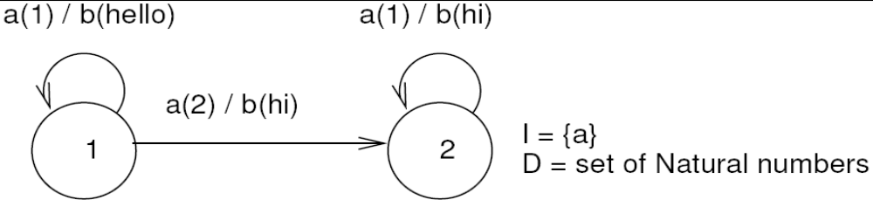
PPFSM – An Example
Notes:
If the model is not deterministic than we may never test some possibilities for inputs when applying on one state. Therefore, no amount of experiments would give the reliable results. Moreover, the real systems such as processors, real-time systems etc are always deterministic in reality. Non-determinism always occurs on an abstraction level.

Slide 10
PPFSM Learning Algorithm
(extension of Angluin's Algorithm)
Output
Symbols
Parameter Values
Primary Table
Auxiliary Table
a
a
1-
ε
b
1-
ε
(1,hello)
(2,hi)
a
b
a
(1,hi)
(2,hi)
Test Query:
a(1)
a(2)a(1)
2-
2-
a(1)a(2)a(1)
aa
b
aa
(1,hi)
Result:
b(hello)
b(hello)b(hi)b(hi)
b(hi)b(hi)
ε is an empty string
Notes:
Learning PPSM. The example is shown through animation. Please run a slide show

Slide 11
Conclusion/Summary
Black Box Integration Testing
Inferring richer models
  e.g., PPFSM
  only partial models
Devise an Integration Testing Strategy based upon richer models
Next target
  implementing algorithms & case-studies
  towards EFSMs
FSM (Mealy) ... Parameterized System ... PPFSM ... EFSM
Notes:
Partial Models: The objective is not to find how much the learned models conform to the original ones, but to find that how much the learned models are supportive for integration testing of learned models.

Slide 12
Thank you for your patience.
Notes:
The finial slide.

