Slide 1

TRex
The Refactoring and Metrics Tool
for TTCN-3 Test Specifications
Paul Baker¹, Dominic Evans¹, Jens Grabowski²,
Helmut Neukirchen², Benjamin Zeiss²
Presented by Rob Thomson¹
¹Motorola Labs,
Viables Industrial Estate, Basingstoke, UK
²Software Engineering for Distributed Systems Group,
University of Göttingen

Slide 2
TTCN-3
Testing and Test Control Notation
  Test specification and test implementation language
  Standardised by ETSI and the ITU
Originally for functional black-box testing of telecoms systems. Now also for
  Internet protocols
  Automotive
  Aerospace
  …

Slide 3
Outline
Motivation
Metrics
Refactoring
TRex Tool
Summary / Outlook

Slide 4
Motivation
Migration of legacy test suites at Motorola:
  Automatic Conversion of tests for a UMTS based component
  60,000 lines of code
  Hard to read, hard to (re-)use, and hard to maintain
Current tools:
  IDE functionality (editing, outline, etc.)
  Compiler
  Test-Management
  But: No support for improving test suites!

Slide 5
Approach
Initial aims:
  Assessment of test suites with respect to
  lessons learnt from experience
  Issue detection
  Test suite restructuring
Assessment and restructuring in TRex using
  Metrics
  Automated Refactorings

Slide 6
Outline
Motivation
Metrics
Refactoring
TRex Tool
Summary / Outlook

Slide 7
TTCN-3 Metrics (1/2)
Quantitative measures of a software product
  Deliver hints about possible quality issues in test suites
TTCN-3 metrics:
  Number of non-commented lines of TTCN-3 source code
  Number of and references to
    Test cases
    Functions
    Altsteps
    Component, data and port types
    Template definitions
    Parameterized templates

Slide 8
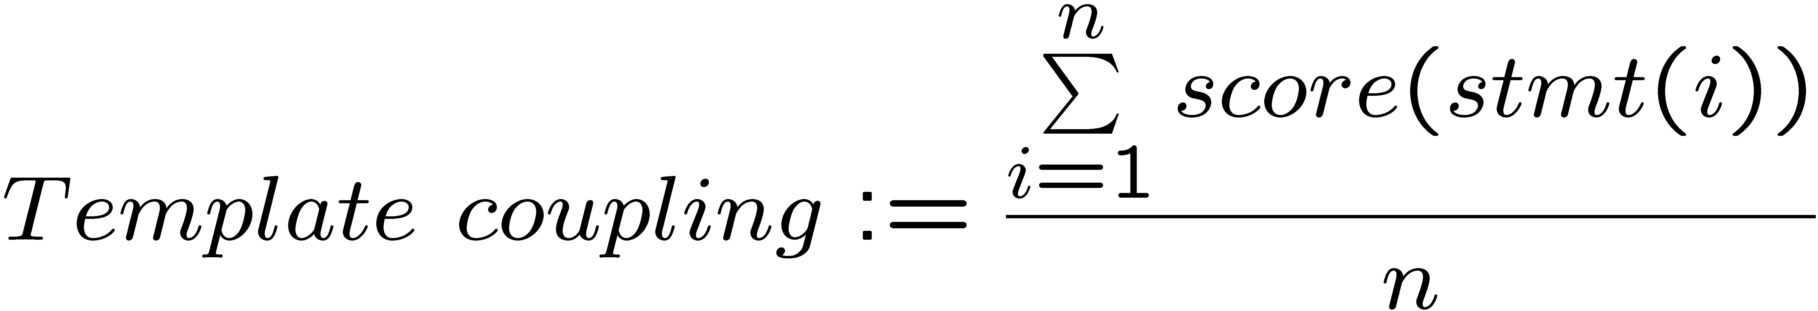
TTCN-3 Metrics (2/2)
Template Coupling:
  Measures the coupling between data description and test behavior

Slide 9
Outline
Motivation
Metrics
Refactoring
TRex Tool
Summary / Outlook

Slide 10
Refactoring: Definition
„a change made to the internal structure of software to make it easier to understand and cheaper to modify without changing its observable behavior“
Fowler, M.: Refactoring – Improving the Design of Existing Code. Addison-Wesley (1999)

Slide 11
TTCN-3 Refactoring Catalog
Refactorings are typically described in catalogs
    Name, Summary, Motivation, Mechanics, Example
28 (of 72) refactorings from Fowler are applicable
20 specific refactorings for TTCN-3
    e.g. Alt-steps, groups, concurrency, module parameterization
TTCN-3 refactoring catalog grouping:
  Test behavior
  Data descriptions
  Overall test suite structure

Slide 12
TTCN-3 Refactoring Catalog
TTCN-3 specific refactorings:
  Test behavior (5 refactorings)
    Extract Altstep
    …
  Data descriptions (6 refactorings)
    Inline Template
    …
  Overall test suite structure (9 refactorings)
    Extract Module
    …

Slide 13
Refactoring: Inline Template Parameter (1/2)
Original code:
module ExampleModule {
type record ExampleType {
boolean ipv6,
charstring ipAddress
}
template ExampleType exampleTemplate(charstring addressParameter) := {
ipv6 := false,
ipAddress := addressParameter
}
testcase exampleTestCase() runs on ExampleComponent {
pt.send(exampleTemplate("127.0.0.1"));
pt.receive(exampleTemplate("127.0.0.1"));
}
}

Slide 14
Refactoring: Inline Template Parameter (2/2)
Refactored code:
module ExampleModule {
type record ExampleType {
boolean ipv6,
charstring ipAddress
}
template ExampleType exampleTemplate := {
ipv6 := false,
ipAddress := "127.0.0.1"
}
testcase exampleTestCase() runs on ExampleComponent {
pt.send(exampleTemplate);
pt.receive(exampleTemplate)
}
}

Slide 15
Automation
Automated calculation of metrics
  Locates problematic code pieces using appropriate boundary values
  Used for refactoring suggestions
Tool supported refactoring
  Lowers the probability that the observable behavior is changed due to a refactoring
  Takes less time than manual refactoring
  Is well known from the Java world: Eclipse JDT, Jetbrains IDEA

Slide 16
Outline
Motivation
Metrics
Refactoring
TRex Tool
Summary / Outlook

Slide 17
TRex Features (1/3)
TTCN-3 core notation editing
  Syntax Highlighting
  Content Assist
  Outline View
  Code Formatter
  Text hover
  Open Declaration
  Find References
Compiler Integration
  Telelogic Tau G2/Tester

Slide 18
TRex Features (2/3)
Refactorings (currently):
  Rename
  Inline Template
  Inline Template Parameter
  Parameterize Template
Metrics
  Basic metrics
  Metrics-based refactoring suggestions

Slide 19
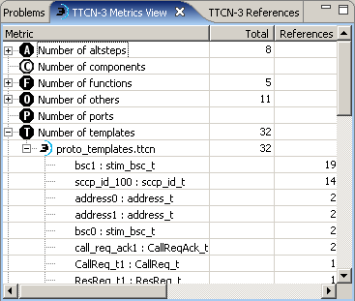
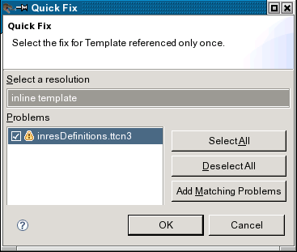
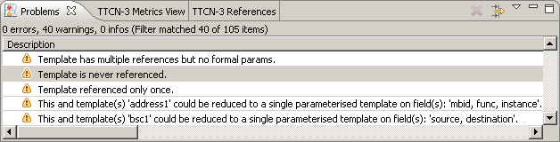
TRex Features (3/3)

Slide 20
Outline
Motivation
Metrics
Refactoring
TRex Tool
Summary / Outlook

Slide 21
Summary
Metrics and refactoring for TTCN-3:
  Address maintenance, reusability and readability problems of converted legacy test suites
  Less error-prone and less time consuming due to tool support
TRex:
  IDE for TTCN-3
  Automatic assessment and restructuring of test suites

Slide 22
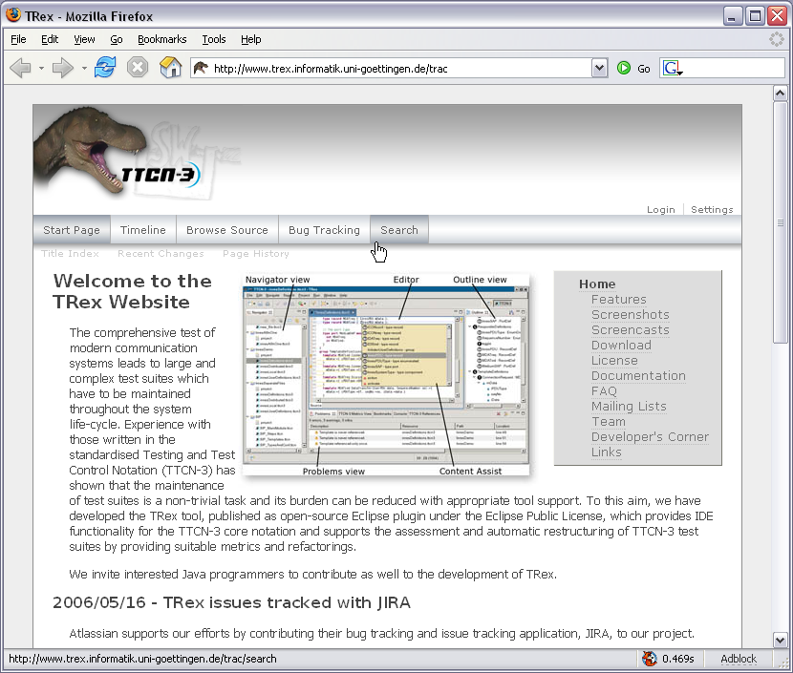
TRex Availability
www.trex.informatik.uni-goettingen.de
TRex is open source and available now!
Eclipse Public License
Interested java developers are welcome to join the project

Slide 23
Outlook
Enhanced editing functionality
More refactoring implementations
Metrics based on control-flow and call-graphs
Identification of useful metric boundary values
Automatic pattern-based code smell detection

Slide 24
Any Questions?
www.trex.informatik.uni-goettingen.de

Slide 25
Backup

Slide 26
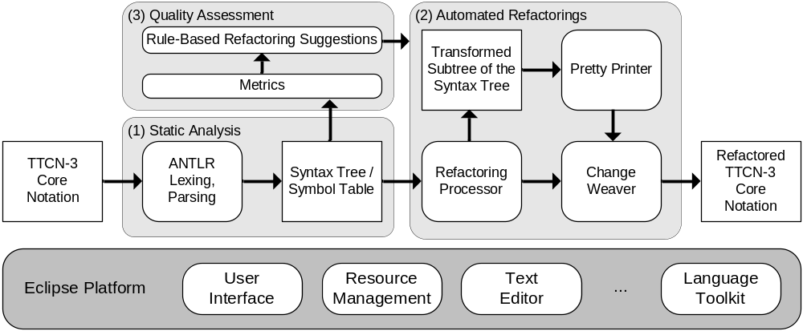
TRex tool chain

Slide 27
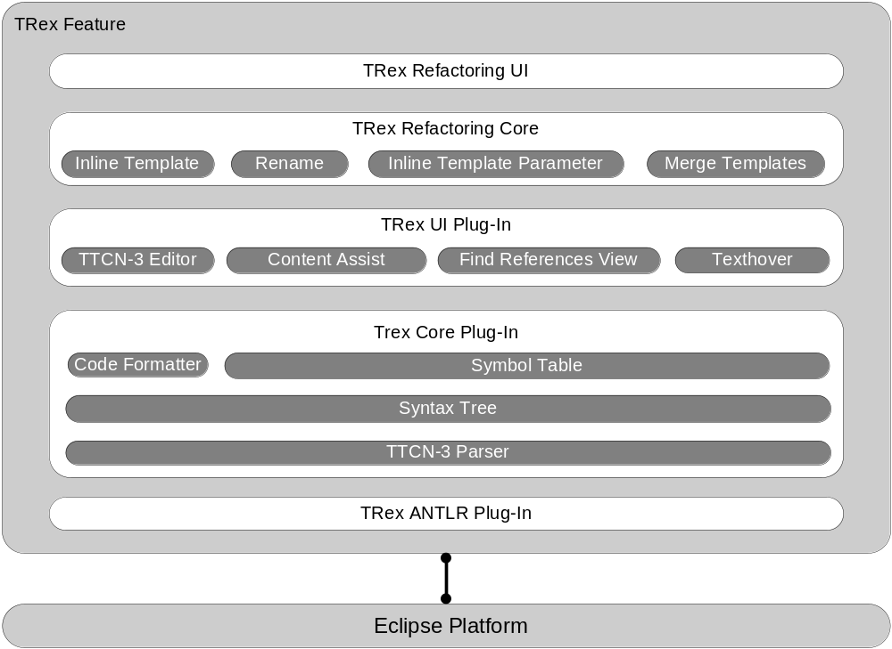
TRex Architecture

