Slide 1

James Miller
University of Alberta jm@ece.ualberta.ca
An XP inspired test-oriented life-cycle production strategy for building embedded biomedical applications

Slide 2

Overview
An “Experience Report” in many ways
  Based upon a cross-section of projects
Domain of Application
  Lots of nasty details
No big ideas
  Could not use big ideas
Adapt pre-existing process
  Incremental Change
Adopt “proven” industrial processes
  “easy” sell!!!
Steady as she goes
  Adapt the industrial process incrementally
  Based around providing tool support

Slide 3
Domain of Application
Embedded Systems
Ubiquitous Systems
Health Informatics

Slide 4
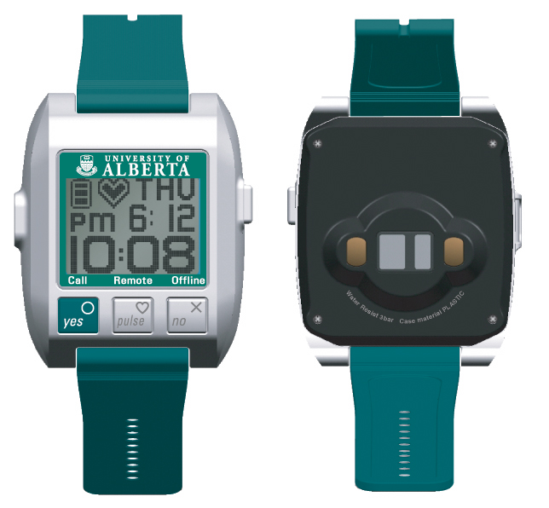
Wireless Wearable Physiological Monitor

Slide 5
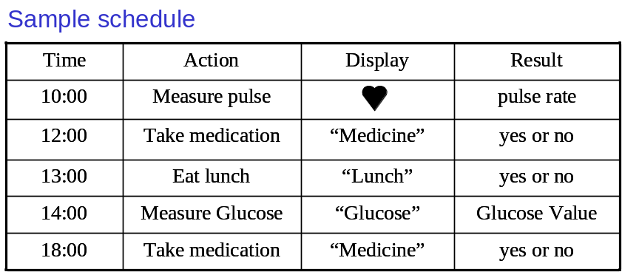
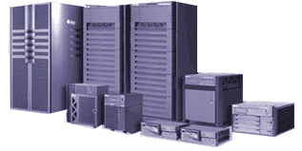


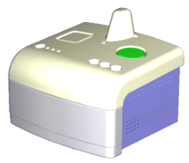

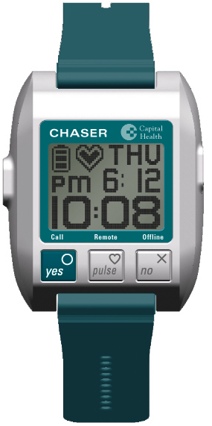

System Overview
Central server (CS)
Schedule
Internet
Schedule
Data
Home
Internet
Wireless Station (WS)
Data
Call
Glucose monitor
Clinician
Features
Bi-directional communication
Integration of additional devices to WS
Wearable pulse sensor (WPS)

Slide 6


Slide 7
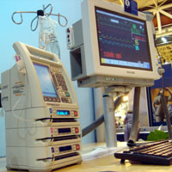

Baxter struggles with FDA after recall of Colleague Pump -- May, 2006
Recalled 256,000 Colleague drug-infusion pumps used to deliver medications to patients intravenously.
In 2005, Baxter issued four warnings of serious flaws.
Issues RELATED TO HARDWARE OR SOFTWARE DESIGN may be linked to seven deaths and 16 serious injuries.

Slide 8
Constraints
Asset-based Construction
Systems, not software, Engineering
Systems highly sensitive to defects
Participants
  dominated by Engineers and Clinical staff
  Software only staff in a minority.
  Cultural, Language and Location Diversity
No common production approach across participants
Domain has very limited ideas on
  development process
  tool support

Slide 9
Pre-existing Process
Product Envisagement
  Product Design: Exploration / Requirements
Prototyping Phase
  Exploration of the Solution
Initial Production System
  Translation into/onto Destination “Platform”
Full Production System
  Add in all the details….

Slide 10
New Process : “XP-ish”
Product Envisagement
  Impact automate-able Acceptance tests?
Prototyping Phase
  TDD for non-software people?
Initial Production System
  TDD to solve DBC issues?
Full Production System
  Is tool support feasible?

Slide 11


Stage 1 : Product Design
Communication Vehicle
  Verbal plus user stories
Communication Control
  Acceptance Tests (questions are ….)
  Everybody, at all stages, writes them
  “Customer” accepts or rejects
  Helps with level of detail; domain-specific terminology; differences in background.
  Coverage, trace-ability, documentation

Slide 12
Problems: Non-functional Requirements and tests
For many types of systems, these issues are paramount.
Agile approaches leave these to the end
– disastrous!
Encode as Acceptance Tests – okay?
Test as we go? Partial testing?

Slide 13
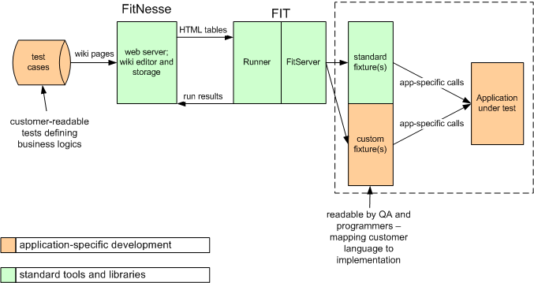
Solution: Domain Specific Support

Slide 14
Stage 2 : prototyping Stage
Written in Matlab
Driven by acceptance tests
TDD-oriented approach
  Unit tests – in Matlab
  Inexact testing objectives
  Refactoring not recommended

Slide 15
Acceptance tests support for Stages 2, 3 and 4
HOST MACHINE
DSPFixture.VDSPColumnFixtureTest
VoltHigh | VoltLow | outputTemperature
10 | 100 | 195
20 | 100 | 155
30 | 100 | 115 expected
 |  | 135 actual
FitNesse
Web server
Wiki editor and storage
Fit
Server
Fixture for
Test table
MATLAB API
DSP Interface class
C++ API
VisualDSP API
VDSP Environment
MATLAB ENGINE
Simulation Environment
TARGET PLATFORM

Slide 16
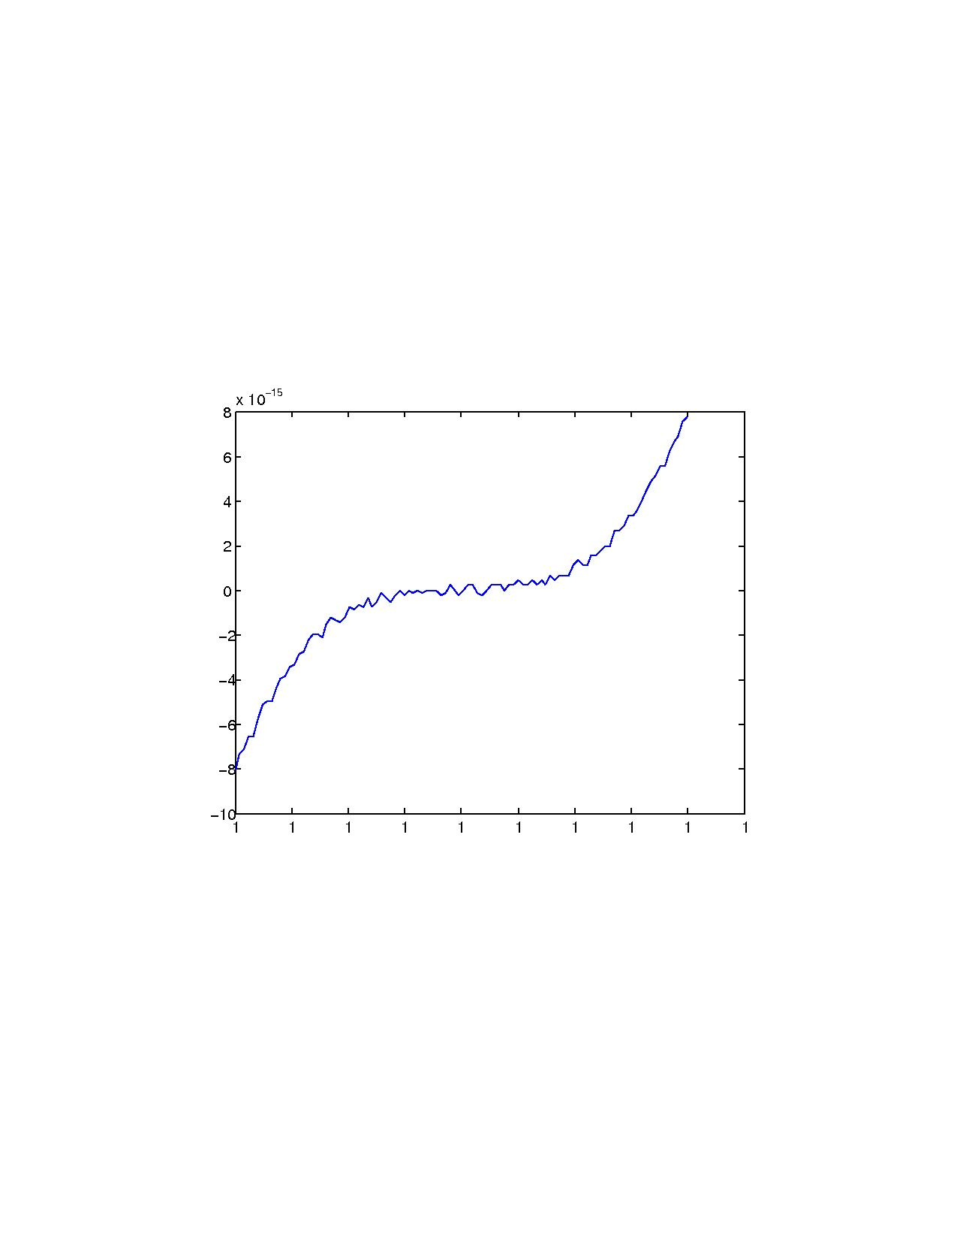
Inexact testing
Noise introduced by truncation and rounding errors
Finding the root of a simple cubic

Slide 17
Stage 3: Initial Production System
Matlab -> C++/C
Floating point -> fixed point
Committing to hardware
Half TDD; Half DBC?
Some non-functional tests/checks
Still no traditional “Refactoring”
  “Refactoring” for code quality – debatable
  “Refactoring” for efficiency – often more important

Slide 18
Non Functional tests
Approach by simulators
Currently - Via embedded manufacturer's simulators and associated tools
e.g. Power estimation analysis with power-oriented assertions
Need for more simulation tools, e.g. Ubiwise

Slide 19
Stage 4: Full Production System
Onto manufacturers development boards
Lots and lots of low-level issues….
Unit testing framework now needs to understand the platform
  Hardware-specific assertions.
“printing” is now a problematic operation

Slide 20
Stage 4: Full Production System
Memory Availability and Code Placement
  Impact of cache on timing
  on-chip (code) and external (test) memories
Processor architectures and families
  Multi-processor / multi-core
Does the board have enough facilities?
  e.g. utilize Watchdog registers for timing assertions.

Slide 21
Conclusions
Porting any methodology into this domain is a non-trivial process.
A test-driven process potentially has many advantages within this domain.
Many problems still exist in our attempts at implementing the process.

