Slide 1
Data-state Diversity
for
Test Data Search
Mohammad Alshraideh and Leonardo Bottaci
Department of Computer Science
University of Hull, Hull, UK

Slide 2
Introduction
Automatic test data generation for unit testing.
Test data should achieve branch coverage.
Data generated by heuristic search process.
Search only as effective as guidance of heuristic.
No single heuristic is effective for all programs.
A new heuristic is presented for a class of programs that until now have been unsolveable.

Slide 3
Test Data Generation: Existing work
boolean flag = false;
if (x == 3) { minimise cost = abs(x – 3)
flag = true;
}
... //ASSIGNMENTS TO flag
if (flag) { cost function limited to 2 values
//TARGET BRANCH
Cost function is constant for almost all inputs
result: no guidance to search

Slide 4
Test Data Generation: Existing work
Constant cost functions arise in various situations.
AllTrue(boolean[] a) { AllTrue(boolean[] a) {
boolean alltrue = true; double alltrue = -1.0;
for (i = 0; i < 64; i++) { for (i = 0; i < 64; i++) {
alltrue = alltrue && a[i]; alltrue = alltrue + cost(a[i]);
} }
if (alltrue) { if (alltrue < 0) {
//TARGET BRANCH //TARGET BRANCH
original program transformed program

Slide 5
Test Data Generation: Existing work
AllTrue(boolean[] a) { AllTrue(boolean[] a) {
boolean alltrue = true; boolean alltrue = true;
for (i = 0; i < 64; i++) { int counter = 0;
if (alltrue && a[i]) double fitness = 0.0
alltrue = true; for (i = 0; i < 64; i++) {
else if (alltrue && a[i]) {
alltrue = false; alltrue = true;
} fitness += 1.0;
if (alltrue) { } else {
//TARGET BRANCH alltrue = false;
}
counter++;
}
if (fitness == counter) {
//TARGET BRANCH
original program transformed program

Slide 6
Example for which previous loop transformation will not work
Orthogonal(int[] a, int[] b) { //a, b CONTAIN 0, 1
int product = 0;
for (i = 0; i < 64 && product == 0; i++) {
product = a[i] * b[i];
}
if (product == 0) {
//TARGET
If exit early from loop, cost at target branch is always 1.

Slide 7
Another example
Log10(int x) { //x in [1, 100,000]
a[0] = 0; Single path to the
a[1] = a[2] = a[3] = a[4] = a[5] = 1; problem conditional.
double y = log10(x); // y in [0, 5]
int k = ceiling(y); // k in [0, 5]
if (a[k] == 0) {
//TARGET BRANCH, k MUST BE 0 TO EXEC TARGET
5
4
k
3
2
1
0
1
10,000
100,000
x

Slide 8
Domain-Range ratio
A program or segment of a program that implements a mapping will have a domain-range ratio.
Testability Metric mentioned by Voas.
Ratio of the size of the domain to the size of the range.
The greater the ratio, the greater the information loss and the more difficult the program is to test.

Slide 9
Another example
Mask(char[] a) {
char x = 0x55; // 01010101
for (i = 0; i < 64; i++) {
...
x = x & a[i]; // BITWISE AND
}
if (x == 0x55) {
// TARGET BRANCH
Single path to the problem conditional.
16 possible values for x but 0x0 most likely at conditional

Slide 10
Instrumenting the data state
Log10(int x) { //x in [1, 100,000]
a[0] = 0; Single path to the
a[1] = a[2] = a[3] = a[4] = a[5] = 1; problem conditional.
double y = log10(x);
int k = Inst(ceiling(y), “k1”); // k in [0, 5]
if (a[k] == 0) {
// TARGET BRANCH, k MUST BE 0 TO EXEC TARGET
Inst maintains histogram of values assigned to k.
Each test case associated with a set of histograms.
GA population of test cases placed into equivalence classes according to equal histogram sets.

Slide 11
Fitness function
k population equivalence classes.
Use Shannon entropy as a measure of population diversity
-∑ ^{k}_{i = 1} p_{i} log p_{i}
Test case fitness function includes measure of increase in entropy, if any, produced by that test case.
maxE - (newE – currE) * newE / maxE
maxE = maximum entroypy
currE = current entroypy, before test added to population
newE = new entroypy, after test added to population

Slide 12
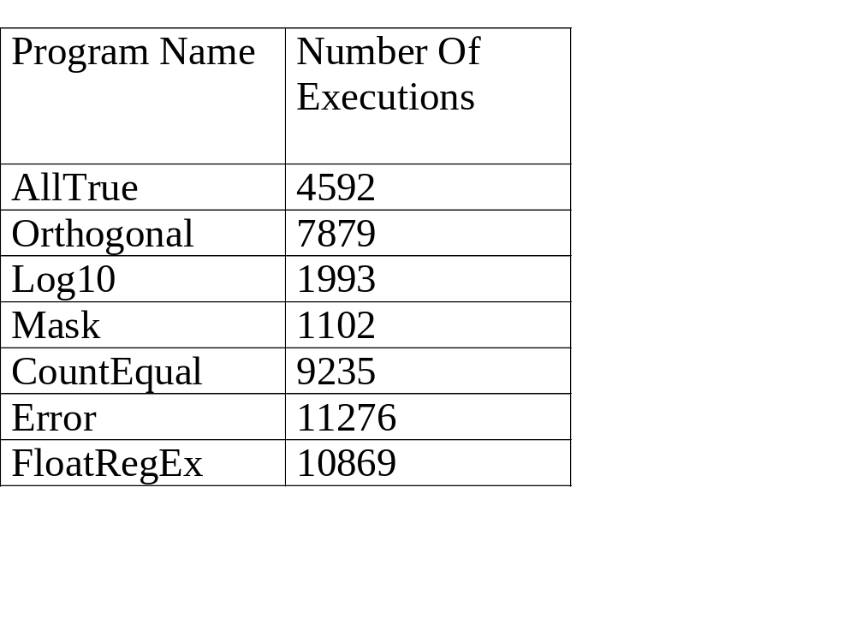
Some results

Slide 13
Applicability
Log10(int x) { //x in [1, 100,000]
… Mapping must be progressive
… to instrument intermediate data states.
double y = log10(x);
int k = ceiling(y); Proximity of rare intermediate data states
if (a[k] == 0) { and rare cost function values.
// k MUST BE 0 TO EXEC
5
4
k
3
2
1
0
1
10,000
100,000
x

Slide 14
Conclusions
Identified a kind of program for which it is difficult to generated test data, e.g. constant branch cost.
No scope to exploit methods that search control flow space.
Searching for data state diversity is a heuristic for escaping constant cost regions of the search space.

