Slide 1
Testing the Implementation of Business Rules using Intensional Database Tests
David Willmor and Suzanne M Embury
Informatics Process Group
School of Computer Science
The University of Manchester

Slide 2
What are we testing?
BUSINESS
Database System
Database
Application
Application
Application

Slide 3
Business Rules
Descriptions of the business’s policies and principles
IN TERMS OF BUSINESS CONCEPTS!!
  “no customer may have > 2 unpaid orders”
  “a customer is a gold customer if they have placed > 50 orders in the last year”
Rules are embedded within information systems
  Often as a combination of a software application and database
Rules are often company wide
Rules are integral to the operation of the business
  Often as a combination of a software application
Rules may be the result of external influences
  Market changes & Laws etc…
Rules often change!

Slide 4
Business Rules
We need to capture the business rules somewhere
Specification
Source Code
Database
Application
Test Cases
Business
Rules

Slide 5
Challenges for testing Business Rules?
Rule implementations spread amongst code units
  Also inside the database (stored procedures/triggers)
Omission is as important (or disastrous) as the incorrect implementation of a new rule
Rules may be violated by certain combinations of use cases
  In isolation they may not violate the rule
Rules cannot be tested in isolation – they interact with each other

Slide 6
Our approach
Test Suite
  Focussed on verifying the functionality of the software system
+
Business Rules
  Expressed in some form of rule language
→
New Augmented Test Suite
  Has the same testing functionality of the existing test suite
  Each test case will check that each business rule has been enforced correctly

Slide 7
Database Test Cases
Test case for database systems:
  P the program under test
  i the application input(s)
  o the application output
  DB_{i} initial database state
  DB_{o} output database state
Database state can be specified
  Extensionally
  Intensionally

Slide 8
Intensional Test Cases
Previous approaches specify the database state extensionally (i.e. DBUnit as XML files)
An alternative is to specify the state intensionally
  cf. {1, 2, 3, 4, 5} with { x | x ∈ N ∧ x ≥ 1 ∧ x ≤ 5 }
How can this be done for databases?
  Answer: constrained queries
      AT LEAST 1 :cn GENERATED BY
      SELECT custNo FROM customer
      WHERE customerClass = 'A' AND
      balanceMinimum < -200
Willmor & Embury ICSE 2006

Slide 9
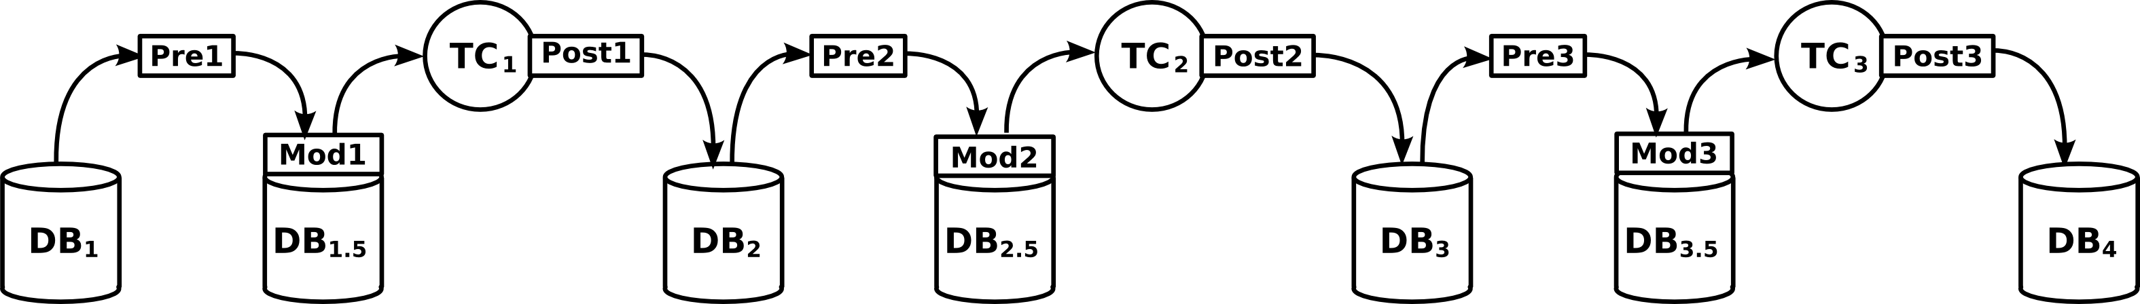
Executing an Intensional Test Suite

Slide 10
Why Intensional Test Cases
Tester does not need to specify entire database state
  Quicker to specify test cases
Declarative specification allows automatic database preparation
  Maximise number of test cases that can execute
All details of test case localised in single “document”
  Fewer embedded literals
  Less brittle in face of data/schema changes
A test can be executed against different database states without user involvement (Java-like view of test execution)
  Allows testing against realistic data volumes
  Certain faults may only be exposed when certain data values are present
  Test cases can be executed against copies of databases from customers
It is easy to automatically add new conditions to an existing test case

Slide 11
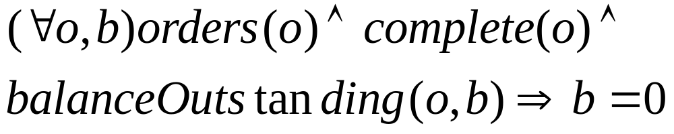
Checking a Business Rule
Business Rule:
SQL Query:
  SELECT * FROM orders WHERE complete = true AND balanceOustanding != 0;
Constrained Query:
  NO * GENERATED BY SELECT * FROM orders WHERE complete = true AND balanceOustanding != 0;

Slide 12
Example Augmented Test Case
public class OrderTest extends DatabaseTestCase {
public void testCompleteOrder() {
checkCondition("NO * GENERATED BY SELECT *
FROM orders WHERE complete = true AND
balanceOutstanding != 0;");
preCondition("ANY :orderID GENERATED BY SELECT
orderID FROM orders WHERE complete = ’false’");
OrderSystem.completeOrder(binding(":orderID"));
postCondition("EXACTLY 1 :oid GENERATED BY SELECT
orderID FROM orders WHERE orderID = :orderID AND
complete=’true’");
checkCondition("NO * GENERATED BY SELECT *
FROM orders WHERE complete = true AND
balanceOutstanding != 0;");
}
}

Slide 13
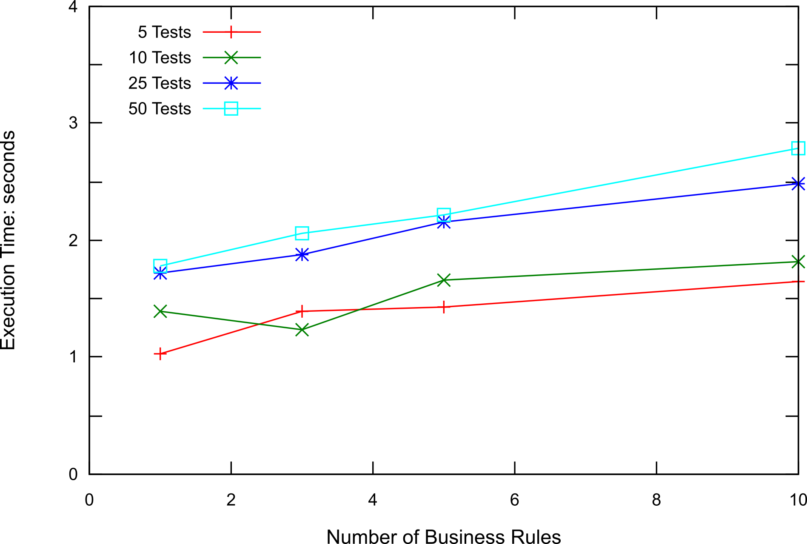
Cost of Augmenting the Test Suite

Slide 14
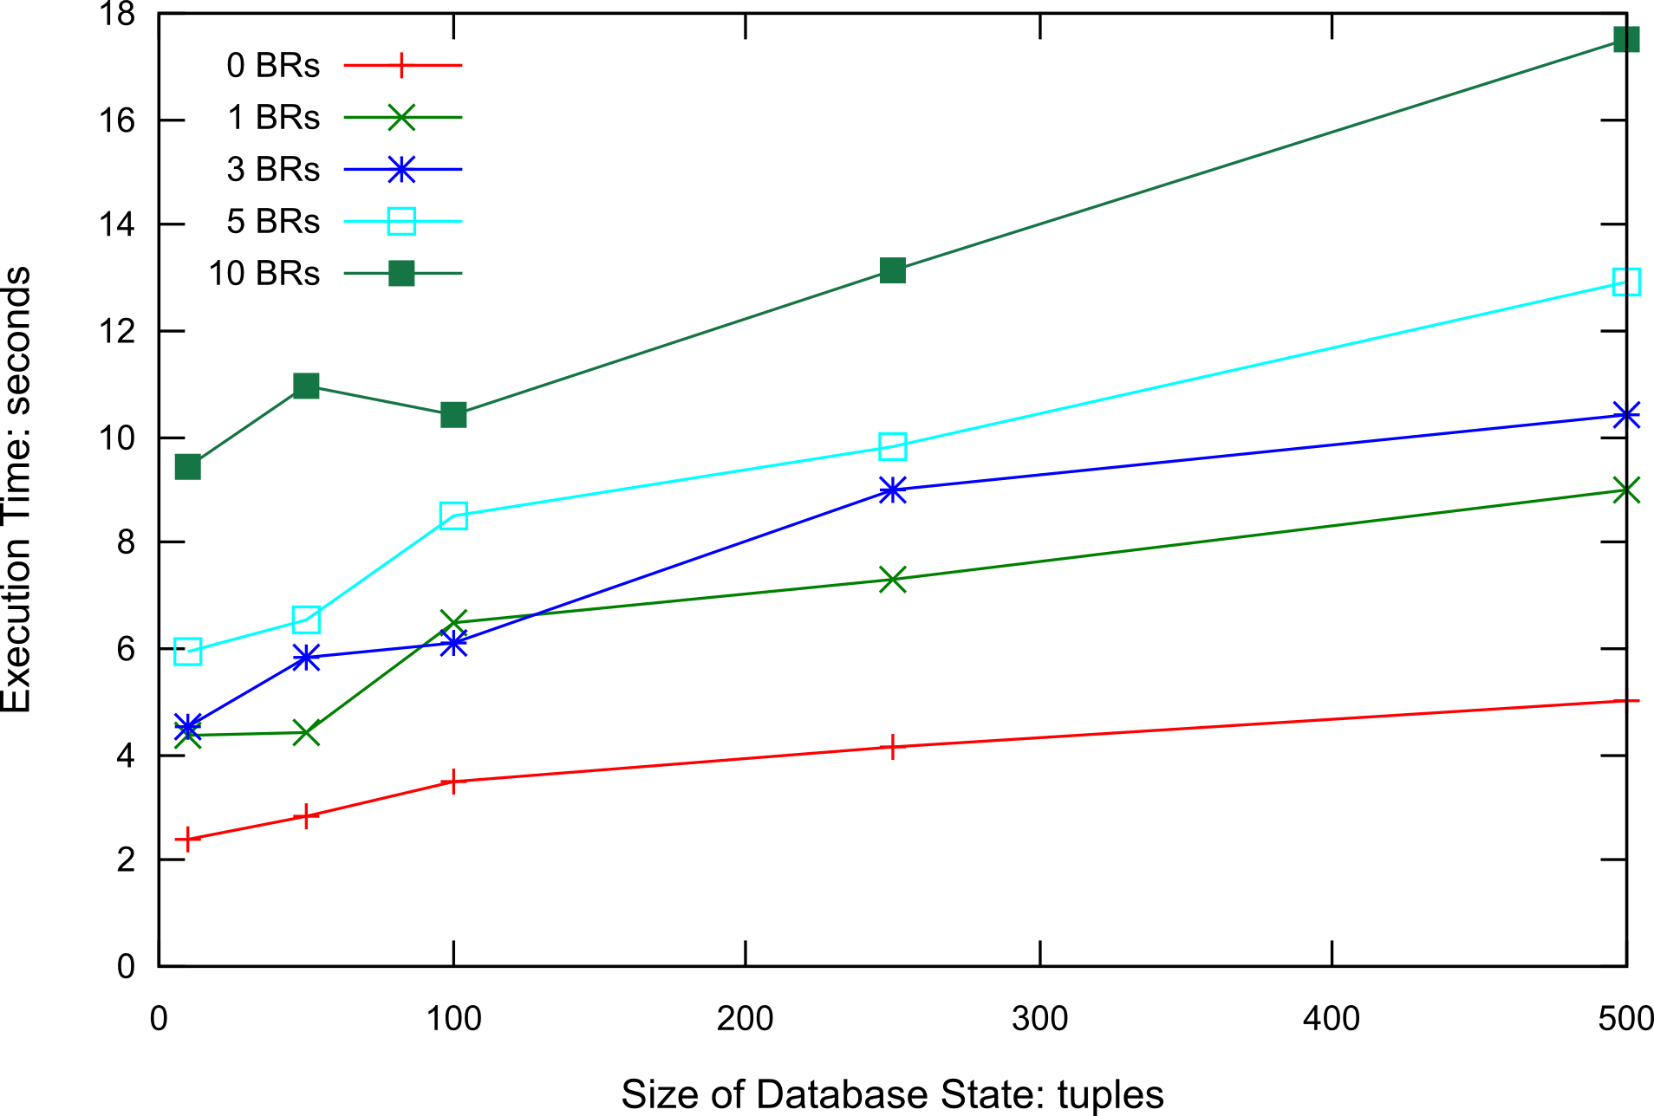
Execution Time of Test Suite

Slide 15
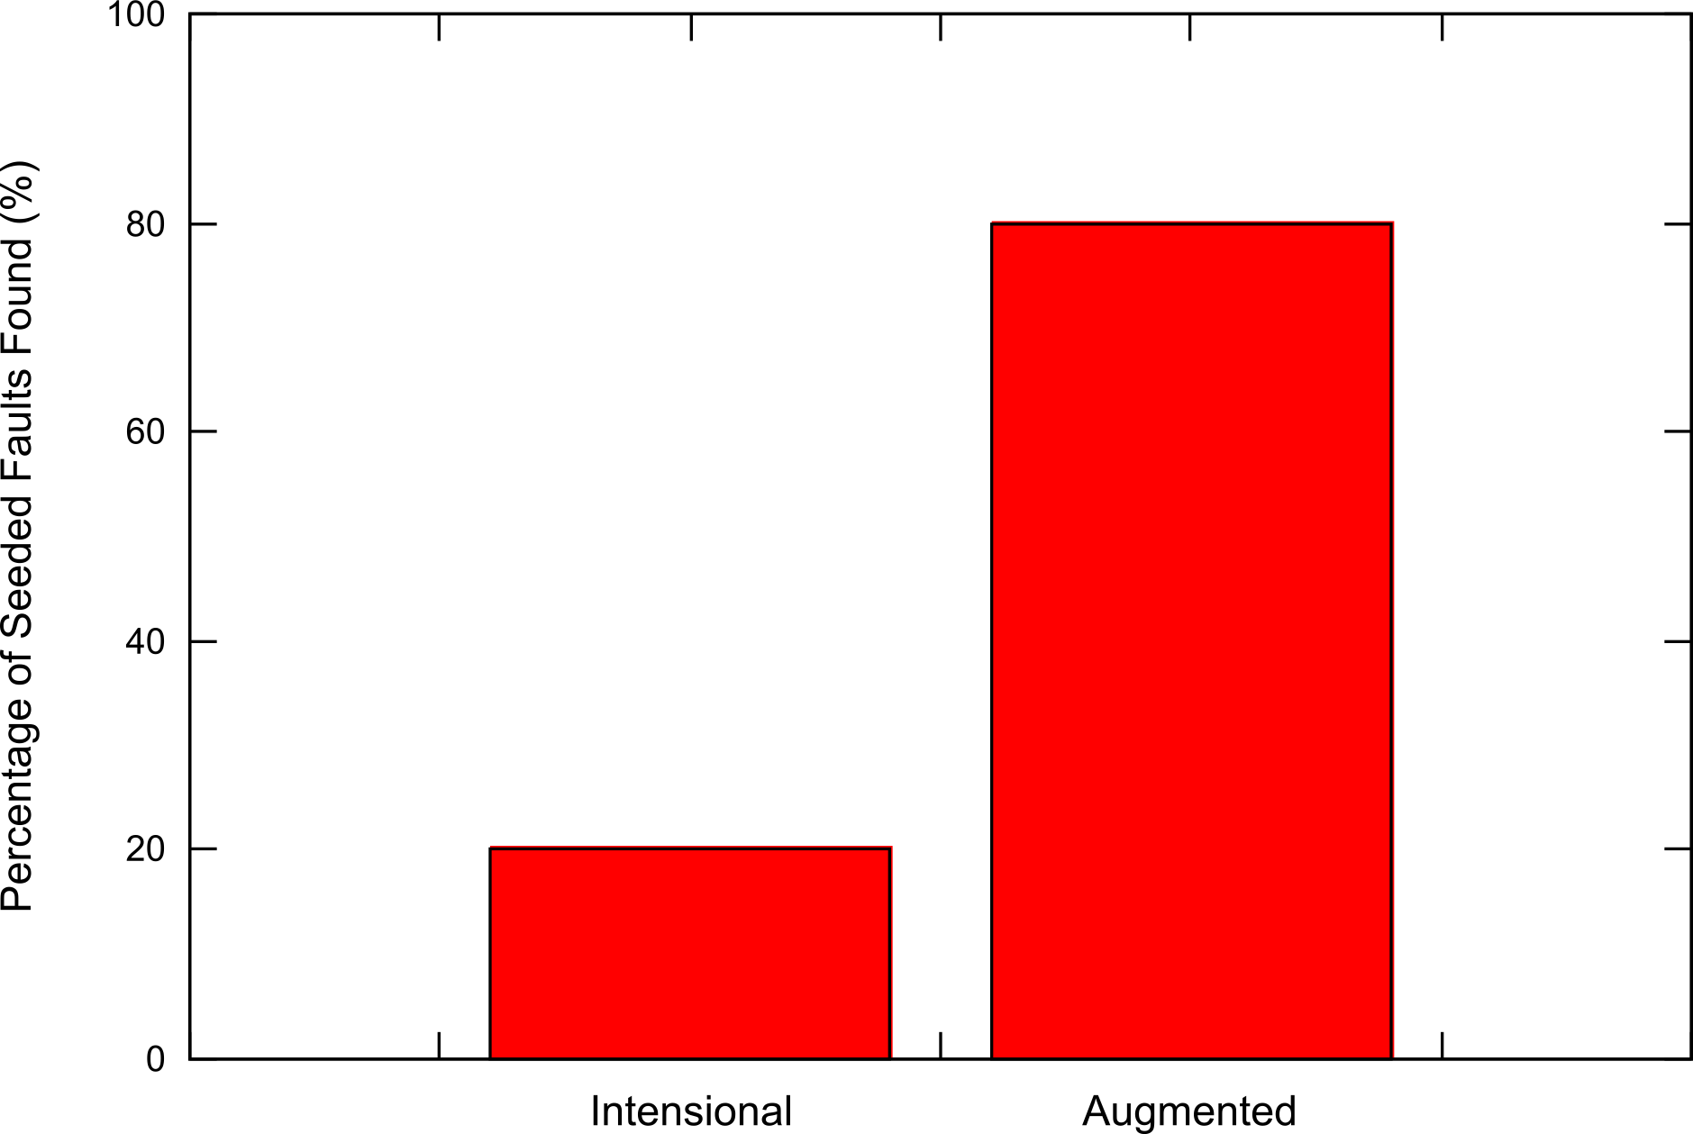
Fault Coverage

Slide 16
Improving Our Results
Reducing the number of business rules to check
  Can you isolate which rules a test may violate?
Reducing the scope of check-conditions
  Do you have to check the entire database?
Encourage rule failures
  Can you put the database into a valid state that may subsequently cause a rule to be violated?
Taking account of historical data
  Business Rules evolve and so data from the past may not enforce todays rules but may still be valid
Testing rule engines
More complicated business rules in different languages
  Plugin architecture of our tool makes this possible

