Slide 1
Generation of Conformance Test Suites for Compositions of Web Services Using Model Checking
TAIC PART. Testing: Academic & Industrial Conference.
Windsor (UK) - August, 2006
José García-Fanjul, Claudio de la Riva and Javier Tuya
University of Oviedo (Spain)
This work is supported by the Ministry of Science and Education (Spain) under the National Program for Research, Development and Innovation, projects IN2TEST (TIN2004-06689-C03-02) and REPRIS (TIN2005-24792-E).

Slide 2
Motivation
Investment in web services software is increasing [IDC, 2006]:
  Doubling from 2003 to 2004 (reaching $2,3 billion).
  (Expectedly) becoming $15 billion by 2009.
… but there are not many research works on testing web services software.

Slide 3
Do we need new testing methods for web services?
Testing web services software is different.
Some unresolved challenges (from [Zhang and Zhang, 2005] and [Canfora and Di Penta, 2006])
  The need to remotely test web services, with its associated cost.
  Lack of observability of the service code and structure.
  The ability to dynamically search and invoke web services.

Slide 4
The research hypothesis
A new method for generating test suites for compositions of web services is needed, with these characteristics:
  It will be static (no need to execute the software for obtaining the test cases).
  The selection of the test cases will be guided by adequacy criteria.
  The only required input will be a specification of the composition (BPEL).
    No knowledge about the partners particular behaviour.

Slide 5
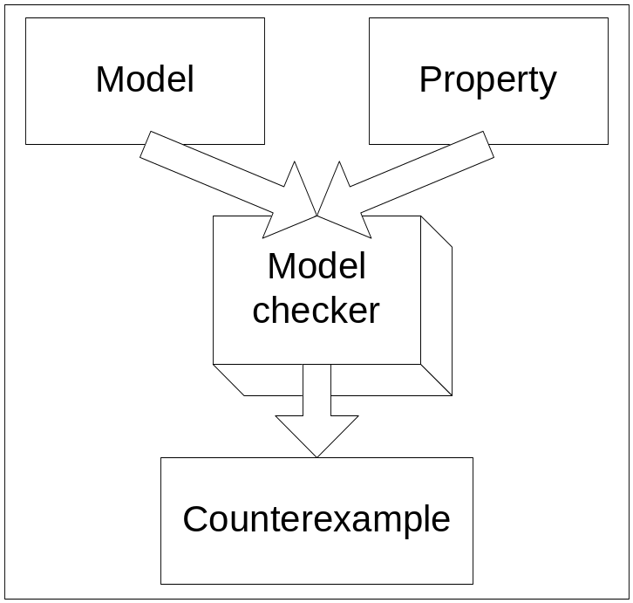
Background: Model checking
A formal verification technique to automatically ascertain if a property holds in a model.
1) A model must be
built for the system
we want to check.
2) Properties must
be specified.
3) The tool (model checker)
searches all the possible
states within the model.
4) If the property does
not hold, it provides
a counterexample
showing its violation.

Slide 6
Using model checking for software testing [Ammann, 1998]
To obtain a test case for a certain condition C.
The model checker
(for instance, SPIN)
is fed with a model
for the software…
2) …and a LTL formula
stating that C never
holds.
Model of the
software
C NEVER
holds
3) The output obtained
from the tool is a
counterexample in
which the software
fulfils C.
4) That counterexample can
be transformed into a test
case, as it describes an
execution of the software
in which the desired test
condition holds.
Counterexample (fulfilling C)

Slide 7
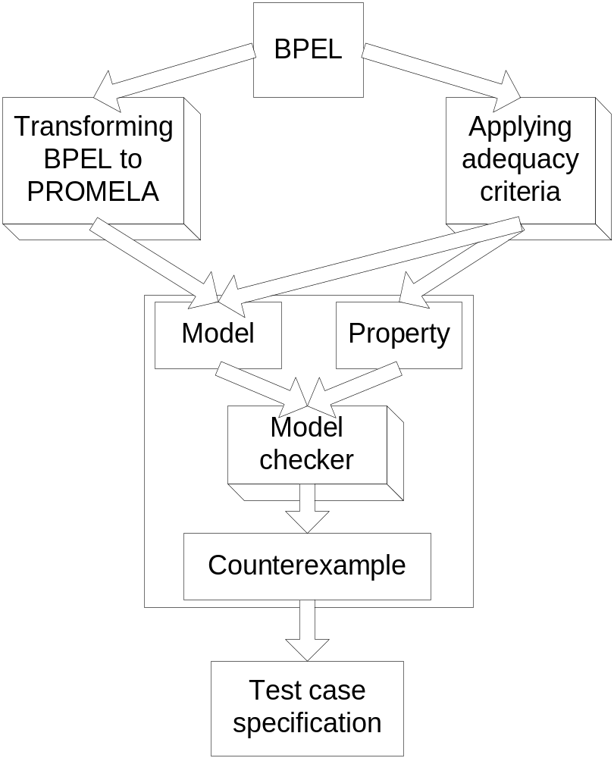
Overview of the method
2) Adequacy criteria will be used to select test requirements. So:
The PROMELA code will be instrumented to discern if an execution meets a requirement.
LTL properties will be properly constructed (the negation of the requirements).
A model will be
built from the BPEL
specification of the
business process.
3) The model checker
is executed, and
counterexamples
obtained.
4) Counterexamples are transformed into test cases specifications.

Slide 8
Preliminary work
The method has been applied to a sample composition called “loan approval”.
  Its objective is to conclude whether a certain request for a loan will be approved or not.
The chosen criterion has been a transition coverage criterion.

Slide 9
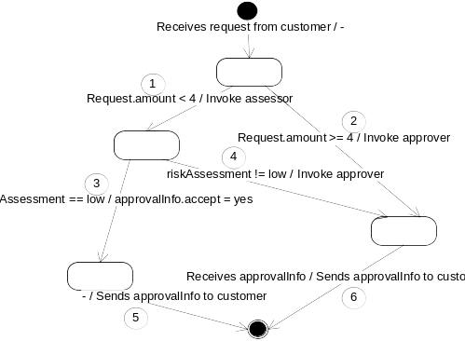
A representation of the “loan approval” sample composition.
3) Requests made for a large
amount of money or which
are evaluated by the assessor
as not having a low risk will
be examined by another
partner (“approver”).
1) Receives a request
from a partner
called “customer”
2) The “assessor”
Partner measures the
risk associated with
low amount requests.

Slide 10
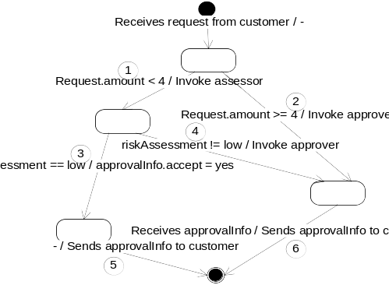
Test cases for the “loan approval” sample composition.
First test case: Transition #1
LTL property: [] (!tran1)

Slide 11
Extracting a test case from the counterexample.
0 :in run customer()
1 cus request.firstName
Proce Statement customer customer customer customer
1 cus request.name = und 0 0 3 0
1 cus request.amount = 3 0 0 3 3
0 :in run bpel_loan_appr 0 3 3 3
2 bpe f1a1==0 0 3 3 3
Proce Statement bpel_loa bpel_loa bpel_loa bpel_loa bpel_loa customer customer customer customer
0 :in run approver() 0 0 0 0 0 0 3 3 3
0 :in run assessor() 0 0 0 0 0 0 3 3 3
1 cus values: 1!3,3,3 0 0 0 0 0 0 3 3 3
1 cus BPEL_loanApprovalP 0 0 0 0 0 0 3 3 3
Proce Statement BPEL_loa bpel_loa bpel_loa bpel_loa bpel_loa bpel_loa customer customer customer customer
2 bpe values: 1?3,3,3 [3,3,3] 0 0 0 0 0 0 3 3 3
[...]
customer: request.amount = 3
customer: BPEL_loanApprovalPort_IN!request
bpel: request.amount<4
bpel: tran1 = true
bpel: loanassessor_riskAssessmentPort_IN!request
assessor: riskAssessment.risk = low
assessor: loanassessor_riskAssessmentPort_OUT! riskAssessment
bpel: tran3 = true
bpel: approvalInfo.accept = yes
bpel: tran5 = true
bpel: BPEL_loanApprovalPort_OUT!approvalInfo
bpel: bpel_ends = true
INPUTS
1. the customer makes a request for an amount of 3 (less than four)
2. the risk assessment from the assessor is low
EXPECTED OUTPUT
The reply to the customer is affirmative.

Slide 12
Test cases for the “loan approval” sample composition.
First test case: It covers transition #1… but also #3 and #5.
☺
☺
☺

Slide 13
Test cases for the “loan approval” sample composition.
First test case: It covers transition #1… but also #3 and #5.
Second test case: It covers transitions 2 and 6.
☺
☺
☺
☺
☺

Slide 14
Test cases for the “loan approval” sample composition.
First test case: It covers transition #1… but also #3 and #5.
Second test case: It covers transitions 2 and 6.
Third test case: It covers transition 4 (and also 1 and 6).
☺
☺
☺
☺
☺
☺

Slide 15
Expected contributions
Main contribution:
  Definition of a new method to obtain conformance test suites for compositions of web services. The method will rely on a model checking tool (SPIN) for obtaining the test cases specifications.
Specifically, research will address how to:
  Transform a BPEL specification to a PROMELA model.
  Instrument PROMELA code, considering the adequacy criteria.
  Construct LTL properties for the counterexamples to show sample executions of the model that meet the criteria.
  Automatically obtain a test suite specification from the counterexamples that SPIN provides.

Slide 16
Thank you for your attention
José García-Fanjul
jgfanjul@uniovi.es

