Slide 1



On the Testing Maturity of Software Producing Organizations
Mats Grindal
Jeff Offutt
Jonas Mellin

Slide 2
The study
Informal observations over 10+ years of consultancy indicate low test maturity
Goal: assess and document aspects of test maturity
Method: Interviews with test managers
Main questions:
  Is the testing in development projects guided by a test strategy?
  Which test case selection methods are used in the development projects?
  What is the knowledge of the test teams?
  When are testers involved in the projects?
  How much time is spent on testing in the development projects?

Slide 3
Investigated organizations
12 organizations
Explicit goal to have diversity in the sample
  Age: 5 – 50 years
  1 – 9 years since last reorganization
  15 – 2000 employees
  15 – 600 employed in development organization
  Parallel development: 2 – 100 products / versions
  Size of project: 3 – 50 calendar months
  Size of project: 1700 – 288000 person hours
  Type of products:
    6 web / mainframe / client server
    6 embedded / safety critical

Slide 4
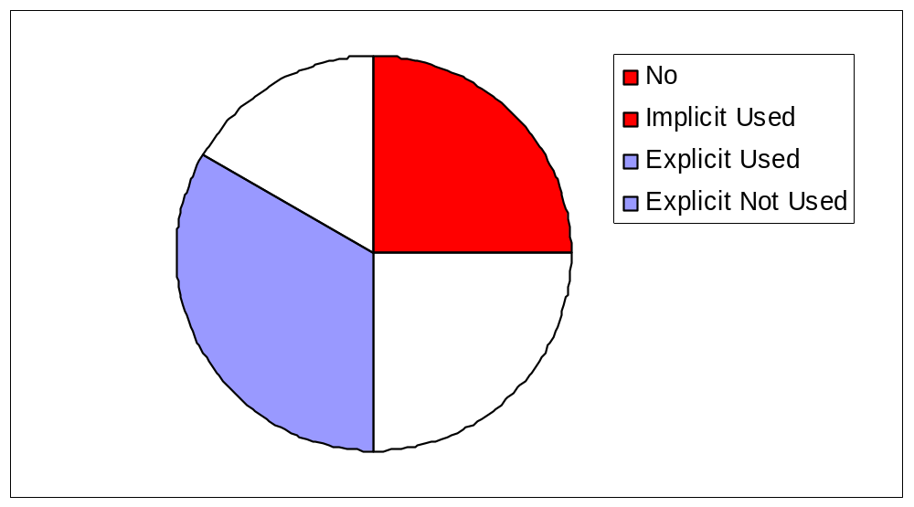
Use of test strategy
2
3
Only two test strategies
give advice on test case
selection methods
3
4

Slide 5
Use of test case selection methods
3 of 12 have structured use test case methods
  2 produce safety critical SW
  1 produce e-commerce SW
Not all organizations that produce safety critical software use test case selection methods
Used test case methods
  Equivalence Partitioning (2)
  Boundary Value Analysis (2)
  Cause-Effect Graphing (1)
  Combination Strategies (1)
  Requirements Coverage (1)

Slide 6
Test team knowledge
Three types of knowledge
  Test theory
  Product design
  Product usage / domain knowledge
  Ranks 1 – 5 (1:poor, 5:excellent)
Test theory
  Web + mainframe + CS (6): 2.83
  Safety critical + embedded (6): 3.67
Product design
  Web + mainframe + CS (6): 3.00
  Safety critical + embedded (6): 3.16
Domain knowledge
  Web + mainframe + CS (6): 4.5
  Safety critical + embedded (6): 3.00

Slide 7
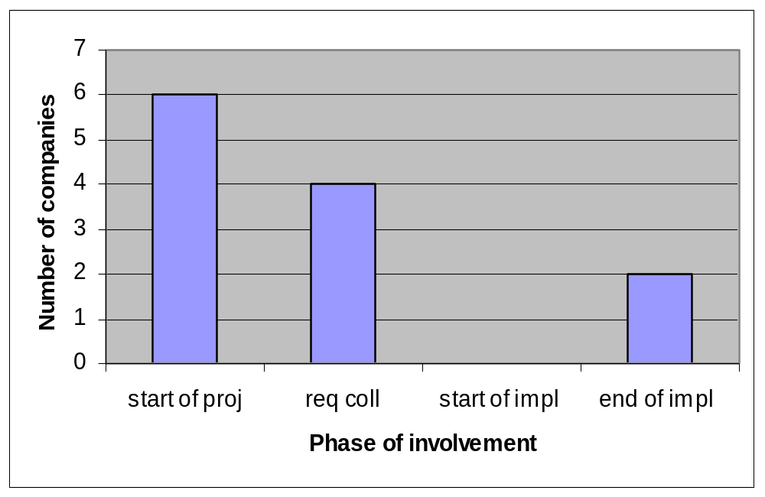
Moment of involvement
Both these make
Mainframe
Based
systems

Slide 8
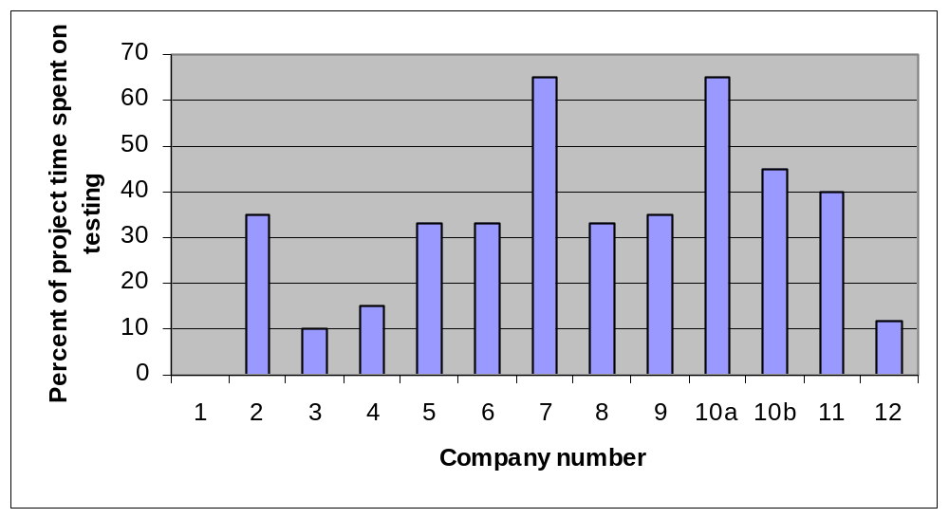
Relative effort spent on testing
No data

Slide 9
Relative effort spent on testing
Two types of projects:
Little new development =>
lots of regression testing
Much new development =>
relatively less testing
No data

Slide 10
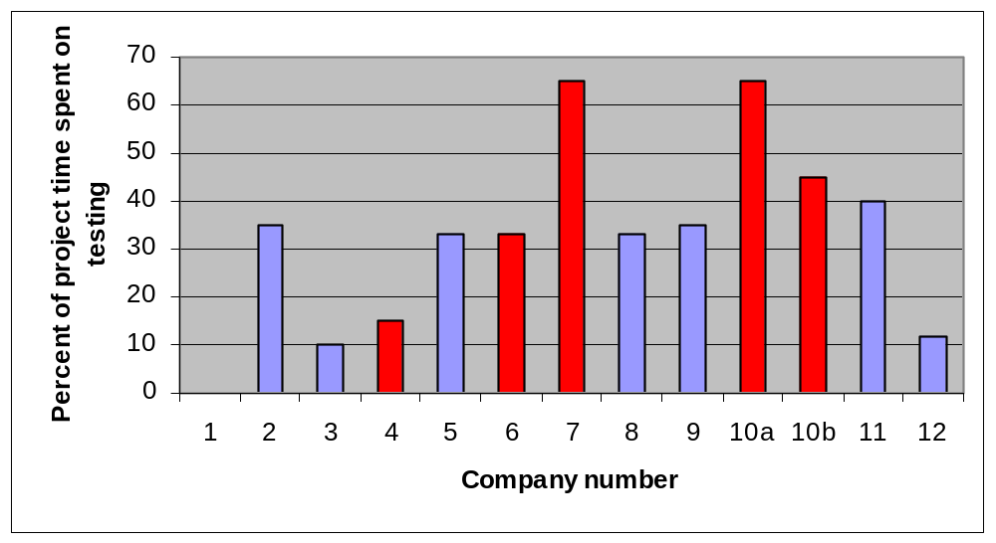
Relative effort spent on testing
No data
Safety critical products

Slide 11
Time consumption of testing phases
Data only available for nine organizations
Same two organizations with
  Advice on test case selection usage in test strategy
  Highest test time consumption
  Even distribution of test time across phases
% of total
test time
general patterns
7 orgs
2 orgs
50
Pre Comp Int Sys Acc
Exec Test Test Test Test

Slide 12
Main observations
Our results generally agree with two similar investigations, one in Australia and one in Canada
Test strategy and structured use of testing methods not widely applied
Testers start working early and are judged to be fairly knowledgeable
On average 35% of project time is spent on testing but wide variation
Most of the testing effort is spent in system testing

Slide 13
Discussion, and future work
An explicit test strategy seems to help organizations in general
  Correlation: Yes
  Causality: ?
The type of project affects the amount of testing in a project (e.g., new features vs maintenance)
  Is it relevant to talk about relative test time consumption?
Hard to improve
  Good testers (in particular in domain knowledge) compensate for lack of structure and organization
  Metrics are not collected so it is hard to estimate potential improvements
  Products are already good enough to generate profit.
  i.e., improved quality of products through testing is not always an economical driver

Slide 14
Benefits
for industry
  Launch a metrics program
  Educate upper management
  Embrace new research
  Provide opportunities for case studies
for academia
  Different organizations have different needs
  Change has to come in small steps (James Miller yesterday)
  Further investigations
    Role of automation, organization, test tools, development environment etc…

