Slide 1
The effectiveness of refactoring based on a compatibility testing taxonomy and a dependency graph
Steve Counsell and Robert Hierons, Brunel University,
Rajaa Najjar, George Loizou and Youssef Hassoun Birkbeck, London
TAIC PART (Cumberland Lodge 31st August 2006)

Slide 2
Introduction
A key software engineering discipline to emerge over recent years is that of ‘refactoring’
  a change made to software to improve its structure without necessarily changing the program’s semantics
Benefits include reduced complexity and increased comprehensibility of the code
‘Refactoring is the reversal of software decay’
72 refactorings proposed by Fowler (1999):
  Each has specific mechanics:
    to ‘rename a method’ so that the purpose of the method is expressed more clearly, the method’s name is changed and all references to the originally-named method are changed also

Slide 3
Introduction (cont.)
Each requires testing to be undertaken after each step
  For ‘rename method’, we also have to consider the case of any subclasses or super class influences
  Testing required after each logical step
For more complex refactorings, there are more steps in the mechanics, more cases to consider and more testing
The real pain:
  The mechanics of undertaking refactoring X require the use of refactoring Y, which itself requires the use of refactoring Z…..
Research question:
  How can we understand these inter-relationships, with specific focus on ‘minimising’ the testing burden?

Slide 4
van Deursen and Moonen’s (VD&M) Taxonomy
Refactoring should preserve program semantics
VD&M’s stance on this:
  “Ideally, this is verified by ensuring that all the tests pass before and after a refactoring. In practice, it turns out that such verification is not always possible: some refactorings restructure the code in such a way that tests can only pass after the refactoring if they are modified.”
They suggest a taxonomy to describe which refactorings preserve tests and which do not; initially described by two categories:
  Incompatible: The refactoring destroys the original interface. All tests which rely on the old interface must be adjusted in some way to accommodate the new interface.
  Backwards Compatible: The refactoring extends the original interface. The tests keep running via the original interface and will pass if the refactoring preserves tested behaviour.
In fact, four categories can be identified…….

Slide 5
The VD&M Taxonomy (cont.)
Compatible: Refactorings that do not change the original interface (Type B refactorings)
Backwards Compatible: Refactorings that change the original interface and are inherently backwards compatible since they extend the interface (Type C refactorings)
Make Backwards Compatible: Refactorings that change the original interface and can be made backwards compatible by adapting the old interface (Type D refactorings)
Incompatible: Refactorings that change the original interface and are not backwards compatible because they may make such considerable changes that they are not compatible in any sense (Type E refactorings)

Slide 6
The VD&M Taxonomy (cont.)
Type B refactorings (Preferable)
Change Bi-directional Association to Unidirectional, Replace Magic Number with Symbolic Constant, Replace Nested Conditional with Guard Clauses, Consolidate Duplicate Conditional Fragments, Replace Conditional with Polymorphism, Replace Delegation with Inheritance, Replace Inheritance with Delegation, Replace Method with Method Object, Remove Assignments to Parameters, Replace Data Value with Object, Introduce Explaining Variable, Replace Exception with Test, Change Reference to Value, Split Temporary Variable, Decompose Conditional, Introduce Null Object, Preserve Whole Object, Remove Control Flag, Substitute Algorithm, Introduce Assertion, Extract Class, Inline Temp.
Lots of ‘Replacing’, some ‘preserving’ and ‘substituting’
Plenty of raw code refactorings

Slide 7
The VD&M Taxonomy (cont.)
Type C refactorings (Not too bad)
Consolidate Conditional Expression, Replace Delegation with Inheritance, Replace Inheritance with Delegation, Replace Record with Data Class, Introduce Foreign Method, Pull Up Constructor Body, Replace Temp with Query, Duplicate Observed Data, Self Encapsulate Field, Form Template Method, Extract Super class, Extract Interface, Push Down Method, Push Down Field, Extract Method, Pull Up Method, Pull up Field.
Still some ‘Replacing’ refactorings
Of interest is the high number of inheritance-based refactorings in this category
  Tend to stick together

Slide 8
The VD&M Taxonomy (cont.)
Type D refactorings (Not a disaster)
Change Unidirectional Association to Bi-directional, Replace Parameter with Explicit Methods, Replace Parameter with Method, Separate Query from Modifier, Introduce Parameter Object, Parameterize Method, Remove Middle Man, Remove Parameter, Rename Method, Add Parameter, Move Method.
A strong emphasis on parameter-based manipulations
  The addition or removal of parameters easily masked by a wrapper on the original code

Slide 9
The VD&M Taxonomy (cont.)
Type E refactorings (Bad news)
Replace Constructor with Factory Method, Replace Type Code with State/Strategy, Replace Type Code with Subclasses, Replace Error Code with Exception, Replace Subclass with Fields, Replace Type Code with Class, Change Value to Reference, Introduce Local Extension, Replace Array with Object, Encapsulate Collection, Remove Setting Method, Encapsulate Downcast, Collapse Hierarchy, Encapsulate Field, Extract Subclass, Hide Delegate, Inline Method, Inline Class, Hide Method, Move Field.
Of note is the high number of encapsulation-based refactorings
  The power of encapsulation as an OO concept can work both-ways

Slide 10
VD&M in perspective
While useful and interesting, what is the influence of a nested refactoring?
  For example, the ‘Introduce Parameter Object’ refactoring, applicable when a group of parameters are lumped to form an object, requires the use of the ‘Add Parameter’ refactoring
  Both are of Type D (which is not a particular problem)
  The Extract Class refactoring (Type B) must use the ‘Move Field’ refactoring (Type E) – this is a problem:
    ‘Use Move Field on each field you wish to move’ and ‘Use Move Method to move methods over from old to new’.
We thus need to re-appraise each of the Type B,C, D and E refactorings previously stated

Slide 11
A Dependency Graph
To assess the inter-relationships between refactorings, we developed a dependency graph showing which refactorings used other refactorings
The graph took one person three months to develop and required all seventy-two refactorings to be parsed, analyzed and checked
From the graph so produced, we could then determine:
  Which Type B refactorings only used other Type B refactorings?
  Which Type C refactorings only used other Type C refactorings and/ore Type B refactorings?
  Which Type D refactorings used only combinations of Type D, Type C and Type B refactorings?
We could also eliminate any refactoring for which a ‘chain’ of refactorings emanate and hence invalidate the three questions

Slide 12
The VD&M Taxonomy, Re-visited
Type B refactorings (the eight survivors)
  Consolidate Duplicate Conditional Fragments, Replace Inheritance with Delegation, Remove Assignments to Parameters, Introduce Explaining Variable, Replace Exception with Test, Introduce Null Object, Substitute Algorithm, Inline Temp.
We can use these refactorings without fear of having to use any C,D or E type refactorings
Many of these are ‘pure code’ refactorings
Type C refactorings (the eight survivors)
  Replace Inheritance with Delegation, Self Encapsulate Field, Extract Interface, Push Down Method, Push Down Field, Extract Method, Pull Up Method, Pull Up Field.
We can use these refactorings without fear of having to use any D or E type refactorings
Perhaps inheritance isn’t that bad after all (arguably, 6 fall into this category)

Slide 13
The VD&M Taxonomy, Re-visited
Type D refactorings (the ten survivors):
  Change Unidirectional Association to Bi-directional, Replace Parameter with Explicit Methods, Separate Query from Modifier, Introduce Parameter Object, Parameterise Method, Remove Middle Man, Remove Parameter, Rename Method, Add Parameter, Move Method.
Some of these are ‘core’ refactorings
  Commonly used and ‘sinks’ in the dependency graph
We don’t care about Type E refactorings!
  Whatever refactorings they use

Slide 14
Implications of the results
Try to choose Type B refactorings from the revised list
  Within Type B refactorings
    Orphan refactorings
  Then Type C, then Type D from the respective revised lists
Avoid Type E refactorings
We have assumed that each Type B,C or D Type refactoring have equivalent complexities in terms of mechanics:
  Choose Type B refactorings with the least complex mechanics
Of course, the developer may have no choice as to which refactoring they would like to undertake
  In which case our advice may be pointless

Slide 15
Two follow-up studies….

Slide 16
Empirical Study
Built a tool that automatically extracted refactoring data from seven Java open-source systems of different application types.
For each release of these systems:
  Parsed the Java source code
  Saved information about fifteen refactorings
  Used heuristics to determine if any of those fifteen refactorings had been applied
Plotted the data thus extracted

Slide 17
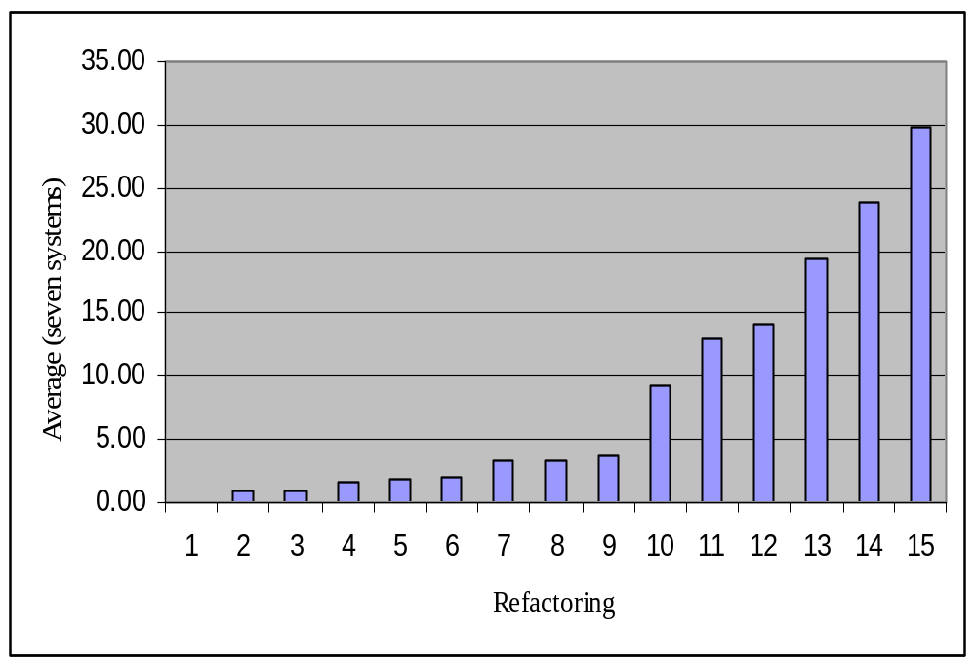
1) Encapsulate Downcast
2) Push Down Method
3) Extract Subclass
4) Encapsulate Field
5) Hide Method
6) Pull Up Field
7) Extract Super class
8) Remove Parameter
9) Push Down Field
10) Pull Up Method
11) Move Method
12) Add Parameter
13) Move Field
14) Rename Method
15) Rename Field.

Slide 18
Type | Applicable Refactorings
B | None
C | Pull Up Method (10-65), Push Down Field (9-26), Extract Superclass (7-23), Pull Up Field (6-14), Push Down Method (2-6),
D | Move Method (11-88), Add Parameter (12-99), Rename Method (14-167), Rename Field (15-200), Remove Parameter (8-24),
E | Move Field (13-135), Hide Method (5-13), Encapsulate Field (4-12), Extract Subclass (3-6), Encapsulate Downcast (1-0)
Perhaps developers do avoid
Type E refactorings!

Slide 19
The VD&M Taxonomy (cont.)
Type B refactorings (Preferable)
Change Bi-directional Association to Unidirectional, Replace Magic Number with Symbolic Constant, Replace Nested Conditional with Guard Clauses, Consolidate Duplicate Conditional Fragments, Replace Conditional with Polymorphism, Replace Delegation with Inheritance, Replace Inheritance with Delegation, Replace Method with Method Object, Remove Assignments to Parameters, Replace Data Value with Object, Introduce Explaining Variable, Replace Exception with Test, Change Reference to Value, Split Temporary Variable, Decompose Conditional, Introduce Null Object, Preserve Whole Object, Remove Control Flag, Substitute Algorithm, Introduce Assertion, Extract Class, Inline Temp.
Lots of ‘Replacing’, some ‘preserving’ and ‘substituting’
Plenty of raw code refactorings

Slide 20
Code Smell Analysis
What is a code smell?
  structures in the code that ‘sometimes scream for’ the possibility of refactoring (c.f. ‘stenches’)
Fowler specifies 22 code smells
Example: Long parameter list
    Signify constant change
    Difficult to understand
    Difficult to use
To remedy ‘apply deodorant’ this smell, we may apply a set of refactorings
Question: Which of these 22 smells can be remedied by using only refactorings drawn the revised Type B, C and D lists.

Slide 21
Bad Smell (BS) | Refactorings Remedies | Type Profile
Alternative Classes with Different Interfaces | Rename Method, Move Method | D, D
Refused Bequest | Replace Inheritance with Delegation | B/C (remedy appears in both categories)

Slide 22
Bad Smell (BS) | Refactorings Remedies | Type Profile
Primitive Obsession | Replace Data Value with Object, Extract Class, Introduce Parameter Object, Replace Array with Object, Replace Type Code with Class, Replace Type Code with Subclasses, Replace Type Code with State/Strategy | B, B, D, E, E, E, E
Data Class | Move Method, Encapsulate Field, Encapsulate Collection | D, E, E

Slide 23
Some threats…..
We still don’t know if developers actually refactor consciously
How can we expect to manage OSS development?:
  Do our results confirm that OSS developers avoid high-level (inheritance-based) refactorings?
  Are we being too naïve wrt testing efficiency and strategies?
  Do developers always just go for the most smelliest smells rather than weigh up the impact that will have on testing effort?

Slide 24
Conclusions/Future work
What use is the research to developers?:
From a testing perspective:
  Choose individual refactorings carefully
    You may end up with a chain
  Choose the eradication of smells carefully
    Your testing effort required may be the worst smell
Future work:
  Extending analysis of the relationship types ‘may’ and ‘must’
  Refactoring dependency list analysis
    Which refactorings are ‘used’ or ‘used by’ other refactorings

Slide 25
Thanks for listening!

