Slide 1

Empirical Assessment of
Test-First Approach
Liang Huang and Mike Holcombe
Department of Computer Science, University of Sheffield

Slide 2
Background
Research Questions
The Pilot Study
Future research

Slide 3
Background
Research Questions
The Pilot Study
Future research

Slide 4
Background (1/3)
Problems with Traditional Method
1. Bureaucratic
2. The inflexible requirements specifications
Agile Method
For example, Feature Driven Design (FDD), CrystalClear, eXtreme Programming (XP), and Test-Driven Development (TDD)

Slide 5
Background (2/3)
Test First and Test Last
Story
Story
Implementation
Write Tests
Write Tests
Implementation
Run test cases
Rework
Run test cases
Rework
All pass?
All pass?
No
No
Yes
Yes
Next Story
Next Story
Test Last
Test First
How Test Last and Test First work respectively

Slide 6
Background (3/3)
Motivation of Research
To find evidence which of these ways of developing software are actually better and, perhaps more importantly to find out why the better ones are better

Slide 7
Background
Research Questions
The Pilot Study
Future research

Slide 8
Research Questions
1. Can Test First Approach help programmers obtain higher productivity?
2. Which group of subjects is more likely to deliver software of higher quality?
3. Do programmers using Test First make more effort on testing?
4. Are there any relationships between the testing effort, productivity and software quality?
5. Does Test First help to reduce the effort made on coding?
6. Does the conformance to methodology (Test First or Test Last) help programmers obtain higher productivity and software quality?
7. Does Test First approach help programmers to begin their work earlier?
8. In what situation Test First approach is the most effective?

Slide 9
Research Questions
1. Can Test First Approach help programmers working in teams obtain higher productivity?
2. Which group of subjects is more likely to deliver software of higher quality?
3. Do programmers using Test First make more effort on testing?
4. Are there any relationships between the testing effort, productivity and software quality?
5. Does Test First help to reduce the effort made on coding?
6. Does the conformance to methodology (Test First or Test Last) help programmers obtain higher productivity and software quality?
7. Does Test First approach help programmers to begin their work earlier?
8. In what situation Test First approach is the most effective?

Slide 10
Background
Research Questions
The Pilot Study
Future research

Slide 11
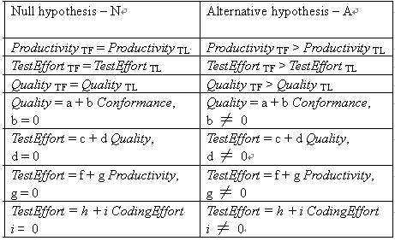
Pilot Study (1/8)
Formalized Hypotheses for the first 6 research questions

Slide 12

Pilot Study (2/8)
Contexts: Sheffield Software Engineering Observatory
Subjects: 29 second year undergraduates major in
computer science
Language: Java and PHP
Apparatus: PHP 5.0, Eclipse, CVS and JUnit
Goal system: 3 different projects of small to middle size, one of which is based on an existed system
Procedure
1. Assigned to Test-First group & Test-Last group
2. Training courses
3. Meeting with external clients for the requirements capture
4. Software Development
5. Requirements changed in the first 5 weeks, and then were fixed
6. Software delivery
7. Assessment and prize awarding

Slide 13
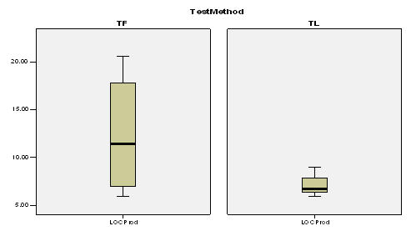
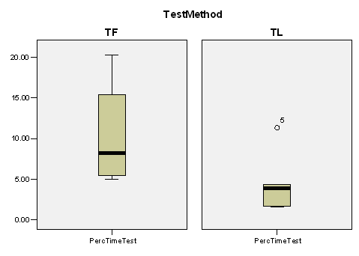
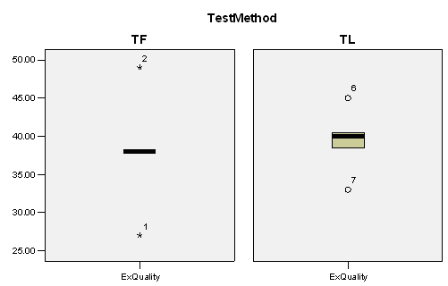
Pilot Study (3/8)
Data analysis
More effort was made on testing in Test First teams
Neither Test First teams were more productive nor they deliver software of higher external quality
Box plots for
Productivity, Test Effort, and External Quality

Slide 14
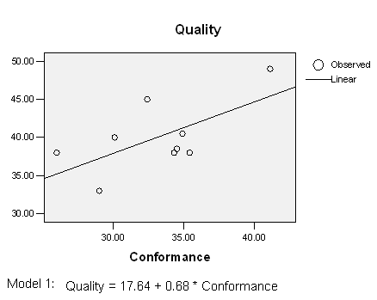
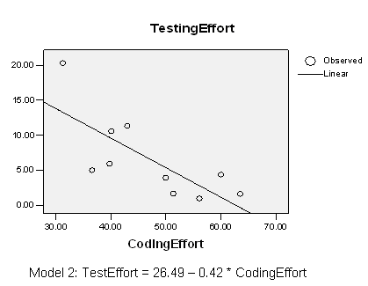
Pilot Study (4/8)
Data Analysis
Two Models were built
Correlations between TestEffort, Productivity, and Quality are not significant

Slide 15
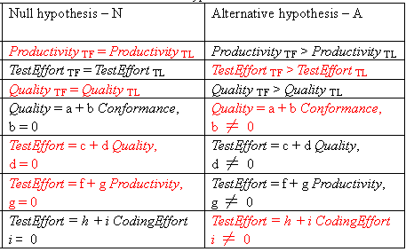
Pilot Study (5/8)
Summary

Slide 16
Pilot Study (6/8)
Interpretation
TestEffort TF > TestEffort TL
More tests
Not experienced subjects
Requirements change

Slide 17
Pilot Study (7/8)
Interpretation
Quality = 17.64 + 0.68 * Conformance
Conformance of methodology helps programmers write code of higher quality and prevent new errors from being introduced
Subjects swap from one method to another did worse

Slide 18
Pilot Study (8/8)
Interpretation
TestEffort = 26.49 – 0.42 * CodingEffort
Doing more testing reduces the amount of rework

Slide 19
Background
Research Questions
The Pilot Study
Future research

Slide 20
Future Research
The assessment scheme for methodology conformance and external quality will be demonstrated
Data will be collected from the repository and analyzed to obtain more data points
New tools will be developed and put into use in future experiments
Further studies will be conducted in the Genesys to find answers to research questions that are not answered in pilot study

Slide 21
Thanks for listening

