Slide 1
Use Case-Based Acceptance Testing of a Large Industrial System: Approach and
Experience Report
Dr. S. Roubtsov,
Ir. P. Heck
TAIC PART 2006
Cumberland Lodge, Windsor
August, 31 2006
Notes:
My name is Serguei Roubtsov I’m from Laboratory for Quality Software which is an activity of two universities in the Netherlands: TU/e and the Univ. of Nijmegen.
Our lab participates in industrial projects which we use in our research in the area of software verification, validation and testing where we develop new approaches, methods and tools.
In this presentation I would like to present the results of one of such projects namely….
In this project LaQuSo was involved since spring 2004 till summer 2005.

Slide 2
Outline
E-Ticketing System for the Netherlands
LaQuSo Assignment
Field Survey
Approach
Test Preparation
Test Execution
Conclusion: Lessons Learned
Notes:
First of all, let me outline my presentation.
In the beginning I would like to say a few words about the e-ticketing system fro the Netherlands itself, next I will talk about…, then I will discuss the results of …

Slide 3

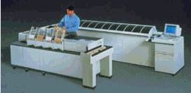
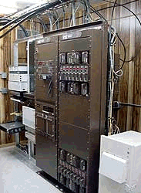

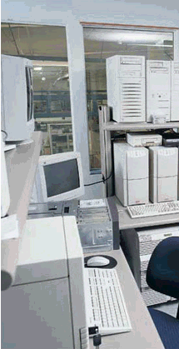


Dutch E-Ticketing System: overview
Initialization &
Personalization
Centre
Central
Clearing
House
System
Central
Processing
System
of
Public
Transport
Organization
Bank
Station
Processing
System
E-ticket
Front-end
Device
- main transaction flows
Notes:
Purpose
Level 0: smart card : e-purse (‘easy trip’) and products (types, IO-products). Personal cards: personal data, bank account info, auto-reload
Level 1: front-end devices: check-in (out) gates, Point-Of-Sales Terminals (POST), Ticket-Vending-Machines (TVM), possibly other: small merchants’ shops, parking meters, etc;
Levels 2-3: station and central processing systems.
Level 4: Central Back Office (CBO). CCHS and IPC

Slide 4
Dutch E-Ticketing System: architecture
Bank
Central Back Office
Central Clearing House
Clearing Operator (CO) &
Card Issuer (CI)
Initialization and Personalization Center
Level 4
CPS PTO 1
…
CPS PTO n
…
…
Level 3
SPS
…
SPS
SPS
…
SPS
…
…
…
…
Level 2
Front-end devices
Front-end devices
…
…
Level 1
E-tickets - smart cards
Level 0
card usage transaction flow settlement reports
blacklists bank interface files
Notes:
Multilevel architecture
Transaction flow through secure private network.
Usage transactions
Initialisation transactions and other types of non financial transactions
Blacklisting
Bank interface
Clearing and settlement reports
Transparent transactions: only level 4 stores the data and performs day-time validation and day-end clearing and settlement
The subject of this project was the CBO system only; the other levels and the entire system were tested separately during FAT, integrations tests, so-called end-to-end dress rehearsal. LaQuSo took part in some of these activities as well but they were not part of our initial assignment and they are out of the scope of the current presentation

Slide 5
Involved Parties
Customer:
Trans Link Systems (TLS): NS (national railway), Connexxion, GVB (Amsterdam), RET (Rotterdam), HTM (The Hague) ~90% public transport market
Supplier:
East West Consortium (EW): Accenture, Thales, Vialis, MTR & Octopus Cards Ltd -Hong Kong prototype system
Supplier was responsible for Site Acceptance Testing
Notes:
The participants of the project were namely:
…
According to the CBO contract part of TLS activities including system factory (FAT) and site acceptance testing (SAT) were outsourced to EW. This implied all the phases from test planning and preparation to test execution and result interpretation. So, the developers of the system were assigned to perform its final acceptance effort.
This approach has its drawbacks. The suppliers have both an interest in supplying a properly working system which satisfies the customer as well as meeting the deadlines within budget.

Slide 6
LaQuSo Assignment
To take part in SAT of CBO (Level 4):
to participate in SAT planning
to validate completeness and correctness of requirements coverage by tests
to assess test specification and reporting documents
to witness tests and evaluate their results
Notes:
So, TLS invited us to take part in the SAT as an independent third party …

Slide 7
Field Survey: User Requirements Sources
Contract
Business rules document
Conceptual design
High level system design
Processes supporting the system
Some of the documents were not finalized
Requirements were not listed formally
Notes:
It was discovered that no user requirements were formally listed at the moment.
Moreover, a number of the design documents had not been completely finalized. The reason for this was that the project was still an evolving organism, with many stakeholders having different interests and responsibilities involved from both sides. This especially concerned so-called ”Dutch delta” - the specifics of the Dutch e-ticketing system against its Hong Kong prototype:
there were such differences as extensive usage of PTO products with a card, certain legal requirements regarding electronic money circulation in the Netherlands, data privacy legislation, and also some minor issues like for instance the switch to daylight saving time, etc.

Slide 8
Requirements for Testing
Use case-based approach
System and processes had to be tested separately (two testing teams)
No connection with levels 0 to 3 during testing (use of simulators)
Compliance with IEEE 829 standard
Notes:
Regarding a testing approach, it was agreed that a use case based approach had to be implemented. What was meant by that, was that test cases had to be designed according to system usage scenarios, triggered mostly by the events at the Level 0/Level 1 interface. That was all: no further elaboration was made.
Also, it was settled among the parties that the system (software) and operations (supporting human-machine processes) would be tested separately.
Finally, during the CBO SAT no connection with lower levels was planned to be available.
The IEEE 829 standard was mandated as a basis for software test documentation.

Slide 9
Results of Field Survey
Testing approach needed to be elaborated
User requirements had to be retrieved from the project documentation and listed formally
Changes in documentation would lead to multiple iterations of requirements adjustment and tracing
Notes:
Here are the quite obvious conclusions we made after the field survey…

Slide 10
Approach: Problem statement
Little data in literature as to how to apply use case based approach to large scale systems
  use cases would contain very coarse steps: how to convert them into precise test cases?
  almost all triggers and some of the steps were at levels 0 to 3 (out of scope): how to adjust them to level 4?
  could be too many test cases with similar control flows: how to reuse test procedures?
Notes:
APPROACH
Use case based approach is applicable for SAT because it provides a view on the behaviour of a system from the user’s perspective and acceptance testing is a process of comparing the software system to its initial requirements and the current needs of its end users.
However, a use case based approach to testing is not particularly described in detail in the literature. Some publications, the ideas of which we found useful, are presented online in form of short presentations and manuals. The main idea of the publications is to focus on use case scenarios in order to provide sound coverage of functional requirements, whereas the transformation of those scenarios into test cases seems to be straight forward: just represent at the necessary level of detail each path of a use case scenario as a separate test case. Our experience has shown us that such a direct mapping is not so easy. Namely,…

Slide 11
Approach: Three-Level Specification
Test Scenarios: end-to-end use case scenarios
Test Scripts: procedures describing how to perform testing of relevant steps of test scenarios
Test Cases: instances of test scripts with test data
Notes:
Finally, a three level test specification approach was proposed by the LaQuSo team and accepted by TLS and EW.
At the highest level use case scenarios were introduced. They were given the name ”test scenarios”.
Test scripts:…
Test cases:…

Slide 12
Test Scenario Format
Test scenario name
Test scenario ID
List of actors
Test preconditions
Steps of main test scenario
Test post conditions
List of variations
List of exceptions
List of related test scenarios
Notes:
Steps of the main test scenario represent most frequent system behaviour in form of a sequential control flow whereas variations and exceptions are the possible alternatives.
So, variations as well as the main control flow were the prototypes for different positive test cases with similar test procedures, whereas exceptions were the prototypes for negative test cases, which had to demonstrate the system’s ability to recover from failures.
The list of related test scenarios included into the test scenario specification had to contain test scenarios which were either used by this one at certain steps or, the other way around, used it as a step. This would give us the opportunity to reuse some test scenarios in the lower level test specifications.

Slide 13
Test Scenario Example
Buy PTO-IO product
ID: TS.COP.08
Actors: Customer, Product Retailer (PR), Product Owner (PO), Card Issuer (CI), Clearing Operator (CO)
Preconditions (Input): Card master ID is created during the card production Card is authorized and usable in the system Product profile is registered and valid (effective and not expired) in level 4 CCHS
Main scenario Customer requests for PTO-I/O product and fills in a form for certain products. PR (POST) performs the following checks before product loading: product availability, for example, effective date of product profile; card type support, for example, P-Card only; customer availability, for example, age limitation. Customer pays for the product. PR loads the product in the card: logs in as operator under “commercial shift” on the POST terminal; holds card in the reader and select the preferred screen; flags the required product; accepts transaction. PR (system) sends “Product Sales” transaction to CO via Level 3 CPS. CO (system) performs day-time transactions validations. CO (system) forwards the validated transaction to corresponding CI and Cross Selling Product Sale (CSPS) transaction to PO (CSPS transaction means that PR is not equal to PO. As a result, PO doesn’t have the sale information. In order to forward such transactions to corresponding PO, CO consolidates and generates transaction files for PO): CO consolidates “Not on us” product transactions and generates product transaction files for individual PO periodically; PO retrieves consolidated product transaction files from file server of CO. CI (system) performs day-time transaction validations. CI (system) updates Card Master. PO retrieves consolidated product transaction files from file server of CO System before End-Of-Day process.
Notes:
This is an example of a typical test scenario. It describes a use case when a customer comes to a point of sails terminal to buy and activate in his card some product of several transport organizations, for example a monthly ticket for the train and the bus…

Slide 14
Test Scenario Example (Cont.)
Post-conditions After point 3, product is loaded in the card and it can be used if product is effective. Product transactions file is stored in CCHS before forwarding to individual PO during end of day process. Card Master is updated.
Variations Buy single PTO product (No cross selling in this case). Buy / load product at TVM (selling machine). (Only certain products, for which no form has to be filled in, can be bought at TVM.) Exceptions CO day-time transaction validation fails (exceptions are captured in the exception report). CI day-time transaction validations fails (exceptions are captured in the exception report). Transactions are not received by CO. Wrong product loaded on the card. Quality problem with the card. Card is blacklisted. Device is blacklisted. Sent transactions are not received by Card Master. Sent transactions are not correctly updated in Card Master. Product loading fails because of malfunctioning device (POST / TVM). Product loading fails because of faulty cards. Related test scenarios Buy a card with PTO product (preloaded). Perform Day-time validation (CO/CI).
Notes:
Variations and exceptions are presented in this format by their short descriptions only and not by the sequences of steps like the main flow.
At this point our specification differs from the standard one, in which each alternative path has to be described properly. This compromise between the desired level of detail and lack of information was proposed by our counterparts and we accepted it because, not all the processes, especially the ones covering exceptional situations, were in place at that moment and it was agreed that all variations and exceptions would be described in detail at the lower levels of the test specification.

Slide 15
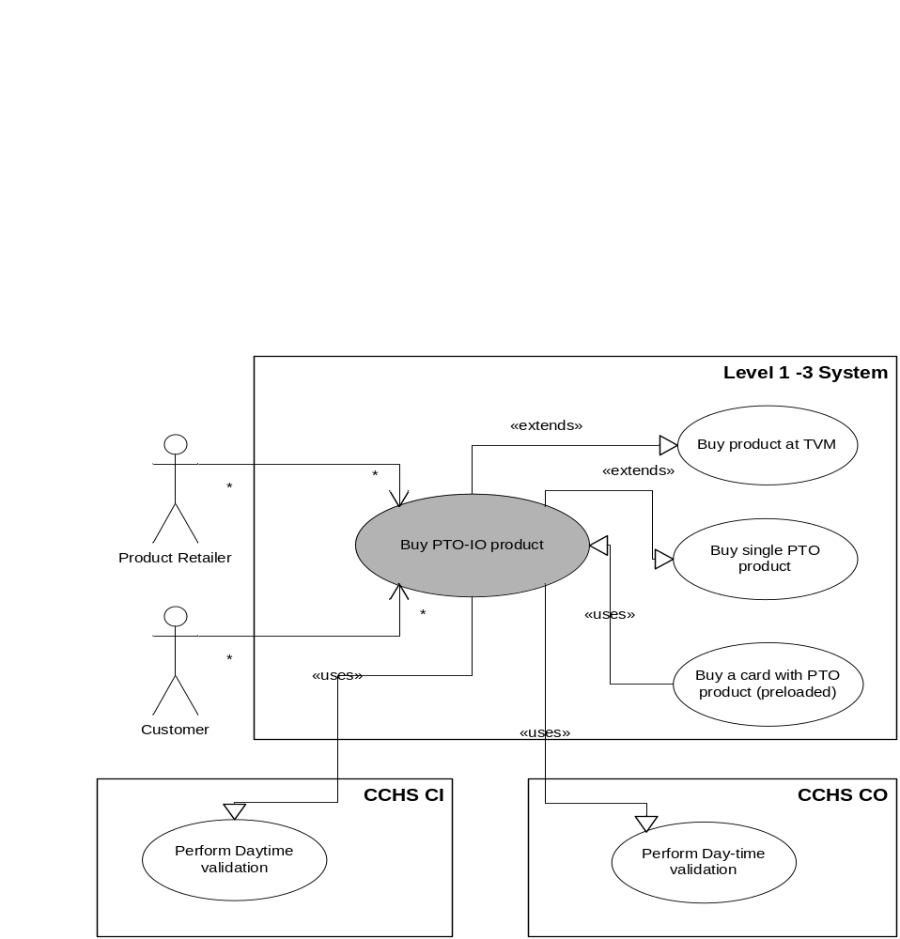
Relations between Test Scenarios
Level 4 System
Notes:
Regarding the related test scenarios, it was the way how we intended to introduce reuse of test specifications
The relationships within the test scenario ”Buy PTO-IO product” are shown here:
Our test scenario reuses the test scenario ”Perform Day-time Validation for CO/CI”, which is depicted by the << uses >> relation directed to the reused scenario.
The test scenario ”Buy a card with PTO product (preloaded)” can reuse ours.
Finally, two possible variations of the main scenario are linked to it by << extends >> relations.

Slide 16
Test Script Items
ID
Reference to the parent test scenario/variation/exception
Description of (”how to do”) each step of the parent main scenario / variation / exception
Input data types
Pass and fail criteria
Notes:
The second level of the test specification was presented by test scripts, which had to contain a procedure describing how to perform the testing of steps from test scenarios:
Each test script had to become an elaborate description of just one path of a certain - parent - test scenario, the path related to the level 4
A test script description at any step could contain a reference to another test script. This way the idea of test procedure specification reuse had to be implemented.
The exact format of the test script was not defined at that moment. The reason for this was that testing had to be split into two parts: system and operations testing, and both testing teams had different preferences how to visualize test scripts and what tools to use

Slide 17
Test Case Items
ID
Reference to the parent test script
Steps from the parent test script
Input data values for each step
Expected results for each step
Notes:
The lowest level of our test specification was presented by test cases, which were considered as instances of test scripts.
The exact format of a test case was not specified as well. However, the mandatory items listed above would allow for test cases to reuse the same test script in two different ways:
first, by using different data values of the same data type specified in the parent test script and,
second, by performing not all the steps specified in the parent test script or by altering those steps.
This way the main goal of coverage could be implemented: to cover every main scenario, variation or exception by at least one test case.

Slide 18
Mapping to IEEE 829 Standard
Our Item
Test plan
Test scenario
Test script
Test case specification
IEEE 829 Item
Test plan
Test design specification
Test procedure
Test case specification
Notes:
Regarding compliance with the IEEE 829 standard: its spirit was preserved.
What is different is that, in the standard, both test design and test case specifications are used to develop the corresponding test procedure, whereas in our three-level approach test scripts are designed from test scenarios and, then, test cases are derived from test scripts.
The rationale behind this is that use case based testing is essentially a process-centric approach: this process is roughly known at the very beginning as a use case. So, the logical way would be to unfold it into a detailed script and, then, to split the script into several cases.

Slide 19
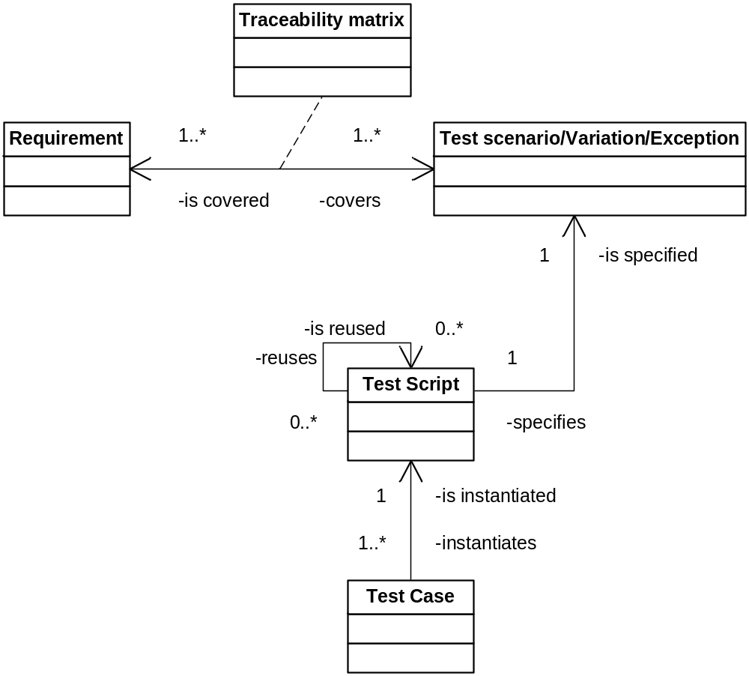
Requirements Coverage: Traceability Model
Notes:
Another major goal had to be achieved: to provide coverage and traceability of user requirements through all the levels of test artefacts.
The UML class diagram shows that all testing artefacts are traceable from the test cases up to a particular main scenario, variation or exception. The obvious way to trace requirements would be to put references to the corresponding requirements into each test scenario.
However, it is well known that user requirements and design specifications, the highest level of which represent use case scenarios, are usually expressed in different dimensions. So, such references would always be arbitrary.
Moreover, some test scenarios would cover some requirements just partially and no reference could reflect such partial coverage.

Slide 20
Requirement Traceability Matrix (fragment)
TS ID Req. ID | TS.CSE.1 | TS.CSE.1.V1 | TS.CSE.1.V2 | TS.CSE.1.V3 | TS.CSE.1.V4 | TS.CSE.1.V5 | TS.CSE.1.V6 | TS.CSE.1.E1 | TS.CSE.1.E2 | TS.CSE.1.E3
CCHS functional requirements
1.1 | 0.1 |  |  |  |  |  |  |  | 0.1
1.2 | 0.1 |  |  |  |  |  | 1
1.3 | 0.1
1.4 | 0.1
1.5 | 0.1 |  |  |  |  |  |  |  |  | 0.1
1.6 | 0.1
1.7 |  |  |  |  |  |  |  | 0.1
1.8 |  | 1
1.9 | 0.1
1.10
1.11 |  |  | 1
1.12 | 0.1
Notes:
Our solution was a requirements traceability matrix which placed against requirements (in rows) all main test scenarios, variations and exceptions (in columns). If a requirement is covered by any particular element in the columns, the corresponding cell has to be marked. We realized that such mapping was also subjective but at least the association presented by a matrix was traceable in both directions: we could analyze how any particular requirement is spread among test scenarios and how many requirements are relevant to any test scenario, variation and exception.
Also we made an attempt to quantify the degree of coverage by numbering marks from 0 to 1, where 1 meant complete coverage.
Adding up the numbers in each row, we were able to assess which requirements were not covered at all and which ones were possibly ”over-tested”. Adding up the numbers in each column it was possible to find test scenarios, variations and exceptions which did not cover any requirement at all and, therefore, were probably redundant.

Slide 21
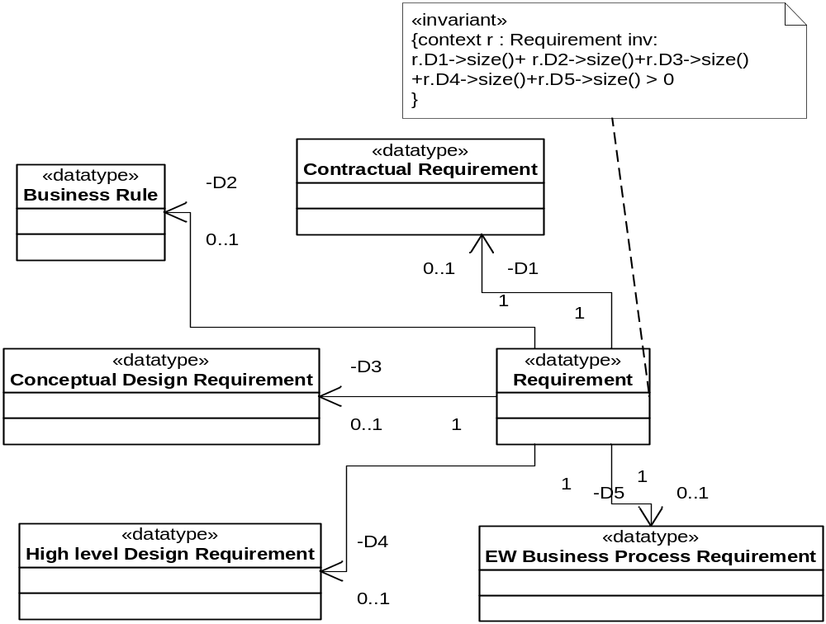
Documentation Traceability Model
Requirement has to be mentioned in at least one document
Notes:
TEST PREPARATION
We started with requirements specification. All five sources of requirements were thoroughly reviewed in attempt to retrieve user requirements. To be put on the list, a requirement had to be literally mentioned in at least one of those documents as shown in the traceability model presented above: the OCL (Object Constraint Language) invariant means that for each requirement at least one document source has to exist.
A certain amount of outdated and ambiguous requirements was discovered. To eliminate ambiguity we had to adjust contradictory requirements which belonged to the documents of lower priority. The process took several iterations of review and, at this time, the EW team were our reviewers.

Slide 22
Requirements specification document (fragment)
Cate- gory | R e q. ID | Requirement | Requirement Description | CBO Contr. | Business rules | C o n c e p t D e s i g n | CCHS HLD | P r o c e s s e s | TLS Remarks | East-West Comments
Daytime Clearing | 1.1 | All transactions, including e-purse and product transactions, are sent to the Clearing Operator for clearing and settlement during the business day. | The system will deal with the valid transactions on a daily basis. A transaction is a message from level 0 to level 4 affecting a product or a financial settlement. | 3.2.1.1 | 5.1 |  |  | [DT] |  | Almost all transactions are sent to the CO, but not all (e.g. CA transactions not). Only I/O sales and refund transactions are cleared and settled, not all transactions.
 | 1.2 | Transactions are sent to Clearing Operator either continuously in small batches throughout the day, or as one big file at the end of each day. | For non-connected equipment, e.g. bus, some transactions are not sent on the exact business day but the day after as the connection is not real time. | 3.2.1.1 | 5.1; 6.1.1.1 |  |  |  | It needs testing how this big file can be validated at the end of the day
Notes:
There was no requirements specification tool available at TLS at the moment so we just put the requirements specifications into an Excel workbook as separate sheets containing IPC and CCHS functional and non functional requirements.
A fragment of the requirements specification sheet is presented above. Apart from requirements specifications it contains columns with direct references to the contractual documents.
The same requirements specification document was used by both parties for reviewing, adding comments on reviews, etc.

Slide 23
Test Scenarios Reviewing
Error type | Effect on test scripts/cases
Missing preconditions | Missing input data
Missing steps | Missing steps in scripts
Conditionals (”if”...”then”...”else”) | Missing scripts and/or cases presented by alternative paths
Actor of a step is unclear | Impossible to tell user input from system reaction
Missing postconditions | Missing/wrong pass/fail criteria
Missing variations/exceptions | Missing scripts and/or cases
Notes:
The LaQuSo team reviewed test scenarios process in several iterations. At the first step we checked the quality of each presented test scenario. We checked both the content and the formal structure. The content was validated against the project documents, against logic and, sometimes, against common sense. The structure was checked against the agreed format. Some typical errors encountered during reviewing together with their probable impact on future test scripts and cases are shown in the Table above.
At the next iteration completeness of the test scenarios document was assessed using traceability matrix. By that time a lot of contractual issues were settled, which demanded one more walk through the requirements specification list. The first version of the requirements traceability matrix revealed that about 90% of the functional requirements covered by the test scenarios whereas non functional requirements coverage was more modest: about 60%. Those of them which we accepted as covered were mostly performance and system management/maintenance requirements. For performance issues it was decided that functional test scenarios could be reused with stress loads of data. A separate set of test scenarios called ”IT operations” was designed for system management & maintenance testing.
The residual of non covered reqs. was written down and marked as ”Open issues”.

Slide 24
Test Scripts/Cases Reviewing
Test Scenario Name
Buy PTO – IO product
Test Scenario ID
TS.COP.08
reference to test scenario
Test Script ID
TSC.COP.08
S
t
e
p
Main scenario
Ops L 0/3
Op
s
L
4
T
L
S
Op
s
L
4
EW
S
ys
t
e
m
L
0
/
3
S
y
s
t
em
L4
Test Cycle ID
Script ID
Test
Script Description
Test Data Specification
Actions
Expected Results
1
√
€
€
€
€
Testing procedure plus input data
Output data and pass criteria
2
√
€
€
Elaborate steps
and/or
IDs of test
scripts reused
by
this one
Test data
definitions
and values
3
√
€
€
4
√
€
€
5
€
√
€
6
€
€
€
€
√
6a
€
€
€
€
√
7
€
€
€
€
√
steps of test scenario
8
€
€
€
€
√
9
€
€
√
10
€
√
€
system SAT related steps
Notes:
The EW testing team produced two sets of test scripts: the first one was meant for the system SAT and the second one - for operations testing. The variant of a test script proposed for the system testing is shown above.
This format is a kind of joint version of a test script and test cases. All agreed mandatory items of both of them are recognizable in the format.
Column ”Test Data Specification” contained the types of data prepared for the test, e.g. a card number, a product ID, etc., as well as actual values of that data.
Several test cases were usually merged. The column ”Actions...” contains a detailed description of testing steps together with system input data. The ”Expected Results” column contained expected system outputs being pass criteria for each test step.
The solution providing reuse was such that any sequence of steps is allowed to have a unique ID so that it can be referred to from any other test script or from variations or exceptions.
Several columns representing different system levels provide an easy way of separating CBO related steps from lower level steps and, within the CBO, splitting up system related steps and pure operational steps performed by TLS or EW: for instance, only the steps 6 to 9 marked by ticks ”V” were to be tested during the system part of the SAT.

Slide 25
Test Execution: System Testing
IPC (Card Initialization & Personalization Center)
  many issues, e.g.:
    incomplete coverage of ‘Dutch delta’
    ‘ghost’ cards
    data input validation failure
CCHS (Central Clearing House)
  Rigid sets of test data were generated by simulators. Tests were very well rehearsed. Few minor bugs were found
Notes:
Test execution
EW organized two testing teams: one for system testing consisted of system developers and the other included CBO supporting staff. LaQuSo was witnessing both test cycles.
System IPC testing implied actual production of e-tickets of different kinds as well as performance testing. The testers were willing to leave some time for free format testing. This vivid process revealed quite a lot of bugs especially related to the so-called ”Dutch delta”. This required a few more sessions of regression testing, although, in general, the system functioned as it was specified.
Regarding CCHS system testing: rigid sets of test data were predefined in advance by a simulator. No space was left for free hand testing.
(Moreover, the sets of transactions were quite randomly generated. As a result, the history of transactions related to one particular card had nothing to do with the real life situation. For example, during testing it was possible to have a card in the Card Master which was blocked before it was actually initialized or its e-purse was auto-reloaded before the card was sold and it was uncertain whether or not this was a testing approach side effect or a system failure. Such a test data preparation approach, of course, was acceptable for system integration testing, however, it made it hard to support the use case based approach, in which triggers of system events have to be in a logical order.)

Slide 26
Test Execution: Operations Testing
IPC
  System tests were reused with emphasis on supporting processes
    data gaps in supporting forms, reports, etc.
    poorly defined interfaces between EW and TLS processes
CCHS
  Free format (negative, boundary, etc.) testing through user interface
    more than 130 issues (system and operations, about 30% of critical and high severity)
Notes:
The LaQuSo witnesses had the impression test data was carefully selected the tests were very well rehearsed. Of course, this had nothing to do with the artifice of the testers; it was a clear drawback of the test organizational approach when the developers were chosen to be responsible for the SAT.
It is well known that the developers are always honestly aware that their system is perfect and what needs to be done is to prove this for the customer. On the contrary, a tester has to have an opposite attitude: for him to find a bug is a real positive result. It is psychologically very hard for a developer to obtain such an attitude.
So, we decided to do two things: first, to try to ”shake the boat” during the operations testing and, second, to walk through the requirements list one more time in order to directly compare requirements with the content of the tests we saw. This way, having had already more knowledge of the system, we would be able to assess the soundness of the test content.
The operations testing team consisted of people responsible for system maintenance. So, they were willing to find system weaknesses. Both the IPC and CCHS systems were subjected to thorough examination. The success was especially apparent with the CCHS. Dozens of defects were discovered both in Graphical User Interface (GUI) and back-end business logic just through the not hasty analysis of the GUI response to different inputs using negative, boundary-value testing and other known testing techniques.

Slide 27
Test Results
During 3 months all critical and high level issues, as well as a half of the medium ones were resolved
94% of the listed requirements were covered. The rest (network, security, bank interface, etc.) could not be tested within the level 4 in isolation
The pilot system (all levels) was launched in April 2005 in Rotterdam region
Notes:
All regression tests were finalized till April, 2005. Of about 130 issues previously encountered, all critical and high level ones, as well as about 50% of the medium ones were resolved and the corresponding defects were closed. The rest was postponed until new releases as change or enhancement
requests.
The final requirements coverage analysis performed by the LaQuSo project team revealed that roughly 94% of the listed requirements were covered during the SAT. The remaining part lay on the boundaries between the CCHS and other parts of the system (network security, bank interface, etc.) and could
not be tested having had only the Level 4 system in isolation. Although the tests took much longer than it was expected, they were completed successfully before the system launch.

Slide 28
Conclusion: Lessons Learned
Use case based approach is suitable for SAT
Three level use case based approach is feasible for large systems
SAT has to be performed independently of the supplier. The tester should be either the customer or a third party
Doing acceptance testing rely on people who is going to run the system
Modern requirement-management tools can improve requirements traceability and SAT efficiency drastically
Notes:
Here are our final conclusions.
I think the results of the project have proved that our approach was feasible and suitable for large scale systems.

