Slide 1
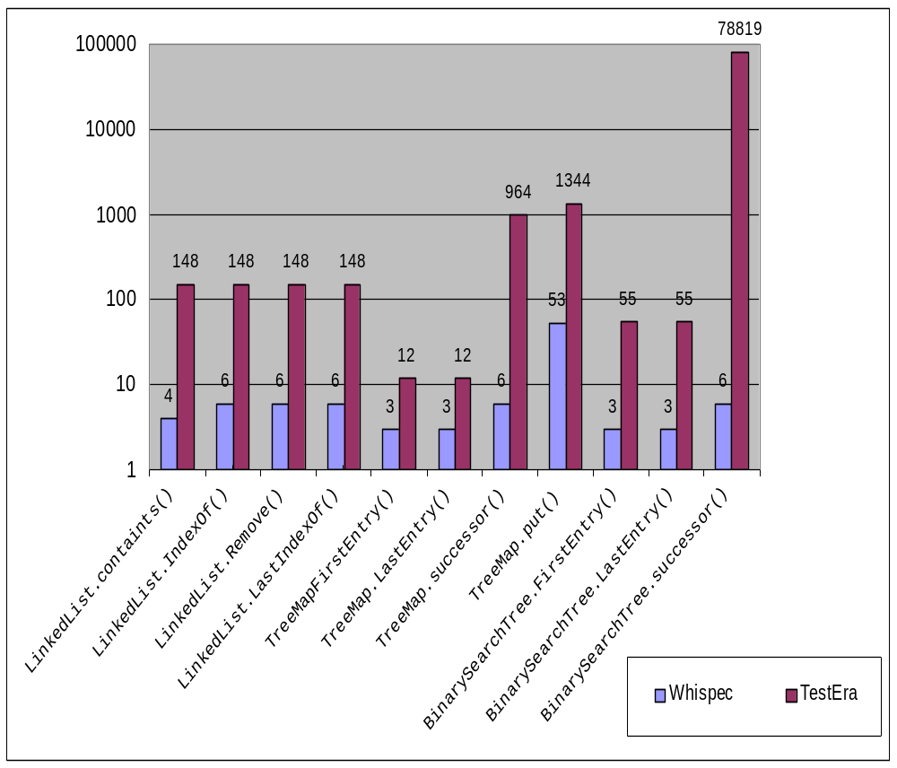
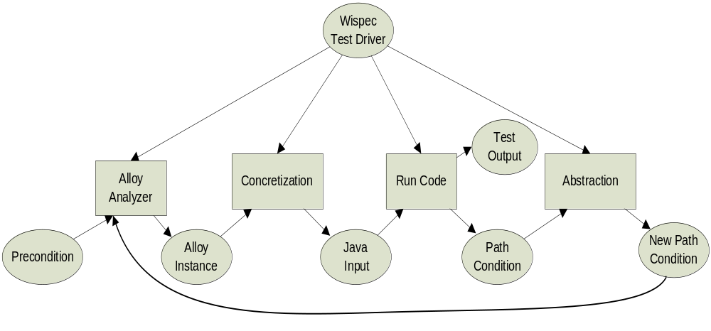
A Case for White-box Testing Using Declarative Specification
Danhua Shao Sarfraz Khurshid Dewayne E. Perry
Department of Electrical and Computer Engineering
The University of Texas at Austin,
Austin, TX 78712
{dshao, khurshid, perry}@ece.utexas.edu
Introduction
White-box testing and black-box testing are two commonly used and complementary techniques in automatic testing.
The specification-based black-box testing, such as TestEra, is not efficient in generating tests for code coverage.
We propose Whispec to extend the specification-based testing to support white-box testing.
Key idea: integration of both preconditions and path conditions with relational logic so that they are solved together for test generation.
Contributions
Specification-based white-box approach: Under the relational logic model, conjunct preconditions with path conditions in test generation.
Implementation: During the execution of one test case, Whispec does Breadth First Search to cover different branches as early as possible.
Evaluation: Compared with TestEra, Whispec will generate fewer test cases to achieve the same branch coverage.
Framework
In Whispec, the constraints are written in Alloy, a first-order language based on relations.
Given the precondition constraint, we first solve it using the Alloy Analyzer and concretize the solution into a test input.
We execute the method on that input and build path conditions for the resulting execution path.
After abstraction, the path condition is translated into new path conditions representing previously unexplored paths.
We run the analyzer on a conjunction of the precondition and a new path condition.
The solution is concretize into a new test input and triggers next round test generation.
The iterative execution of Whispec can systematically enumerate inputs that maximize code coverage.
Experiment
We compared the Whispec with TestEra using a variety of data structure implementations from the Java libraries.
Given the limit on the size of data structures and path conditions, we run Whispec and TestEra to generate tests to maximize branch coverage.
The results show that, under the same branch coverage, Whispec generates significantly smaller test suites than TestEra.

