Slide 1
Test Effort Estimation Models Based on Test Specifications
Eduardo Aranha (ehsa@cin.ufpe.br)
Paulo Borba (phmb@cin.ufpe.br)
Informatics Center of the Federal University of Pernambuco, Brazil
Motorola Brazil Test Center Research Project
TAIC PART 2007

Slide 2
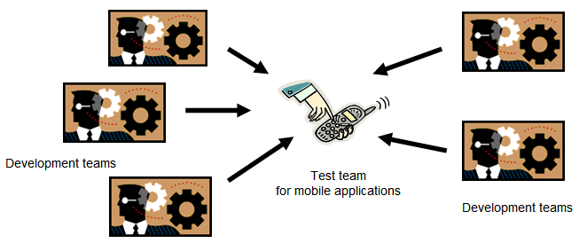
How to plan test schedules and resources?
Several development teams
Limited test resources
Test of different parts of different applications

Slide 3






How Can We do Test Estimations?
Quality
Test Size
/ Complexity
Test Specifications
…
Product Exp.
Test Estimates
Test Capability
…
Test team
Test
Estimation Model
Test Platform
Test Tools
Test
Environment
…

Slide 4


Proposed Estimations Models
Quality Criteria
…
Tools, Experience, ...
The specifications of a given test suite
Tests sorted to maximize coverage with minimal effort
23.5
man-hours
The specifications of a given test suite
Maximum Effort
(optional)
Estimated test execution effort
Tests to not execute
Manual Test Execution Effort Estimation
Test Coverage x Execution Effort Analysis
Tools, Experience, ...
…
APIs, Experience, ...
23.5
man-hours
Tests to automate
The specifications of a given test suite
The specifications of a given test suite
Estimated test automation effort
Frequency of execution
Tests to execute manually
APIs, Experience, ...
Test Automation Effort Estimation
Cost-benefit Analysis to Prioritize Tests for Automation

Slide 5
Assigning Points to Test Specifications
System Characteristics
Exercised by the Test Step
Screen navigation
File manipulation
Pressed keys
Network usage
. . .
a
C₁
C₂
…
C_{n}
b
b
...
Low
Avg
High
Low
Avg
High
Influence
Levels
Test Specification
c
...
c
30
60
Guidelines
Calibration
Automation
Contribution of the Test Step:
d
...
...
350
220
175
Points Assigned
to the Test Case:
e
880

Slide 6
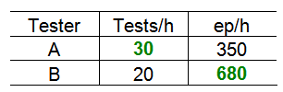
Execution Points and Automation Points
Give us the possibility to
  Sort the tests
  Better analyze test productivity
  Better analyze team capacity

Slide 7
Empirical Studies in the Mobile Application Domain
Survey and expert assessment
  Identify relevant characteristics and risk factors
  Define influence levels and weights
Experiment
  Validate the measure of test size and execution complexity
  Calibration of characteristics weights based on the collected data
Case studies
  Calibration of risk factors based on the collected data
  Evaluate the accuracy of the estimation model
  Verify the cost to use the model in the mobile application domain

Slide 8
Conclusions
New aproach of test effort estimation and test selection
  Based on the test specification
  Test size and execution/automation complexity
  Team experience, environment conditions, etc.
Empirical studies to calibrate and evaluate the model

Slide 9
Questions?
Test Effort Estimation Models Based on Test Specifications
Eduardo Aranha (ehsa@cin.ufpe.br)
Paulo Borba (phmb@cin.ufpe.br)
Informatics Center of the Federal University of Pernambuco, Brazil
Motorola Brazil Test Center Research Project

