Slide 1
Software Fault Prediction using Language Processing
Dave Binkley
Henry Field
Dawn Lawrie
Maurizio Pighin
Loyola College in Maryland
Universita’ degli Studi di Udine

Slide 2
What is a Fault?
Problems identified in bug reports
  Bugzilla
Led to code change

Slide 3
And Fault Prediction?
Metrics
Source code
Fault Predictor
…
…
“ignore”
consider
Ohh look at!

Slide 4
“Old” Metrics
Dozens of structure based
  Lines of code
  Number of attributes in a class
  Cyclomatic complexity

Slide 5
Why YAM?
(Yet Another Metric)
Many structural metrics bring the same value
  Recent example
  Gyimothy et al. “Empirical validation of OO metrics …” TSE 2007

Slide 6
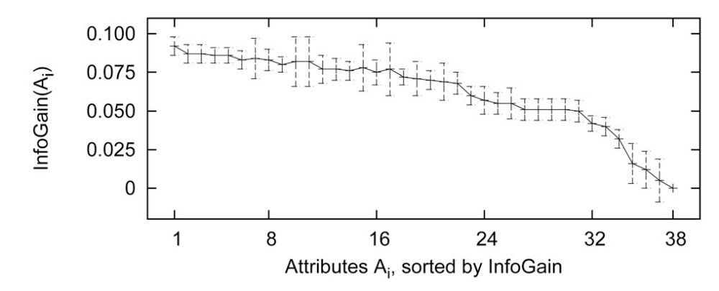
Why YAM?
Menzies et al. “Data mining static code attributes to learn defect predictors.”
TSE 2007

Slide 7
Why YAM? -- Diversity
“ …[the] measures used … [are] less important than having a sufficient pool to choose from.
Diversity in this pool is important.”
Menzies et al.

Slide 8
New Diverse Metrics
SE
IR
Nirvana
Use natural language semantics
(linguistic structure)

Slide 9
QALP -- An IR Metric
SE
QALP
Nirvana

Slide 10
What is a QALP score?
Use IR to `rate’ modules
  Separate code and comments
  Stop list -- ‘an’, ‘NULL’
  Stemming -- printable -> print
  Identifier splitting
    go_spongebob -> go sponge bob
  tf-idf term weighting – [ press any key ]
  Cosine similarity – [ again ]

Slide 11
tf-idf Term Weighting
Accounts for term frequency
- how important the term is a document
Inverse document frequency
- how common in the entire collection
High weight --
frequent in document but rare in collection
Notes:
Class Point compare term ‘point’ and term ‘angle’ in rotate

Slide 12

Cosine Similarity
= COS ( )
Document 1
Football
Document 2
Cricket

Slide 13
Why the QALP Score in Fault Prediction
High QALP score
(Done)
High Quality
Low Faults

Slide 14
Fault Prediction Experiment
QALP
LoC / SLoC
Source code
Fault Predictor
“ignore”
…
…
Ohh look at!
consider

Slide 15
Linear Mixed-Effects
Regression Models
Response variable
= f ( Explanatory variables)
In the experiment
Faults = f ( QALP, LoC, SLoC )

Slide 16
Two Test Subjects
Mozilla – open source
  3M LoC 2.4M SLoC
MP – proprietary source
  454K LoC 282K SLoC

Slide 17
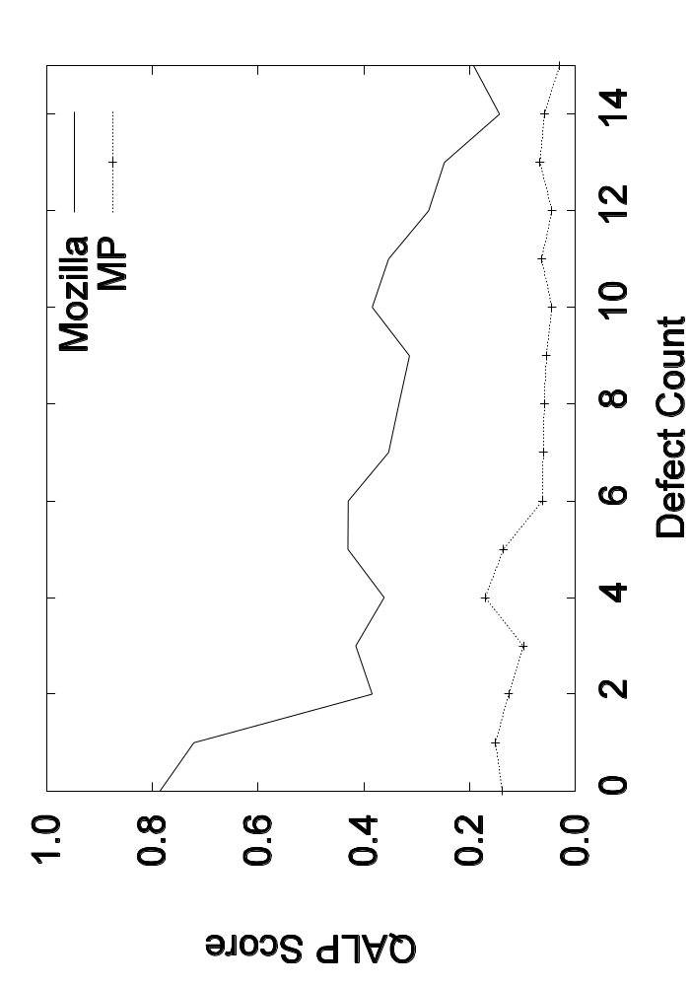
QALP score Envelope

Slide 18
Mozilla Final Model
defects = f(LoC, SLoC, LoC * SLoC)
  Interaction
R² = 0.16
Omits QALP score ☹

Slide 19
MP Final Model
defects = -1.83
+ QALP(-2.4 + 0.53 LoC - 0.92 SLoC)
  + 0.056 LoC - 0.058 SLoC
R² = 0.614 (p < 0.0001)

Slide 20
MP Final Model
defects = -1.83
+ QALP(-2.4 + 0.53 LoC - 0.92 SLoC)
  + 0.056 LoC - 0.058 SLoC
LoC = 1.67 SLoC (paper includes quartile approximations)
defects = … + 0.035 SLoC
► more (real) code … more defects ☺

Slide 21
MP Final Model
defects = -1.83
+ QALP(-2.4 + 0.53 LoC - 0.92 SLoC)
  + 0.056 LoC - 0.058 SLoC
“Good” when coefficient of QALP < 0
Interactions exist

Slide 22
Consider QALP Score Coefficient
(-2.4 + 0.53 LoC - 0.92 SLoC)
Again using LoC = 1.67 SLoC
QALP(-2.4 - 0.035 SLoC)
☺ Coefficient of QALP < 0

Slide 23
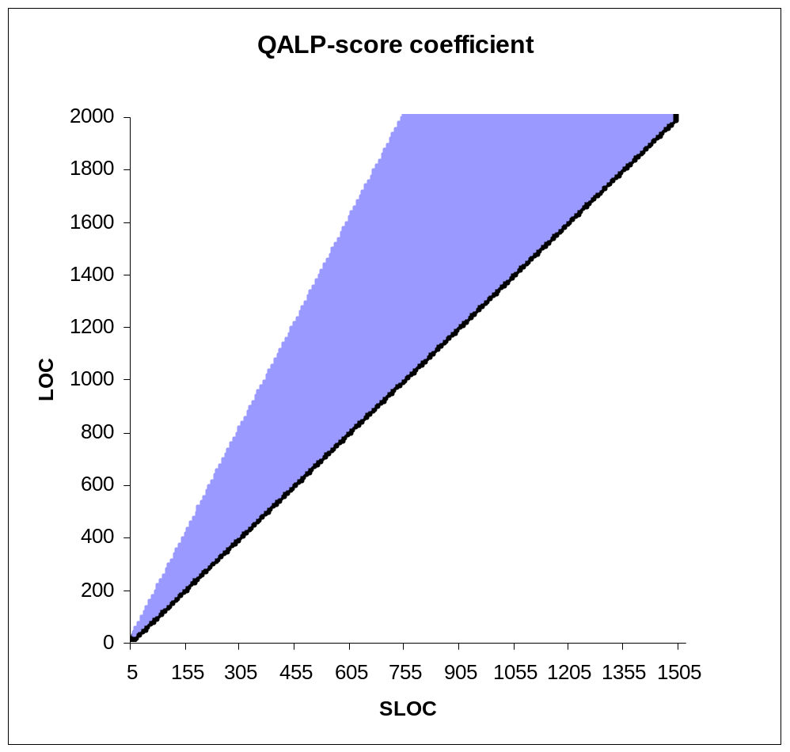
Consider QALP Score Coefficient
(-2.4 + 0.53 LoC - 0.92 SLoC)
Graphically

Slide 24
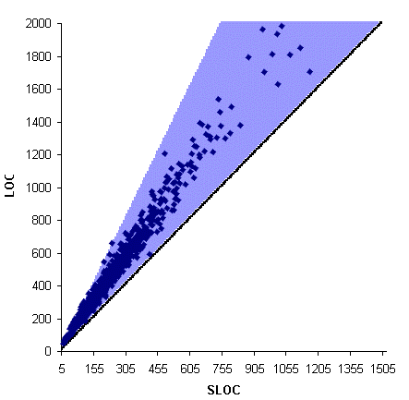
Good News!
Interesting range ➔ coefficient
of QALP < 0 ☺

Slide 25
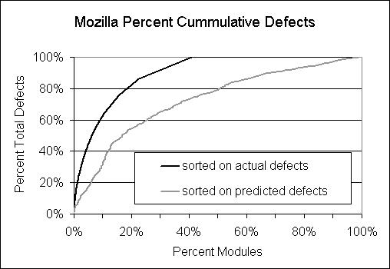
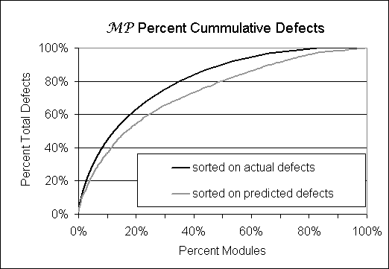

Slide 26
Ok I Buy it …
Now What do I do?
(not a sales pitch)
High LoC → more faults
➔
Refractor longer functions
Obviously improves metric value

Slide 27
Ok I Buy it …
Now What do I do?
(not a sales pitch)
But, …
High LoC → more faults
➔
Join all Lines
Obviously improves metric value
But faults?

Slide 28
Ok I Buy it …
Now What do I do?
But, …
High QALP score → fewer faults
➔
Add all code back in as comments
- Improves score ☺

Slide 29
Ok I Buy it …
Now What do I do?
High QALP score → fewer faults
➔
Consider variable names in low scoring
functions.
Informal examples seen

Slide 30
Future
Refractoring Advice
Outward Looking Comments
  Comparison with external documentation
Incorporating Concept Capture
  Higher quality identifiers are worth more

Slide 31
Summary
Diversity – IR based metric
Initial study provided mixed results

Slide 32
Question?

Slide 33
Ok I Buy it …
Now What do I do?
The Neatness ☺ metric
pretty print code
lower edit distance → higher score

Slide 34
Ok I Buy it …
Now What do I do?
Neatness → fewer faults (unproven)
➔
True for a most students ☺

