Slide 1
Improving Evolutionary Testing in the Presence of Function-Assigned Flags
formerly: DaimlerChrysler
Stefan Wappler Technical University of Berlin (DCAITI)
André Baresel QVI Tech GmbH
Joachim Wegener Berner & Mattner Systemtechnik GmbH

Slide 2
Agenda
- Evolutionary Structural Testing
- Function-Assigned Flags
- How Related Approaches Perform
- Our Approach
- Experimental Results

Slide 3
Background
Automatic Generation of Structure-Oriented Unit Tests
→ Achieve High Code Coverage
→ Evolutionary Structural Testing
DAIMLERCHRYSLER
Procedural Software
ETS (Evolutionary Testing System)
Object-Oriented Software
EvoUnit (Evolutionary Unit Tester)

Slide 4
Evolutionary Structural Testing
2
1
3
if( 100 == -1 )
d = |100+1|=101
if( 0 == -1 )
d = |0+1|=1
if( -10 < 0 )
d = |0+10|=10
1
2
1
+ 0.3 = 1.3
+ 0.01 = 1.01
+ 0.05 = 2.05
Notes:
Automated Test Generation
Structure-Oriented Testing, guided by a code coverage criterion (e.g. branch coverage)
Transform Task to generate test for a particular code element to an optimization problem

Slide 5
Evolutionary Structural Testing
Notes:
Automated Test Generation
Structure-Oriented Testing, guided by a code coverage criterion (e.g. branch coverage)
Transform Task to generate test for a particular code element to an optimization problem

Slide 6
The Flag Problem – Function-Assigned Flags
d
if( a == -1 )
d = |a+1|
a
if( isNull(b) )
d = |1-isNull(b)|
d
b
Notes:
Automated Test Generation
Structure-Oriented Testing, guided by a code coverage criterion (e.g. branch coverage)
Transform Task to generate test for a particular code element to an optimization problem

Slide 7
How Related Approaches Perform
int func(int c) {
int flag = 0;
if( c == 0 )
flag = 1;
if( flag )
// test goal
}
int func(int c) {
int flag;
flag = isZero(c);
if( flag )
// test goal
}
void add(IStack s, Object e) {
if( s.isFull() )
// test goal
else
s.add( e );
}
Bottaci
Harman et al.
Baresel & Sthamer
Liu et al.
McMinn & Holcombe
Bottaci
Harman et al.
Baresel & Sthamer
Liu et al.
McMinn & Holcombe
Bottaci
Harman et al.
Baresel & Sthamer
Liu et al.
McMinn & Holcombe
Notes:
Dynamic Analysis required instead of Static Analysis

Slide 8
Our Approach
class Stack {
Object[] elems = new Object[10];
int freeIdx = 0;
boolean isFull() {
if( freeIdx < elems.length )
return false;
else return true;
}
void push(Object elem) {
if( isFull() )
throw new Error();
else elems[freeIdx++] = elem;
} }
double
-distance( freeIdx, `>=‘, elems.length );
distance( freeIdx, `<‘, elems.length );
d
> 0 )
d = max(-isFull()+k,0)
isFull()

Slide 9
Our Approach
class Stack {
Object[] elems = new Object[10];
int freeIdx = 0;
double isFull() {
if( freeIdx < elems.length )
return –distance(freeIdx, `>=‘, elems.length);
else return distance(freeIdx, `<‘, elems.length);
}
boolean push(Object elem) {
if( isFull() > 0 )
return false;
else { elems[freeIdx++] = elem; return true; }
} }
double
-distance( isFull(), `<=‘, 0);
distance( isFull(), `>‘, 0); }

Slide 10
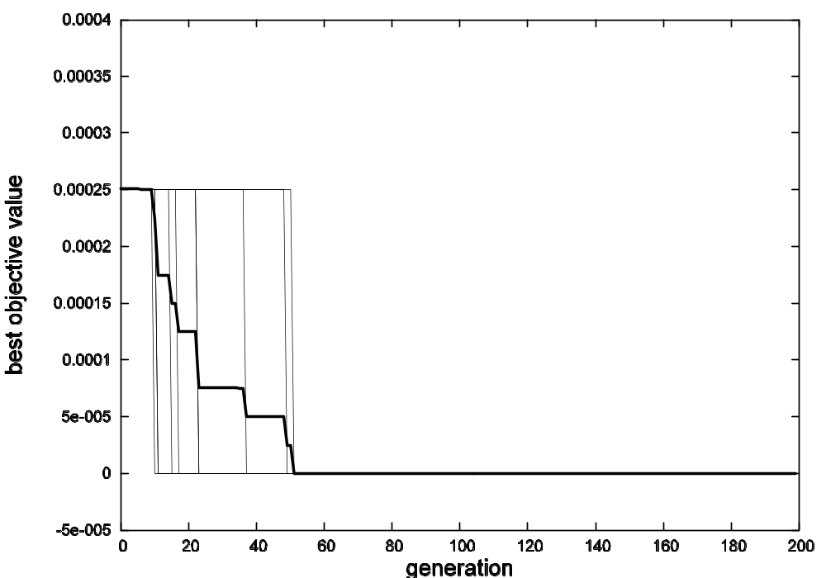
Experiment

Slide 11
Conclusion
Strengths
- Addresses Function-Assigned Flags
- Applicable to both Procedural ET and Object-Oriented ET
- Addresses Dynamic Binding (``dynamic analysis‘‘)
- Automatable Code Transformation
Weaknesses/Limitations
- Very small Distance Values can occur
- Application to Particular Types of Function-Assigned Flags investigated
Future Work
- Investigation into other Types of Function-Assigned Flags
(Loop-Assigned Flags, Sequential Flag Assignments, …)

Slide 12
Discussion
Thank you for your attention!

