Slide 1
RETAIL INTELLIGENCE & PERFORMANCE REPORT
Customer Shopping
Behavior Analysis
Translating 3,900 customer transactions across 50 locations into strategic merchandising and retention decisions.
Realized by Aya.T
Notes:
Introduce the executive summary of the customer shopping behavior dataset, covering transaction volume, customer segments, and merchandising opportunities.

Slide 2
EXECUTIVE SUMMARY
3,900 purchases reveal a repeat-heavy customer base
CORE METRICS & PROFILE
3,900
44.1
Recorded transactions across 25 products, 4 categories & 50 locations
Average customer age, reflecting a mature, prime-earning demographic
$59.76
3.75
Average purchase amount, consistent across major spending tiers
Average review rating (37 missing ratings imputed by category median)
The dataset spans 50 locations across 25 products, providing a statistically reliable view of basket sizes, satisfaction ratings, and core customer profiles.
Realized by Aya.T
Notes:
Highlight the broad baseline: 3,900 transactions, stable basket values around $60, and strong overall sentiment at 3.75 stars.

Slide 3
METHODOLOGY & ARCHITECTURE
The analysis pipeline turns transactions into business signals
A four-stage transformation from raw transaction logs into decision-ready business intelligence.
01
02
03
04
1. Prepare
2. Validate
3. Analyze
4. Activate
Clean 37 missing ratings, standardize column syntax, and engineer age and purchase-frequency cohorts.
Audit consistency, drop the redundant promo-code field, and verify categorical integrity.
Load the clean data into PostgreSQL to run structured commercial and behavioral queries.
Surface core findings, interactive filters, and margin signals in a dynamic Power BI workspace.
Realized by Aya.T
Notes:
Walk through the four engineering phases: data preparation, validation, SQL analysis in PostgreSQL, and final visualization in Power BI.

Slide 4
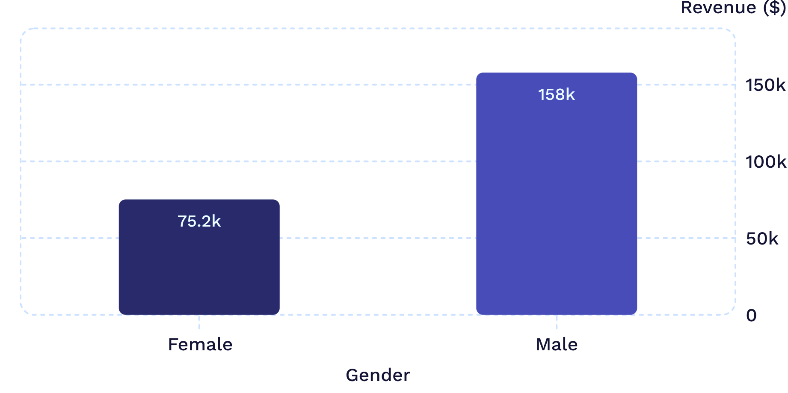
REVENUE DISTRIBUTION
Male customers drive 68% of recorded revenue
Male shoppers generated $157,890 compared to $75,191 from female shoppers across recorded orders.
STRATEGIC IMPLICATION
Combine demographic lenses
While male shoppers generate more than double the recorded sales volume, campaign decisions must not isolate gender alone.
Merchandising and promotional allocation must be paired with category mix, age cohort performance, and localized product preferences.
Notes:
Point out the male revenue dominance ($158K vs $75K), but emphasize caution against single-attribute targeting without category context.

Slide 5
RETENTION & CONVERSION INFLECTION
Loyalty is strong, but subscription penetration is low
SUBSCRIPTION GAP
73%
Repeat behavior exists at scale, yet subscription enrollment remains the clearest commercial expansion opportunity.
Non-Subscribers
Non-subscribers contribute $170,436 in revenue versus $62,645 from active subscribers (27% penetration).
3,116
701
83
Loyal
Returning
New
Converting repeat and loyal shoppers into formal recurring subscribers represents the highest-leverage retention move.
Primary repeat purchase core
Second-stage retention pool
Recent acquisition cohort
Notes:
This is the central strategic finding: over 3,100 customers are classified as loyal, yet only 27% subscribe, leaving $170K in uncommitted revenue.

Slide 6
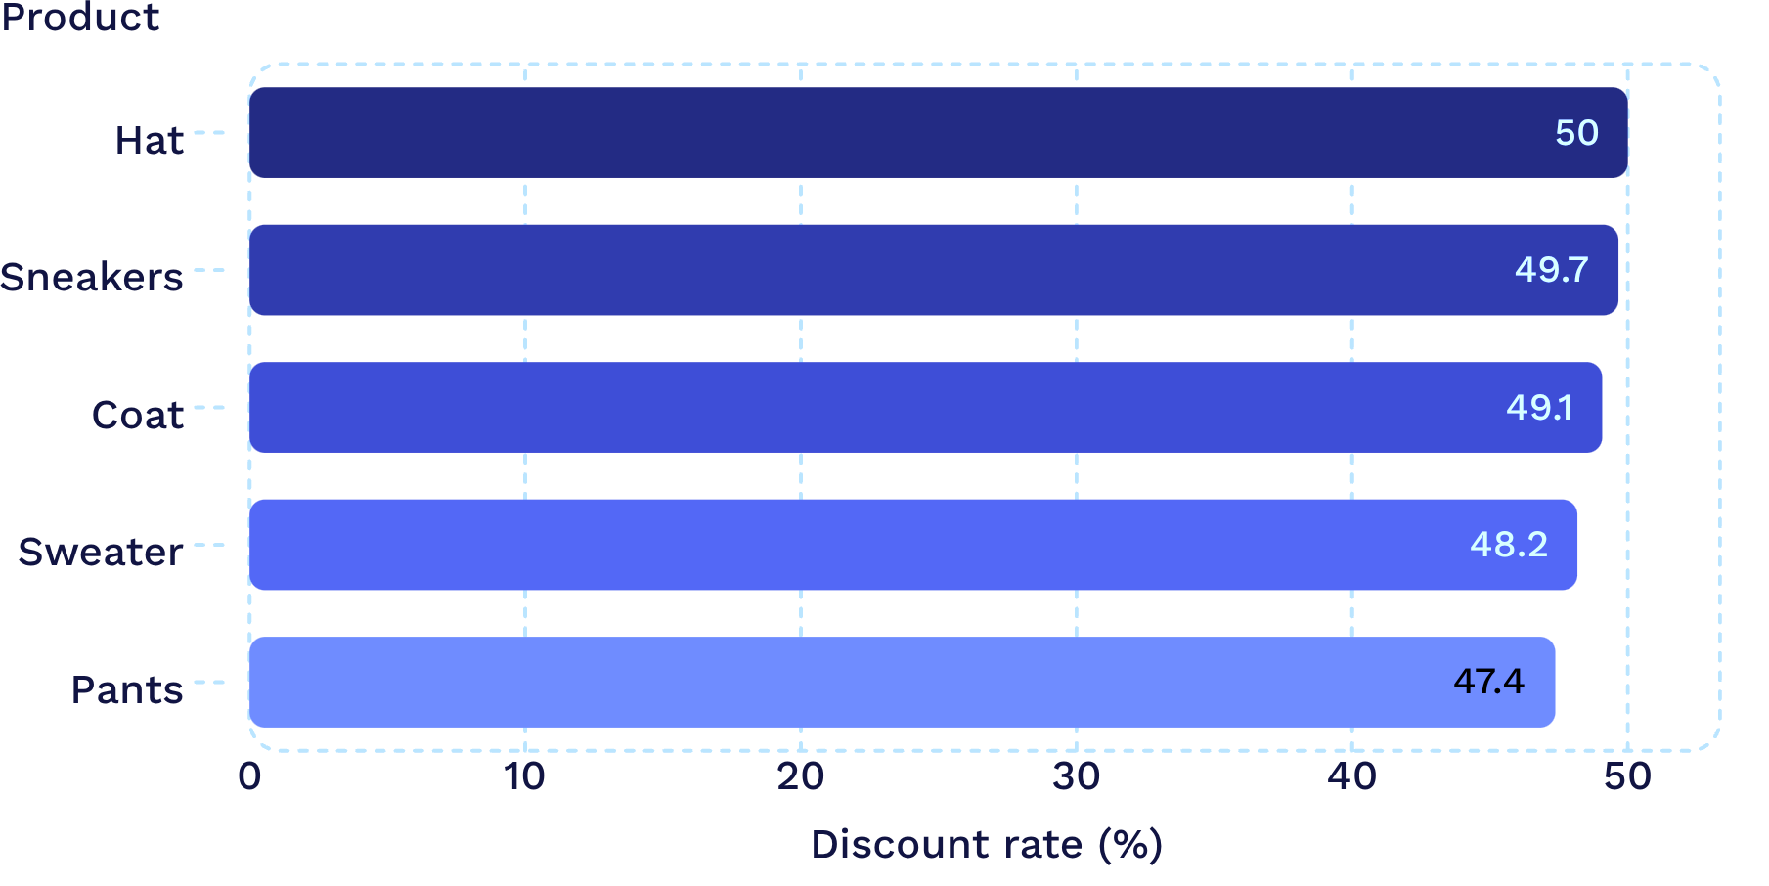
DISCOUNT ELASTICITY
Discounts can lift value without defining the whole basket
Top discount-dependent products hover near 50%, while 839 customers spent above the average purchase amount while applying a discount.
PRICING DISCIPLINE
Implication
Use targeted offers where discount sensitivity is high, while protecting margin on less-dependent products.
Notes:
Note that 839 customers maintained above-average order values with discounts. Emphasize margin protection on low-dependence items.

Slide 7
CATALOG STRATEGY
Product signals point to a focused merchandising story
Category Leaders
Top-Rated Products
Category | Leader
Accessories | Jewelry
Clothing | Blouse
Footwear | Sandals
Outerwear | Jacket
Product | Rating
Gloves | ★ 3.86
Sandals | ★ 3.84
Boots | ★ 3.82
Hat | ★ 3.80
Skirt | ★ 3.78
Implication: combine high ratings with purchase volume to choose hero products for campaigns and onsite placement.
Realized by Aya.T
Notes:
Present the dual perspective: top volume drivers by category alongside highest-rated products. Note that Sandals appear in both groups.

Slide 8
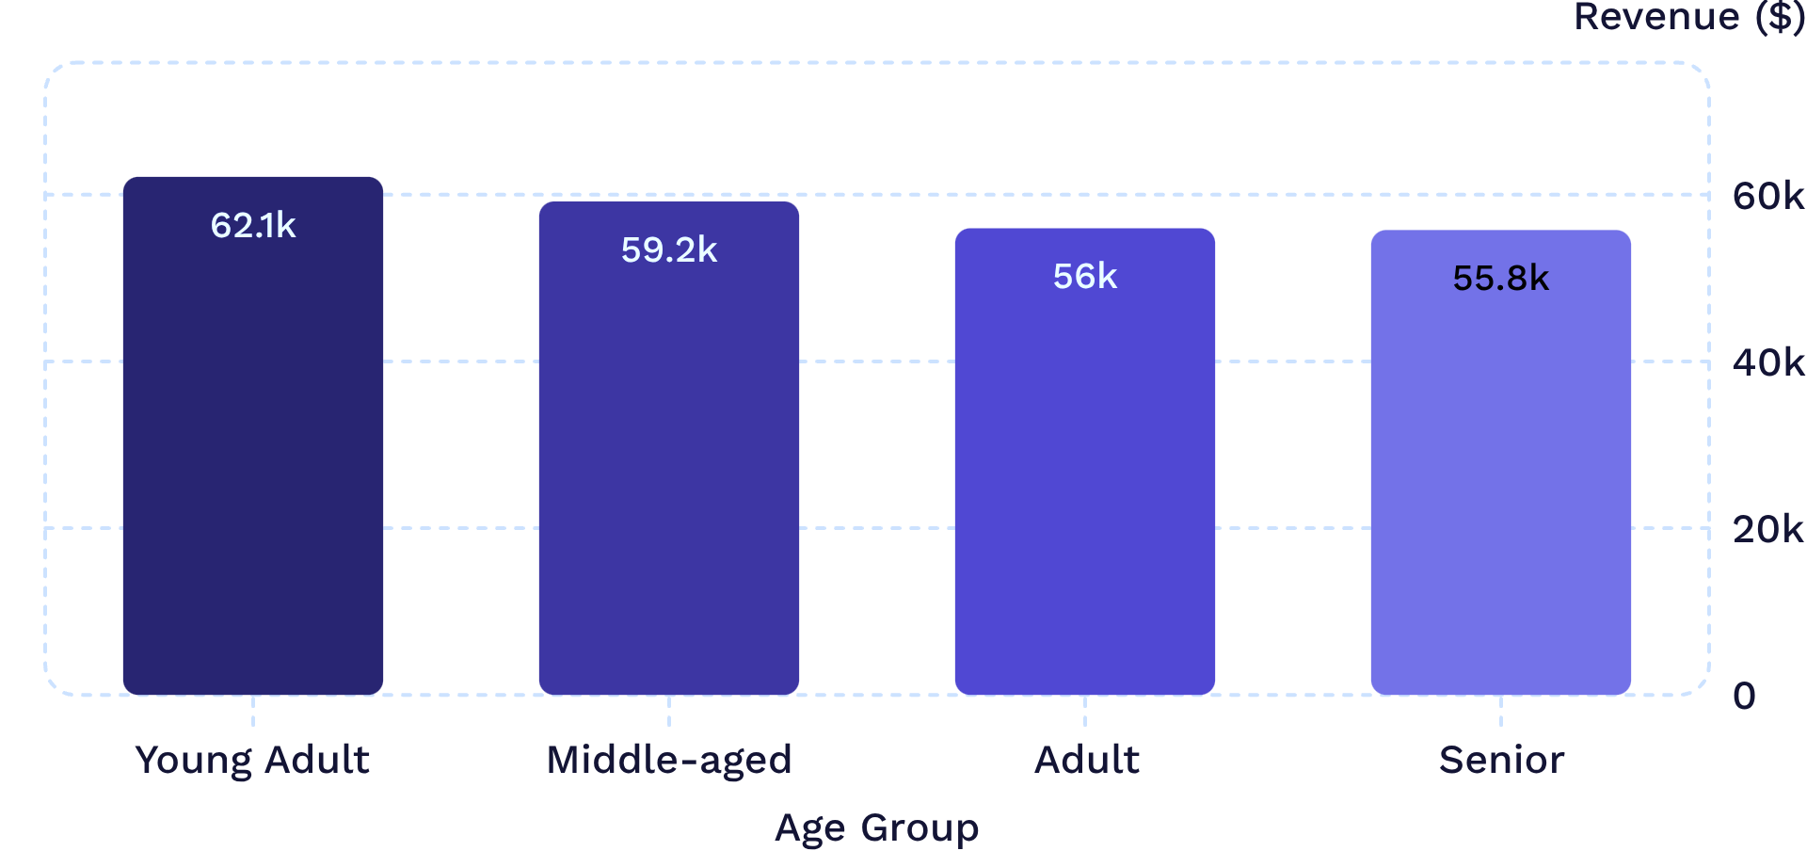
DEMOGRAPHIC REVENUE
Age groups contribute revenue more evenly than expected
PORTFOLIO READOUT
Young Adults lead revenue, but the four age groups are relatively close.
Revenue by age group
Young Adult: $62,143
Middle-aged: $59,197
Adult: $55,978
Senior: $55,763
Readout: prioritize Young Adult slightly, but avoid a single-segment strategy.
Notes:
Young Adults lead revenue, but the four age groups are relatively close. Prioritize Young Adult slightly, but avoid a single-segment strategy.

Slide 9
FULFILLMENT & LOGISTICS
Express shipping commands a modest premium
DELIVERY ECONOMICS
+$2.02 basket difference
STANDARD
EXPRESS
Fast delivery can be positioned as a convenience upsell, but the $2.02 gap should be tested against shipping cost and conversion.
$58.46
$60.48
Average Standard purchase
Average Express purchase
Notes:
Express purchase: $60.48; Standard purchase: $58.46. The $2.02 gap should be tested against shipping cost and conversion.

Slide 10
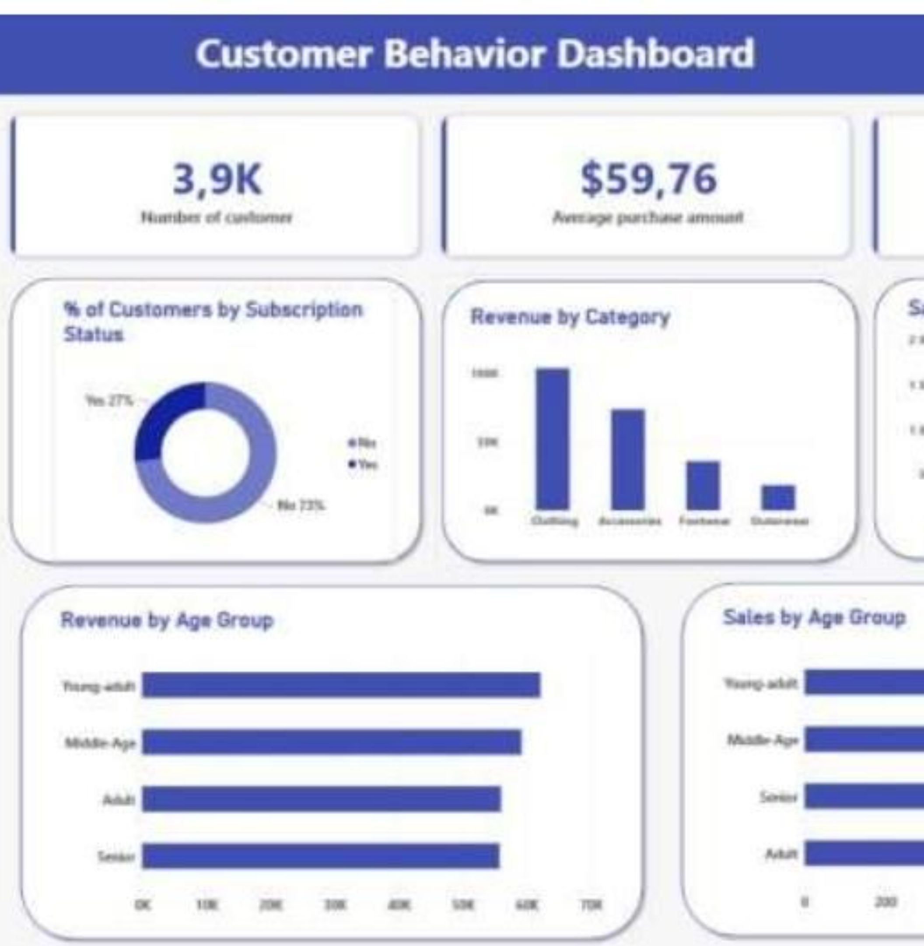
OPERATIONAL DASHBOARD
Power BI turns the analysis into a decision surface
Filters: Subscription status, gender, category, shipping type
Core KPIs: 3.9K customers; $59.76 average purchase amount; 3.75 average review rating
Views: Subscription mix; revenue and sales by category; revenue and sales by age group
Realized by Aya.T
Notes:
Conclude with the Power BI dashboard implementation, showcasing how business stakeholders can interactively explore the data by category, age, and subscription tier.

