Slide 1
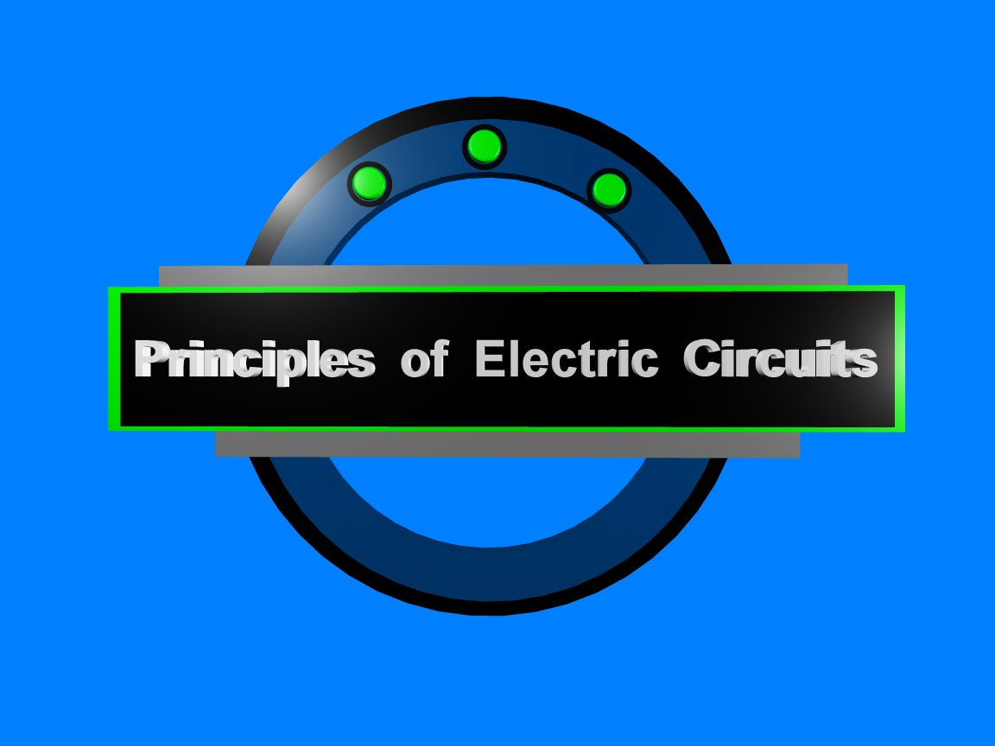
Chapter 2

Slide 2
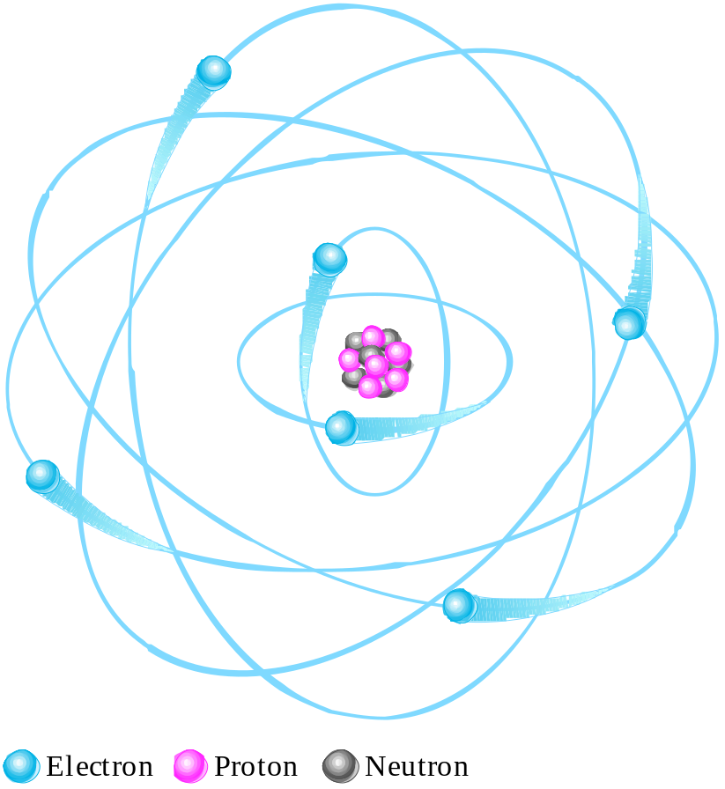
Summary
The Bohr atom is a tool for visualizing atomic structure.
The nucleus is positively charged and has the protons and neutrons.
Electrons are negatively charged and in discrete shells.
The atomic number is the number of protons and determines the particular element.
In the neutral atom, the number of electrons is equal to the number of protons.

Slide 3
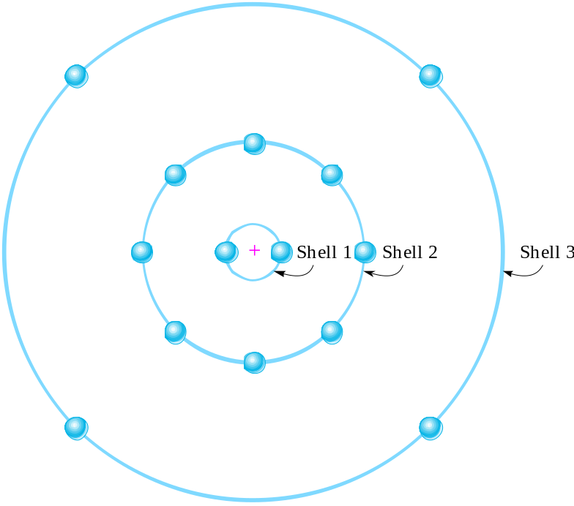
Summary
The outer shell is called the valence shell. Electrons in this shell are involved in chemical reactions and in metals they account for electrical and thermal conductivity.
A neutral Si atom is shown. There are 4 electrons in the valence shell.
Question:
Is Si a conductor, insulator, or semiconductor?
Semiconductor

Slide 4
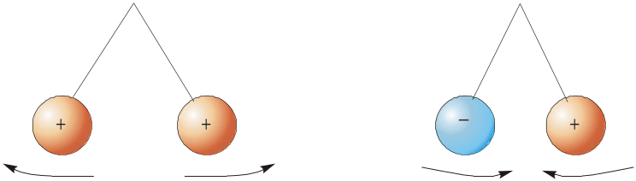
Summary
There is a force (F) between charges. Like charges repel; unlike charges attract.
The force is directly proportional to charge.
The force is inversely proportional to square of distance.

Slide 5
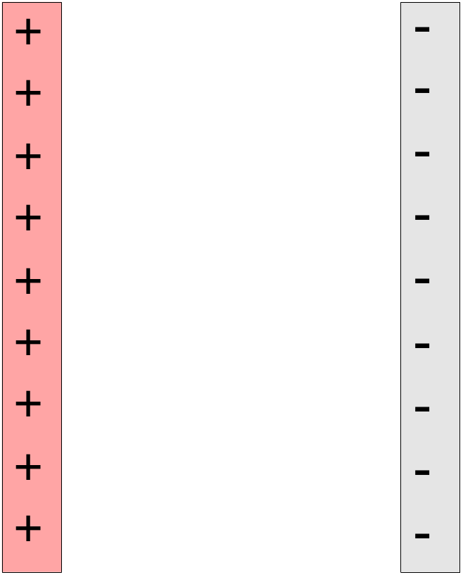
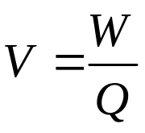
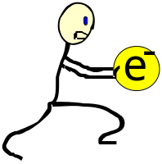
Voltage
Voltage (V) is the work (W) per charge (Q); it is responsible for establishing current.
Work is done as a charge is moved in the electric field from one potential to another.
Voltage is the work per charge done against the electric field.

Slide 6
One Volt
Definition of voltage
One volt is the potential difference (voltage) between two points when one joule of work is used to move one coulomb of charge from one point to the other.

Slide 7
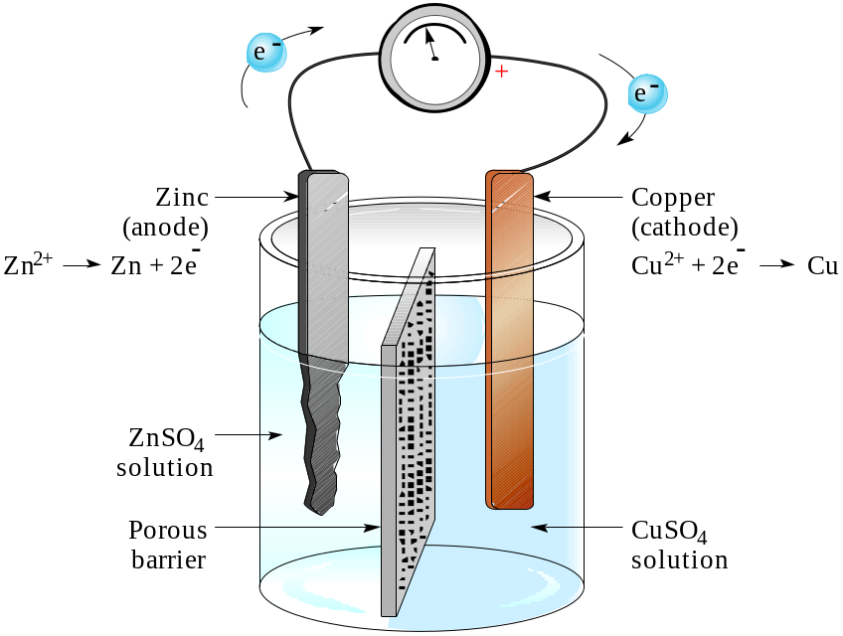
Summary
Voltage
Voltage is responsible for establishing current.
Sources of voltage include batteries, solar cells, and generators. A Cu-Zn battery, such as you might construct in a chemistry class, is shown.

Slide 8
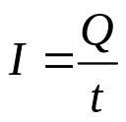
Current
Current (I) is the amount of charge (Q) that flows past a point in a unit of time (t).
One ampere is a number of electrons having a total charge of 1 C move through a given cross section in 1 s.
Question:
What is the current if 2 C passes a point in 5 s?
0.4 A

Slide 9
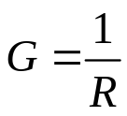
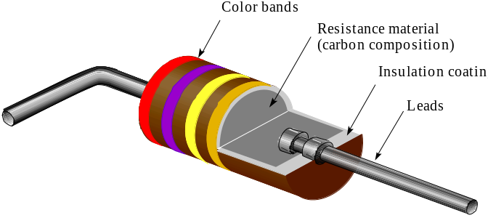
Summary
Resistance is the opposition to current.
One ohm (1 Ω) is the resistance if one ampere (1 A) is in a material when one volt (1 V) is applied.
Conductance is the reciprocal of resistance.
Components designed to have a specific amount of resistance are called resistors.

Slide 10
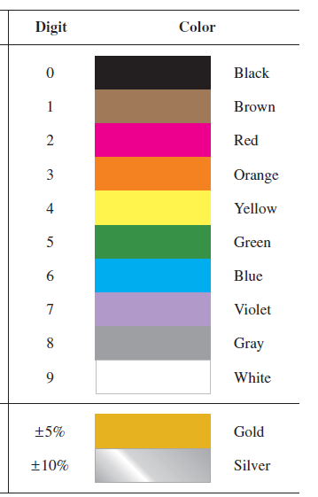
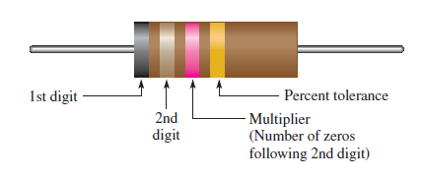
Resistor Color Coding

Slide 11
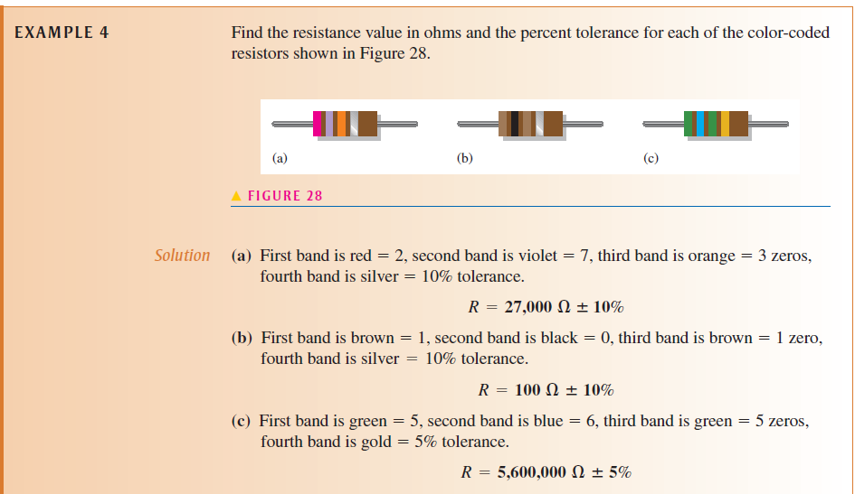

Slide 12
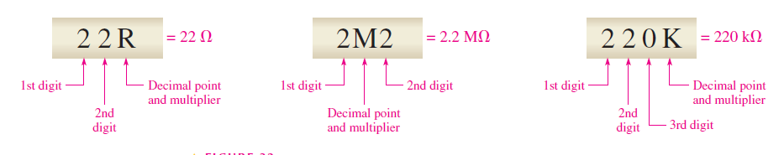
Resistor Label Code:
alphanumeric label typically consists of only three digits or two or three digits and one of the letters R, K, or M.
The letter is used to indicate the multiplier, and the position of the letter indicates the decimal point placement. The letter R indicates a multiplier of 1 (no zeros after the digits), the K indicates a multiplier of 1000 (three zeros after the digits), and the M indicates a multiplier of 1,000,000 (six zeros after the digits).

Slide 13
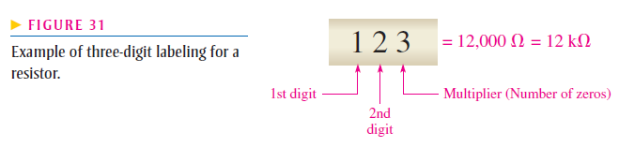
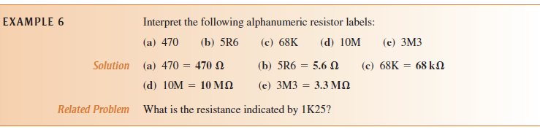

Slide 14
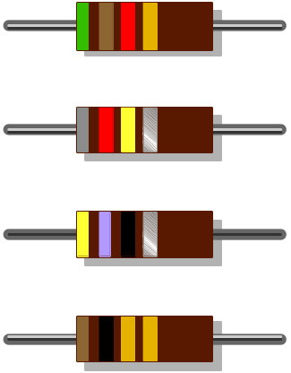
Summary
Question
What is the resistance and tolerance of each of the four-band resistors?
5.1 kΩ ± 5%
820 kΩ ± 5%
47 Ω ± 10%
1.0 Ω ± 5%

Slide 15
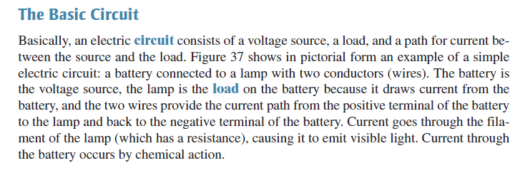
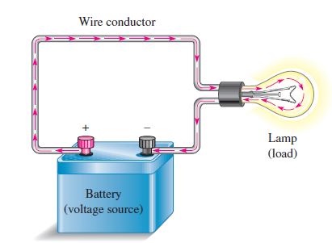
Electric Current Direction

Slide 16
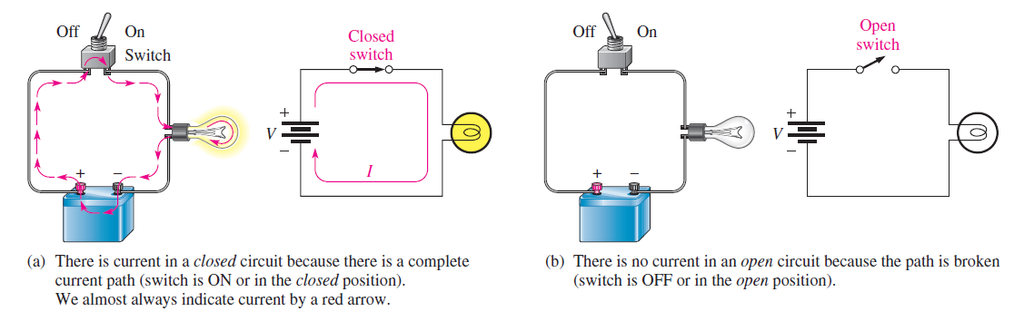
Open Switch and Close Switch

Slide 17
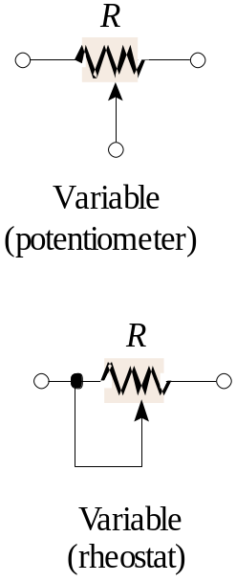
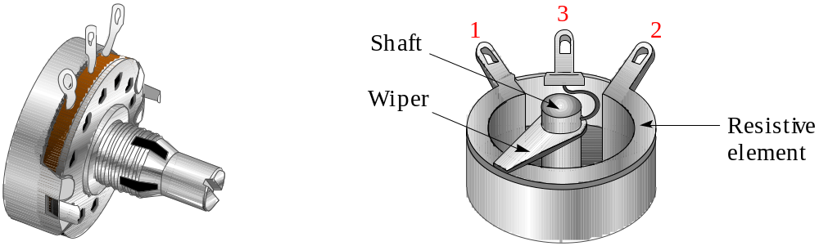
Summary
Variable resistors include the potentiometer and rheostat. A potentiometer can be connected as a rheostat.
The center terminal is connected to the wiper

Slide 18
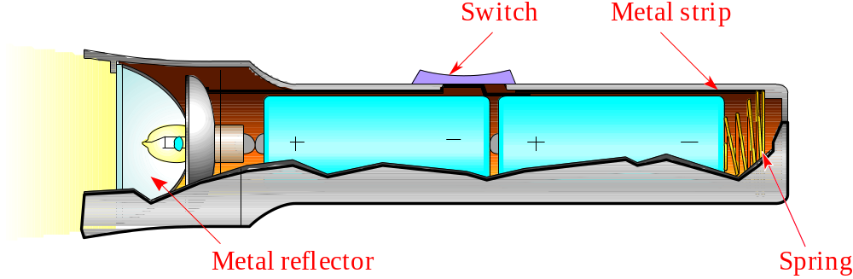
Summary
A basic circuit consists of 1) a voltage source, 2) a path and 3) a load. An example of a basic circuit is the flashlight, which has each of these.

Slide 19
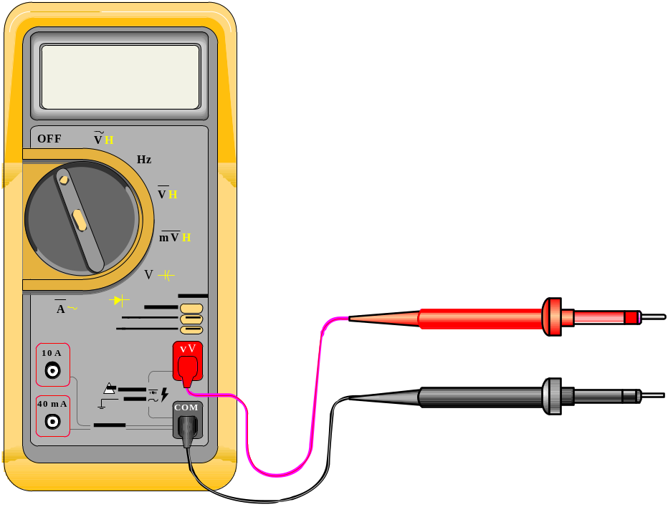
Summary
An important multipurpose instrument is the DMM, which can measure voltage, current, and resistance. Many include other measurement options.

Slide 20
Summary
You need to recognize safety hazards and know what to do in an emergency. Read and review all of the precautions given in the text. Some key ones are:
Electrical
Shock - know the location of emergency shutoff. Know and follow safety rules in the lab.
Electrical safety
Use Class-C extinguisher for electrical fires. Be aware of burn hazards with jewelry.
Work area
A safe area is neat. The area should be inspected regularly for hazards.

Slide 21

Selected Key Terms
Ampere
AWG
Charge
Circuit
The unit of electrical current
(American Wire Gauge) A standardization based on wire diameter
An electrical property of matter that exists because of an excess or a deficiency of electrons. Charge can be either + or −.
An interconnection of electronic components designed to produce a desired result. A basic circuit consists of a source, a load, and an interconnecting path.

Slide 22
Selected Key Terms
Conductance
Coulomb
Current
Electron
Ground
Ohm (Ω)
The ability of a circuit to allow current. The unit is the siemans (S).
The unit of electrical charge.
The rate of flow of electrical charge.
A basic particle of electrical charge in matter. The electron possesses a negative charge.
The common or reference point in a circuit.
The unit of resistance.

Slide 23
Selected Key Terms
Potentiometer
Resistance
Rheostat
Siemens
Volt
Voltage
A three-terminal variable resistor.
The opposition to current. the unit is the ohm (Ω).
A two-terminal variable resistor.
The unit of conductance
The unit of voltage or electromotive force.
The amount of energy per charge available to move electrons from one point to another in an electric circuit.

Slide 24
Quiz
1. The atomic number is the number of
a. protons in the nucleus
b. neutrons in the nucleus
c. protons plus neutrons in the nucleus
d. electrons in the outer shell

Slide 25
Quiz
2. Valence electrons are
a. in the outer shell
b. involved in chemical reactions
c. relatively loosely bound
d. all of the above

Slide 26
Quiz
3. The atomic particle responsible for electrical current in solid metallic conductors is the
a. proton
b. electron
c. neutron
d. all of the above

Slide 27
Quiz
4. The symbol for charge is
a. C
b. Ω
c. Q
d. W

Slide 28
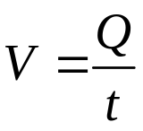
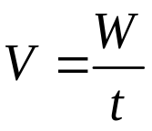

Quiz
5. The definition for voltage is
a.
b.
c.
d.

Slide 29
Quiz
6. A battery stores
a. electrons
b. protons
c. ions
d. chemical energy

Slide 30
Quiz
7. The unit of conductance is the
a. ohm
b. coulomb
c. siemen
d. ampere

Slide 31
Quiz
8. A four-color resistor with the color bands gray-red-black-gold is
a. 73 Ω
b. 82 Ω
c. 680 Ω
d. 820 Ω

Slide 32
Quiz
9. A 330 kΩ ± 5% resistor has the color bands
a. red-red-brown-gold
b. orange-orange-yellow-gold
c. yellow-yellow-red-gold
d. yellow-yellow-green-gold

Slide 33
Quiz
10. The circular mil is a unit of
a. length
b. area
c. volume
d. resistance

Slide 34
Quiz
Answers:
1. a
2. d
3. b
4. c
5. c
6. d
7. c
8. b
9. b
10. b

Slide 35
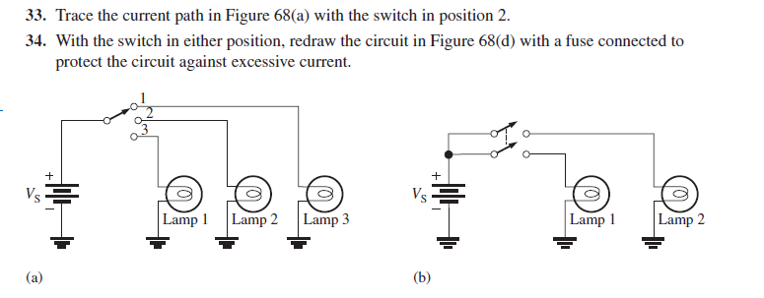
HOME WORK

Slide 36
