Slide 1
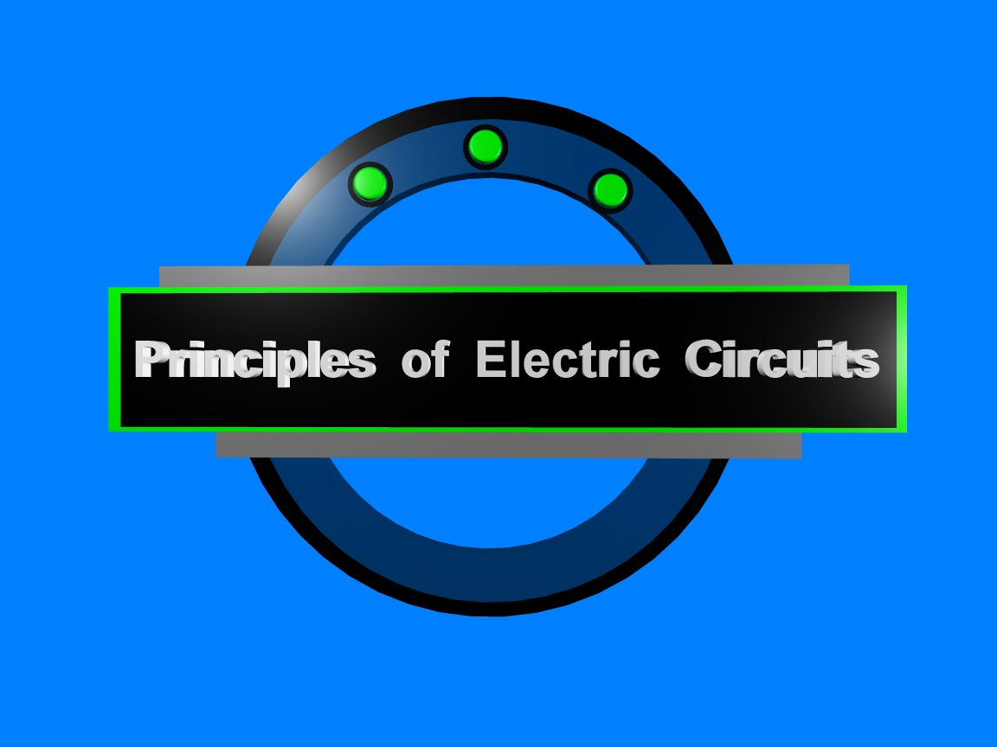
Chapter 3

Slide 2
Summary
Review of V, I, and R
Voltage is
the amount of energy per charge available to
move electrons from one point to another in a circuit.
Current is
the rate of charge flow and is measured in
amperes.
Resistance is
the opposition to current and is measured
in ohms.

Slide 3
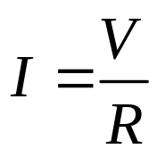
Summary
The most important fundamental law in electronics is Ohm’s law, which relates voltage, current, and resistance.
Georg Simon Ohm (1787-1854) studied the relationship between voltage, current, and resistance and formulated the equation that bears his name.
Question:
What is the current in from a 12 V source if the resistance is 10 Ω?
1.2 A

Slide 4

Summary
Ohm’s law
If you need to solve for voltage, Ohm’s law is:
Question:
What is the voltage across a 680 Ω resistor if the current is 26.5 mA?
18 V

Slide 5
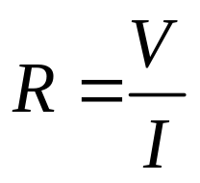
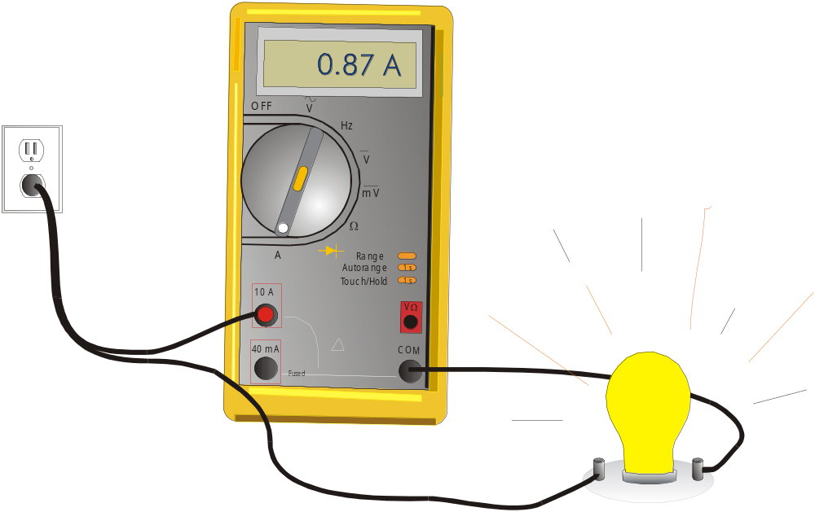
Summary
Ohm’s law
If you need to solve for resistance, Ohm’s law is:
Question:
What is the (hot) resistance of the bulb?
132 Ω
115 V

Slide 6
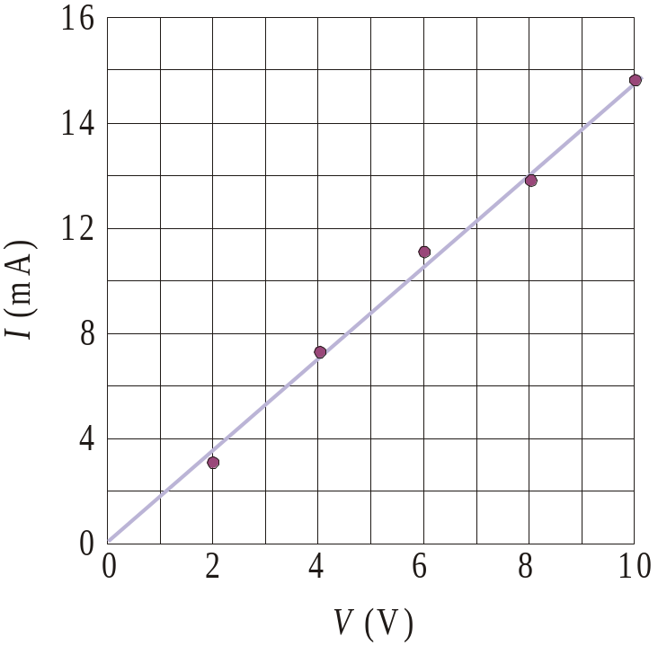
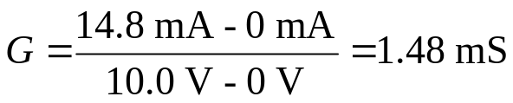
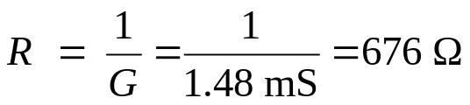
Summary
A student takes data for a resistor and fits the straight line shown to the data. What is the resistance and the conductance of the resistor?
Graph of Current versus Voltage
The slope represents the conductance.
The reciprocal of the conductance is the resistance:

Slide 7
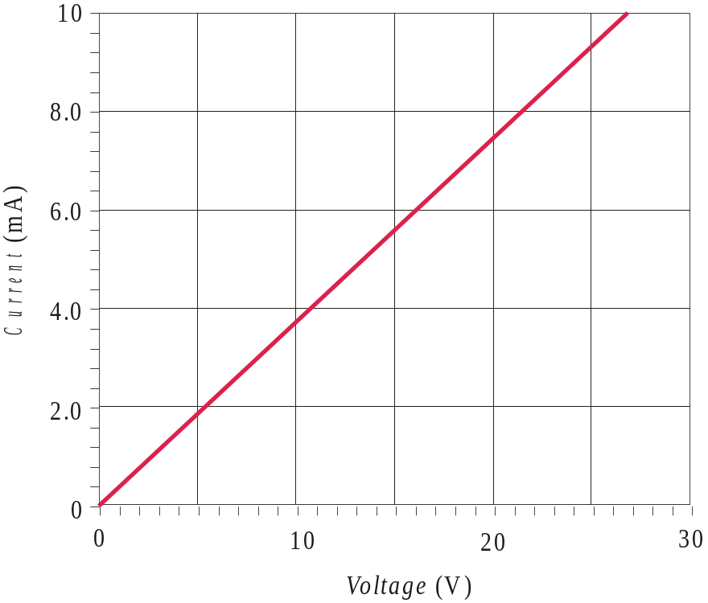
Summary
Graph of Current versus Voltage
Notice that the plot of current versus voltage for a fixed resistor is a line with a positive slope. What is the resistance indicated by the graph?
2.7 kΩ
What is its conductance?
0.37 mS

Slide 8
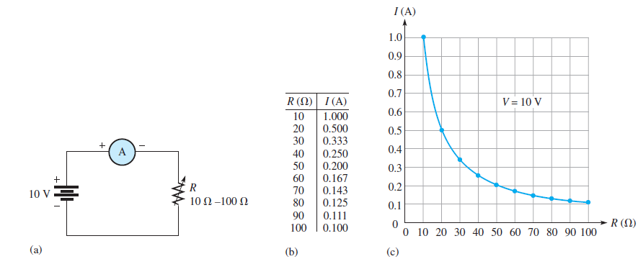
Summary
Graph of Current versus Resistance

Slide 9
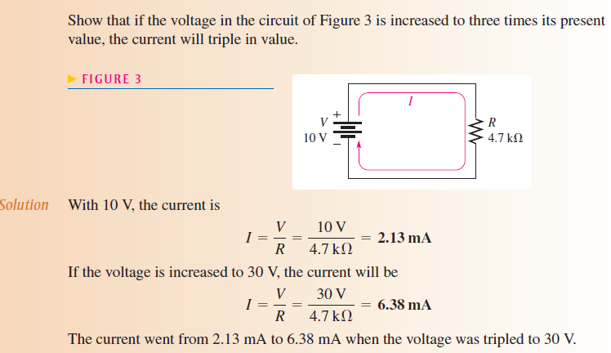

Slide 10
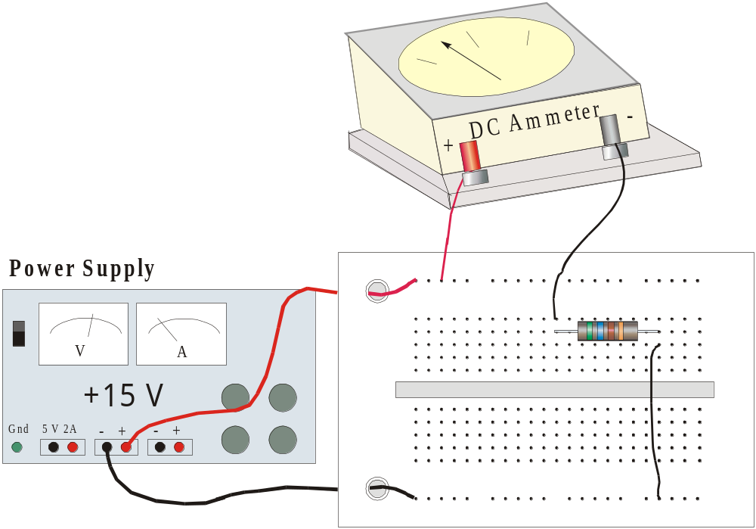
Summary
Application of Ohm’s law
26.8 mA
The resistor is green-blue brown-gold. What should the ammeter read?

Slide 11

Summary
Troubleshooting
Some questions to ask before starting any troubleshooting are:
Has the circuit ever worked?
If the circuit once worked, under what conditions did it fail?
What are the symptoms of the failure?
What are the possible causes of the failure?

Slide 12

Summary
Troubleshooting
Plan the troubleshooting by reviewing pertinent information:
Schematics
Instruction manuals
Review when and how the failure occurred.

Slide 13

Summary
Troubleshooting
You may decide to start at the middle of a circuit and work in toward the failure. This approach is called half-splitting.
Based on the plan of attack, look over the circuit carefully and make measurements as needed to localize the problem. Modify the plan if necessary as you proceed.

Slide 14

Selected Key Terms
Linear
Ohm’s law
Troubleshooting
Characterized by a straight-line relationship.
A law stating that current is directly proportional to voltage and inversely proportional to current.
A systematic process of isolating, identifying, and correcting a fault in a circuit or system.

Slide 15
Quiz
1. Holding the voltage constant, and plotting the current against the resistance as resistance is varied will form a
a. straight line with a positive slope
b. straight line with a negative slope
c. parabola
d. hyperbola

Slide 16
Quiz
2. When the current is plotted against the voltage for a fixed resistor, the plot is a
a. straight line with a positive slope
b. straight line with a negative slope
c. parabola
d. hyperbola

Slide 17
Quiz
3. For constant voltage in a circuit, doubling the resistance means
a. doubling the current
b. halving the current
c. there is no change in the current
d. depends on the amount of voltage

Slide 18
Quiz
4. A four-color resistor has the color-code red-violet-orange-gold. If it is placed across a 12 V source, the expected current is
a. 0.12 mA
b. 0.44 mA
c. 1.25 mA
d. 4.44 mA

Slide 19
Quiz
5. If the current in a 330 Ω resistor is 15 mA, the applied voltage is approximately
a. 5.0 V
b. 22 V
c. 46 V
d. 60 V

Slide 20
Quiz
6. The current in a certain 4-band resistor is 22 mA when the voltage is 18 V. The color bands on the resistor are
a. blue-gray-red-gold
b. red-red-brown gold
c. gray-red-brown-gold
d. white-brown-red-gold

Slide 21
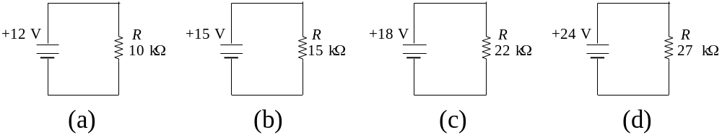
Quiz
7. The circuit with the largest current is
a. (a)
b. (b)
c. (c)
d. (d)

Slide 22
Quiz
8. The circuit with the smallest current is
a. (a)
b. (b)
c. (c)
d. (d)

Slide 23
Quiz
9. Before troubleshooting a faulty circuit you should find out
a. If the circuit ever worked
b. The conditions that existed when it failed
c. The symptoms of the failure
d. All of the above

Slide 24
Quiz
10. A troubleshooting method that starts in the middle and works toward a fault is
a. short-circuit testing
b. comparison testing
c. half-splitting
d. resistance testing

Slide 25
Quiz
Answers:
1. d
2. a
3. b
4. b
5. a
6. c
7. a
8. c
9. d
10. c

Slide 26
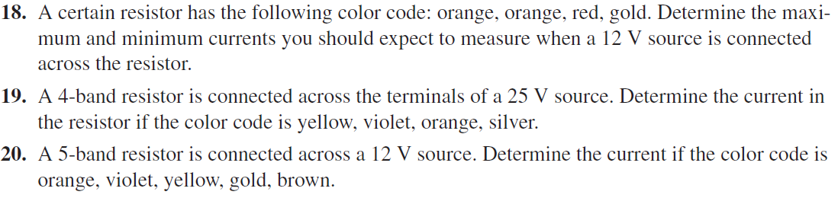


HomeWork
Upload on portal as per given deadline

