Slide 1
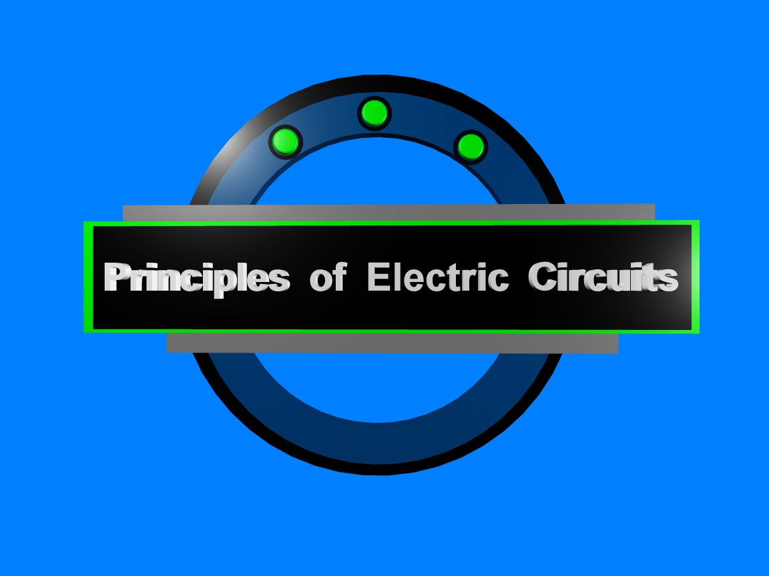
Chapter 4

Slide 2
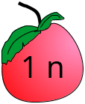
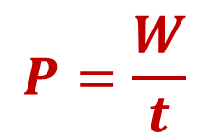
Summary
Energy
Energy is the ability to do work, and power is the rate at which energy is used.
Energy, W, is the ability to do work and is measured in joules. One joule is the work done when a force of one newton is applied through a distance of one meter.
1 m
One watt (W) is the amount of power when one joule of energy is used in one
second.

Slide 3
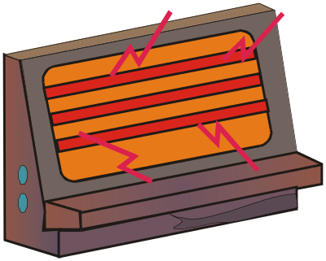
Summary
Energy
The kilowatt-hour (kWh) is a much larger unit of energy than the joule. There are 3.6 x 10⁶ J in a kWh. The kWh is convenient for electrical appliances.
Question:
What is the energy used in operating a 1200 W heater for 20 minutes?
1200 W = 1.2 kW
20 min = 1/3 h
1.2 kW X 1/3 h =0.4 kWh

Slide 4
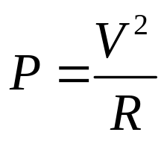


Summary
Power
Power is the rate energy is “used” (actually converted to heat or another form). Power is measured in watts (or kilowatts). Notice that rate always involves time.
One watt = one joule/second
Three equations for power in circuits that are collectively known as Watt’s law are:

Slide 5
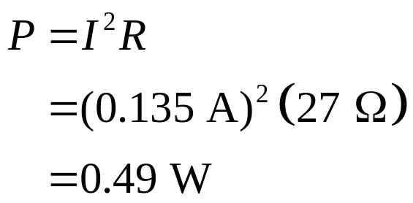
Summary
Power
Example-1:
What power is dissipated in a 27 Ω resistor is the current is 0.135 A?
Solution:
Given that you know the resistance and current, substitute the values into P =I ²R.

Slide 6
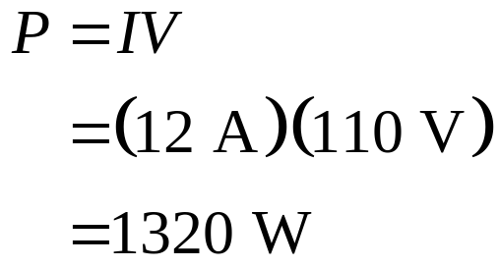
Summary
Power
Example-2:
What power is dissipated by a heater that draws 12 A of current from a 110 V supply?
Solution:
The most direct solution is to substitute into P = IV.

Slide 7
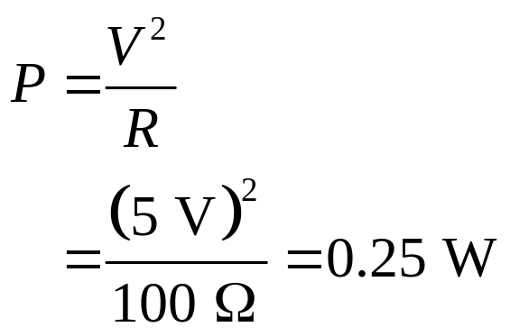
Summary
Power
Example-3:
What power is dissipated in a 100 Ω resistor with 5 V across it?
Solution:
V
2
=
The most direct solution is to substitute into .
P
R
It is useful to keep in mind that small resistors operating in low voltage systems need to be sized for the anticipated power.

Slide 8
Summary
Resistor failures
Resistor failures are unusual except when they have been subjected to excessive heat. Look for discoloration (sometimes the color bands appear burned). Test with an ohmmeter by disconnecting one end from the circuit to isolate it and verify the resistance. Correct the cause of the heating problem (larger resistor?, wrong value?).
Normal Overheated

Slide 9
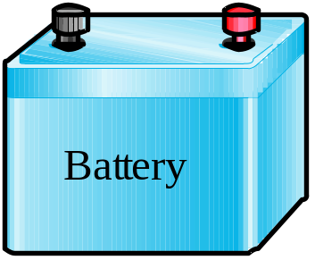
Summary
Ampere-hour Rating of Batteries
Expected battery life of batteries is given as the ampere-hours specification. Various factors affect this, so it is an approximation. (Factors include rate of current withdrawal, age of battery, temperature, etc.)
Question:
How many hours can you expect to have a battery deliver 0.5 A if it is rated at 10 Ah?
20 h

Slide 10
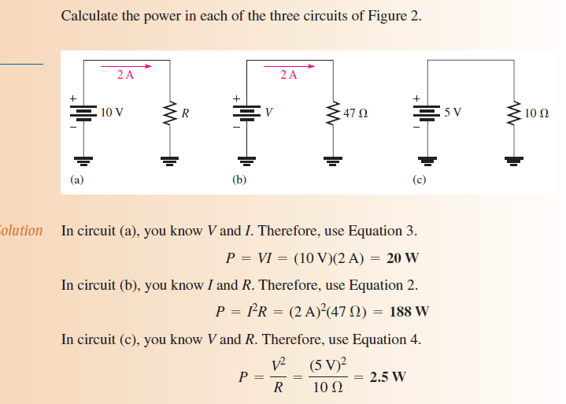

Slide 11
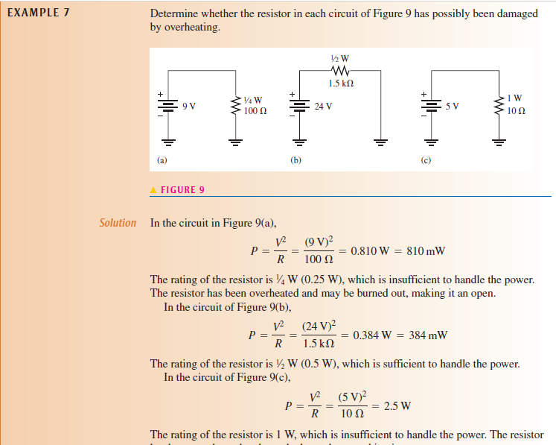

Slide 12
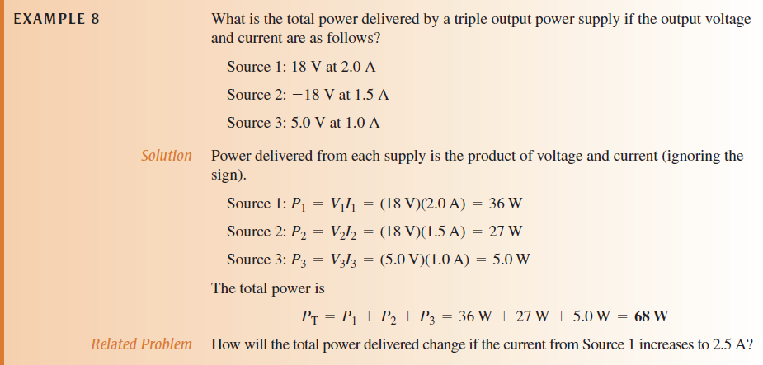

Slide 13
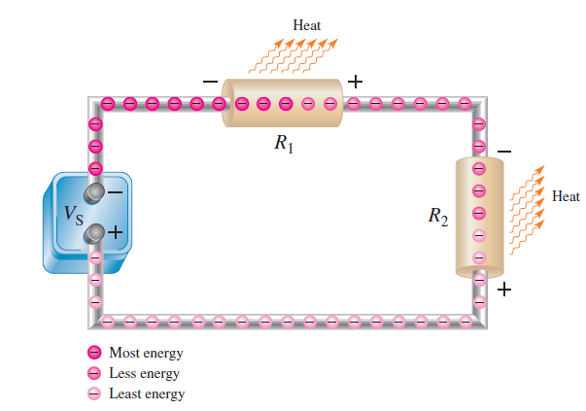

Slide 14
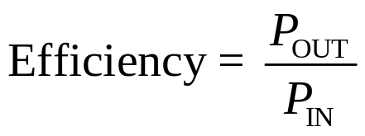
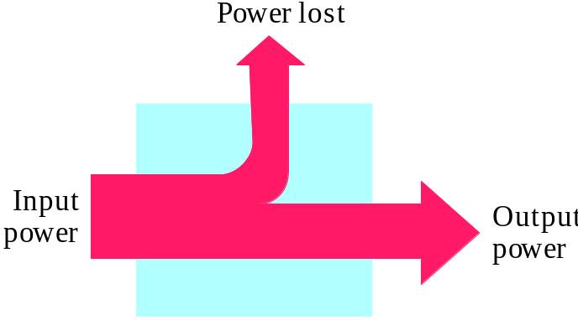
Summary
Power Supply Efficiency
Efficiency of a power supply is a measure of how well it converts ac to dc. For all power supplies, some of the input power is wasted in the form of heat. As an equation,
Question:
What is the efficiency of a power supply that converts 20 W of input power to 17 W of output power?
85%

Slide 15

Selected Key Terms
Ampere-hour rating
Efficiency
Energy
Joule
A number determined by multiplying the current (A) times the length of time (h) that a battery can deliver that current to a load.
The ratio of output power to input power of a circuit, usually expressed as a percent.
The ability to do work.
The SI unit of energy.

Slide 16
Selected Key Terms
Kilowatt-hour (kWh)
Power
Watt
A large unit of energy used mainly by utility companies.
The rate of energy useage
The SI unit of power.

Slide 17
Quiz
1. A unit of power is the
a. joule
b. kilowatt-hour
c. both of the above
d. none of the above

Slide 18
Quiz
2. The SI unit of energy is the
a. volt
b. joule
c. watt
d. kilowatt-hour

Slide 19
Quiz
3. If the voltage in a resistive circuit is doubled, the power will be
a. halved
b. unchanged
c. doubled
d. quadrupled

Slide 20
Quiz
4. The smallest power rating you should use for a resistor that is 330 Ω with 12 V across it is
a. ¼ W
b. ½ W
c. 1 W
d. 2 W

Slide 21
Quiz
5. The power dissipated by a light operating on 12 V that has 3 A of current is
a. 4 W
b. 12 W
c. 36 W
d. 48 W

Slide 22
Quiz
6. The power rating of a resistor is determined mainly by
a. surface area
b. length
c. body color
d. applied voltage

Slide 23
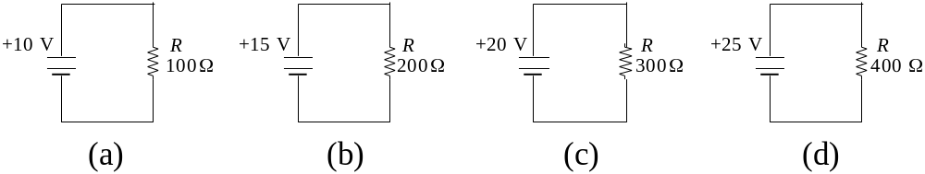
Quiz
7. The circuit with the largest power dissipation is
a. (a)
b. (b)
c. (c)
d. (d)

Slide 24
Quiz
8. The circuit with the smallest power dissipation is
a. (a)
b. (b)
c. (c)
d. (d)

Slide 25
Quiz
9. A battery rated for 20 Ah can supply 2 A for a minimum of
a. 0.1 h
b. 2 h
c. 10 h
d. 40 h

Slide 26
Quiz
10. The efficiency of a power supply is determined by
a. Dividing the output power by the input power.
b. Dividing the output voltage by the input voltage.
c. Dividing the input power by the output power.
d. Dividing the input voltage by the output voltage.

Slide 27
Quiz
Answers:
1. d
2. b
3. d
4. b
5. c
6. a
7. d
8. a
9. c
10. a

Slide 28

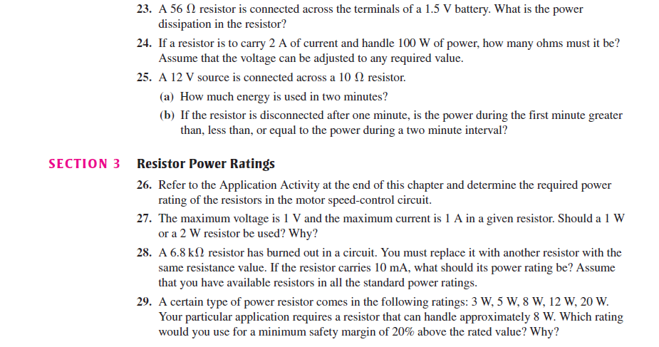

Slide 29


