Slide 1
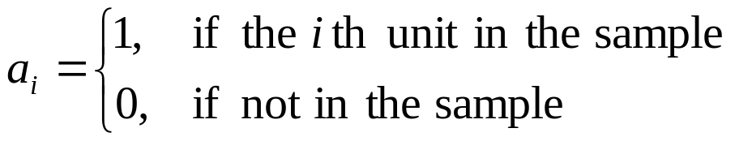

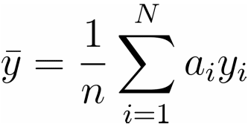
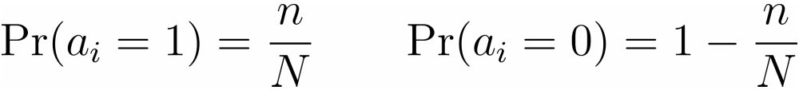


An alternative method of proof
Define
The sample mean may be written
Clearly
So is distributed as a binomial variate with

Slide 2
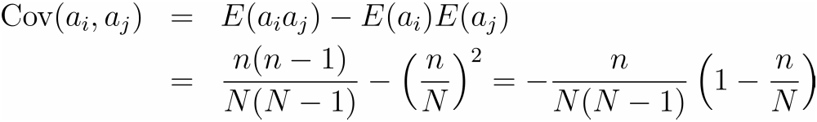
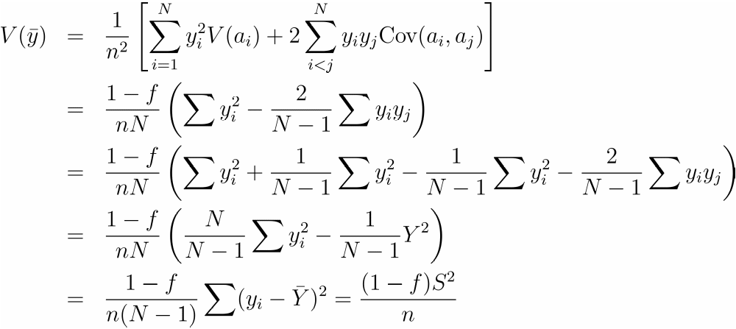

Slide 3

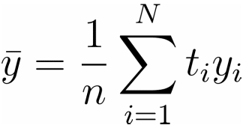

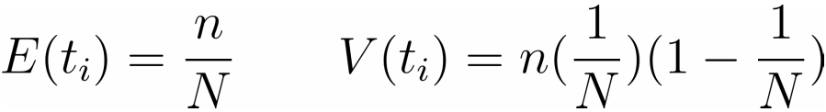
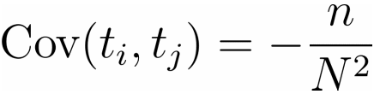
Random sampling with replacement
The ith unit may appear 0,1,2,…,n times in the sample
: the number of times that the ith unit appears
Since is distributed as a binomial variate with
The variates follow a multinomial distribution,

Slide 4
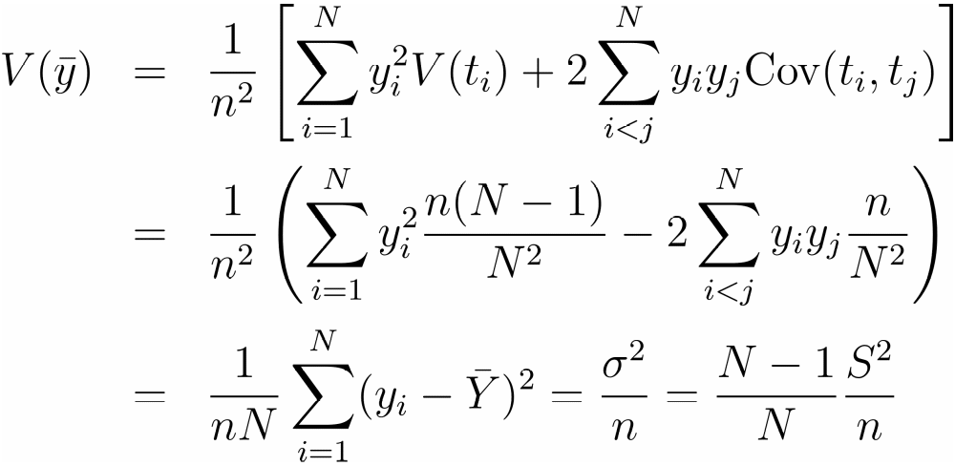



in sampling without replacement is only
times the variance in sampling with replacement.
They are equal to each other when .

