Slide 1

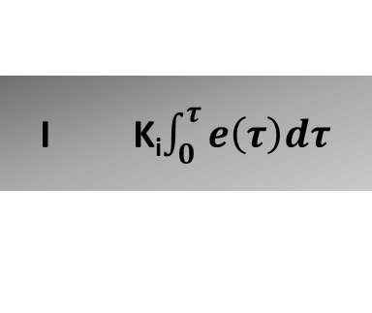


r(t)
y(t) ₋
+
Plant/process
$$∑$$
e(t)
P K_{p}e(t)
u(t)
+
$$∑$$
+
I K_{i}$\int_{0}^{τ}{e\left(τ\right)dτ}$
+
I K_{d}$\frac{de(t)}{dt}$

Slide 2
Y
R_{z}
R_{xz}
R_{yz}
R
X
R_{x}
R_{y}
Z

Slide 3
Y
R_{z}
A_{zr}
R
X
A_{xr}
R_{x}
A_{yr}
R_{y}
Z

Slide 4
Y
R_{z}
R
X
R_{x}
R_{y}
Z

Slide 5

+Z
Y-
X+
X-
X = 0g
Y = 0g
Z = 0g
Z-

Slide 6

+Z
X-
Y-
Lực quán tính ảo 1g
Gia tốc1g
X+
X = -1g
Y = 0g
Z = 0g
Z-

Slide 7

+Z
X-
Y-
Lực hấp dẫn 1g
X+
X = 0g
Y = 0g
Z = -1g
Z-
Mặt đất

Slide 8


Z+
X+
Y-
Lực hấp dẫn 1g
Z-
X-
X = -0.71g
Y = 0g
Z = -0.71g
Mặt đất

Slide 9
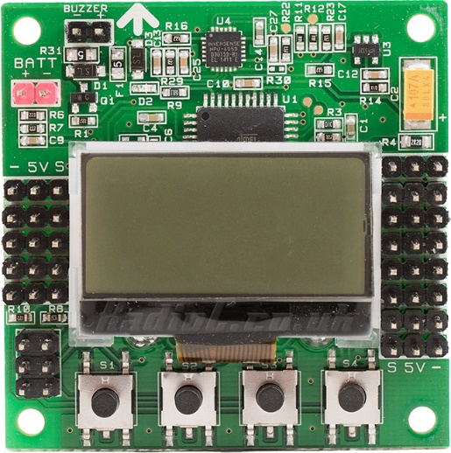
Cảm biến mpu6050
Vi điều khiển Atmega644p
LCD
(không sử dụng)
GPIO
Nạp code qua ISP
4x key
(không sử dụng)

Slide 10
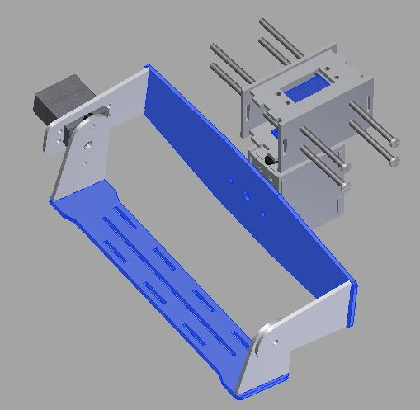
Ser vo X

Slide 11
Điện trở kéo lên
Vcc
Master
Slave
data
SDA
SCL
SDA
SCL
clock
SDA
SCL
SDA
SCL

Slide 12
START waitTransmissionI2C
data_for_TWCR_reg
TWCR = data_for_TWCR_reg
TWCR & (1<<TWINT) == 0
True
False
END waitTransmissionI2C

Slide 13
START i2c_writeReg
write_to_address
write_at_register
write_with_vaule
write_to_address = write_to_address << 1
waitTransmissionI2C((1<<TWINT) | (1<<TWSTA) | (1<<TWEN))
TWDR = write_to_address
waitTransmissionI2C((1<<TWINT) | (1<<TWEN))
TWDR = write_at_register
waitTransmissionI2C((1<<TWINT) | (1<<TWEN))
TWDR = write_with_vaule
waitTransmissionI2C((1<<TWINT) | (1<<TWEN))
END i2c_writeReg

Slide 14
START i2c_read_reg_to_buf
write_to_address
write_at_register
*write_to_buffer
size_of_buffer
write_to_address = write_to_address << 1
waitTransmissionI2C((1<<TWINT) | (1<<TWSTA) | (1<<TWEN))
TWDR = write_to_address
waitTransmissionI2C((1<<TWINT) | (1<<TWEN))
TWDR = write_at_register
waitTransmissionI2C((1<<TWINT) | (1<<TWEN))
TWDR = write_at_register
waitTransmissionI2C((1<<TWINT) | (1<<TWEN))
write_to_address = ((write_to_address << 1) | 1)
waitTransmissionI2C((1<<TWINT) | (1<<TWSTA) | (1<<TWEN))
TWDR = write_to_address
waitTransmissionI2C((1<<TWINT) | (1<<TWEN))
size_of_buffer == 0
False
waitTransmissionI2C((1<<TWINT) | (1<<TWEN) | (1<<TWEA))
*write_to_buffer++ = TWDR
size_of_buffer--
True
waitTransmissionI2C((1<<TWINT) | (1<<TWEN))
*write_to_buffer = TWDR
TWCR = (1 << TWINT) | (1 << TWEN) | (1 << TWSTO)
END i2c_read_reg_to_buf

Slide 15
Đọc cảm biến
Bộ lọc kalman
PID cho trục X
PID cho trục X
PID cho trục X
PID cho trục Y
PID cho trục X
PID cho trục Z

Slide 16
START up_data_pid
pTerm
iTerm
dTerm
return_value
err = 0 – global_angle
delta_time = t_now – global_time_old
global_time_old = t_now
dTerm = global_Kd * err
derivative = (err – golabl_err_old)/delta_time
dTerm = global_Kd * derivative
global_intergral += err * delta_time
iTerm = global_Ki * global_intergral
golbal_err_old = err
return_value = pTerm + iTerm + dTerm
return return_value
END up_data_pid

Slide 17
START prgram
EVERY_1000_us()
False
False
get_raw_angle_x()
get_raw_angle_y()
get_raw_angle_z()
global_angle_x = get_angle_x()
global_angle_y = get_angle_y()
global_angle_z = get_angle_z()
control_servo_x()
control_servo_y()
control_servo_z()
pwm_x = Up_data_pid_X()
pwm_y = Up_data_pid_Y()
pwm_z = Up_data_pid_Z()

