Slide 1
Brigade Operations (Brigade Ops)

Slide 2
Introduction
Brigade Ops simulates modern combat between two opponents of equal abilities.
Maneuver units are Companies and Platoons.
Brigade Ops is meant to simulate tactical decision-making at the brigade level.
The game is suitable for teaching tactical decision-making and problem solving.

Slide 3
Game Concept
Single player hotseat. Hotseat means that both players use the same computer to play the game.
2d graphics.
Minimal sound.
Easy to play and understand.

Slide 4
Game Overview
Playable in a browser over the internet or LAN.
The player makes the appropriate level of decisions.
Low hardware requirements.
Low network requirements.
NOT a 3d game.
NOT a first-person shooter or side-scroller.

Slide 5
Gameplay
Brigade Ops is played on a 2d map which is overlaid with a hexagonal grid.
Players choose a scenario which gives them the information they need in order to play the game. For example mission objectives, enemy and friendly forces, etc.
The hex grid is used to control movement and combat.
Players take turns moving their units and attacking enemy units.
At the end of four turns the game ends and a winner is determined.
There are two sides Bluefor which stands for Blue Forces (Blue).
Opfor which stands for Opposing Force (Red).

Slide 6
Technical Goals
Playable on any operating system.
Only playable over a LAN or Internet connection. Using a client and a server.
Must be compatible with all the major browsers, Chrome, Opera, Firefox, IE, etc.

Slide 7
Game Assets
All images should be in jpg or png format.
Sound (to be determined)
Animations (to be determined)
Map image jpg or png format.
Unit icons jpg or png format.
Game markers jpg or png format.
Terrain File which specifies the map image and terrain data.
Scenario File which includes unit data, and player information needed to play the game.

Slide 8
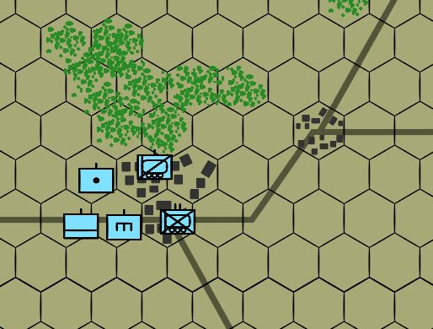
Map and Bluefor Units
Wood Hexes
Town Hex
This screen shot shows five Bluefor units. All of the unit icons are using NATO symbols.

Slide 9
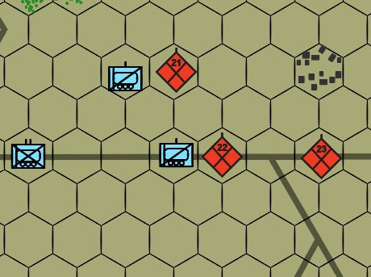
Map and Bluefor/Opfor Units
Bluefor unit
Opfor unit

Slide 10
Development Software
Javascript is the language of choice for this project mainly because it is the language most used on the internet.
Phaser is A FREE game development framework for Javascript and provides all the functionality for a 2d game.

Slide 11
Prototype
The most minimal version of the program that uses simple movement and combat functionality.
Should not take more than two or three months to code.
Determine if the Phaser game library is useable for future versions of the program.
Determine additional resousces that may be required for the next version of the program.

Slide 12
Minimum Viable Product
The MVP version should be good enough to show potential customers.
Significantly more development time.
Should include all core functionality and a more detailed model of military operations.
Game art should be professionally done.
Must include three to five different scenarios.

