Slide 1
Food Order System

Slide 2
Submitted By:
Oabdel Hasan
Registration No:
16502000589
Session: 2016-17
Taijul Islam
Registration No:
16502000590
Session: 2016-17
Supervised By:
S.M.Mahmudul Hasan
Lecturer
Department of Computer science and Engineering
New Model Degree collage

Slide 3
Outline
Motivation
Project Feasibility
Implementation
System Model
Web Ordering System Module
Schema Diagram
ER Diagram
Web Interfaces

Slide 4
Motivation
The motivation for designing this application came because my family is involved in the fast food business and I personally do not like waiting for long in the store or to have to call store to place an order especially during the peak lunch or dinner hours. Moreover, I value recent learning about the PHP languages as well as seeing how powerful and dynamic they are when it comes to web designing and applications. The languages used to build this application are PHP, HTML and database at the back-end because I found them to be extremely useful while working on the technologies.

Slide 5
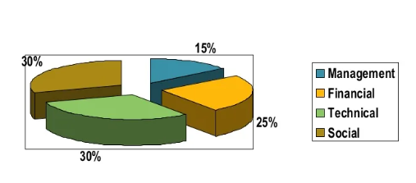
Project Feasibility

Slide 6
Implementation
Hardware Interface:
Pentium Processor
60 MB of free hard-drive space
128 Mb Ram
Software Interface:
Operating system:windows(vista/7 or above)
Web browser:IE 10 or Above,Mozila FF
Xampp Platfrom

Slide 7
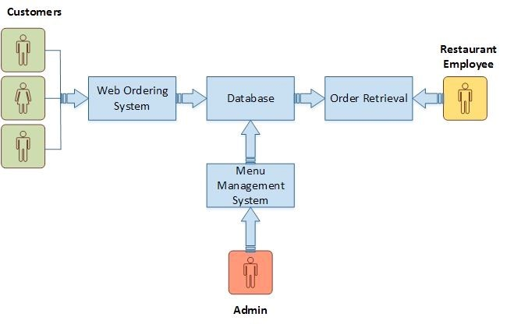
System Model

Slide 8
Web Ordering System Module
Create an account.
Manage their account.
Log in to the system.
Navigate the restaurant’s menu.
Select an item from the menu.
Add an item to their current order.
Review their current order.
Remove an item/remove all items from their current order.
Provide payment details.
Place an order.
Receive confirmation in the form of an order number.
View order placed.

Slide 9
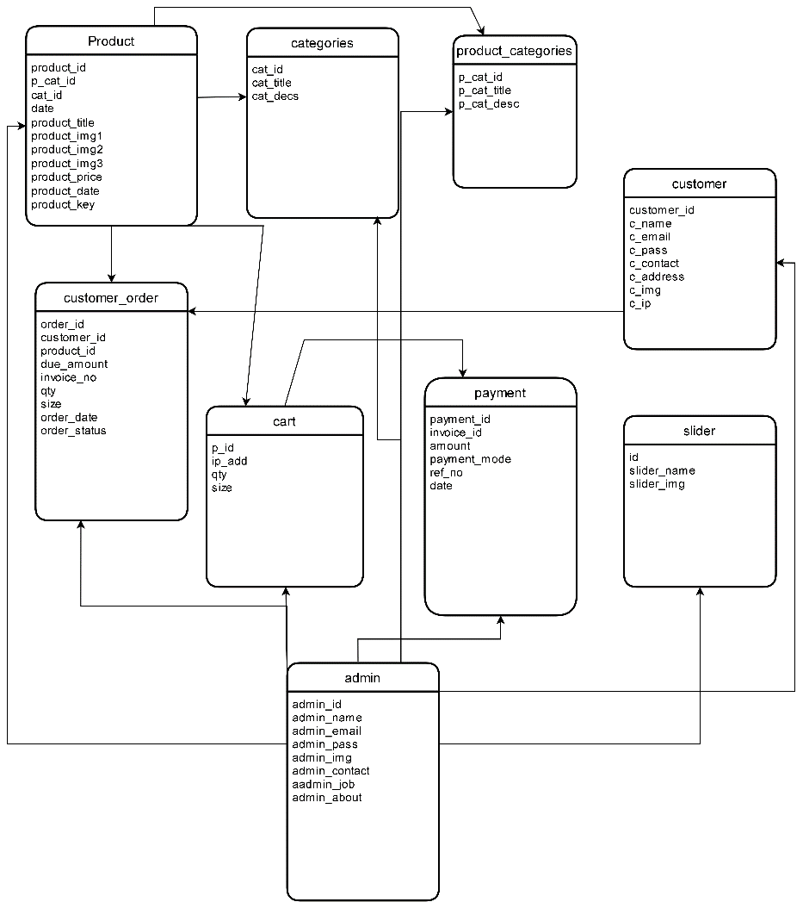
Schema Diagram

Slide 10
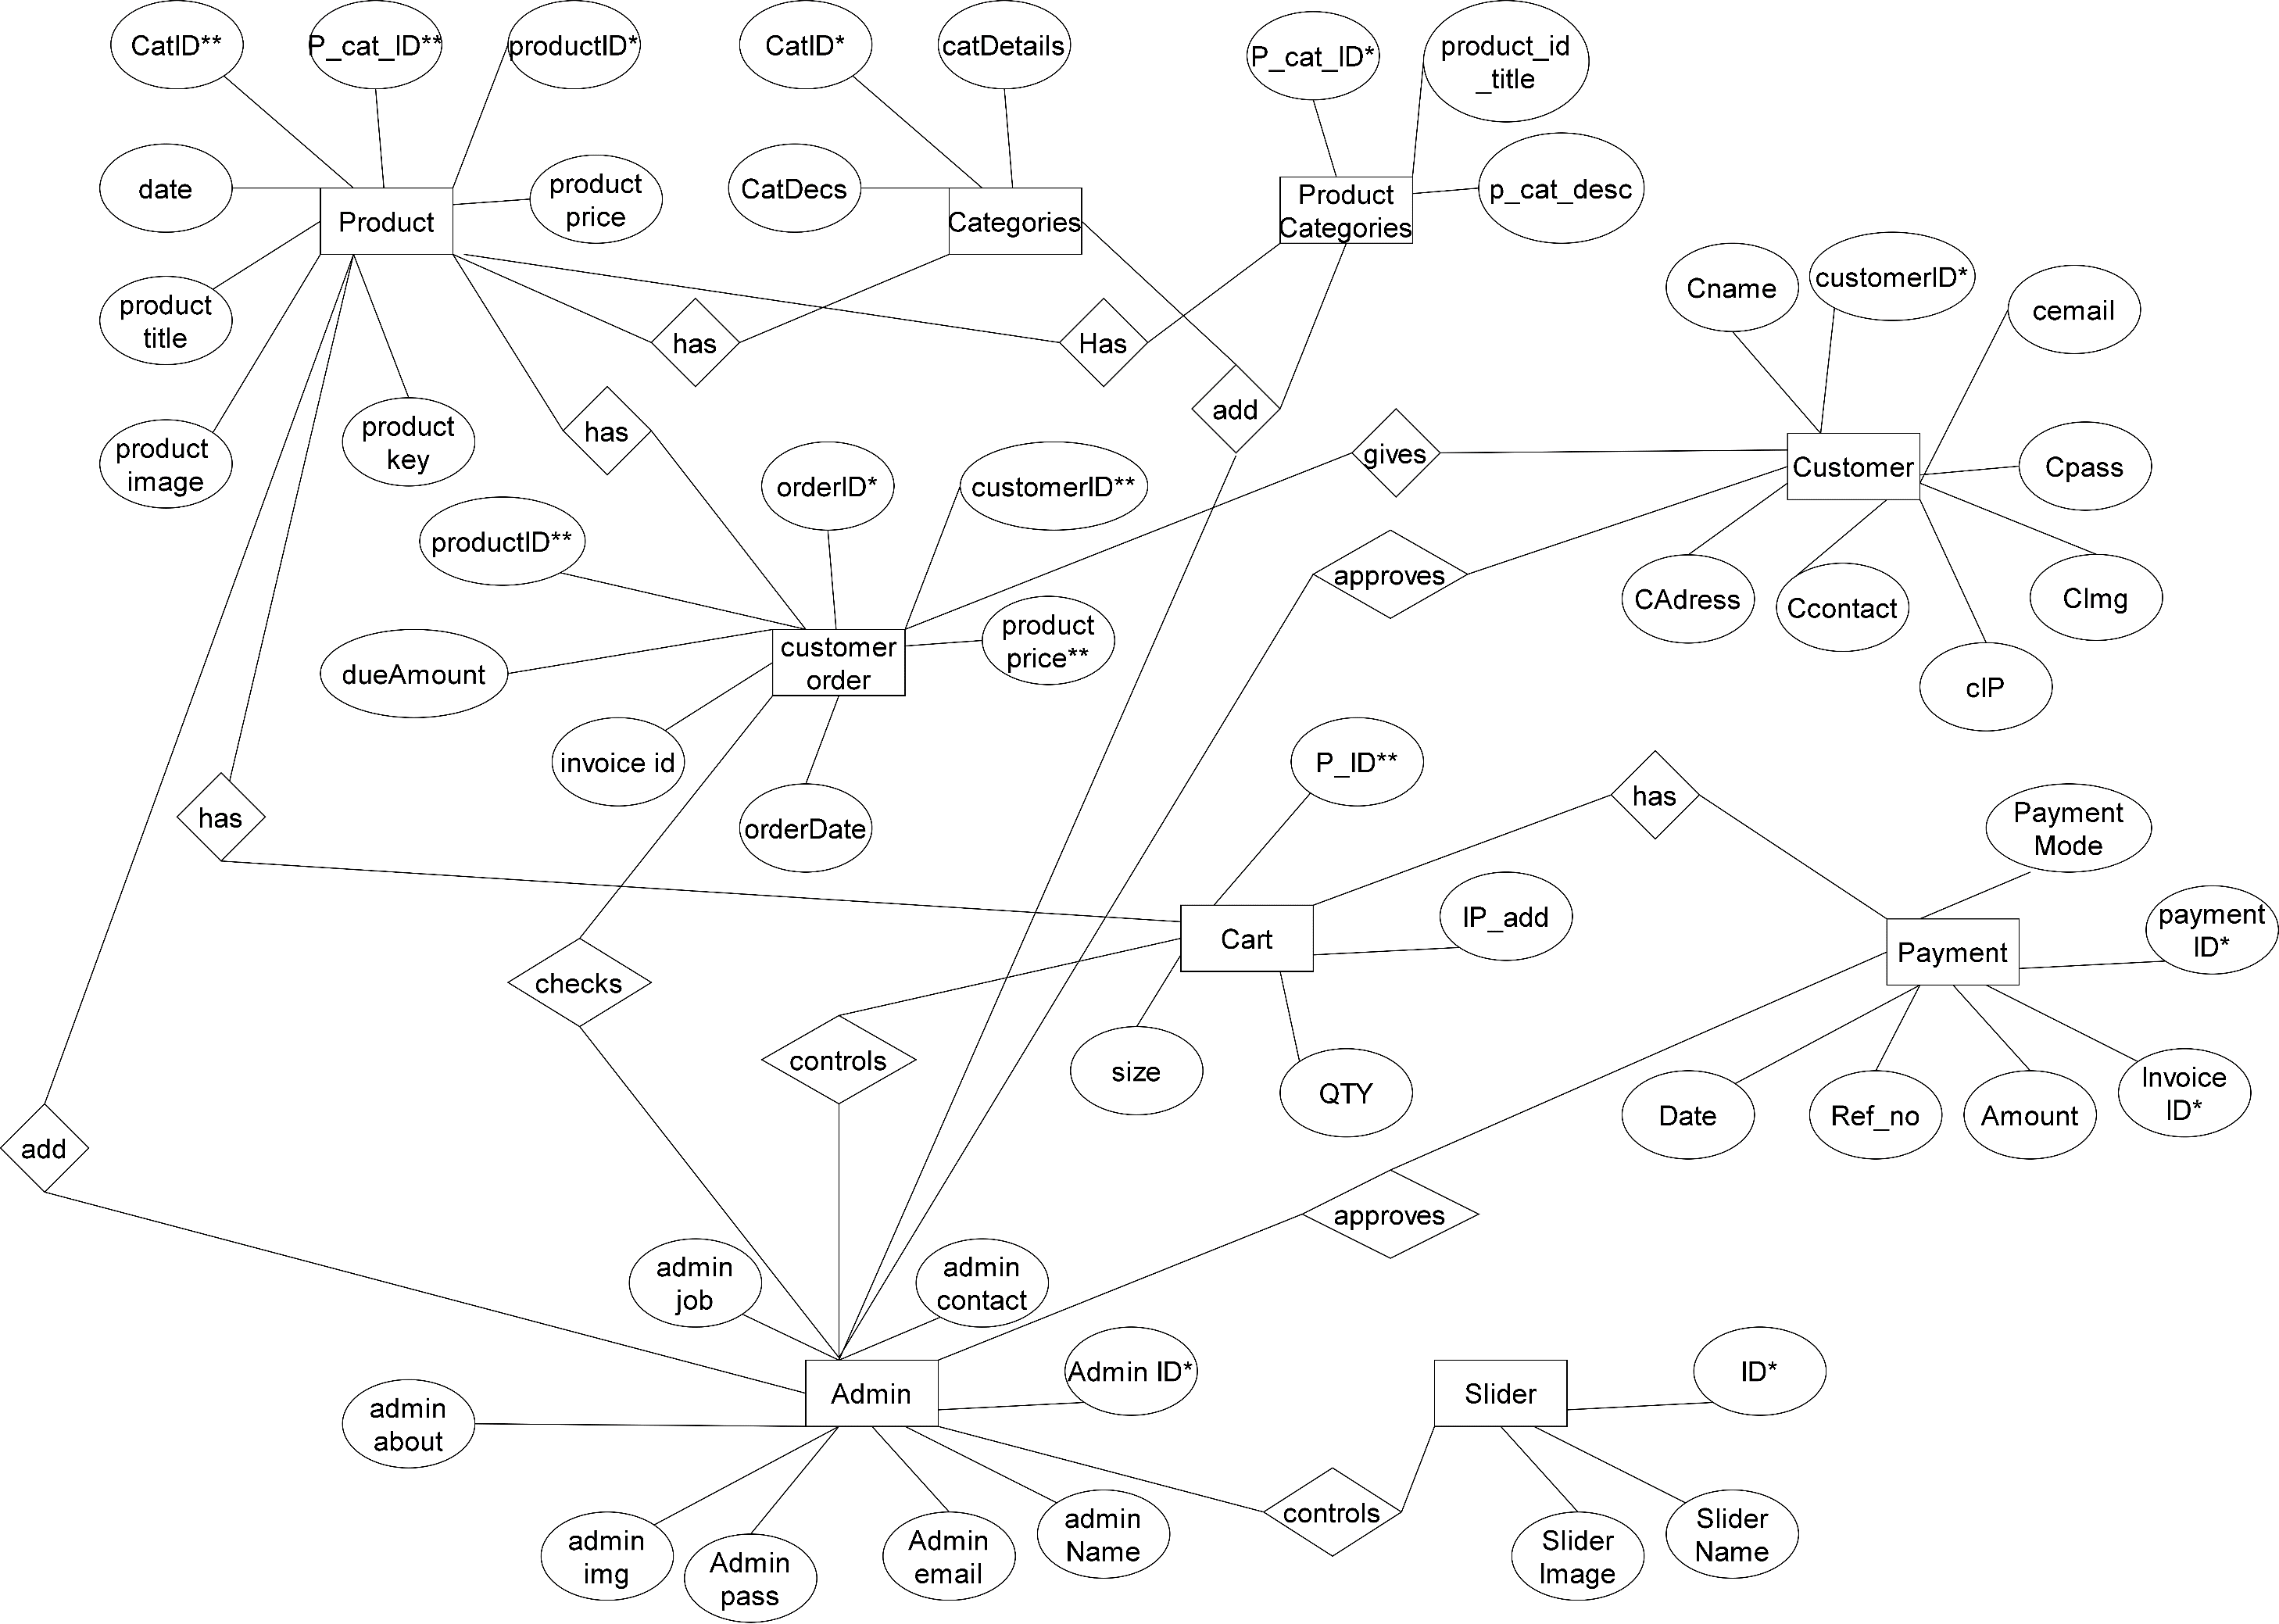
ER Diagram

Slide 11
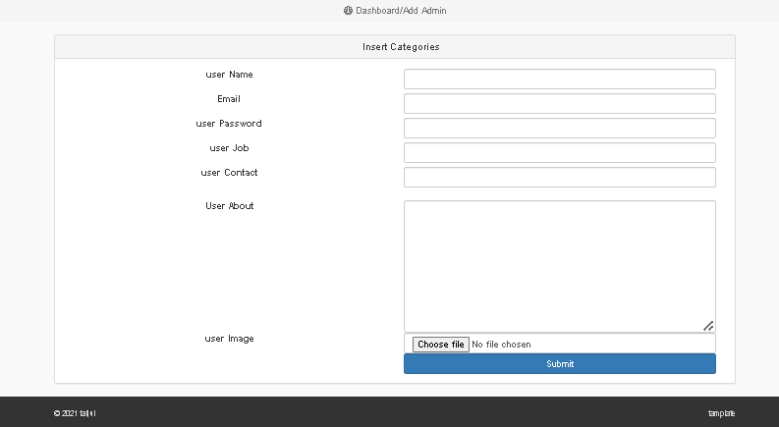
Web Interfaces

Slide 12
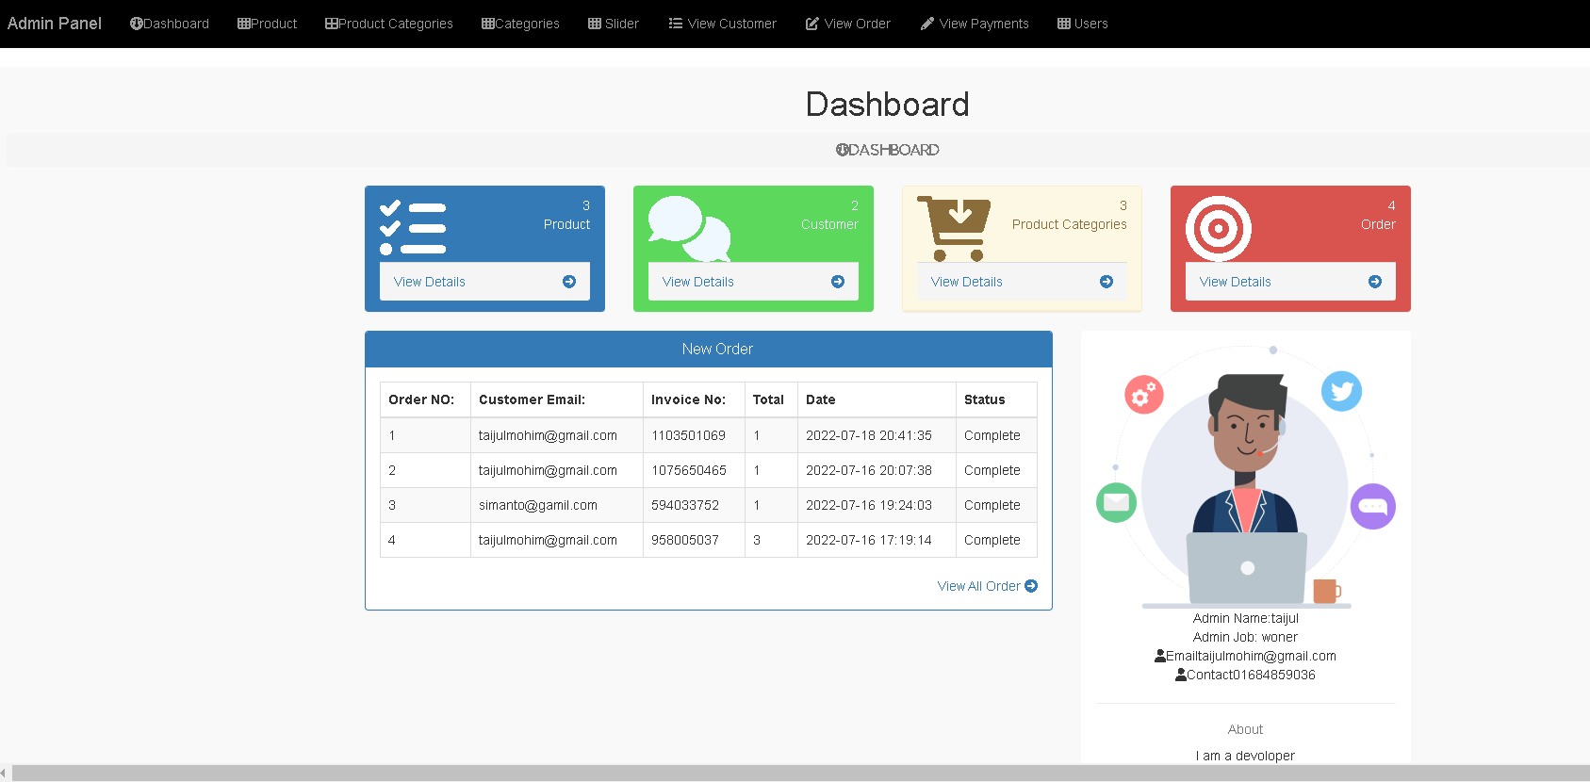
Web Interfaces

Slide 13
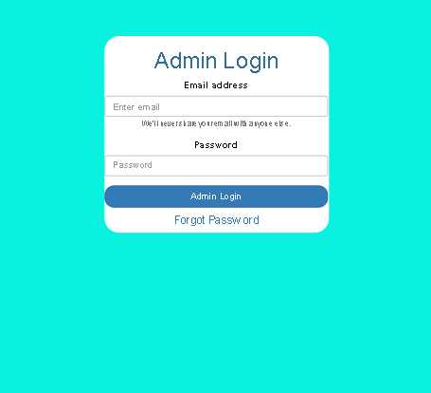
Web Interfaces

Slide 14
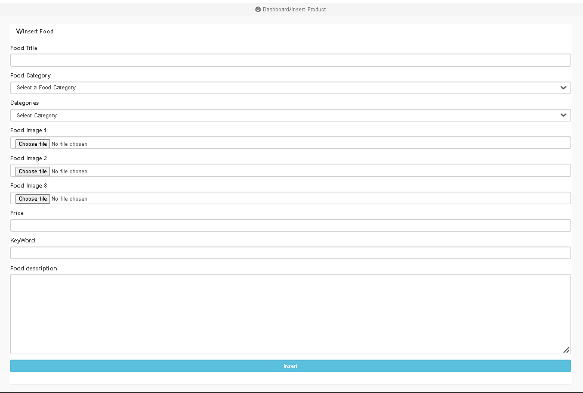
Web Interfaces

Slide 15
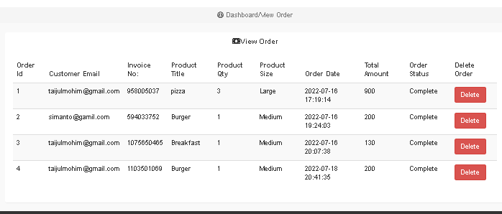
Web Interfaces

Slide 16
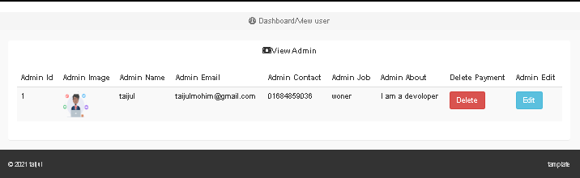
Web Interfaces

Slide 17
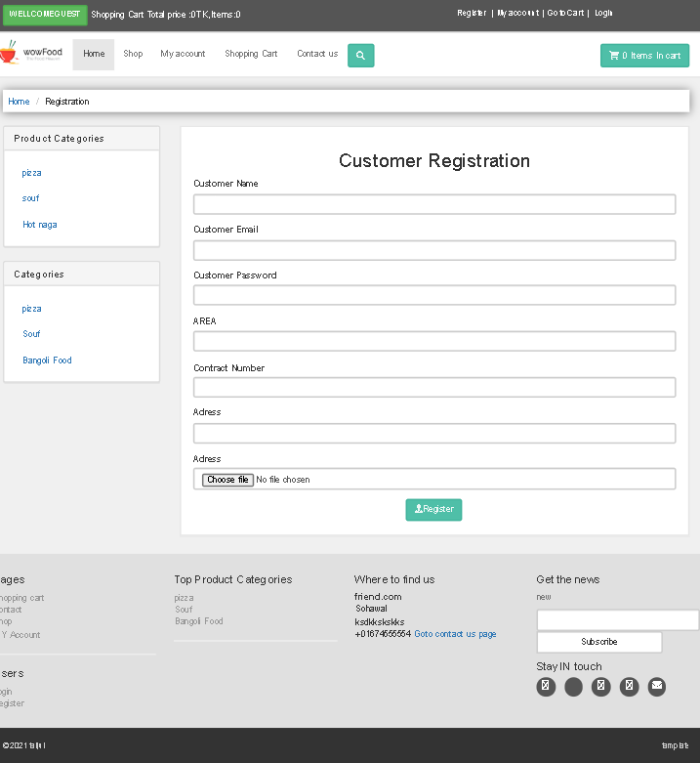
Web Interfaces

Slide 18
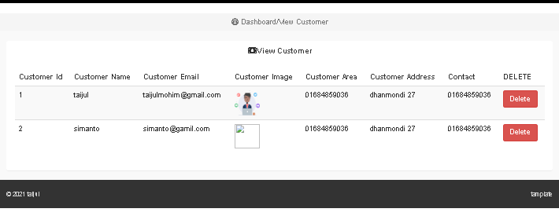
Web Interfaces

Slide 19
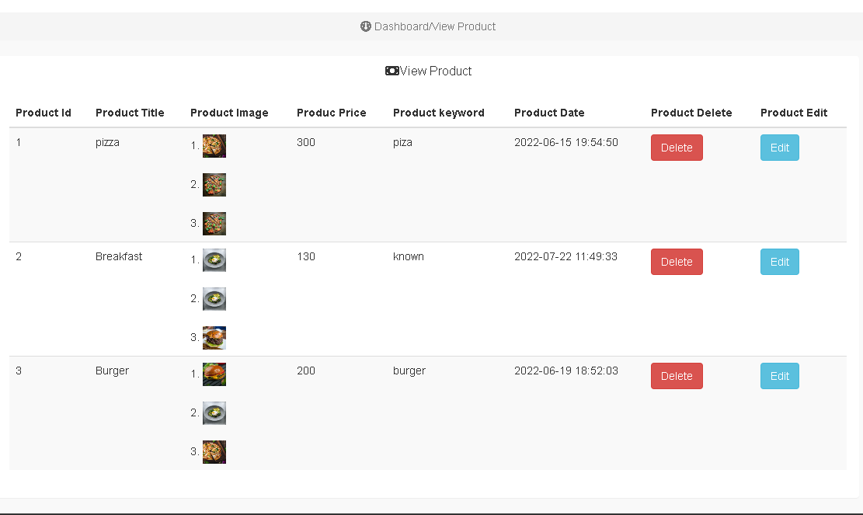
Web Interfaces

Slide 20
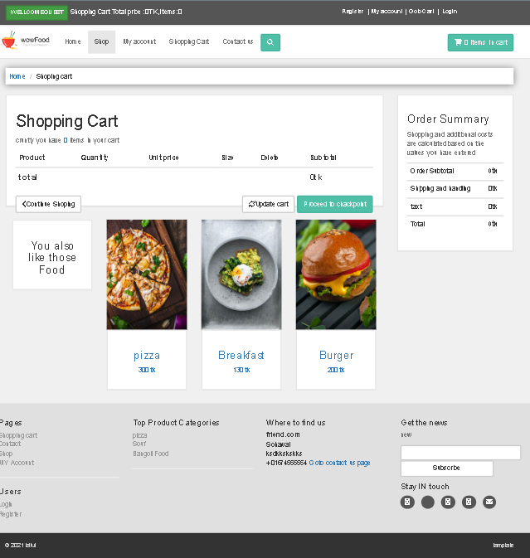
Web Interfaces

Slide 21
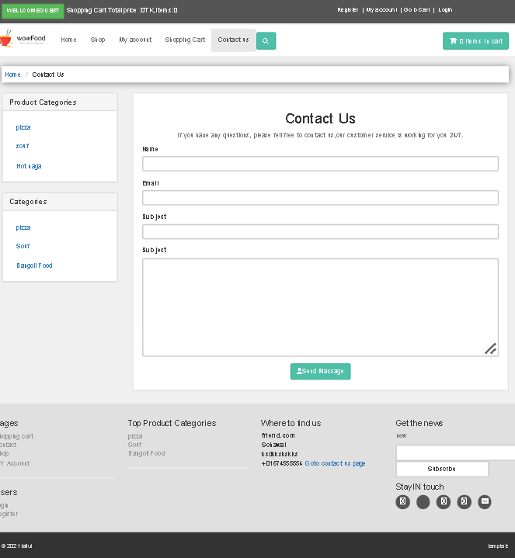
Web Interfaces

Slide 22
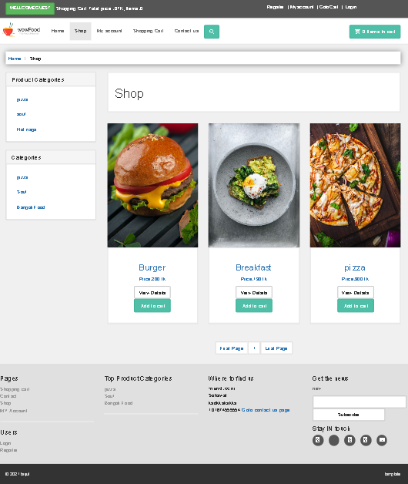
Web Interfaces

Slide 23
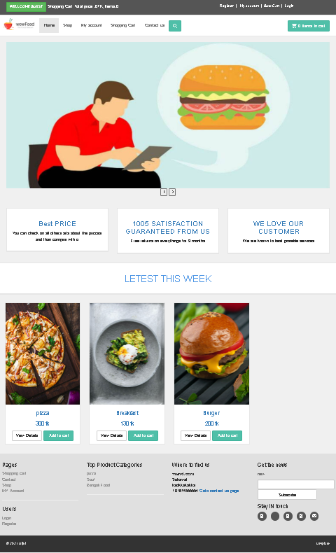
Web Interfaces

Slide 24
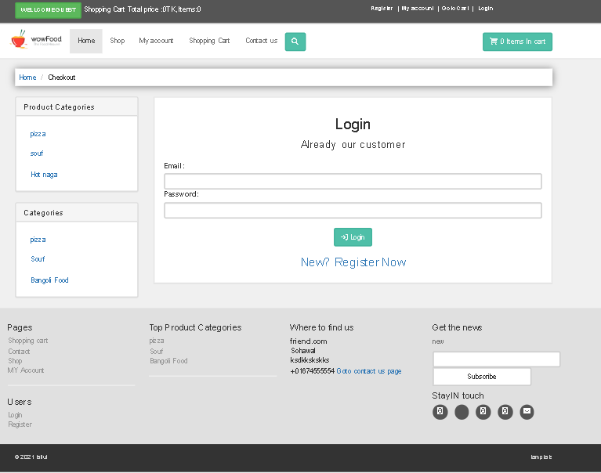
Web Interfaces

Slide 25
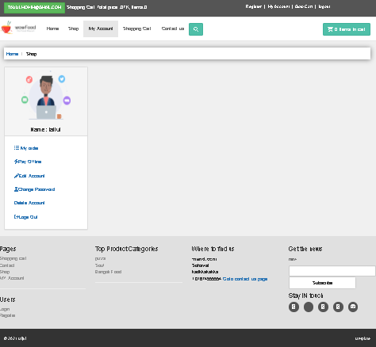
Web Interfaces

Slide 26
Future Work
Update Security System
Mobile Application
Multiple Store

Slide 27
Thank You

