Slide 1
Linux Debugging Guide

Slide 2
Logging
Debugging, Monitoring of daemon
syslogd, systemd-journald
syslogd log file /var/log/messages /var/log/kern.log /var/log/syslog.log …
cat, tail, grep, etc.. $ tail -f /var/log/messages $ tail -f /var/log/messages | grep “string to search” $ cat /var/log/messages | grep “string to search”
lnav
log file navigator
Command line tool
Support input as multiple log files
Filter-in, Filter-out string pattern
http://lnav.readthedocs.org/en/latest/hotkeys.html

Slide 3
Journald
Logging system provided by systemd
Manage all kind of log on system ex) stdout / syslog / audit-data / kmsg
Log data /var/log/journal/***, /run/log/journal/*** /var/log/journal/MACHINE-ID/system.journal
Save log data as database format : provide journalctl tool for displaying log
https://www.digitalocean.com/community/tutorials/how-to-use-journalctl-to-view-and-manipulate-systemd-logs

Slide 4
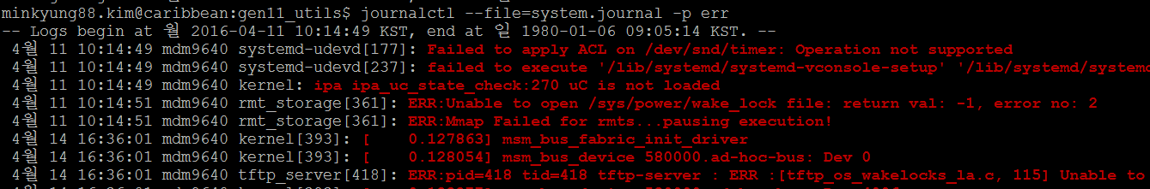
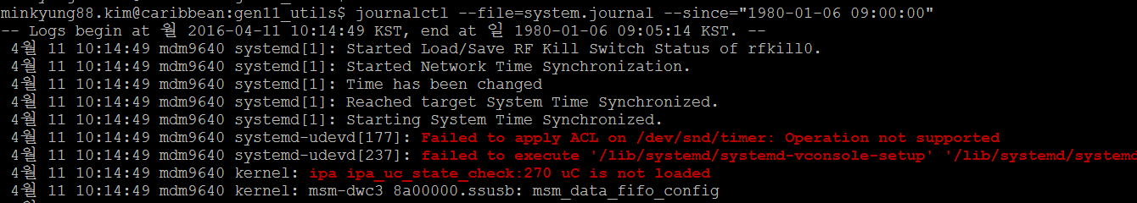
journalctl
$ journalctl --file=system.journal Read all logs (--file option specify log file)
$ journalctl -p err : show error level only
$ journalctl --unit=test.service : read logs generated by test.service
$ journalctl --since "2015-01-10" --until "2015-01-11 03:00“ : show logs between specified date
$ journalctl –k : show kernel logs only

Slide 5
objdump
Disassemble
Display headers
$ arm-linux-gnueabi-objdump -D -S <elf> | less -D: disassemble for all section -d: disassemble for executable section -S: Show source code if available
$ arm-linux-gnueabi-objdump -x <elf> | less -x: display all headers -h: display section headers

Slide 6
addr2line / nm
Get line number of source for given address $ arm-linux-gnueabi-addr2line -e testapp 0x10762 –f main /home/munyoung.hwang/project/gen11/src/misc/testapp/main.c:5 usage: arm-linux-gnueabi-addr2line –f –e <elf> <addr> -e: elf file -f: show function name
Get address for given function $ arm-linux-gnueabi-nm testapp | grep main 00010750 T main result format: Addr SymbolType SymbolName symbol type: if upper case, the symbol is global. “r” “R”: read only symbol “t” “T”: symbol is in text section “b” “B”” symbol is in BSS section “d” “D”: symbol is in data section ☞ refer “man nm”
$ arm-linux-gnueabi-addr2line –f -e testapp 0x10762 main /home/munyoung.hwang/project/gen11/src/misc/testapp/main.c:5 usage: arm-linux-gnueabi-addr2line –f –e <elf> <addr> -e: elf file -f: show function name
$ arm-linux-gnueabi-nm testapp | grep main 00010750 T main result format: Addr SymbolType SymbolName symbol type: if upper case, the symbol is global. “r” “R”: read only symbol “t” “T”: symbol is in text section “b” “B”” symbol is in BSS section “d” “D”: symbol is in data section ☞ refer “man nm”

Slide 7
strace
System Call Trace
Simple and Fast, but Powerful
Usage strace [options] PROG strace [options] -p PID
Useful options -c: count, time for system calls -o file: set output file -e expr: filter system call ex) strace –e open,read,write ls

Slide 8
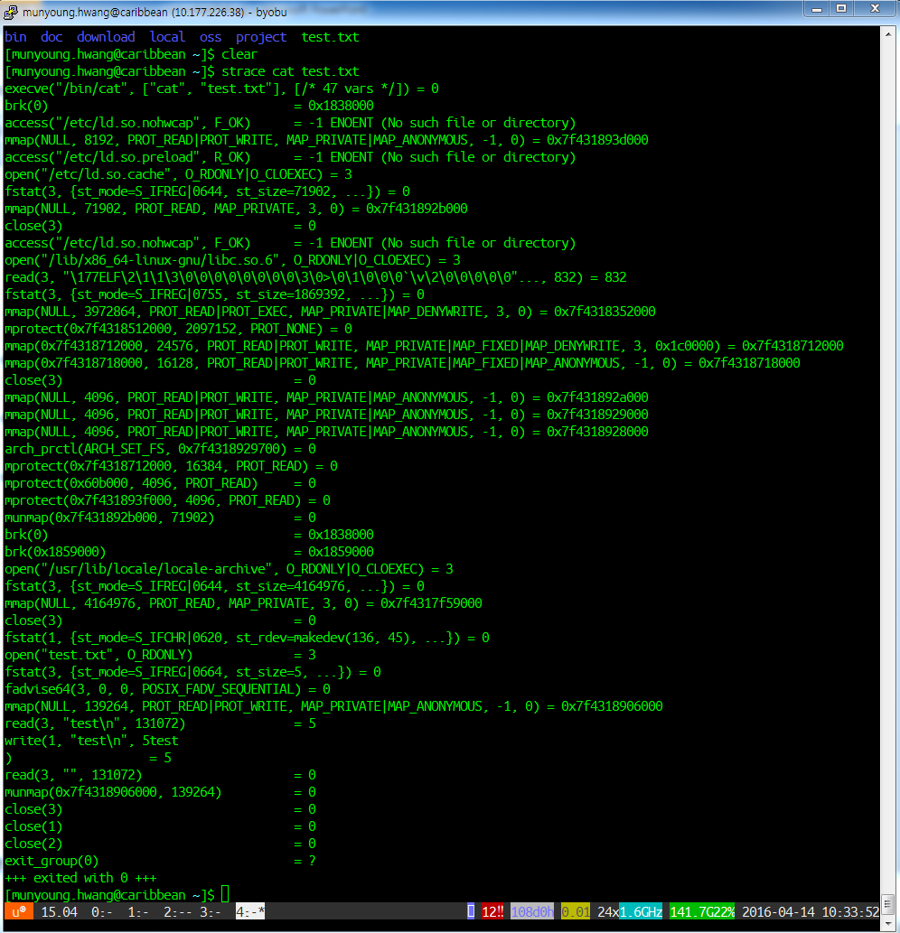
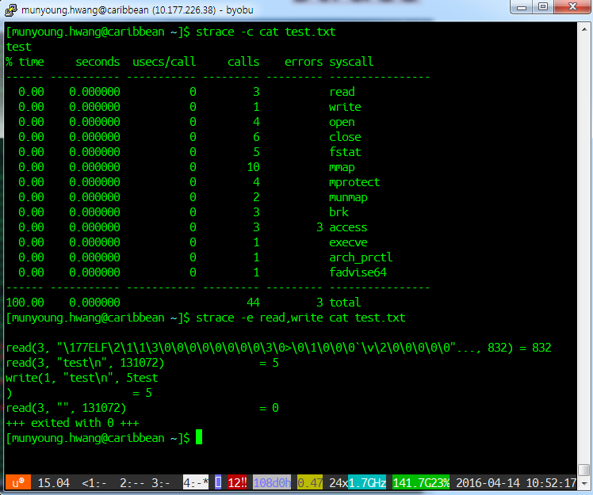
strace

Slide 9
ltrace
Dynamic(runtime) Library Call Trace
Similar to strace
Usage ltrace [options] PROG ltrace [options] -p PID
Useful options -c: count, time for library calls -o file: set output file -e expr: filter library call -i: show ip address of each library call

Slide 10
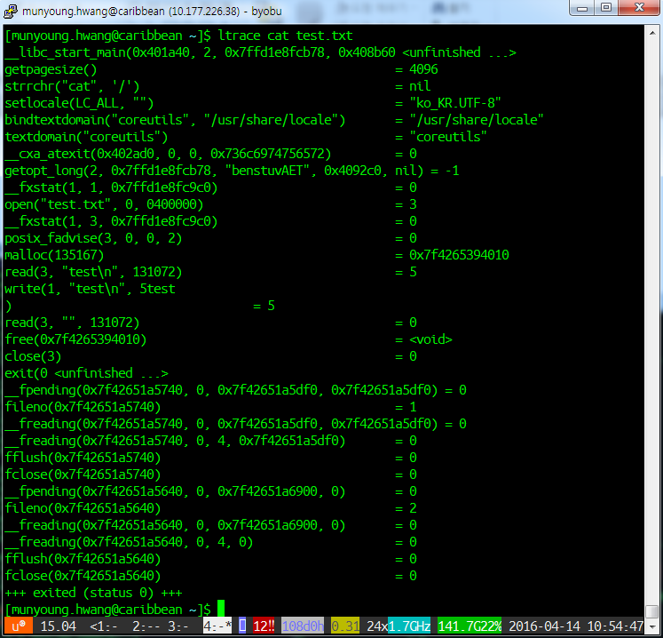
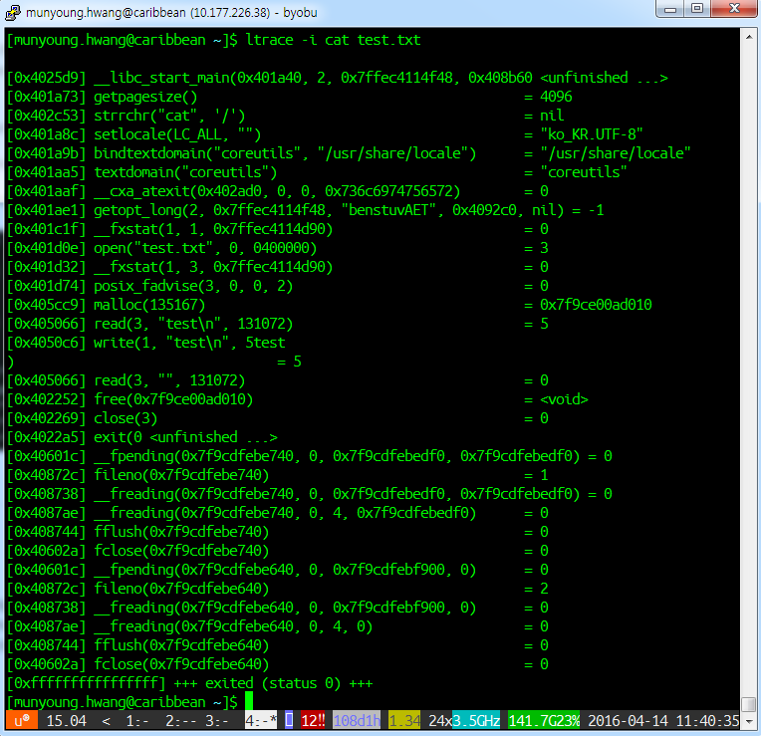
ltrace

Slide 11
qemu
qemu?
Machine emulator (qemu-system-arm,…)
CPU emulator(qemu-arm,…) run directly arm executables.
qemu-arm
Static build
Support gdb
$ arm-linux-gnueabi-gcc -static -o testapp main.c
$ qemu-arm testapp
Hello world!
$ qemu-arm -g 2345 testapp
$ arm-linux-gnueabi-gdb testapp
(gdb) target remote :2345

Slide 12
gdb – remote debug
Download GCC toolchain http://releases.linaro.org/components/toolchain/binaries/4.9-2016.02/arm-linux-gnueabi/
Build application (host) adding “-g” compile option for debug symbol
Push application to device (host) $ adb push testapp /data/
Run gdbserver (device) $ gdbserver :2345 /data/testapp $ gdbserver --attach :2345 <PID>
Port forward using adb (host) $ adb forward tcp:2345 tcp:2345
Run gdb (host) $ arm-linux-gnueabi-gdb testapp (gdb) target remote :2345

Slide 13
gdb – windows
Download GCC toolchain http://releases.linaro.org/components/toolchain/binaries/4.9-2016.02/arm-linux-gnueabi/gcc-linaro-4.9-2016.02-i686-mingw32_arm-linux-gnueabi.tar.xz
Setting PATH for toolchain <gdbcmd.bat> file @echo off rem Set path for Linaro gnueabi tool chain. set ARM_GCC=D:\Developer\gcc-linaro-4.9-2016.02-i686-mingw32_arm-linux-gnueabi\bin set ADB=D:\Developer\adb set PATH=%ADB%;%ARM_GCC%;%PATH% cmd
In gdb session (gdb) set substitute-path /home/munyoung.hwang y: (gdb) target remote :2345 (gdb) break main (gdb) continue
Your network drive to linux build machine

Slide 14
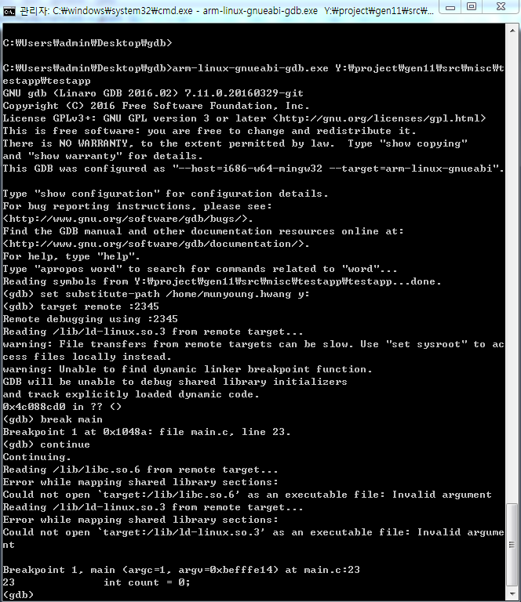
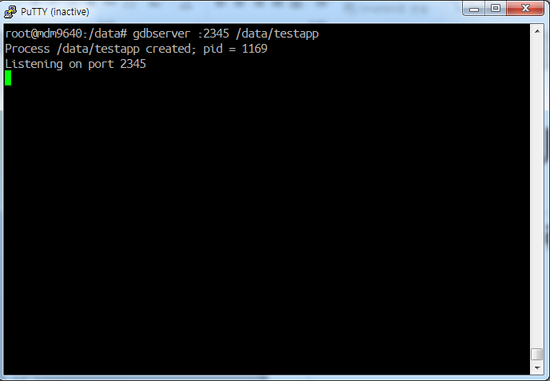
gdb – testapp demo

Slide 15
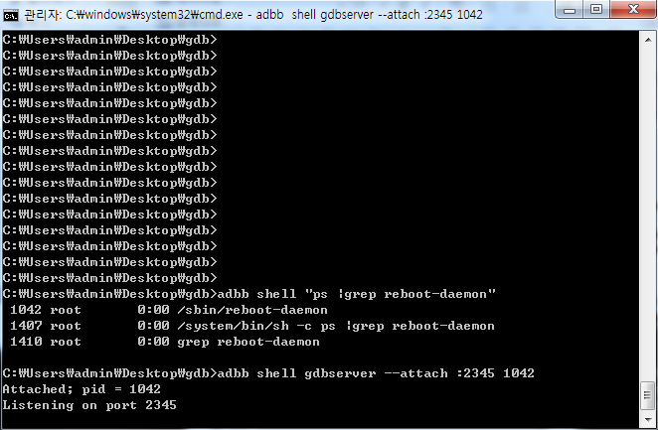
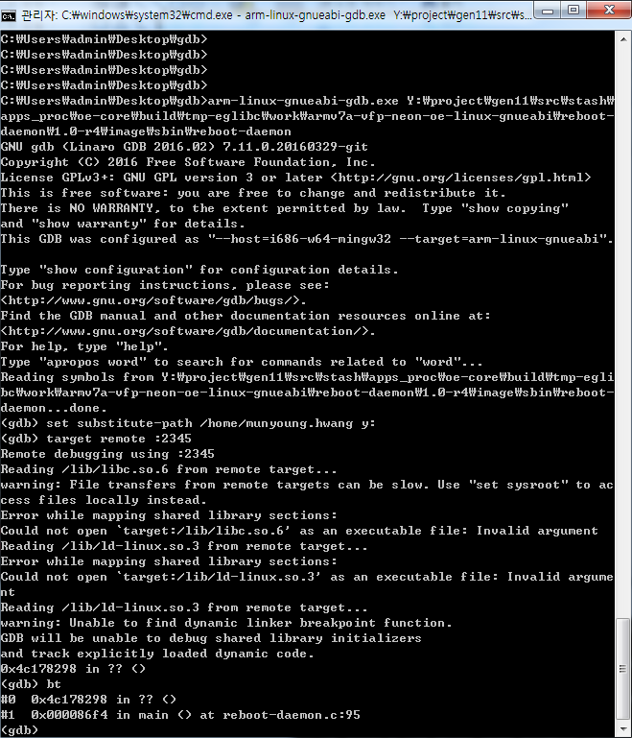
gdb – attach running process

Slide 16
gdb – batch file (1)
gdbserver.bat
@echo off
set BIN_PATH=%~f1
set BIN_NAME=%~n1
echo BIN_PATH=%BIN_PATH%
echo BIN_NAME=%BIN_NAME%
adbb.exe push %BIN_PATH% /data/
adbb.exe forward tcp:2345 tcp:2345
adbb.exe shell chmod +x /data/%BIN_NAME%
adbb.exe shell gdbserver :2345 /data/%BIN_NAME%
gdb-cmd-init
set substitute-path /home/munyoung.hwang y:
break main
target remote :2345
Continue
run_gdb.bat
arm-linux-gnueabi-gdb.exe --command=gdb-cmd-init %1

Slide 17
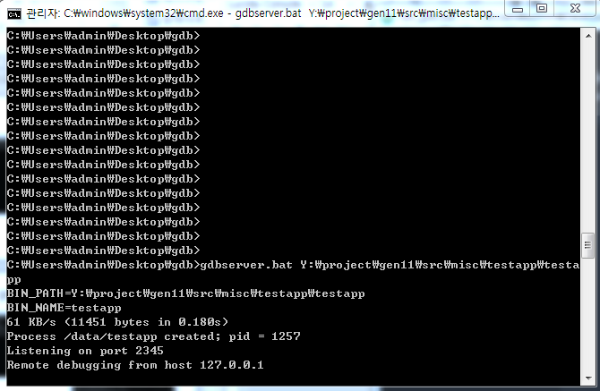
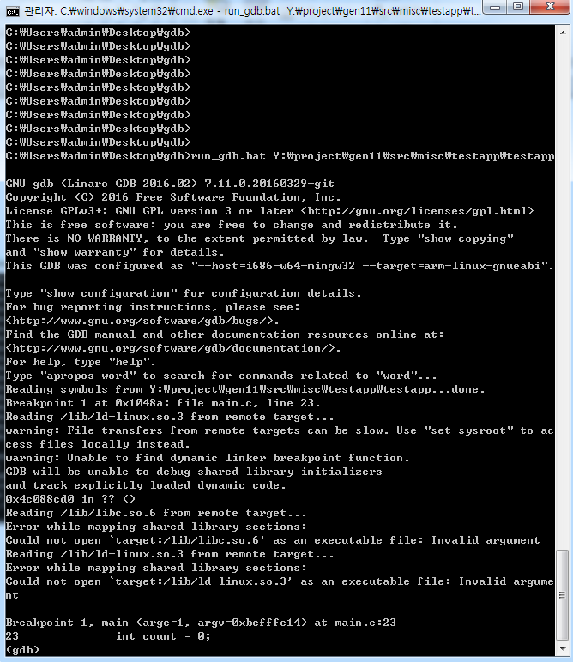
gdb – batch file (2)
gdbserver.bat
run_gdb.bat

Slide 18
gdb – commands
help <cmd>
Execution run, kill, continue
Code list, disassemble
Variable, Memory print, x
Breakpoint break, tbreak, watch, delete display, undisplay info break, info watch
Stepping next, step, ni, si, finish
Callstack backtrace(bt), up, down
Target info registers, info target, info thread, thread
Scripting source <file>

Slide 19
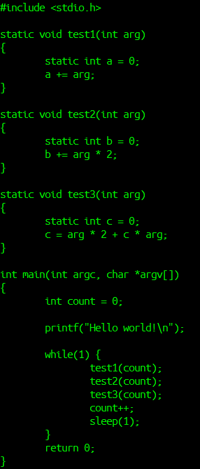
gdb – demo
main.c
Examine gdb command
(gdb) list
(gdb) next
(gdb) n
(gdb) n
(gdb) s
(gdb) backtrace
(gdb) list test1
(gdb) tbreak test1
(gdb) info break
(gdb) continue
(gdb) backtrace
(gdb) list
(gdb) print a
(gdb) next
(gdb) print a
(gdb) list main
(gdb) <enter>
(gdb) print count
(gdb) bt
(gdb) up
(gdb) print count
(gdb) down (gdb) display a
(gdb) finish
(gdb) list
(gdb) break if count < 3
(gdb) display count
(gdb) c
(gdb) c
^C
(gdb) info break
(gdb) delete 3
(gdb) info break
(gdb) tbreak test2
(gdb) c
(gdb) print b
(gdb) watch b
(gdb) c
(gdb) c
(gdb) info break
(gdb) delete 5
(gdb) print /x b
(gdb) x/1x &b
(gdb) x/16x &b
(gdb) list test3
(gdb) break main.c:6 if a>50 && a<100
(gdb) continue
(gdb) disassemble (gdb) ni
(gdb) disassemble
(gdb) info registers
(gdb) info target
(gdb) info thread
(gdb) thread 1

Slide 20
Eclipse – CDT
Eclipse IDE for C/C++ Developers
Download from http://www.eclipse.org/downloads/packages/eclipse-ide-cc-developers/mars2
Extract ZIP file and run “eclipse”

Slide 21
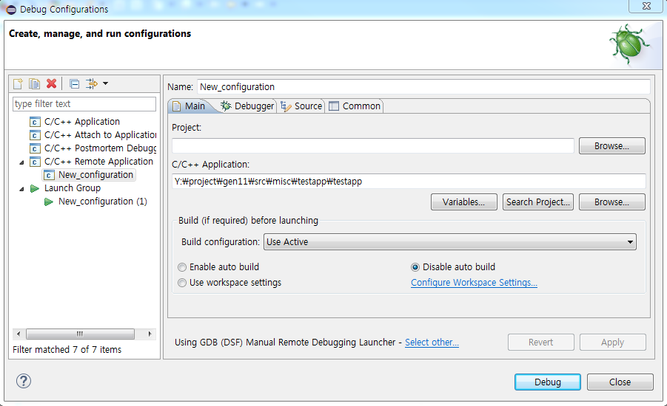
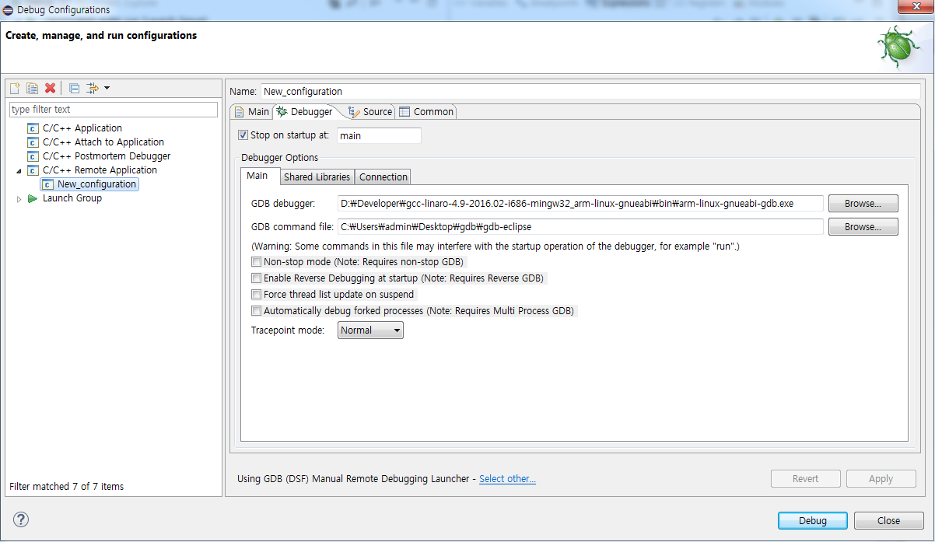
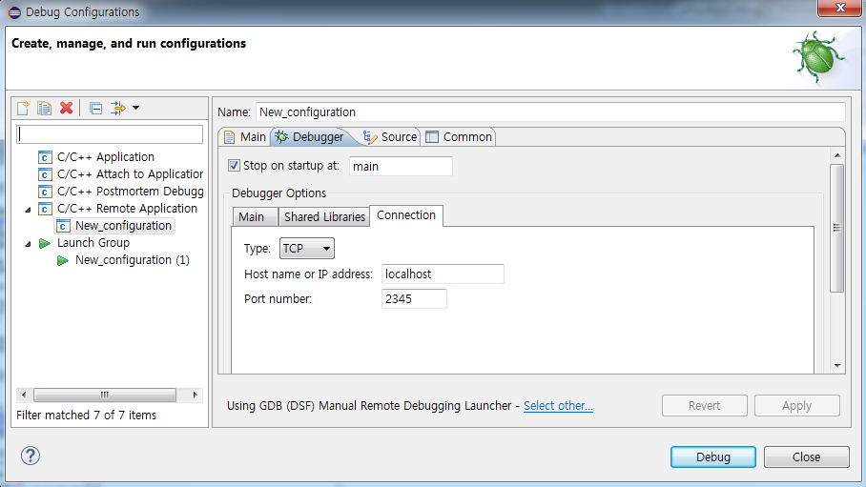
Eclipse – setting gdb
Menu>Run>Debug Configuration
gdb-eclipse
set substitute-path /home/munyoung.hwang y:

Slide 22
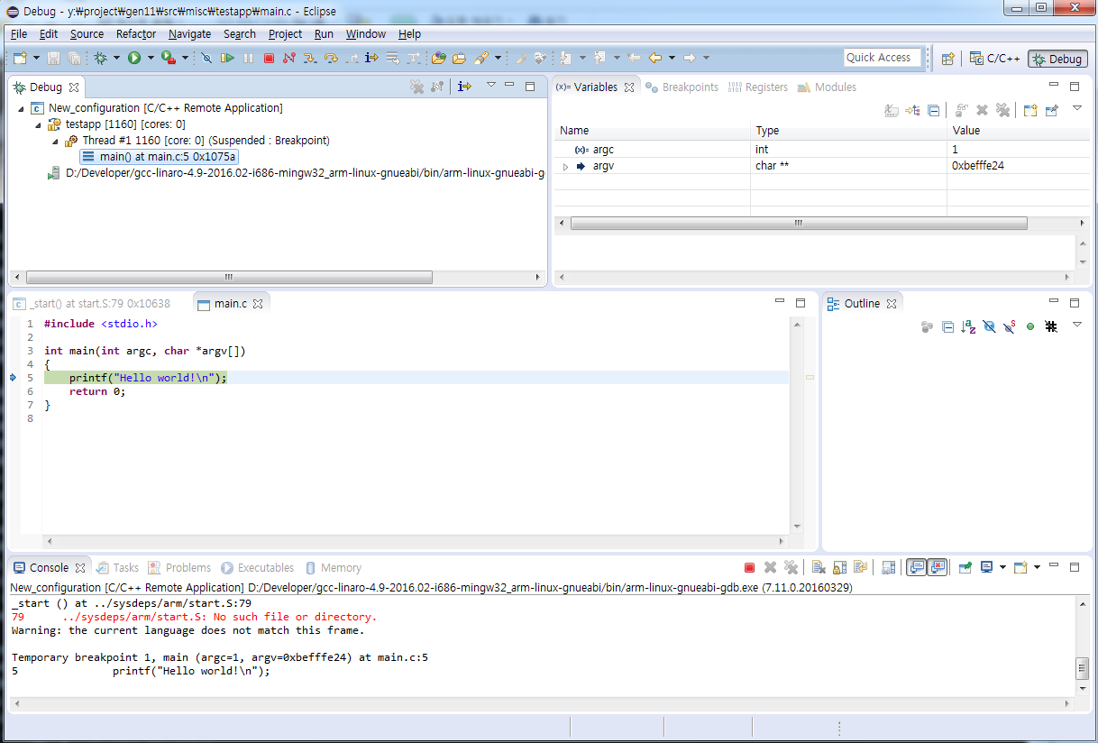
Eclipse – debug flow
gdbserver.bat <app-to-debug>
Run debug on eclipse

Slide 23
Eclipse – Launch Group (1)
Create Empty Project
Add link of binary to debug
resource_loc variable
resource_name variable
Add External Tools
gdbserver.bat
Add Remote Application in debug configuration using resource_loc variable
Add Launch Group
Add “gdbserver.bat” → Debug

Slide 24
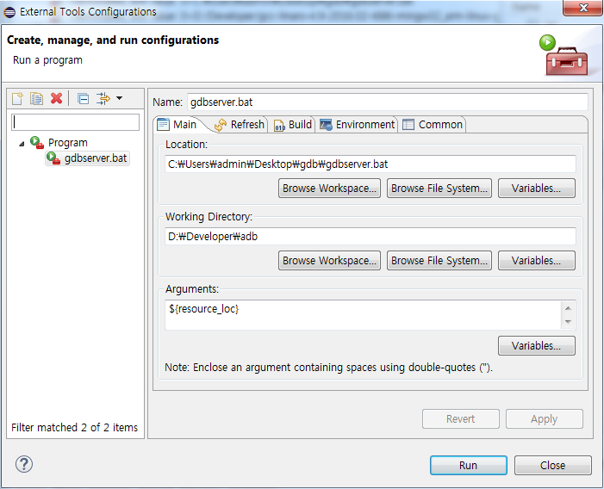
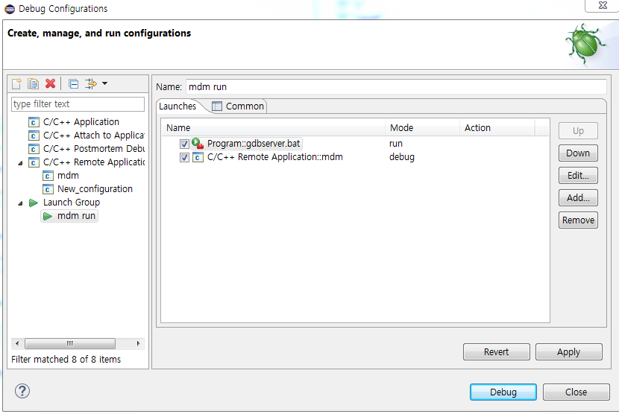
Eclipse – Launch Group (2)

Slide 25
ASAN (Address Sanitizer)
Detect memory corruption
Heap use after free
Heap buffer overflow
Stack buffer overflow
Global buffer overflow
GCC insert instrumentation code
For enabling ASAN
Add -fsanitize=address option on compile

Slide 26
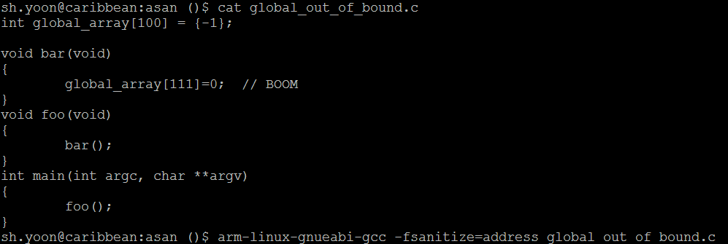
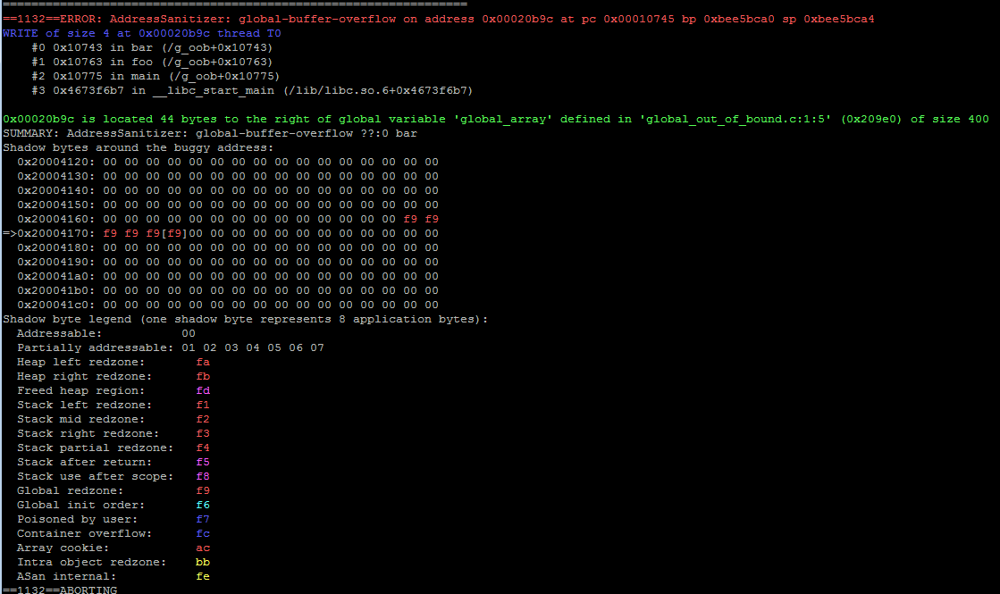
ASAN - example

Slide 27
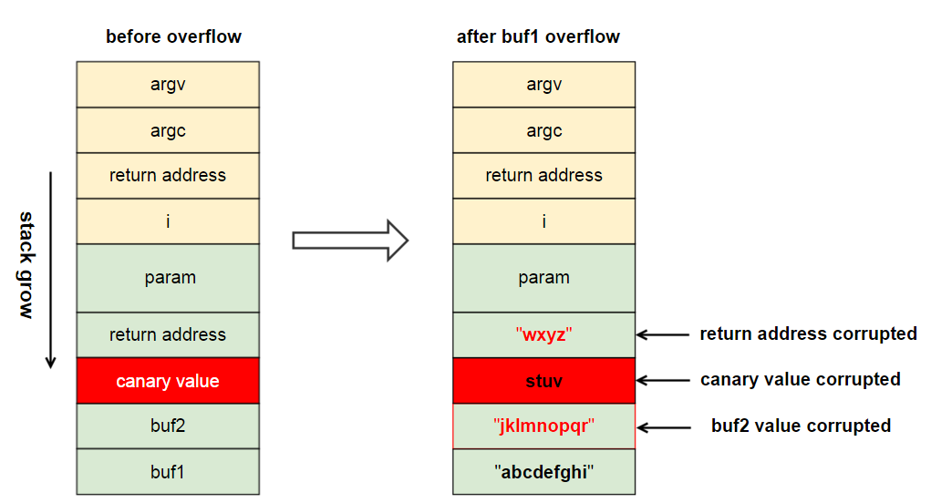
SSP (Stack Smashing Protector)
GCC insert canary value to stack
Check the value when return function

Slide 28
SSP – compile option
GCC compile option
-fno-stack-protector
-fstack-protector Enable SSP only if function uses array more than 8 bytes
-fstack-protector-strong Enable SSP if function with .. references to local variable address local arrays
-fstack-protector-all Every function

Slide 29
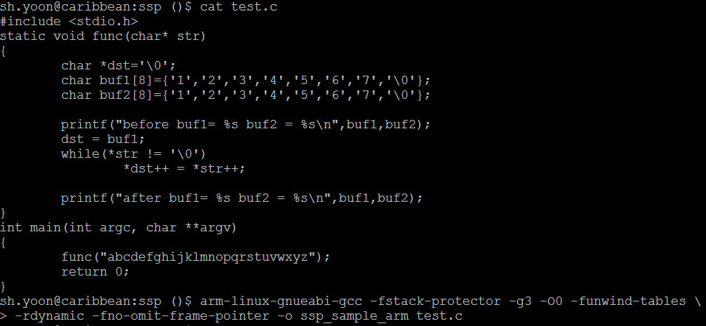
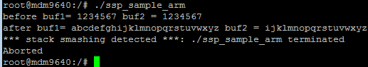
SSP - example

Slide 30
libsegv – compile
Print call stack on app crash
libsegv handles SIGSEGV signal
Need to rebuild app with GCC option -funwind-tables
Need to preload ligsegv
LD_PRELOAD=/usr/lib/libsegv.so ./sample_app

Slide 31
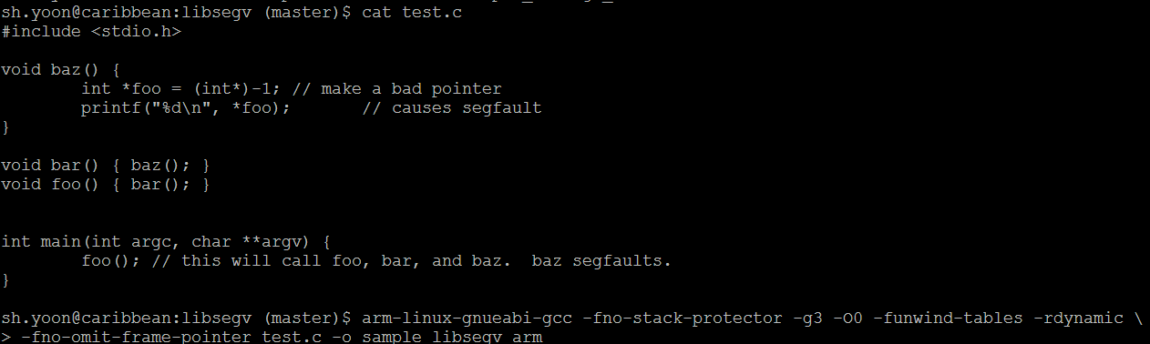
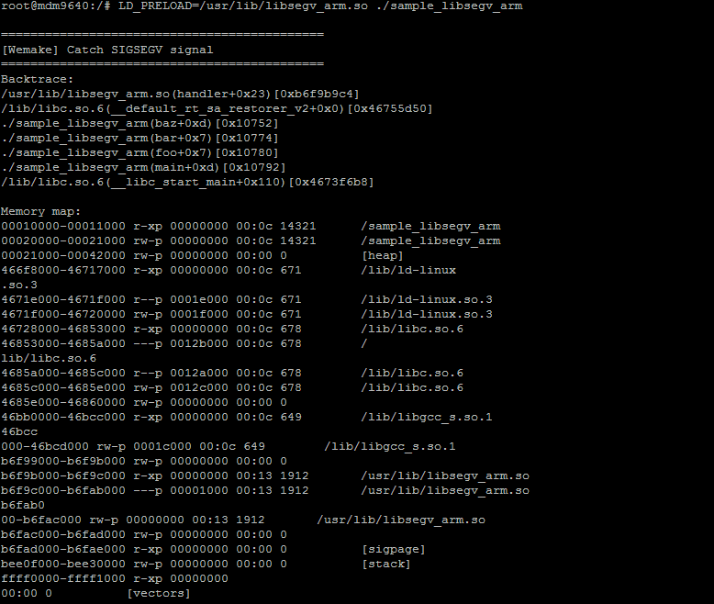

Slide 32
THE END

