Slide 1
Practical Guide for Kernel Development
Kernel Development

Slide 2
History
Version | Date | Change | Author
0.01 | 12 Sep 2016 | First One | Hyunuk Yang

Slide 3
Contents
01 Linux Kernel
02 Linux Device Driver
03 Target Kernel Development
04 Practical Session.

Slide 4
Linux Kernel

Slide 5


Linux Introduction
Linux
Unix-Like and POSIX-Compliant Computer Operating System.
The defining component of Linux is the Linux Kernel.
Free and Open-Source Software.
Packaged Linux = Linux Distribution
Uses : Desktop, Netbook, Server, Smart Devices, Embedded Devices, Gaming, Specialized Uses.

Slide 6
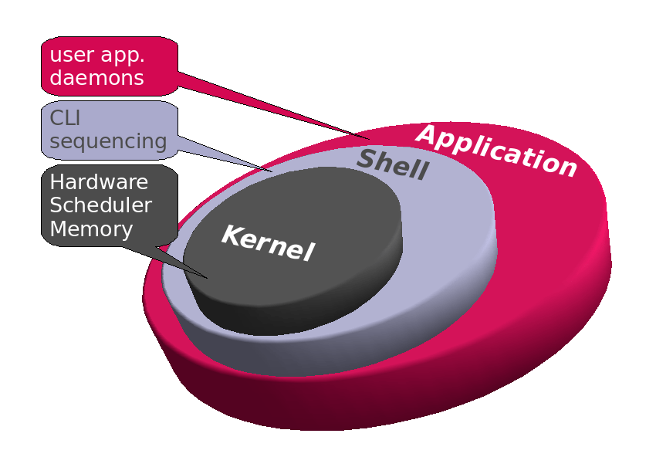
Linux Introduction
Linux Kernel.
Created and Conceived in 1991 by Linus Tovalds
Free Software ( After version 0.12 with GNU General Public License )
Deployed Traditional Computer System and Embedded Devices.
Huge Rise In Popularity Of The Android Operating System.

Slide 7
Linux Introduction
Key Feature
Portability and hardware support. Runs on most architectures.
Scalability. Can run on super computers as well as on tiny devices (4 MB of RAM is enough).
Compliance to standards and interoperability.
Exhaustive networking support.
Security. It can't hide its flaws. Its code is reviewed by many experts.
Stability and reliability
Modularity. Can include only what a system needs even at run time.
Easy to program. You can learn from existing code. Many useful resources on the net.

Slide 8
Linux Introduction
Main Role
Manage all the hardware resources: CPU, memory, I/O.
Provide a set of portable, architecture and hardware independent APIs to allow user space applications and libraries to use the hardware resources.
Handle concurrent accesses and usage of hardware resources from different applications.
Example: a single network interface is used by multiple user space applications through various network connections. The kernel is responsible to ``multiplex'' the hardware resource.

Slide 9
Linux Introduction
System Call
The main interface between the kernel and user space is the set of system calls
About 300 system calls that provide the main kernel services
File and device operations, networking operations, inter-process communication, process management, memory mapping, timers, threads, synchronization primitives, etc.
This interface is stable over time: only new system calls can be added by the kernel developers
This system call interface is wrapped by the C library, and user space applications usually never make a system call directly but rather use the corresponding C library function

Slide 10
Advantages and Disadvantages for Embedded Device
Good
GPL ( GNU : General Public License ) → Freely Opened → Many Users → Stable
Loadable Module for Device Driver and Kernel Feature.
POSIX-Compliant
Many HW Platform ( ARM, PPC, MIPS, x86, ETC )
Multi-Tasking
Virtual Memory
Networking
Bad
Develop Environment.
Not Real-Time OS ( this is an option )
More Memory Usage comparing RTOS.
Windows System for Embedded Device.

Slide 11
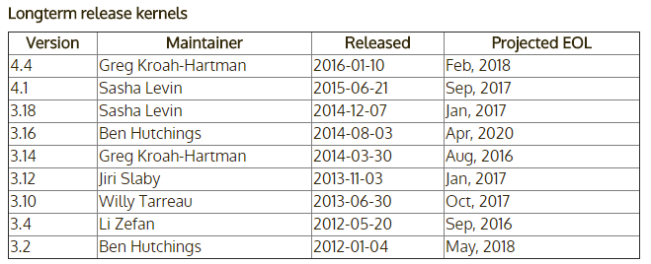
Linux Introduction
Linux Kernel Source
https://www.kernel.org
Latest Stable Kernel is 4.7.2
Prepatch : “RC”, mainline kernel pre-releases
Mainline : all new features are here. This is released every 2~3 months. This tree is maintained by Linux Torvalds.
Stable : After each mainline kernel is released, it it considered “stable”.
Longterm : there are several “longterm maintenance” kernel releases provided for the purpose of backporting bugfixes for older kernel trees.

Slide 12
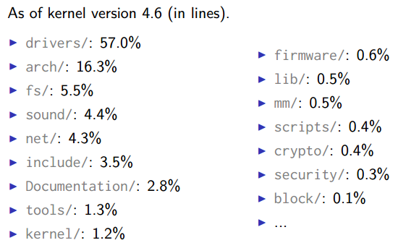
Linux Introduction
Linux Kernel Size
Linux 4.6 sources: Raw size: 730 MB (53,600 files, approx 21,400,000 lines) gzip compressed tar archive: 130 MB xz compressed tar archive: 85 MB
Minimum Linux 3.17 compiled kernel size, booting on the ARM Versatile board (hard drive on PCI, ext2 filesystem, ELF executable support, framebuffer console and input devices): 876 KB (compressed), 2.3 MB (raw)
Why are these sources so big? Because they include thousands of device drivers, many network protocols, support many architectures and filesystems...
The Linux core (scheduler, memory management...) is pretty small!

Slide 13
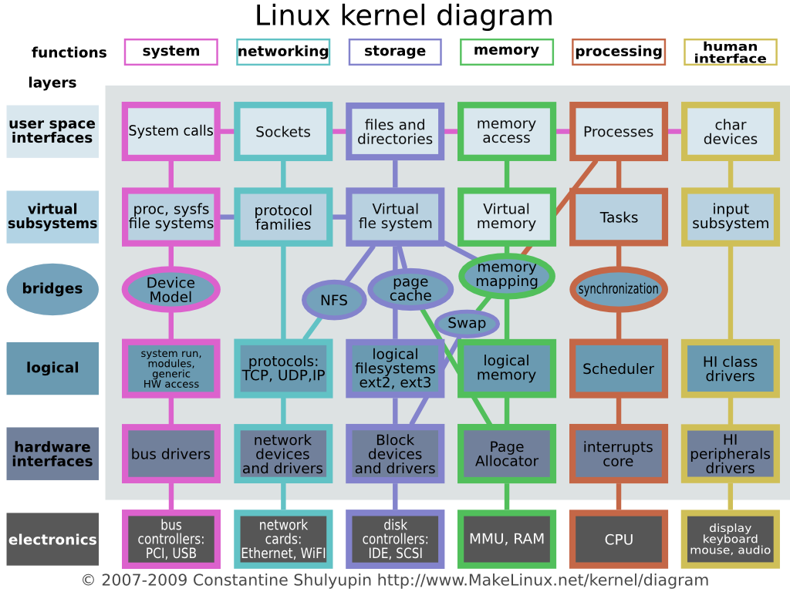
Linux Kernel Structure

Slide 14
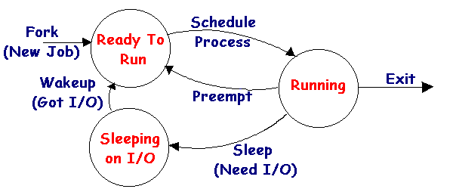
Process
Concept
A process is an executing ( running ) instance of a program.
Frequently referred to as “tasks”
Each Process is given a unique number, referred to as a process identification ( PID )
Management
Process Creation and Destroy
Process Scheduling
Synchronization
Process Communication
Status
New
Running
Waiting : wait for I/O completion or Signal
Ready : ready to get processing.
Terminated

Slide 15
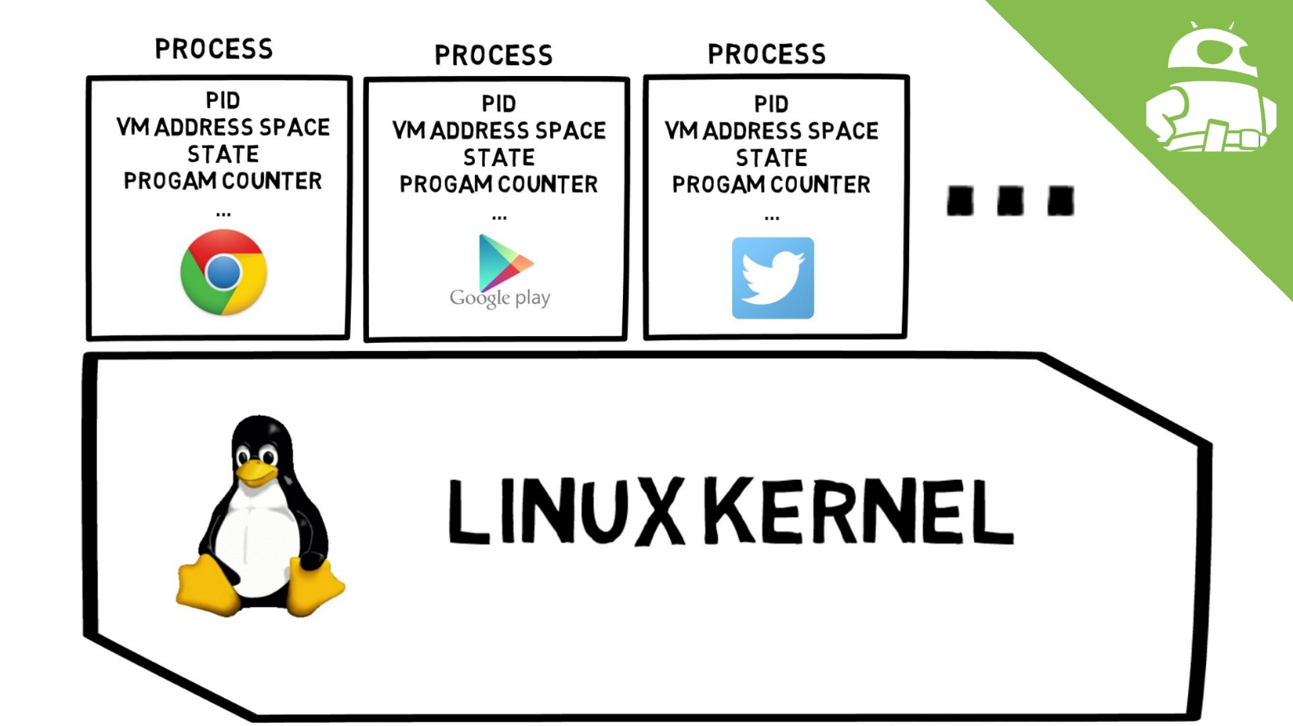
Process
Process Context
A snapshot of running process
User : text, data, stack, shared memory, etc
Register : pc, cpsr, sp, common registers
System : process status, PID, Page table, Kernel Stack.

Slide 16
Process
Process Related Commands
ps –aux
kill
top
pstree
cat /proc/1/status
Fg, bg
Process State Value
R : Running or Ready to Run
S : Sleep
I : Idle ( between R and S ? )
T : Suspended
Z : Zombie
N : niced
< : high priority by artificially.
+ : Fore-ground process group
E : Terminating
X : Tracing ( by using gdb )

Slide 17
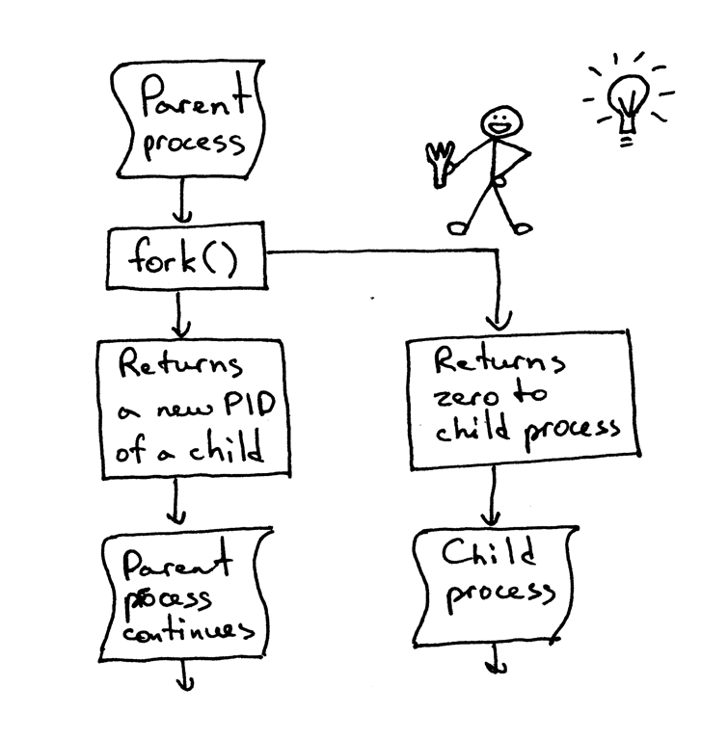
Process
Create Processes
Program : fork() family , exec() family.
User Command : execute a command in the shell

Slide 18
Process
Process , Thread?
Confusion about the terms process, thread and task
In Unix, a process is created using fork() and is composed of
An address space, which contains the program code, data, stack, shared libraries, etc.
One thread, that starts executing the main() function.
Upon creation, a process contains one thread
Additional threads can be created inside an existing process, using pthread_create()
They run in the same address space as the initial thread of the process
They start executing a function passed as argument to pthread_create()

Slide 19
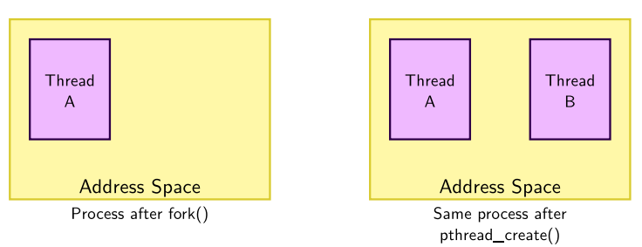
Process
Process, Thread : Kernel Point of view
The kernel represents each thread running in the system by a structure of type struct task_struct
From a scheduling point of view, it makes no difference between the initial thread of a process and all additional threads created dynamically using pthread_create()

Slide 20
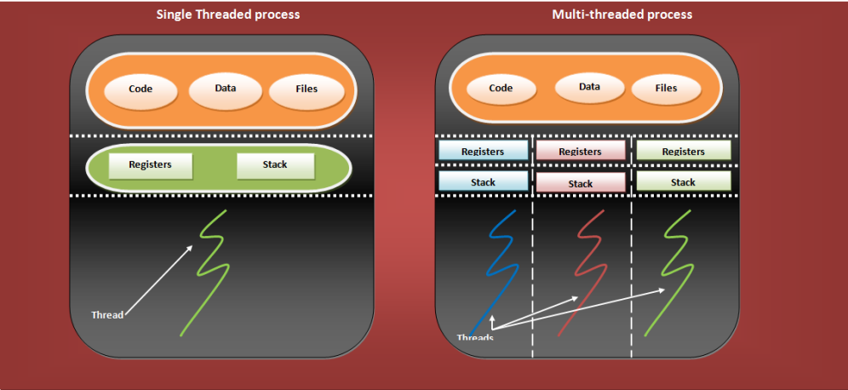
Thread
In Detail

Slide 21
Thread
Thread
Enable concurrent programming and, on multiple processor systems
To the Linux kernel, there is no concept of a thread
Linux implements all threads as standard processes
Linux Kernel doesn’t provide any special scheduling semantics or data structure to represent threads.
In Linux, thread is merely a process that shares certain resources with other processes.
Each thread has a unique task_struct and appears to the kernel as a normal process.
Why Thread is necessary
Share the data, No need IPC
Concurrency processing. ( Multi processor )
Fast Context Switching.
Smaller Memory Usage.
Fast process creation.
An example for WEB Server.
A single process : client waiting time is long.
Multi process : new process creation by every clients request.
Multi-Threaded single process : new thread creation by every clients request

Slide 22
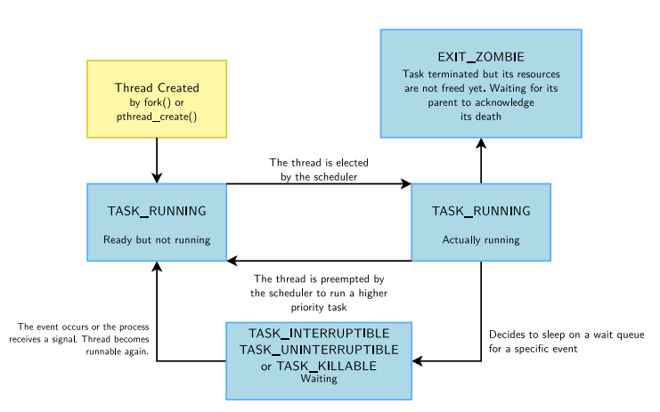
Thread
A Thread Life

Slide 23
Scheduler
The Linux scheduler provides the multitasking capabilities and is evolving over the kernel releases with the aim of providing a deterministic scheduling policy. The instances that are understood by the scheduler.
Kernel Threads : These are processes that do not have a user context. They execute in the kernel space as long as they live.
User process: Each user process has its own address space thanks to the virtual memory. They enter into the kernel mode when an interrupt, exception, or a system call is executed. Note that when a process enters the kernel mode, it uses a totally different stack. This is referred to as the kernel stack and each process has its own kernel stack.
User thread: The threads are different execution entities that are mapped to a single user process. The user space threads share a common text, data, and heap space. They have separate stack addresses. Other resources such as open files and signal handlers are also shared across the threads.

Slide 24
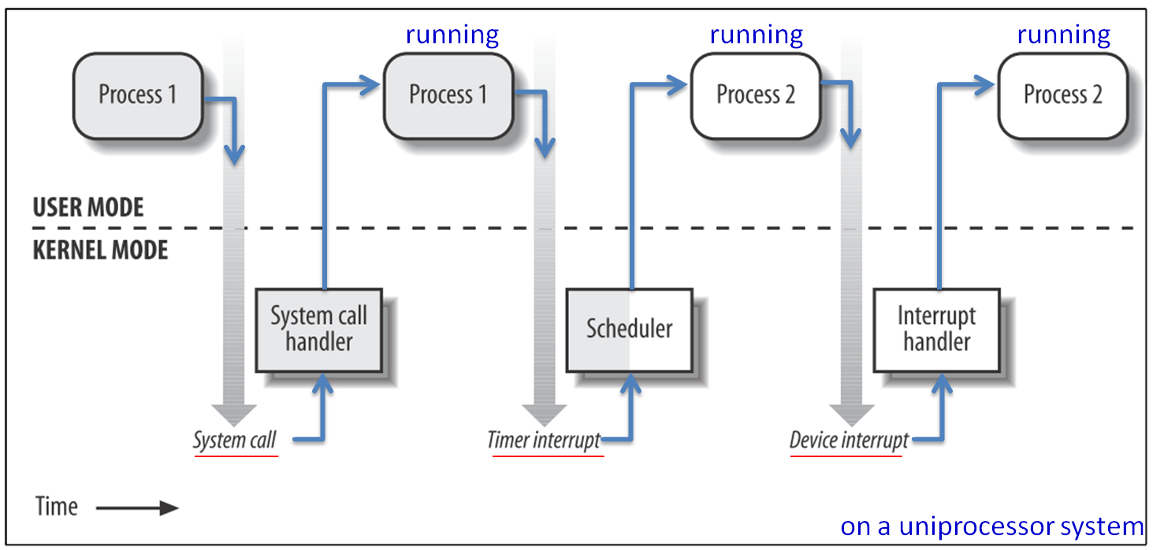
Kernel and Process
Kernel Mode and User Mode

Slide 25
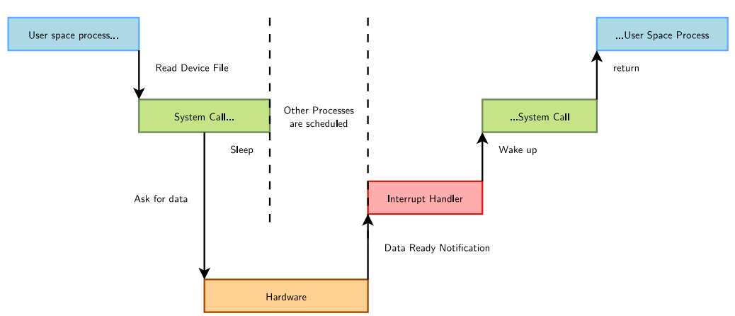
Kernel and Process
Need Sleeping
Sleeping is needed when a process (user space or kernel space) is waiting for data

Slide 26
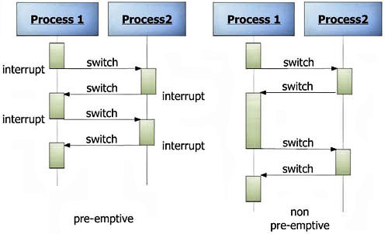
Scheduler
Type of Scheduler
Non-Preemptive ( Option )
Preemptive ( Linux Default )

Slide 27
Concurrent Access to Resources: Locking
Source of concurrency issue
In terms of concurrency, the kernel has the same constraint as a multi-threaded program: its state is global and visible in all executions contexts
Concurrency arises because of
Interrupts, which interrupts the current thread to execute an interrupt handler. They may be using shared resources.
Kernel preemption, if enabled, causes the kernel to switch from the execution of one system call to another. They may be using shared resources.
Multiprocessing, in which case code is really executed in parallel on different processors, and they may be using shared resources as well.
The solution is to keep as much local state as possible and for the shared resources, use locking.

Slide 28
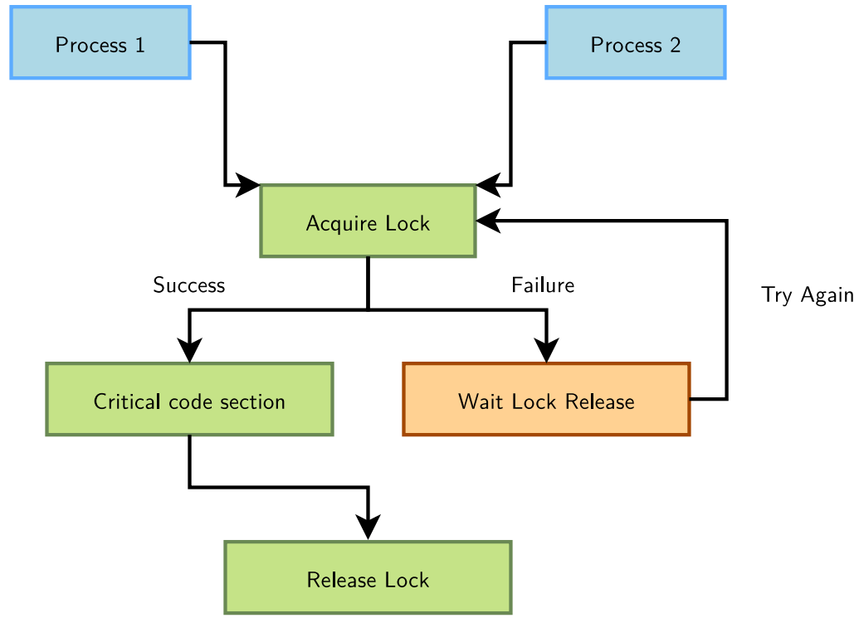
Concurrent Access to Resources: Locking
Concurrency protection with locks

Slide 29
Concurrent Access to Resources: Locking
Linux Mutex
The kernel's main locking primitive
The process requesting the lock blocks when the lock is already held. Mutexes can therefore only be used in contexts where sleeping is allowed.
Mutex definition: #include <linux/mutex.h>
Need Study…

Slide 30
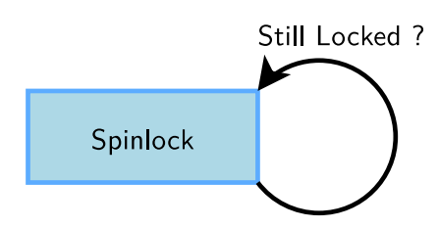
Concurrent Access to Resources: Locking
Spinlocks
Locks to be used for code that is not allowed to sleep (interrupt handlers), or that doesn't want to sleep (critical sections). Be very careful not to call functions which can sleep!
Originally intended for multiprocessor systems
Spinlocks never sleep and keep spinning in a loop until the lock is available.
Spinlocks cause kernel preemption to be disabled on the CPU executing them.
The critical section protected by a spinlock is not allowed to sleep.

Slide 31
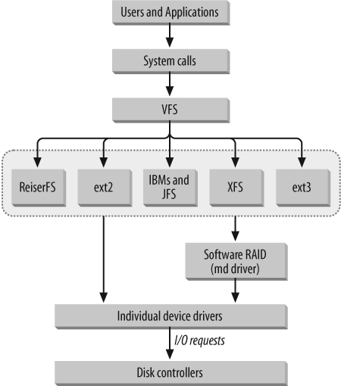
VFS ( Virtual File System )
VFS
Provides common interface for all file-system.
Implemented in SW layer of the Linux kernel.
Perform all system call.
Support DISK File System. ( EXT2, 3, 4, etc )
Support Embedded File System. ( JFFS2, YAFFS etc )
Network File System ( NFS, SMB )
Special File System ( proc, sys, dev )
Use same system call ( open, read, write, ioctl )

Slide 32
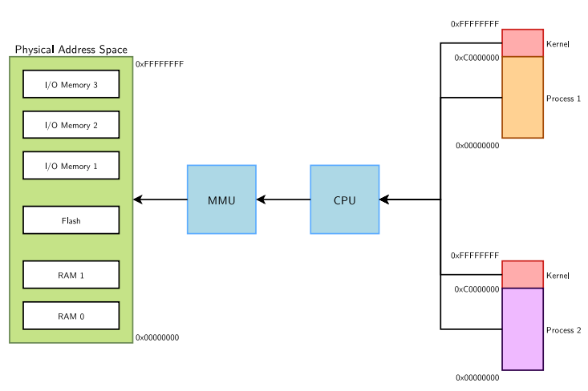
Memory Management
Physical and Virtual Memory.

Slide 33
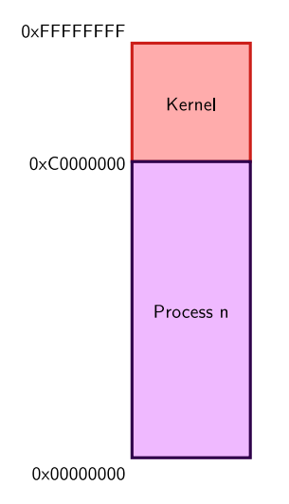
Memory Management
Virtual Memory Organization
1GB reserved for kernel-space
Contains kernel code and core data structures, identical in all address spaces
Most memory can be a direct mapping of physical memory at a fixed offset
Complete 3GB exclusive mapping available for each user space process
Process code and data (program, stack, ...)
Memory-mapped files
Not necessarily mapped to physical memory (demand fault paging used for dynamic mapping to physical memory pages)
Differs from one address space to another

Slide 34
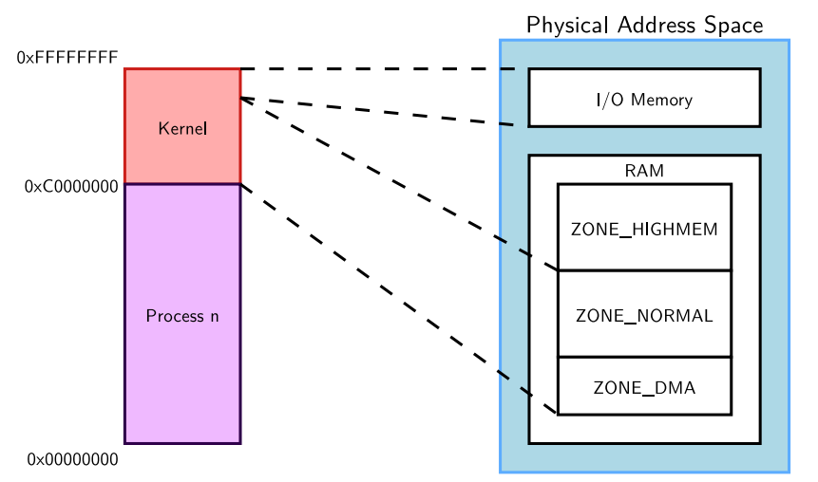
Memory Management
Physical and Virtual Memory Mapping

Slide 35
Memory Management
Note on user space memory
New user space memory is allocated either from the already allocated process memory, or using the mmap system call
Note that memory allocated may not be physically allocated:
Kernel uses demand fault paging to allocate the physical page (the physical page is allocated when access to the virtual address generates a page fault)
... or may have been swapped out, which also induces a page fault
User space memory allocation is allowed to over-commit memory (more than available physical memory) ⇒ can lead to out of memory
OOM killer kicks in and selects a process to kill to retrieve some memory. That's better than letting the system freeze.

Slide 36
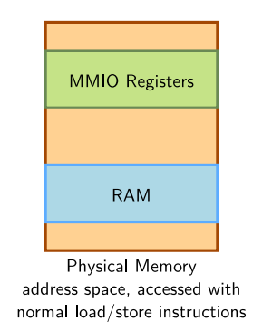
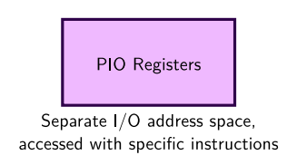
I/O Memory and Ports
Port I/O and Memory-Mapped I/O
MMIO
Same address bus to address memory and I/O devices
Access to the I/O devices using regular instructions
Most widely used I/O method across the different architectures supported by Linux
PIO
Different address spaces for memory and I/O devices
Uses a special class of CPU instructions to access I/O devices

Slide 37
I/O Memory and Ports
Mapping I/O memory in virtual memory
Load/store instructions work with virtual addresses
To access I/O memory, drivers need to have a virtual address that the processor can handle, because I/O memory is not mapped by default in virtual memory.
The ioremap function satisfies this need:
Caution: check that ioremap() doesn't return a NULL address!
#include <asm/io.h> void __iomem *ioremap(phys_addr_t phys_addr, unsigned long size); void iounmap(void __iomem *addr);

Slide 38
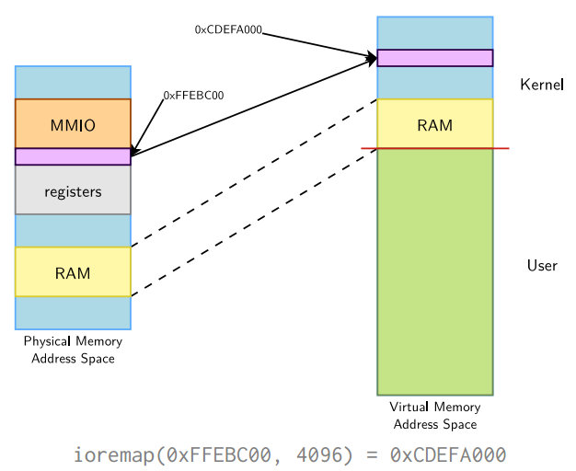
I/O Memory and Ports
ioremap()

Slide 39
Linux Device Driver

Slide 40
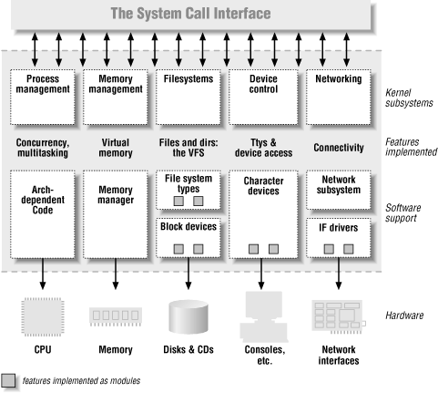
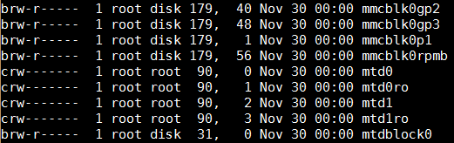
Linux Device Driver
User Access HW Resource.
By using system call. ( there are the limitations for all devices )
By using file I/O. → more flexible.
Module and Device File
A driver module can be loaded at running time. More efficient for the Kernel Resources.
Device Files are “/dev/*”.
These devices is treated as an file. But these are HW resources. Some are SW Resources.
Device file has Type and Major & Minor number information.

Slide 41
Linux Device Driver
Common Attributes
Kernel code : Device drivers are part of the kernel and, like other code within the kernel, if they go wrong they can seriously damage the system. A badly written driver may even crash the system, possibly corrupting file systems and losing data.
Kernel Interfaces : Device drivers must provide a standard interface to the Linux kernel or to the subsystem that they are part of. For example, the terminal driver provides a file I/O interface to the Linux kernel and a SCSI device driver provides a SCSI device interface to the SCSI subsystem which, in turn, provides both file I/O and buffer cache interfaces to the kernel.
Kernel Mechanisms and services : Device drivers make use of standard kernel services such as memory allocation, interrupt delivery and wait queues to operate.
Loadable : Most of the Linux device drivers can be loaded on demand as kernel modules when they are needed and unloaded when they are no longer being used. This makes the kernel very adaptable and efficient with the system's resources
Configurable : Linux device drivers can be built into the kernel. Which devices are built is configurable when the kernel is compiled.
Dynamic : As the system boots and each device driver is initialized it looks for the hardware devices that it is controlling. It does not matter if the device being controlled by a particular device driver does not exist. In this case the device driver is simply redundant and causes no harm apart from occupying a little of the system's memory

Slide 42
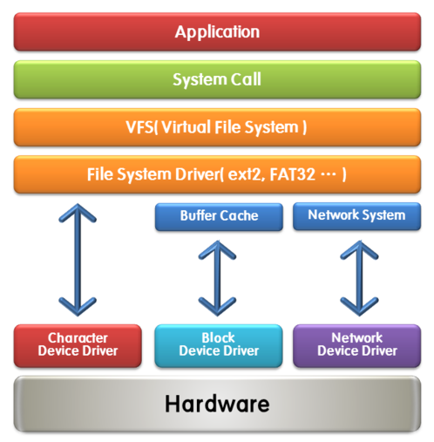
Linux Device Driver
Type Of Device Driver
Character : They are used to provide user space applications access to all other types of devices (input, sound, graphics, serial, etc.). They are also visible to the applications as device files in /dev
Block :They are used to provide user space applications access to raw storage devices (hard disks, USB keys). They are visible to the applications as device files in /dev.
Network : They are represented as network interfaces, visible in user space using ifconfig.
Most devices are character devices, so we will study these in more details

Slide 43
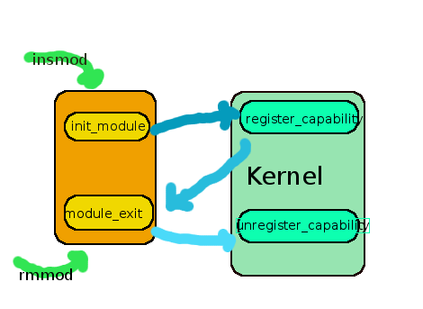
Kernel Module
Module Loading
Load the whole module file onto memory
Parse the ELF and module information
Check the module information to determine whether the module is loadable or not
Layout the sections and copy to the final location
Add the module to the kernel
Resolve the symbols and apply relocations
Copy module parameters
Call the init function

Slide 44
Kernel Module
Devices: everything is a file
A very important Unix design decision was to represent most system objects as files
It allows applications to manipulate all system objects with the normal file API (open, read, write, close, etc.)
So, devices had to be represented as files to the applications
This is done through a special artifact called a device file
It is a special type of file, that associates a file name visible to user space applications to the triplet (type, major, minor) that the kernel understands
All device files are by convention stored in the /dev directory

Slide 45
Kernel Module
Let’s Make An Kernel Module ( Hello word )
Makefile
obj-m := test.o KDIR := /home/huyang/VN_Mentoring_M1/device/platform/sdk/os/kernel PWD := $(shell pwd) CROSS_COMPILE :=mipsel-linux- ARCH :=mipsel default: $(MAKE) -C $(KDIR) SUBDIRS=$(PWD) modules clean: rm -rf *.ko rm -rf *.mod.* rm -rf .*.cmd rm -rf *.o

Slide 46
Kernel Module
test.c
#include <linux/init.h> #include <linux/module.h> #include <linux/kernel.h> static int hello_init(void) { printk("Hello, world \n"); return 0; } static void hello_exit(void) { printk("Goodbye, world\n"); } module_init(hello_init); module_exit(hello_exit); MODULE_LICENSE("Dual BSD/GPL");

Slide 47
Kernel Module
Module Utility
lsmod : displays a list of currently loaded modules
Insmod : load a kernel module
rmmod : unload a kernel module
depmod : generate dependency information between modules
modprobe : load the module along with its dependencies
Module License
GPL : GNU Public License v2 or later
GPL v2 : GNU Public License v2
GPL and additional rights : GNU Public License v2 and more
Dual BSD/GPL : GNU Public License v2 or BSD license choice
Dual MPL/GPL : GNU Public License v2 or Mozilla license choice
Proprietary : Non free products. ( Several kernel API is not allowed to access, But It is not big problem )

Slide 48
Kernel Module
Let’s Make An Kernel Module With Parameter
Makefile
obj-m := param.o KDIR := /home/huyang/VN_Mentoring_M1/device/platform/sdk/os/kernel PWD := $(shell pwd) CROSS_COMPILE :=mipsel-linux- ARCH :=mipsel default: $(MAKE) -C $(KDIR) SUBDIRS=$(PWD) modules clean: rm -rf *.ko rm -rf *.mod.* rm -rf .*.cmd rm -rf *.o

Slide 49
Kernel Module
param.c
#include <linux/init.h> #include <linux/module.h> #include <linux/kernel.h> #include <linux/moduleparam.h> static int onevalue = 1; static char *twostring = NULL; module_param(onevalue, int, 0); module_param(twostring, charp, 0); static int hello_init(void) { printk("Hello, world [onevalue=%d:twostring=%s]\n", onevalue, twostring ); return 0; } static void hello_exit(void) { printk("Goodbye, world\n"); } module_init(hello_init); module_exit(hello_exit); MODULE_AUTHOR("Hyunuk huyang@humaxdigital.com"); MODULE_DESCRIPTION("Module Parameter Test Module"); MODULE_LICENSE("Dual BSD/GPL");
In the Shell
[ root@ ] # insmod param.ko onevalue=0x23 twostring=“OMG!” [ root@ ] # dmesg

Slide 50
Kernel Module
Kernel Message
Name | String | Meaning | alias function
KERN_EMERG | "0" | Emergency messages, system is about to crash or is unstable | pr_emerg
KERN_ALERT | "1" | Something bad happened and action must be taken immediately | pr_alert
KERN_CRIT | "2" | A critical condition occurred like a serious hardware/software failure | pr_crit
KERN_ERR | "3" | An error condition, often used by drivers to indicate difficulties with the hardware | pr_err
KERN_WARNING | "4" | A warning, meaning nothing serious by itself but might indicate problems | pr_warning
KERN_NOTICE | "5" | Nothing serious, but notably nevertheless. Often used to report security events. | pr_notice
KERN_INFO | "6" | Informational message e.g. startup information at driver initialization | pr_info
KERN_DEBUG | "7" | Debug messages | pr_debug, pr_devel if DEBUG is defined
KERN_DEFAULT | "d" | The default kernel loglevel
KERN_CONT | "" | "continued" line of log printout (only done after a line that had no enclosing \n) | pr_cont

Slide 51
Kernel Module
Let’s Test Kernel LOG Level with previous example
Hint
Ex) printk(KERN_INFO, “System OK\n”);
In the Shell Each number : “current” “default” “minimum” “boot-time-default”
[ root@ ] # cat /proc/sys/kernel/printk 4 4 1 7 [ root@ ] # echo 8 > /proc/sys/kernel/printk 8 8 1 7

Slide 52
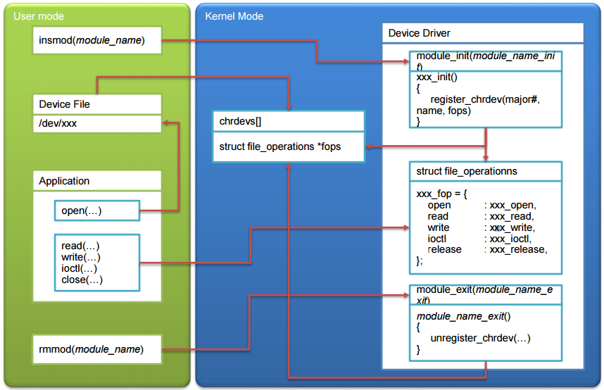
Character Device Driver

Slide 53
Character Device Driver
Register Character Device Driver
int register_chrdev(unsigned int major, const char *name, struct file_operations *fops);
int unregister_chrdev(unsigned int major, const char *name);
register_chrdev | unregister_chrdev
int xxx_init(boid) { register_chrdev(240, “char_dev”, &xxxx_fops); } module_init(xxx_init); | int xxx_exit(boid) { unregister_chrdev(240, “char_dev”); } module_exit(xxx_exit);

Slide 54
Character Device Driver
Let’s Make an Character Device Driver
call_dev.c(1) | call_dev.c(2)
#include <linux/init.h> #include <linux/module.h> #include <linux/kernel.h> #include <linux/fs.h> #include <linux/errno.h> #include <linux/types.h> #include <linux/fcntl.h> #define CALL_DEV_NAME "calldev" #define CALL_DEV_MAJOR 240 int call_open (struct inode *inode, struct file *filp) { int num = MINOR(inode->i_rdev); printk( "call open -> minor : %d\n", num ); return 0; } | loff_t call_llseek (struct file *filp, loff_t off, int whence ) { printk( "call llseek -> off : %08X, whenec : %08X\n", off, whence ); return 0x23; } ssize_t call_read(struct file *filp, char *buf, size_t count, loff_t *f_pos) { printk( "call read -> buf : %08X, count : %08X \n", buf, count ); return 0x33; } ssize_t call_write (struct file *filp, const char *buf, size_t count, loff_t *f_pos) { printk( "call write -> buf : %08X, count : %08X \n", buf, count ); return 0x43; }

Slide 55
Character Device Driver
call_dev.c(3) | call_dev.c(4)
int call_ioctl (struct inode *inode, struct file *filp, unsigned int cmd, unsigned long arg) { printk( "call ioctl -> cmd : %08X, arg : %08X \n", cmd, arg ); return 0x53; } int call_release (struct inode *inode, struct file *filp) { printk( "call release \n" ); return 0; } struct file_operations call_fops = { .owner = THIS_MODULE, .llseek = call_llseek, .read = call_read, .write = call_write, .ioctl = call_ioctl, .open = call_open, .release = call_release, }; | int call_init(void) { int result; printk( "call call_init \n" ); result = register_chrdev( CALL_DEV_MAJOR, CALL_DEV_NAME, &call_fops); if (result < 0) return result; return 0; } void call_exit(void) { printk( "call call_exit \n" ); unregister_chrdev( CALL_DEV_MAJOR, CALL_DEV_NAME ); } module_init(call_init); module_exit(call_exit); MODULE_LICENSE("Dual BSD/GPL");

Slide 56
Character Device Driver
Any Problem?
Problem?
error: unknown field 'ioctl' specified in initializer Check This Site! http://lwn.net/Articles/115651/ “ioctl” was changed to “unlocked_ioctl” in file_operations with 3.X Kernel.

Slide 57
Character Device Driver
Then We need User Application to use the driver.
call_app.c(1) | call_app.c(2)
#include <stdio.h> #include <sys/types.h> #include <sys/stat.h> #include <sys/ioctl.h> #include <fcntl.h> #include <unistd.h> #define DEVICE_FILENAME "/dev/calldev" int main() { int dev; char buff[128]; int ret; printf( "1) device file open\n"); dev = open( DEVICE_FILENAME, O_RDWR|O_NDELAY ); | if( dev >= 0 ) { printf( "2) seek function call\n"); ret = lseek( dev, 0x20, SEEK_SET ); printf( "ret = %08X\n", ret ); printf( "3) read function call\n"); ret = read(dev,0x30, 0x31 ); printf( "ret = %08X\n", ret ); printf( "4) write function call\n"); ret = write(dev,0x40,0x41 ); printf( "ret = %08X\n", ret ); printf( "5) ioctl function call\n"); ret = ioctl(dev, 0x51, 0x52 ); printf( "ret = %08X\n", ret ); printf( "6) device file close\n"); ret = close(dev); printf( "ret = %08X\n", ret ); } return 0; }

Slide 58
Character Device Driver
Execute User Application
In the Shell
[ root@ ] # ./a.out Something Error! [ root@ ] # mknod /dev/calldev c 240 32 [ root@ ] # ./a.out
Reserved Major Number
Documentation/devices.txt
240-254 char LOCAL/EXPERIMENTAL USE 240-254 block LOCAL/EXPERIMENTAL USE Allocated for local/experimental use. For devices not assigned official numbers, these ranges should be used in order to avoid conflicting with future assignments.

Slide 59
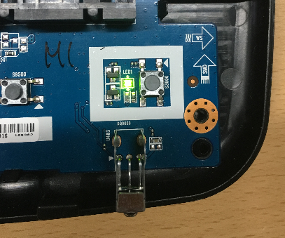
Character Device Driver
Making LED Control Driver with IOCTL.
P302 참고하여 아래 LED 를 제어할 수 있는 예제 추가.

Slide 60
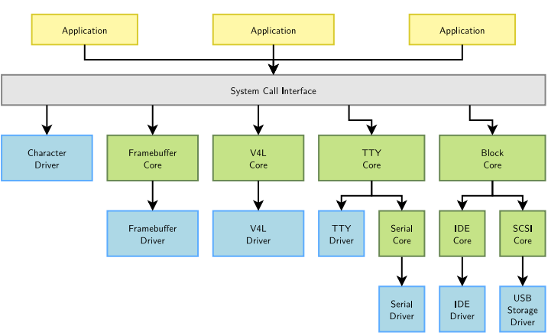
Character Device Driver
Beyond the Character driver
Many device drivers are not implemented directly as character drivers
They are implemented under a framework, specific to a given device type (framebuffer, V4L, serial, etc.)
The framework allows to factorize the common parts of drivers for the same type of devices
From user space, they are still seen as character devices by the applications
The framework allows to provide a coherent user space interface (ioctl, etc.) for every type of device, regardless of the driver

Slide 61
Block Device Driver
Block Device Driver makes
An user application can use a block device
Through a filesystem, by reading, writing or mapping files
Directly, by reading, writing or mapping a device file representing a block device in /dev
In both cases, the VFS subsystem in the kernel is the entry point for all accesses
A filesystem driver is involved if a normal file is being accessed
The buffer/page cache of the kernel stores recently read and written portions of block devices
It is a critical component for the performance of the system

Slide 62
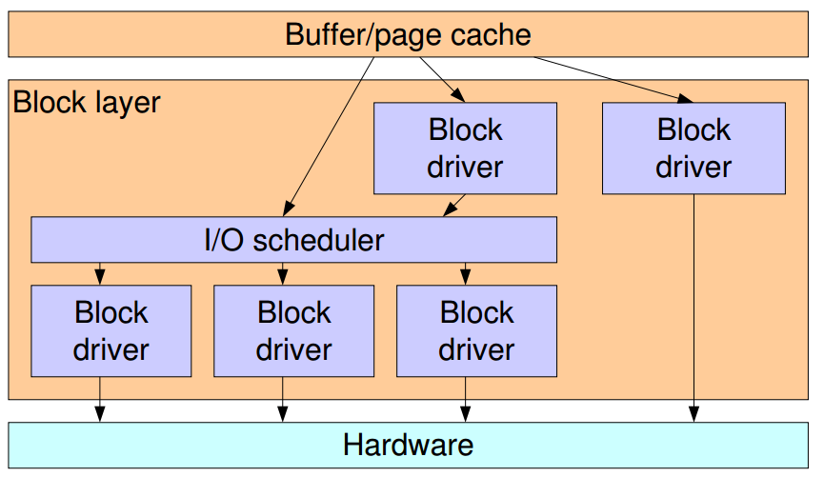
Block Device Driver
Inside The Block Layer
The block layer allows block device drivers to receive I/O requests, and is in charge of I/O scheduling
I/O scheduling allows to
Merge requests so that they are of greater size
Re­order requests so that the disk head movement is as optimized as possible
Several I/O schedulers with different policies are available in Linux.
A block device driver can handle the requests before or after they go through the I/O scheduler

Slide 63
Block Device Driver
Simple Block Device Driver are implemented in “drivers/block”
loop.c, the loop driver that allows to see a regular file as a block device
brd.c, a ramdisk driver
nbd.c, a network­based block device driver
I/O Scheduler is implemented in “drivers/block”
*­iosched.c
Process Making Block Device Driver
See. http://free-electrons.com/doc/block_drivers.pdf

Slide 64
Block Device Driver
램디스크 ( brd.c )를 활용한 Block Device Driver Test 추가.

Slide 65
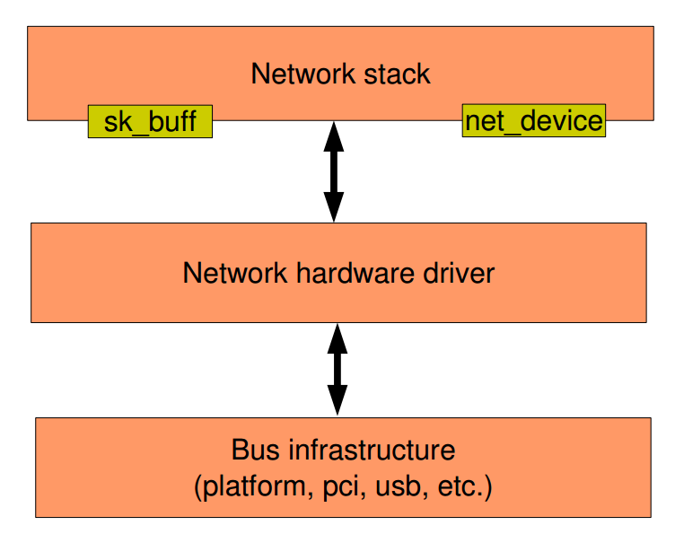
Network Device Driver
Architecture

Slide 66
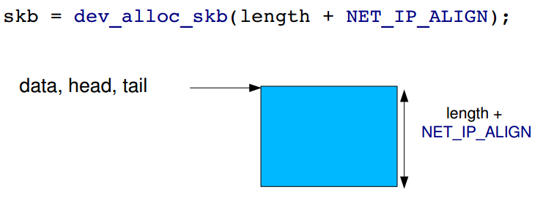
Network Device Driver
Allocating a SKB
Function dev_alloc_skb() allows to allocate an SKB
Can be called from an interrupt handler. Usually the case on reception.
On Ethernet, the size allocated is usually the length of the packet + 2, so that the IP header is word­-aligned (the Ethernet header is 14 bytes)

Slide 67
Network Device Driver
Allocating a SKB
Function dev_alloc_skb() allows to allocate an SKB
Can be called from an interrupt handler. Usually the case on reception.
On Ethernet, the size allocated is usually the length of the packet + 2, so that the IP header is word­-aligned (the Ethernet header is 14 bytes)

Slide 68
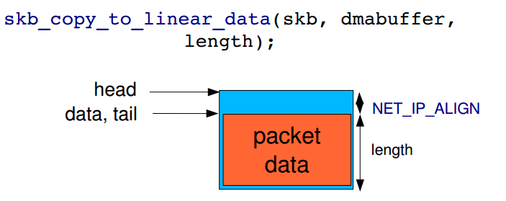
Network Device Driver
Copy the received data
The packet payload must be copied from the DMA buffer to the SKB, using
static inline void skb_copy_to_linear_data(struct sk_buff *skb, const void *from, const unsigned int len);
static inline void skb_copy_to_linear_data_offset(struct sk_buff *skb, const int offset, const void *from, const unsigned int len);

Slide 69
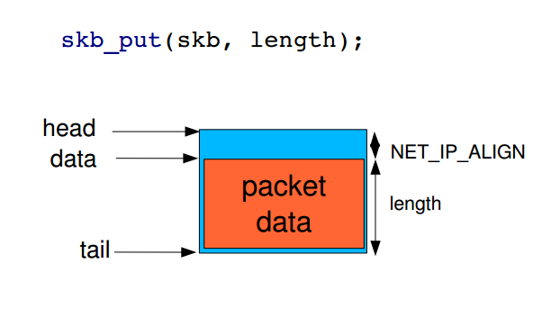
Network Device Driver
Update pointers in SKB
skb_put() is used to update the SKB pointers after copying the payload

Slide 70
Network Device Driver
struct net_device
This structure represents a single network interface
Allocation takes place with alloc_etherdev()
The size of private data must be passed as argument. The pointer to these private data can be read in net_device­>priv
alloc_etherdev() is a specialization of alloc_netdev() for Ethernet interfaces
Registration with register_netdev()
Unregistration with unregister_netdev()
Liberation with free_netdev()

Slide 71
Network Device Driver
struct net_device_ops
The methods of a network interface. The most important ones:
ndo_open(), called when the network interface is up'ed
ndo_close(), called when the network interface is down'ed
ndo_start_xmit(), to start the transmission of a packet
And others:
ndo_get_stats(), to get statistics
ndo_do_ioctl(), to implement device specific operations
ndo_set_rx_mode(), to select promiscuous, multicast, etc.
ndo_set_mac_address(), to set the MAC address
ndo_set_multicast_list(), to set multicast filters
Set the netdev_ops field in the struct net_device structure to point to the struct net_device_ops structure.

Slide 72
Network Device Driver
Utility Functions
netif_start_queue()
Tells the kernel that the driver is ready to send packets
netif_stop_queue()
Tells the kernel to stop sending packets. Useful at driver cleanup of course, but also when all transmission buffers are full.
netif_queue_stopped()
Tells whether the queue is currently stopped or not
netif_wake_queue()
Wake­up a queue after a netif_stop_queue(). The kernel will resume sending packets

Slide 73
Network Device Driver
Transmission
The driver implements the ndo_start_xmit() operation
The kernel calls this operation with a SKB as argument
The driver sets up DMA buffers and other hardware­dependent mechanisms and starts the transmission
Depending on the number of free DMA buffers available, the driver can also stop the queue with netif_stop_queue()
When the packet has been sent, an interrupt is raised. The driver is responsible for
Acknowledging the interrupt
Freeing the used DMA buffers
Freeing the SKB with dev_kfree_skb_irq()
If the queue was stopped, start it again
Returns NETDEV_TX_OK or NETDEV_TX_BUSY

Slide 74
Network Device Driver
Reception
Reception is notified by an interrupt. The interrupt handler should
Allocate an SKB with dev_alloc_skb()
Reserve the 2 bytes offset with skb_reserve()
Copy the packet data from the DMA buffers to the SKB
skb_copy_to_linear_data() or
skb_copy_to_linear_data_offset()
Update the SKB pointers with skb_put()
Update the skb­>protocol field with eth_type_trans(skb, netdevice)
Give the SKB to the kernel network stack with netif_rx(skb)

Slide 75
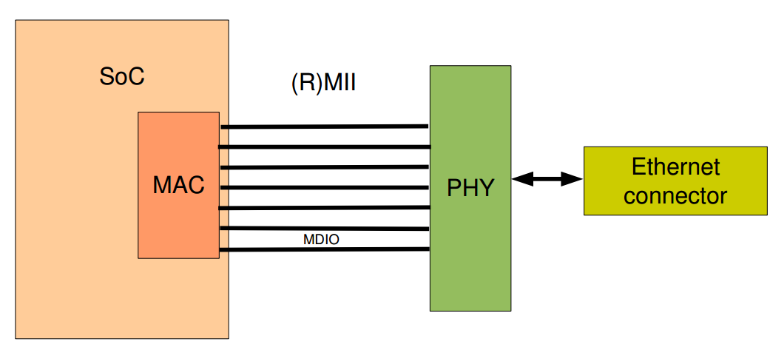
Network Device Driver
Communication with the PHY
Usually, on embedded platforms, the SoC contains the Ethernet controller, that takes care of layer 2 (MAC) communication.
An external PHY is responsible for layer 1 communication.
The MAC and the PHY are connected using a MII or RMII interface
MII = Media Independent Interface
RMII = Reduced Media Independent Interface
This interface contains two wires used for the MDIO bus (Management Data Input/Output)
The Ethernet driver needs to communicate with the PHY to get information about the link (up, down, speed, full or half duplex) and configure the MAC accordingly

Slide 76
Network Device Driver
PHY in the kernel
The kernel provides a framework that
Exposes an API to communicate with the PHY
Allows to implement PHY drivers
Implements a basic generic PHY driver that works with all PHY
Implemented in drivers/net/phy/
Documented in Documentation/networking/phy.txt

Slide 77
Network Device Driver
Dummy Network Device Driver 작성하여 패킷 전송 LOG 확인하도록…
Th

Slide 78
Target Kernel Development

Slide 79
Kernel Source Directory
arch/<ARCH>
Architecture specific code
arch/<arch>/mach-, machine/board specific code
arch/<arch>/include/asm, architecture-specific headers
arch/<arch>/boot/dts, Device Tree source files, for some architectures
block/
Block layer core
COPYING
Linux copying conditions (GNU GPL)
CREDITS
Linux main contributors
crypto/
Cryptographic libraries
Documentation/
Kernel documentation. Don't miss it!
drivers/
All device drivers except sound ones (usb, pci...)

Slide 80
Kernel Source Directory
firmware/
Legacy: firmware images extracted from old drivers
fs/
Filesystems (fs/ext4/, etc.)
include/
Kernel headers
include/linux
Linux kernel core headers
include/uapi
User space API headers
init/
Linux initialization (including init/main.c)
usr/
Code to generate an initramfs cpio archive
virt/
Virtualization support (KVM)

Slide 81
Kernel Source Directory
ipc/
Code used for process communication
Kbuild
Part of the kernel build system
Kconfig
Top level description file for configuration parameters
kernel/
Linux kernel core (very small!)
lib/
Misc library routines (zlib, crc32...)
MAINTAINERS
Maintainers of each kernel part. Very useful!
Makefile
Top Linux Makefile (sets arch and version)
mm/
Memory management code (small too!)

Slide 82
Kernel Source Directory
net/
Network support code (not drivers)
README
Overview and building instructions
REPORTING-BUGS
Bug report instructions
samples/
Sample code (markers, kprobes, kobjects...)
scripts/
Scripts for internal or external use
security/
Security model implementations (SELinux...)
sound/
Sound support code and drivers
tools/
Code for various user space tools (mostly C)

Slide 83
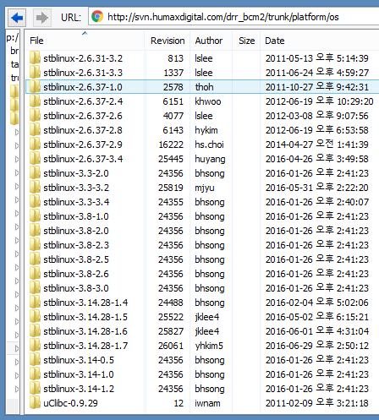
Broadcom Kernel Source
stblinux source from BROADCOM
All SOC Vendors Provide Kernel Source with HW Platform Ported.
The baseline kernel from kernel.org
Broadcom leading Team Releases stblinux for Broadcom STB Platform. They releases linux kernel for Android Platform.
https://github.com/Broadcom/stblinux ( I’m not sure it’s official source )

Slide 84
Kernel Building
Build the Kernel Humax Source Tree.
Where does default configuration come from?
device/product_config/platform/sdk/os/kernel/m1/rev0.1/kernel_config.cfg
In the Shell
huyang@RDKDev01:~/VN_Mentoring_M1/device/make$ make kernel
Build the Kernel in the Kernel Source Directory.
In the Shell
huyang@RDKDev01:~/VN_Mentoring_M1/device/platform/sdk/os/kernel$ export PATH=$PATH:/opt/toolchains/stbgcc-4.5.3-1.3/bin/ huyang@RDKDev01:~/VN_Mentoring_M1/device/platform/sdk/os/kernel$ make vmlinux

Slide 85
Kernel Configuration
Kernel Configuration and Build System
The kernel configuration and build system is based on multiple Makefiles
One only interacts with the main Makefile, present at the top directory of the kernel source tree
Interaction takes place
using the make tool, which parses the Makefile
through various targets, defining which action should be done (configuration, compilation, installation, etc.). Run make help to see all available targets.
Example
cd “Linux kernel Source Directory”
make <target>

Slide 86
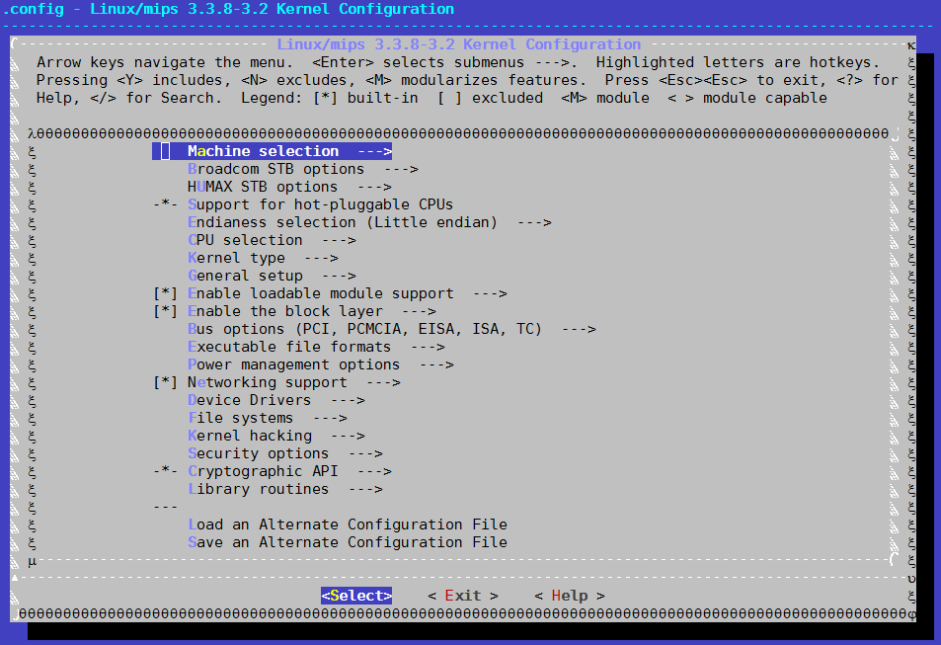
Kernel Configuration
Configuration
In the Shell
huyang@RDKDev01:~/kernel_direcotyr $ make menuconfig

Slide 87
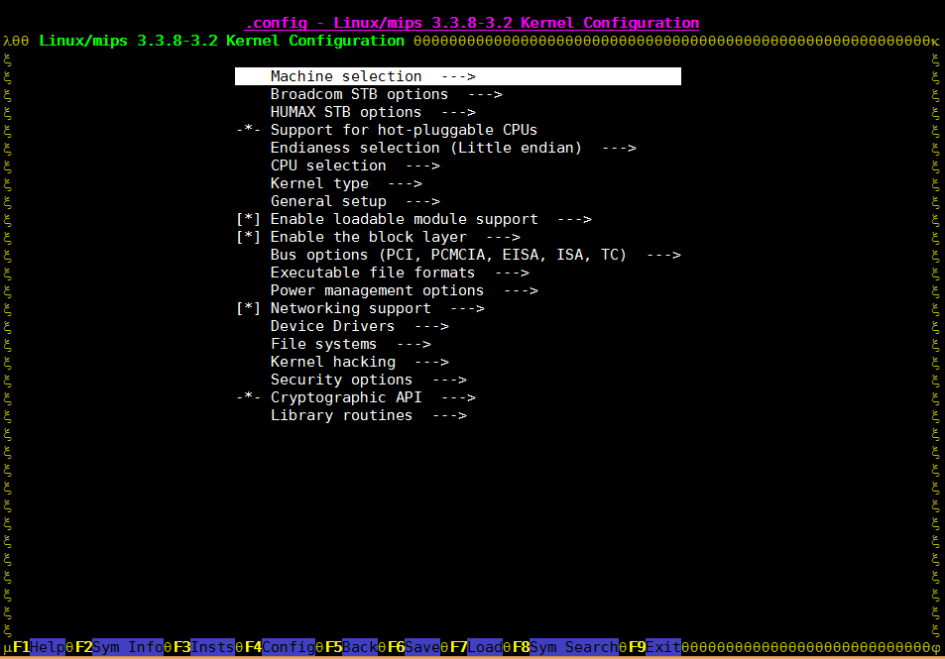
Kernel Configuration
Configuration
In the Shell
huyang@RDKDev01:~/kernel_direcotyr $ make nconfig

Slide 88
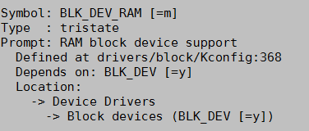
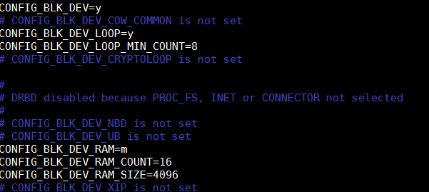
Kernel Configuration
Let’s change the CONFIG_BLK_DEV_RAM as a module.
Search it “/BLK_DEV_RAM + Enter “
Check “.config”

Slide 89
Kernel Configuration
Build Modules
In the Shell
huyang@RDKDev01:~/kernel_direcotyr $ make modules huyang@RDKDev01:~/kernel_direcotyr $ make modules SUBDIR=drivers/block

Slide 90
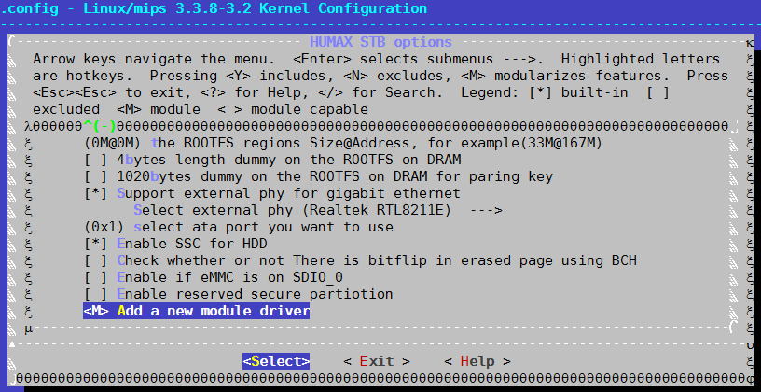
Including Kernel Module
Let’s add a “hello world module” to Kernel Source
Target directory : drivers/brcmstb/test.c
CONFIG_NAME : CONFIG_MODULE_TEST
See. Documentation/kbuild/kconfig-language.txt

Slide 91
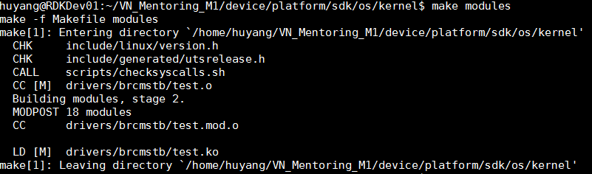
Including Kernel Module
Expected Result

Slide 92
Including Kernel Module
Let’s add a LED Control Driver to Kernel Source
Target directory : drivers/brcmstb/
CONFIG_NAME : CONFIG_LED_CONTROL
작업했던 led driver 를 소스안에 포함시킬수 있도록

Slide 93
M1 Kernel
Modification Point
HUMAX_PLATFORM_BASE Define.
So, When build Entire Kernel Image.
In the Shell
huyang@RDKDev01:~/kernel_direcotyr $ grep HUMAX_PLATFORM_BASE * -rn | grep -v ".cmd" | grep -v ".svn"
In the Shell
huyang@RDKDev01:~/kernel_direcotyr $ make CFLAGS_KERNEL="-DHUMAX_PLATFORM_BASE -DHUMAX_PLATFORM_DEBUG -DCONFIG_TTY_NUM=2" vmlinux

Slide 94
Practical Session

Slide 95
Practice 1.
Let’s add a log messages that you want to see at any driver or subsystem.

Slide 96
Practice 2.
In the drr_bcm2/trunk/platform/os/stblinux-3.3-3.2, Let’s find what was the modification with “fs/ecryptfs”. Use svn log.

Slide 97
THANK YOU

