Slide 1
Overview of Linux Kernel
Overview of architecture
Communicate between user pace and Kernel space
Filesystem
Tai2.tran

Slide 2
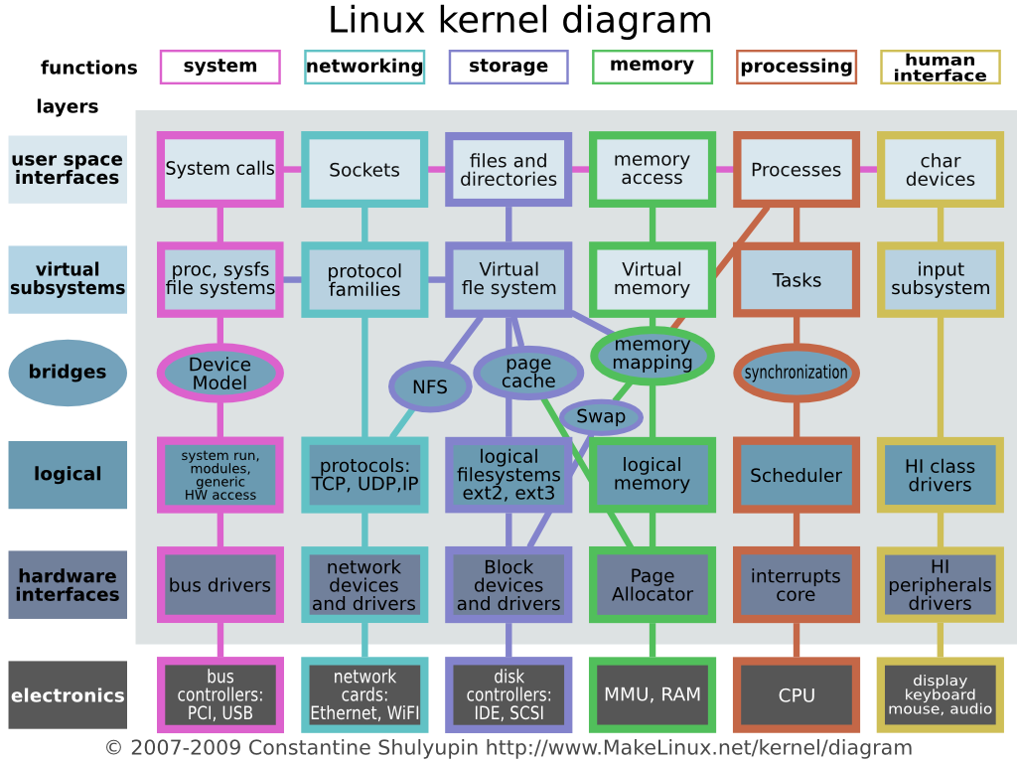
Structure

Slide 3
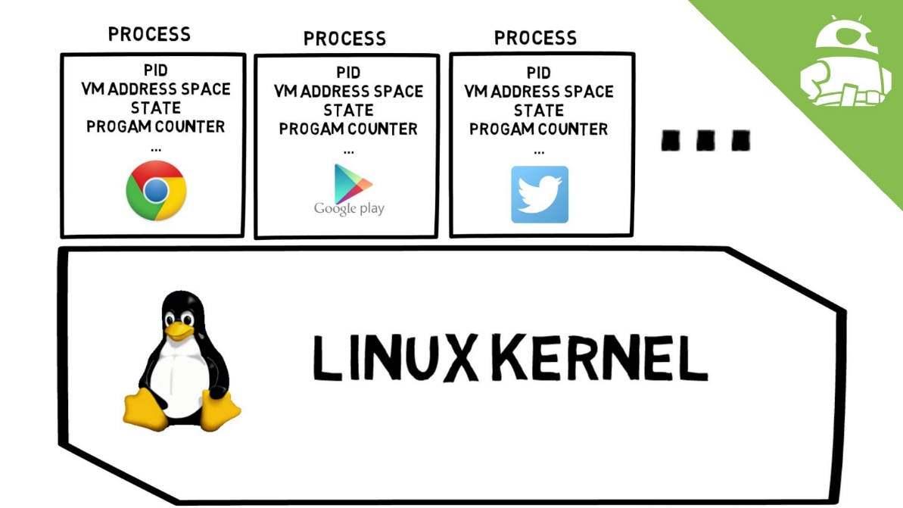
Process

Slide 4
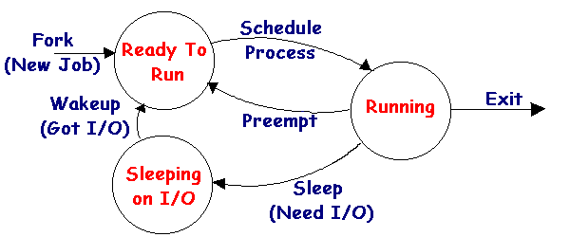
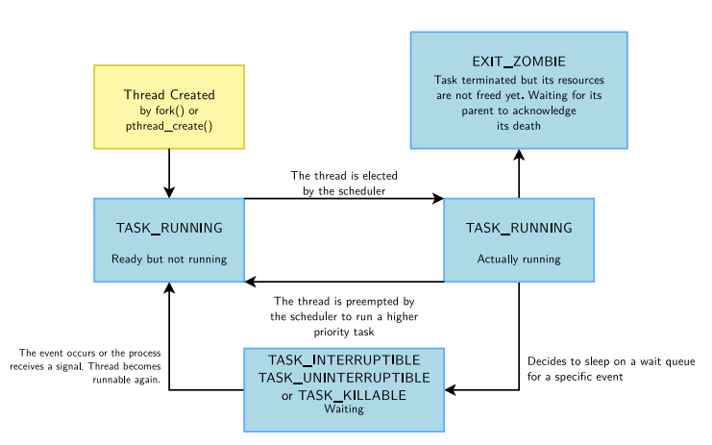
Process

Slide 5
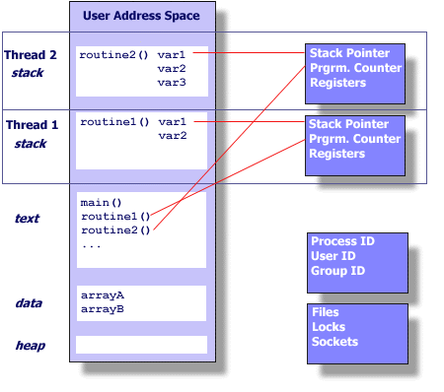
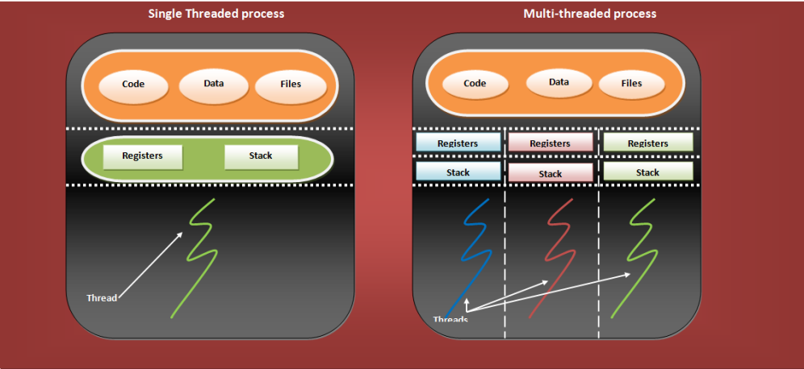
Multi-threaded process

Slide 6
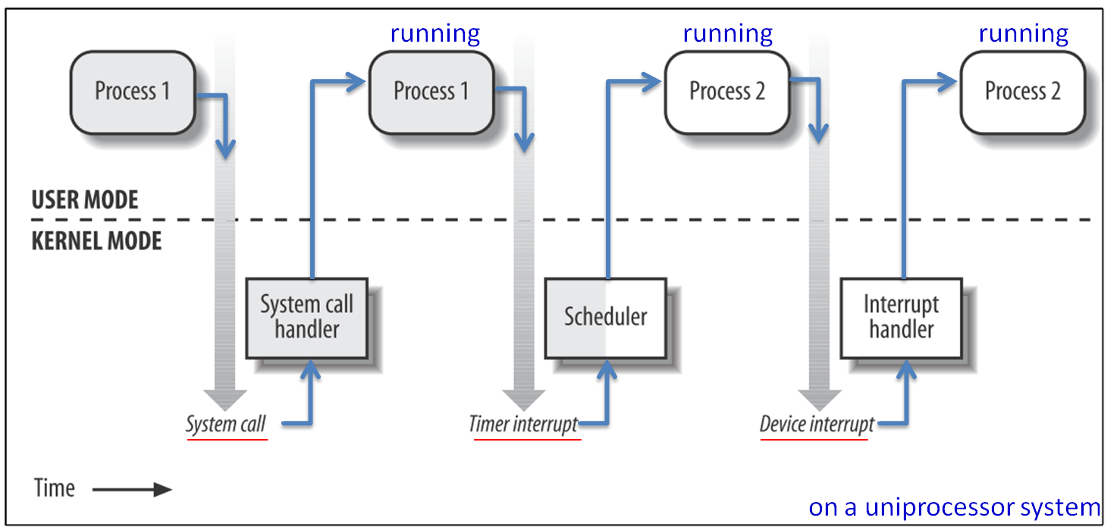
Kernel mode and user mode

Slide 7
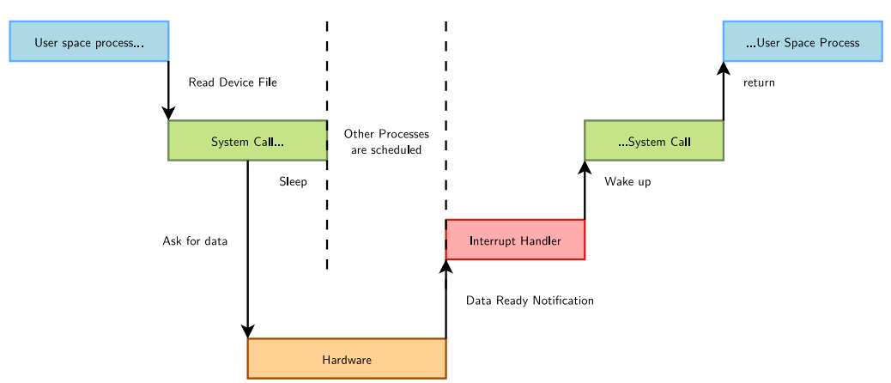
Kernel mode and user mode

Slide 8
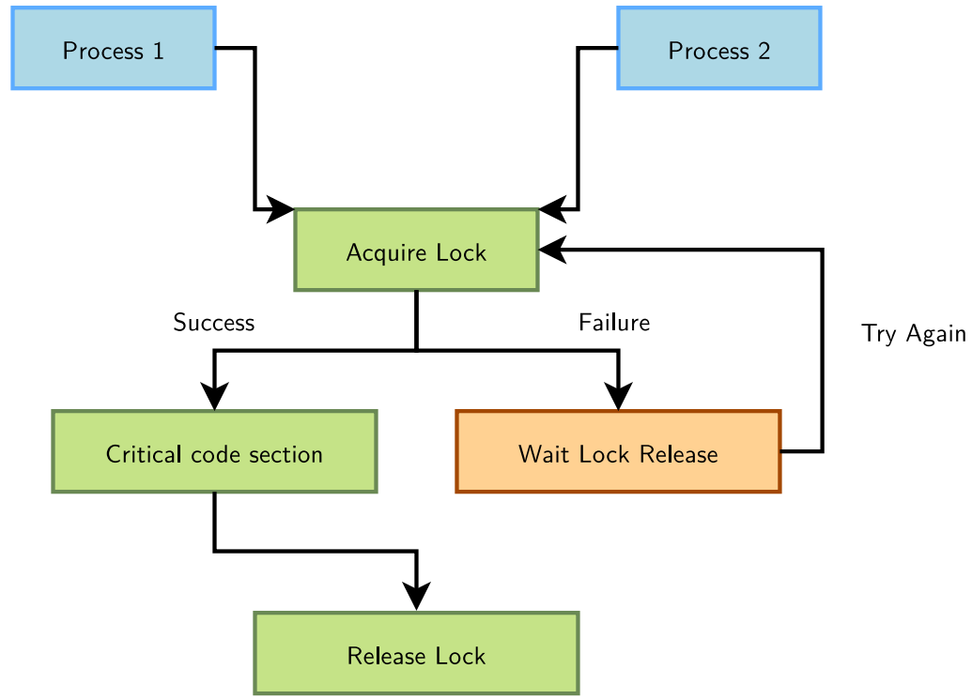
Concurrent access

Slide 9
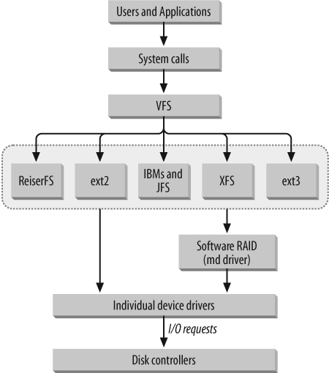
VFS (Virtual File system)
Disk file system
Special file system (proc, debugfs,
sysfs)

Slide 10
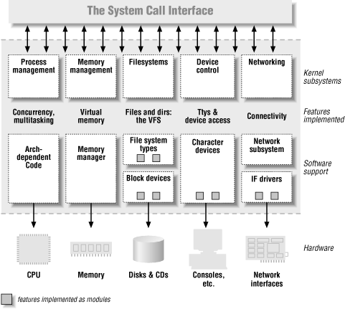
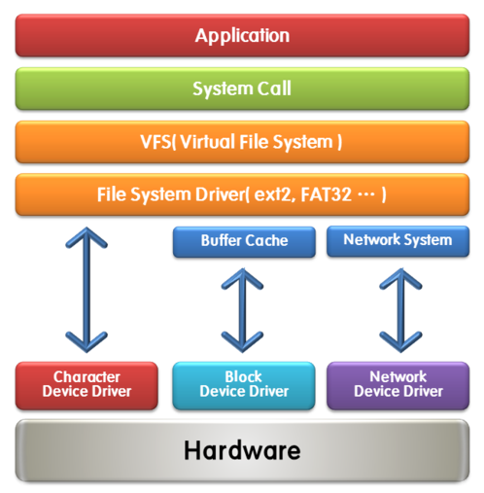
Linux device driver

Slide 11
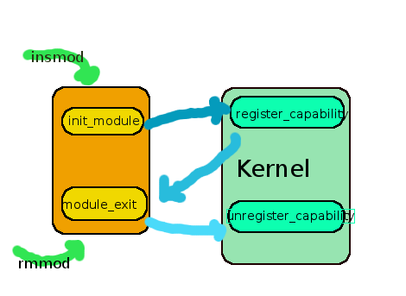
Kernel module

Slide 12
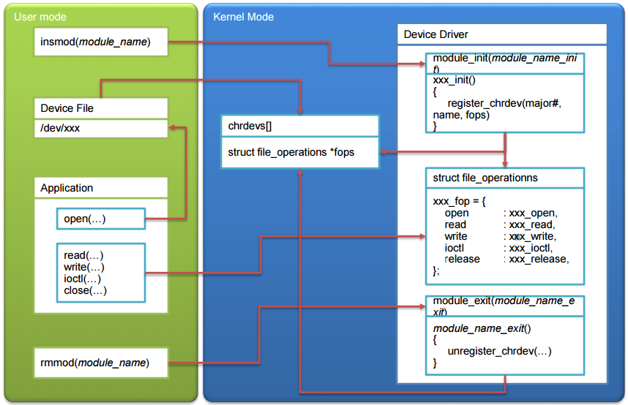
Character device driver

Slide 13
Communicate between user space and kernel space
procfs (Done)
https://en.wikipedia.org/wiki/Procfs
https://github.com/karelzak/util-linux/blob/master/sys-utils/lscpu.c
sysfs
debugfs
file, directory is created on fly (based RAM file system) (differ with ext2, etx3)
character device
ioctl
system call
mmap
sysctl
socket based mechanism
udp socket
netlink socket

Slide 14
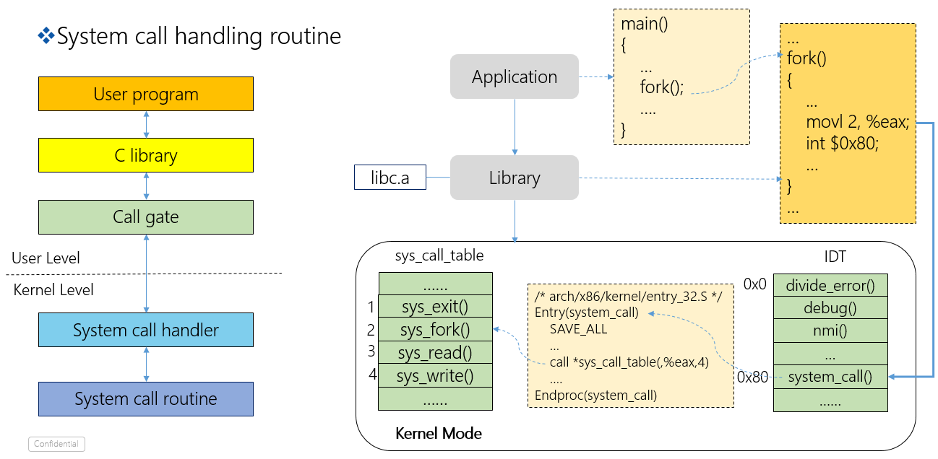
System call

Slide 15
File descriptor
File descriptors
File table
0
read
Inode table
1
…
/home/os/study/Makefile
2
write
…
…
…
/etc/passwd
…

Slide 16
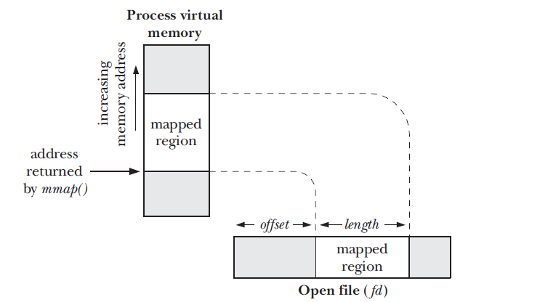
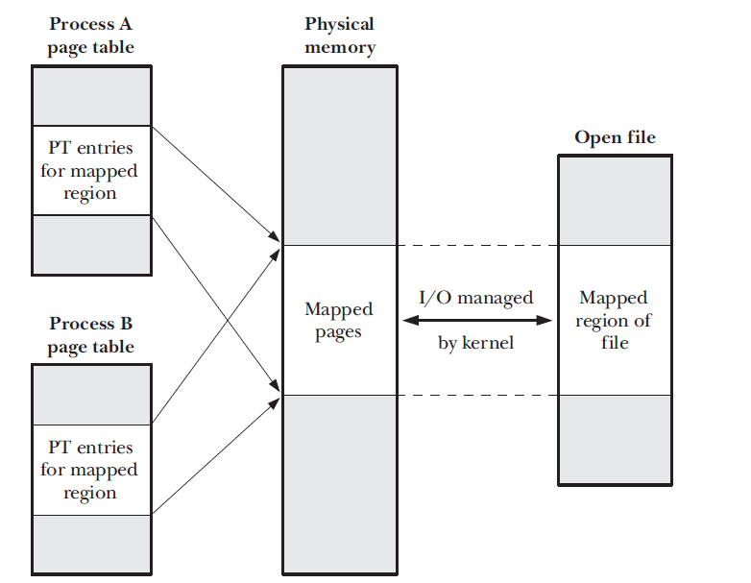
mmap

Slide 17
End of Document

