Slide 1
LGEDV-CodeChecker for detecting C++ vulnerability
Design Overview and Technical Details
Tran Anh Tai
May 30, 2025

Slide 2







Outline
Introduction
System Architecture
3 Static Analysis Design AI Analysis with Copilot
1
2
4
5 Local AI Analysis with Ollama
6 Package Configuration
Future Improvements
7

Slide 3
Introduction
Purpose: A Visual Studio Code extension to detect C++ vulnerabilities.
Methods:
Static Analysis using cppcheck, clang-tidy, and clang –analyze. AI-based analysis using GitHub Copilot and local AI (Ollama).
Target Users: C++ developers aiming to enhance code security.
Key Features:
Custom LGEDV rules using clang-tidy. Integration with Copilot for rule-based checks, both LGEDV rules and Misra C++.
Local AI analysis with Ollama for detailed reports.

Slide 4
Design Overview
LGEDV-CodeChecker
AI Analysis
Static Analysis (cppcheck, clang-tidy, clang)
(Copilot and local AI with Ollama)
Custom Clang-tidy for LGEDV rules

Slide 5
Static Analysis Workflow
Tools Used:
cppcheck: Comprehensive static analysis for C++ code.
clang-tidy: Custom LGEDV rules for specific vulnerability detection.
clang –analyze: Static analyzer for deeper code inspection.
Process:
1
2
3
4
5
Check if the active file is a C++ file (.cpp, .h, .hpp, .cxx, .cc). Run clang-tidy with custom LGEDV rules (–checks=-*,custom-*). Execute cppcheck with all checks enabled (–enable=all).
Run clang –analyze for additional analysis.
Generate a consolidated report (.static-report.txt).
Output: Detailed report with findings from all tools, saved in the same directory as the source file.

Slide 6
Copilot Integration
Use Copilot: How to connect and request Copilot ?
Important notice:
Copilot does not publish API. Using its API such as REST API via engineering reverse is considered as risk and violate Copilot policy seriously.
Solution:
Use VSCode extension to automatically copy pre-defined prompt, which is read from set of rules. User only pastes the prompt to chat box without effort of rewriting long prompt.
1
2
3
4

Slide 7
Copilot Integration
Purpose: Leverage GitHub Copilot to detect C++ vulnerabilities based on predefined rules.
Rule Files:
Misracpp2008GuideLines.md
LGEDVRuleGuidelines.md
StaticAnalysicGuidelines.md
Workflow:
1
2
Validate active editor and C++ file type.
Construct a prompt combining rule files and code analysis requirements.
Execute Copilot Chat command or copy prompt to clipboard if
unavailable.
Suggest refactored code to comply with rules.
3
4
Output: Copilot provides violation details with line numbers and refactoring suggestions.

Slide 8
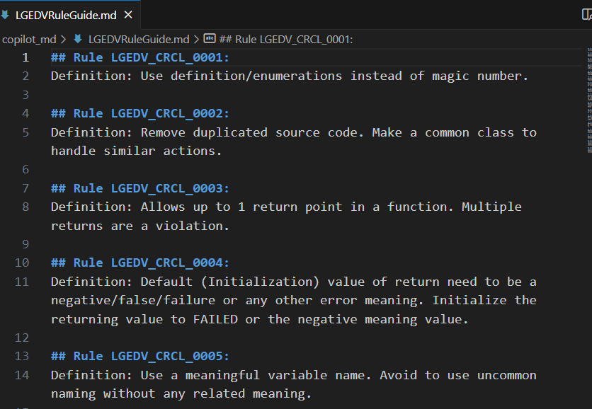
Copilot Integration

Slide 9
Ollama Integration
Purpose: Use local AI model (Ollama with qwen3:8b) for detailed C++ vulnerability analysis.
Workflow:
1
2
3
4
5
6
Validate C++ file and read its content.
Add line numbers to code for precise issue reporting. Create a prompt for Ollama with analysis instructions.
Check and start Ollama service if necessary (systemd or direct).
Stream analysis results to a report file (.ai-report.txt).
Provide refactored code suggestions.
Error Handling:
Prompt size validation (max 1MB). Service availability checks.
Temporary file management.
Output: Detailed report with line-specific issues and refactoring suggestions.

Slide 10
Package Configuration (package.json)
Key Fields:
name: lgedv-code-checker displayName: LGEDV Code Checker description: Check C++ Vulnerability version: 0.0.1
engines: VS Code ≥ 1.100.0
Activation Events: Trigger on commands like lgedv.checkStaticAll, lgedv.checkCppVulnByCopilot. Commands and Menus:
Context menu integration for C++ files in Explorer and Editor. Commands for static and Copilot-based checks.
Dependencies:
TypeScript, ESLint, and VS Code testing tools.

Slide 11
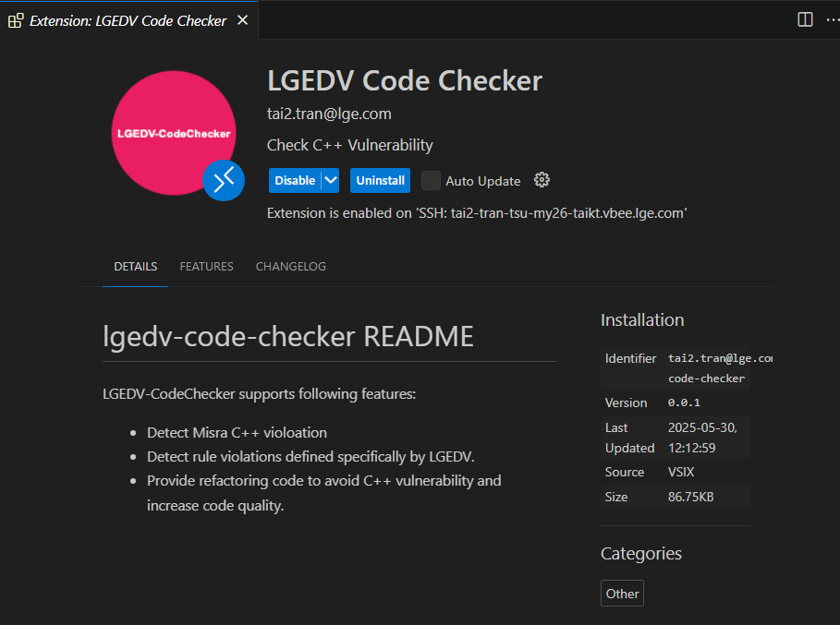
Demo

Slide 12
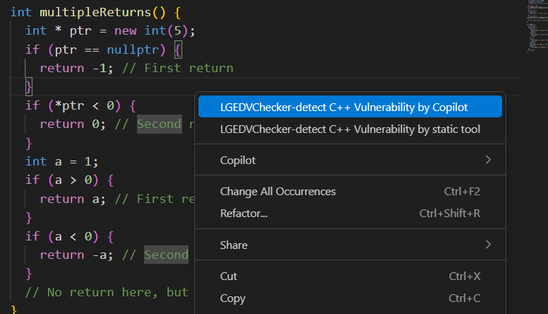
Demo

Slide 13
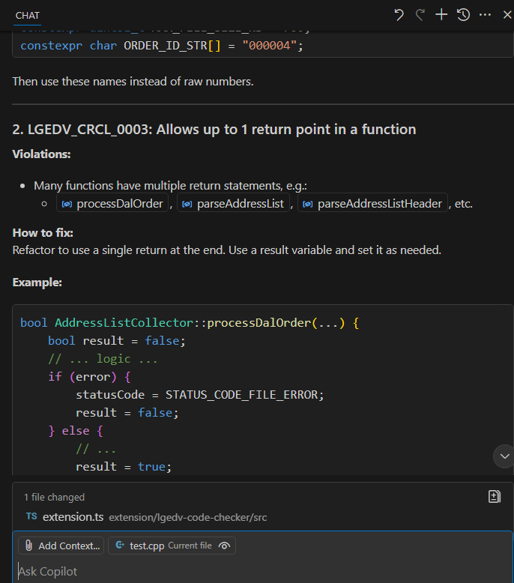
Demo

Slide 14
Evaluation
Method | Copilot | static tool | Local AI with Ollama
Pros | - High quality of violation detection - Response time is fast - The code suggestion is good | - High security - High quality of violation detection - Free of cost | - High security - Free of cost
Cons | - Low security with high risk of exposing sensitive data. - What happens if an AI model uses LG data for training? - High cost for the license | - Requires high effort for supporting custom rules (custom clang-tidy) | - Low performance because of the training quality of the open-source model - Require good hardware - Response time is slow

Slide 15
Future Improvements
Enhanced Rule Customization: Allow users to edit LGEDV rules via a VS Code settings UI.
Real-time Diagnostics: Integrate analysis results directly into VS Code’s Problems panel.
CI/CD integration: Integrate analysis results with CI/CD process
Extended AI Support: Support for additional local AI models and cloud-based AI services.
User Feedback Integration: Collect user feedback to refine AI prompts and rule sets.

Slide 16
Conclusion
The LGEDV Code Checker provides a robust solution for C++ vulnerability detection.
Combines static analysis (cppcheck, clang-tidy, clang) with AI-driven insights (Copilot, Ollama).
Generates detailed reports for both static and AI analyses.
Future enhancements will focus on usability, performance, and extended AI capabilities.
Thank you for your attention!

