Slide 1
Code-Guard tool for detecting C++ vulnerability
Tran Anh Tai
May 30, 2025

Slide 2
Outline
Introduction
Design Overview
Static Analysis
AI solution
Evaluation
Future Improvements
Conclusion

Slide 3
Introduction
Purpose
- A tool to detect C++ vulnerabilities.
Focus on standard MISRA C++ rules, LGEDV-defined rules and OEM-defined rules
Activity of source code review is time consuming, how to make it fast? http://collab.lge.com/main/display/DCVCC/5.+AlarmMgr
Methods
- Static Analysis using cppcheck, clang-tidy, and clang
AI-based analysis using Copilot with MCP (Model Context Protocol)
Combine both static-based analysic and AI-based analysic to increase result correctness (AI is not always true and can create false-positive result)

Slide 4
Design Overview
Code-Guard tool
AI Analysis
Static Analysis (cppcheck, clang-tidy, clang)
(Copilot using MCP for understanding local resource context)
Custom Clang-tidy for LGEDV rules

Slide 5
Static Analysis
Library used:
cppcheck: Comprehensive static analysis for C++ code.
clang-tidy: Custom LGEDV rules for specific vulnerability detection.
clang: Static analyzer for code inspection.

Slide 6
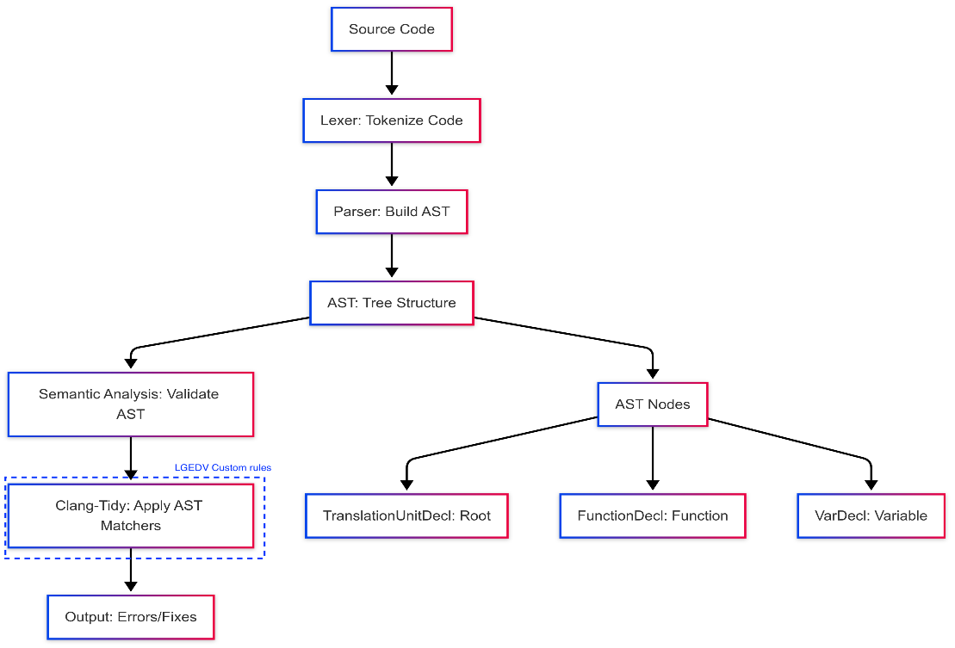

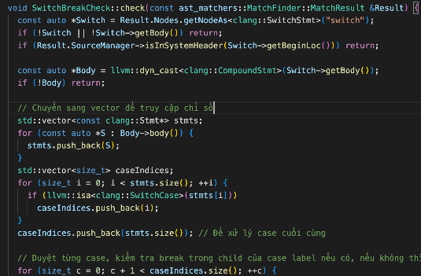
Static Analysis
Clang-tidy for custom rules
AST: Abstract Syntax Tree
Clang-Tidy parses C++ source code into an AST, a tree representation of code's syntactic structure.
Custom rules are “checkers" that traverse AST to identify patterns that violate specific coding guidelines.

Slide 7
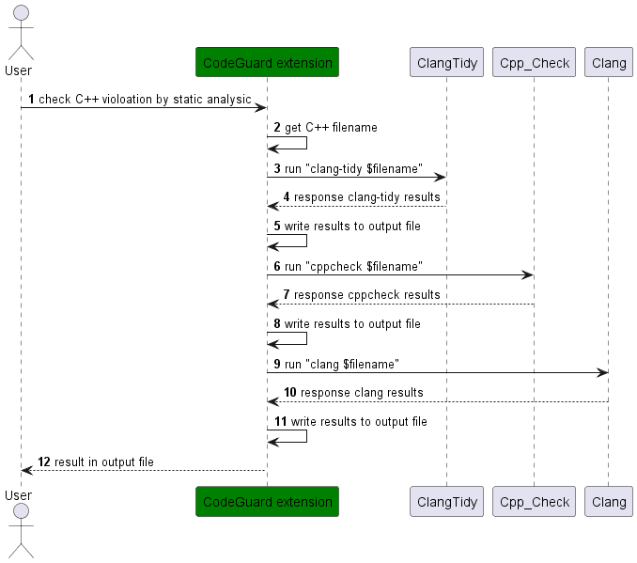
Static Analysis

Slide 8
AI solution
Purpose
- Leverage GitHub Copilot to detect C++ vulnerabilities based on predefined rules.
Pre-defined Rules (Markdown format)
- Misracpp2008GuideLines.md
- LGEDVRuleGuidelines.md
- StaticAnalysicGuidelines.md
3
4

Slide 9
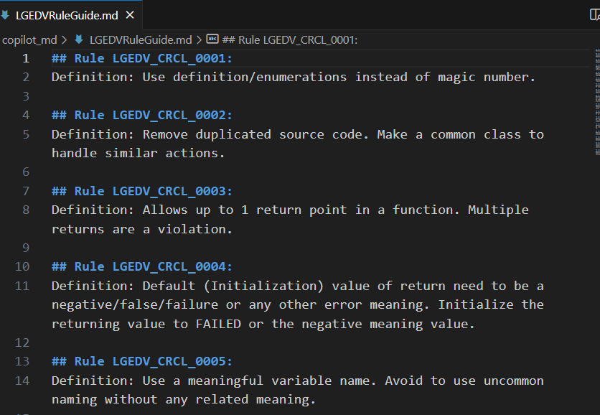
AI solution
Pre-defined rules
- Markdown format

Slide 10
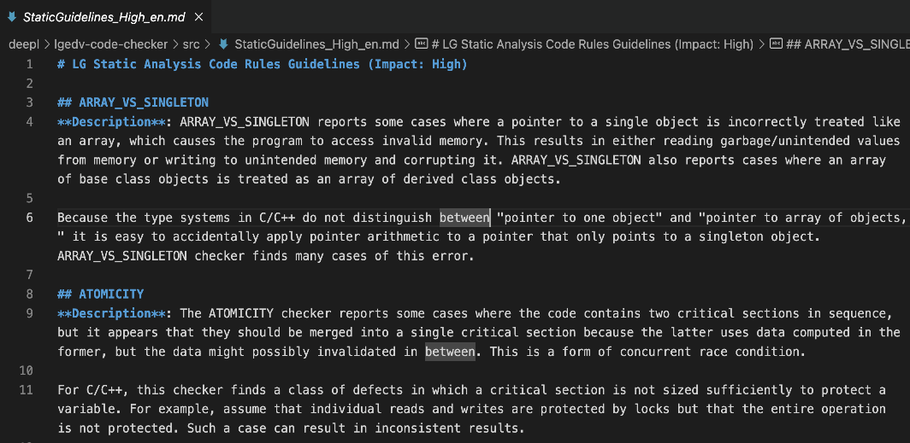
AI solution
Pre-defined rules
- Markdown format

Slide 11
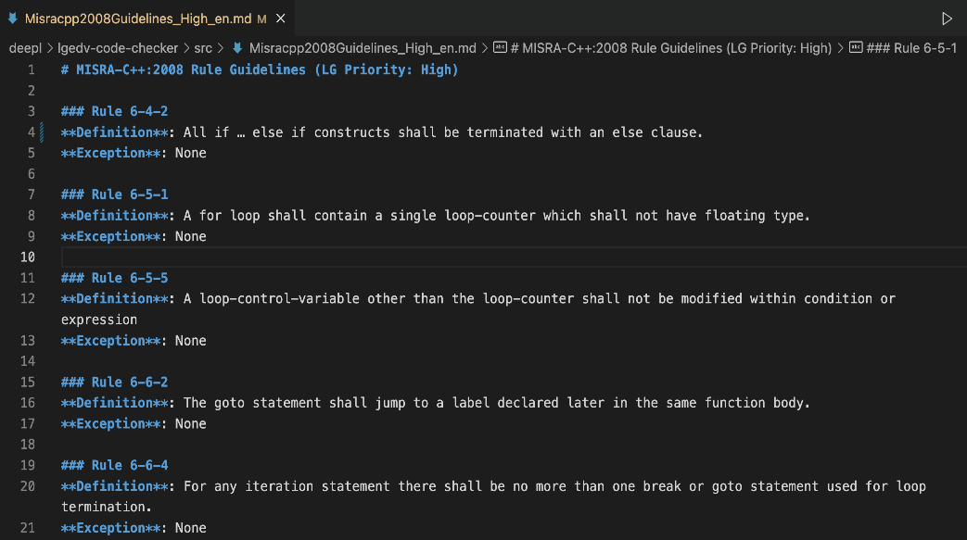
AI solution
Pre-defined rules
- Markdown format

Slide 12
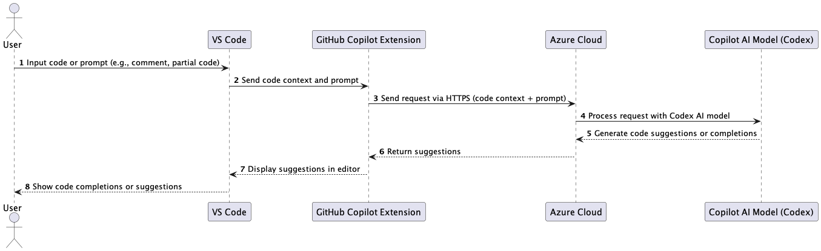
AI solution
How Copilot works

Slide 13
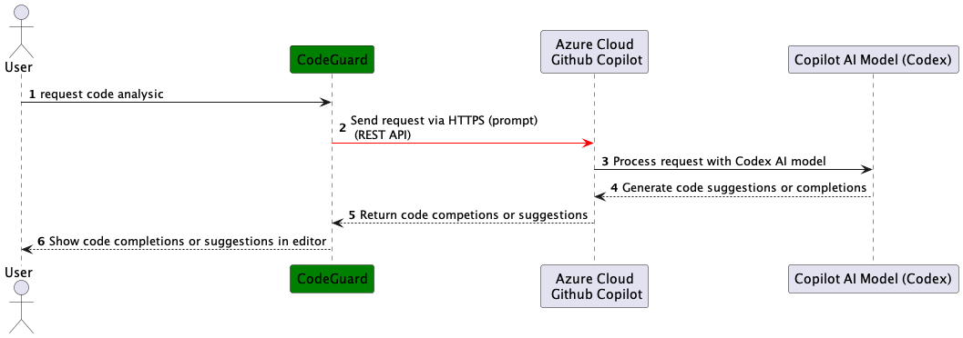
AI solution
Expected Design:
Copilot provides REST API for clients to use it
Unfortunately, Copilot does not publish its API

Slide 14
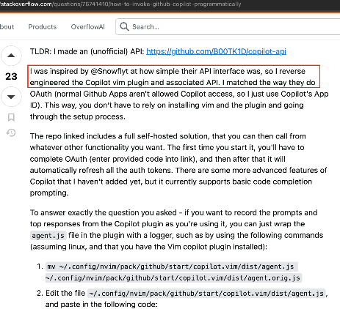
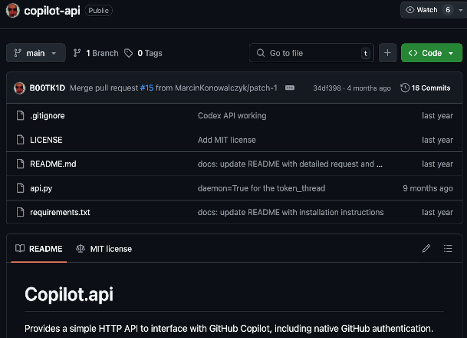
AI solution
Potential solution: (not applicable)
- Identify Copilot’s API through reverse engineering with Copilot Vim plugin

Slide 15
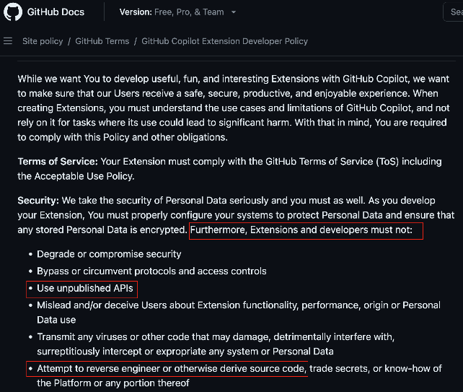
AI solution
Is that acceptable solution?
- No. Because it violates Copilot policy.
- If trying to use, Github account can be banned and risk of illegal activities.
Policy: https://docs.github.com/en/site-policy/github-terms/github-copilot-extension-developer-policy

Slide 16
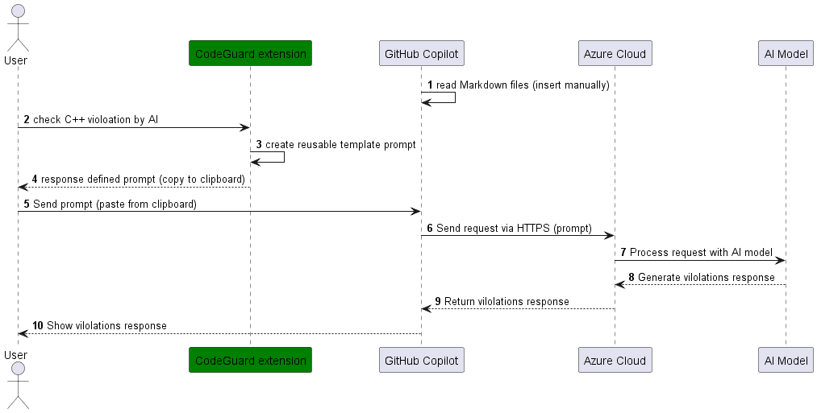
AI solution
Option 1 (not selected)
- Use Copilot Chatbox as current official method provided by Copilot
- But support flexibility of user for typing prompt automatically

Slide 17
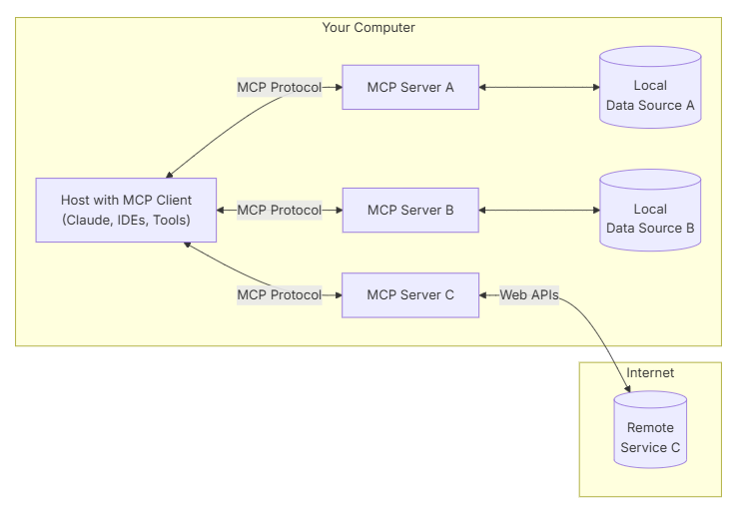
AI solution
Option 2: Use MCP (Model Context Protocol) (selected )
- Provides a standardized way for AI models to explore and interact with external tools, applications, and data sources

Slide 18
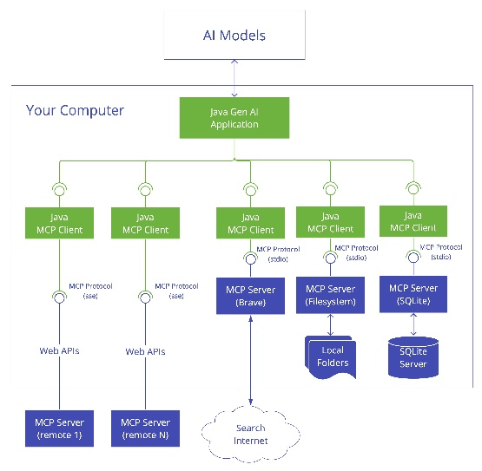
AI solution
Option 2: Use MCP (Model Context Protocol)
MCP server can
Expose data through Resources
Provide functionality through Tools
Define interaction patterns through Prompts (reusable templates for LLM interactions)

Slide 19
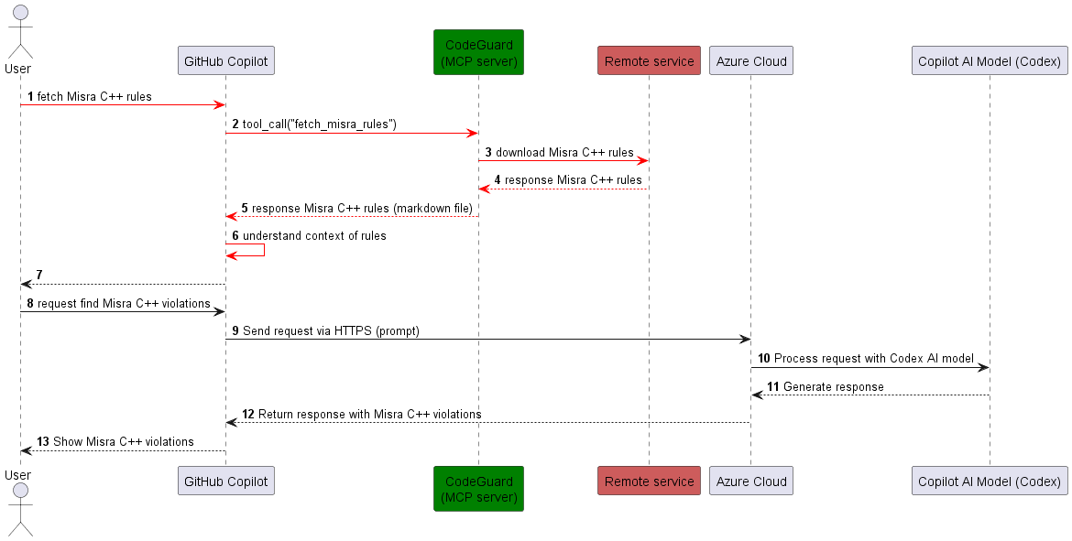
AI solution
Option 2: Use MCP (Model Context Protocol)

Slide 20
Local AI with Ollama (experimental)
Purpose
- Use local AI model (Ollama with qwen3:8b) for detailed C++ vulnerability analysis.
Process - Create a prompt for Ollama with analysis instructions.
- Check and start Ollama service if necessary (systemd or direct).
- Stream analysis results to a report file (.ai-report.txt).

Slide 21
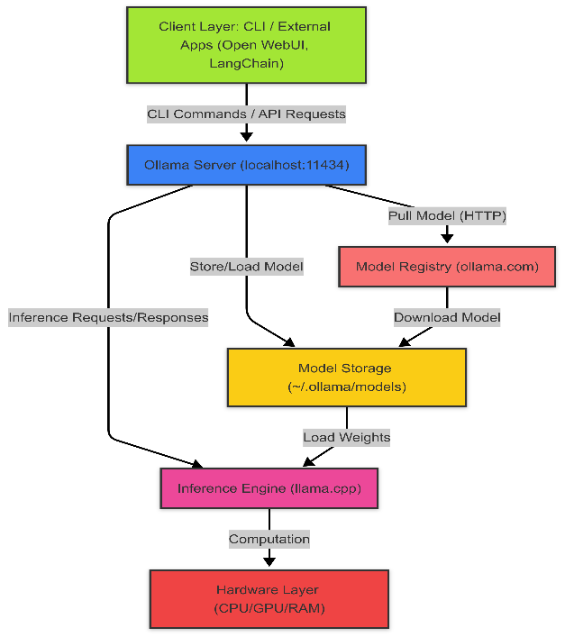
Local AI with Ollama (experimental)
Overview design
- Download open-source AI Model and perform AI task locally on PC

Slide 22
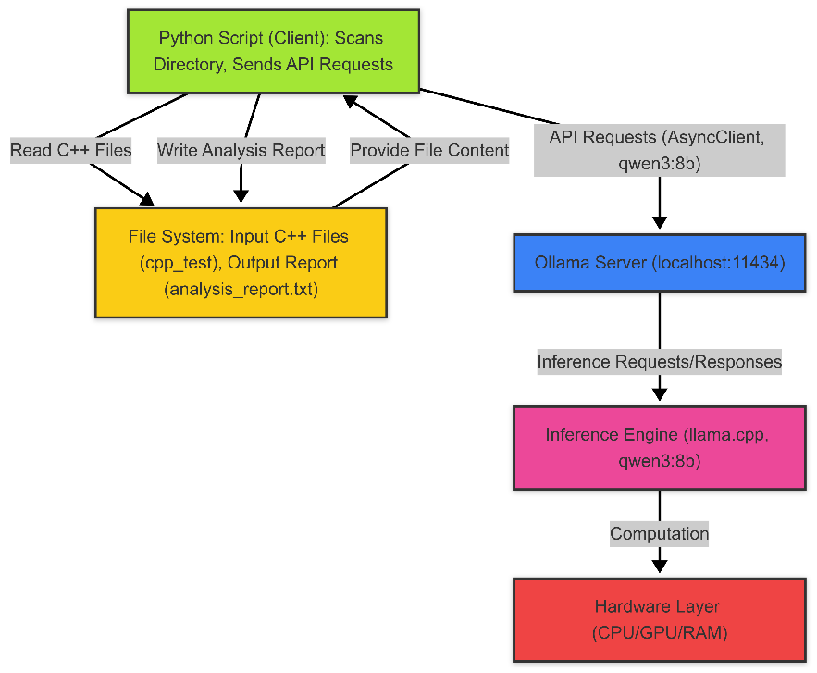
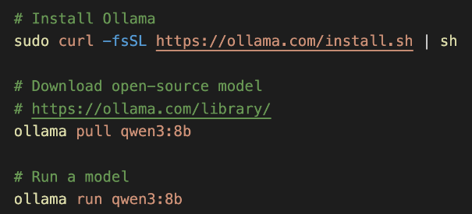
Local AI with Ollama (experimental)
Specific design

Slide 23
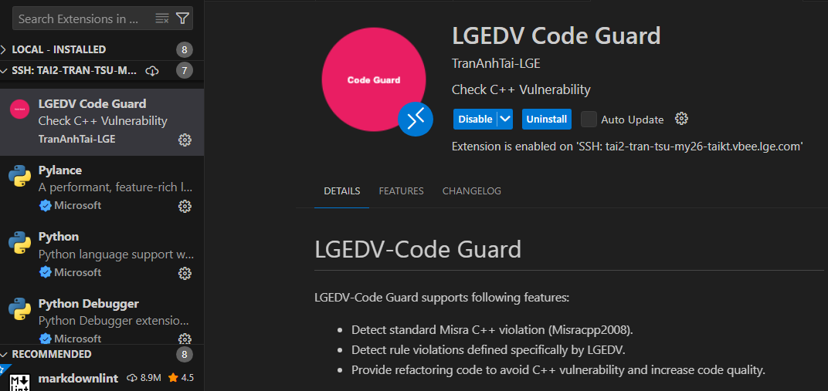
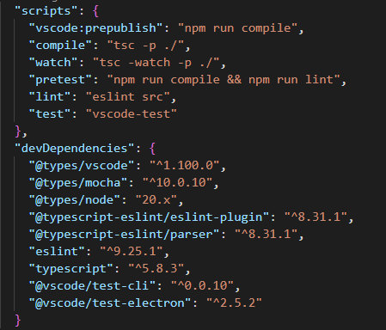
Evaluation
Install Code-Guard tool
Dependency

Slide 24
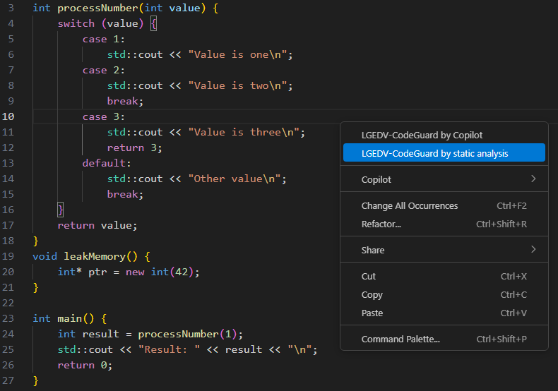
Evaluation
Test file
- Select analytical mode by right-click

Slide 25
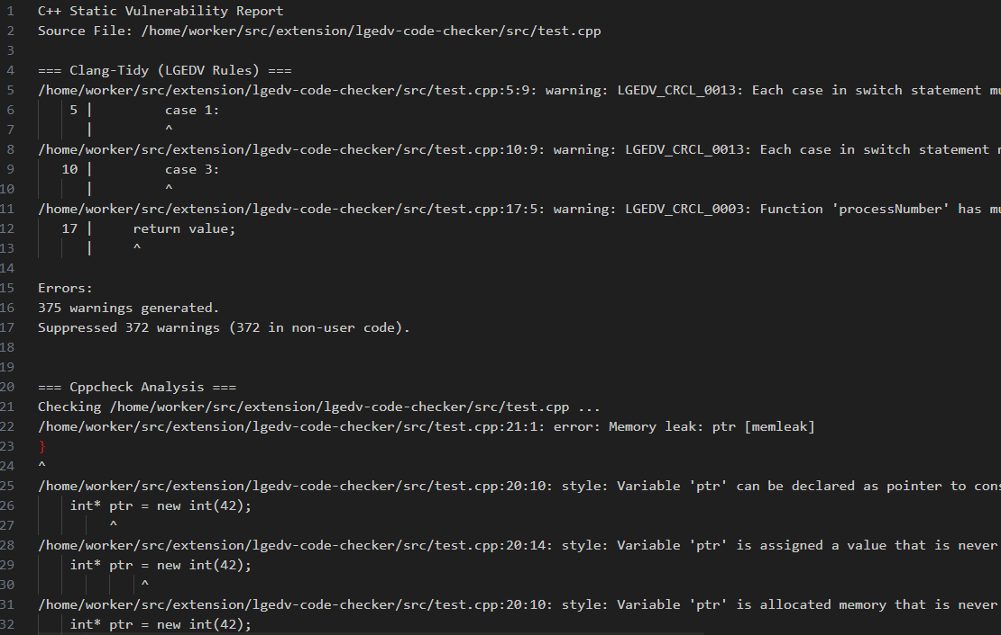
Evaluation
Static analysic
- Cppcheck, clang-tidy with custom rule

Slide 26
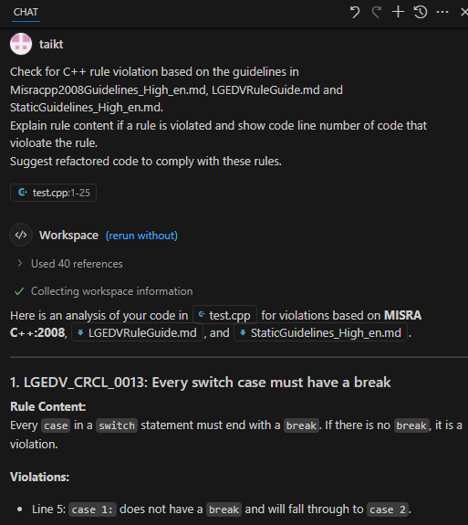
Evaluation
CodeGuard
Extension
- AI solution Option #1

Slide 27
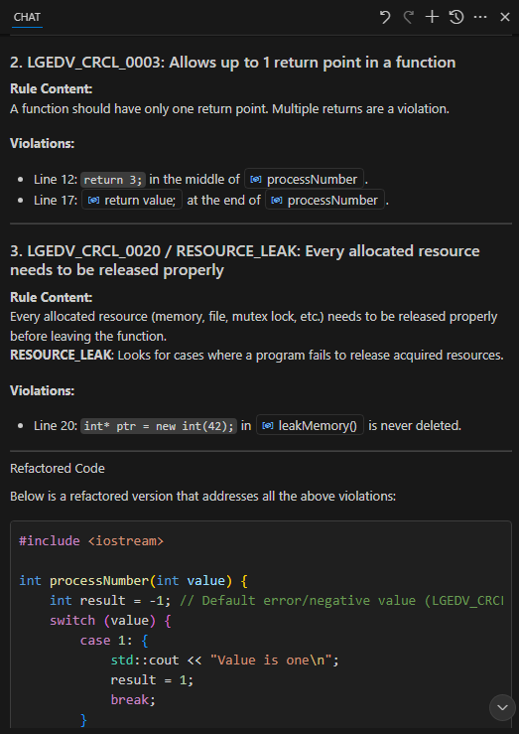
Evaluation
CodeGuard
Extension
- AI solution Option #1

Slide 28
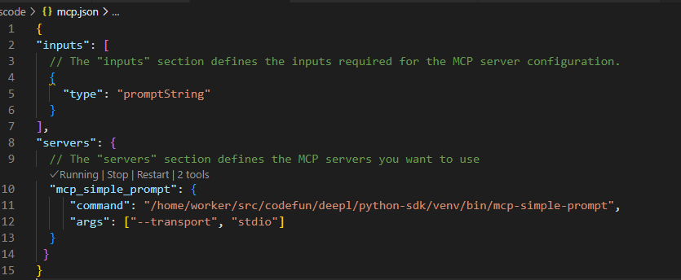
Evaluation
AI analysis with MCP – AI solution, option #2
1. Start MCP server

Slide 29
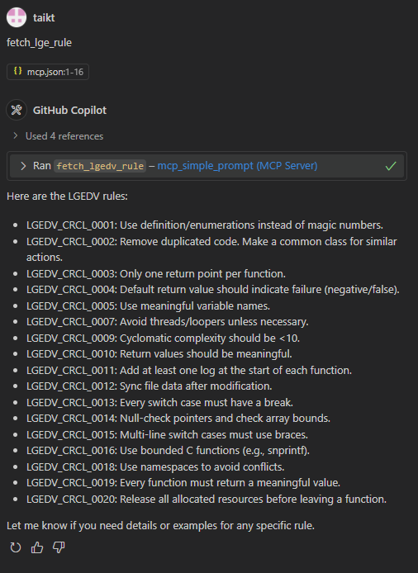
Evaluation
AI analysis with MCP and Copilot
(option #2 )
2. Fetch LGE rule

Slide 30
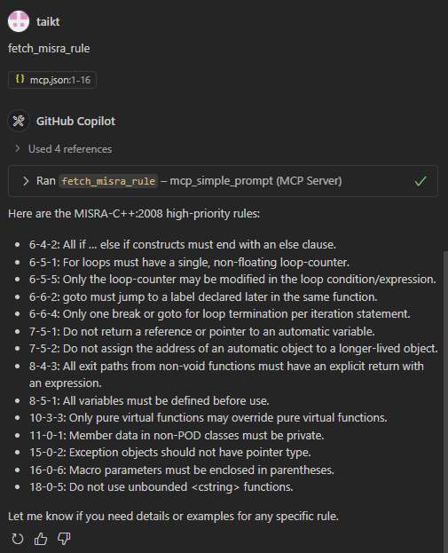
Evaluation
AI analysis with MCP and Copilot
( option #2 )
2. Fetch Misra rule

Slide 31
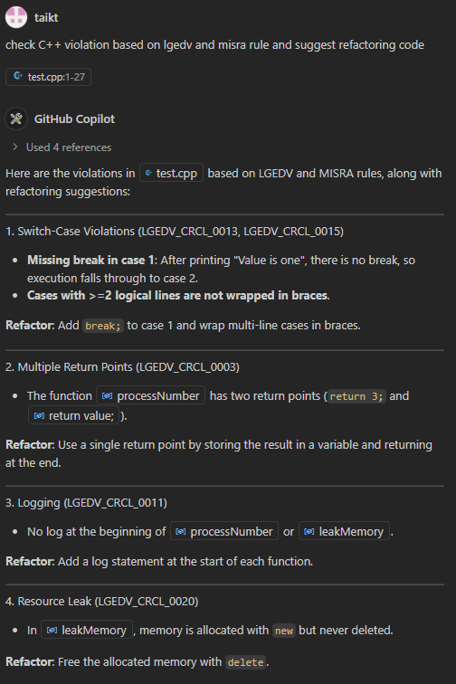
Evaluation
AI analysis with MCP and Copilot (Option #2 )
2. Check C++ violation based on rules

Slide 32
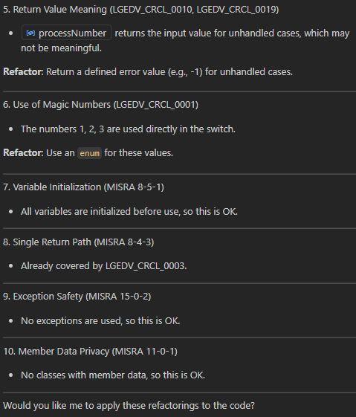
Evaluation
AI analysis with MCP and Copilot (Option #2 )
2. Check C++ violation based on rules

Slide 33
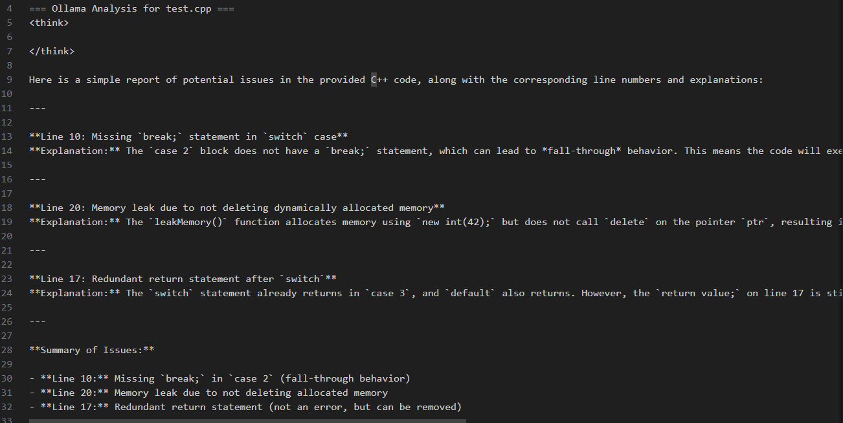
Evaluation
Local AI output (ollama)

Slide 34
Evaluation
Method | Copilot with MCP | Static tool | Local AI with Ollama
Pros | - High quality of violation detection ability - Response time is fast - The code suggestion is good | - High security (work locally) - High quality of violation detection ability for custom rule. - Free of cost | - High security (work locally) - Free of cost
Cons | - Low security with risk of exposing sensitive data. | - Requires high effort for supporting custom rules (custom clang-tidy) | - Low performance because of the training quality of open-source AI model - Require good hardware to use AI locally - Response time is slow
Decision | Selected | Selected | Reject

Slide 35
Future Improvements
- Use Copilot’s REST API: Use API if Copilot publishes in future.
- CI/CD integration: Integrate analysis results with CI/CD process
Extended AI Support: Support for additional local AI models and cloud-based AI services.
Improve AI-based analysis quality: detect difficult rules such as finding potential race condition.

Slide 36
Conclusion
- Code-Guard tool provides a robust solution for C++ vulnerability detection.
- Combines static analysis (cppcheck, clang-tidy, clang) with AI-driven insights (Copilot with MCP).
- Future enhancements will focus on usability, performance, and extended AI capabilities.

