Slide 1
LGE Internal Use Only
Propose an efficient asynchronous task management technique for Tiger platform in Telematics projects
SW Architectural Design
26/5/2025
Tran Anh Tai - Software Engineering Team - LGEDV

Slide 2
LGE Internal Use Only
Agenda
Project Overview
Project Context
Current Design
Problem of Current Design
Limitation of C++ standard library
Propose new async mechanism
Overall Design
Implementation and Verification

Slide 3
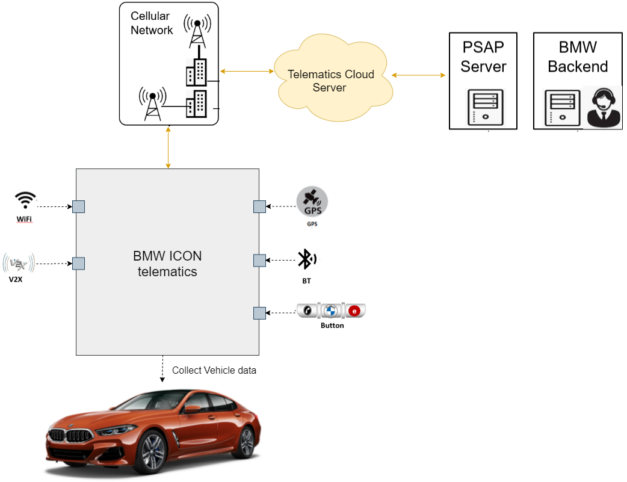
1. Project Overview
LGE Internal Use Only
What is Tiger platform for Telematics?
Provide core services such as diagnostic service, route service,etc to be used in various telematics projects
Provide base SW framework to be reused and inherited by other applications and services.
This project is to improve the Tiger framework quality

Slide 4
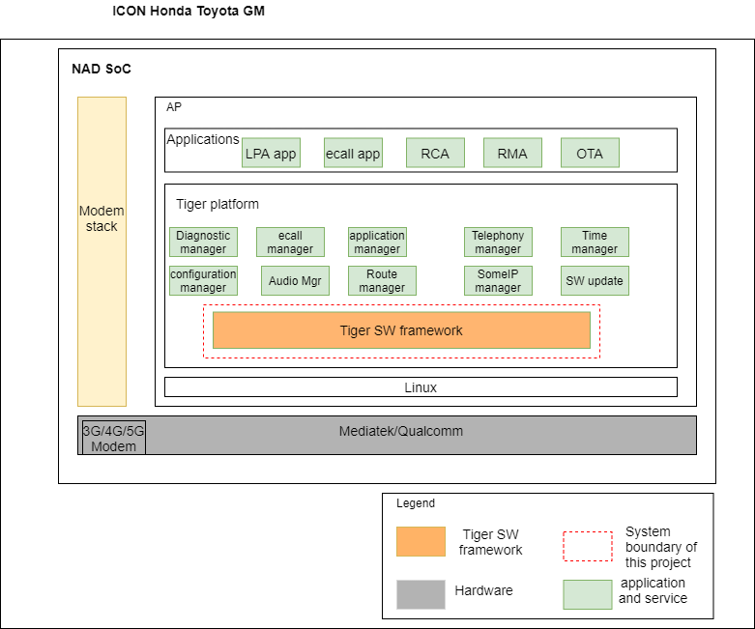
2. Project Context
LGE Internal Use Only
System Context Diagram
NAD SoC: applications and services developed by LGE
Tiger SW framework:
Provide base class which is inherited by applications and services
Provide utility for processing asynchronous operations

Slide 5
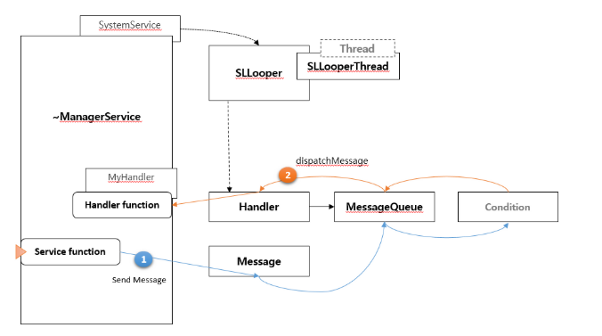
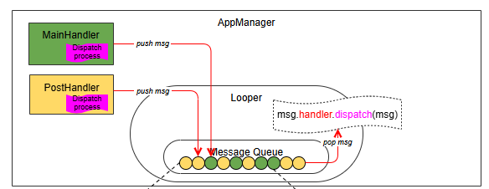
2. Current design
LGE Internal Use Only
- How Async operation is handled?

Slide 6
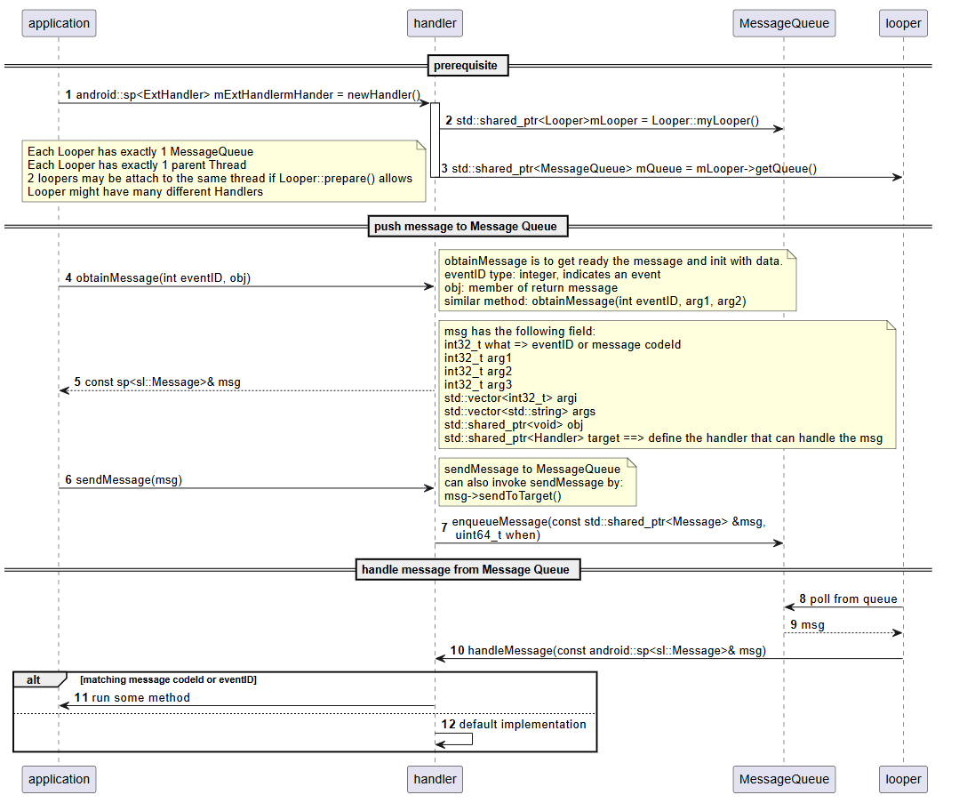
2. Current design
LGE Internal Use Only

Slide 7
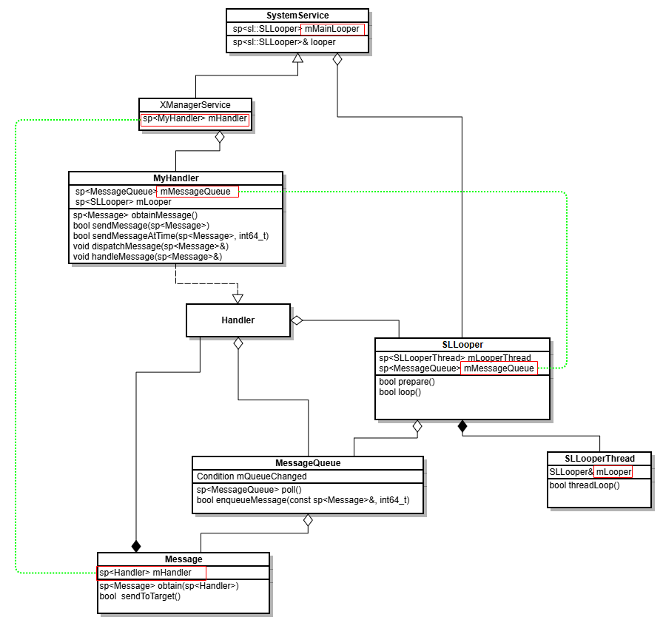
2. Current design
LGE Internal Use Only

Slide 8
3. Problem of current design
LGE Internal Use Only
Only support message-based asynchronous operation -> impact usability(maintainability)
Lack support for function-based type (callable objects)
Using current async operation in Tiger library is complex -> impact usability(maintainability)
Take more effort for developing
The more complex code is, the more error-prone code is
Tiger library doesn’t handle well for CPU-bound task efficiently -> impact performance
Lead to stuck in event loop
Timer mechanism on Tiger library is based on Linux Thread -> impact efficiency
Lead to exhausts system resources because of creating each new thread for new timer
Not support a chain of asynchronous operations -> impact usabilitiy

Slide 9
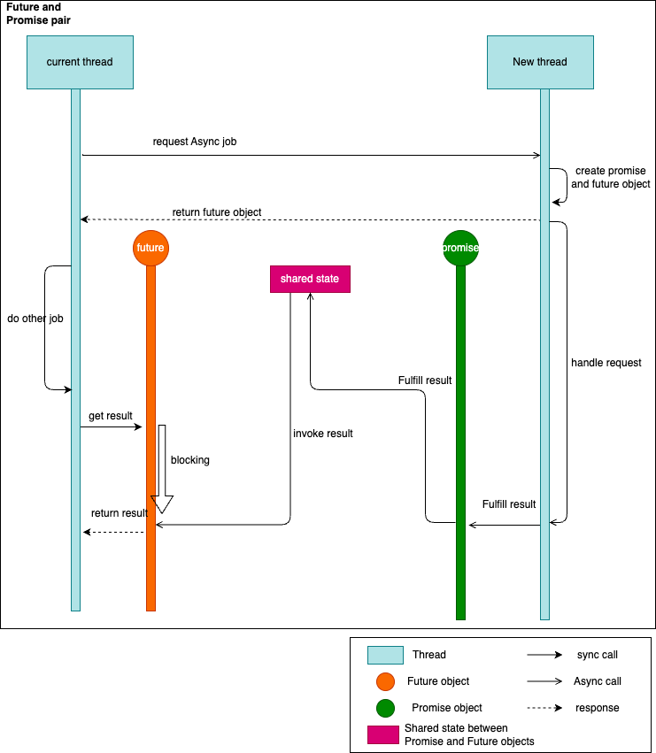
4. Limitation of C++ standard library
LGE Internal Use Only
Current C++ library doesn’t provide well async operation mechanism
C++ library offer std::async() or std::future/std::promise
Require new thread for each async operation, which causes expensive cost of OS for thread context switching and allocate/destroy threads.
JavaScript offers better async operation
Simpler API for use
Reduce cost of creating thread(one thread is enough)

Slide 10
5. Propose new asynchronous mechanism
LGE Internal Use Only
Propose a new async C++ library which is inspired by Promises/A+ specification
New future and promise mechanism are proposed
Provide simpler API for user application -> improve Userability
New async library can handle CPU-bound task better -> improve Performance
Support a chain of asynchronous operations -> improve Userability
Propose new timer mechanism which works effectively in new async library -> improve Efficiency (using resource optimally)

Slide 11
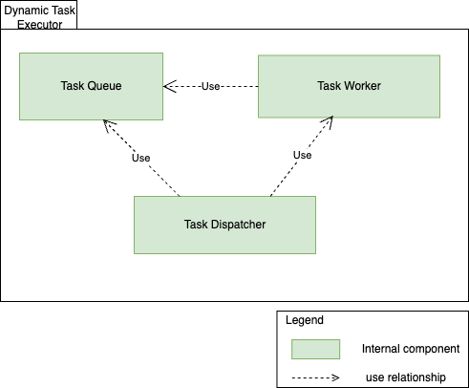
6. Overall Design - Task Executor
LGE Internal Use Only
Static view

Slide 12
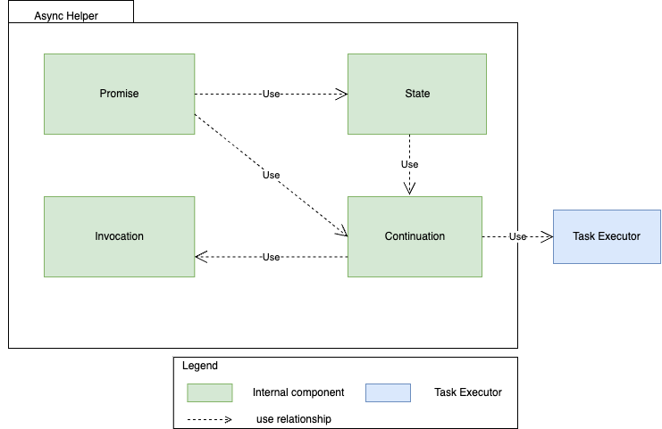
6. Overall Design - Async Helper
LGE Internal Use Only
Static view

Slide 13
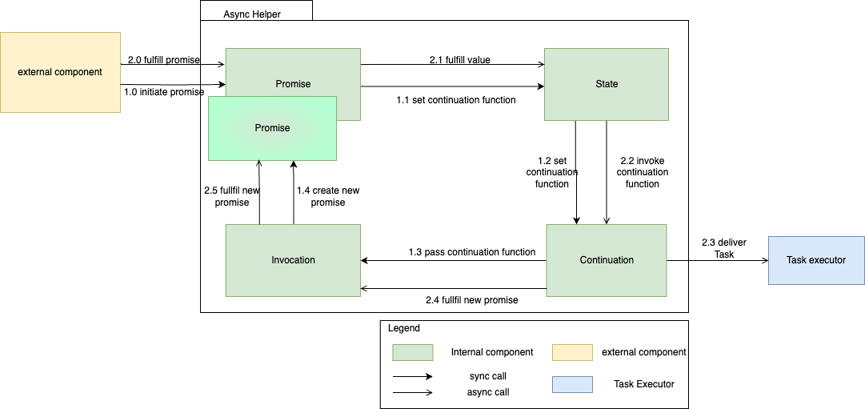
6. Overall Design - Async Helper
LGE Internal Use Only
Internal interaction of Async Helper

Slide 14
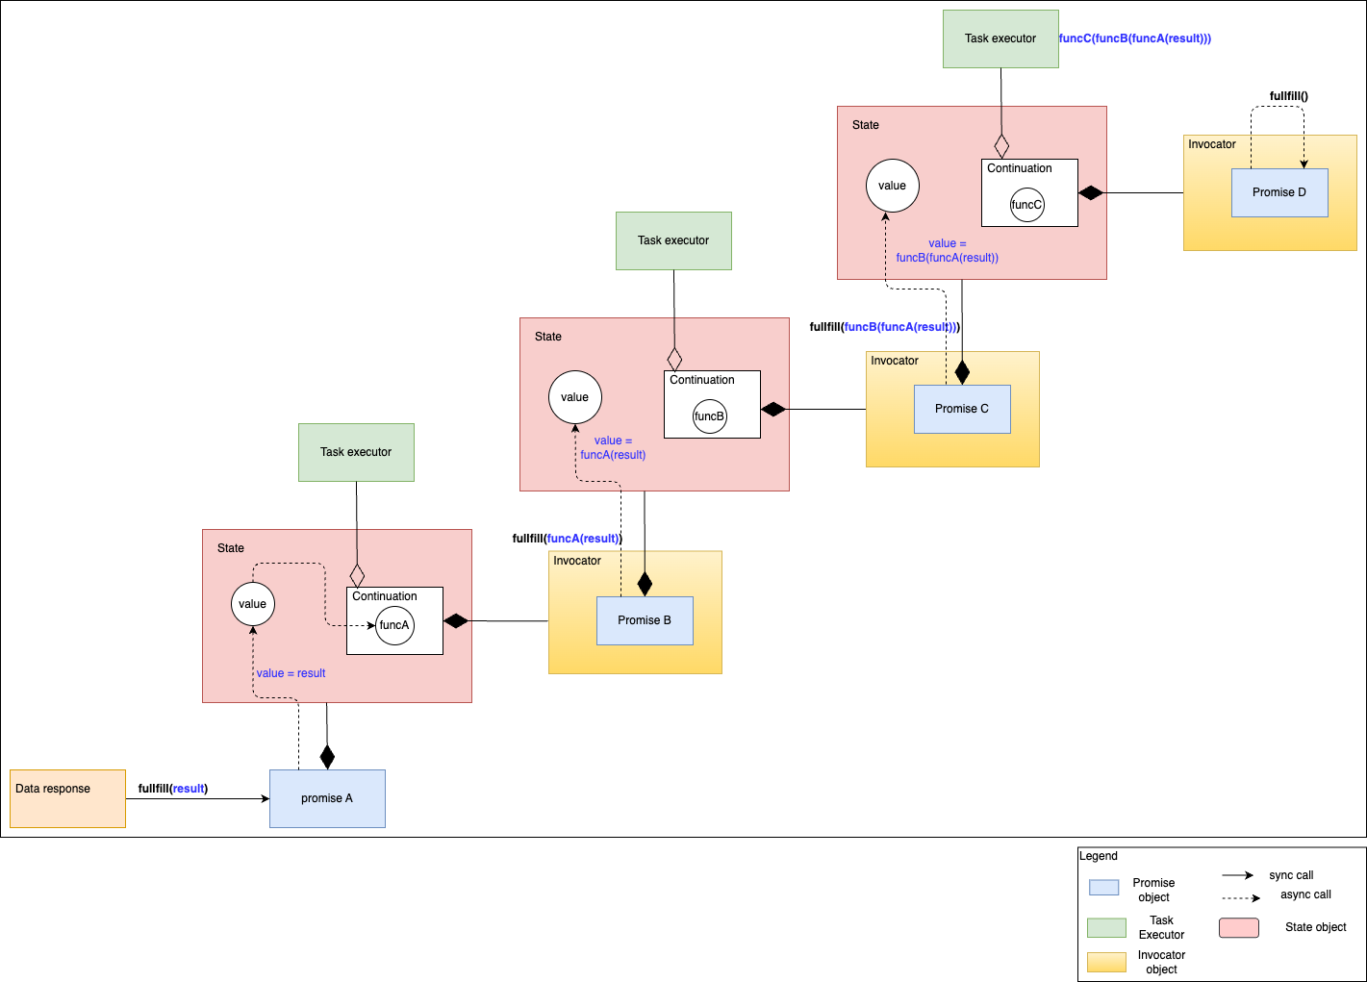
6. Overall Design - Async Helper
LGE Internal Use Only
Promise Chain

Slide 15
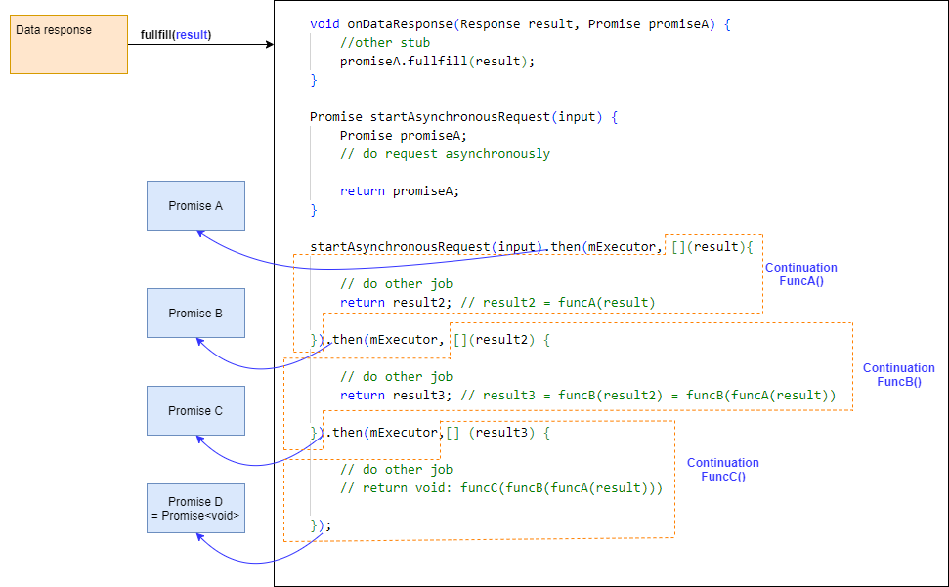
6. Overall Design - Async Helper
LGE Internal Use Only
Example of use case prototype

Slide 16
7. Implementation and verification
In progress

Slide 17
Thank you for your listening!

