Slide 1
Code-Guard tool for detecting C++ vulnerability
Tran Anh Tai
May 30, 2025

Slide 2
Outline
Introduction
Design Overview
Static Analysis
Clang-tidy for custom rules
Local AI with Ollama
Copilot Integration
Package Configuration
Evaluation
Future Improvements
Conclusion

Slide 3
Introduction
Purpose
- A VSCode extension to detect C++ vulnerabilities.
- Focus on LGEDV-defined rules
- Support standard MISRA C++ rules
Methods
- Static Analysis using cppcheck, clang-tidy, and clang –analyze.
- AI-based analysis using GitHub Copilot and local AI (Ollama).

Slide 4
Design Overview
Code-Guard tool
AI Analysis
Static Analysis (cppcheck, clang-tidy, clang)
(Copilot and local AI with Ollama)
Custom Clang-tidy for LGEDV rules

Slide 5
Static Analysis
Library used:
cppcheck: Comprehensive static analysis for C++ code.
clang-tidy: Custom LGEDV rules for specific vulnerability detection.
clang –analyze: Static analyzer for deeper code inspection.
Process:
Check if the active file is a C++ file (.cpp, .h, .hpp, .cxx, .cc).
Run clang-tidy with custom LGEDV rules (–checks=-*,custom-*). Execute cppcheck with all checks enabled (–enable=all).
Run clang –analyze for additional analysis.
Generate a consolidated report (.static-report.txt).
Output:
- Detailed report with findings from all open source libraries

Slide 6
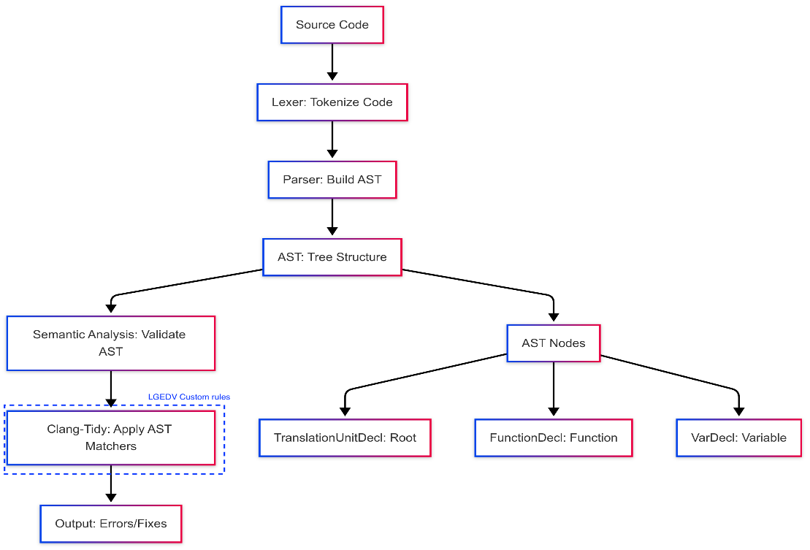
Clang-tidy for custom rules
Overview design

Slide 7
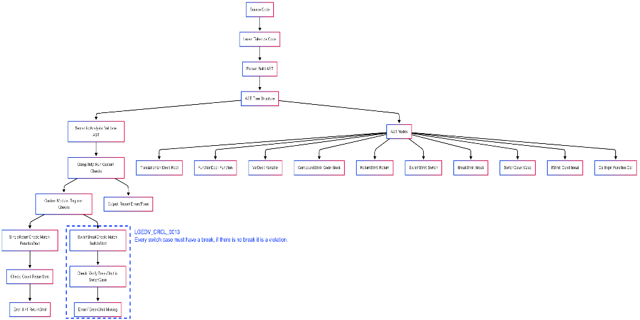
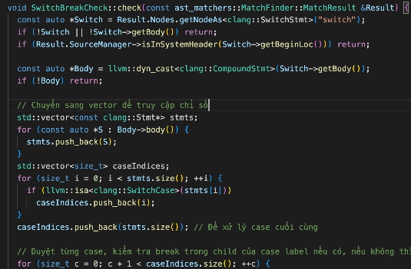
Clang-tidy for custom rules
Detailed design

Slide 8
Local AI with Ollama
Purpose
- Use local AI model (Ollama with qwen3:8b) for detailed C++ vulnerability analysis.
Process - Create a prompt for Ollama with analysis instructions.
- Check and start Ollama service if necessary (systemd or direct).
- Stream analysis results to a report file (.ai-report.txt).
Output:
- Detailed report with line-specific issues and refactoring suggestions.

Slide 9
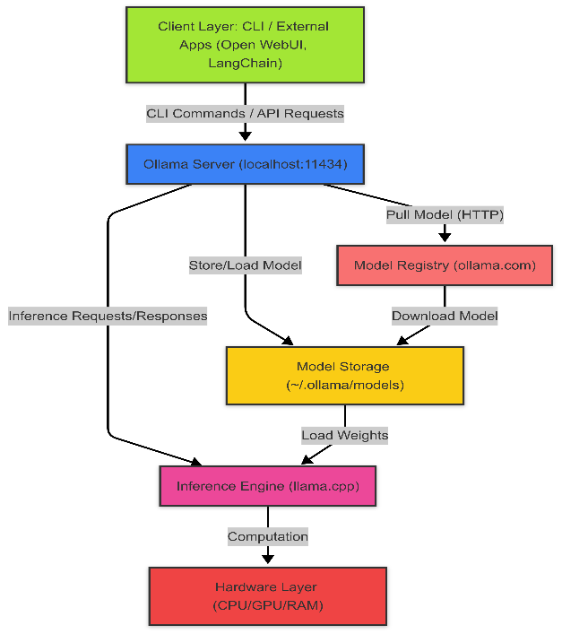
Local AI with Ollama
Overview design
- Download open-source AI Model and perform AI task locally on PC

Slide 10
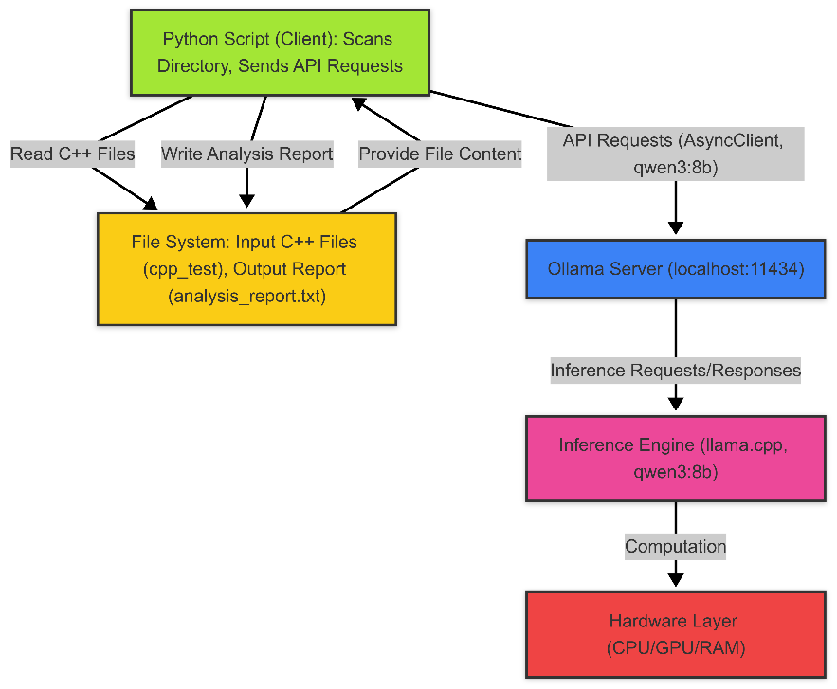
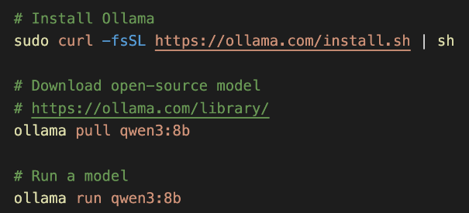
Local AI with Ollama
Specific design

Slide 11
Copilot Integration
Purpose
- Leverage GitHub Copilot to detect C++ vulnerabilities based on predefined rules.
Pre-defined Rules (Markdown format)
- Misracpp2008GuideLines.md
- LGEDVRuleGuidelines.md
- StaticAnalysicGuidelines.md
Output:
- Copilot provides violation details with line numbers and refactoring suggestions.
3
4

Slide 12
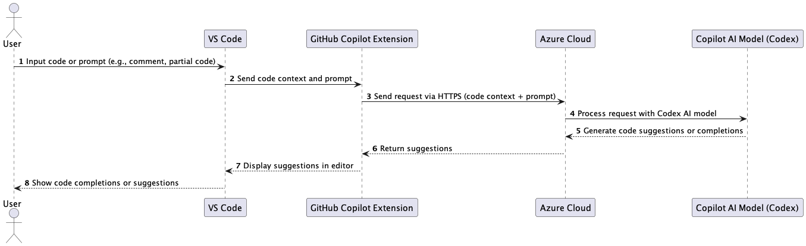
Copilot Integration
How Copilot works

Slide 13
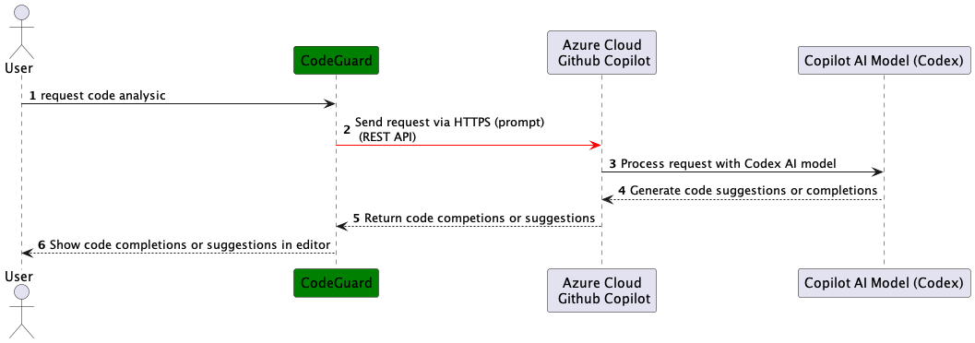
Copilot Integration
Expected Design:
Copilot provides REST API for clients to use it
Unfortunately, Copilot does not publish its API

Slide 14
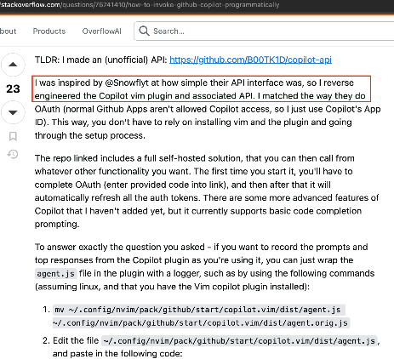
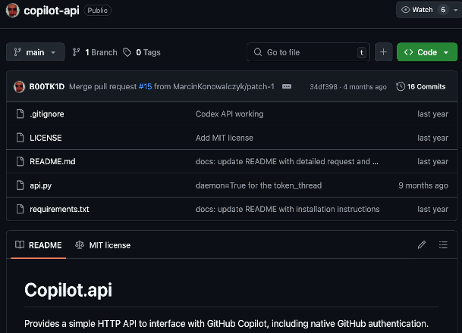
Copilot Integration
Potential solution:
- Identify Copilot’s API through reverse engineering with Copilot Vim plugin

Slide 15
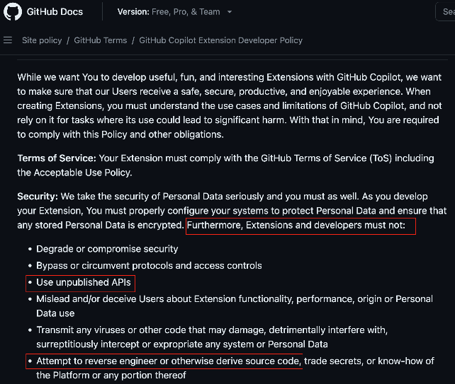
Copilot Intergration
Is that acceptable solution?
- No. Because it violates Copilot policy.
- If trying to use, Github account can be banned and risk of illegal activities.
Policy: https://docs.github.com/en/site-policy/github-terms/github-copilot-extension-developer-policy

Slide 16
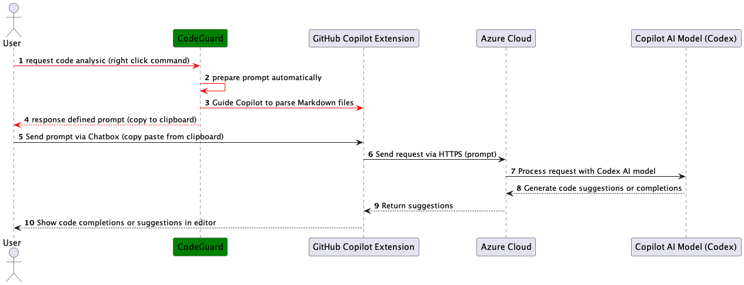
Copilot Integration
Selected Solution
- Use Copilot Chatbox as current official method provided by Copilot
- But support flexibility of user for typing prompt automatically

Slide 17
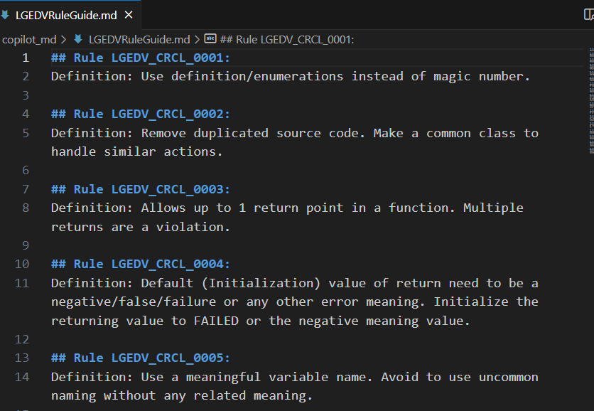
Copilot Integration
Pre-defined rules
- Markdown format

Slide 18
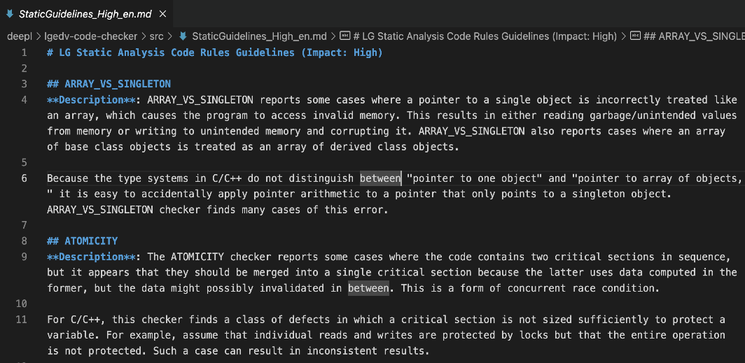
Copilot Integration
Pre-defined rules
- Markdown format

Slide 19
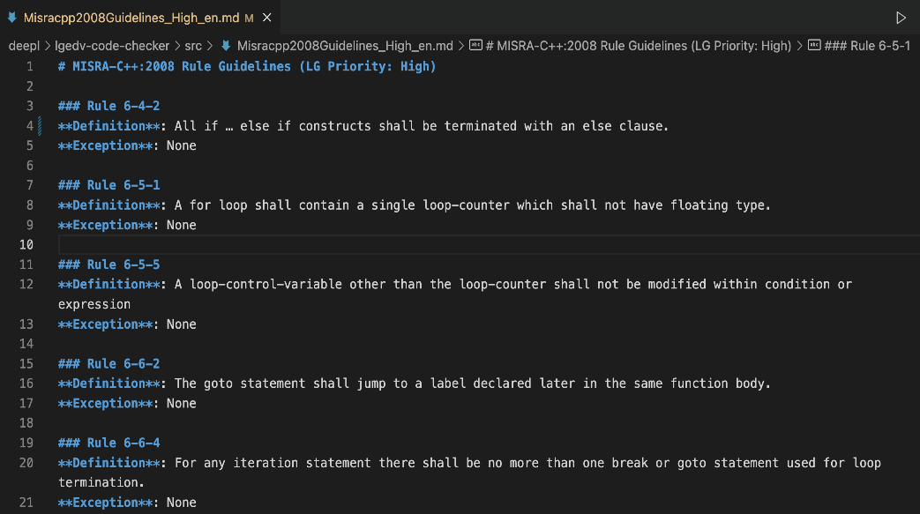
Copilot Integration
Pre-defined rules
- Markdown format

Slide 20
Package Configuration (package.json)
Key Fields:
Nam: code-guard
DisplayName: Code-Guard
Version: 0.0.1
Engines: VS Code >= 1.100.0
Commands and Menus:
Context menu integration for C++ files in Editor.
Commands for static and Copilot-based checks
Dependencies:
- TypeScript

Slide 21
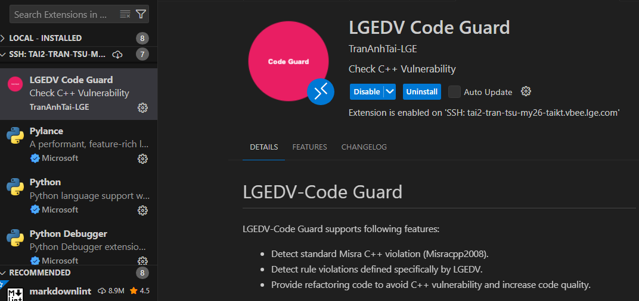
Evaluation
Install Code-Guard tool

Slide 22
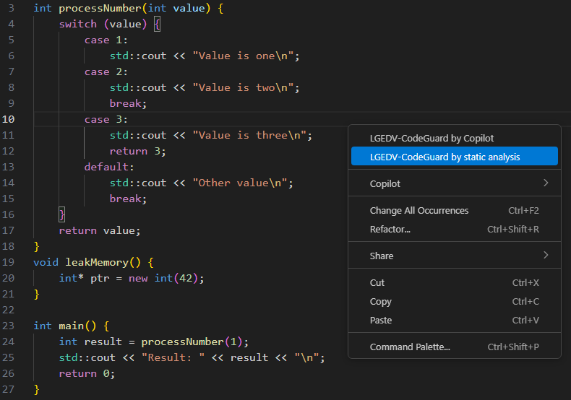
Evaluation
Test file
- Select analytical mode by right-click

Slide 23
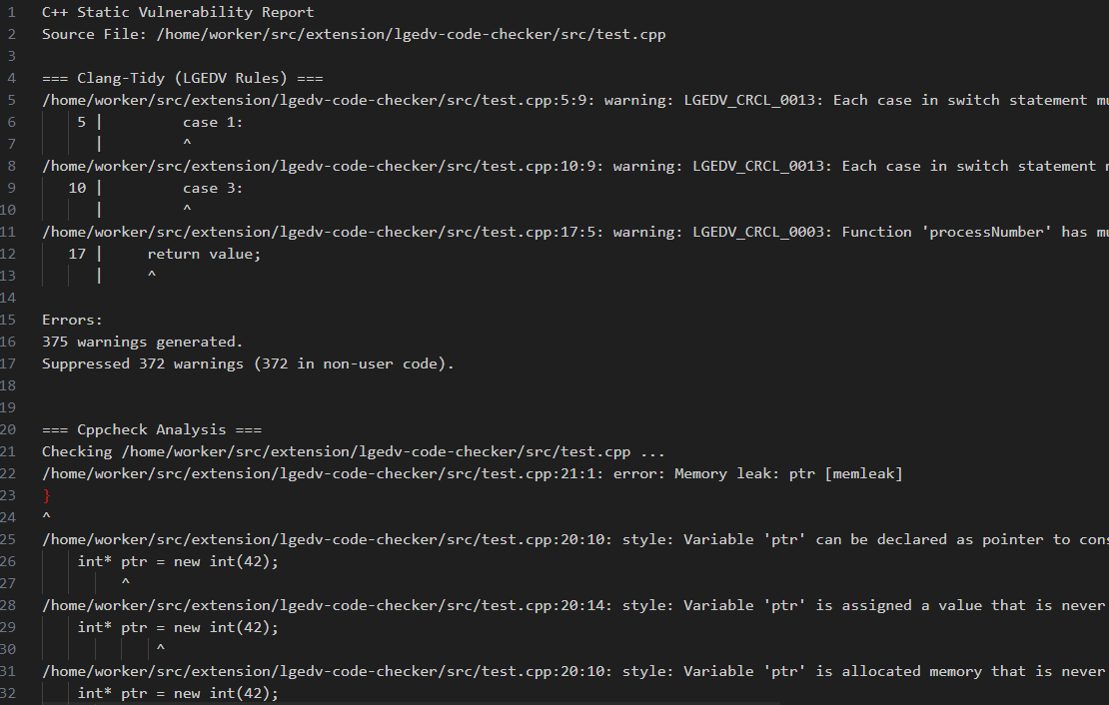
Evaluation
Static analysic output
- Cppcheck, clang-tidy with custom rule

Slide 24
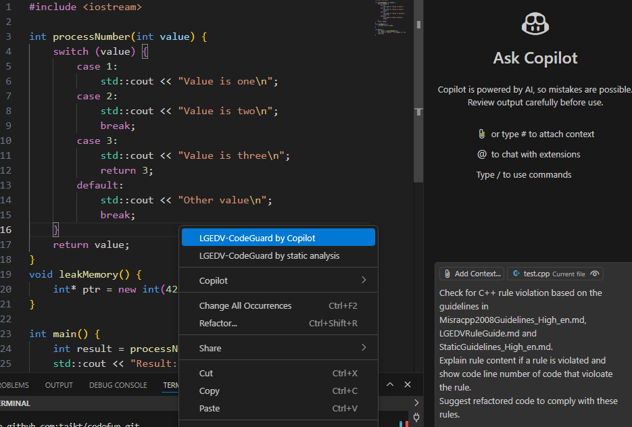
Evaluation
Copilot output
- Prompt is copied automatically to clipboard

Slide 25
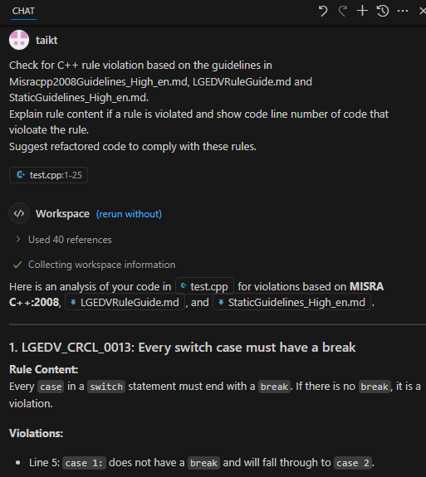
Evaluation
Copilot output

Slide 26
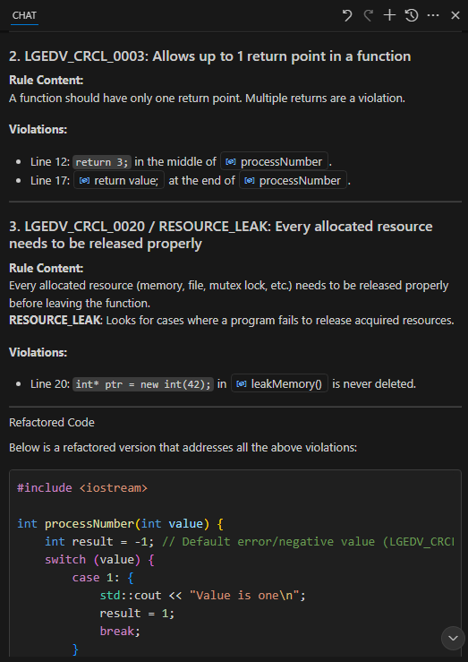
Evaluation
Copilot output

Slide 27
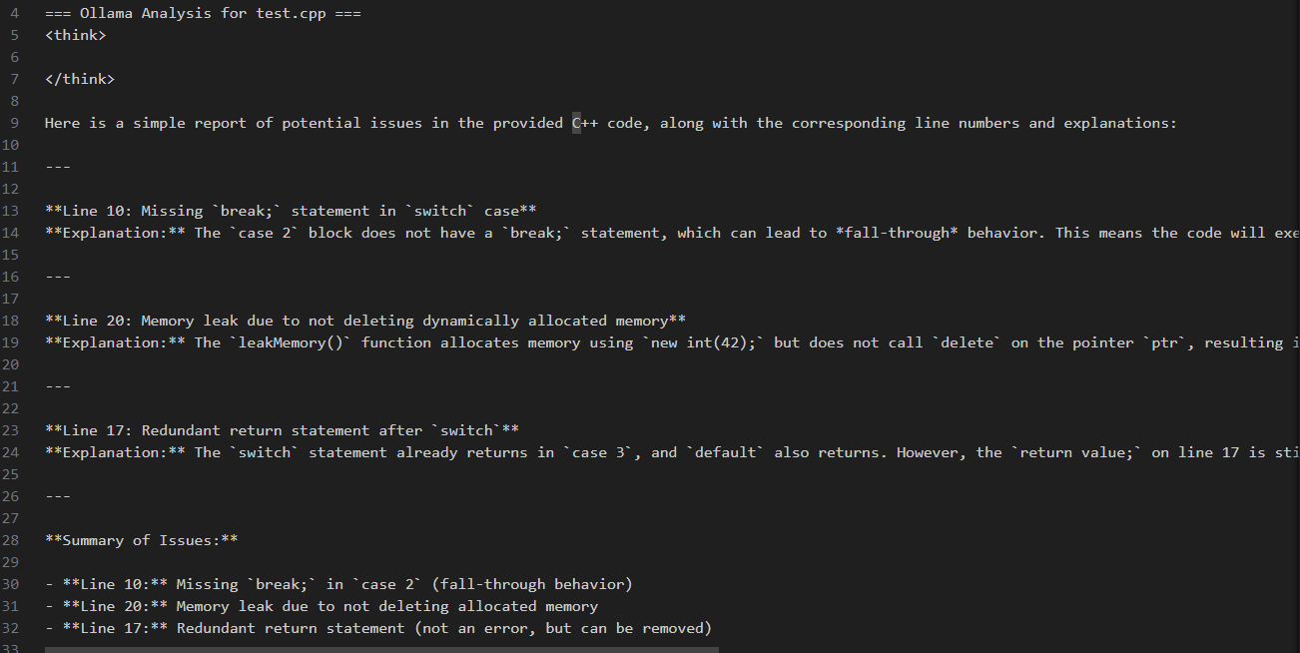
Evaluation
Local AI output (ollama)

Slide 28
Evaluation
Method | Copilot | Static tool | Local AI with Ollama
Pros | - High quality of violation detection ability - Response time is fast - The code suggestion is good | - High security (work locally) - High quality of violation detection ability for custom rule. - Free of cost | - High security (work locally) - Free of cost
Cons | - Low security with high risk of exposing sensitive data. - What happens if AI model uses LG data for training? - High cost for the license | - Requires high effort for supporting custom rules (custom clang-tidy) | - Low performance because of the training quality of open-source AI model - Require good hardware to use AI locally - Response time is slow

Slide 29
Future Improvements
Enhanced Rule Customization: Allow users to update LGEDV rules via a VS Code settings UI.
Real-time Diagnostics: Integrate analysis results directly into VS Code’s Problems panel.
Use Copilot’s REST API: Use API if Copilot publishes in future.
CI/CD integration: Integrate analysis results with CI/CD process
Extended AI Support: Support for additional local AI models and cloud-based AI services.
User Feedback Integration: Collect user feedback to refine AI prompts and rule sets.

Slide 30
Conclusion
- Code-Guard tool provides a robust solution for C++ vulnerability detection.
- Combines static analysis (cppcheck, clang-tidy, clang) with AI-driven insights (Copilot, Ollama).
- Generates detailed reports for both static and AI analyses.
- Future enhancements will focus on usability, performance, and extended AI capabilities.

