Slide 1
LGE Internal Use Only
Event Loop Framework for Modern C++ Applications
SW Architectural Design
26/9/2025
Tran Anh Tai - Software Engineering Team – LGEDV 2023 - 2024: BMW ICON SW architect
2024 - Present: Honda SW architect

Slide 2
LGE Internal Use Only
Agenda
Project Overview
Project Context
Architecture Drivers
Architecture Representation
Architecture Decision Rationale
Validation
Conclusion

Slide 3
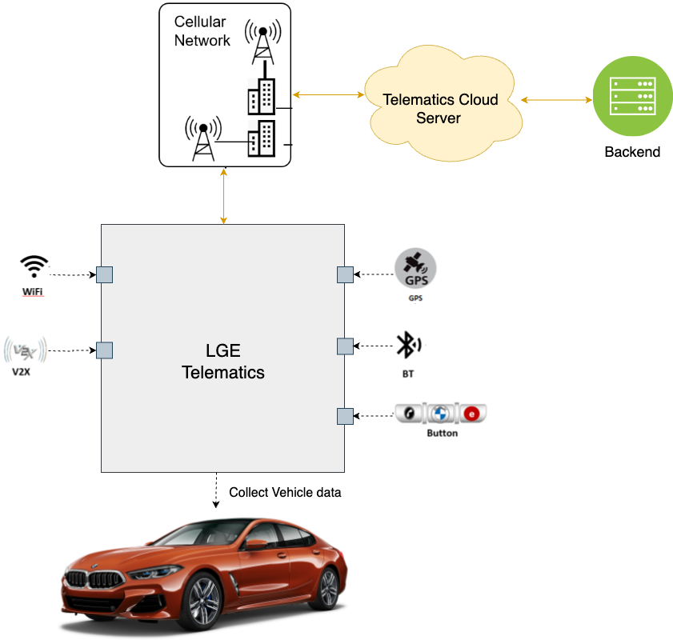
1. Project Overview
LGE Internal Use Only
- LGE Telematics projects for Honda, BMW, Toyota, and GM leverage the LGE Tiger platform
provides reusable, reliable, and robust services in the Telematics domain.
- Tiger platform uses Tiger Looper as its core event loop mechanism to manage tasks for applications and services.
- This project aims to enhance event loop architecture of Tiger platform.
- This project proposes SW Task Framework – an event loop framework designed to deliver significant performance improvements while maintaining backward compatibility.
SW Task Framework
- A high-performance C++ library for asynchronous event handling, timer management. - Use for a wide range of applications
Including automotive embedded systems, IoT devices, desktop and UI applications, real-time data processing, robotics, and backend services.
- Homepage: https://taikt.github.io/sw_task/index.html
Fig 1: Telematics system

Slide 4
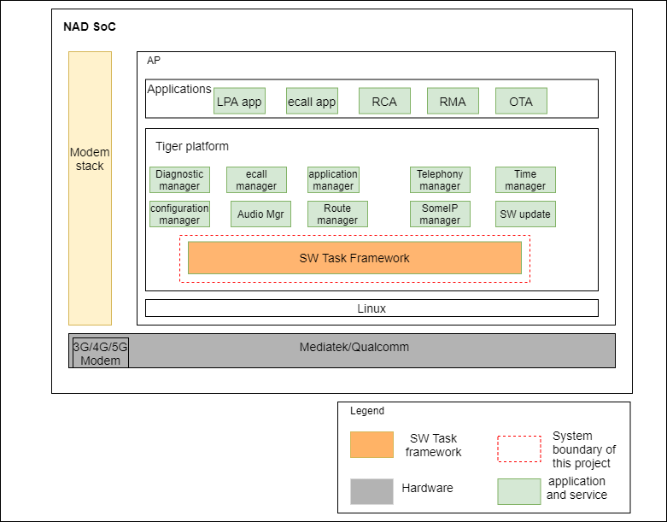
2. Project Context
LGE Internal Use Only
System Context Diagram
NAD SoC: include applications and services developed by LGE
SW Task framework:
A high-performance, modern C++ event loop framework designed to compare Tiger Looper with superior architecture and developer experience.
Serves as the foundational event/task management layer for Tiger platform services.
Fig 2: System Context Diagram

Slide 5
3. Architectural Drivers
LGE Internal Use Only
High-level Functional Requirement
Req. ID | Description
FR-01 | Event Loop Management: Framework shall provide event loop functionality to process messages, functions, and timers in unified manner.
FR-02 | Message Processing: Framework shall support Android-style message handling with Handler pattern for backward compatibility as currently used in Tiger Looper.
FR-03 | Function Execution: Framework shall execute C++ lambda functions and std::function objects asynchronously on appropriate threads.
FR-04 | Promise Chain Operations: Framework shall support Promise creation, chaining, and exception propagation for async workflows (following design of JavaScript Promise A+ standard)
FR-05 | Timer Management: Framework shall create, schedule, and cancel timers with millisecond precision using efficient kernel mechanisms
FR-06 | Error Handling: Framework shall propagate exceptions through promise chains and provide error callbacks for async operations (following design of JavaScript Promise A+ standard).
FR-07 | Framework shall support Coroutines C++20 asynchronous feature.

Slide 6
3. Architectural Drivers
LGE Internal Use Only
Quality Attribute
Req. ID | Description | Attribute | Business importance | Difficulty (Technical) | Priority
QA-01 | Framework must handle high-frequency events with response time under 1 sec. | Performance | H | H | 1
QA-02 | Framework must provide optimal resource utilization with advanced timer management | Efficiency | H | H | 2
QA-03 | Framework should hide system complexity and support multiple programming paradigms. | Useability | M | M | 4
QA-04 | Framework should provide backward compatible API enhancement for Tiger Looper. Legacy client source code using Tiger Looper should not be impacted when using new framework. | Reusability | H | M | 3
Legend
*Priority(1-5): the lower the value, the higher the priority *H: High, M: Medium.

Slide 7
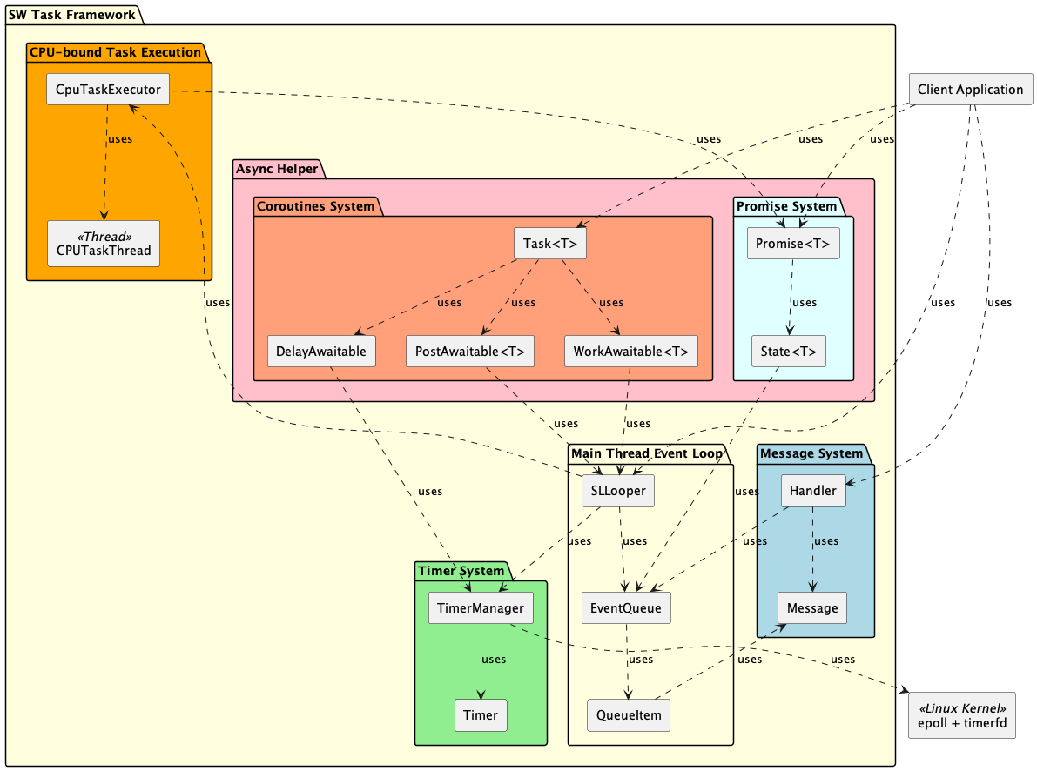

4. Architectural Representation
Static View of SW Task Framework
Component | Description | SRS
SLLooper | Facade for unified event loop, handles function/message/timer | FR-01, FR-02, QA-01
EventQueue | Thread-safe queue for messages and functions | FR-02, QA-03
QueueItem | Abstract base class for all queueable event items | FR-01, QA-03
Handler | Android-style message handler for backward compatibility | FR-02, QA-04
TimerManager | Manages timers, schedules/cancels with millisecond precision | FR-05, QA-02
CPUTaskThread | Thread for executing heavy tasks asynchronously | FR-03, QA-01
Promise | Template for async result, supports chaining and error propagation | FR-04, FR-06, QA-01
State | Template for state management and cross-thread coordination | FR-04, FR-06, QA-01
Task | C++20 coroutine wrapper for async task lifecycle management with start/done/get operations | FR-07, QA-01
DelayAwaitable | Awaitable object for non-blocking coroutine suspension with timer-based delays | FR-07, QA-01
PostAwaitable | Awaitable object for executing functions on main event loop thread with co_await | FR-07, QA-01
WorkAwaitable | Awaitable object for executing CPU-bound functions on background thread with co_await | FR-07, QA-01
Fig 3: Module view for SW Task framework

Slide 8
5.0 Issue of Tiger Looper
Only C++11 is supported.
Modern, high‑performance C++ standards (C++14/17/20) are not available, including newer asynchronous capabilities such as coroutines.
Event loop blocks on CPU-bound tasks (heavy task)
Tiger Looper uses single event thread architecture, all operations run sequentially on one thread
There is no parallelism, no ability to utilize multiple CPU cores
Under load, CPU-bound tasks can freeze the system and create a severe sequential bottleneck
Exceptions are not supported
If an exception occurs inside the event loop, it is not caught; clients must implement their own exception handling.
Timer management is inefficient
With SIGEV_THREAD, each timer expiration causes Linux to spawn a new thread to run the callback, leading to high resource consumption when many timers are active.
Usability is limited due to verbose asynchronous client code using message/handler pattern.
Large switch-case blocks in HandleMessage() make client code harder to maintain and evolve (high complexity, low extensibility).
8

Slide 9
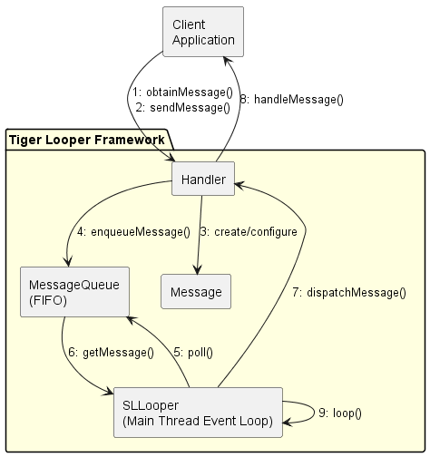
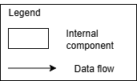
5.1 Architectural Decision - Performance
QA-01 | Framework must handle high-frequency events with response time under 1 sec.
AS-IS (Tiger Looper)
Single Event Thread Architecture
- Tiger Looper is a C++ library for event loop, which is based on Android-style handling (message, handler, looper).
- Client application creates message using obtainMessage(), send it to event loop using sendMessage().
- The event loop run on a separate event loop thread and handle messages in message queue asynchronously using dispatchMessage().
- The dedicated event loop thread prevents blocking of the main application thread when processing multiple events.
Fig 4: System Context Diagram
9

Slide 10
5.1 Architectural Decision - Performance
TO-BE (SW Task)
- To meet QA-01: Framework must handle high-frequency events with response time under 1 sec (Performance).
SW Task framework use two strategies:
Strategy 1
- Use single thread or multi-thread event-loop architecture based on type of different workloads
- Clarify and handle task/events based on type of task load (normal/heavy)
Strategy 2
- Use Promise-based concurrency (Promise A+ standard in JavaScript): design following JS Promise standard but implementation in C++.
- Use Coroutines-based concurrency (C++ 20 feature for async operation)
10

Slide 11
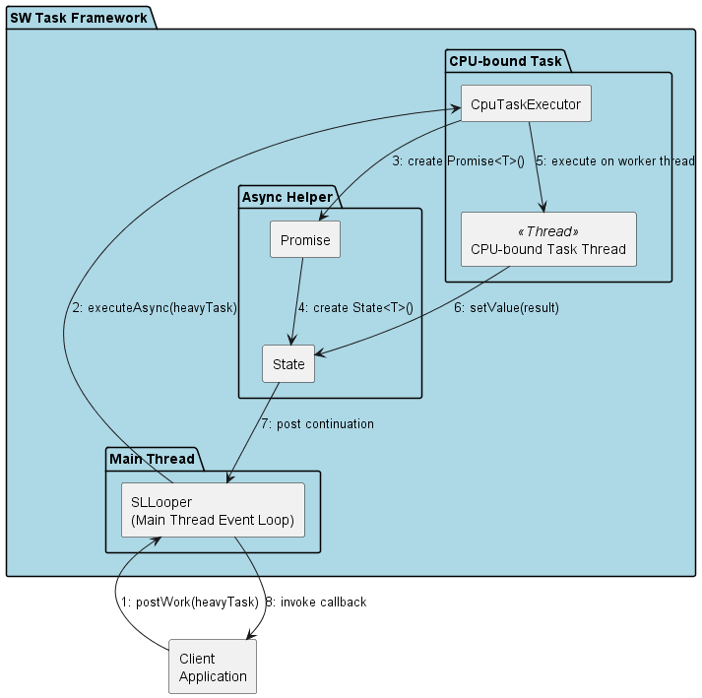
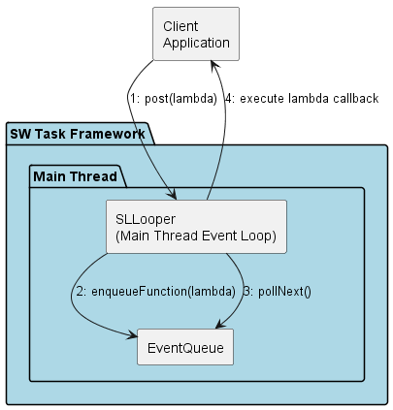
5.1 Architectural Decision - Performance
QA-01 | Framework must handle high-frequency events with response time under 1 sec.
TO-BE (SW Task)
Strategy 1: Advanced Multi-Thread Architecture for Different Workloads Main idea: - SW Task uses main event loop thread for handle light/normal tasks and a separate thread for heavy task (on demand).
- User selects actively proper API based on task type. Post() for light task and PostWork() for heavy task.
- Framework doesn’t detect CPU bound task automatically to avoid additional overhead, let User decide it.
- Same idea in Nodejs https://docs.libuv.org/en/v1.x/guide/threads.html#id1 Main event loop thread: Handle light/normal task
- Processes non-blocking I/O operations and light/normal events
- All callbacks executed on main thread ensuring responsiveness, never blocks on heavy computations.
CPU-bound task thread: Handle heavy task
- Dedicated thread for heavy processing operations (file operations, JSON parsing, crypto)
- Completely isolated from main event loop thread
- Communicates results back via Promise/State mechanism (introduce later)
- Prevents main event loop blocking during intensive computations
Handle light/normal task
Handle heavy task
Fig 5: Communication Diagram for handling event/task
11

Slide 12
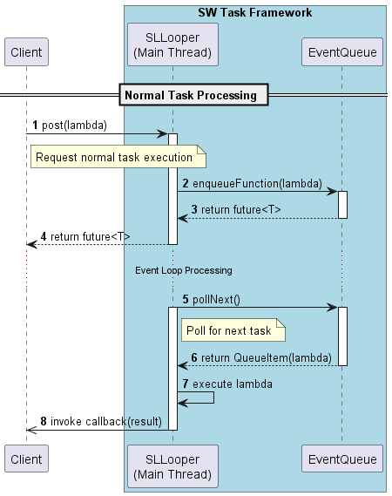
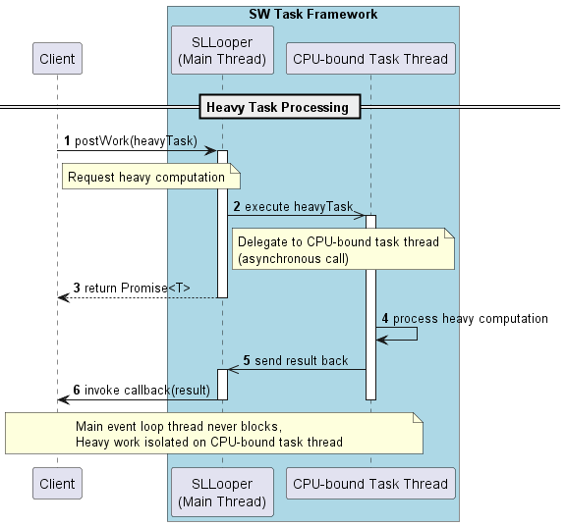
5.1 Architectural Decision - Performance
QA-01 | Framework must handle high-frequency events with response time under 1 sec.
TO-BE (SW Task)
Strategy 1: Advanced Multi-Thread Architecture for Different Workloads
- Client uses post() for light/normal task and postWork() for heavy task.
- For light task, it is handled in main event loop thread (non-blocking)
- For heavy task, it is handled asynchronously in separate thread, then send back result to main event loop thread to callback response to Client through Promise system (introduce later).
Fig 6: Sequence Diagram for handling light/normal task
Fig 7: Sequence Diagram for handling heavy task (simple view)
12

Slide 13
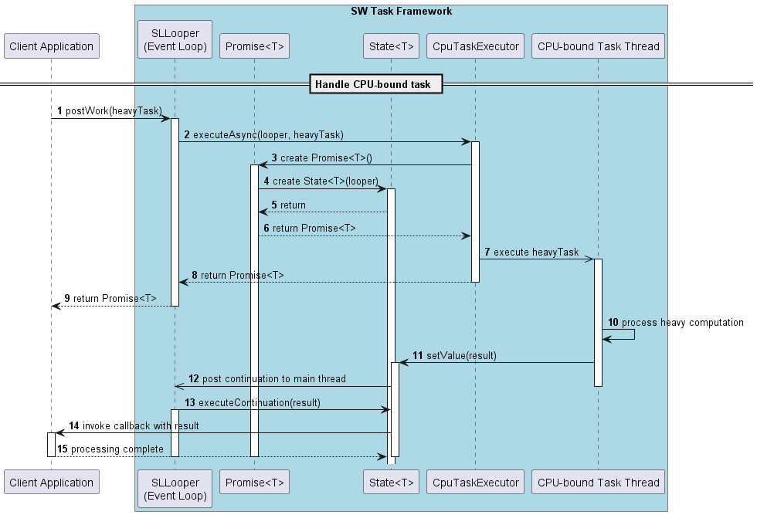
5.1 Architectural Decision - Performance
QA-01 | Framework must handle high-frequency events with response time under 1 sec.
TO-BE (SW Task)
Strategy 1: Advanced Multi-Thread Architecture for Different Workloads
- This diagram shows interaction of internal components of SW task (Main event loop thread, Promise system, CPU-bound task thread)
Fig 8: Sequence Diagram for handling heavy task (detailed view)
13

Slide 14
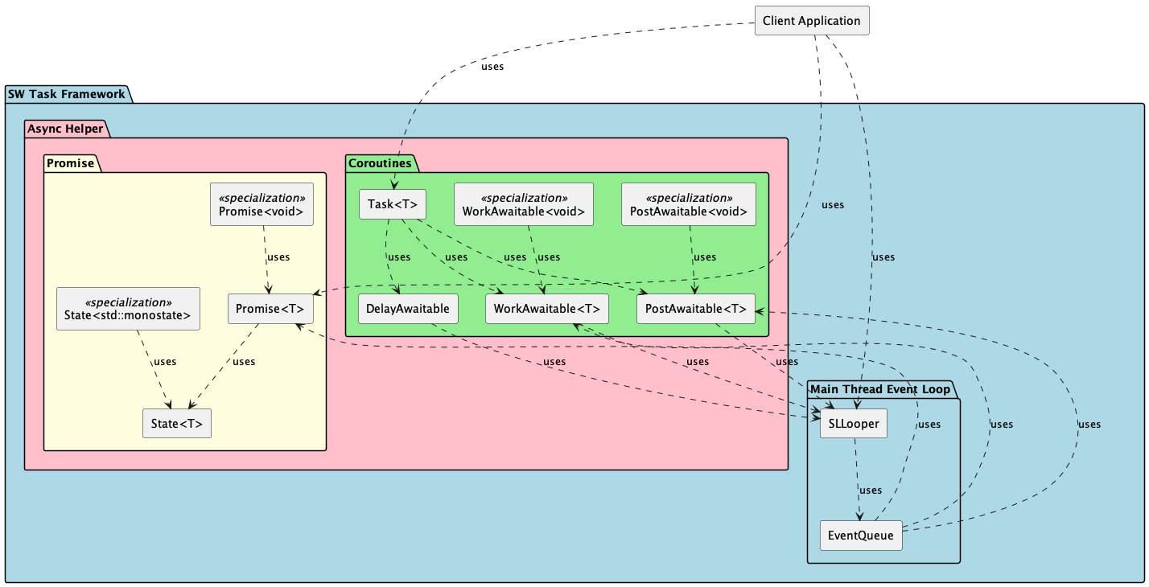
5.1 Architectural Decision - Performance
QA-01 | Framework must handle high-frequency events with response time under 1 sec.
TO-BE (SW Task)
Strategy 2: use Concurrency
Issue of synchronous call: - Sync call blocks CPU and caller has to wait result response.
- Caller cannot do other job during waiting time, reducing efficiency
Technical Constraints
- C++ 20 provides Coroutines feature to support asynchronous operation effectively.
- JavaScript provides Promise A+ standard: Efficient for handling async operation with low cost. https://promisesaplus.com/
Propose asynchronous helper
- Propose an Async helper based on JavaScript Promise A+ standard and Coroutines C++ 20 (both features run independently): provide rich async API options for user
- Async Helper avoids Callback hell problem and provides convenient usage for Client code.
Fig 9: Module view for Async Helper
14

Slide 15
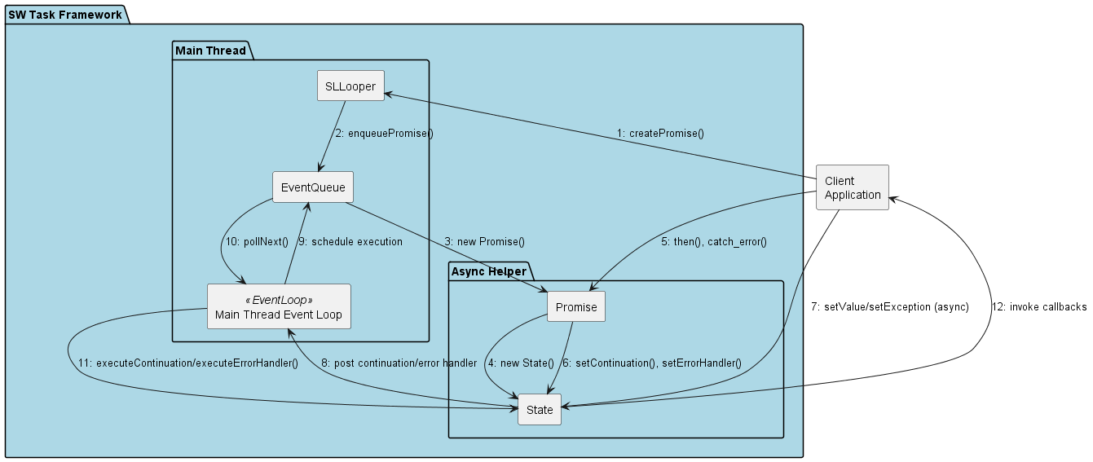
5.1 Architectural Decision - Performance
QA-01 | Framework must handle high-frequency events with response time under 1 sec.
TO-BE (SW Task)
Strategy 2.a: Promise-based Concurrency
- Store callback in Promise<T> object as continuation function
- When Promise value is fulfilled, continuation is executed asynchronously on main thread event loop
- Support Promise chain: sequence of multiple callbacks triggered in sequential order with exception handling
Fig 10: Communication diagram for Promise flow
15

Slide 16
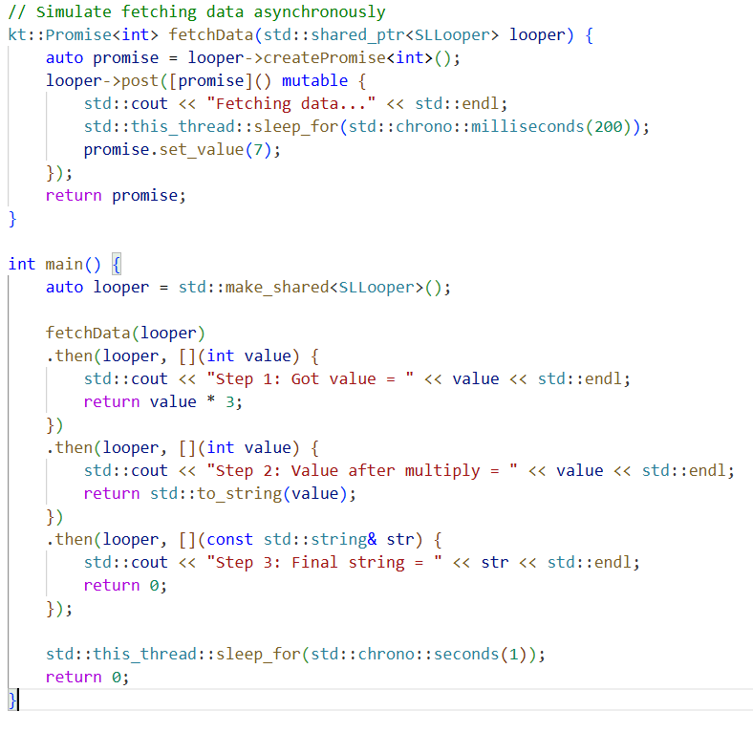
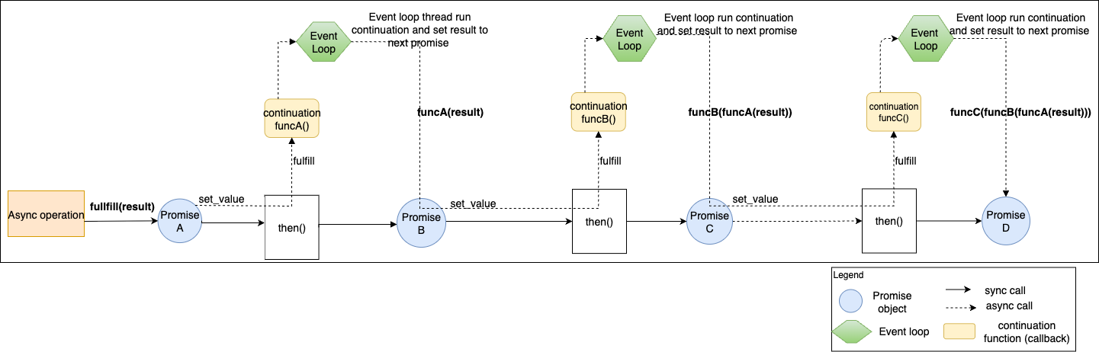
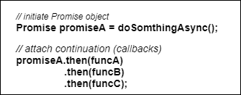
5.1 Architectural Decision - Performance
LGE Internal Use Only
TO-BE (SW Task)
Strategy 2.a: Promise-based Concurrency - Promise Chain example
Fig 11: Visualize promise chain and user code (callbacks recursively)

Slide 17
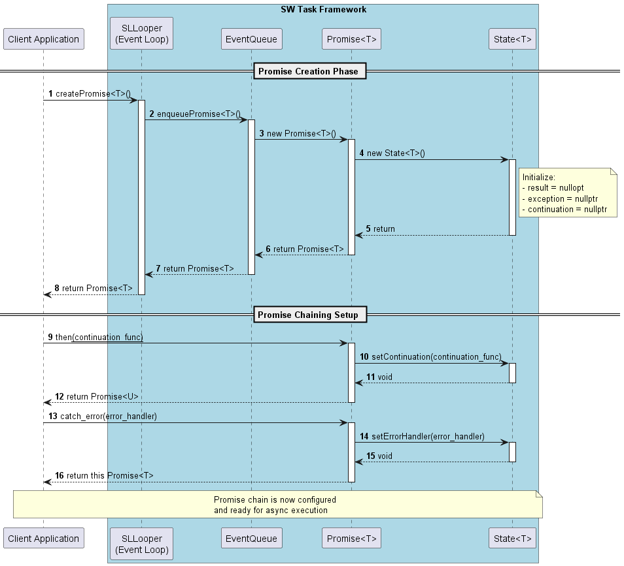
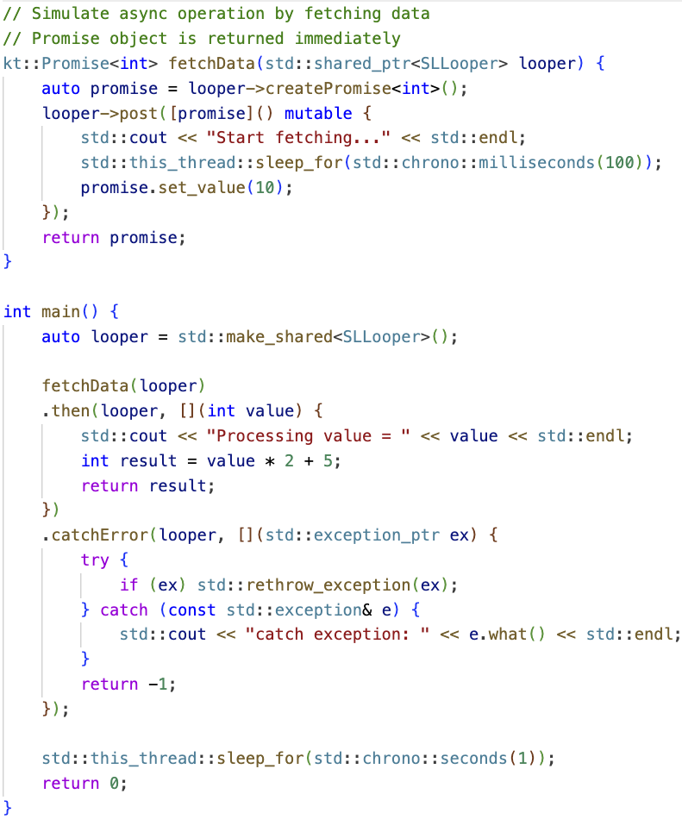
5.1 Architectural Decision - Performance
QA-01 | Framework must handle high-frequency events with response time under 1 sec.
TO-BE (SW Task)
Strategy 2.a: Promise-based Concurrency
User code (C++)
Fig 12: mapping user code with sequence diagram (a)
17

Slide 18
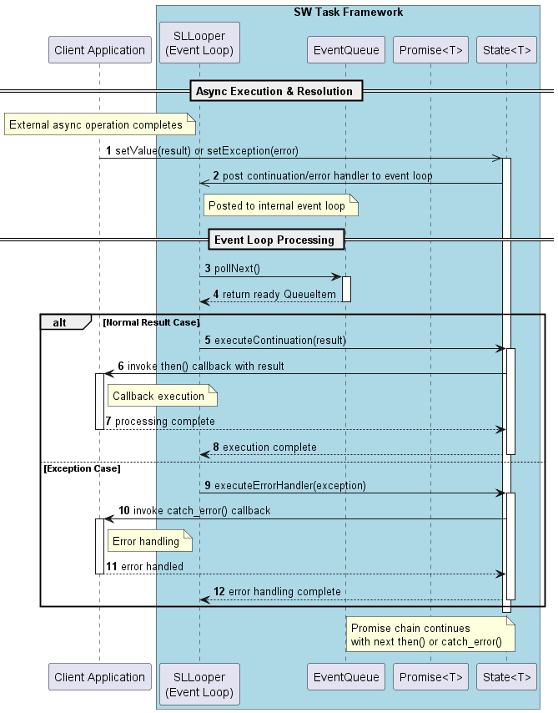
5.1 Architectural Decision - Performance
QA-01 | Framework must handle high-frequency events with response time under 1 sec.
TO-BE (SW Task)
Strategy 2.a: Promise-based Concurrency
User code (C++)
Fig 13: mapping user code with sequence diagram (b)
18

Slide 19
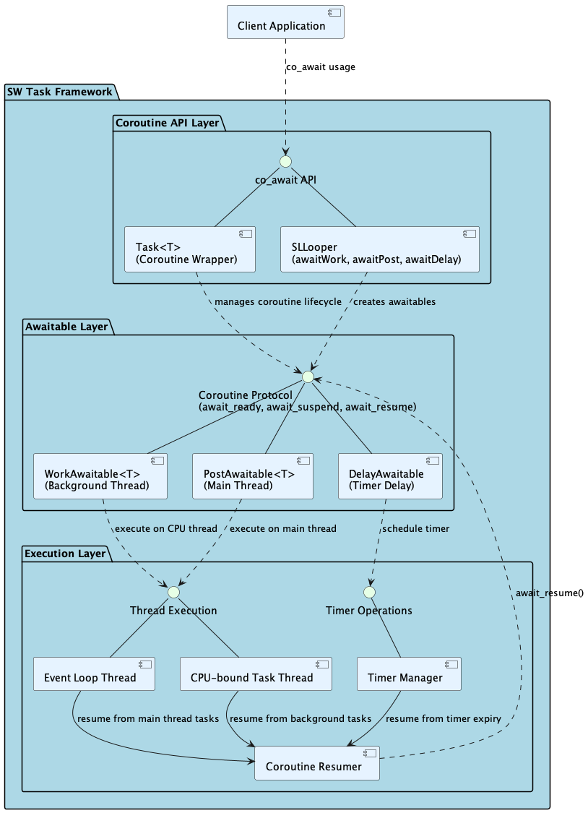
5.1 Architectural Decision - Performance
QA-01 | Framework must handle high-frequency events with response time under 1 sec.
TO-BE (SW Task)
Strategy 2.b: Coroutines-based Concurrency
- Protocol Compliance: All awaitables implement standard C++20 coroutine protocol - Task<T>: Return type of a coroutine, it represents entire coroutine. It manage lifecycle and execution state.
- PostAwaitable<T>: An object used with co_await to define a specific async operation. It implements await_ready(), await_suspend(), await_resume() to manage suspension and resumption of couroutine.
Fig 14: Coroutines design (C&C diagram)
19

Slide 20
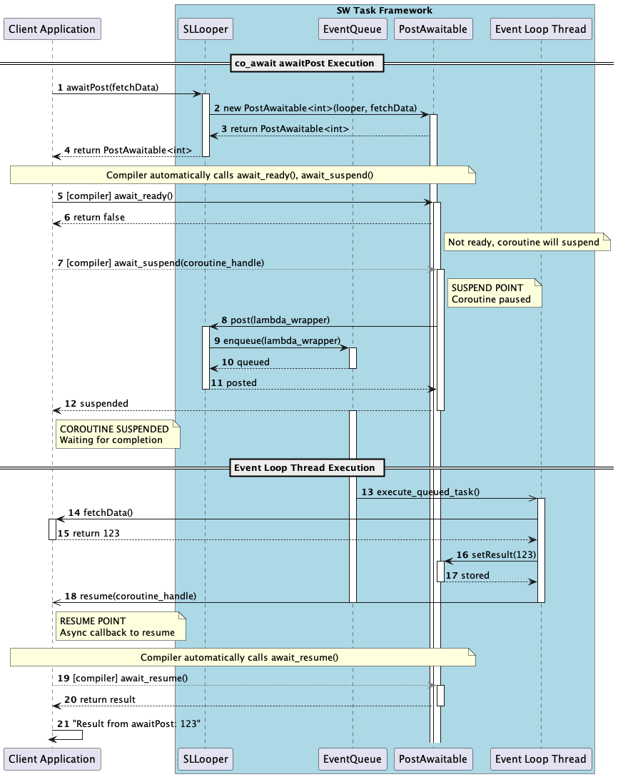
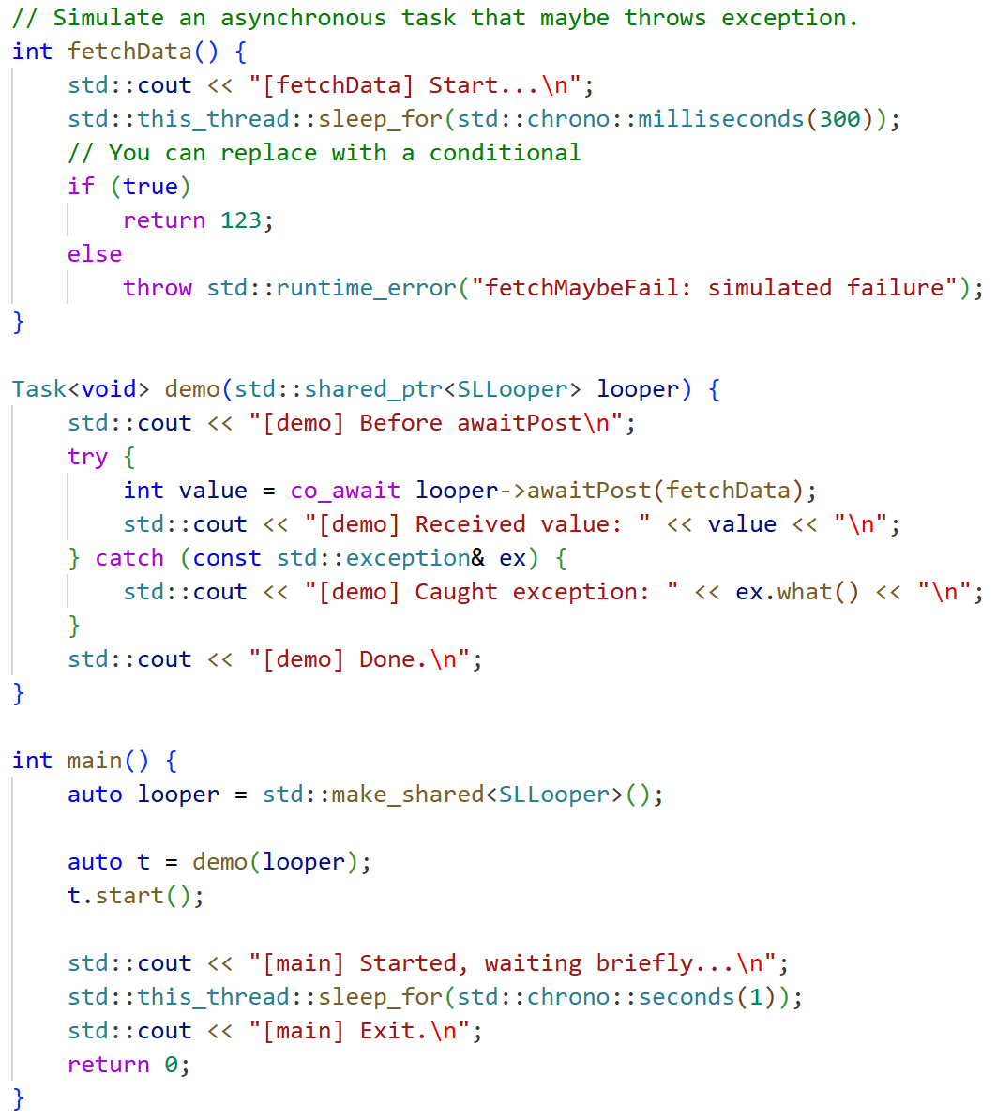
5.1 Architectural Decision - Performance
QA-01 | Framework must handle high-frequency events with response time under 1 sec.
TO-BE (SW Task)
Strategy 2.b: Coroutines-based Concurrency
Fig 15: Map user code with sequence diagram
20

Slide 21

5.1 Architectural Decision - Performance
QA-01 | Framework must handle high-frequency events with response time under 1 sec.
Architectural Decision
Alternatives design | SW Task | Tiger Looper
Pros | Non-blocking processing: never freezes on heavy tasks Dedicated CPU-bound task thread: Heavy computation isolated from main event loop. Multi-core utilization: Can leverage all available CPU cores Parallel workload processing: normal task and CPU-bound tasks run simultaneously Coroutines C++20-based async and Promise-based async(JavaScript Promise A+ standard): provide efficient async operation This design shows that QA-01 is satisfied in architectural rationale. Verification section later proves practical result. | Low memory footprint: Single thread uses less memory Simple execution model: No thread coordination overhead Predictable behavior: Sequential execution is deterministic
Cons | Thread overhead: Multiple threads consume more memory Context switching cost: Some overhead from thread coordination | Only support C++ 11 (old standard) Blocking: CPU tasks freeze entire application Single-threaded bottleneck: Cannot utilize multiple CPU cores Sequential processing: All operations must wait in line Poor scalability - Performance degrades significantly under load No parallelism - Cannot handle concurrent operations
Decision | Selected | Rejected

Slide 22
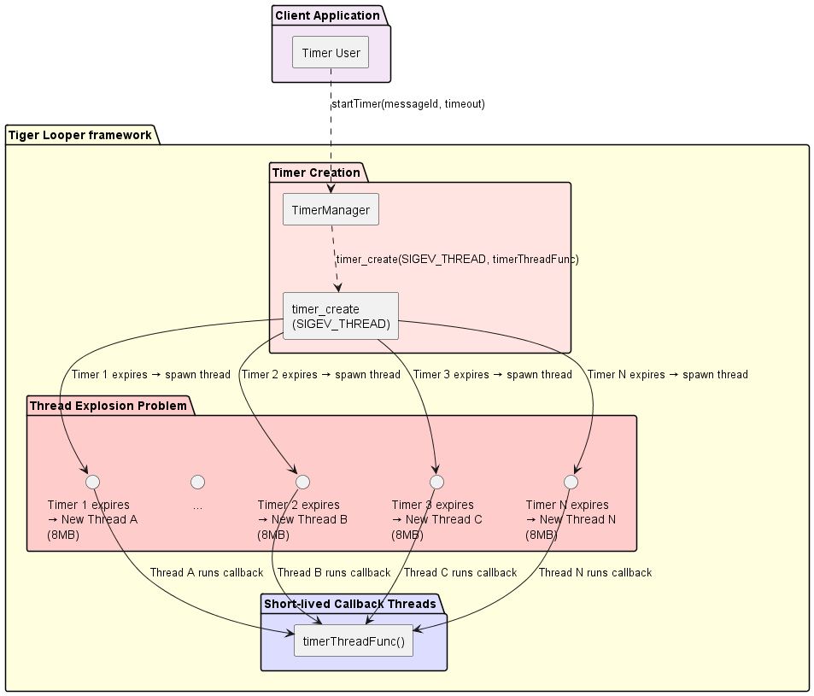
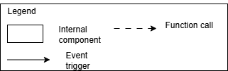
5.2 Architectural Decision – Efficiency (resource utilization)
QA-02 | Framework must provide optimal resource utilization with advanced timer management
AS-IS (Tiger Looper)
Resource Waste Issue:
- Tiger Looper uses POSIX timer creation (timer_create with SIGEV_THREAD type) https://man7.org/linux/man-pages/man2/timer_create.2.html
- Each timer creates new thread to handle timer callback → Massive memory overhead
100 timers = 100 threads = 800MB memory
- System instability under load, poor scalability
- Memory waste: 8MB per timer
- CPU overhead from thread switching
Tiger Looper's thread-per-timer design is fundamentally inefficient for production use.
Fig 16: Timer problem in Tiger Looper
22

Slide 23
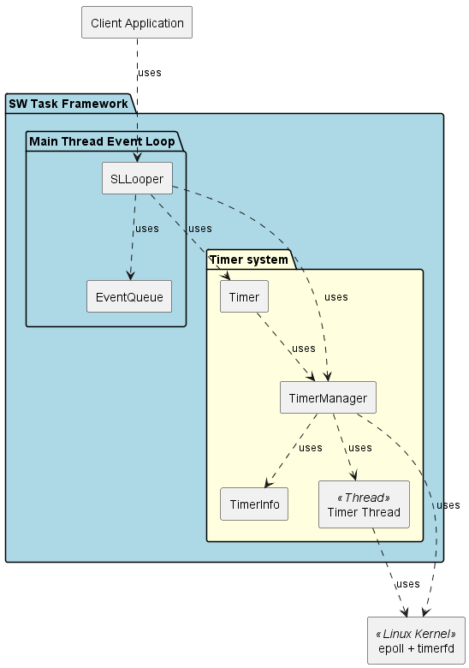
5.2 Architectural Decision – Efficiency (resource utilization)
QA-02 | Framework must provide optimal resource utilization with advanced timer management
TO-BE (SW Task)
Advanced Timer Management
Single dedicated timer thread architecture
- SW Task uses a single timer thread to manage Client application’s timers.
- 1 dedicated timer thread handles 1000+ timers efficiently
- Linux epoll + timerfd kernel integration for optimal performance
- O(1) timer creation, deletion, and expiration operations
- Constant memory usage regardless of timer count
Technical benefits
- Scalability: Single thread scales to thousands of timers
- Kernel Optimization: Direct Linux timerfd integration eliminates polling
- Memory Efficiency: Fixed memory footprint vs. thread-per-timer approach
- Performance: O(1) operations ensure consistent response times
Operational efficiency
- Timer events processed via epoll_wait() with minimal CPU overhead
- Expired timer callbacks posted to main thread for execution
- Automatic cleanup of one-shot timers, persistent handling of periodic timers
- Thread-safe cancellation without blocking timer operations
Fig 17: module view of Timer system in SW Task
23

Slide 24
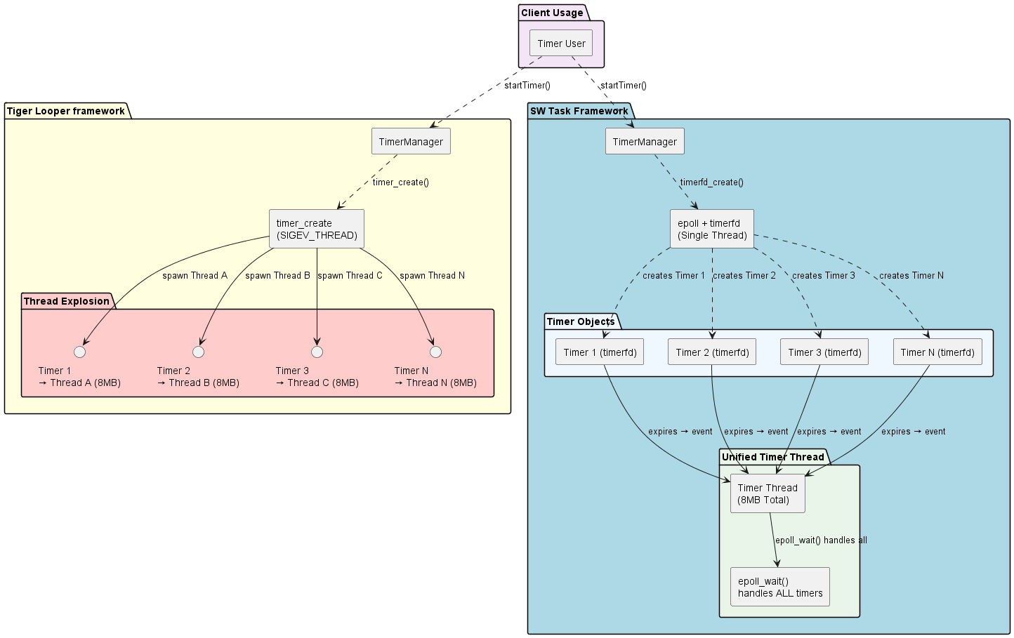
5.2 Architectural Decision – Efficiency (resource utilization)
QA-02 | Framework must provide optimal resource utilization with advanced timer management
Tiger Looper vs. SW Task Comparison
Tiger Problems
- N timers = N threads
- Thread creation overhead
- Context switch cost
SW Task Advantages
- N timers = 1 thread only
- No thread creation cost
- Single epoll_wait() call
- Scales to thousands
Fig 18: compare Timer of SW Task and Tiger Looper
24

Slide 25
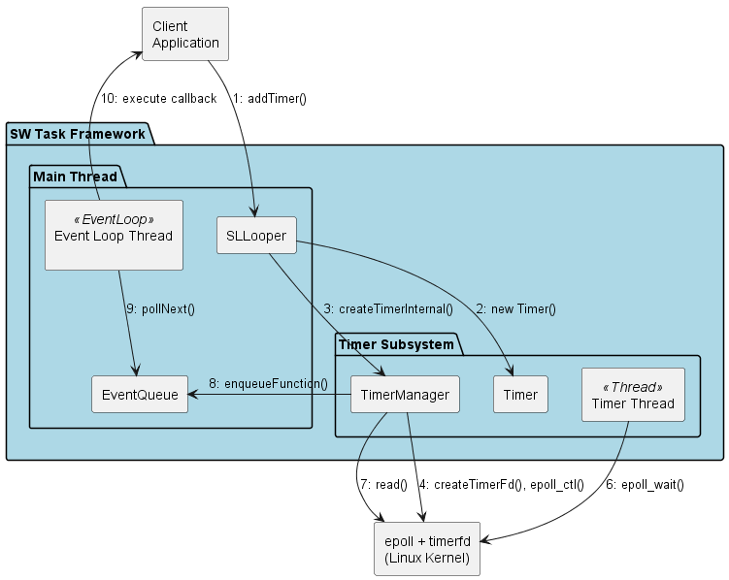
5.2 Architectural Decision – Efficiency (resource utilization)
QA-02 | Framework must provide optimal resource utilization with advanced timer management
TO-BE (SW Task)
Advanced timer management
- Fig 15 shows communication diagram for using timer in SW Task.
- It provides below advantages:
Scalability: Efficiently handles multiple timers and file descriptors with low overhead, ideal for high-concurrency applications.
Unified event loop: Integrates timer events in a single epoll_wait() call, simplifying event-driven programming.
Precision: timerfd provides high-resolution timers, and epoll_wait() ensures accurate, non-blocking event notifications.
Resource efficiency: Minimizes CPU usage by only reporting active timers, avoiding busy polling.
Flexibility: Supports both one-shot and periodic timers, with easy reconfiguration via timerfd_settime().
Fig 19: Communication diagram for timer design
25

Slide 26
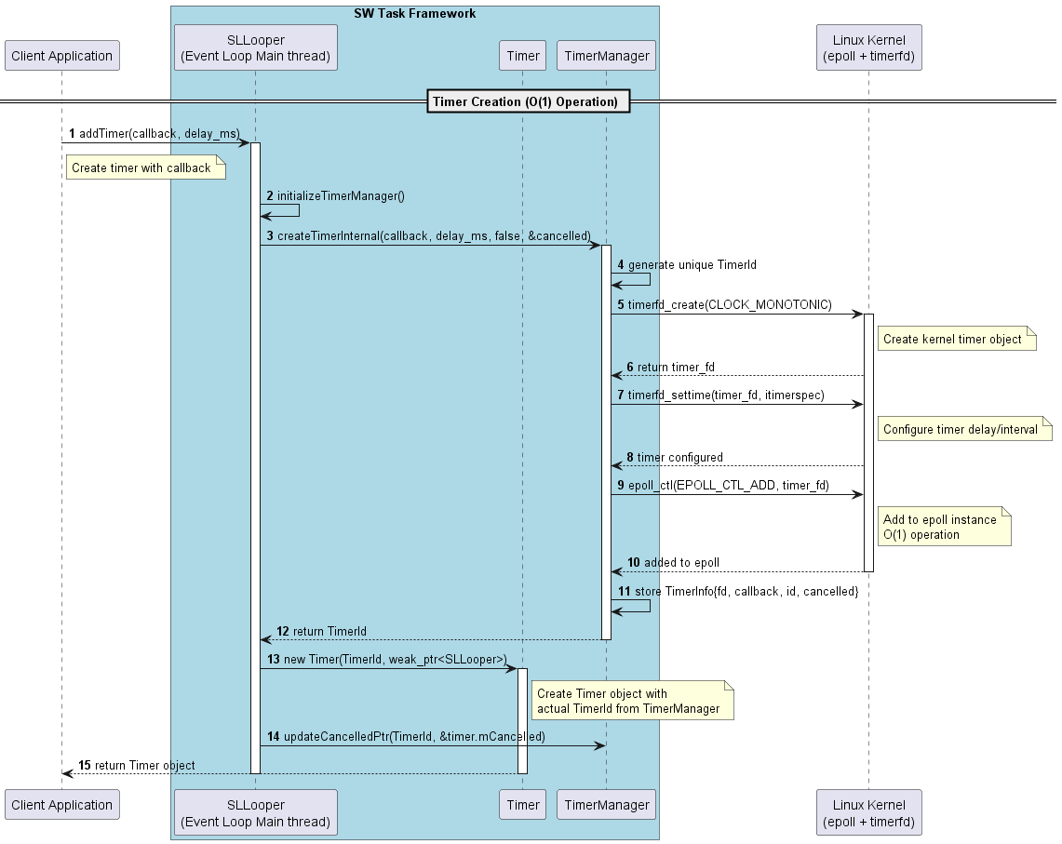
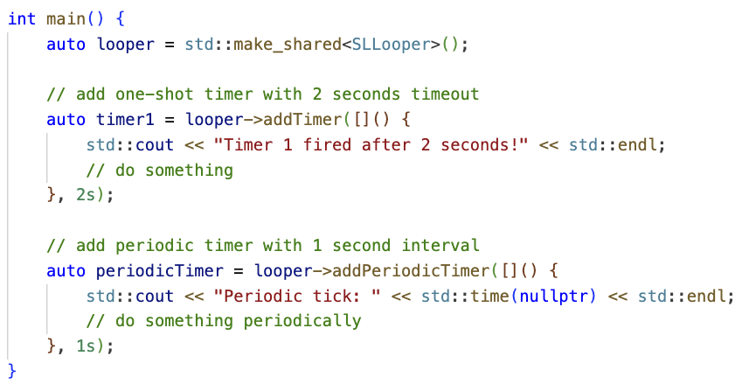
5.2 Architectural Decision – Efficiency (resource utilization)
QA-02 | Framework must provide optimal resource utilization with advanced timer management
TO-BE (SW Task)
Advanced timer management
Timer creation in SW task and simple example in user code.
26
Fig 20: Timer creation

Slide 27
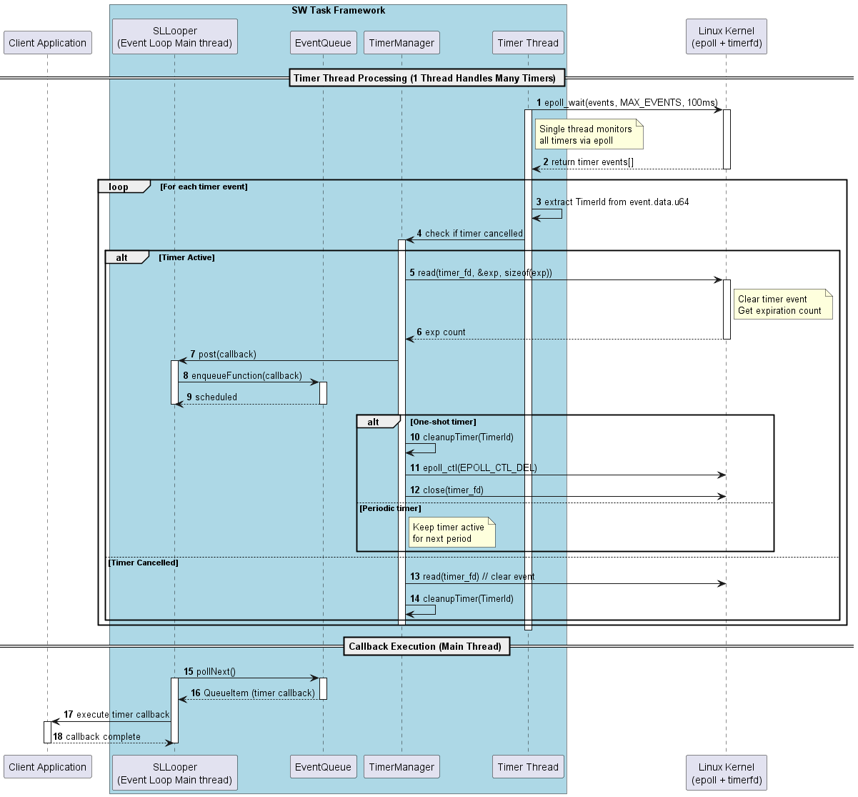
5.2 Architectural Decision – Efficiency (resource utilization)
QA-02 | Framework must provide optimal resource utilization with advanced timer management
TO-BE (SW Task)
Advanced timer management
Internal interaction in detailed.
epoll_wait() is I/O multiplexing to check timer events from Linux kernel.
Fig 21: Internal interaction for Timer processing
27

Slide 28
5.2 Architectural Decision - Efficiency (resource utilization)
Architectural Decision - The design of Timer in SW Task shows that it satisfies QA-02: Framework must provide optimal resource utilization with advanced timer management (Efficiency)
Alternatives design | SW Task | Tiger Looper
Pros | - Single timer thread: Handles 1000+ timers efficiently - Constant memory usage: regardless of timer count - O(1) timer operations: epoll kernel integration - No thread proliferation: Eliminates SIGEV_THREAD waste - Kernel-level optimization: timerfd + epoll - Linear scalability: To thousands of timers - Fixed memory footprint | - Simple resource model: Easy to understand - POSIX compliance: Standard timer APIs - Predictable behavior: Sequential execution is deterministic
Cons | - Linux-specific optimization: epoll dependency | - Thread proliferation: Each timer creates new thread - Exponential memory growth: 100 timers = 800MB memory - High context switch overhead: Excessive CPU waste - System instability under moderate loads
Decision | Selected | Rejected

Slide 29
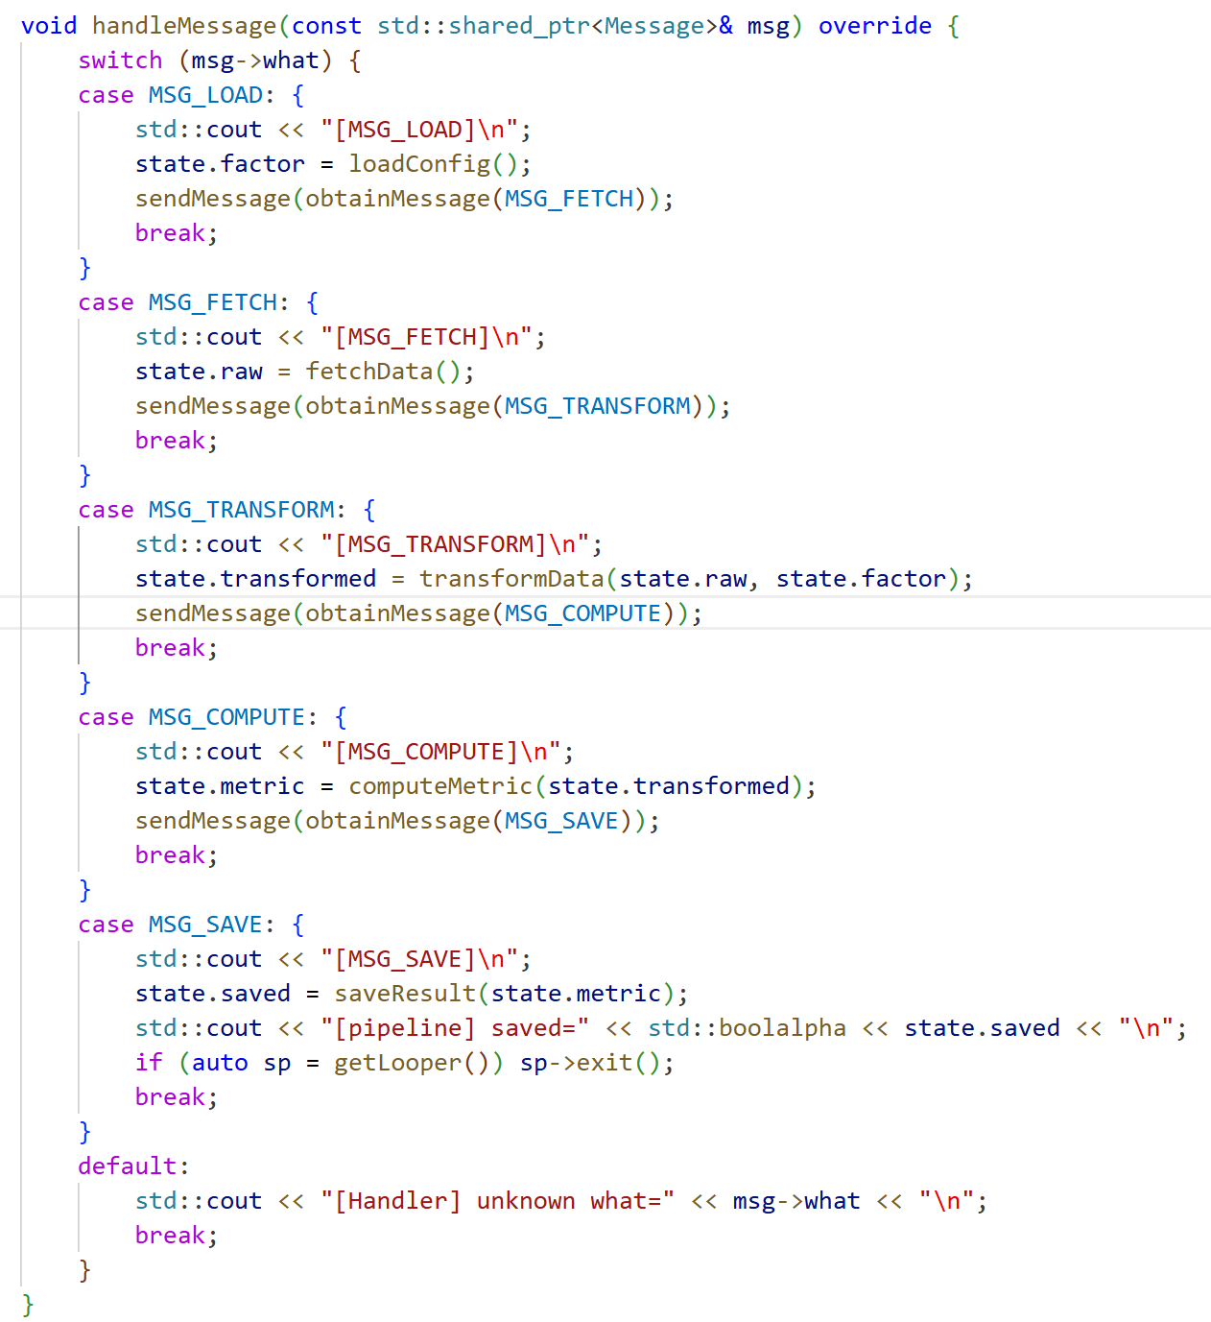
5.3 Architectural Decision – Usability
QA-03 | Framework should hide system complexity and support multiple programming paradigms.
AS-IS (Tiger Looper)
Monolithic Interface
- Tiger Looper uses Android style: message, handler, looper.
- Provide only Message/Handler programming style (Single programming paradigm only)
Verbose asynchronous client code
- Large switch-case blocks in HandleMessage() make client code harder to maintain and evolve (high complexity, low extensibility).
Fig 22: Example of chain of async operations (msg_load, msg_fetch, msg_transform..)
29

Slide 30
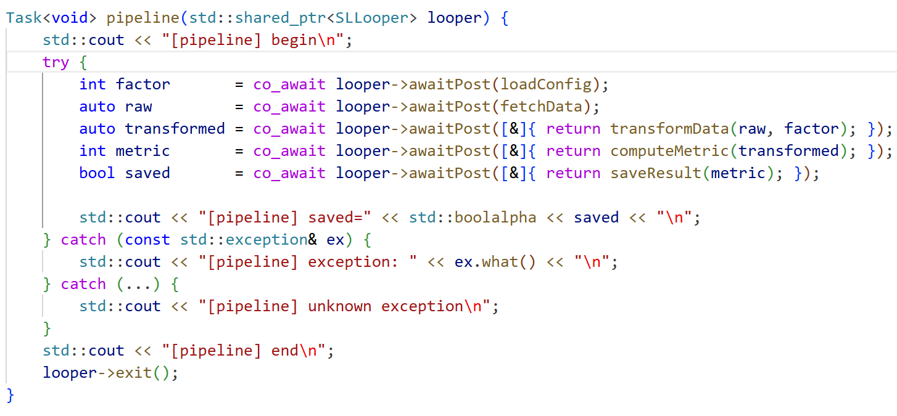
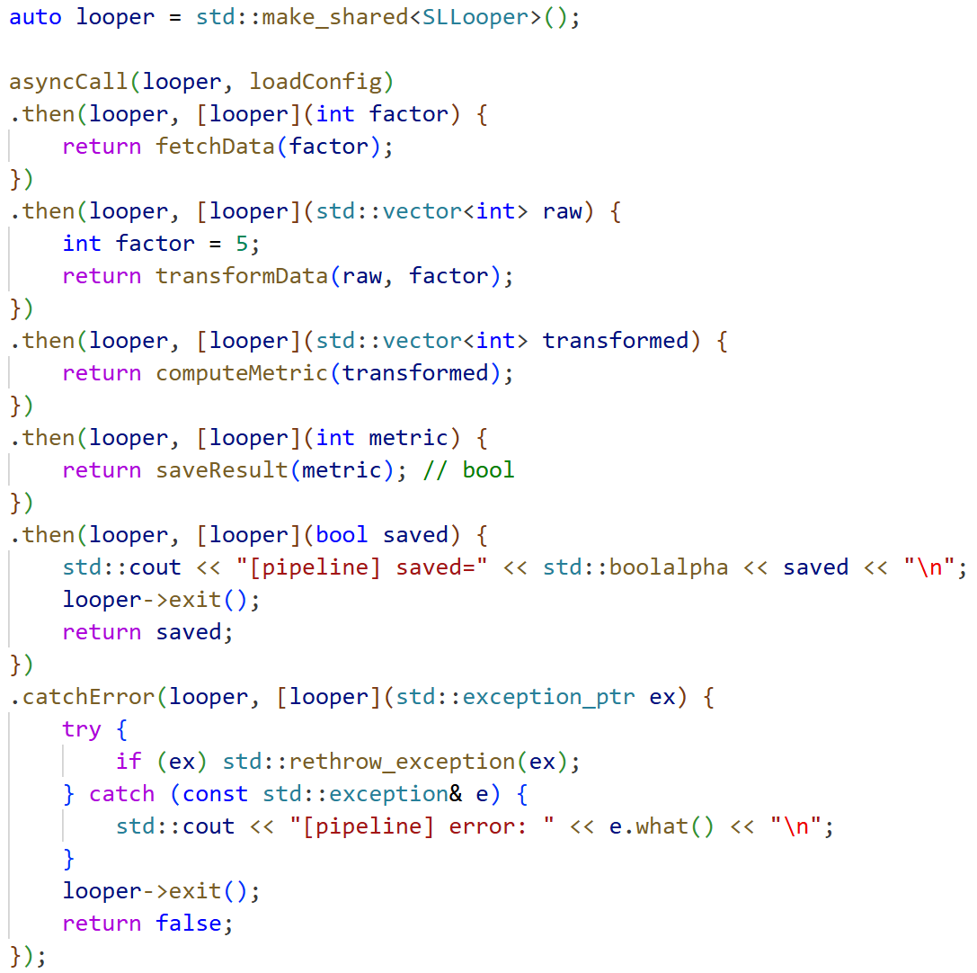
5.3 Architectural Decision – Usability
QA-03 | Framework should hide system complexity and support multiple programming paradigms.
LGE Internal Use Only
TO-BE (SW Task)
Increase user-ability for using convenient asynchronous operations
- Write async code in sync code style.
- Code is simpler, lower complexity and shorter.
Fig 24: Chain of async operation using Coroutines
Fig 23: Chain of async operation using Promise
30

Slide 31
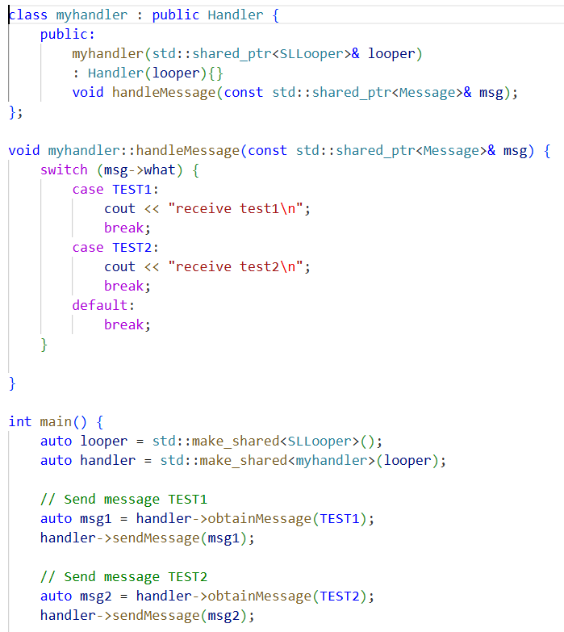
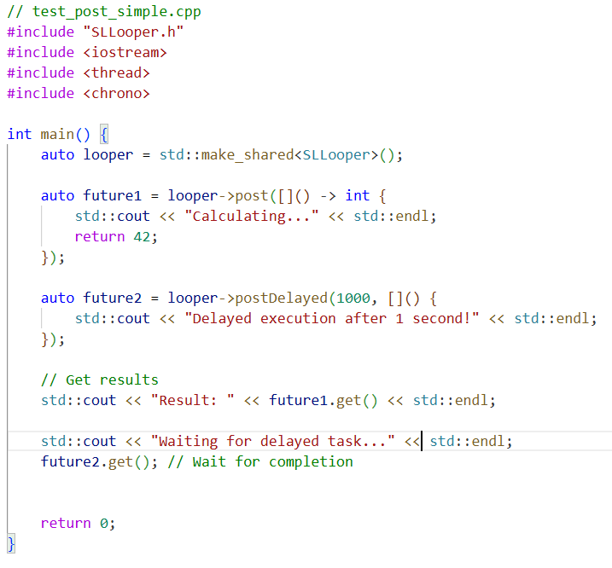
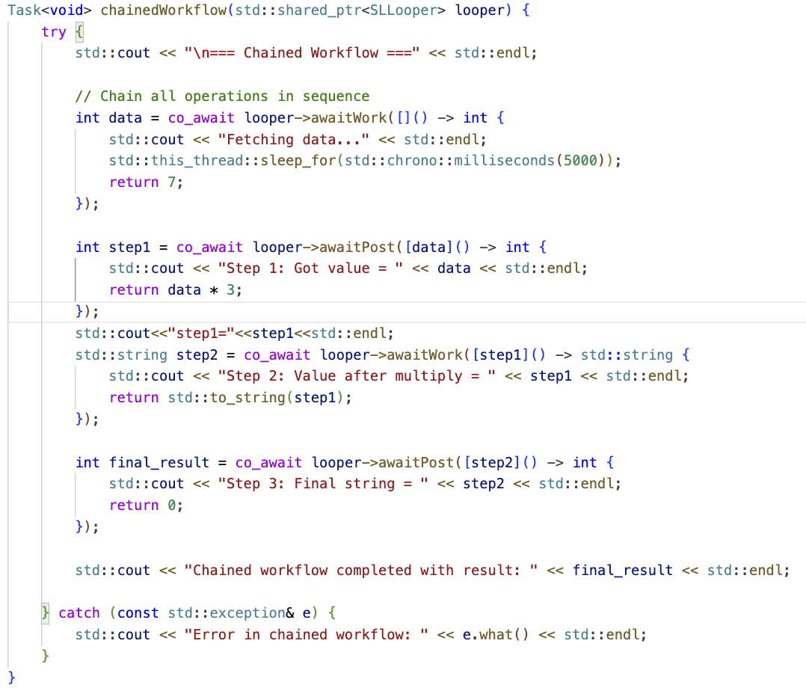
5.3 Architectural Decision – Usability
QA-03 | Framework should hide system complexity and support multiple programming paradigms.
LGE Internal Use Only
TO-BE (SW Task)
Use Facade Pattern
- Use Façade pattern to make simple for user code. - Provides different programming paradigms (Message, functor, promise feature, Coroutines).
Android-style user
Modern C++ style user
JavaScript-style user
Fig 25: Different programming paradigms in SW Task
31

Slide 32
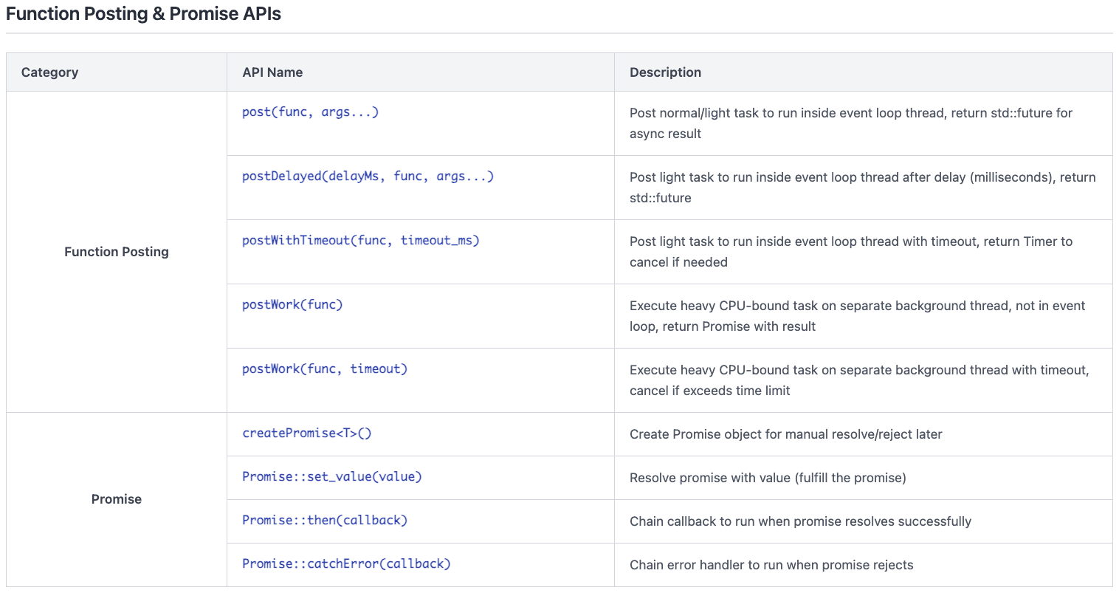
5.3 Architectural Decision – Usability
QA-03 | Framework should hide system complexity and support multiple programming paradigms.
LGE Internal Use Only
TO-BE (SW Task)
SW Task - API Reference Tables
32

Slide 33
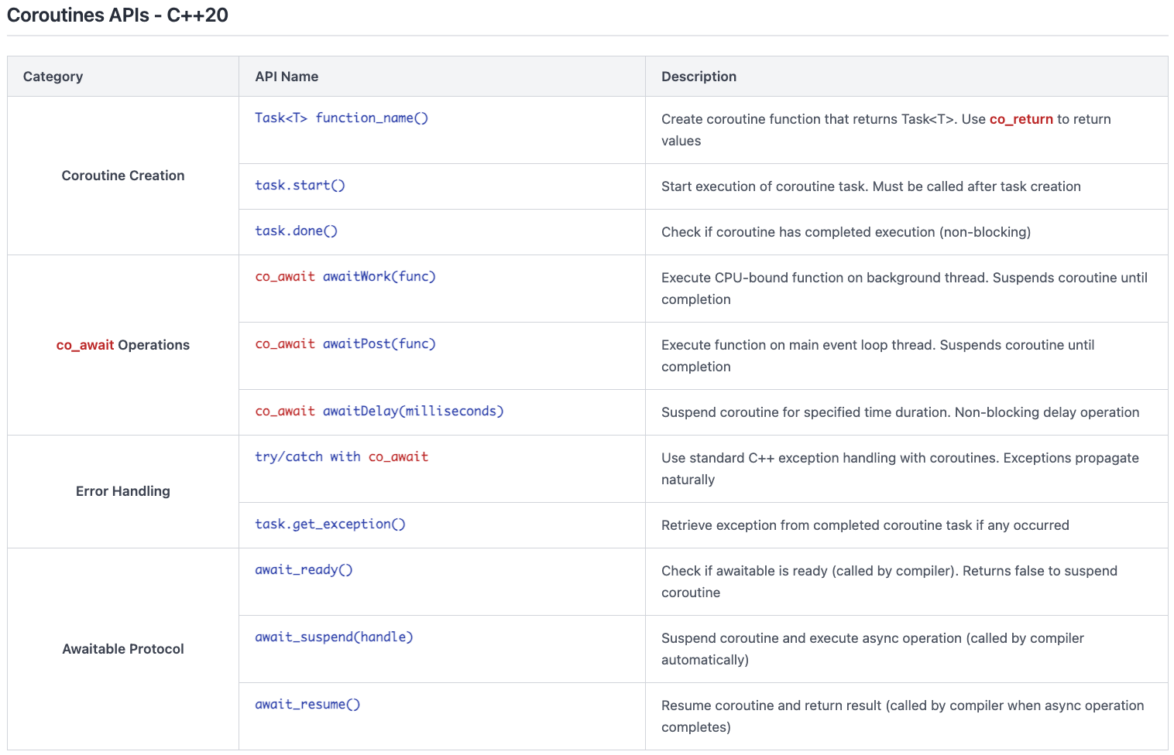
5.3 Architectural Decision – Usability
QA-03 | Framework should hide system complexity and support multiple programming paradigms.
LGE Internal Use Only
TO-BE (SW Task)
SW Task - API Reference Tables
33

Slide 34
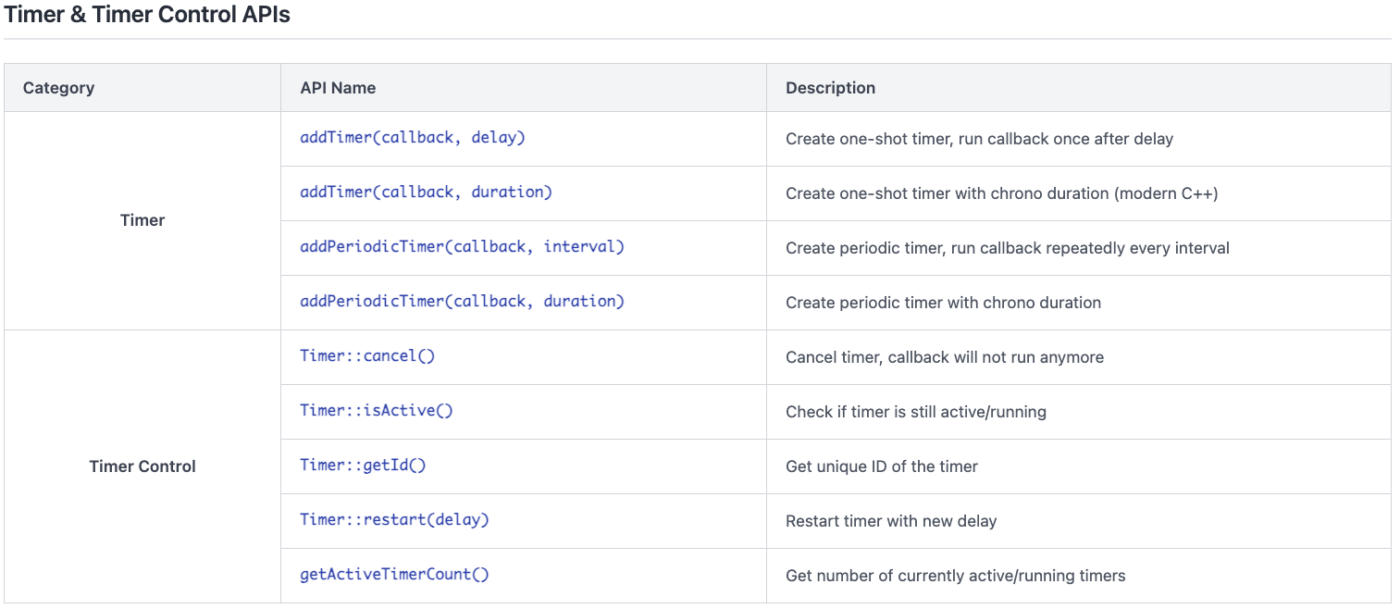
5.3 Architectural Decision – Usability
QA-03 | Framework should hide system complexity and support multiple programming paradigms.
LGE Internal Use Only
TO-BE (SW Task)
SW Task - API Reference Tables
34

Slide 35
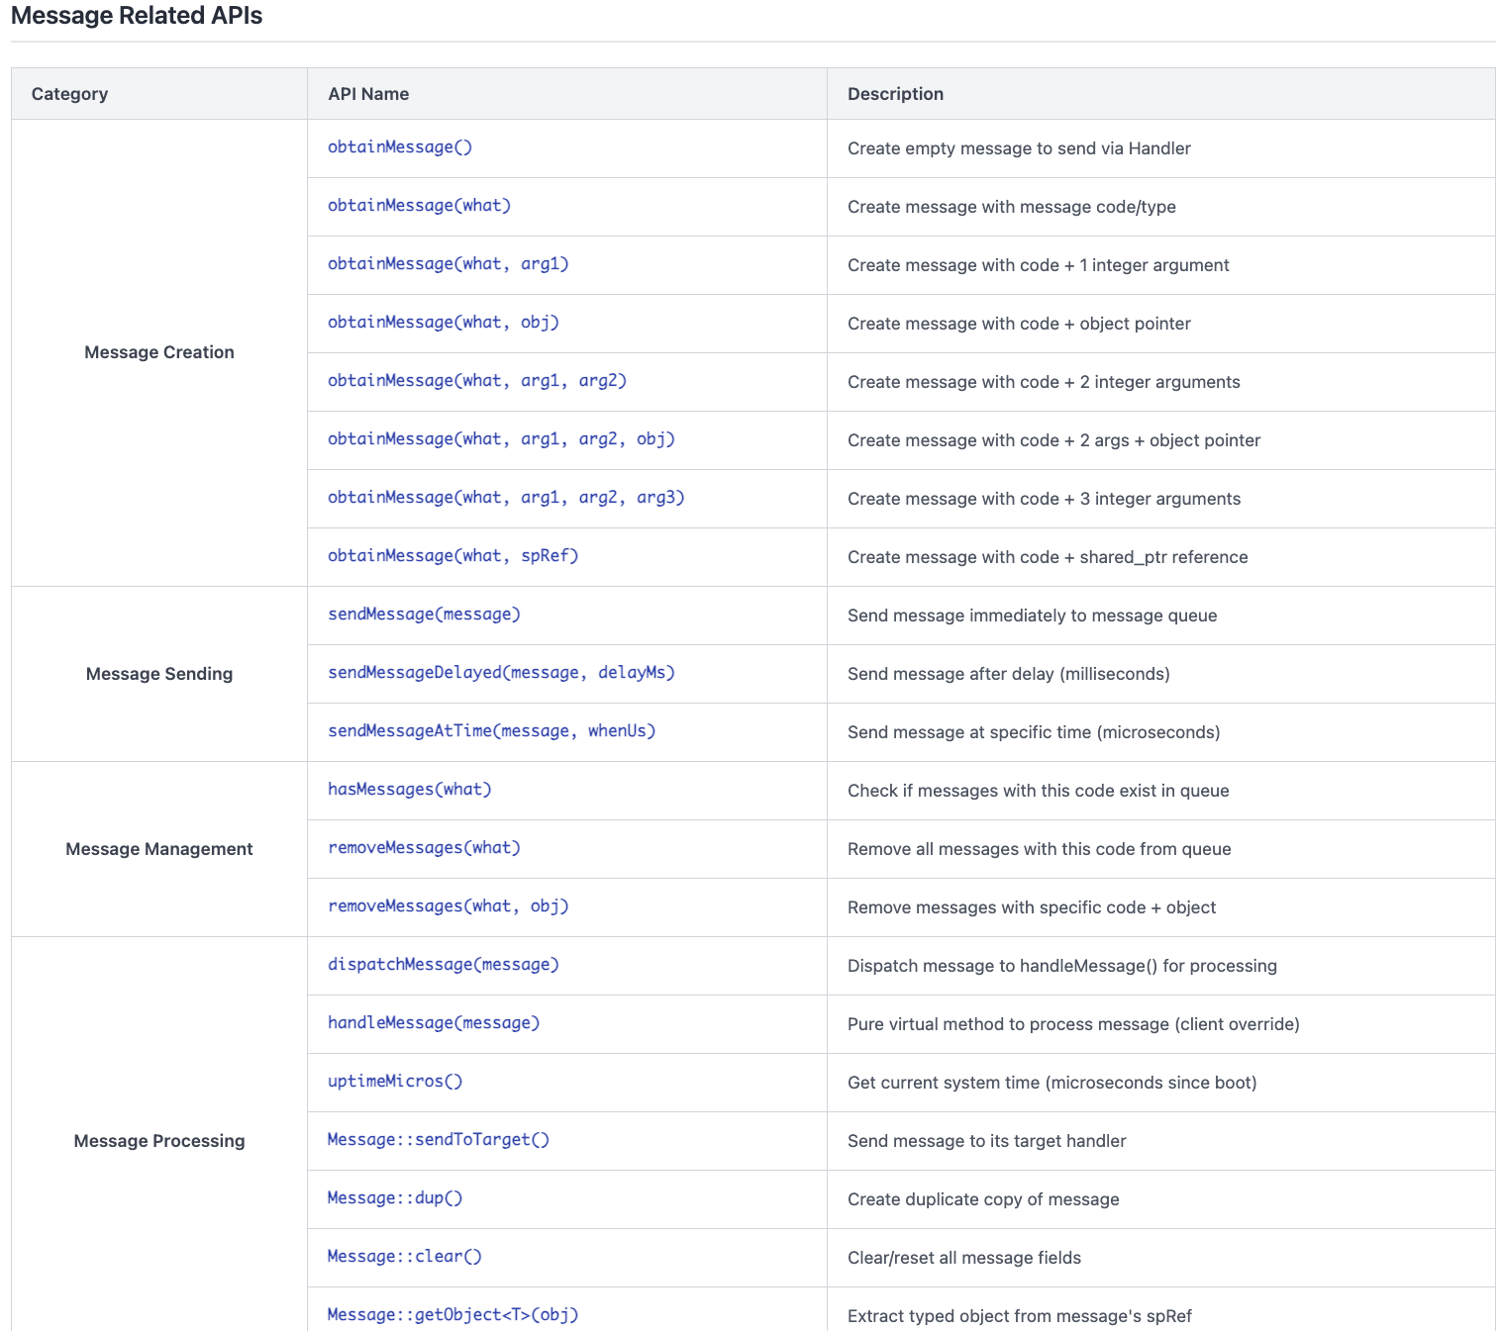
5.3 Architectural Decision – Usability
QA-03 | Framework should hide system complexity and support multiple programming paradigms.
LGE Internal Use Only
TO-BE (SW Task)
SW Task - API Reference Tables
35

Slide 36
5.3 Architectural Decision - Usability
LGE Internal Use Only
Architectural Decision
- The design of Timer in SW Task shows that it satisfies QA-03: Framework should hide system complexity and support multiple programming paradigms.
(Useability)
Alternatives design | SW Task | Tiger Looper
Pros | - Unified interface: Single entry point for all functionality - Facade pattern hides subsystem complexity - Multiple access methods for different skill levels - Familiar Message API for Android style (backward compatibility) - Modern Function API: Supports lambdas, auto, RAII, type-safe operations - Promise API: Advanced async composition, exception propagation - Clean, concise syntax; declarative programming model | - Simple, monolithic interface: Easy to understand for basic use cases - Familiar Handler/Message pattern for Android style developers
Cons | - More complex API may require documentation - Slightly higher learning curve for new users unfamiliar with async patterns | - Only supports single programming paradigm (Message/Handler) - No flexibility or choice for developers - No support for modern C++ features (lambdas, RAII, async) -All developers forced to use same pattern
Decision | Selected | Rejected

Slide 37
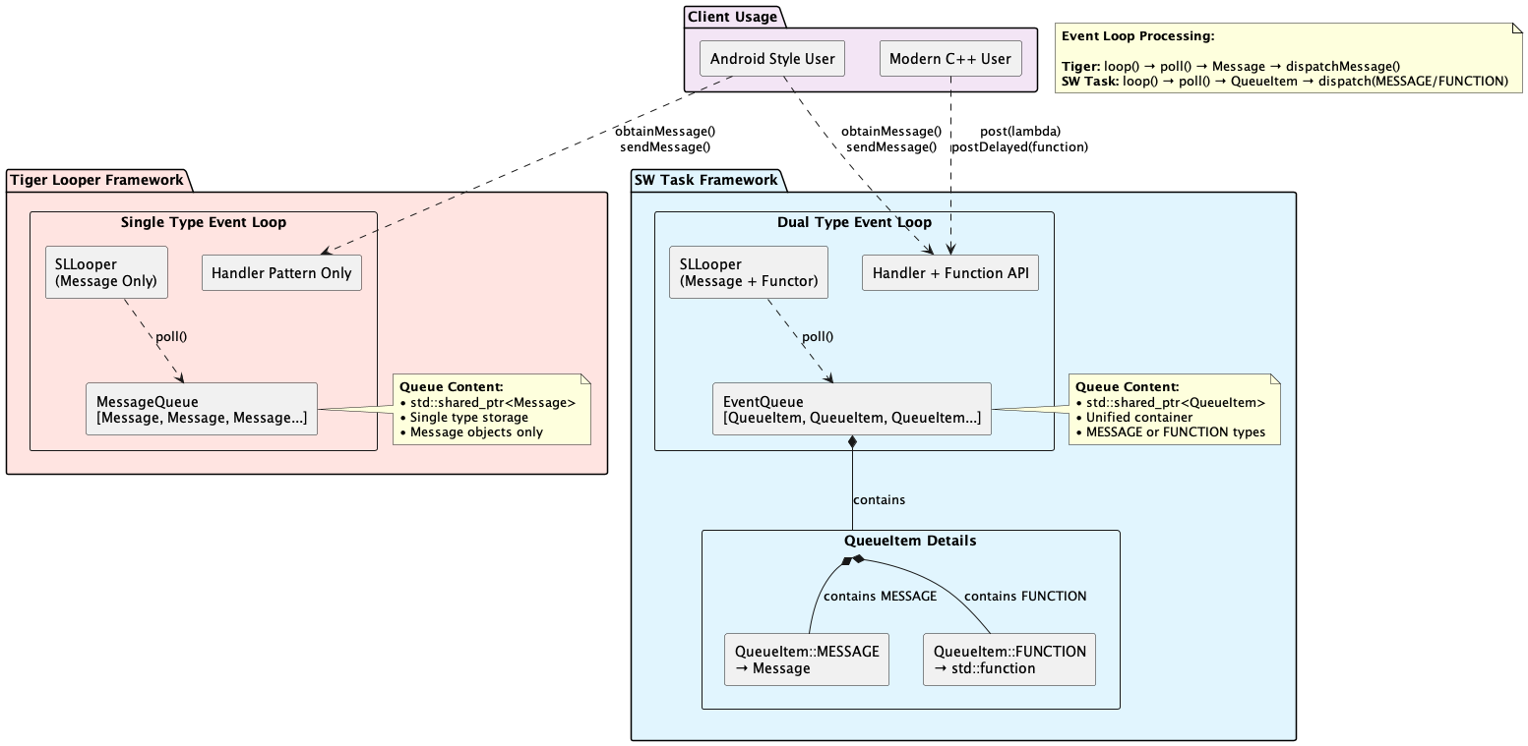

5.4 Architectural Decision – Reusability
QA-04 | Framework should provide backward compatible API enhancement for Tiger Looper. Legacy client source code using Tiger Looper must not be impacted.
LGE Internal Use Only
TO-BE (SW Task)
Backward Compatible Enhancement
Legacy API Preservation:
- All Tiger APIs preserved unchanged
- Existing code compiles without modifications
Modern API Addition:
- Function and Promise APIs added to same classes
- Template-based type safety
- RAII resource management
Unified Processing:
- Message and Function use same event queue
- Legacy and modern code coexist
- Extend MessageQueue to EventQueue, which contains QueueItem elements.
- Message object and Functors (callable objects such as lambda, std::function, std::packaged_task, function pointer) are wrapped in QueueItem elements.
37
Fig 26: Backward compatible design

Slide 38
5.4 Architectural Decision - Reusability
QA-04 | Framework should provide backward compatible API enhancement for Tiger Looper. Legacy client source code using Tiger Looper must not be impacted.
LGE Internal Use Only
Architectural Decision
- The design in SW Task shows that it satisfies QA-04: Framework should provide backward compatible API enhancement for Tiger Looper. Legacy client source code using Tiger Looper must not be impacted (Reusability)
Alternatives design | SW Task | Tiger Looper
Pros | - Legacy API preserved: Existing Tiger APIs remain unchanged - Modern API addition: Function and Promise APIs added to same classes - RAII resource management - Unified processing: Message and Function use same queue - Legacy and modern code coexist - Zero risk migration for existing projects | - Simple, stable legacy API - Easy reuse for projects already using Handler/Message pattern
Cons | - Increased codebase complexity to support both legacy and modern APIs | - No support for modern C++ features (lambdas, promises, RAII) - Difficult to extend or migrate to new programming paradigms - Only one programming style supported; limited flexibility for future reuse
Decision | Selected | Rejected

Slide 39
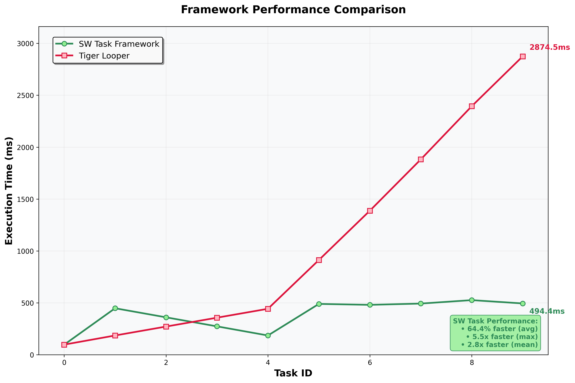
6. Validation
LGE Internal Use Only
Measure performance for SW Task vs. Tiger Looper
Experimental setup
Test scenario: 5 heavy CPU tasks + 5 normal tasks executed simultaneously
Measurement: End-to-end task completion time (post → complete)
Environment: Same hardware/OS conditions for both frameworks
Result
SW Task Framework
- Heavy tasks execute on dedicated CPU-bound task thread - Normal tasks execute on main event loop thread
- Parallel execution prevents blocking
- Consistent ~500ms regardless of task mix
Tiger Looper
- All tasks execute sequentially on single event thread
- Heavy tasks block subsequent task processing
- FIFO queuing causes cumulative delays
- Linear time increase: 526ms → 1247ms → 2874ms
QA-01 Compliance
✅ SW Task meets requirement: All tasks complete under 1 second
❌ Tiger Looper fails: Tasks exceed 1s with 2.87s maximum

Slide 40
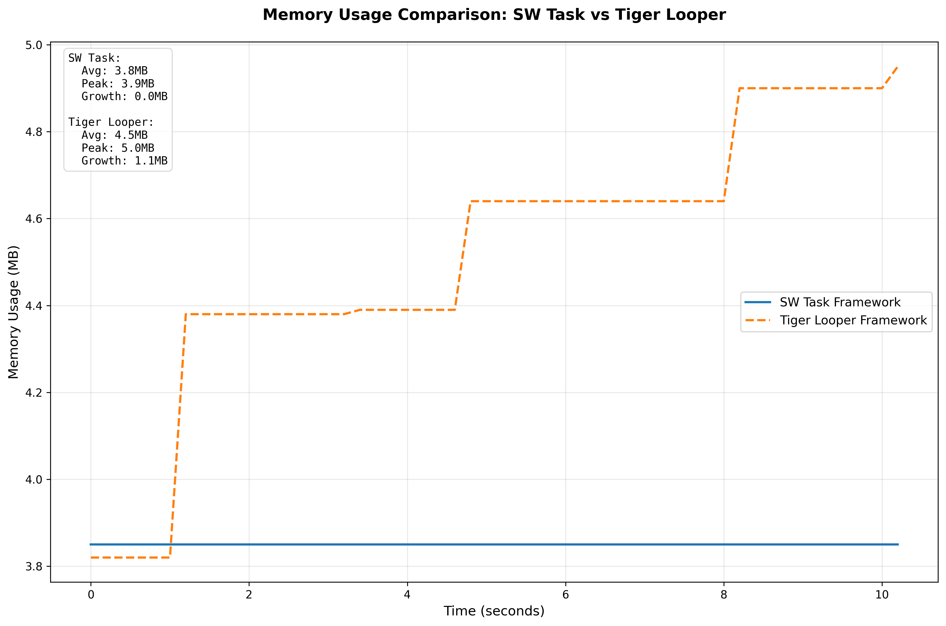
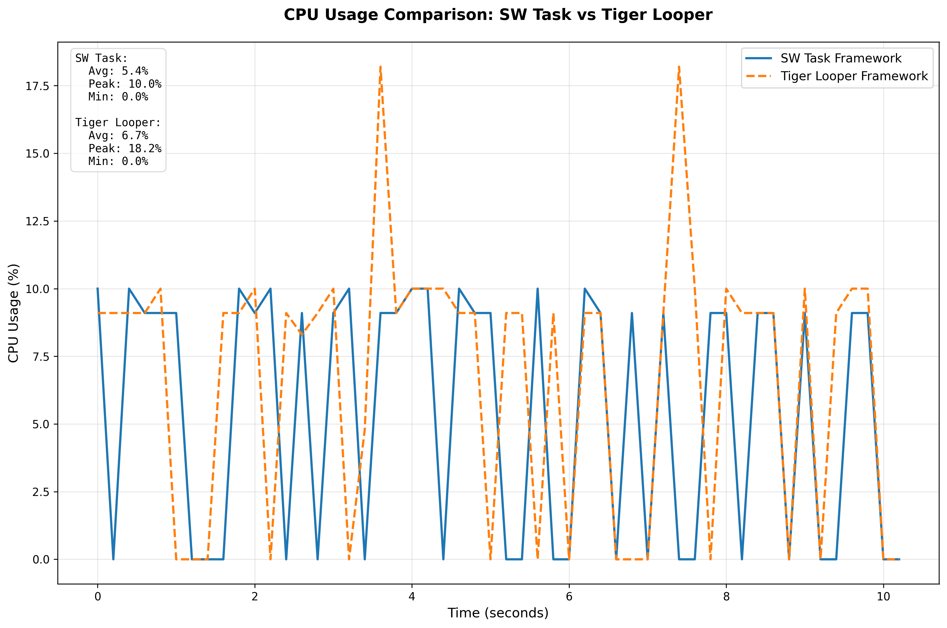
6. Validation
LGE Internal Use Only
Timer operation comparison
Experimental setup
- Load: 1000 one-shot timers + 50 periodic timers
- Duration: 30 seconds continuous operation
- Metrics: CPU usage (%), RAM usage (RSS, MB), Resource efficiency
Memory Efficiency
- SW Task: Flat memory usage (~3.8MB) - optimized timer data structures
- Tiger Looper: Step growth pattern (3.8→4.4→4.9MB) - memory leaks or inefficient allocation
- Result: SW Task uses 29% less memory with stable consumption
CPU Efficiency
SW Task: Consistent low usage with smaller spikes
Tiger Looper: Higher peak CPU (17.8% vs 12.6%) - inefficient timer handling
Result: SW Task delivers 41% lower CPU spikes
QA-02 Compliance
✅ SW Task : Superior resource utilization with 29% memory savings and 41% lower CPU peaks
❌ Tiger Looper: Inefficient resource usage with growing memory footprint

Slide 41
7. Conclusion
LGE Internal Use Only
SW Task Framework: advantages over Tiger Looper
Performance
- Support CPU-bound task handling: non-blocking event loop
- Promise-based and Coroutines-based asynchronous helper: reduce significantly response time by using effective concurrency.
Efficiency
- Single Timer Manager thread manages unlimited timers compared to use thread-per-timer in Tiger Looper.
- Use Linux timerfd and epoll instead of POSIX timer in Tiger Looper: 90% overhead reduction
Usability
- Multi-paradigm: JS-based promise chains, Coroutines, Android-style messages, modern C++17/20
- Rich API: functions Posting, Promise-based and Coroutines-based Async, Timer management, Android-style message.
- Flexible programming models: provide more API options
Reusability
- 100% backward compatible: drop-in replacement, zero migration cost
- Additive enhancement: new features don't break existing code.
- Future-proof: Support modern C++ evolution
SW Task Framework outperforms Tiger Looper framework comprehensively with higher performance, efficient resource efficiency, and API flexibility, while ensuring 100% backward compatibility.

Slide 42
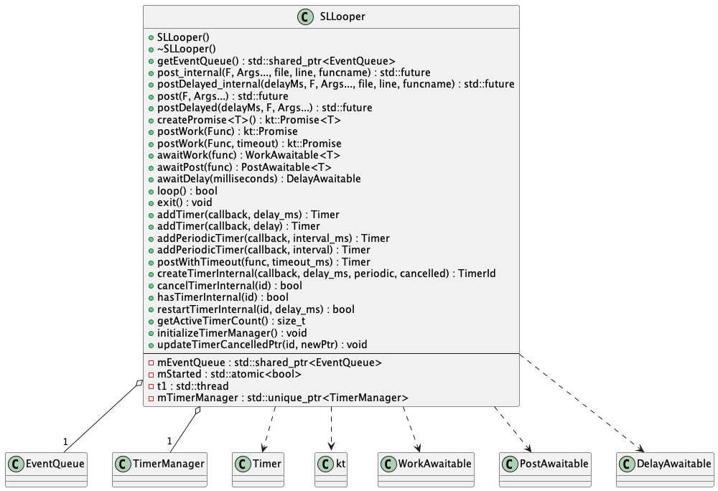
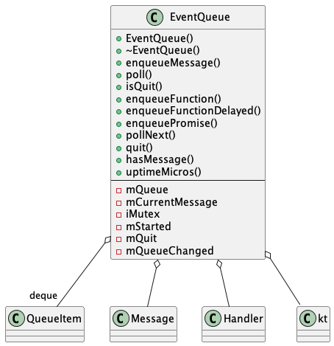
Appendix
LGE Internal Use Only
Class Diagram(1)

Slide 43
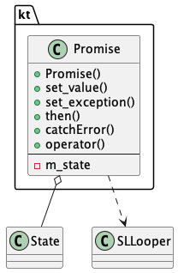
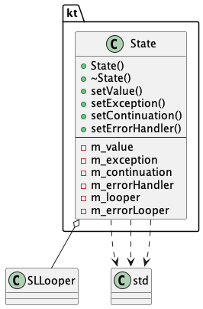
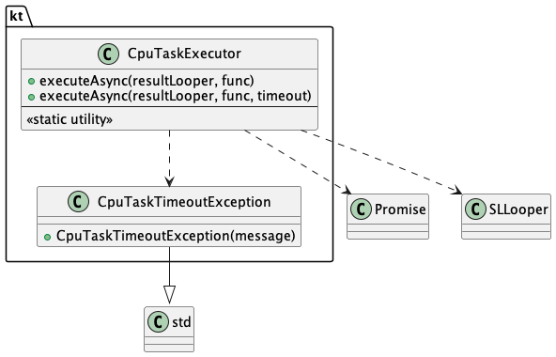
Appendix
LGE Internal Use Only
Class Diagram(2)

Slide 44
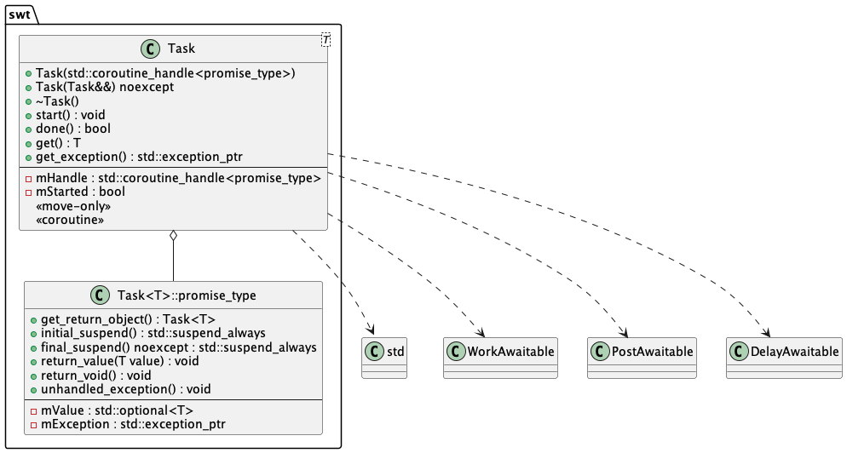
Appendix
LGE Internal Use Only
Class Diagram(3)

Slide 45
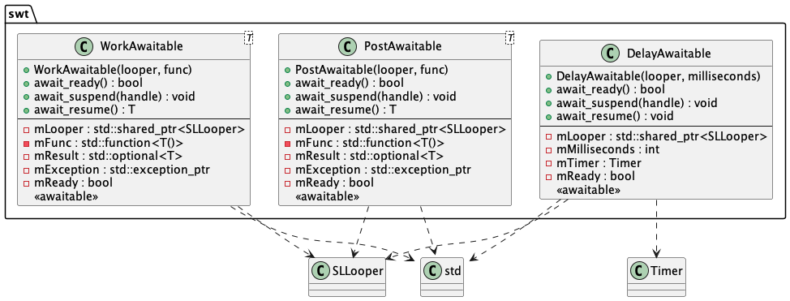
Appendix
LGE Internal Use Only
Class Diagram(4)

Slide 46


Appendix
LGE Internal Use Only
Class Diagram(5)

Slide 47


Appendix
LGE Internal Use Only
Class Diagram(6)

