Slide 1
Analysis of bike sharing dataset: an effort to convert casual riders into members
Data source: https://data.cityofchicago.org/Transportation/Divvy-Trips/fg6s-gzvg/about_data
Tools: SQL (BigQuery) & Tableau

Slide 2
Questions/goals
How do annual members and casual riders use Cyclistic bikes differently?
Why would casual riders buy Cyclistic annual memberships?
How can Cyclistic use digital media to influence casual riders to become members?

Slide 3
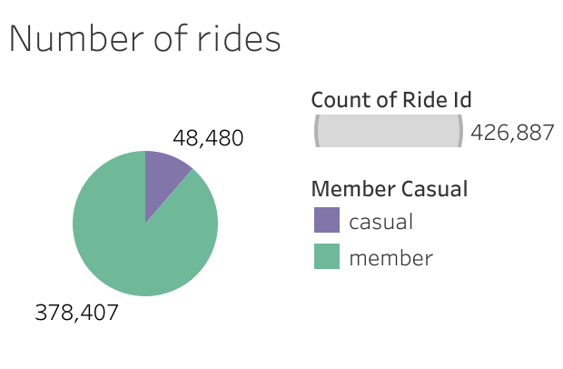
Casual rides are usually longer than members’ rides
2019-2020 years
Year | Average duration of trip in sec, members | Average duration of trip in sec, casual
2019 | 833.47 = 14 min | 3715.74 = 62 min
2020 | 591.67 = 10 min | 1423.31 = 23 min
2020

Slide 4
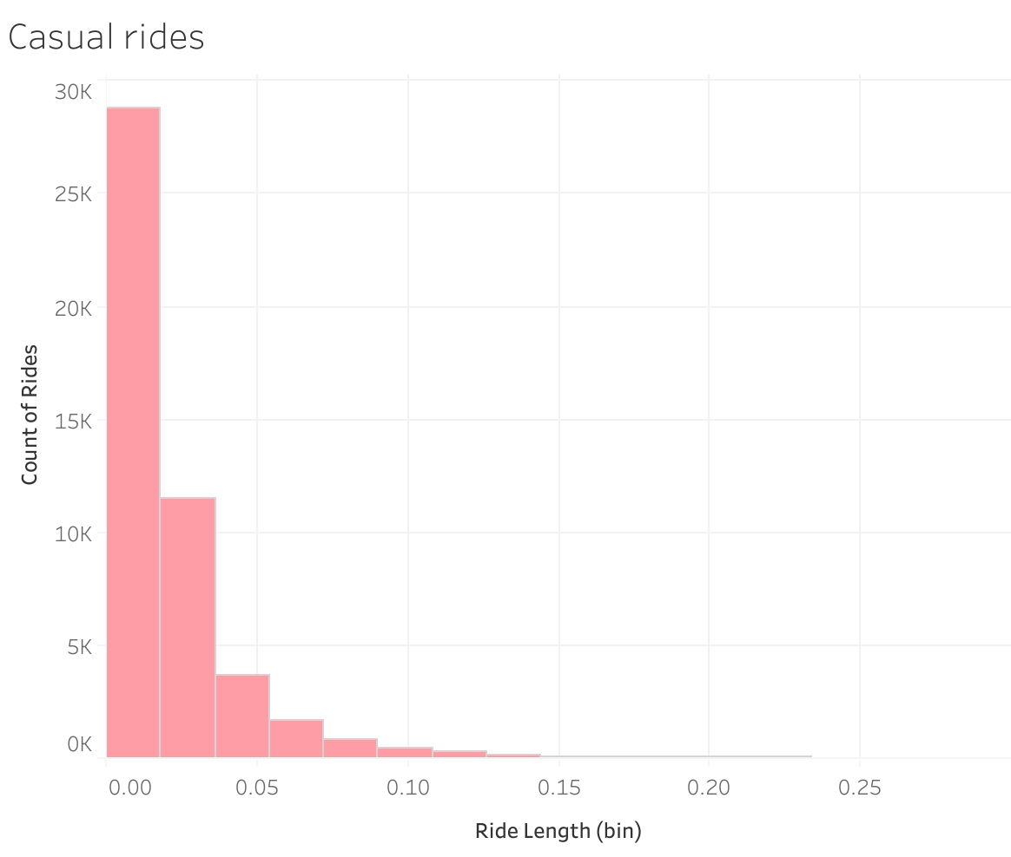
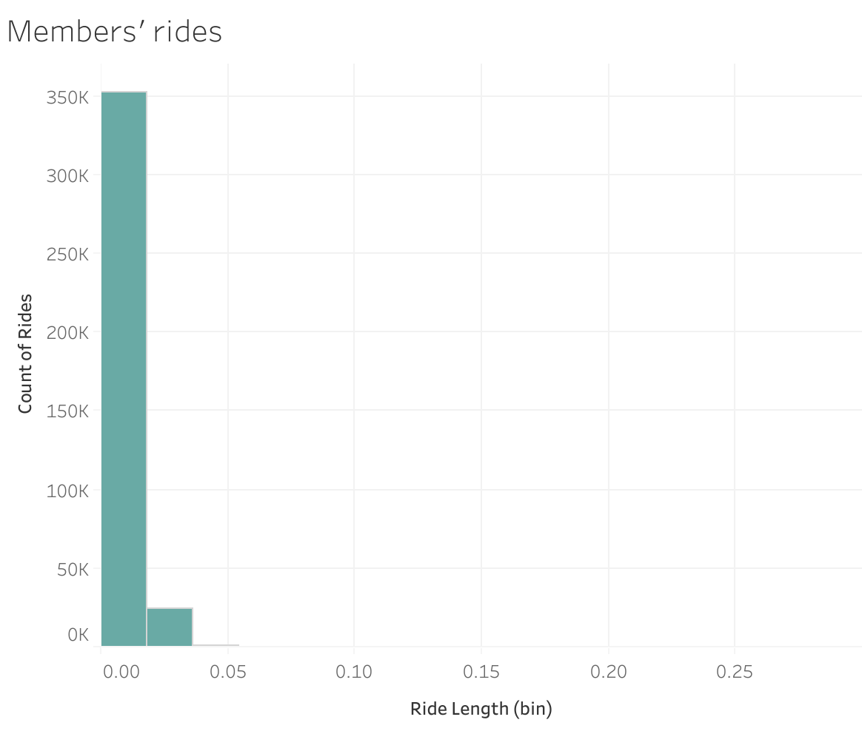
Casual rides are usually longer than members’ rides

Slide 5
Casual customers actively ride on weekends
2019-2020 years (merged)
Day of week | N, trips (members) | N, trips (casual)
Sun | 60,197 | 18,652
Mon | 110,430 | 6,747
Tue | 127,974 | 7,992
Wed | 121,903 | 8,422
Thu | 125,228 | 7,815
Fri | 115,168 | 8,542
Sat | 59,413 | 13,473
2020

Slide 6
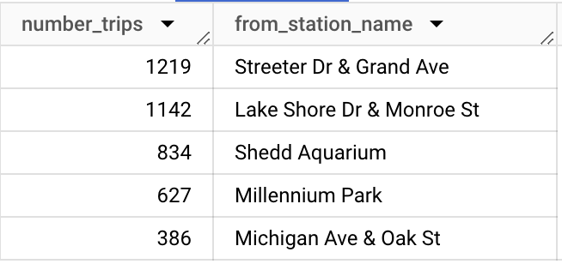
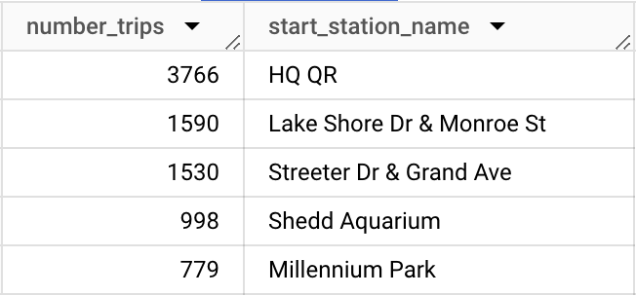
What stations are the most popular start locations among casual riders?
2019
2020
2020 – casual riders
Zoomed in: 2020 – casual riders

Slide 7
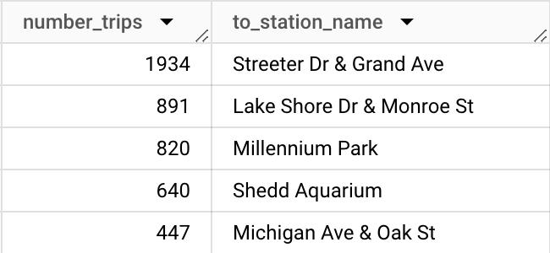
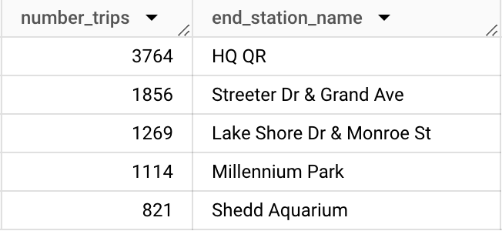
What stations are the most popular end locations among casual riders?
2019
2020

Slide 8
Recommendations
Casual riders may be interested in subscribing to become a member as casual rides are usually long;
A new promotion can target casual riders who ride on Saturdays and Sundays, e.g. we can offer new “weekend promotion”;
We can start promotion in 5 stations that are most popular among casual riders and then assess the revenue:
‘HQ QR’,
‘Streeter Dr & Grand Ave’,
‘Lake Shore Dr & Monroe St’,
‘Shedd Aquarium’,
‘Millenium Park’.

