Slide 1

PAIR 05: PROJECT PRESENTATION
CISC3015 - Data and Information Visualization (2024-1 001)
Tailine J. S. Nonato
Zhong Wanyi

Slide 2

CISC3015 - Data and Information Visualization (2024-1 001)
DOMAIN CATEGORY
Crimes;
Population safety.

Slide 3

CISC3015 - Data and Information Visualization (2024-1 001)
REGION
LOS ANGELES

Slide 4
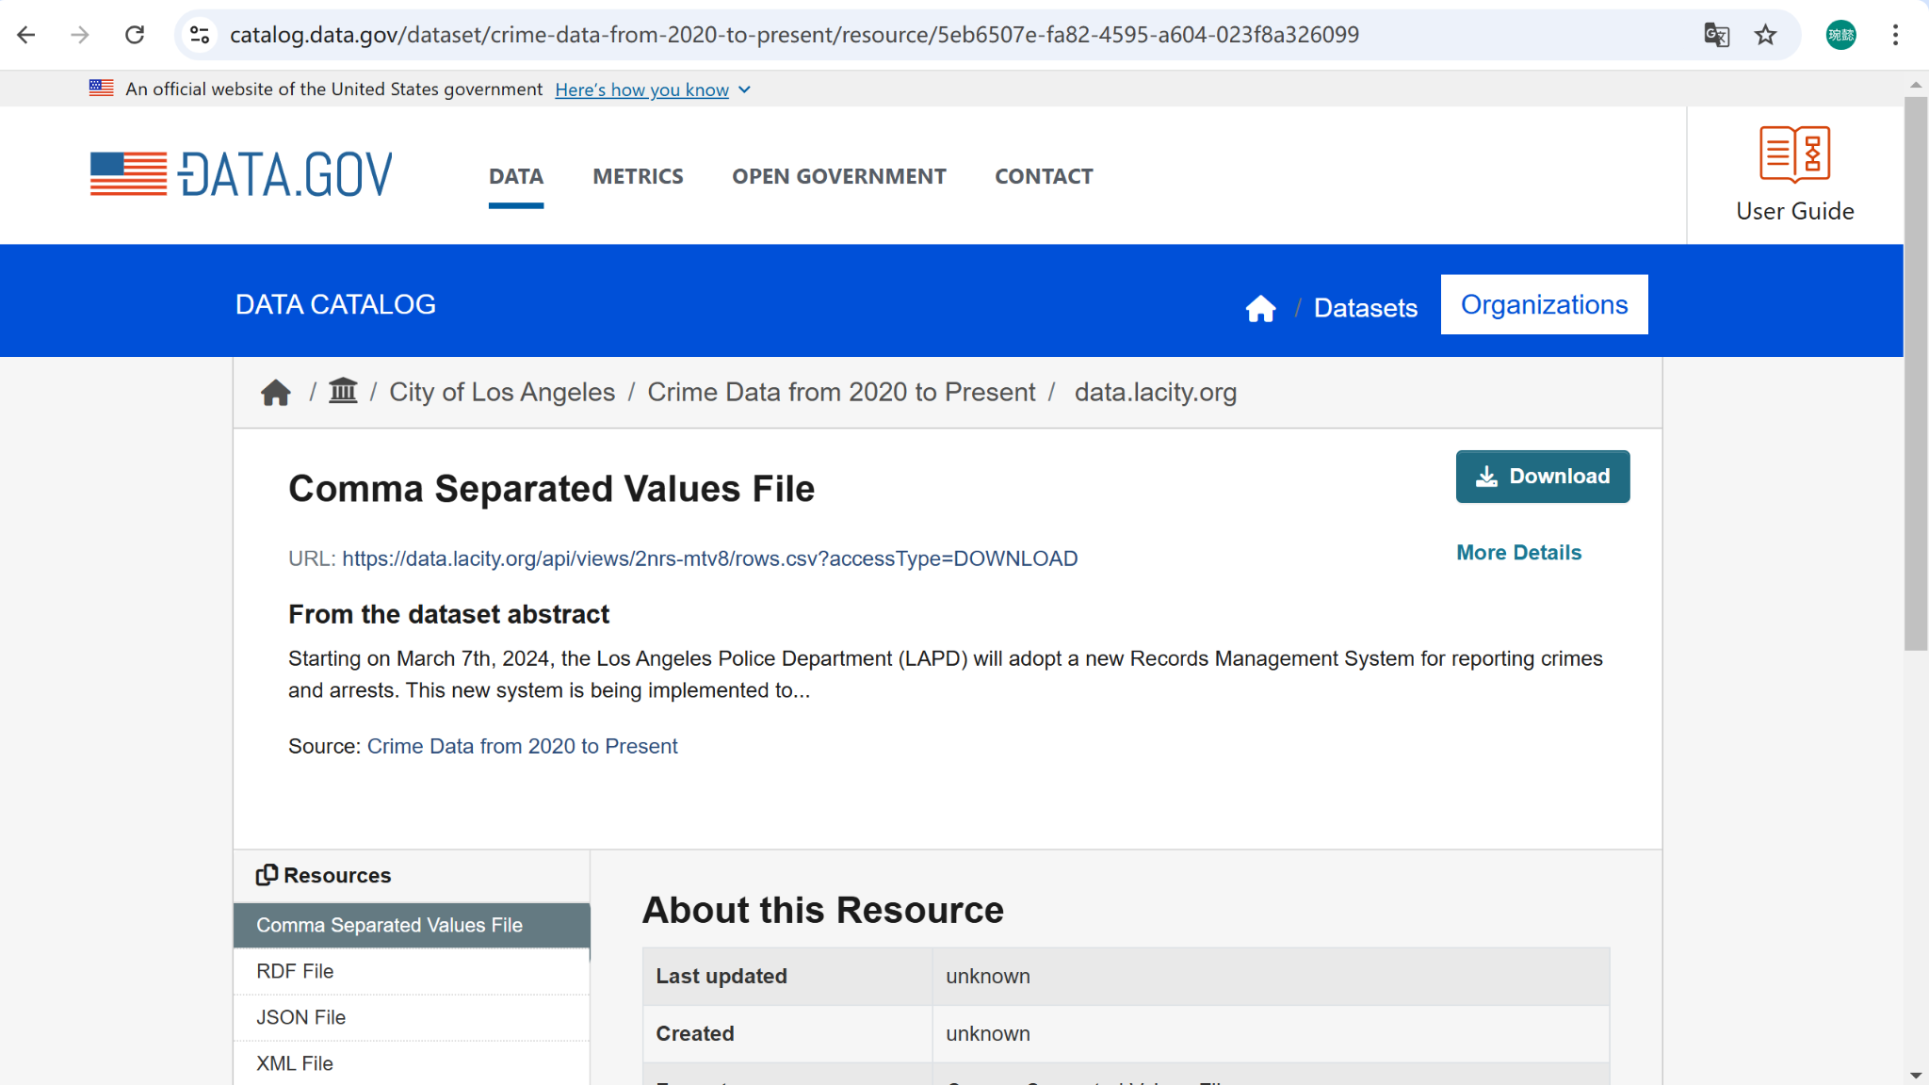
ABOUT THE DATA
CISC3015 - Data and Information Visualization (2024-1 001)

Slide 5
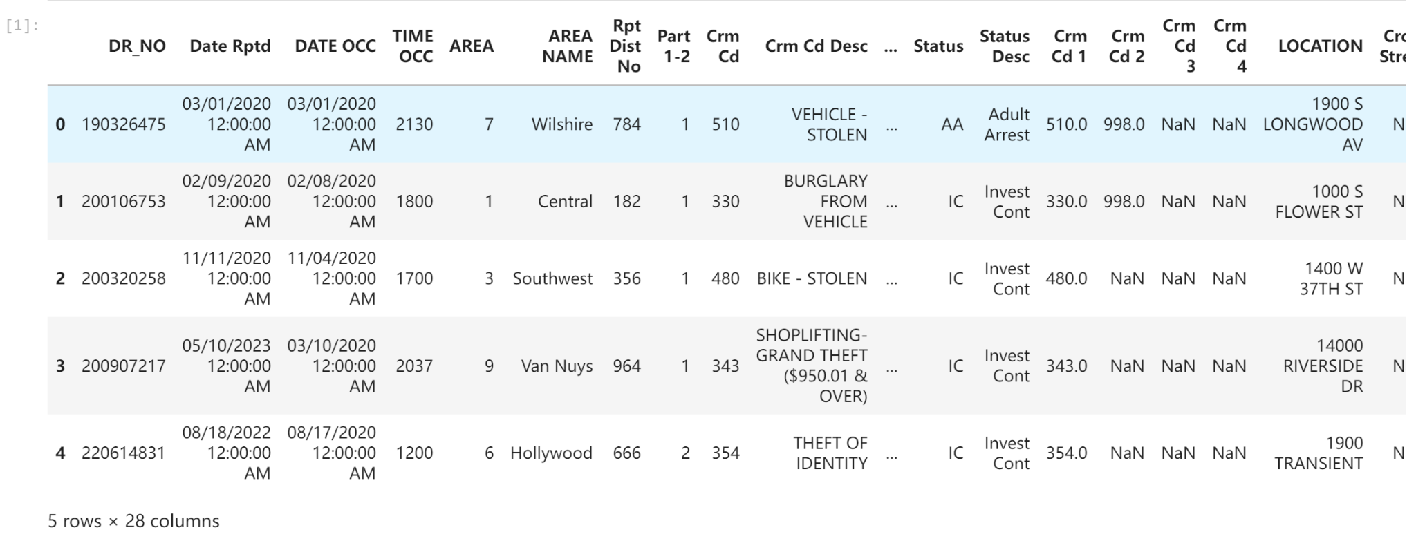
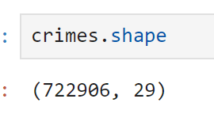
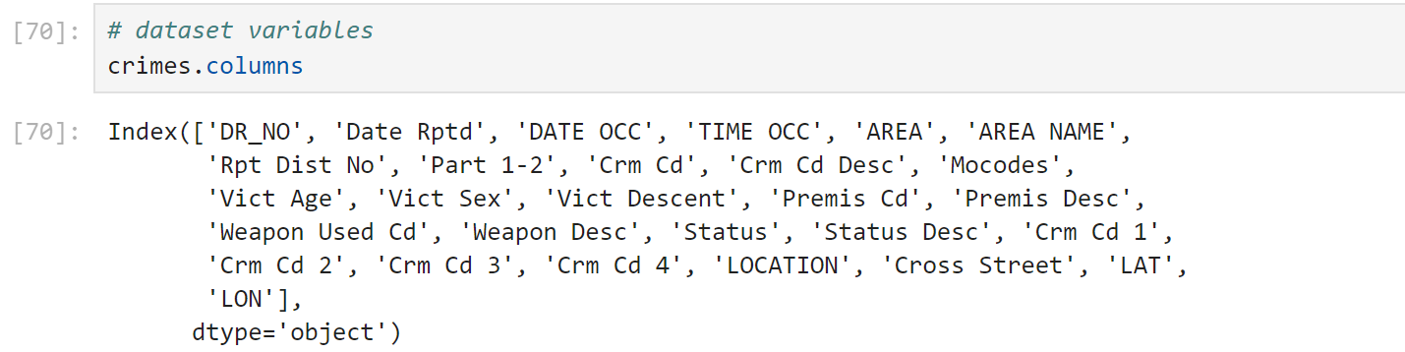
OVERVIEW OF THE DATASET
CISC3015 - Data and Information Visualization (2024-1 001)
Huge dataset. So it was required to clean and filter the data.

Slide 6
MAIN QUESTION
CISC3015 - Data and Information Visualization (2024-1 001)
What are the factors that explain the number of crimes by category in Los Angeles from 2020 to 2024?
Does anything change when looking in detail into criminal homicides?

Slide 7
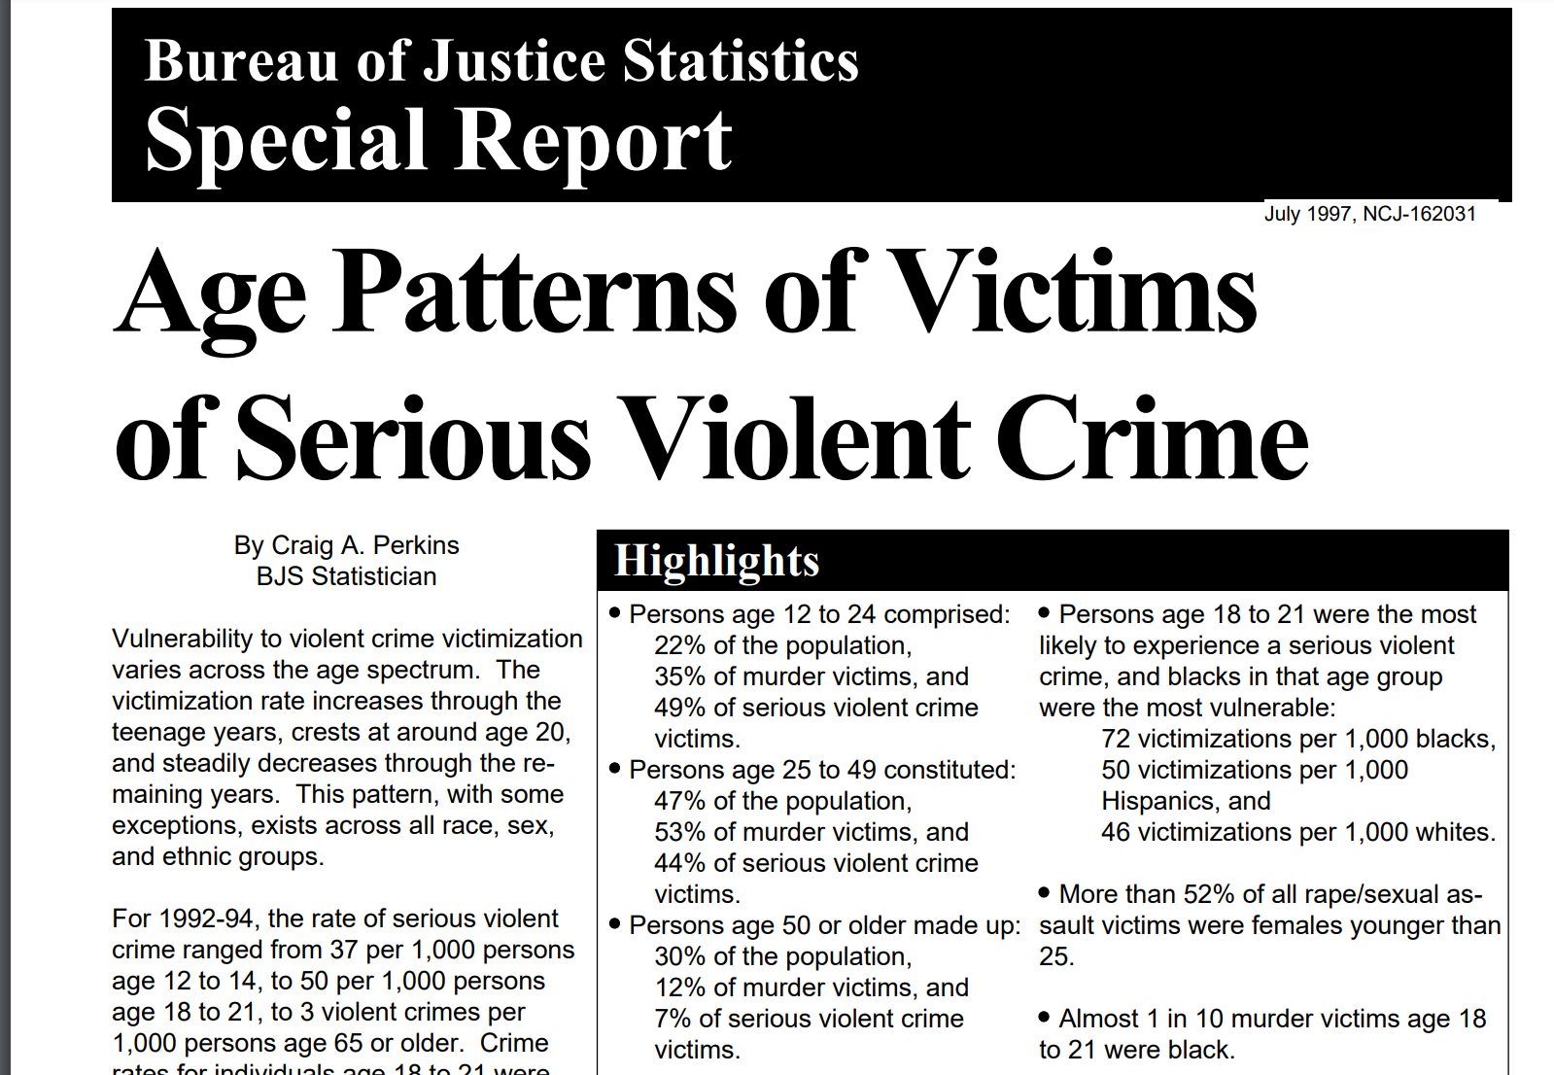
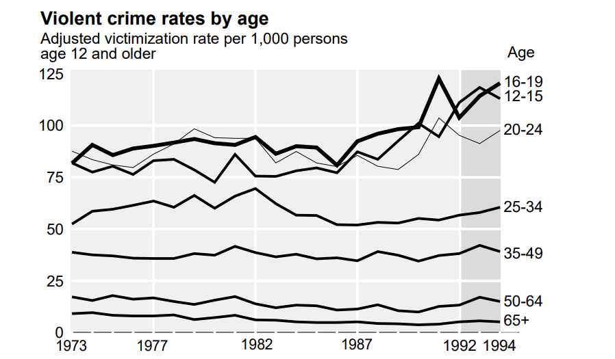
RELATED REFERENCES
CISC3015 - Data and Information Visualization (2024-1 001)

Slide 8
PURPOSE OF OUR PROJECT
CISC3015 - Data and Information Visualization (2024-1 001)
For Individual
Advance knowledge in fields like data analysis, sociology, psychology related to deviant behaviour.
For whole society
Identify high-risk gender and age groups that may need more support services or protection programs to protect their safety in the future.

Slide 9
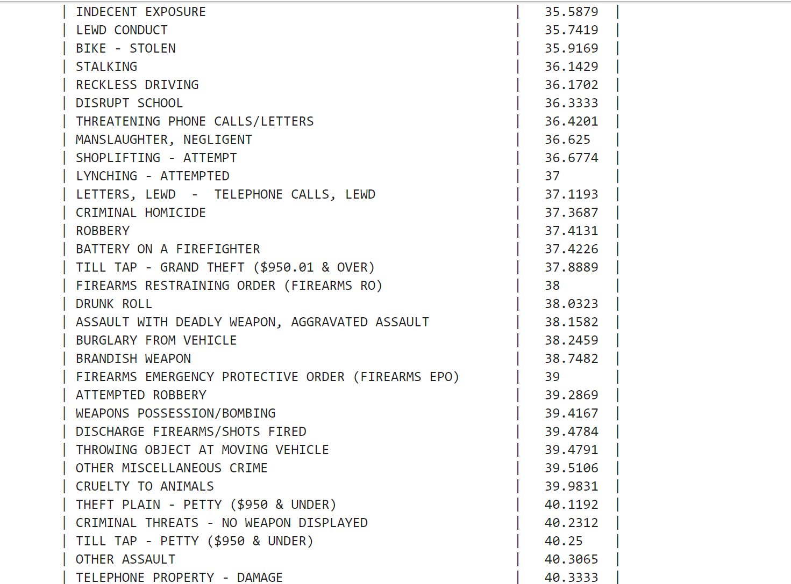
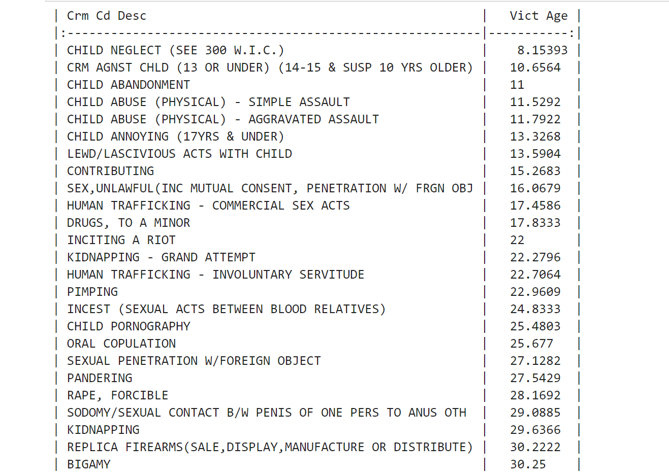
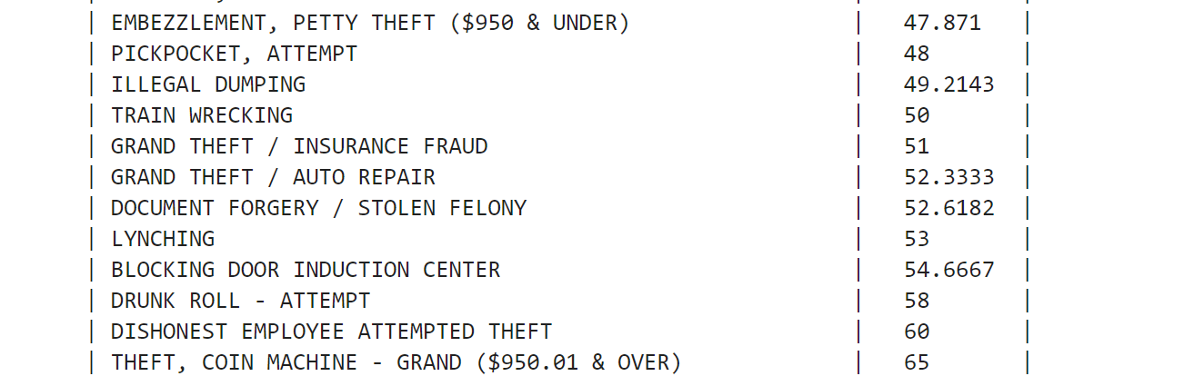
WHY CRIMINAL HOMICIDE?
CISC3015 - Data and Information Visualization (2024-1 001)
After cleaning the data, we find that the number of criminal homicide is 1,538 extracting from the whole 722,906 crimes.

Slide 10
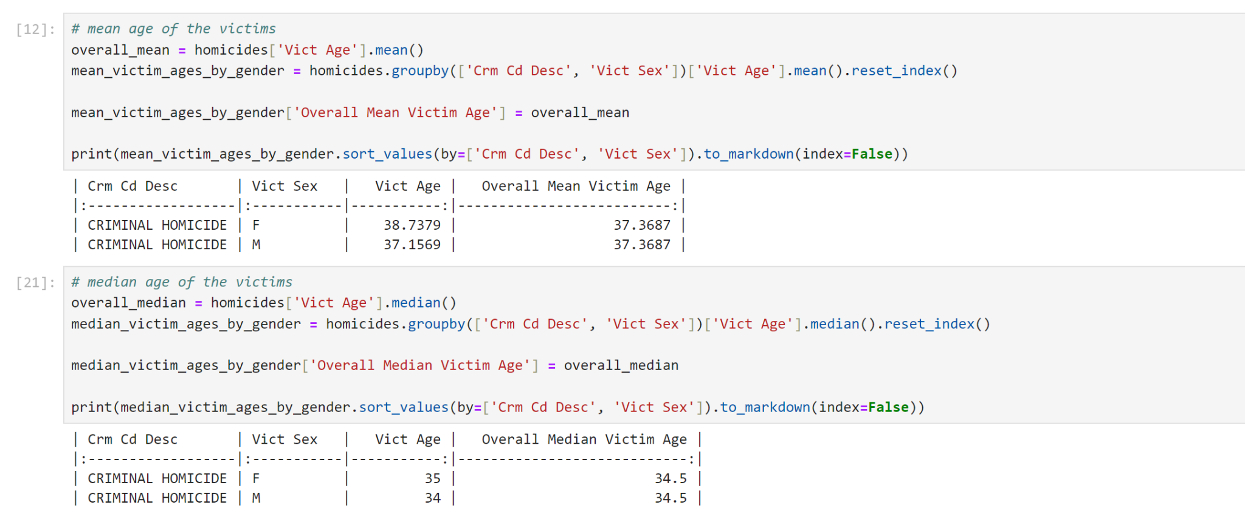
MEAN AND MEDIAN AGE OF THE VICTIM
CISC3015 - Data and Information Visualization (2024-1 001)

Slide 11
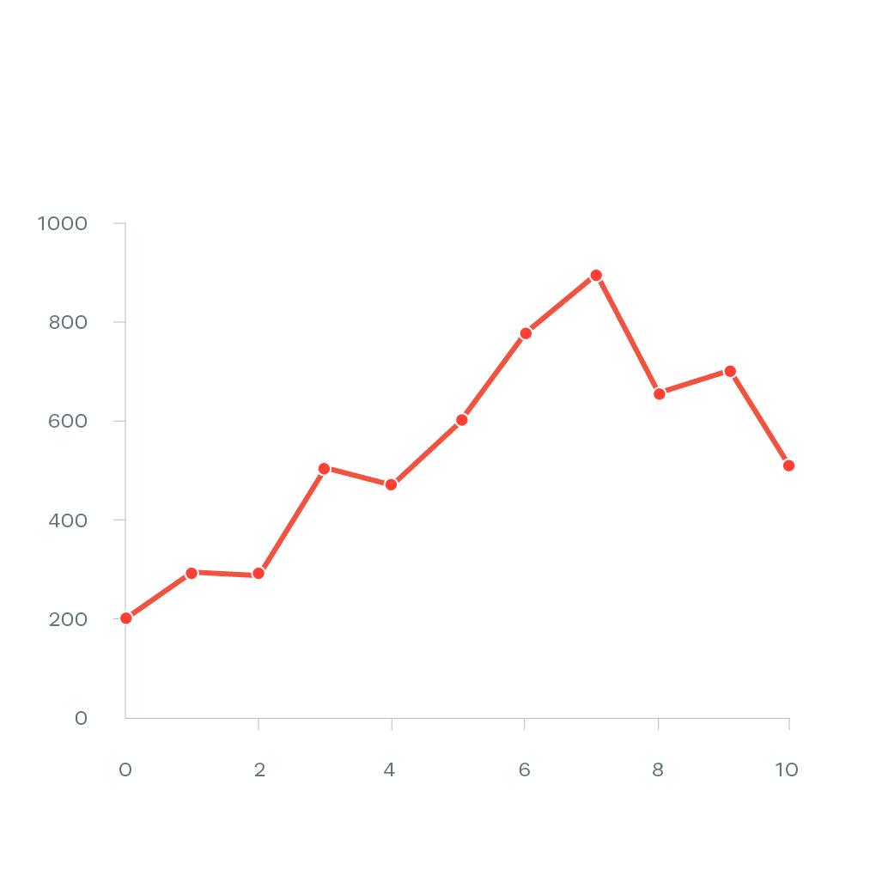
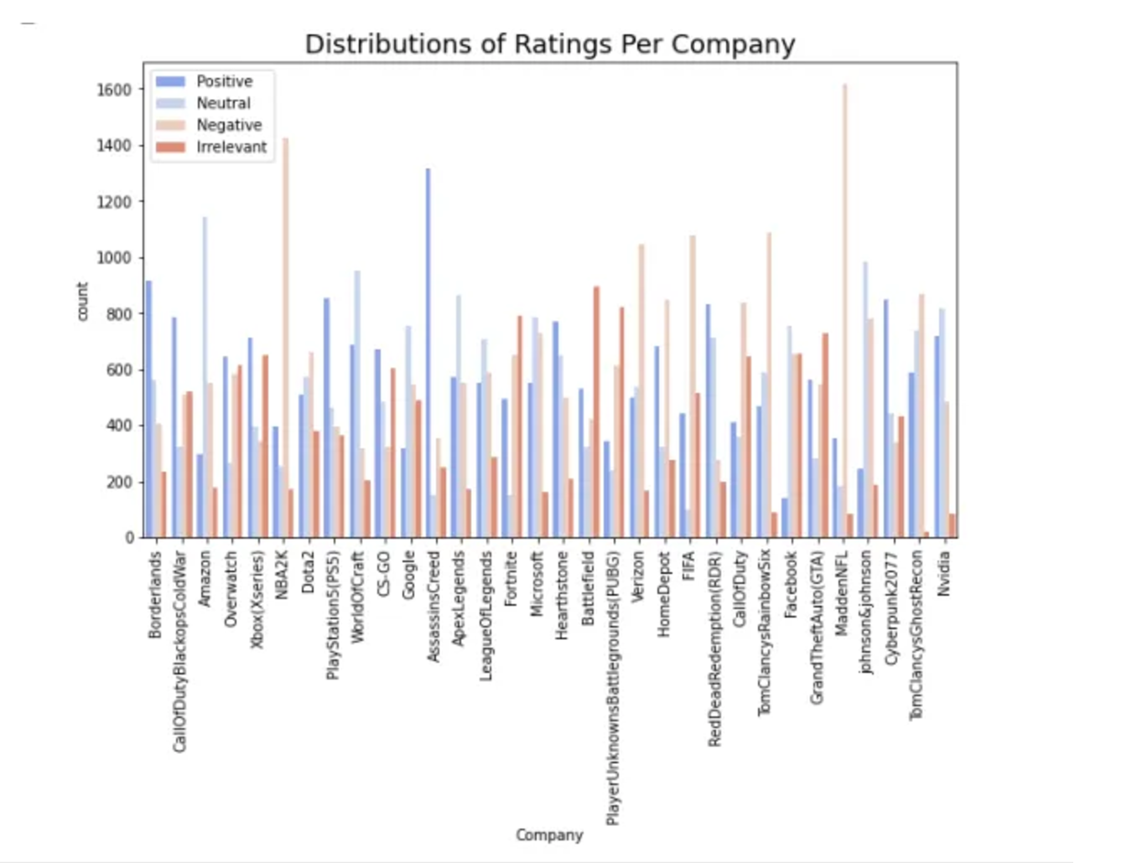
EXPLORATORY DATA ANALYSIS
CISC3015 - Data and Information Visualization (2024-1 001)
Countplot and line plots as our main types of data visualization.

Slide 12
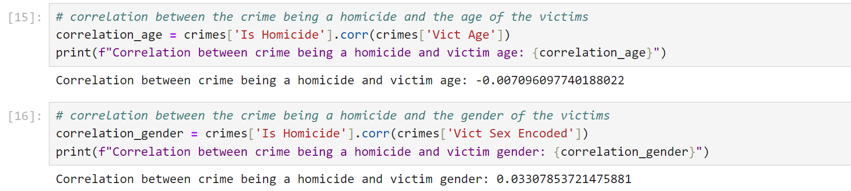
CORRELATION COEFFICIENT
CISC3015 - Data and Information Visualization (2024-1 001)
Value is too small and close to zero!

Slide 13

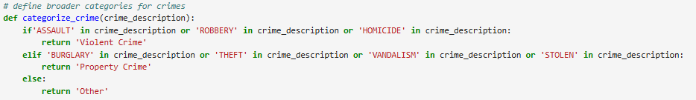
FIRST APPROACH
CISC3015 - Data and Information Visualization (2024-1 001)
There is a total of 138 different crimes in the dataset. In order to smoothly work with the data, we categorized based on the wording used to describe the crime.

Slide 14
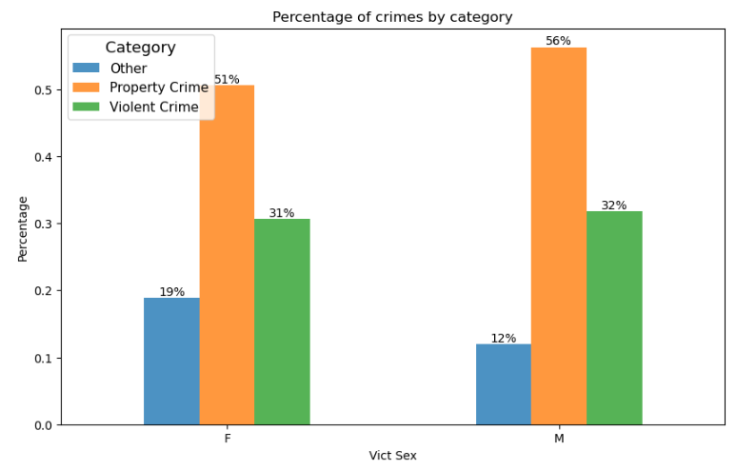
CRIMES BY VICTIM’S SEX
CISC3015 - Data and Information Visualization (2024-1 001)

Slide 15
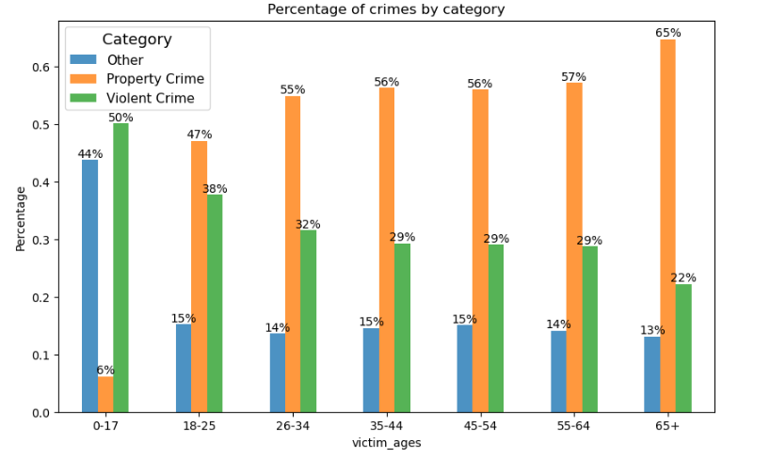
CRIMES BY VICTIM’S AGE
CISC3015 - Data and Information Visualization (2024-1 001)

Slide 16
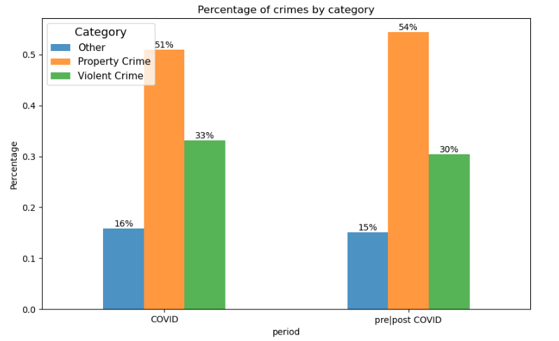
CRIMES BY PERIOD
CISC3015 - Data and Information Visualization (2024-1 001)

Slide 17
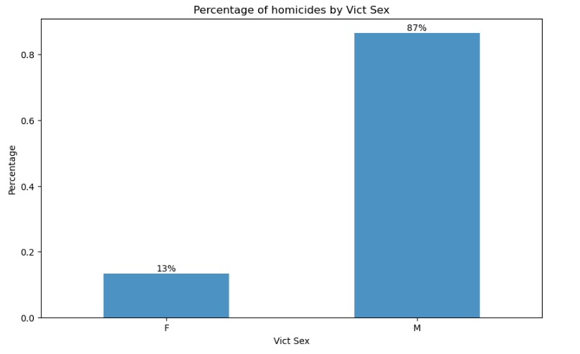
HOMICIDES BY VICTIM’S SEX
CISC3015 - Data and Information Visualization (2024-1 001)

Slide 18
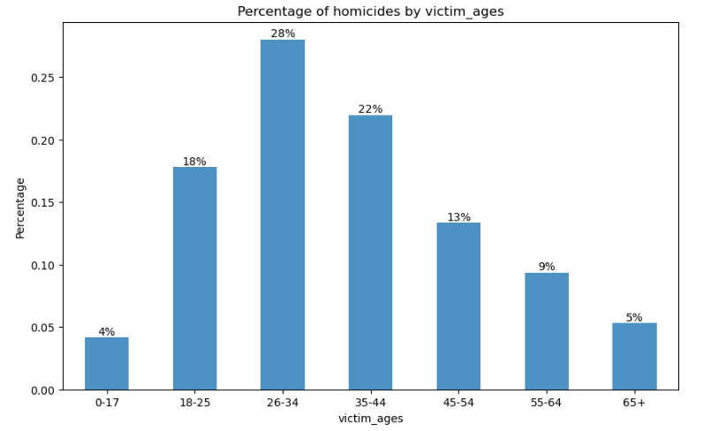
HOMICIDES BY VICTIM’S AGE
CISC3015 - Data and Information Visualization (2024-1 001)
the age group of 26-34 has the highest number of victims ! The chart is shown as a bad normal distribution with lower normality.

Slide 19
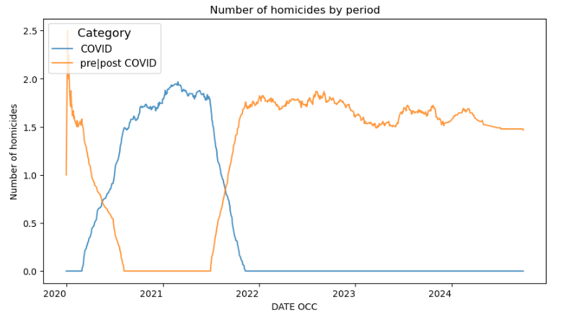
HOMICIDES OVER THE PERIODS
CISC3015 - Data and Information Visualization (2024-1 001)

Slide 20
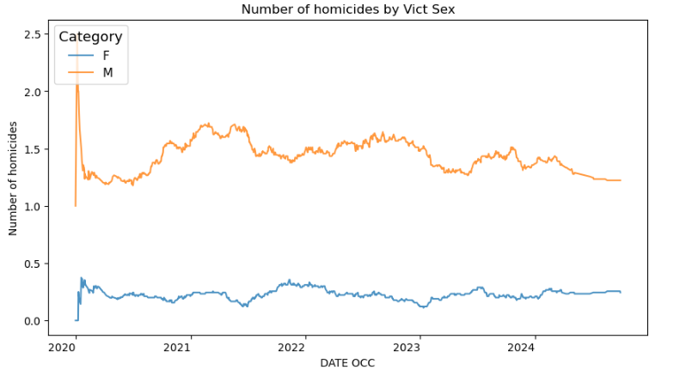
HOMICIDES OVER THE PERIODS
CISC3015 - Data and Information Visualization (2024-1 001)

Slide 21
HOMICIDES OVER THE PERIODS
CISC3015 - Data and Information Visualization (2024-1 001)

Slide 22
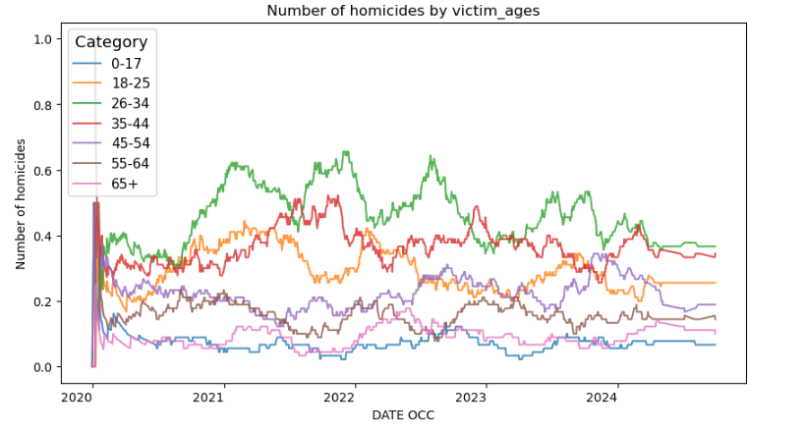
HOMICIDES OVER THE PERIODS
CISC3015 - Data and Information Visualization (2024-1 001)

Slide 23
HOMICIDES (AGE OVERVIEW)
CISC3015 - Data and Information Visualization (2024-1 001)

Slide 24
CONCLUSION
CISC3015 - Data and Information Visualization (2024-1 001)
As much as we did find visual indication that there is some sort of relation between crime category and victim’s age, and between homicide and victim’s sex, it would be hard to affirm these relationships base only on that.
But we can know that the age group of 26-34 has the highest number of victims, with a significantly higher number of male victims compared to female victims.
Hence, the high-risk gender is males group and age groups is people aged 26-34 that may require more resource allocation for victim support services, and policies to enhance public safety.

Slide 25
Thank You for Your Listening !

