Slide 1
UEFA Euro 2016 Tournament Predictive Modeling
Atanas Mirchev Georgi Dikov
Statistical Modelling and Machine Learning
8th July 2016

Slide 2
Modelling Concept
Random Forest as a baseline
Multivariate Logistic Regression with Categorical Dependent Variable
Win/Draw/Loss classification + confidence
Interpretation of the covariate’s importance
Simple to implement, successful
Nested Logistic Regression Binary Classifier
Predict draw or not-draw
If not-draw then predict loss/win
Other Models for Comparison: SVM, Poisson Regression

Slide 3
Data Preparation
Formatting, Data clean-up and correction
Extending with new features
Nation’s GDP, population
Weighted historical scoring in previous editions of the tournament
Feature selection (LS-SVM)
Data visualization (t-SNE)
Notes:
Feature selection on the discrete data: all of them quite insignificant.
Continuous features ranking using Least Squares Support Vector Machine with Radial Basis Function Kernel.

Slide 4
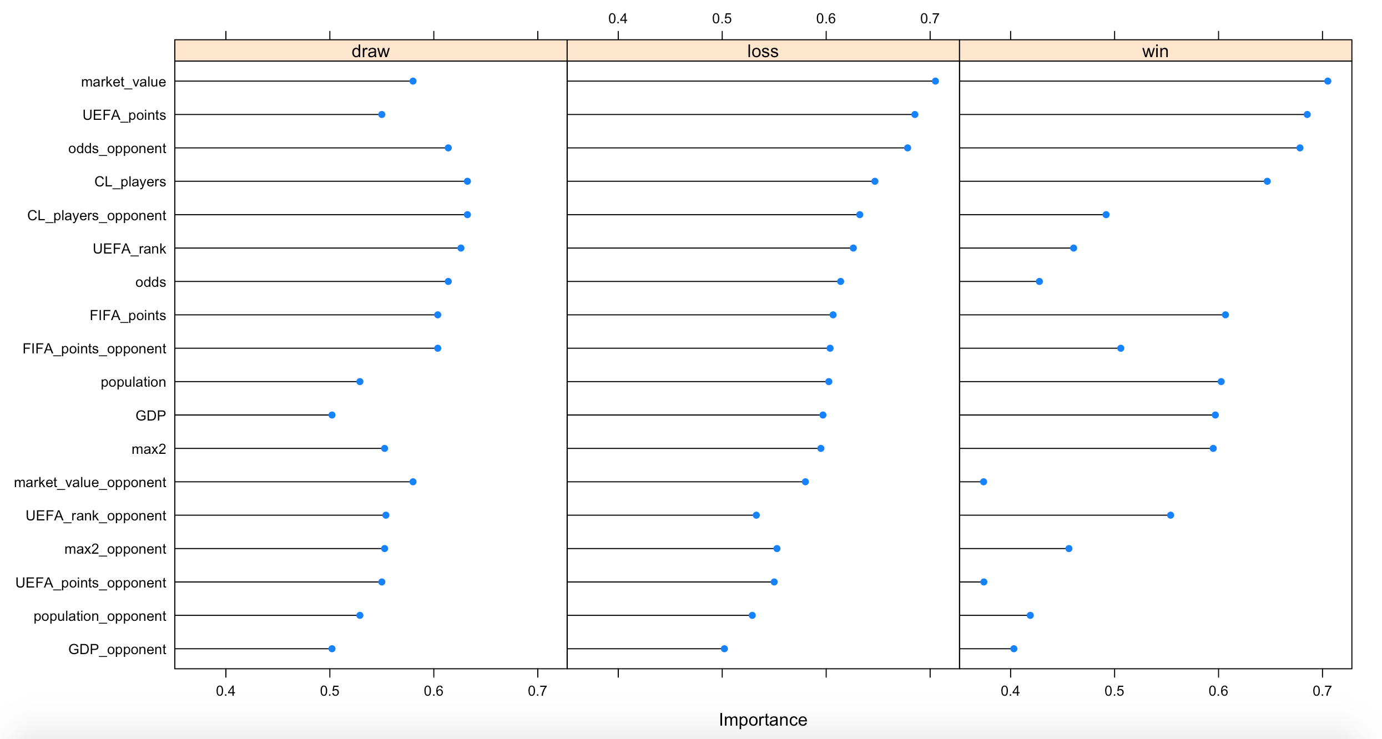

Slide 5
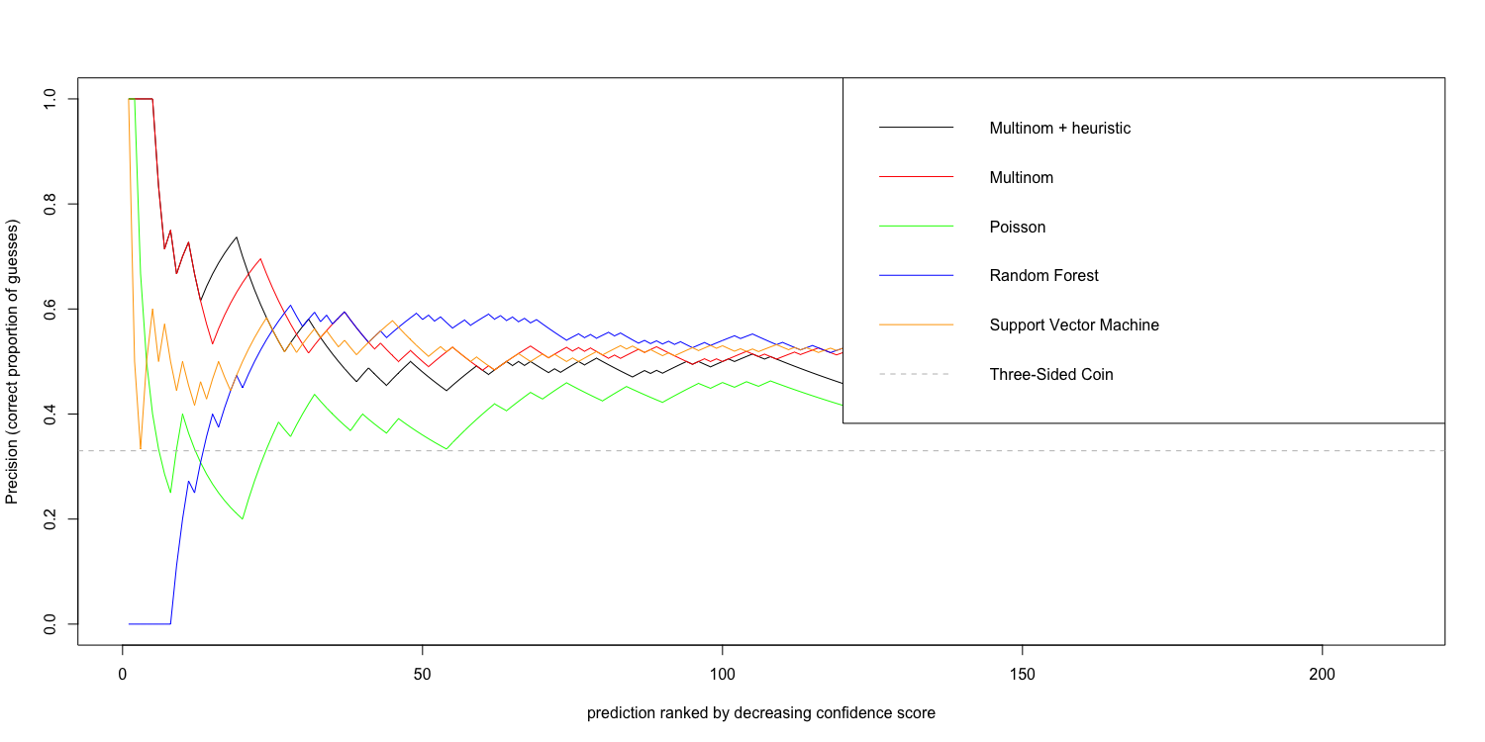
Evaluation and Model Selection

Slide 6
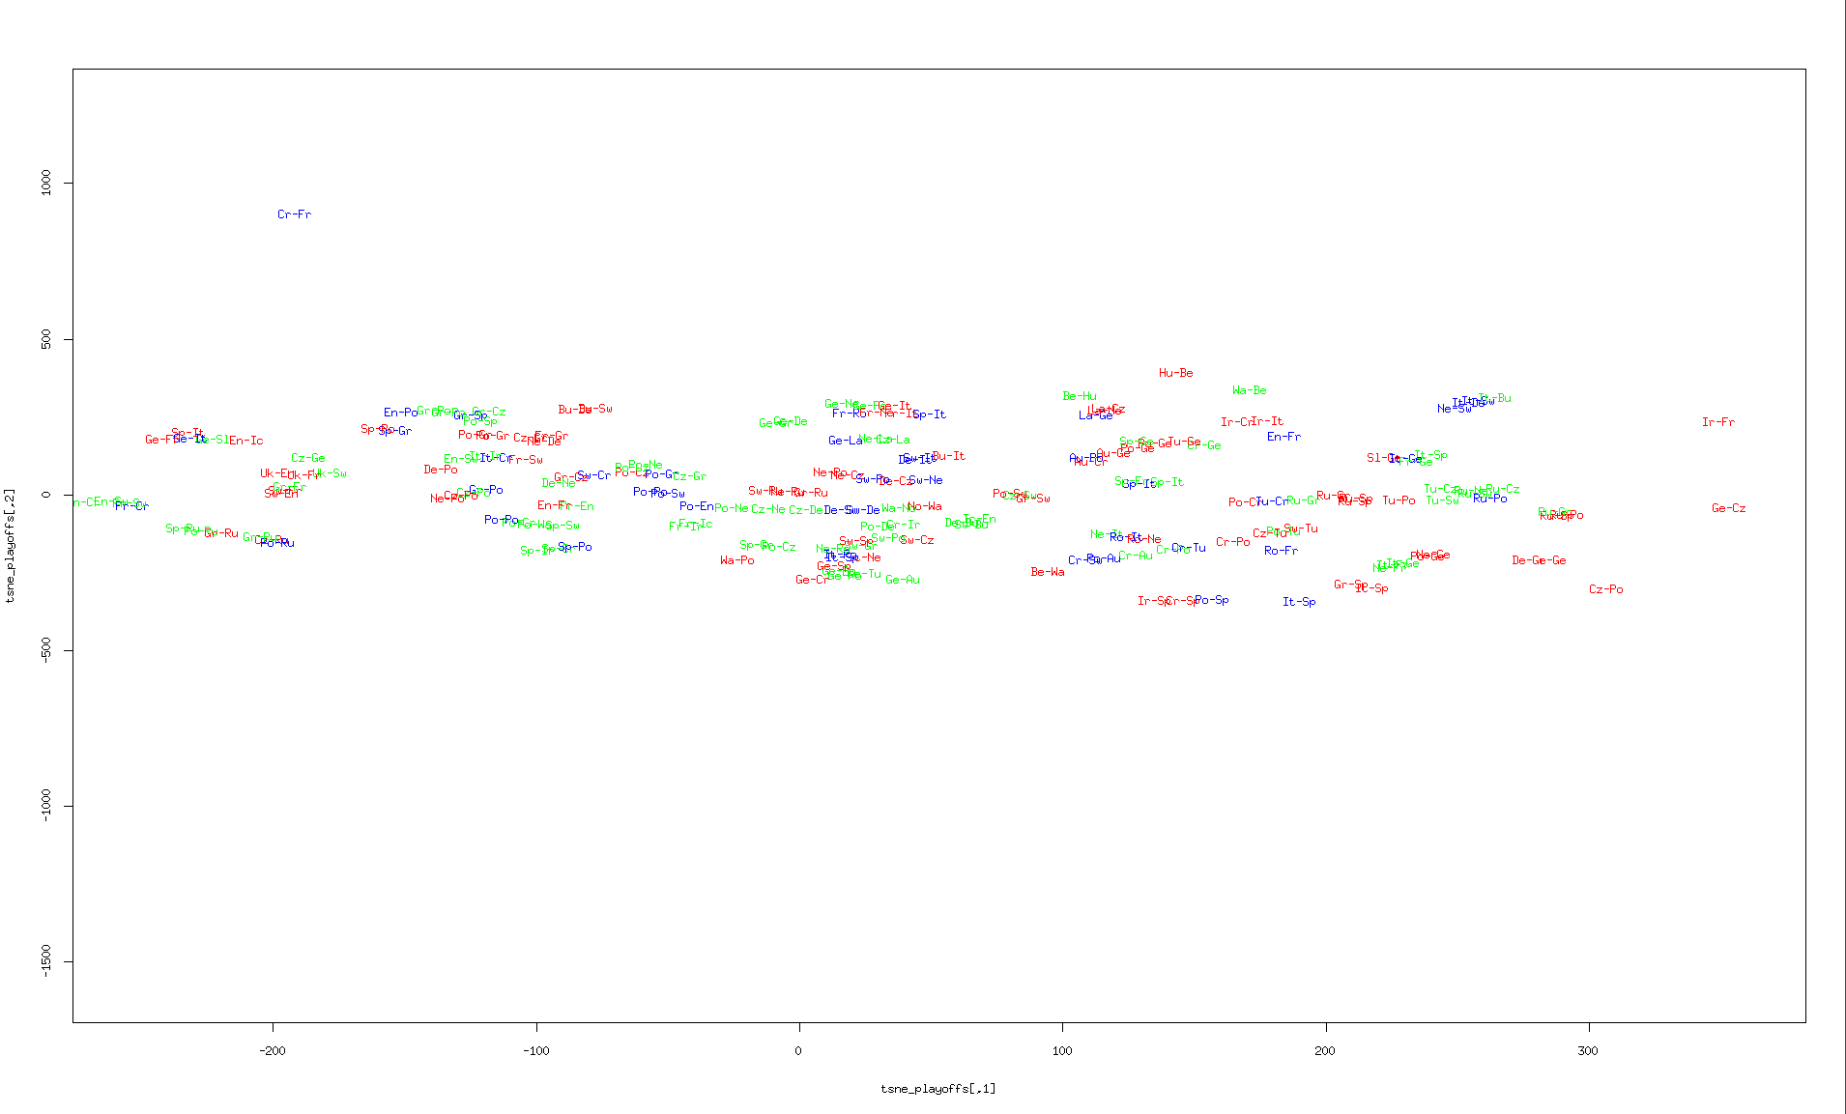
t-SNE on all games

Slide 7
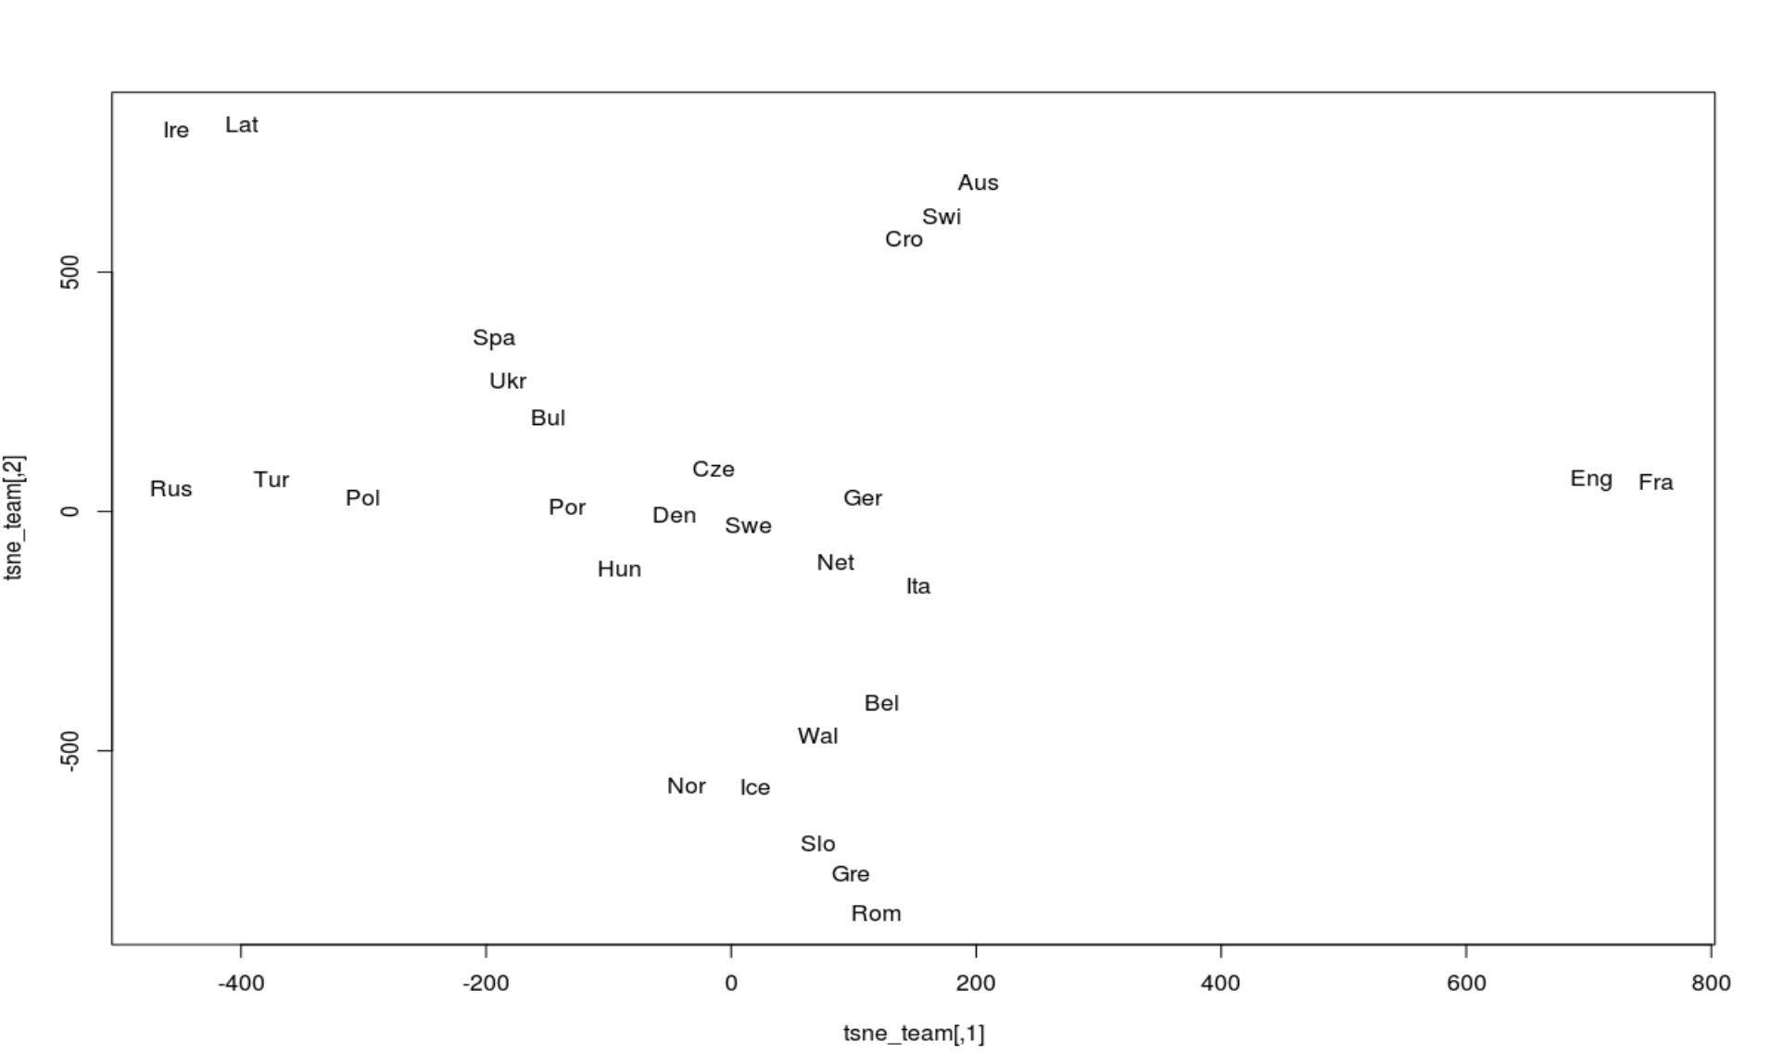
t-SNE on team data only

Slide 8
Conclusions
Probabilistic or not, models are similar in performance
Modeling with Poisson, without additional features is too simple

